Slide 1
Note on Posted Slides
These are the slides that I intended to show in class on Mon. Apr. 1, 2013.
Since it is April 1st, there is an April Fools Day joke in here – one of the slides is complete nonsense – see if you can find it!
They contain important ideas and questions from your reading.
Due to time constraints, I was probably not able to show all the slides during class.
They are all posted here for completeness.

Slide 2
PHY205H1S Physics of Everyday Life Class 21: Colour
Color in Our World
Selective Reflection
Selective Transmission
Mixing Colored Light
Mixing Colored Pigments
Why the Sky Is Blue
Why Sunsets Are Red
Why Clouds Are White
Egg image from http://talesfromtherainbowroom.blogspot.ca/2011_05_01_archive.html

Slide 3
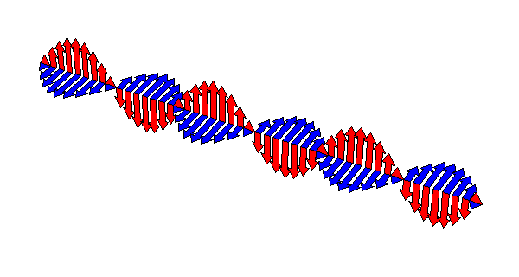
Recall from Chapters 25 and 26…
A changing electric field creates a magnetic field, which then changes in just the right way to recreate the electric field, which then changes in just the right way to again recreate the magnetic field, and so on.
This is an electromagnetic wave.

Slide 4
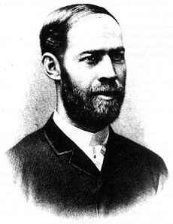
Radio Waves
In 1887, Hertz created radio waves with sparks
Radio Astronomy started in 1933 when Karl Jansky accidentally discovered Sagittarius A – the black hole at the centre of the Milky Way Galaxy
Heinrich Hertz
Radio waves travel at the speed of light, and are used to transmit audio signals, video signals and digital information.

Slide 5
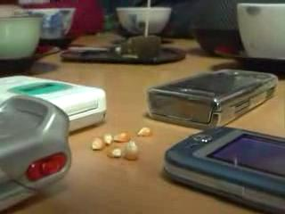
Microwaves
Polarized molecules can be excited via rotational modes, and so absorb heat when exposed to microwaves.
Microwave ovens use 2.45 GHz, which is a good rotational resonance of the water molecule.
Microwaves are used in communication: cell phones, radio astronomy, communications with satellites.
No, your cell phone cannot pop popcorn.

Slide 6
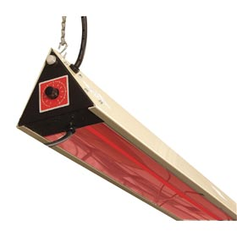
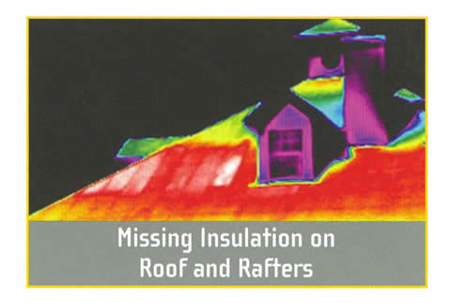
Infrared
“Heat waves” – most molecules have lots of vibrational and rotational resonances in the IR
Room temperature objects emit blackbody radiation which peaks in the infrared.
Digital cameras can detect the near-infrared

Slide 7
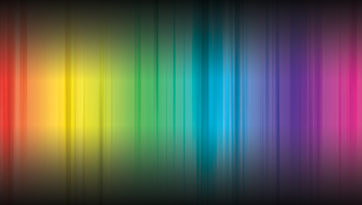
Visible Light

Slide 8
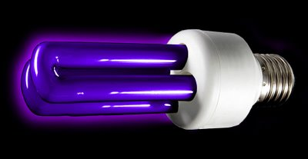
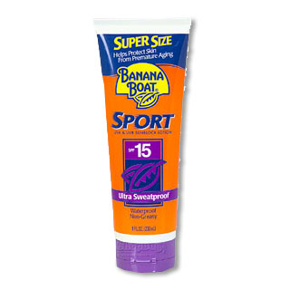
Ultraviolet
Photon energies comparable to many chemical reactions. Mostly absorbed by ozone (O₃) in the stratosphere.
Can damage living tissue
Can cause materials to fluoresce: raises an electron to a high level, and then it emits its energy by a series of downward jumps, each resulting in the emission of a lower energy photon.

Slide 9
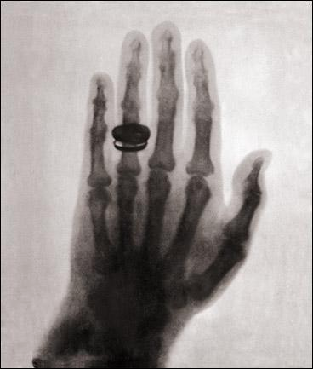
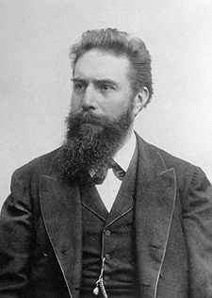
X-rays
Discovered in 1895 by Röntgen
Tend to interact with inner electrons, nearer the nucleus of atoms: Calcium is a better absorber than Carbon because it has deeper electrons.
X-ray Astronomy is done with balloons and satellites: looks at stars and galaxies.
Wilhelm Röntgen

Slide 10
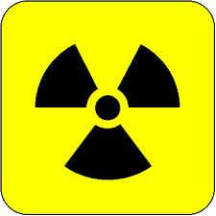
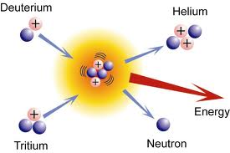
Gamma Rays
Involved in nuclear reactions.
Pretty dangerous ionizing particles (along with beta and alpha)
Some gamma-ray astronomy: Gamma-Ray Bursters are intense, short bursts of gamma rays from extremely distant galaxies

Slide 11
What property of a light wave mainly determines its colour?
Why Sunsets Are Red
CHECK YOUR NEIGHBOR
Its frequency
Its amplitude
Its timbre
A mix of all of the above
Notes:
D. blue.

Slide 12
Color
Color we see depends on frequency of light.
$$0.4 μm$$
$$0.7 μm$$
$$f$$
High Frequency,
Short wavelength
Low Frequency,
Long wavelength
$$λ$$

Slide 13
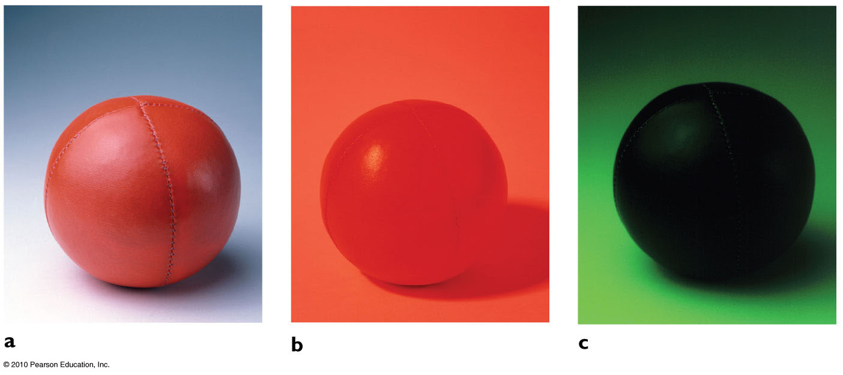
Selective Reflection
A red ball seen under white light.
Only red is reflected, other colors are absorbed.
A red ball seen under red light.
A red ball seen under green light.
There is no source of red light to reflect!

Slide 14
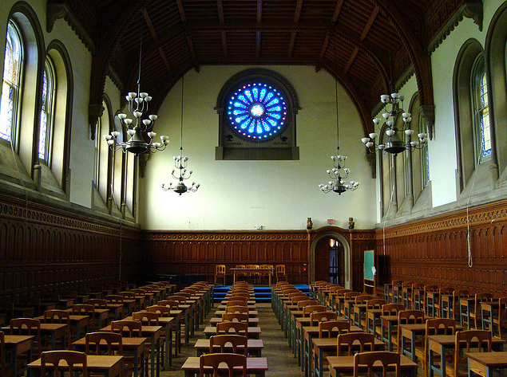
Selective Transmission
[image from http://www.flickr.com/photos/ricardipus/3571089449/in/set-72157607219489528 ]

Slide 15
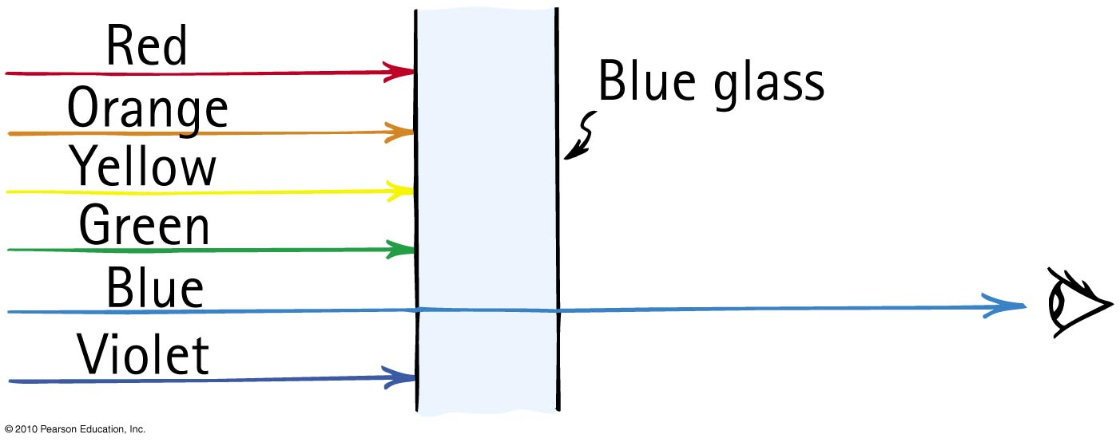
Selective Transmission
Color of transparent object depends on color of light it transmits.

Slide 16
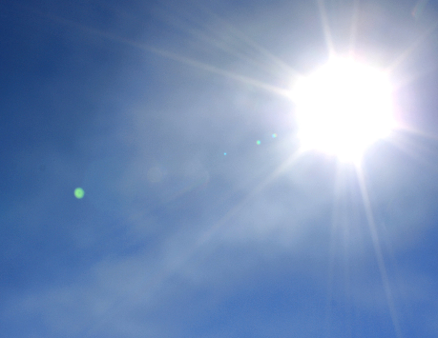
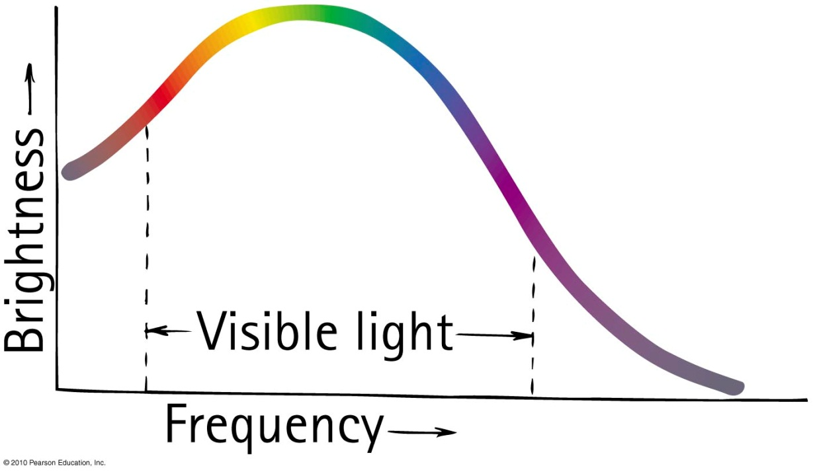
Mixing Colored Light
The spectrum of sunlight is a graph of brightness versus frequency.
Somehow, this mix looks “white” to us.

Slide 17
A beam of white light, when shone through a prism, will end up many different colours. What will happen if a green laser is shone through a prism?
Why Sunsets Are Red
CHECK YOUR NEIGHBOR
It will spread into a small range of colours.
It will change to a single colour other than green.
It will stay green.

Slide 18
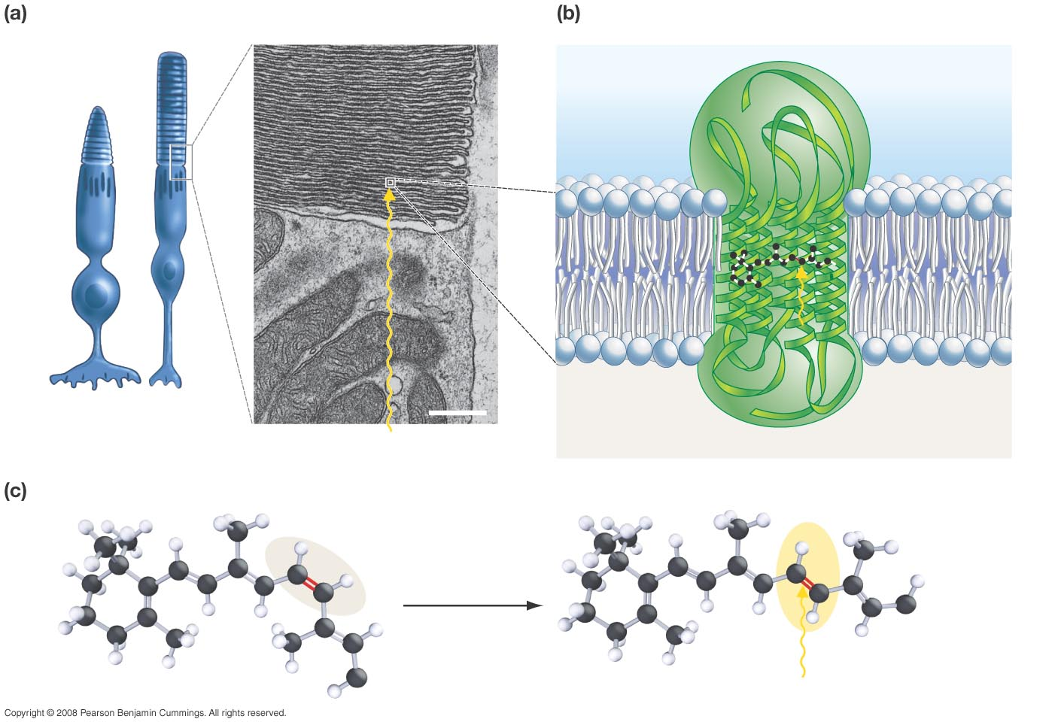
Rods and cones contain stacks of membranes.
Rhodopsin is a transmembrane protein complex.
Opsin (protein component)
Retinal (pigment)
Cone
Rod
0.5 µm
Rhodopsin
Light
Light
The retinal molecule inside rhodopsin changes shape when retinal absorbs light.
cis conformation (inactive)
trans conformation (activated)
Opsin
Opsin
Light
Slide courtesy of Ross Koning, Biology Department, Eastern Connecticut State University
http://plantphys.info/sciencematters/vision.ppt
Notes:
18

Slide 19
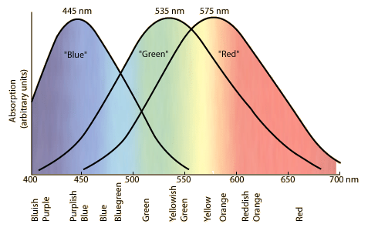
Response Curves for the three types of cones in the retina of the human eye.
Slide from http://hyperphysics.phy-astr.gsu.edu/hbase/vision/colcon.html

Slide 20
Use both eyes, stare at area shown in blue for 15 seconds or so

Slide 21
What do you see on this blank white slide? Blink if needed!
This is called an “after image”
Does it move around as you move your gaze?

Slide 22
Use both eyes, stare at the parrot’s eye for 15 seconds or so
Stare at the bird’s eye for 10 seconds without tilting your head.

Slide 23
Bird Was Red
What colour is the afterimage bird?
orange
green
blue
yellow
None of the above

Slide 24
Use both eyes, stare at the parrot’s eye for 15 seconds or so
Stare at the bird’s eye for 10 seconds without tilting your head.

Slide 25
Bird Was Green
What colour is the afterimage bird?
red
orange
blue
violet
None of the above

Slide 26
Use both eyes, stare at the parrot’s eye for 20 seconds or so
Stare at the bird’s eye for 10 seconds without tilting your head.

Slide 27
Bird Was Blue
What colour is the afterimage bird?
red
orange
yellow
green
None of the above

Slide 28
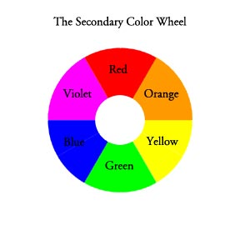
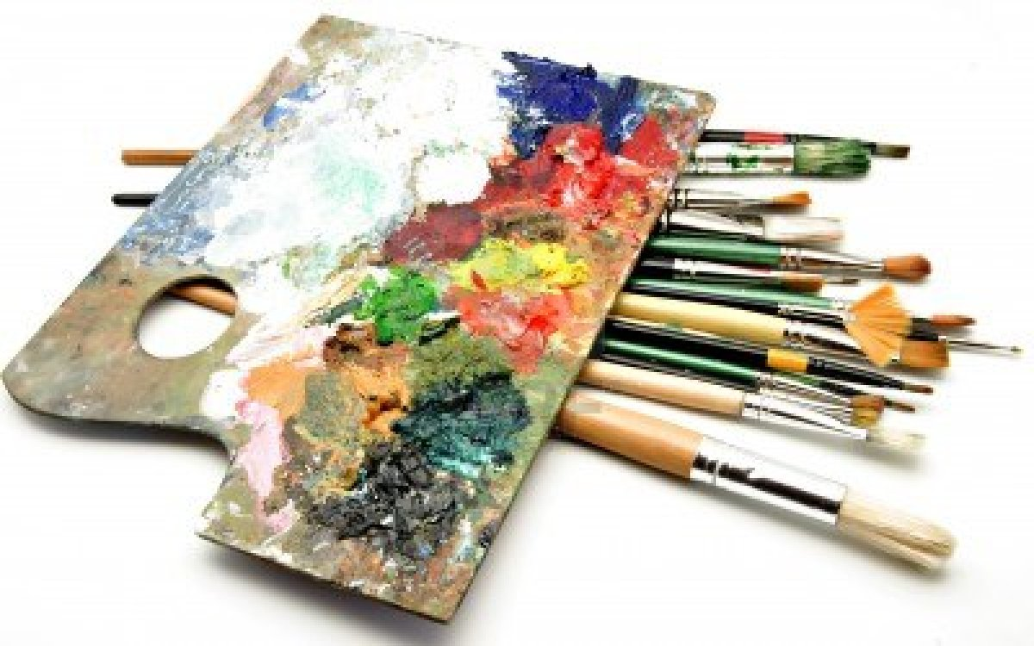
For artists using paint, red blue and yellow are the useful primary colours.
Note that this is different than the RGB additive primaries used in computer screens!
The “opposite” colours match well with my experience of the after-image in the previous slides.
Image is from Designedly, Kristi http://www.designedlykristi.com/tutorials/color_intro/color_theory2.html

Slide 29
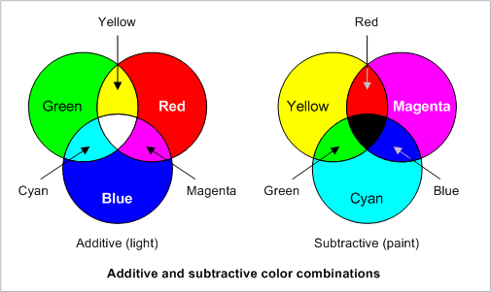
Additive Primary Colours (light bulbs) and Subtractive Primary Colours (ink)

Slide 30
Discussion Question
Why is this square red?
The light bulbs in the projector emit light with blue frequencies
The light bulbs in the projector emit light with green frequencies
The light bulbs in the projector emit light with red frequencies
Both A and B

Slide 31
Discussion Question
Why is the red folder in Harlow’s hand red?
The pigments in the paper absorb light with blue frequencies
The pigments in the paper absorb light with green frequencies
The pigments in the paper absorb light with red frequencies
Both A and B

Slide 32
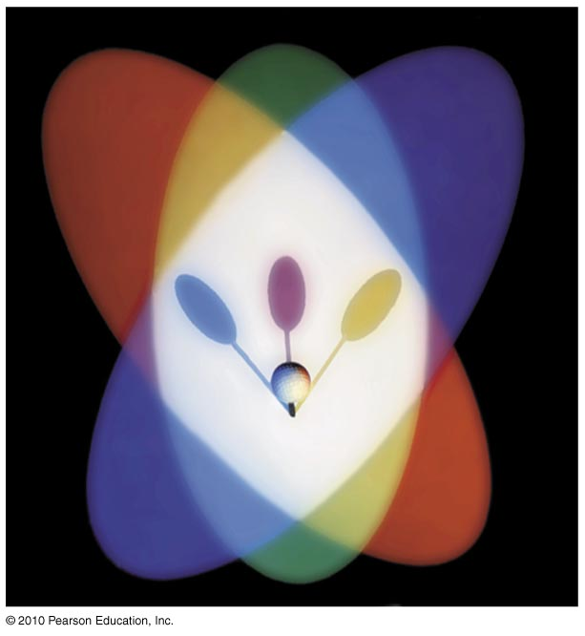
The shadows of the golf ball are the “subtractive primary colors”.
Cyan (opposite of red):
Magenta (opposite of green)
Yellow (opposite of blue)

Slide 33
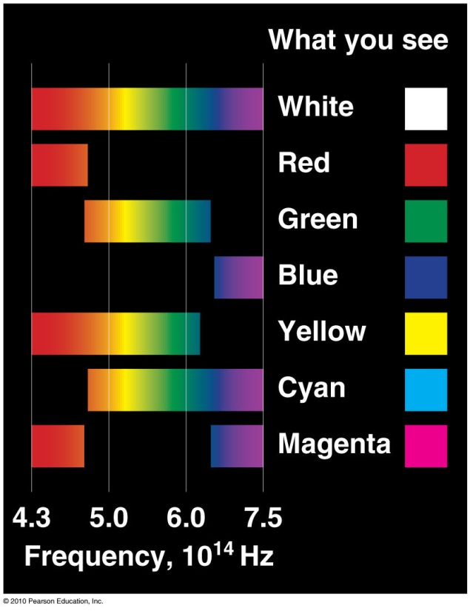

Slide 34
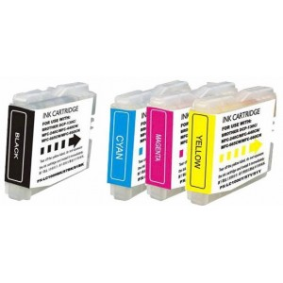
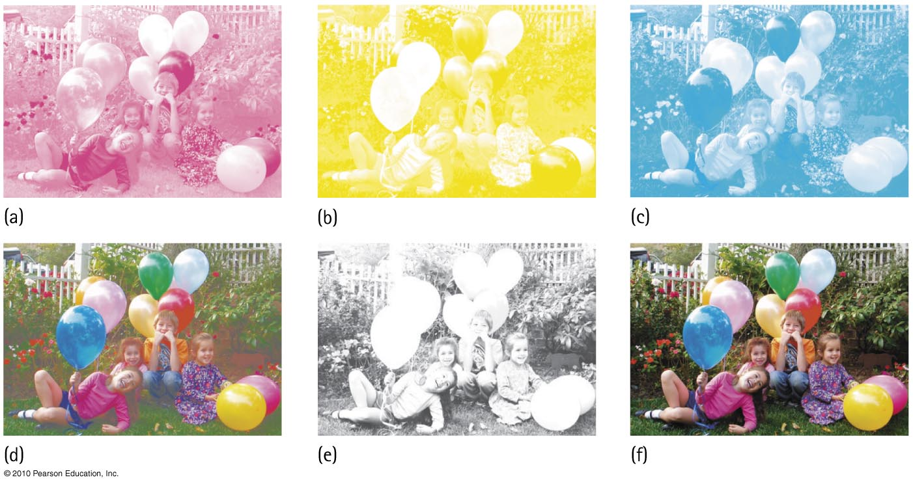
Only four colors of ink are used to print color photographs: magenta, yellow, cyan and black.

Slide 35
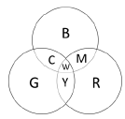
Discussion Question : Using the colour wheel..
When the colour yellow is seen on the screen of your computer, what are the lights being activated in that region of your screen?
Mainly yellow
Blue and red
Green and yellow
Red and green

Slide 36
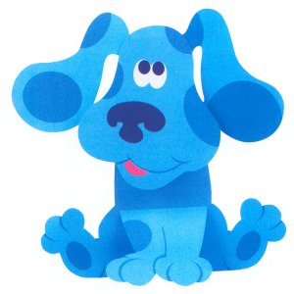
Discussion Question : Using the colour wheel..
If an object is blue, which of the coloured lights below would make the object appear most black?
blue
cyan
yellow
magenta

Slide 37
Discussion Question : Using the colour wheel..
If an object is red, which of the coloured lights below would make the object appear not appear red?
red
orange
white
cyan

Slide 38
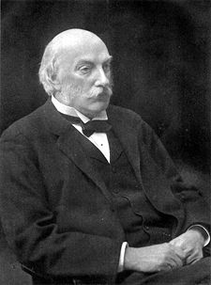
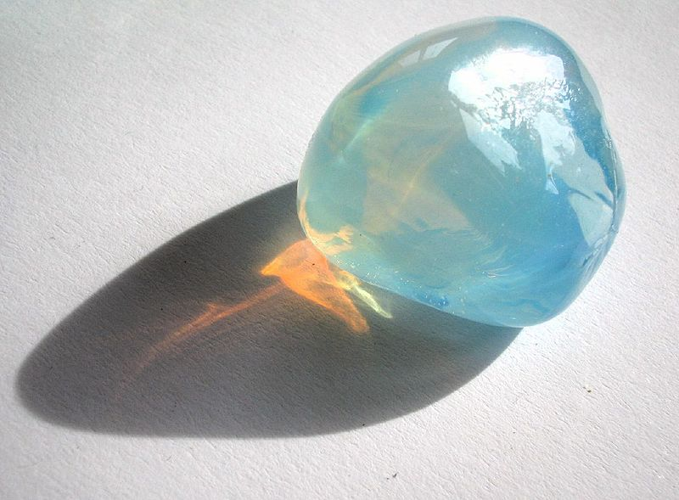
“Daddy, why is the sky blue?”
Rayleigh scattering is elastic scattering of light by particles much smaller than the wavelength of light.
Scattering intensity is proportional to f ⁴
So, higher frequency blue light is scattered much more readily than lower frequency red light.
You see blue light coming from all directions in the sky, as long as there is sunlight passing through the air above you.
John William Strutt, 3rd Baron Rayleigh

Slide 39
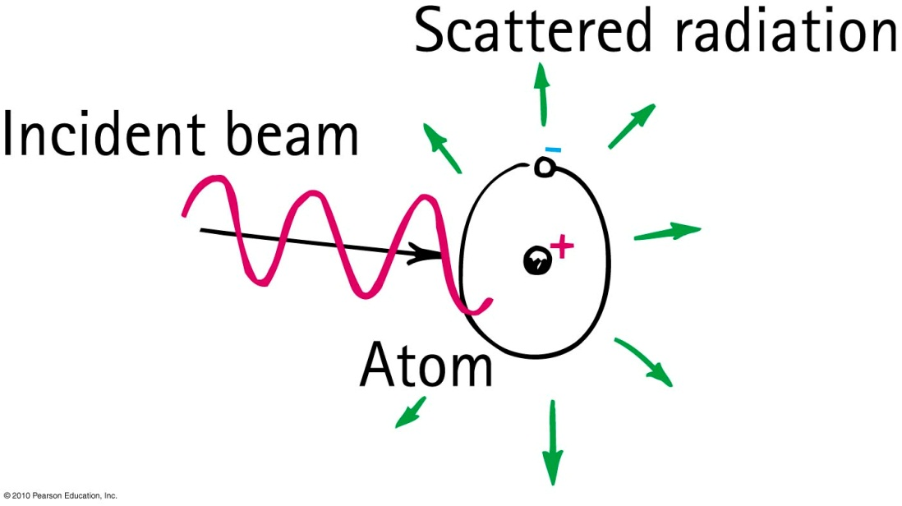
Why the Sky Is Blue
For small scattering particles, like nitrogen or oxygen molecules, higher frequency blue light is scattered much more readily than lower frequency red light.

Slide 40
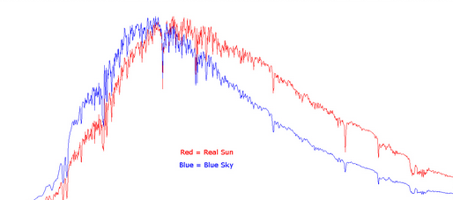
Why the Sky Is Blue
$$frequency$$

Slide 41
If molecules in the sky scattered orange light instead of blue light, the sky would be
Why Sunsets Are Red
CHECK YOUR NEIGHBOUR
A. orange.
yellow.
green.
blue.
Notes:
D. blue.

Slide 42
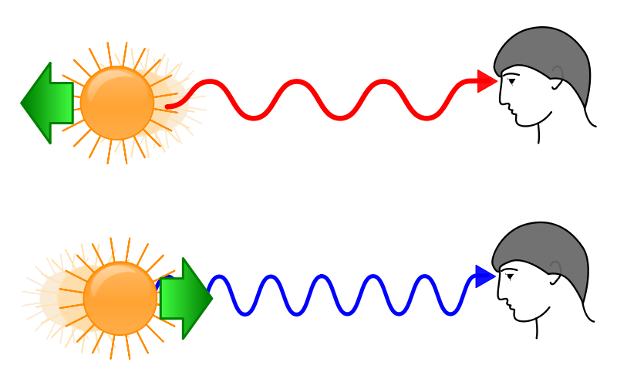
Doppler Shift for Light
When a light source is moving away from you, the spectrum is shifted toward the red.
When a light source is moving toward you, the spectrum is shifted toward the blue.

Slide 43
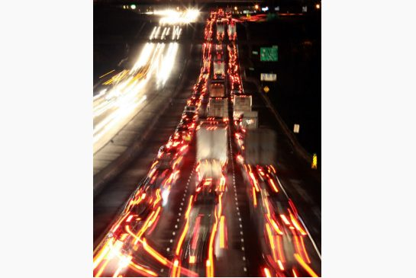
Doppler Shift for Light
The Doppler shift can be observed in the headlights of cars on the highway.
The cars moving away from you appear more red, while the cars moving toward you appear more blue-ish or white.

Slide 44
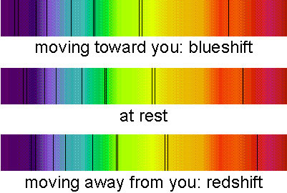
Doppler Shift for Light (yes, really!)
The Doppler shift can be observed with carefully obtained spectra of very fast moving objects like stars
There is a slight shift in “absorption lines”

Slide 45
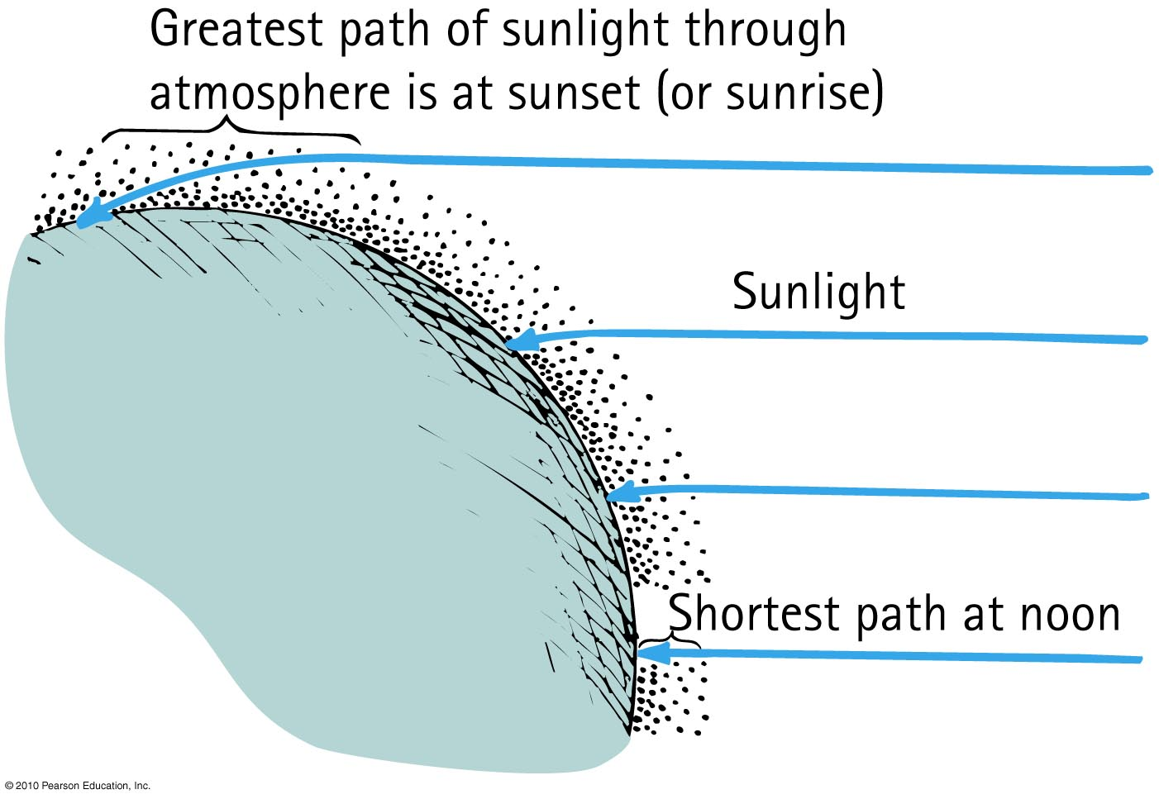
Why Sunsets Are Red
Light that is least scattered is light of low frequencies, which best travel straight through air.

Slide 46
If molecules in the sky scattered orange light instead of blue light, sunsets would be
Why Sunsets Are Red
CHECK YOUR NEIGHBOUR
A. orange.
yellow.
green.
blue.
Notes:
D. blue.

Slide 47
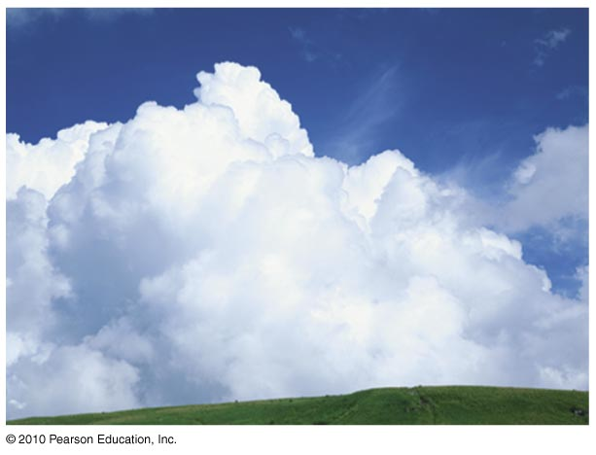
Why Clouds Are White
Clouds are clusters of various sizes of water droplets

Slide 48
Why Clouds Are White
Size of clusters determines scattered cloud color.
Tiny clusters produce bluish clouds.
Slightly large clusters produce greenish clouds.
Larger clusters produce reddish clouds.
Overall result is white clouds.
Slightly larger clusters produce a deep gray.
Still larger clusters produce raindrops.

Slide 49
What does a white sky indicate?
Why Sunsets Are Red
CHECK YOUR NEIGHBOR
The atmosphere has mostly particles smaller than the wavelength of light
The atmosphere has mostly particles larger than the wavelength of light
The atmosphere has a mixture of particle sizes
The atmosphere has a lot of water vapour
The atmosphere is filled with pollutants.

Slide 50
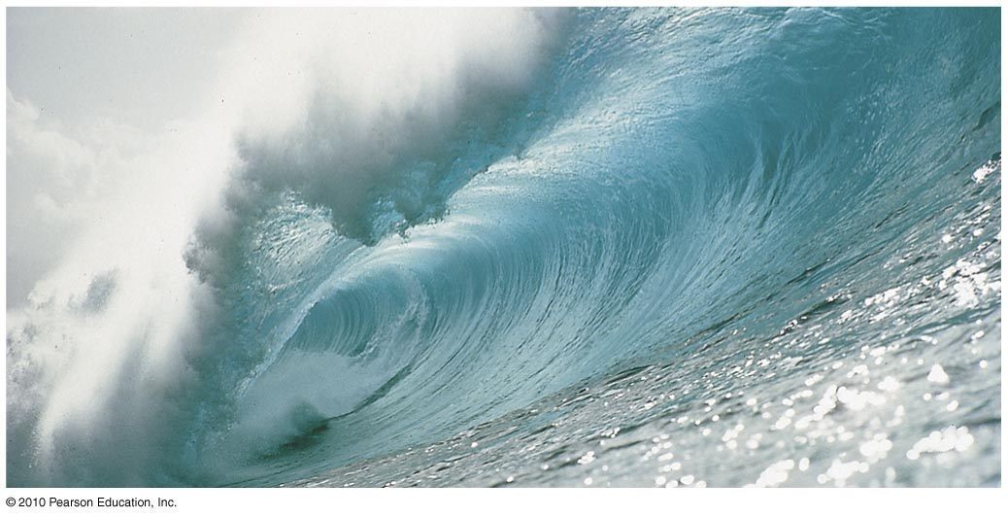
Why Water Is Greenish Blue
Water molecules resonate somewhat in the visible red, which causes red light to be a little more strongly absorbed in water than blue light.
Red light is reduced to one-quarter of its initial brightness by 15 meters of water. There is very little red light in the sunlight that penetrates below 30 meters of water.
When red is removed from white light, the complementary color of red remains: cyan—a bluish-green color.

Slide 51
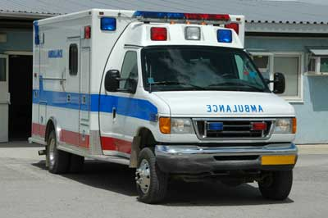
Before class on Wednesday – the LAST CLASS!!!! ☹
Please read Chapter 28, or at least watch the 10-minute pre-class video for class 22.
Something to think about:
What is the difference between a real image and a virtual image?

