Slide 1
Conceptual Physics 11th Edition
Chapter 28:
REFLECTION & REFRACTION
Reflection
Principle of Least Time
Law of Reflection
Refraction
Cause of Refraction
Dispersion
Rainbows
Total Internal Reflection
Lenses
Lens Defects

Slide 2
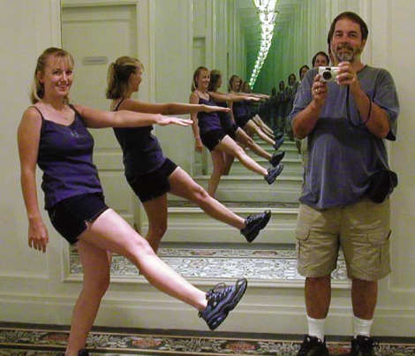
Reflection
We say light is reflected when it bounces back into the medium from which it came.
When light illuminates a shiny metal, electrons move in response to the oscillating electric fields of the illuminating light.
This motion re-emits the light you see reflected.

Slide 3
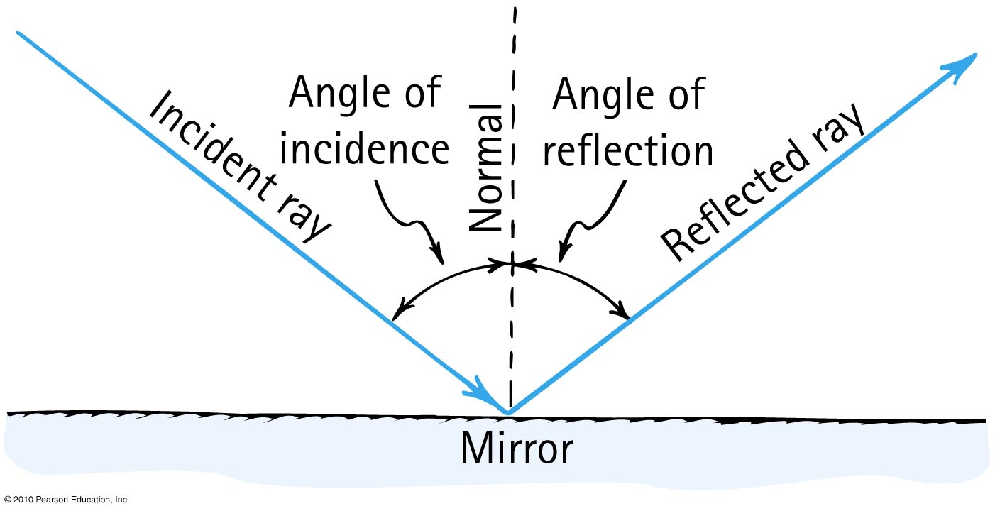
Law of Reflection
The angle of reflection equals the angle of incidence.

Slide 4
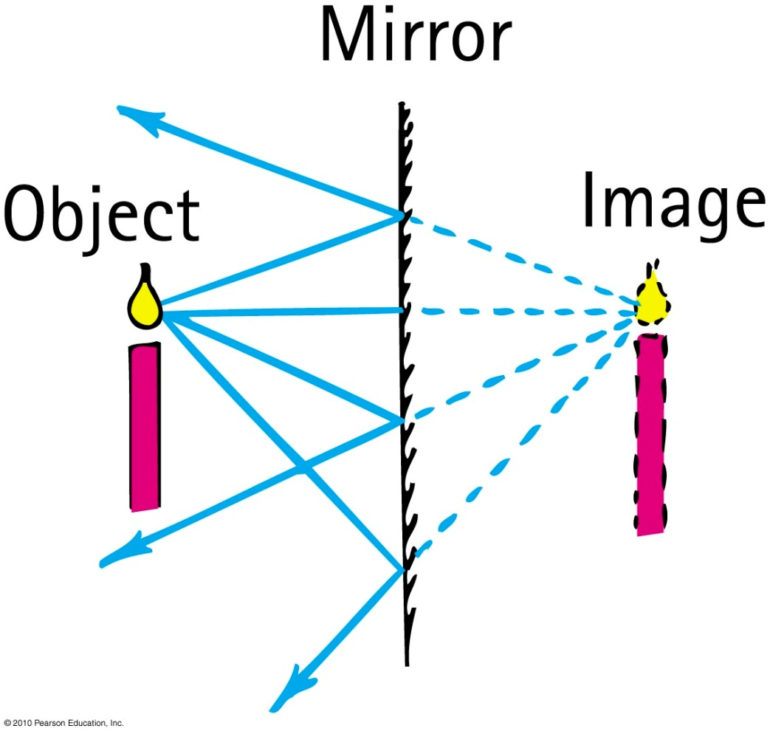
Virtual image
is same size as object, formed behind a mirror, and located at the position where the extended reflected rays converge.
is as far behind the mirror as the object is in front of the mirror.

Slide 5
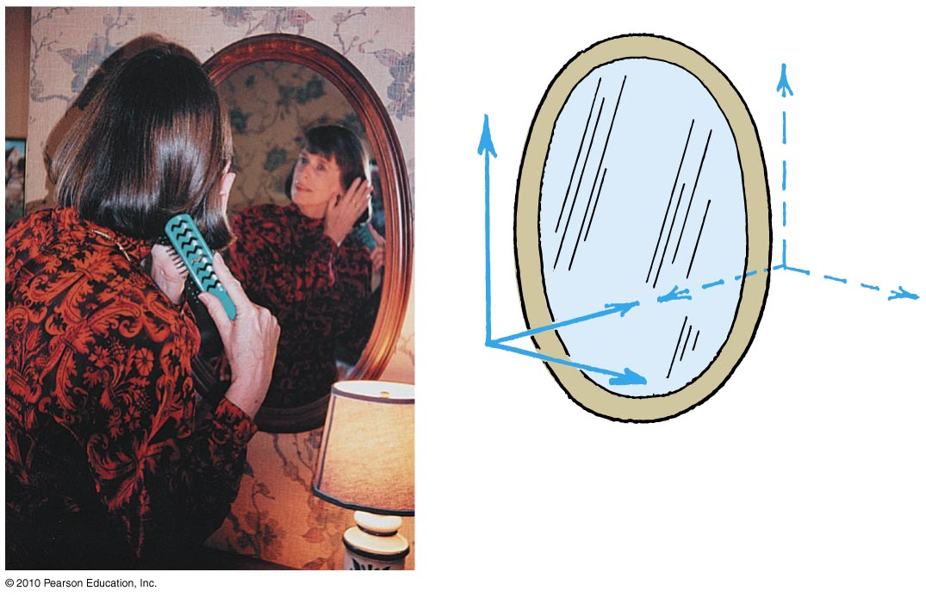
Plane mirror
Note: the only axis reversed in an image is the front-back axis.

Slide 6
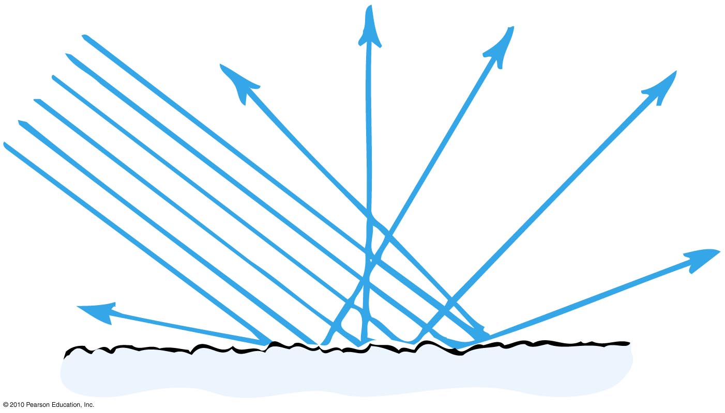
Diffuse reflection
When light strikes a rough or irregular surface and reflects in many directions
Almost everything we see is due to diffuse reflection from surfaces around us.

Slide 7
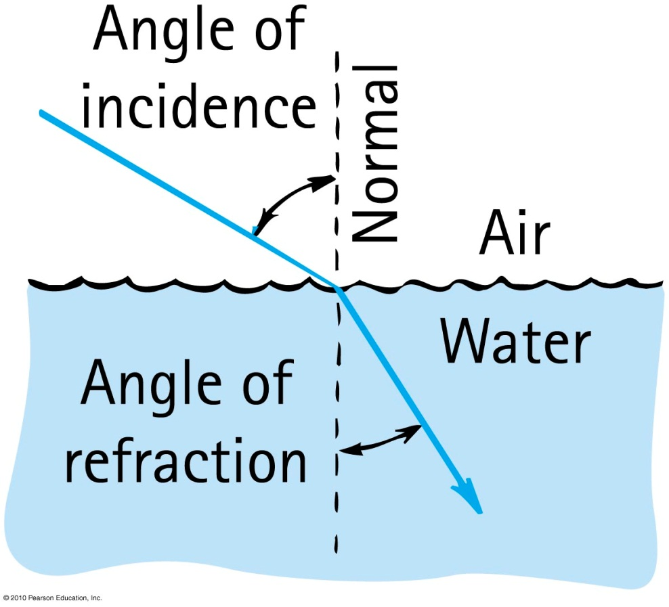
Refraction
When light bends in going obliquely from one medium to another, we call this process refraction.

Slide 8
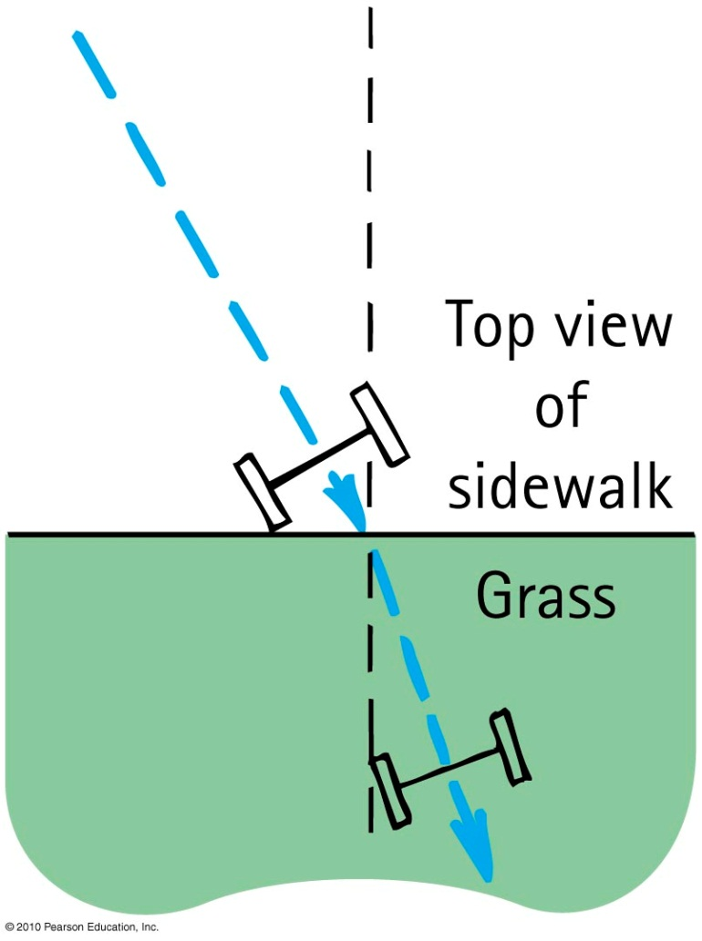
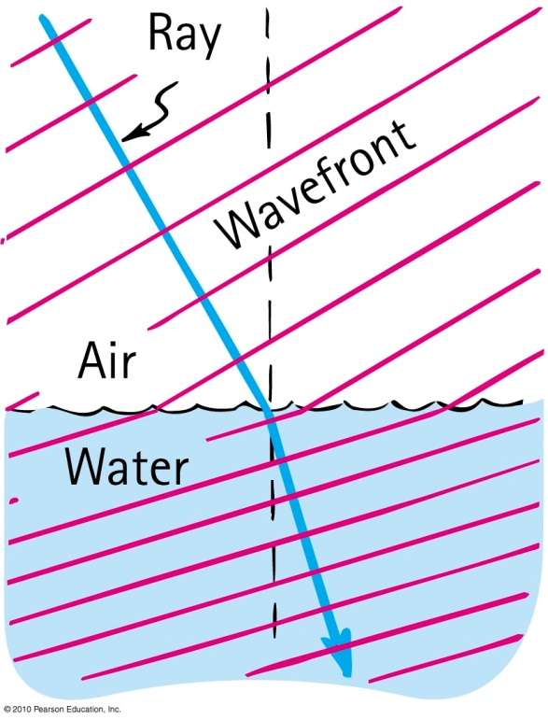
Cause of Refraction
Bending of light when it passes from one medium to another
Caused by change in speed of light

Slide 9
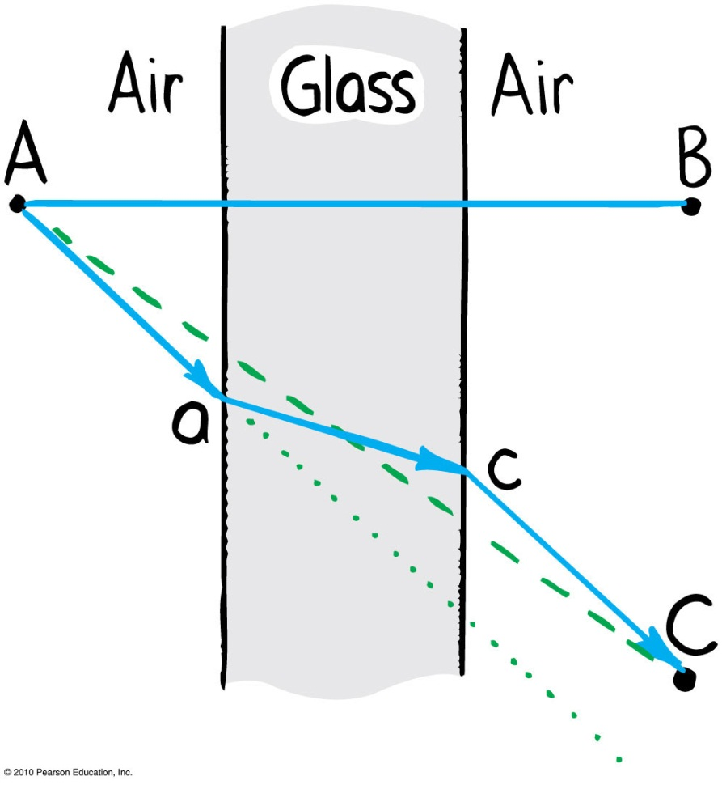
Refraction
Light travels slower in glass than in air, so it minimizes the time it spends in the glass.

Slide 10
Refraction
Index of refraction, n, of a material
indicates how much the speed of light differs from its speed in a vacuum.
indicates the extent of bending of rays.
ratio of speed of light in a vacuum to the speed in a material.
speed of light in vacuum
n =
speed of light in material

Slide 11
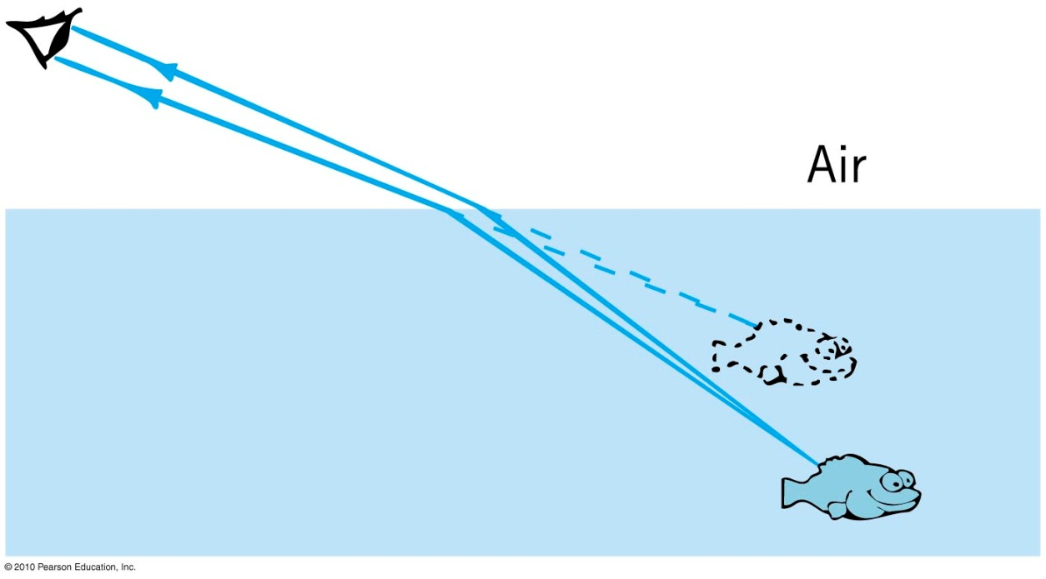
Illusion caused by refraction
Objects submerged in water appear closer to the surface.

Slide 12
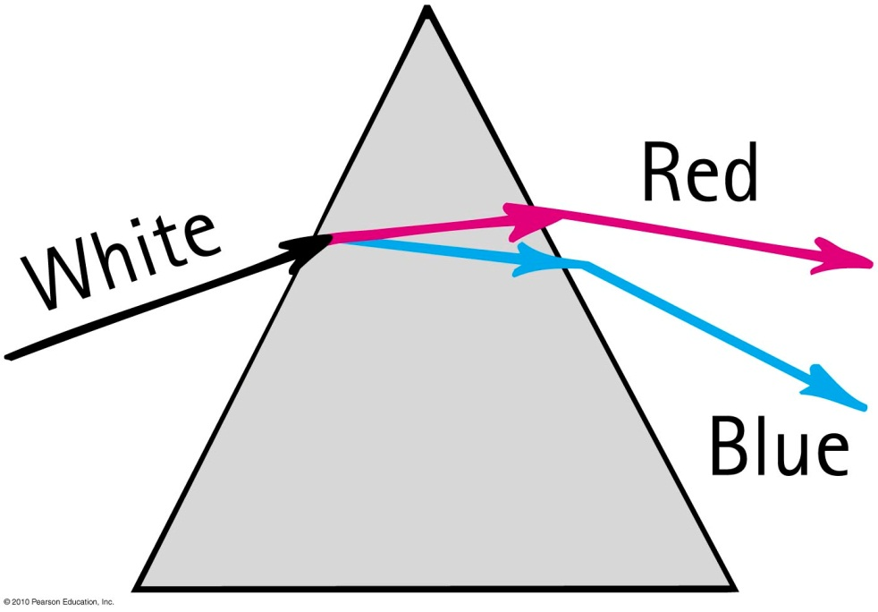
Dispersion
Process of separation of light into colors arranged by frequency
Components of white light are dispersed in a prism (and in a diffraction grating).

Slide 13
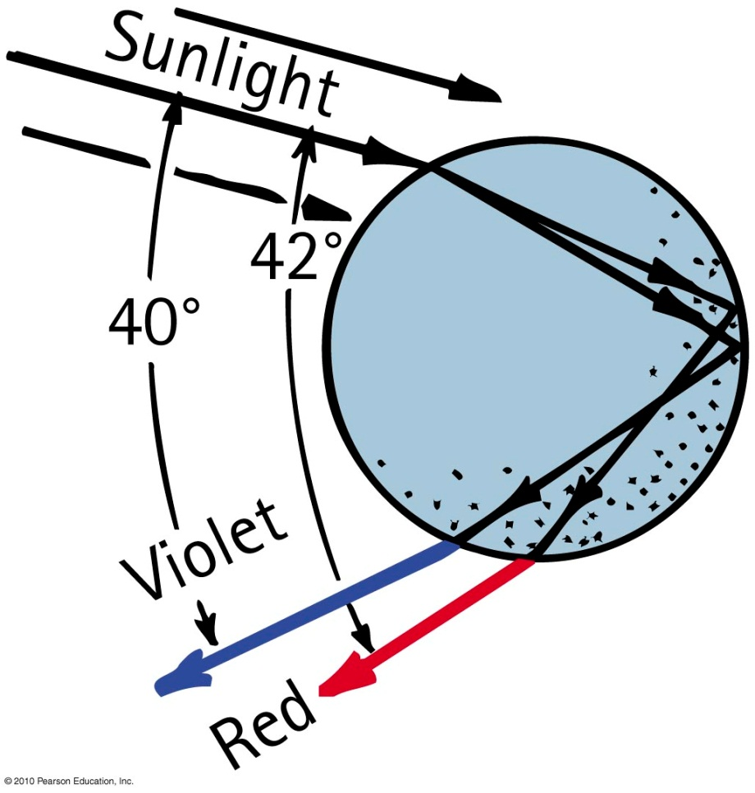
Rainbows
Rainbows are a result of dispersion by many drops.
Dispersion of light by a single drop

Slide 14
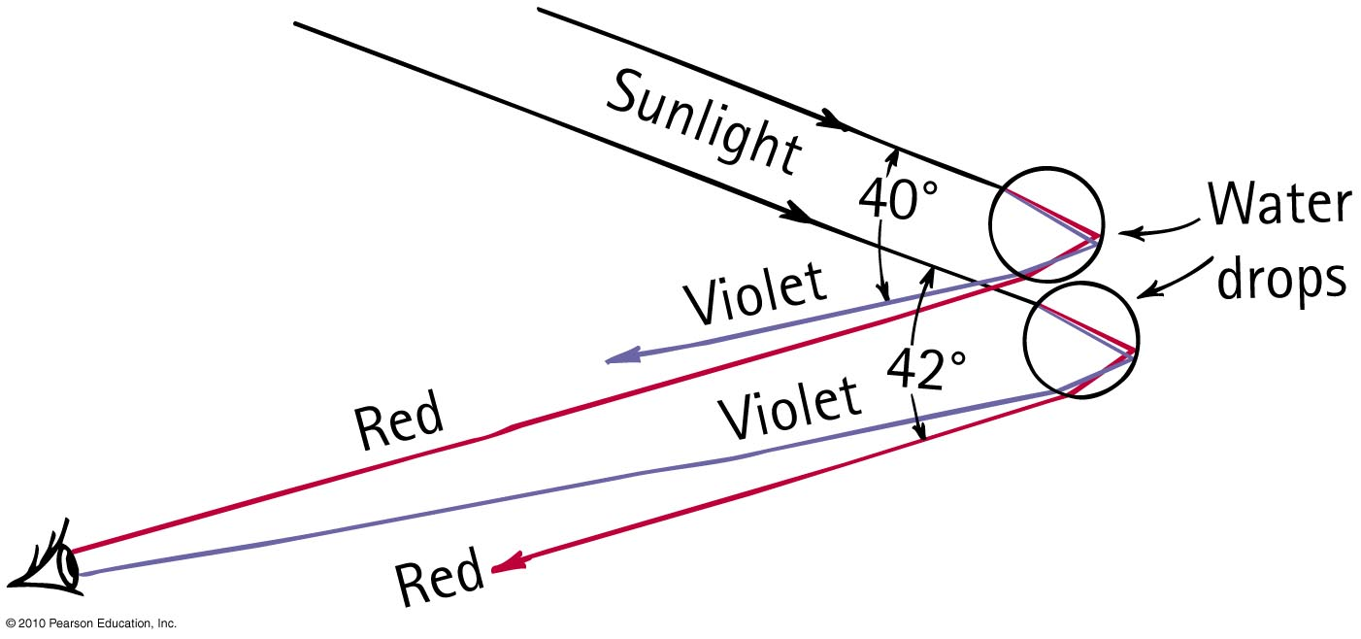
Rainbows
Sunlight incident on two sample raindrops, as shown, emerges from them as dispersed light.
The observer sees the red light from the upper drop and the violet light from the lower drop.
Millions of drops produce the whole spectrum of visible light.

Slide 15
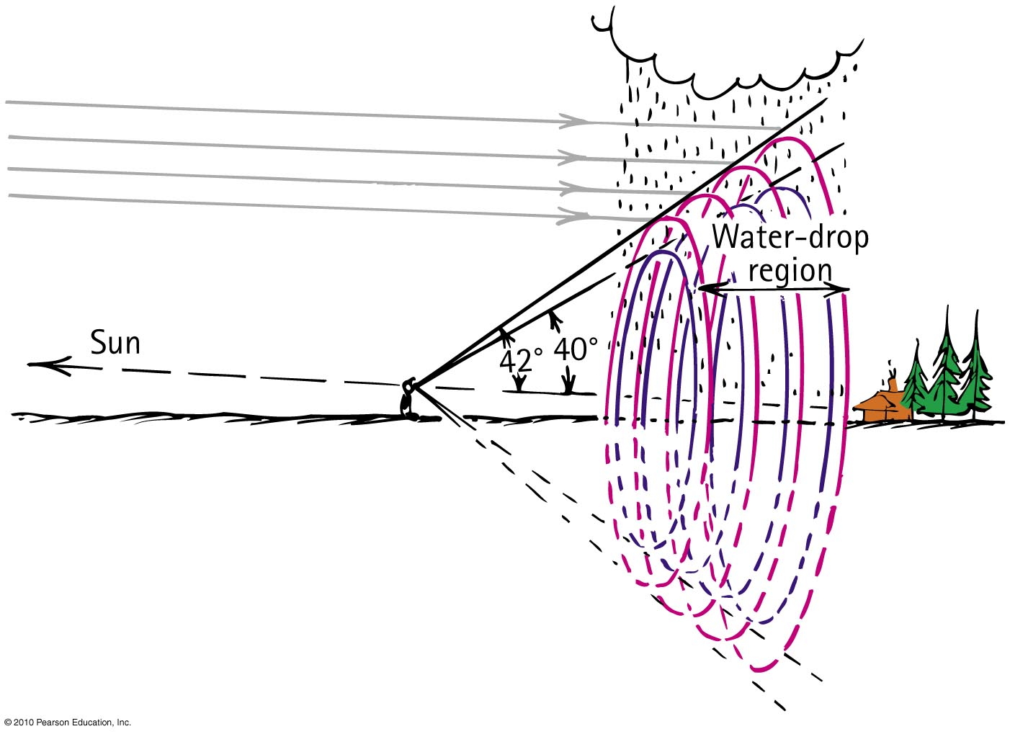
When your eye is located between the Sun (not shown off to the left) and a water drop region, the rainbow you see is the edge of a three-dimensional cone that extends through the water drop region.

Slide 16
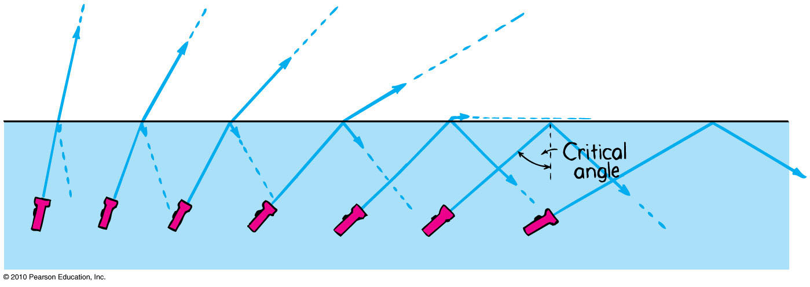
Total Internal Reflection
Total reflection of light traveling within a medium that strikes the boundary of another medium at an angle at, or greater than, the critical angle

Slide 17
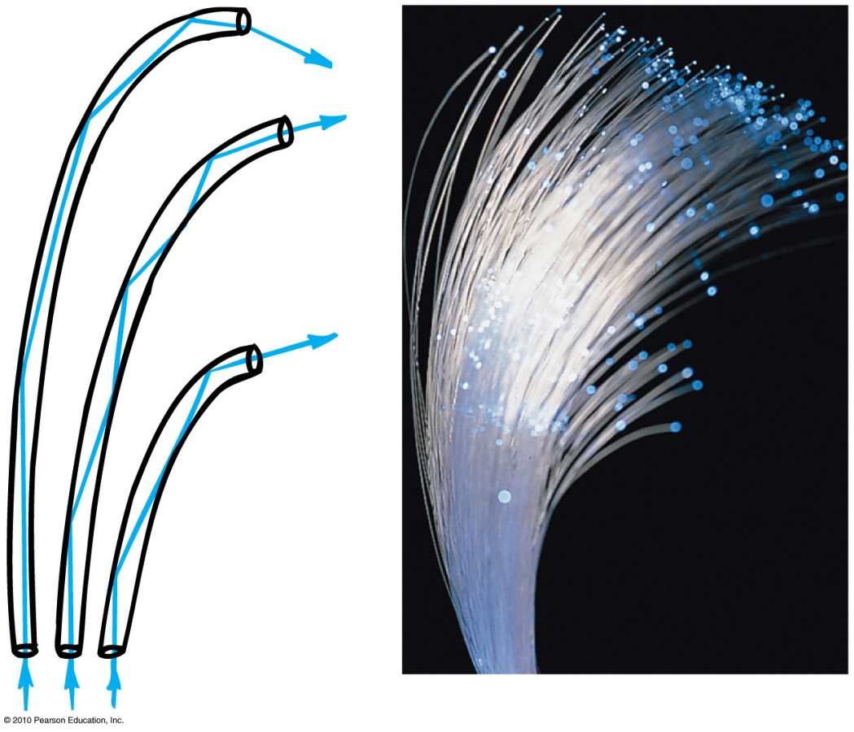
Total Internal Reflection
Optical fibers or light pipes
Thin, flexible rods of special glass or transparent plastic.
Light from one end of the fiber is total internally reflected to the other end, resulting in nearly the same brightness of light.

Slide 18
Lenses
Two common types:
Converging lens
thicker at the center than edges
converges light
Diverging lens
thinner at the center than edges
diverges light

Slide 19
Key features of lenses
Principal axis
line joining the centers of curvature of the two lens surfaces
Focal point
point at which light rays which are parallel on the other side come together
Focal length
distance between the center of the lens and either focal point

Slide 20
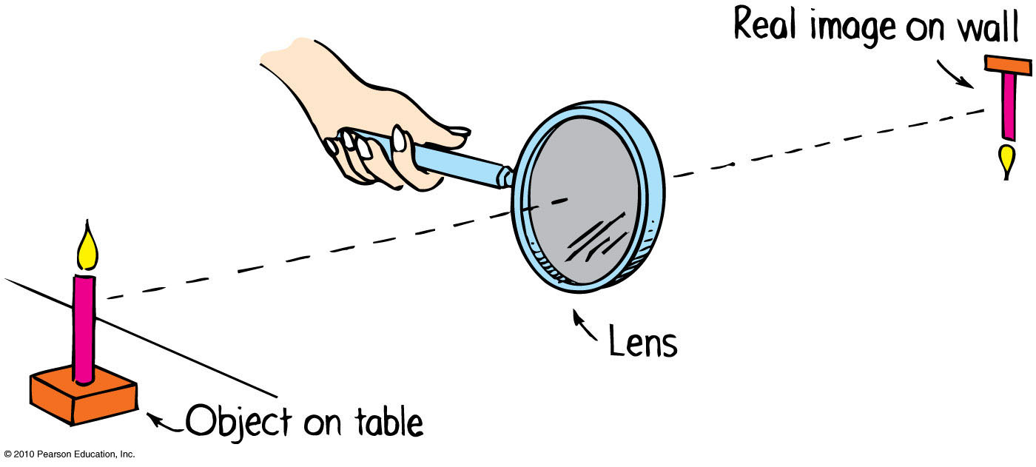
Lenses
A converging lens can project an image.

Slide 21
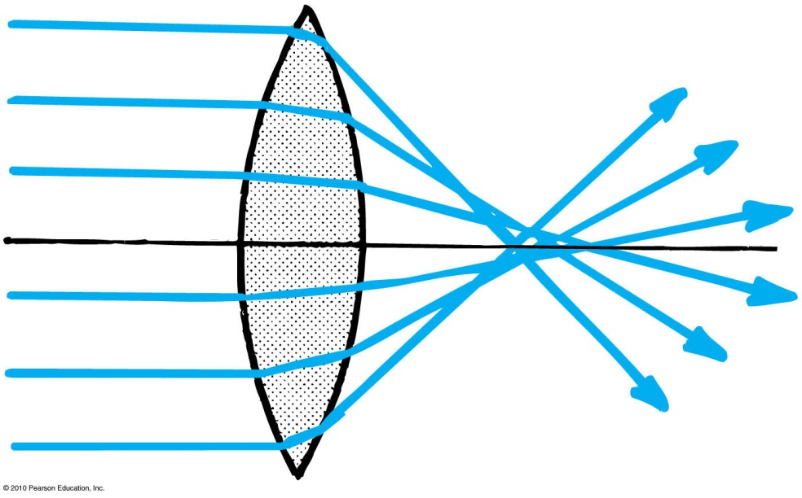
Lens Defects
An aberration is a distortion in an image
Types of aberrations
Spherical aberration
result of light passing through the edges of a lens and focusing at a slightly different place from where light passing through the center of the lens focuses

Slide 22
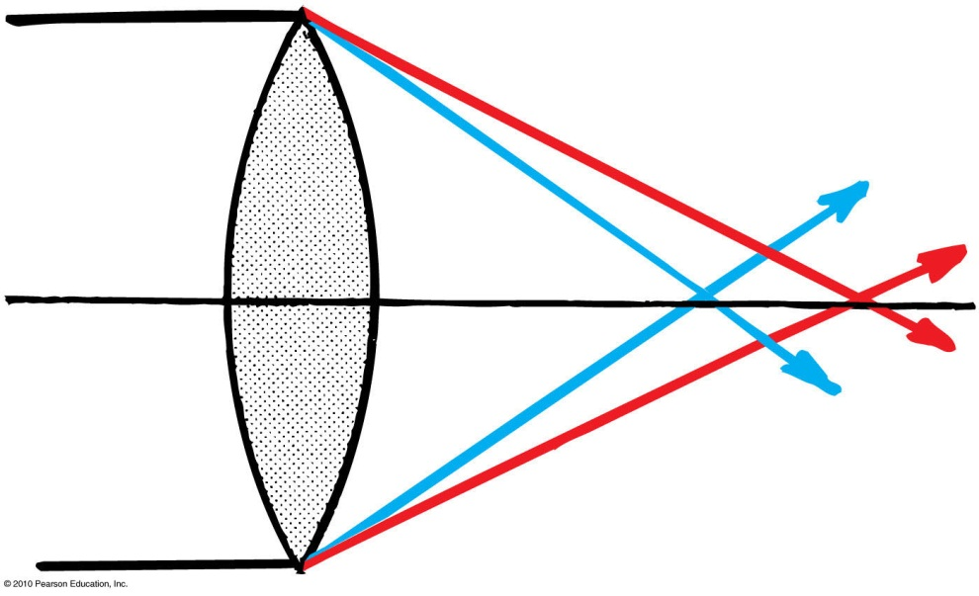
Lens Defects
Chromatic aberration
result of various colors having different speeds and different refractions in the lens
Astigmatism
surfaces of the lens are not perfectly curved

