Slide 1
Note on Posted Slides
These are the slides that I intended to show in class on Wed. Apr. 3, 2013.
They contain important ideas and questions from your reading.
Due to time constraints, I was probably not able to show all the slides during class.
They are all posted here for completeness.

Slide 2
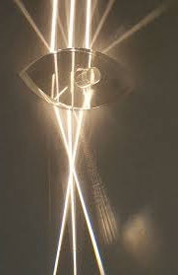
PHY205H1S
Physics of Everyday Life
Class 22: Reflection and Refraction
Law of Reflection
Virtual Image Formation
Image Reversal
Concave Mirrors
Diffuse Reflection
Refraction
Dispersion, Rainbows
Total Internal Reflection
Lenses
Real Image Formation

Slide 3
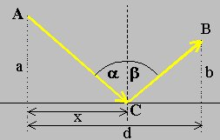
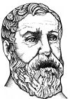
History of Light
50 A.D. – Hero of Alexandria explained Euclid’s Law of Reflection by proposing that light always takes the shortest path between two points.

Slide 4
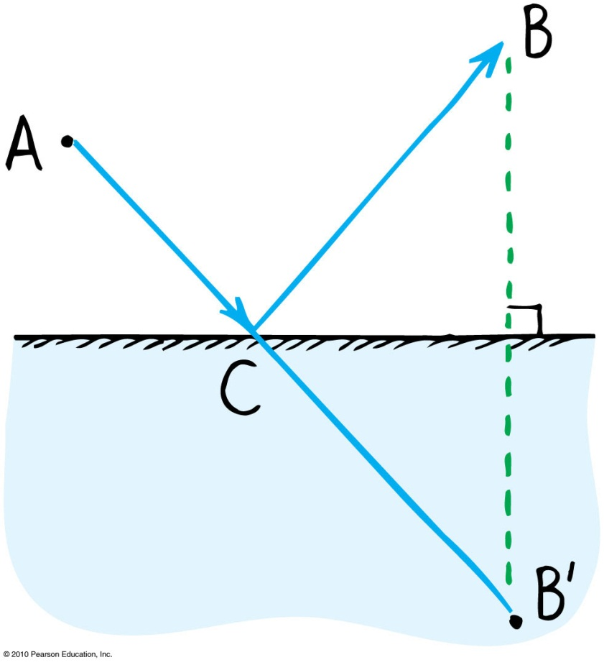
Fermat’s Principle of Least Time
In 1657 Pierre de Fermat modified Hero’s proof to be a path of least time.
B’ is a point along the normal to B, the same distance behind the mirror as B is in front of the mirror
B’ is the virtual image of B
A-C-B is the path along which light takes the shortest time to go from A to the mirror to B

Slide 5
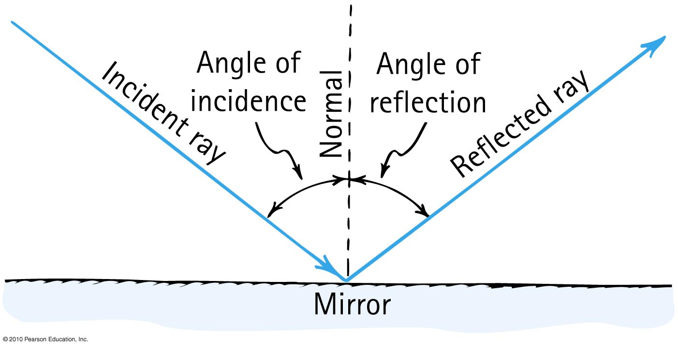
Law of Reflection
The angle of reflection equals the angle of incidence.

Slide 6
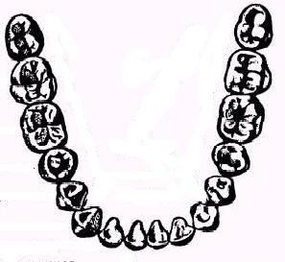
A dentist uses a mirror to look at the back of a second molar (A).
Next, she wishes to look at the back of a lateral incisor (B), which is 90° away.
By what angle should she rotate her mirror?
Mirror
A
B
A. 90°
B. 45°
C. 180°

Slide 7
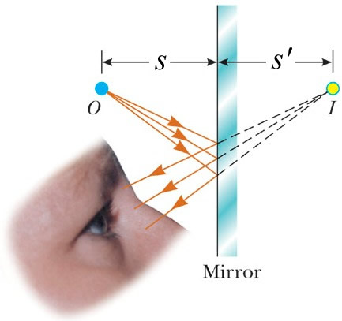
Virtual Image Formation
No light rays actually pass through or even near the image, so it is “virtual”.

Slide 8
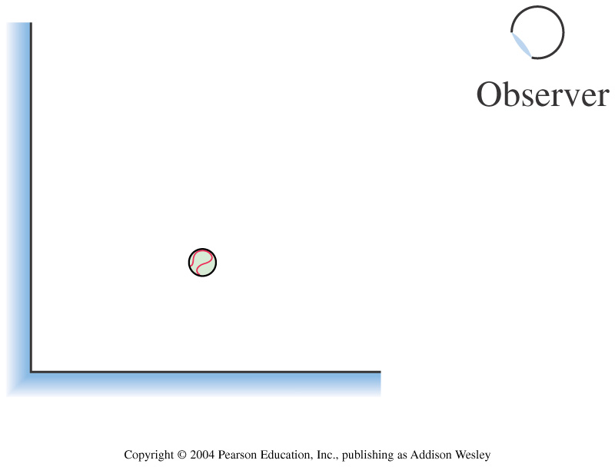
Two plane mirrors form a right angle. How many images of the ball can the observer see in the mirrors?
1
2
3
4
Notes:
STT23.2

Slide 9
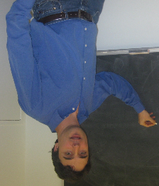
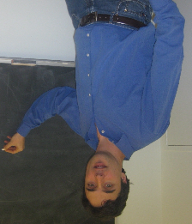
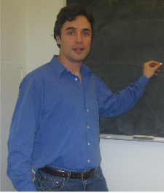
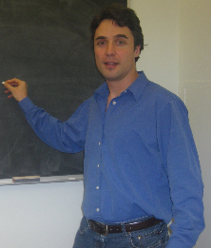
Which picture is most likely a mirror image of Harlow?
A
B
C
D

Slide 10

Virtual Image Formation
Alice looks at Bob’s image a mirror and sees he has a red shoe on the foot to Alice’s left.
Then she asks Bob to turn and face her, so she can compare the image to what Bob looks like in real life.
Bob takes a couple of steps forward, turns around and faces Alice.
Alice notes that the red shoe is now on the foot on the right.
Alice concludes: “Mirrors reverse left and right, not up and down.” Is this true? Can you see any flaws in Alice’s reasoning?
mirror
real

Slide 11
Virtual Image Formation
Bob in Mirror
Bob turns to face Alice
Bob chooses to rotate around a vertical axis, and therefore he looks flipped left-to-right.
But if Bob wants to turn to face Alice, is there any other way to do it?

Slide 12
Virtual Image Formation
Bob in Mirror
Bob stands on his head to face Alice!
If Bob had chosen to face Alice by standing on his head, he would have been flipped up-to-down, and not left-to-right!

Slide 13
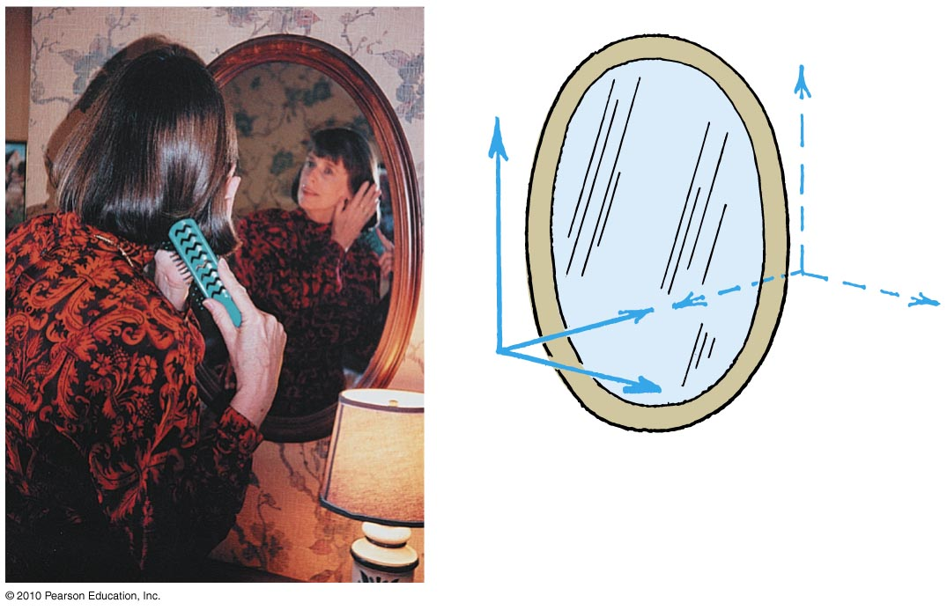
What really happens is the image is reversed front-to-back

Slide 14
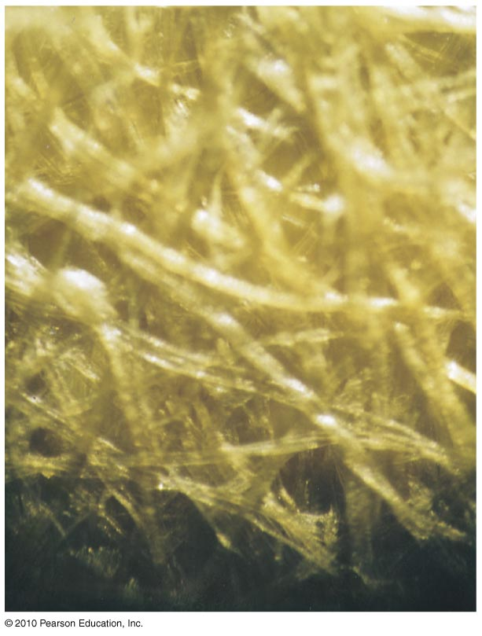
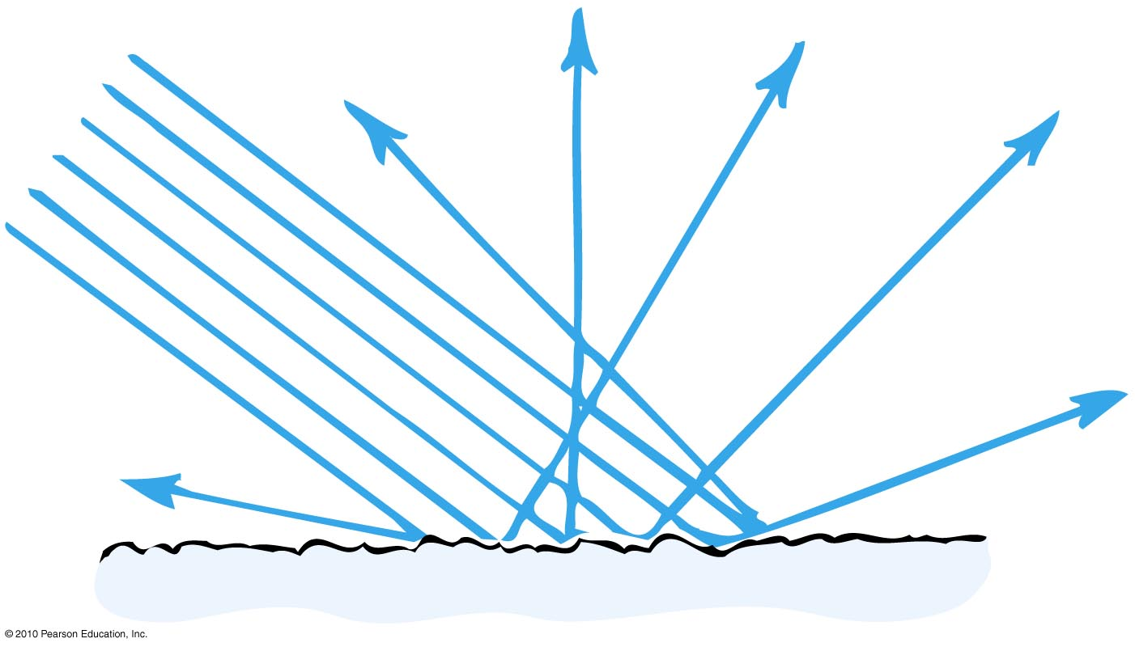
Diffuse reflection
When light strikes a rough or irregular surface and reflects in many directions
Almost everything we see is due to diffuse reflection from surfaces around us.
Magnified view of the surface of ordinary paper

Slide 15
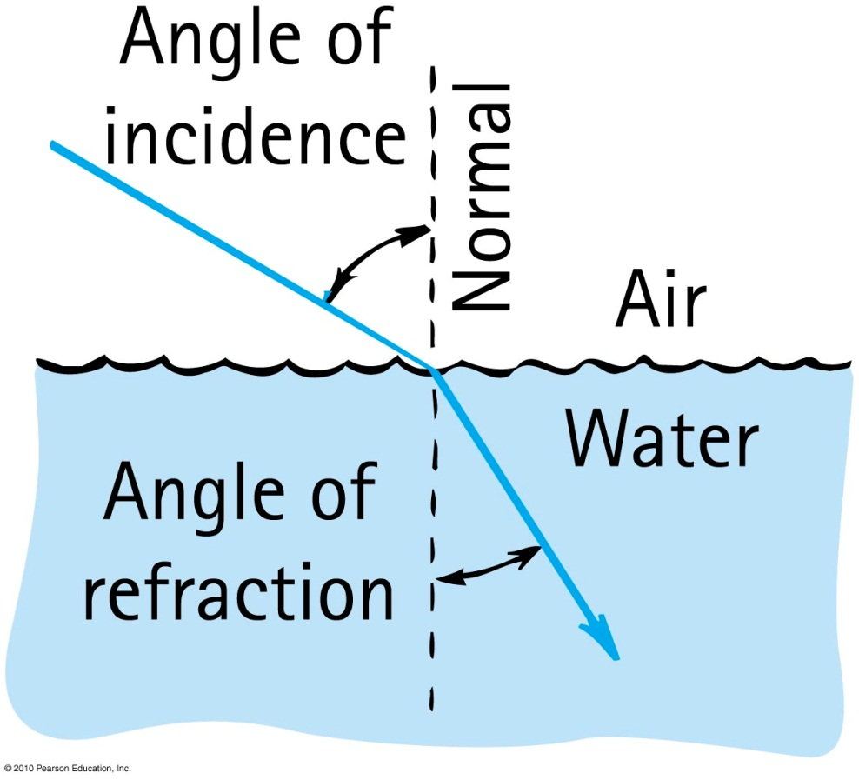
Refraction
When light bends in going obliquely from one medium to another, we call this process refraction.

Slide 16
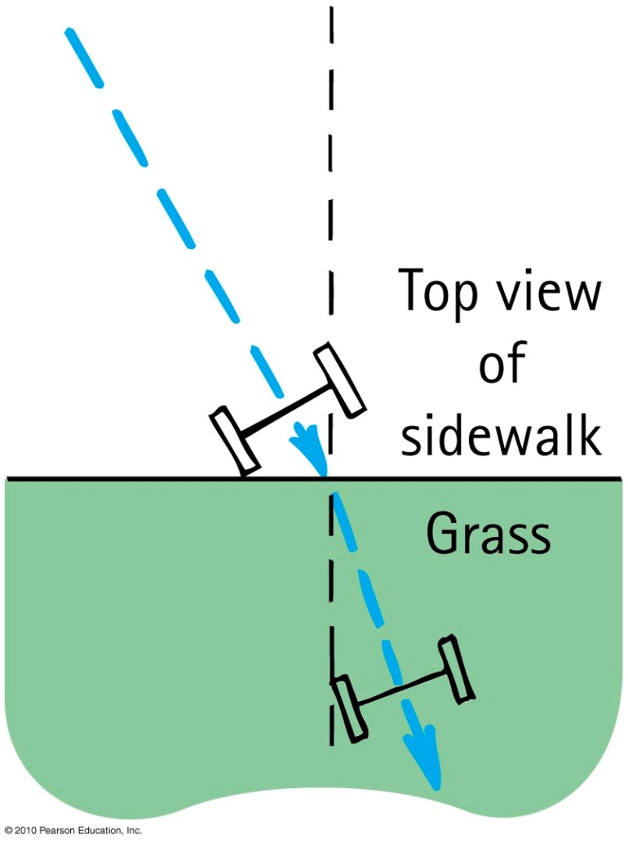
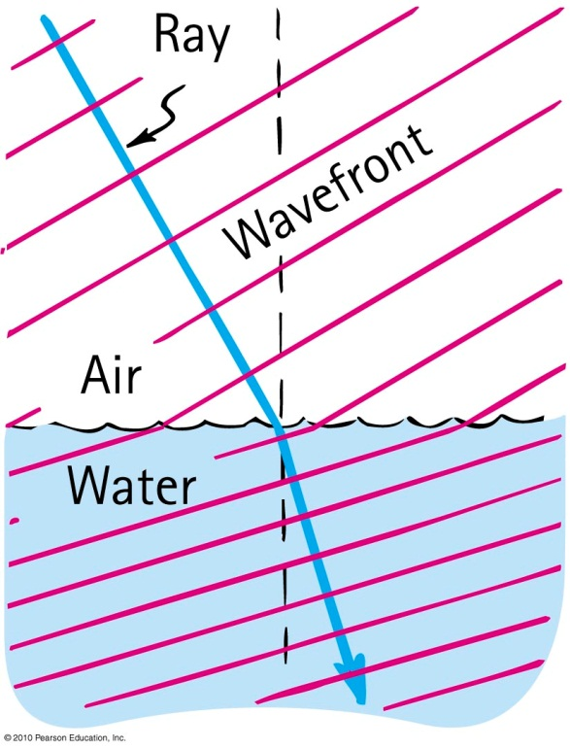
Cause of Refraction
Bending of light when it passes from one medium to another
Caused by change in speed of light

Slide 17
Index of Refraction
v_{medium} is the speed of light in a transparent medium.
c is the speed of light in a vacuum (c=3.00×10⁸ m/s)
n is a dimensionless constant: n≥1
n=1 in a vacuum

Slide 18
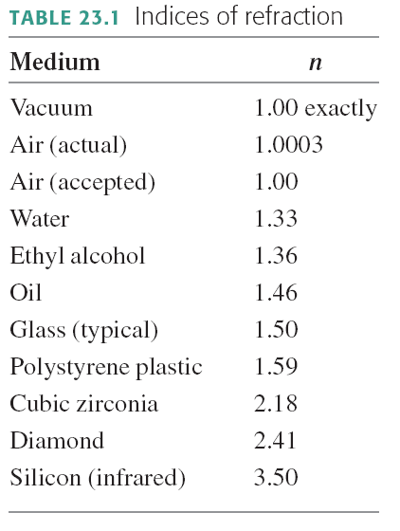

Slide 19

1
A soldier wants to get from point 1 to Point 2 in the shortest amount of time. Marching through mud is much slower than marching on dry land. Which might be the best path?
Dry Land
C
A
B
Mud
Dry Land
2

Slide 20
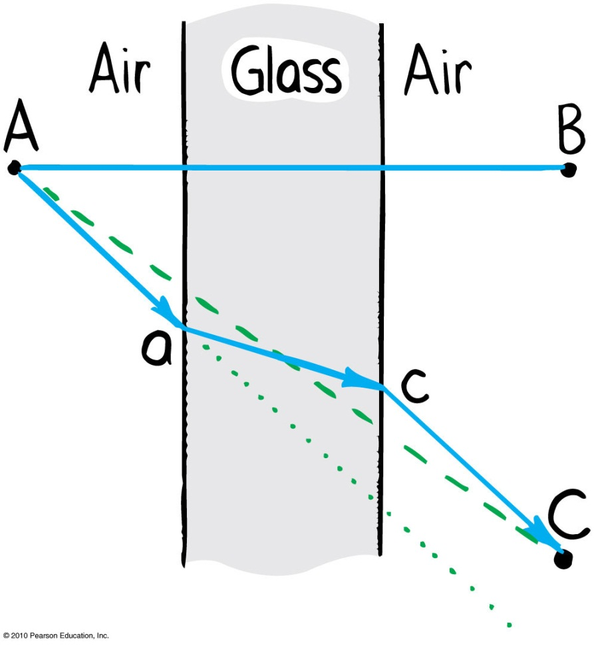
Refraction
  Light travels slower in glass than in air, so it minimizes the time it spends in the glass.

Slide 21
air
water
A fish swims below the surface of the water. An observer sees the fish at:
A. a greater depth than it really is.
B. its true depth.
C. a smaller depth than it really is.

Slide 22
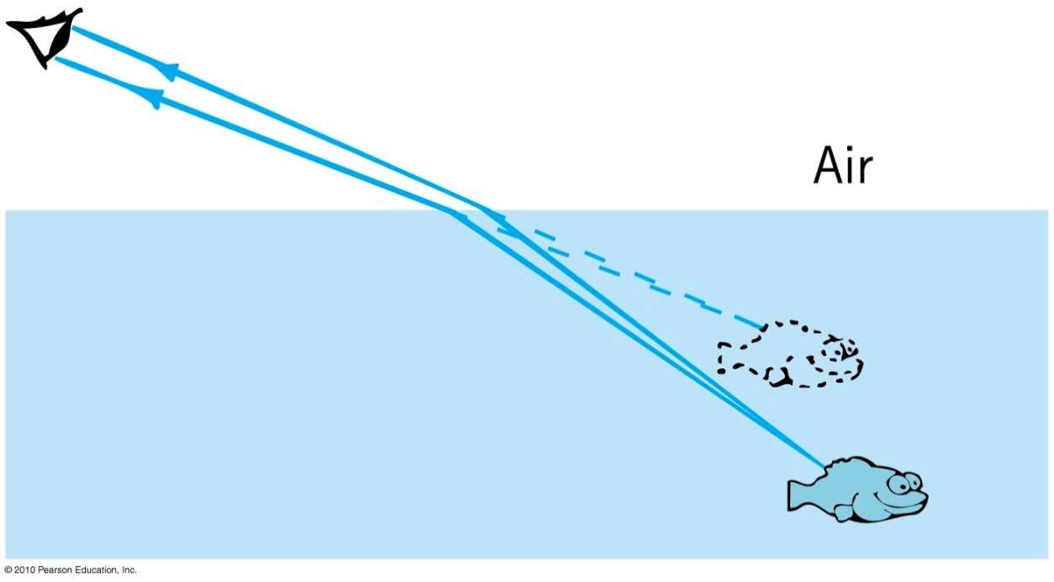
Illusion caused by refraction
Objects submerged in water appear closer to the surface.

Slide 23
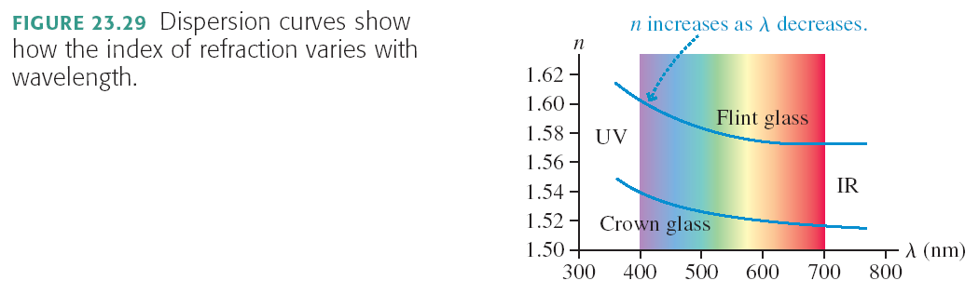
Dispersion
The slight variation of index of refraction with wavelength is known as dispersion. Shown is the dispersion curves of two common glasses. Notice that n is larger when the wavelength is shorter, thus violet light refracts more than red light.

Slide 24
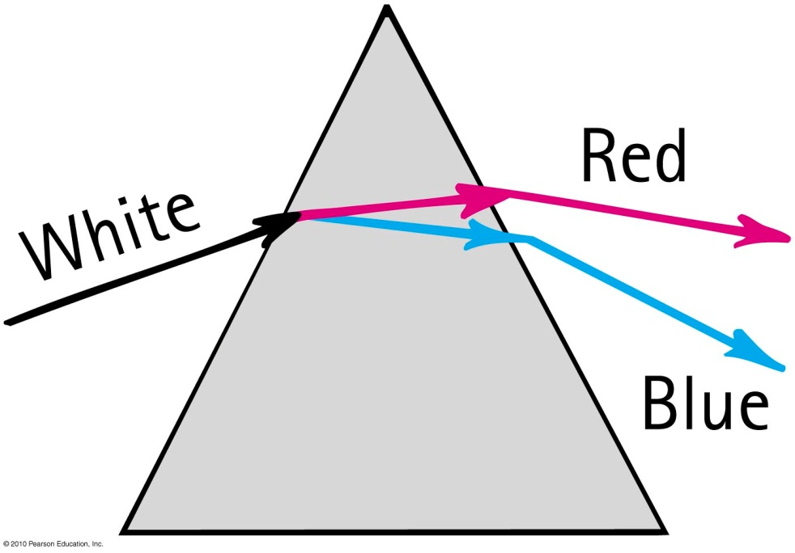
Dispersion
Process of separation of light into colors arranged by frequency
Components of white light are dispersed in a prism (and in a diffraction grating).

Slide 25
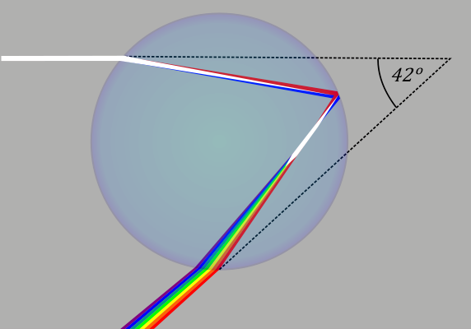
Rainbows
Rainbows are a result of dispersion by many drops.
Dispersion of light by a single drop

Slide 26
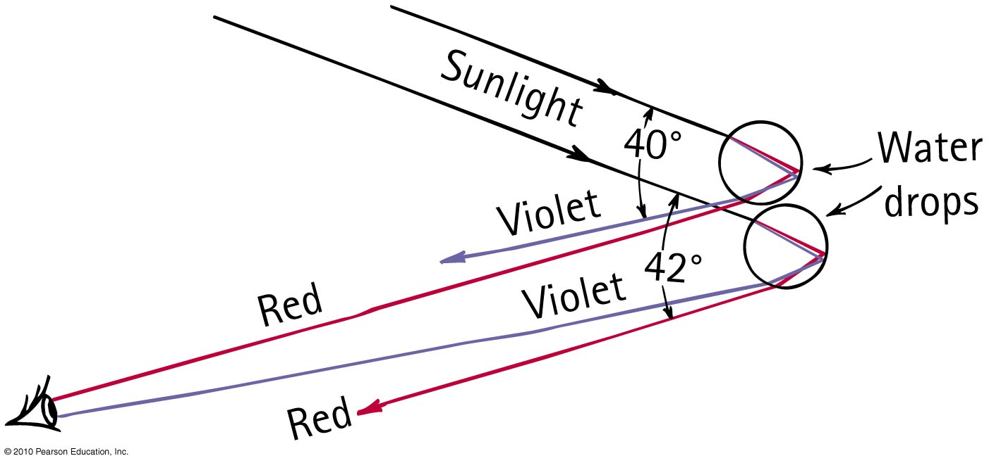
Rainbows
Sunlight incident on two sample raindrops, as shown, emerges from them as dispersed light.
The observer sees the red light from the upper drop and the violet light from the lower drop.
Millions of drops produce the whole spectrum of visible light.

Slide 27
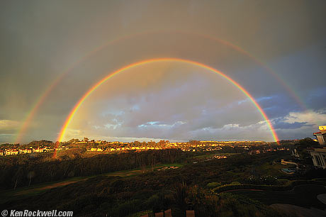
Rainbows
Antisun
Radius of circle is about 41°

Slide 28
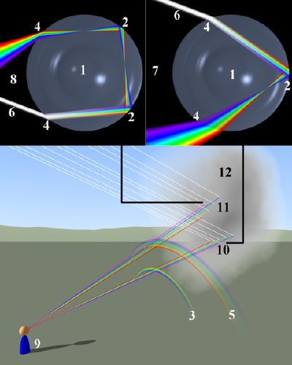
Double-rainbow
The second rainbow has blue on the top, and a radius of about 53°

Slide 29
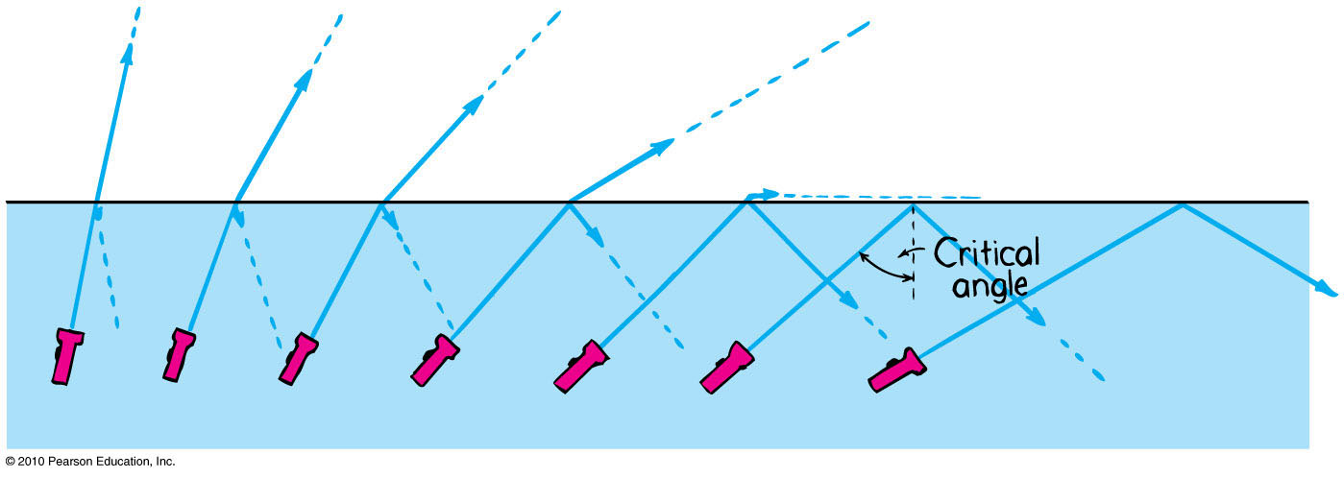
Total Internal Reflection
Total reflection of light traveling within a medium that strikes the boundary of another medium at an angle at, or greater than, the critical angle

Slide 30
Discussion Question
Light waves with speed v₁ are incident upon the flat surface of a material in which they have speed v₂.
For what condition is total internal reflection possible?
v₂ > v₁
v₂ < v₁
v₂ = v₁
All of the above

Slide 31
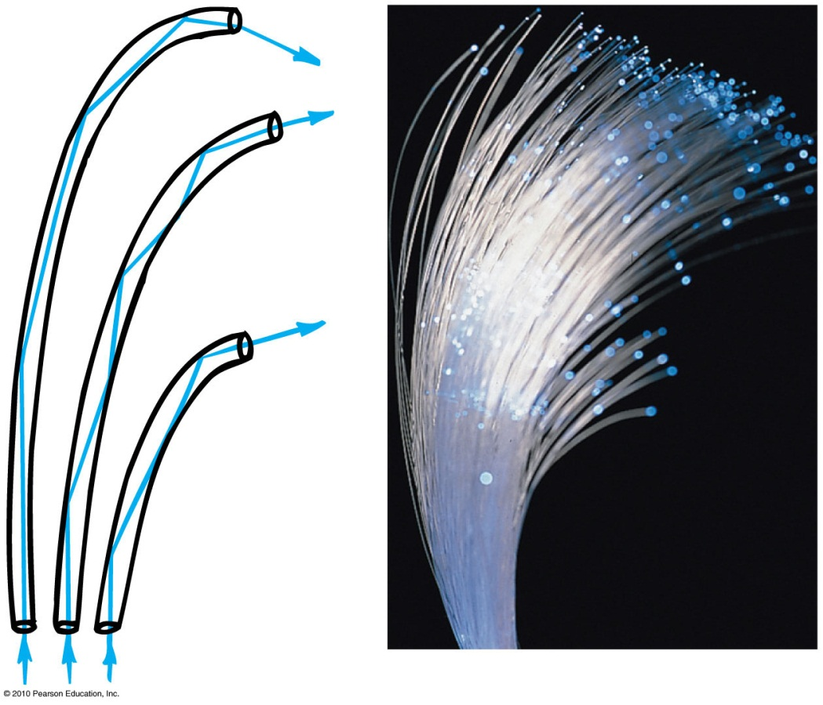
Total Internal Reflection
Optical fibers or light pipes
Thin, flexible rods of special glass or transparent plastic.
Light from one end of the fiber is total internally reflected to the other end, resulting in nearly the same brightness of light.

Slide 32
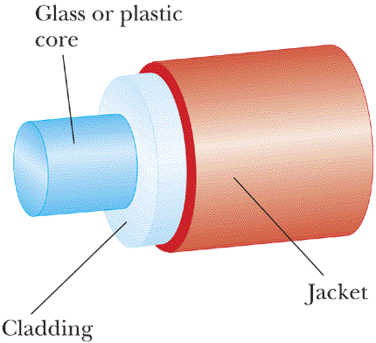
An Optical Fibre
Speed of light in cladding is higher than speed of light in core.

Slide 33
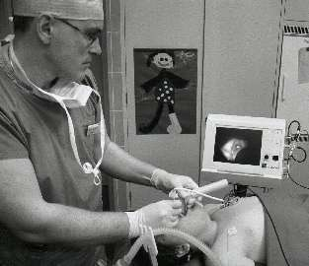
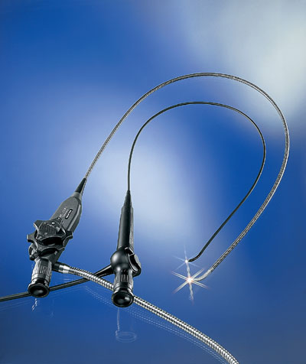
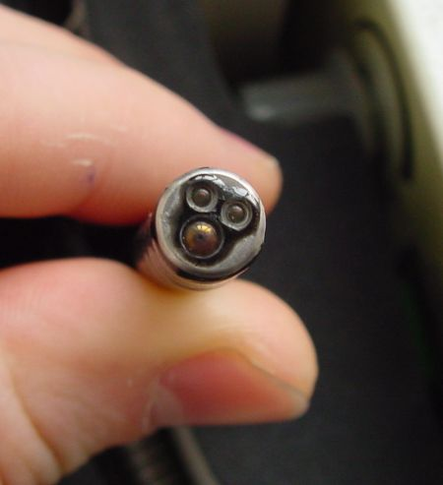
Medical Fibrescopes
Video-laryngoscopy with a flexible fiberscope

Slide 34
Converging Lens
Focal length, f
Focal Point
NOTE: Focal length is defined for initially parallel rays.

Slide 35
Diverging Lens
Negative Focal length, -f
Virtual Focal Point
Rays appear to emerge from Virtual Focal Point

Slide 36
Discussion Question
Which kind of lens can form a real image?
Diverging lens
Converging lens

Slide 37
Diverging rays through a Converging Lens
Focal length, f
If an object emits rays at the focal point, they end up being parallel on the other side of the converging lens.

Slide 38
f
What will happen to the rays emerging to the right of the lens if the face is moved a little further away from the lens?
They will remain parallel.
They will diverge (spread out).
They will converge (toward a focus).

Slide 39
Real Image Formation
Focal length, f
image
Light rays actually pass through the image, and a screen can be placed there, so it is “real”.

Slide 40
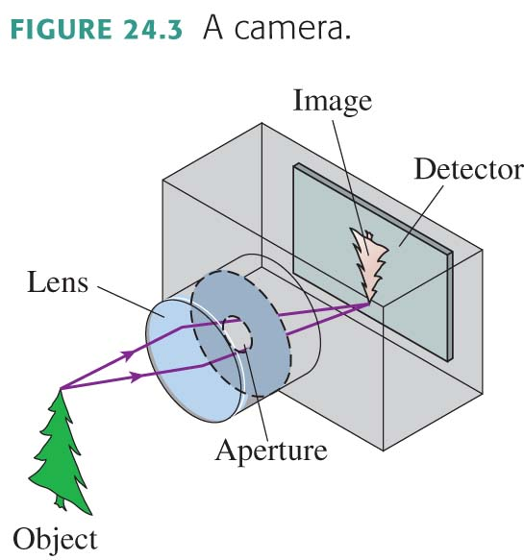
The Camera
A camera “takes a picture” by using a lens to form a real, inverted image on a light-sensitive detector in a light-tight box.
We can model a combination lens as a single lens with an effective focal length (usually called simply “the focal length”)
A zoom lens changes the effective focal length by varying the spacing between the converging lens and the diverging lens.

Slide 41

This is the end!!!!
The final exam, will be:
Tuesday, Apr. 30 at 2:00pm sharp
Room is based on your last name:
A-DO: SS2102
DU-H: SS2117
I-LEQ: SS2118
LI-LO: SS2135
LU- “WANG, X” (ie first initial ≤ X): NR25 = William Doo Auditorium, New College, 45 Wilcocks St
“WANG, Y” (ie first initial ≥ Y) -ZHANG: SEEL = Seeley Hall, Trinity College, 6 Hoskin Ave
ZHAO-ZOU: WI1017 = Wilson Hall, New College, 40 Wilcocks St.
= Sid Smith

Slide 42
This is the end!!!!
The final exam will cover the entire course, including all of the assigned reading plus tutorial materials and what was discussed in class.
Approximately even spread over the course material
Aids allowed [don’t forget to bring these!]:
  A calculator without communication capability.
  Up to three 8×13 cm index cards or equivalent area, which may be written upon on both sides.

Slide 43
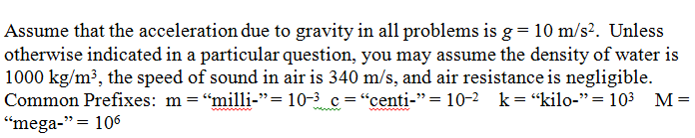
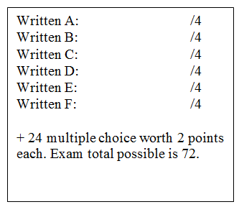
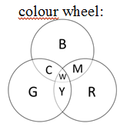
Final Exam: First Page

Slide 44

Please Fill Out the Online Survey For This Course!!!!!!
Your feedback is vital to me. I promise I will read every word you type in the online evaluations.
The online system is open now (you should have received an email already)
The deadline is this Tuesday – please don’t forget!!

Slide 45
Keep in Touch!!
My office hours Apr. 8 through 30 are:
  Mondays 2-3 and 4-5
  Wednesdays 2-3
  Fridays 9-10
I am in MP121-B and my land-line is 416-946-4071 (please don’t send text messages to my land-line)
Please email me ( jharlow@physics.utoronto.ca ) with any questions, or if you’d like to make an appointment outside my office hours.
Keep in touch! This course has been a lot of fun for me and I’d love to hear how you are doing in the future.

