Slide 1
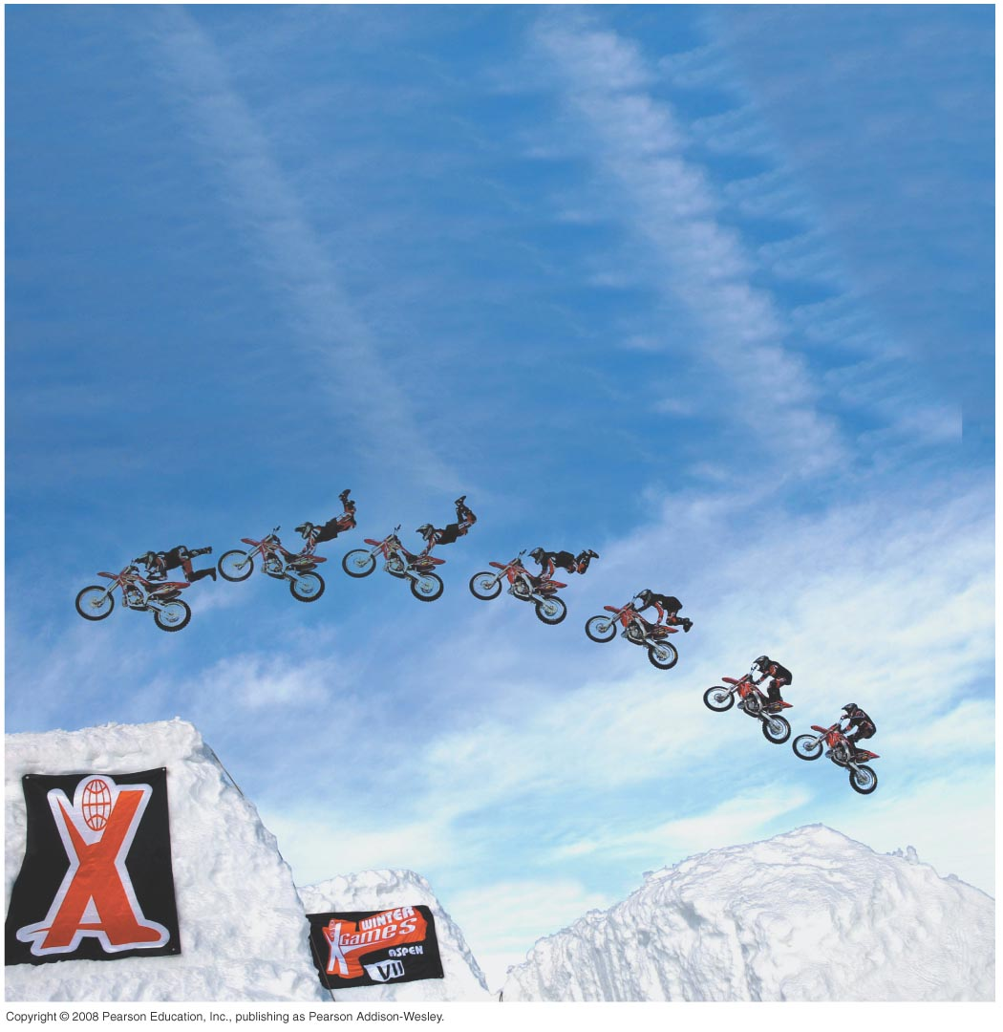
PHY131H1F – Introduction to Physics I Class 2
Today: Chapter 1.
Motion Diagrams
Particle Model
Vector Addition, Subtraction
Position, velocity, and acceleration
Position vs. time graphs

Slide 2
Garden-Variety Clicker Instructions
Status Light
When I start asking clicker questions:
Status light will flash green when your response is registered on my computer.
Status will flash red if your response is not registered.
Power Light
On/Off Switch
Please turn on your clicker now
2

Slide 3
Clicker Question 1
Which car is going faster, A or B?
(Assume these are both motion diagrams.)
A
B
Additional Assignment to do during this quiz:
Learn the name of at least one other student in this course.

Slide 4
Class 2 Preclass Quiz on MasteringPhysics
This was due this morning at 8:00am
897 students submitted the quiz on time (out of 1078 students in the course, so 83% of you)
The first 5 questions, worth 1 point each for answering correctly, had certain correct answers which you can now review. The average on these 5 questions was82?%.
The last question was “Did you complete quiz?” for which 99.6% of you got 20 points for answering “Yes”.
The total is out of 25 for this quiz, worth (1/20th) of 3% of the course

Slide 5
Class 2 Preclass Quiz on MasteringPhysics
70% got correct: The one about significant figures – I’ll go over that in today’s class at the end.
91% got correct: The basic SI units are second, meter, kilogram

Slide 6
MasteringPhysics
Survey Question
How would you describe your experience with MasteringPhysics so far?
Great! I love it!
Okay; I spent about half an hour or less getting it started and doing the first preclass quiz
Frustrating; I spent more than half an hour on installing it and working through the bugs before doing the preclass quiz
Extremely Frustrating: I could NOT do the preclass quiz despite trying very hard
I don’t know; I have not tried to use MasteringPhysics

Slide 7
Class 2 Preclass Quiz on MasteringPhysics
Some common student comments/feedback:
“I got A+ in my grade 12 physics, no topics are hard for me.”
“I honestly can feel my brain crumple as I read through this text. The abstract concepts of velocity and acceleration are difficult for me at this time. I will, however, work very hard to understand what is happening.”
“Da work was incredibly eez dawg. I took da AP Physics, man. I don' need is'. You migh' wanna take up da Sig Figs do'. I don' know any o' dis' Canadian regulations; you know what i'n sayin'? Oder' than dat' it was good.”
“I'm going to be honest and say that I did not do the assigned reading.”

Slide 8
Class 2 Preclass Quiz on MasteringPhysics
“it would be nice if we could be told specifically which common prefixes, unit conversions, approximate lengths and approximate masses we should memorize for this course.”
Harlow Answer: Don’t memorize anything! Just write it on your aid sheet, which is allowed in both tests and the final exam!
“ ‘The translation from words to symbols is the heart of problem solving in physics.’ (p 19 1.7) This quote from the textbook is my favorite quote from this book so far. It gives me a brand new understanding to the concept of a physics problem solving.”
“Having no internet at home really motivates one to complete assignments ahead of time. Save money and get good grades kids, don't get internet.”

Slide 9
The Particle Model
If we restrict our attention to objects undergoing translational motion, we can consider the object as if it were just a single point, without size or shape.
We can also treat the object as if all of its mass were concentrated into this single point.
An object that can be represented as a mass at a single point in space is called a particle.
A particle has no size, no shape, and no distinction between top and bottom or between front and back.

Slide 10
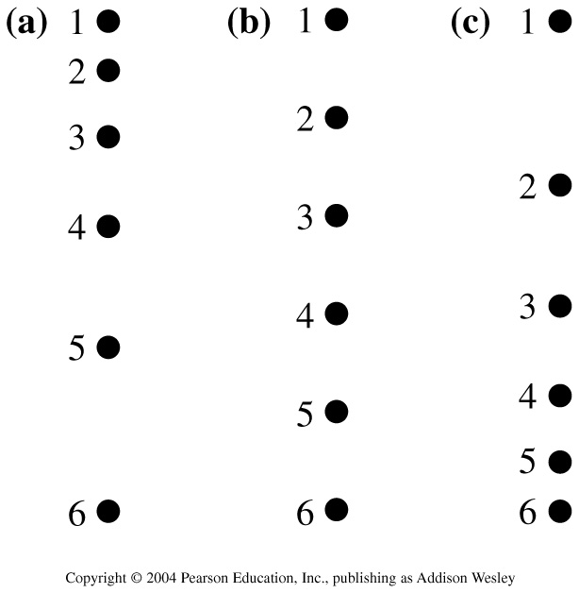
Three motion diagrams are shown. Which is:
a dust particle settling to the floor at constant speed,
a ball dropped from the roof of a building,
a descending rocket slowing to make a soft landing on Mars
Clicker Question 2
A. (a) is ball, (b) is dust, (c) is rocket
B. (a) is ball, (b) is rocket, (c) is dust
C. (a) is rocket, (b) is dust, (c) is ball
D. (a) is rocket, (b) is ball, (c) is dust
E. (a) is dust, (b) is ball, (c) is rocket

Slide 11
Scalars and Vectors
A “scalar” is a quantity that can be represented by one number, and a unit
A “vector” requires at least two numbers: for example, a magnitude and a direction
Examples of scalar quantities: distance, speed, temperature, mass
Some scalars are always non-negative, such as mass or speed
Examples of vector quantities: displacement, velocity, acceleration, force

Slide 12
Distance and Displacement
Distance: how far you traveled.
Displacement: final position minus initial position.
$$d≥\left|Δ\vec{s}\right|$$

Slide 13
Vector Addition
80% of you could do this on today’s pre-class reading quiz!

Slide 14
Vector Subtraction

Slide 15
Speed and Velocity
Average Speed: distance traveled divided by time
Average Velocity: displacement divided by time

Slide 16
Average Velocity
Units of
are metres.
Units of
are metres per second.

Slide 17
Velocity (a.k.a. “instantaneous velocity”)
Units of
are metres.
Units of
are metres per second.

Slide 18
Average Acceleration
Units of
are m/s.
Units of
are m/s².

Slide 19
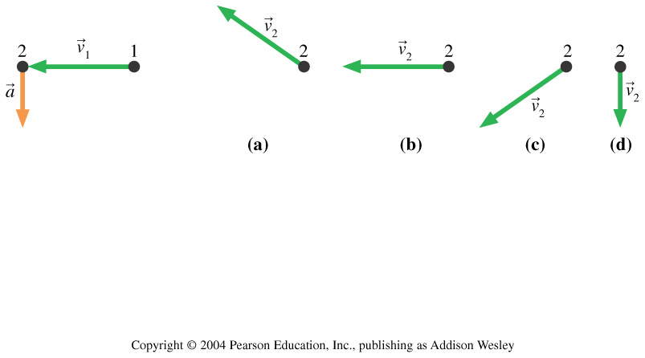
Clicker Question 3
A particle undergoes acceleration $\vec{a}$ while moving from point 1 to point 2.
Which of the choices shows the velocity vector ${\vec{v}}_{2}$ as the object moves away from point 2?

Slide 20
Acceleration (a.k.a. “instantaneous acceleration”)
Units of
are m/s.
Units of
are m/s².

Slide 21
Tactics: Finding the acceleration vector

Slide 22
If an object is slowing down,
Clicker Question 4
its velocity must be positive.
its velocity must be negative.
its acceleration must be positive.
its acceleration must be negative.
the acceleration and velocity vectors must be in opposite directions.

Slide 23
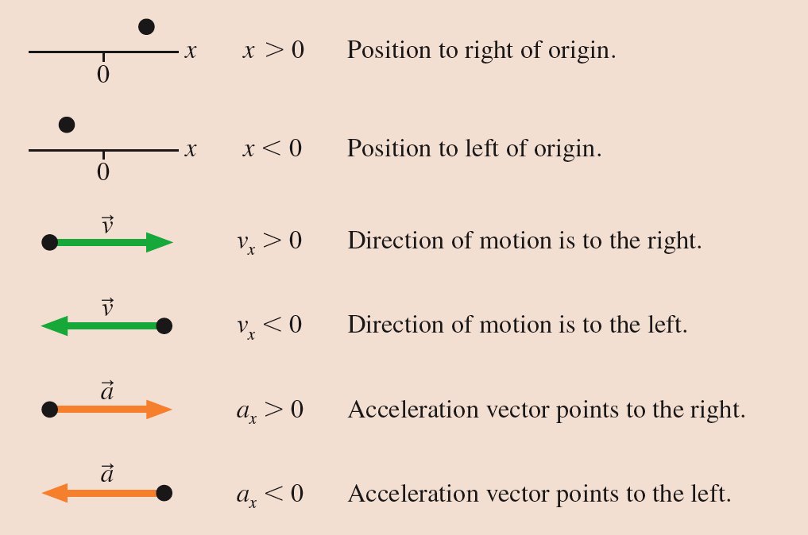
Tactics: Finding the acceleration vector

Slide 24
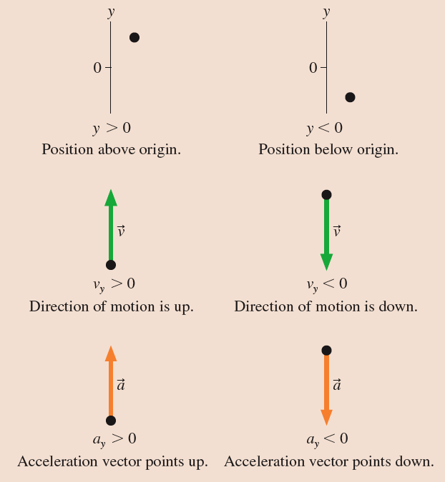
Tactics: Finding the acceleration vector

Slide 25
Clicker Question 5
From a PHY131H1F Past Test
Below is a motion diagram for an object with smooth motion and a constant value of acceleration. We define positive displacements as being toward the right. What can you say about the sign of the acceleration and whether the object is speeding up or slowing down?
The acceleration is negative, and the object is slowing down.
The acceleration is positive, and the object is speeding up.
The acceleration is positive, and the object may be speeding up or slowing down.
The acceleration may be positive or negative, and the object is speeding up.
The acceleration may be positive or negative, and the object may be speeding up or slowing down.

Slide 26
Fall 2013 Test 1 results
C
B
D
F
A
A+
Average test mark was 63%
21% of the class got A
18% got B
19% got C
17% got D
24% failed

Slide 27
Fall 2013 Final Course Marks
B
C
A
644 students completed the course.
That’s ¾ of the students who wrote Test 1.
D
A+
F
32% of the class got A
28% got B
25% got C
10% got D
6% failed

Slide 28
Piazza Discussion Board
This is a fast way to get answers to your questions, sometimes from other students
It is optional, and it is free
Simply visit https://piazza.com/

Slide 29
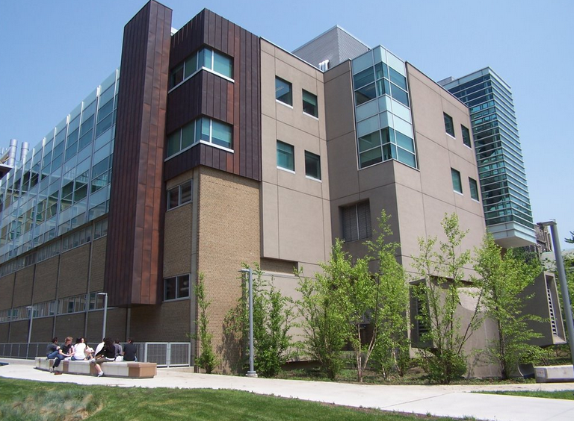
Announcement
Victoria College tutors help with Labs, concepts, and past test questions. Tutoring is free and open to all enrolled Arts and Science physics students.
Location: Lash Miller Chemistry Lounge Undergraduate Lounge (LM204A)
Times this semester: Tuesdays 3:00 – 5:00pm

Slide 30
Clicker Question 6
A ball rolls up a ramp, and then down the ramp. We keep track of the position of the ball at 6 instants as it climbs up the ramp. At instant 6, it stops momentarily as it turns around. Then it rolls back down. Shown below is the motion diagram for the final 6 instants as it rolls down the ramp.
At which instant is the speed of the ball the greatest?
6
9
11
The speed is zero at point 6, but the same at points 7 to 11
The speed is the same at points 6 through 11

Slide 31
Clicker Question 7
A ball rolls up a ramp, and then down the ramp. We keep track of the position of the ball at 6 instants as it climbs up the ramp. At instant 6, it stops momentarily as it turns around. Then it rolls back down. Shown below is the motion diagram for the final 6 instants as it rolls down the ramp.
At which instant is the acceleration of the ball the greatest?
6
9
11
The acceleration is zero at point 6, but about the same at points 7 to 11
The acceleration is about the same at points 6 through 11

Slide 32
Tennis ball thrown straight up:

Slide 33
Suggested Problem Solving Strategy
MODEL
VISUALIZE
SOLVE
ASSESS
Think about and simplify the situation, guess at what the right answer might be.
Draw a diagram. It doesn’t have to be artistic: stick figures and blobs are okay!
Set up the equations, solve for what you want to find. (This takes time..)
Check your units, significant figures, do a “sanity check”: does my answer make sense?
This is just a suggested strategy. Whatever method works for you is fine, as long as you don’t make a mistake, and you show how you got to the correct answer, it’s 100%!

Slide 34
Before Class 3 on Monday
Please read the Error Analysis Mini-Document (10 page PDF) available on course web-site.
Please do the short pre-class quiz
Problem Set 1 on MasteringPhysics is due Sep.21: take a look at it. Don’t leave problem sets until the last minute!
Something to think about: If your height is 150 cm, is there necessarily an error in that number?

