Slide 1
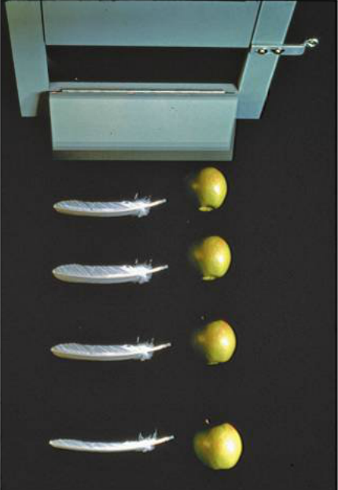
PHY131H1F Class 5
Today, Chapter 2, Sections 2.5 to 2.7
Freefall
Acceleration due to gravity
Motion on an inclined plane
Differentiating velocity to get acceleration
Integrating acceleration to get velocity
Non-constant acceleration

Slide 2
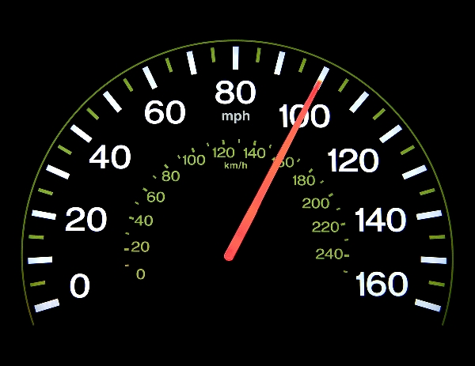
Clicker Question
What does the speedometer in your car measure?
distance traveled
average speed
average velocity
instantaneous speed
instantaneous velocity
[image downloaded Jan. 9 2013 from http://phoneky.com/applications/?p=preview&id=a1a32446&st=2]

Slide 3
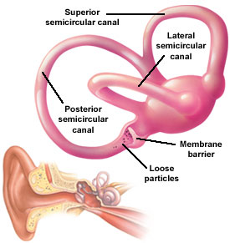
Last day I asked at the end of class:
Video by Aaron Lazare http://youtu.be/sxkcHnogPLE ]
Which is easier to see: velocity or acceleration?
ANSWER: velocity. Our eyes are very good at noticing when things are moving, but it is difficult to tell if an object is accelerating or not just by looking at it.
Which is easier to feel: velocity or acceleration?
ANSWER: acceleration. Since velocity is relative, it is actually impossible to feel if you are moving or not! But it is very easy to feel if you are accelerating. The semicircular canals in your ears are designed specifically to detect acceleration.

Slide 4
Clicker Question
Your car starts at rest, and then you speed up to a maximum of 120 km/hr over a time of 25 seconds. During this time:
both your velocity and acceleration were constant.
your velocity was constant, but your acceleration was changing.
your velocity was changing, but your acceleration was constant.
both your velocity and acceleration were changing.

Slide 5
Very few things in real life have constant acceleration!!!
For something to have constant acceleration, all the forces on the object must remain constant as it moves.
This is rare; it is usually NOT true for people that are running or walking, automobiles, trains, or animals.
Two things actually do have constant acceleration:
Objects in freefall (flying through space under the influence of gravity only with negligible air resistance)
Objects sliding or rolling down an inclined plane (with negligible friction)

Slide 6
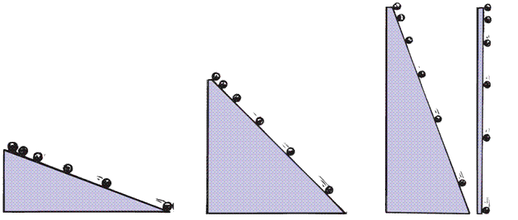
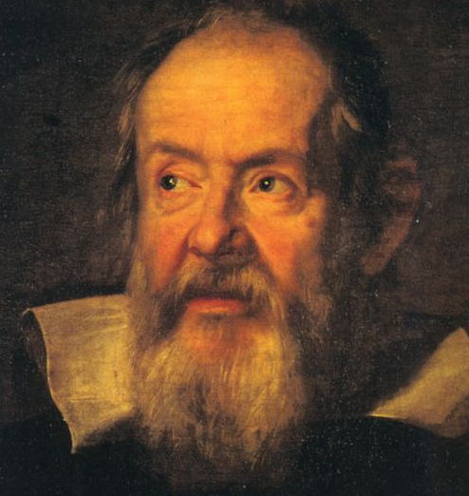
Acceleration due to Gravity
In ~1600, Galileo measured the acceleration of marbles rolling down inclined planes. He found:
Steeper inclines gave greater accelerations.
When the incline was vertical, acceleration was a certain maximum, same as that of a freely falling object.
When air resistance was negligible, all objects fell with the same unchanging acceleration.
Image of Galileo downloaded Sep. 20 2013 from: http://commons.wikimedia.org/wiki/File:Galileo-sustermans.jpg ]

Slide 7
Free Fall
= Falling under the influence of gravity only, with no air resistance.
Freely falling objects on Earth accelerate at the rate of 9.8 m/s/s, i.e., 9.8 m/s²
The exact value of free fall acceleration depends on altitude and latitude on the earth.

Slide 8
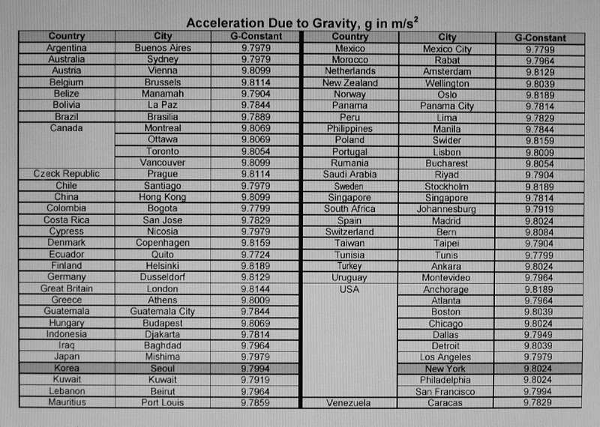
Average: 9.799 m/s²
For Problem Sets, Tests and the Exam in this class: let’s use g = 9.80 m/s²

Slide 9
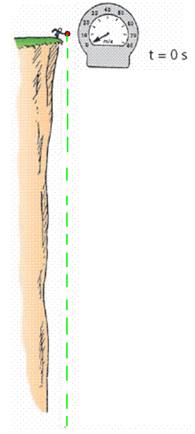
Free Fall—How Fast?
The velocity acquired by an object starting from rest is
So, under free fall, when acceleration is 9.8 m/s², the speed is
9.8 m/s after 1 s.
19.6 m/s after 2 s.
29.4 m/s after 3 s.
And so on.

Slide 10
Clicker Question
A tennis ball is thrown directly upward, and air resistance on the ball is negligible as it flies.
At one instant, it is traveling upward with a speed of 4.9 m/s.
1.0 seconds later, what will its speed be?
0
4.9 m/s
9.8 m/s
15 m/s
20 m/s
Notes:
10

Slide 11
Free Fall—How Far?
The distance covered by an accelerating object starting from rest is
So, under free fall, when acceleration is 9.8 m/s², the distance is:
4.9 m after 1 s,
20 m after 2 s,
44 m after 3 s,
and so on…

Slide 12
Freefall Example
What is the instantaneous velocity of a freely falling object 10.0 s after it is released from a position of rest?
What is its average velocity during this 10.0 s interval?
How far will it fall during this time?

Slide 13
Announcements
The first term test will be on Tuesday, Sep 30, from 6:00pm to 7:30pm.
Test 1 will cover chapters 1-3 plus the Error Analysis Mini-Document, plus what was done in Practicals
You must bring a calculator and one 8.5x11’ aid sheet which you prepare, double-sided
If you have a conflict at that time with an academic activity (test, lecture, tutorial, lab), you must register to write at the alternate sitting of this test by going to portal and filling out the online form no later than Sep. 25 by 4:00pm.

Slide 14
A 600 g basketball and a 60 g tennis ball are dropped from rest at a height of 3 m above the ground. As they fall to the ground, air resistance is negligible. Which of the following statements is true for the balls as they fall?
Clicker Question
The force of gravity is 10 times greater on the basketball than on the tennis ball
The force of gravity is the same on both balls
The force of gravity is slightly larger on the basketball than on the tennis ball

Slide 15
A 600 g basketball and a 60 g tennis ball are dropped from rest at a height of 3 m above the ground. As they fall to the ground, air resistance is negligible. Which of the following statements is true for the balls as they fall?
Clicker Question
The acceleration of the basketball is 10 times greater than the acceleration of the tennis ball
The acceleration of both balls is the same
The acceleration of the basketball is slightly larger than the acceleration of the tennis ball

Slide 16
Motion on an Inclined Plane
Consider an object sliding down a straight, frictionless inclined plane

Slide 17
At time t = 0, small red marble is released from rest at the top of a smooth, frictionless incline that is at an angle θ relative to the horizontal. The red marble begins rolling down the incline. A short time later, when t = T, a blue marble is released from rest at the top of the same incline, and begins to roll in the same direction as the red marble. At a time t = 2T, what is the speed of the red marble relative to the blue marble?
Clicker Question
(From the PHY131H1F Midterm Test 1, Fall 2013.)
$Tg sin\left(θ\right)$
$2Tg sin\left(θ\right)$
$\frac{1}{2}T^{2}g sin\left(θ\right)$
$\frac{3}{2}T^{2}g sin\left(θ\right)$
zero
Notes:
B. the same.

Slide 18
Instantaneous Acceleration
The instantaneous acceleration a_{s} at a specific instant of time t is given by the derivative of the velocity
Note: Knight uses “s” to denote a distance in a general direction. Usually in problems we substitute x or y instead of s.

Slide 19
Finding Velocity from the Acceleration
If we know the initial velocity, v_{is}, and the instantaneous acceleration, a_{s}, as a function of time, t, then the final velocity is given by
Or, graphically,

Slide 20
Clicker Question 7
a
An object starts at rest, and has a constant acceleration of +10 m/s² for 5 seconds.
10 m/s²
How fast is the object going after 5 seconds?
10 m/s
25 m/s
50 m/s
100 m/s
500 m/s
t
5 s

Slide 21
Clicker Question 8
An object starts at rest, and has an initial acceleration of +10 m/s².
As it speeds up, its acceleration decreases at a constant rate.
After 5 seconds, it is traveling at a constant velocity (a = 0).
a
10 m/s²
t
How fast is the object going after 5 seconds?
10 m/s
25 m/s
50 m/s
100 m/s
500 m/s
5 s

Slide 22
When Acceleration Changes Abruptly
Consider an object that has a constant acceleration, a₁, from t_{A} until t_{B}
At t_{B} its acceleration suddenly changes to a₂, and remains constant until t_{C}.
Strategy:
Divide the motion into segments 1 & 2.
You can use the equations of constant acceleration in each segment
The final position and velocity of segment 1 become the initial position and velocity of segment 2.

Slide 23
Challenge Problem 2.77
A rocket is launched straight up with constant acceleration. Four seconds after liftoff, a bolt falls off the side of the rocket. The bolt hits the ground 6.0 s later. What was the rocket’s acceleration?

Slide 24
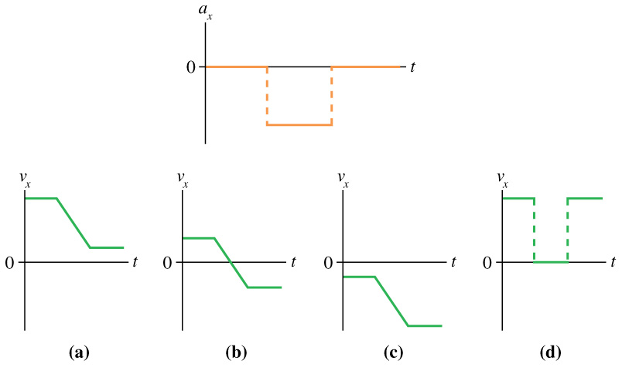
Clicker Question
Which velocity-versus-time graph or graphs goes with this acceleration-versus-time graph? The particle is initially moving to the right and finally to the left.
Notes:
Answer: B

Slide 25
Before Class 6 on Wednesday
Please read Chapter 3 of Knight.
There is a MasteringPhysics PreClass Quiz on chapter 3 due Wed. 8am.
Something to think about: Can you add a scalar to a vector? Can you multiply a vector by a scalar?

