Slide 1
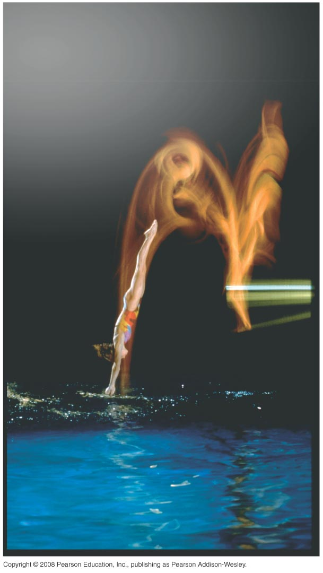
PHY131H1F - Class 7
Today, Chapter 4, sections 4.1-4.4:
Kinematics in One Dimension
Kinematics in Two Dimensions
Projectile Motion
Relative Motion
Test Tomorrow night at 6pm

Slide 2
Clicker Question
A large, light beach ball is falling towards the beach on a windless day. The force of gravity on the ball, ${\vec{F}}_{g}$, is greater than the upward drag force from the air, ${\vec{F}}_{D}$. Which of the following directions is closest to the direction of the net force ${\vec{F}}_{net}={\vec{F}}_{g}+{\vec{F}}_{D}$ on the ball?
North
East
South
West
The net force makes an angle of 90° with respect to all four of these directions.
$${\vec{F}}_{D}$$
$${\vec{F}}_{g}$$
East

Slide 3
Clicker Question
A mouse digs a tunnel 1 m down, then turns and continues digging 1 m East, then turns again and digs 1 m North.
Draw a diagram of the path of the mouse.
How far is the mouse from his starting position?
$3 m$
$2 m$
$1 m$
$\sqrt{3} m$
$\sqrt{2} m$

Slide 4
Last Class I asked:
One bullet is fired horizontally at a very high speed. The other bullet is initially at rest, but is dropped at the exact same moment the first bullet is fired. Which bullet hits the ground first?
ANSWER: They both hit the ground at exactly the same time (assuming flat ground)! The y-motion is totally independent of the x-motion.

Slide 5
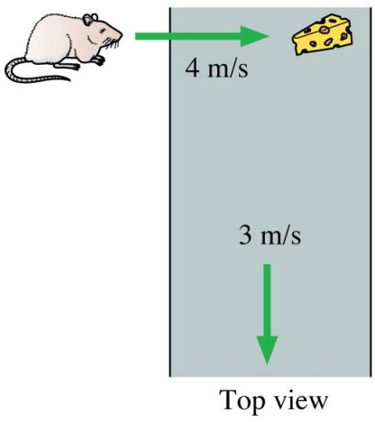
Class 7 Preclass Quiz on MasteringPhysics
This was due this morning at 8:00am
986 students submitted the quiz on time
89% answered correctly: Both bullets hit the ground simultaneously!
77% answered correctly: Bullet hits the coconut (We will try to demonstrate this today)
79% answered correctly: The speed of the mouse relative to the floor is the vector sum of the mouse speed relative to the belt and the belt speed relative to the floor (5 m/s)

Slide 6
Class 7 Preclass Quiz on MasteringPhysics
“what is the mouse relative speed to the cheese? IS THAT 5m/s ？”
Harlow answer: No, it’s 4 m/s.

Slide 7
Class 7 Preclass Quiz on MasteringPhysics
Some common or interesting student comments/feedback:
“The coconut question, is the hunter looking at a coconut that's right on top of him and decided to shoot the coconut from below? or like, is the hunter looking down at a coconut on a cliff and deciding that he will shoot the coconut from a bird's eye view? or like, is the hunter shooting diagonally? horizontally? Are test questions going to be this ambiguous?”
Harlow answer: No. Hopefully the test questions will not be ambiguous at all, and will have one straightforward correct answer. Clicker and pre-class reading questions are not so carefully prepared, to tell the truth – they are meant to get you thinking, and check if you did the reading.

Slide 8
Class 7 Preclass Quiz on MasteringPhysics
“Can we ask appropriate questions during tests or exams?”
Harlow answer: Yes! There will be invigilators wandering the room who can help you interpret what the question is asking – just raise your hand.
“Do we get a formula sheet for the test”
Harlow answer: no, you must bring one with you.
“Can i use line paper as my cheat sheet? or it must be white paper?”
Harlow answer: either is fine. – but it must be handwritten! Computer printouts and photocopies will be confiscated.

Slide 9
Class 7 Preclass Quiz on MasteringPhysics
“Why would someone want to to shoot a perfectly good coconut?”
Harlow answer: Because it’s cruel to shoot a monkey?
“Should we prepare the term test like it is the final one, or just take it easy? PLEASE tell me on Monday in the lecture!”
Harlow answer: That depends on how confident you are about this kinematics and error analysis material. The midterm tomorrow is worth 15% of your mark in the course, the final exam is worth 40%. - All in all, 70% of your mark is from these tests, so it’s important to be prepared for them

Slide 10
Problem Set 2 on MasteringPhysics
This was due last night at 11:59pm
1009 students did the problem set by the deadline
It took a median time of 60 minutes for students to complete the problem set
The average for the 1009 students who submitted on time was 98%.
The most difficult problem seemed to be the propagating errors question – you will have to do this on the test tomorrow!

Slide 11
Analyzing the acceleration vector
An object’s acceleration can be decomposed into components parallel and perpendicular to the velocity.
is the piece of the acceleration that causes the object to change speed
is the piece of the acceleration that causes the object to change direction
An object changing direction always has a component of acceleration perpendicular to the direction of motion.

Slide 12
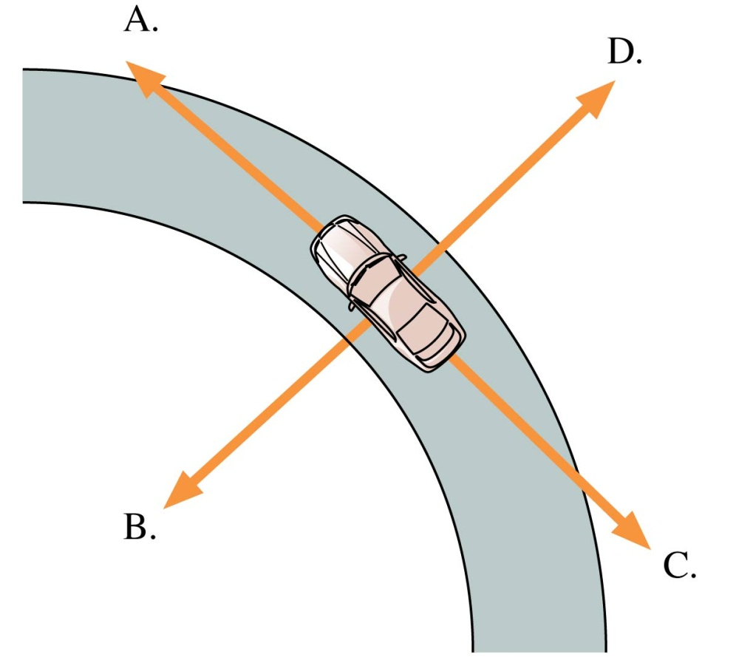
QuickCheck 4.3
Clicker Question
A car is traveling around a curve at a steady 45 mph. Which vector shows the direction of the car’s acceleration?
E. The acceleration is zero.
Slide 4-29

Slide 13
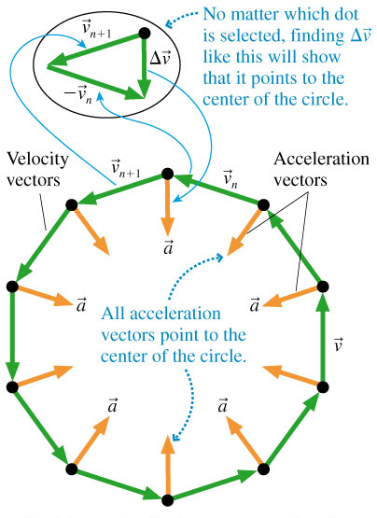
Acceleration
Uniform Circular Motion
Speed is constant.

Slide 14
Midterm Test 1
Tuesday, Sep 30, from 6:00pm to 7:30pm. Tomorrow!
The test will actually begin at 6:10pm and last for 80 minutes; please arrive 10 minutes early if you can, so you can get settled
This test will count for 15% of your mark in the course
There will be no make-up for this test. Students who miss a test for legitimate and documented reasons will have the weight of the test transferred to the other test which will then count for 30% of their course mark
You must go to the correct room, based on your Practical Group
Your practical group is the one that shows under the "My PRA groups" link on the Portal

Slide 15
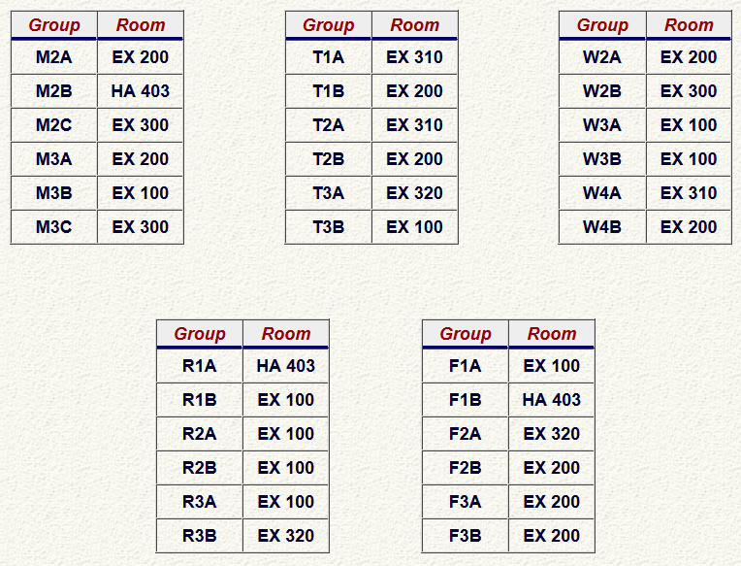
“Which room am I in on Tuesday at 6:00pm?”
EX = Exam Centre, 255 McCaul St.
HA = Haultain Building, 170 College St.

Slide 16
Midterm Test 1
The test will have:
12 multiple-choice questions worth 5 points each (total = 60)
Two long-answer problems counting for a total of 40 points, which will be graded in detail; part marks may be awarded, but only if you show your work.
Please bring:
Your student card.
A calculator without any communication capability.
A pencil with an eraser.
A single, original, handwritten 8 1/2 × 11 inch sheet of paper on which you may have written anything you wish, on both sides.

Slide 17
Midterm Test 1 - hints
Don’t be late. If you’re very early, just wait outside the room.
Spend the first 2 or 3 minutes skimming over the entire test from front to back before you begin. Look for the easy problems that you have confidence to solve first.
Before you answer anything, read the question very carefully. The most common mistake is misreading the question!
Manage your time; if you own a watch, bring it. 14 problems over 80 minutes means an average of 5.7 minutes per problem.
You CANNOT HAVE YOUR PHONE with you or in your pocket at a test or exam at U of T – you must store it in your backpack at the edge of the room, or in a special bag underneath your desk

Slide 18
Midterm Test 1 – more rules
You are also allowed a paper dictionary as an aid – ie it could be a translation dictionary between your first language and English – the invigilator may flip through it to make sure no extra physics-stuff is written in there
Bags, books pencil cases and ALL notes are to be deposited in areas designated by the Chief Presiding Officer and are not to be taken to the examination desk or table. If pencil cases are found on desks, they will be searched.
If you bring a bag (paper, transparent plastic or non-transparent plastic), the following items may be stored inside it under your chair (as long as the bag is large enough): cell phone, wallet, laptop computer.

Slide 19
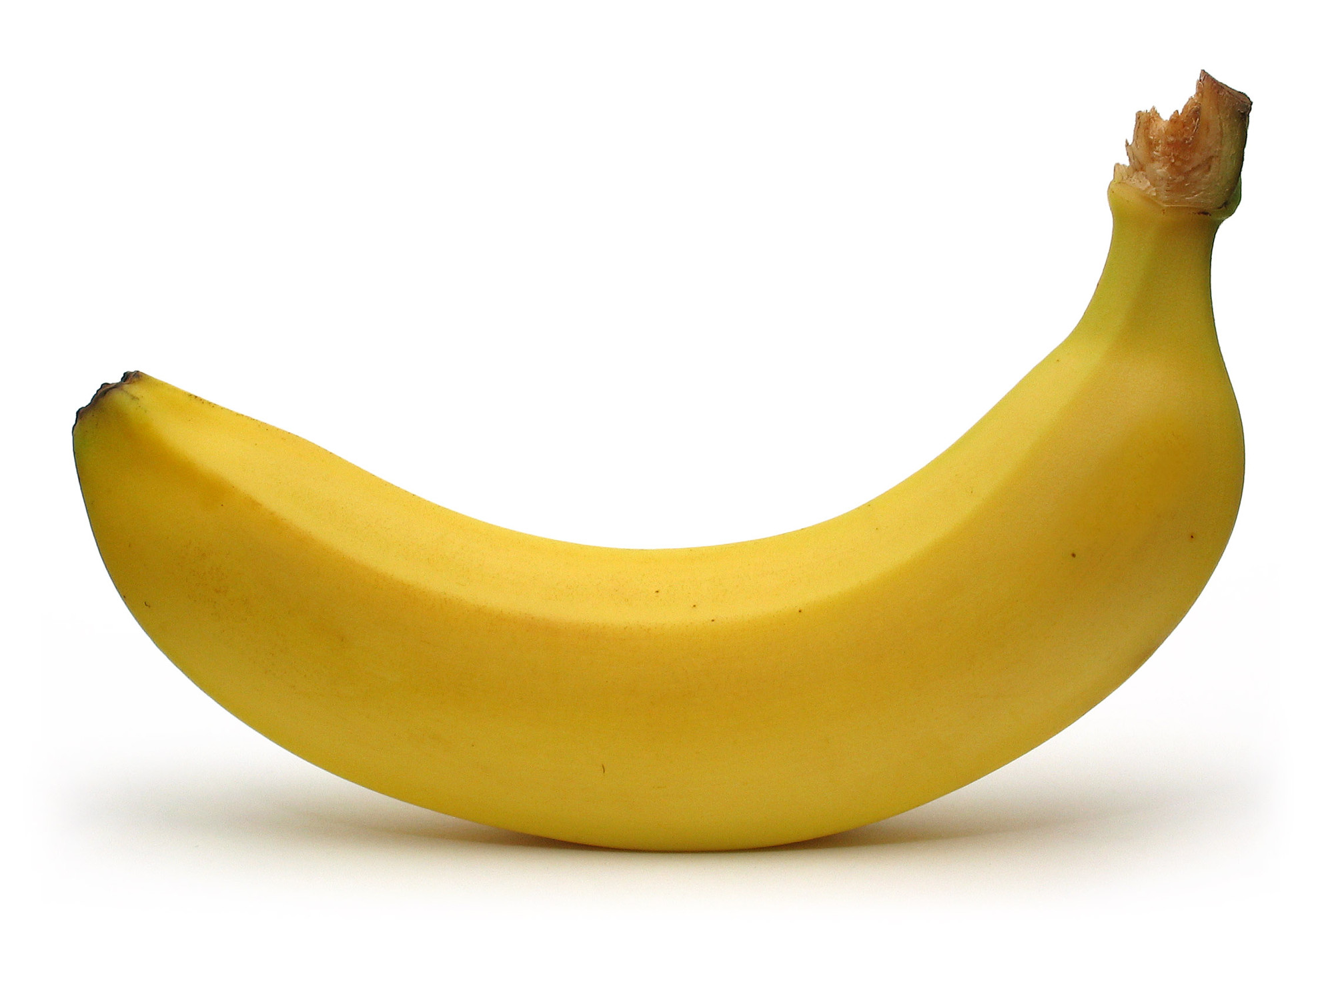
Midterm Test 1 – more hints!
Some of the multiple choice are conceptual and can be answered in less than 2 minutes.. Maybe do these ones first?
If you start a longer problem but can't finish it within about 10 minutes, leave it, make a mark on the edge of the paper beside it, and come back to it after you have solved all the easier problems.
When you are in a hurry and your hand is not steady, you can make little mistakes; if there is time, do the calculation twice and obtain agreement.
Bring a snack or drink.
Don't leave a test early! You might spend the first half getting 95% of the marks you're going to get, and the second half getting the other 5%, but it's still worth it.

Slide 20
Little survey: How are you feeling about the test tomorrow?
I feel confident about the test tomorrow; I believe I will get an A
I’m not too sure what to expect, but I’m hopeful I’ll do well
I have no particularly positive or negative feelings about the test tomorrow..
I’m not too sure what to expect, but I’m worried it will be awful
I am very worried about the test tomorrow; I’m afraid I’m going to fail!

Slide 21
What will the test cover?
Test 1 covers:
Knight Chapters. 1-3
and the Error Analysis in Experimental Physical Science “Mini-Version” 10-page document available on portal.
If it’s in the above reading, on MasteringPhysics, done in classes, or done in Practicals, it is material that is important and that you should know for the tests and final exam.

Slide 22
Where to get good help for free
Your classmates: form a study group
The course web-site: Go to Lectures-Harlow – notice that every PHY131 midterm I’ve ever given is there including full solutions – all organized and for free
Your two graduate student TAs. Learn their email address, office hours, and office location.
Me. After class, office hours are T12, F10 in MP121-B, email
Professor Meyertholen, office hours are M2, F12-2 in MP129-A, email
The Physics Drop-In Centre in MP125, back corner MTWR 12-3, F11-2
Vic College Tutoring Centre in LM204A, R10-12, F3
Academic Success Centre in Koffler 1st floor, inside the Career Centre

Slide 23
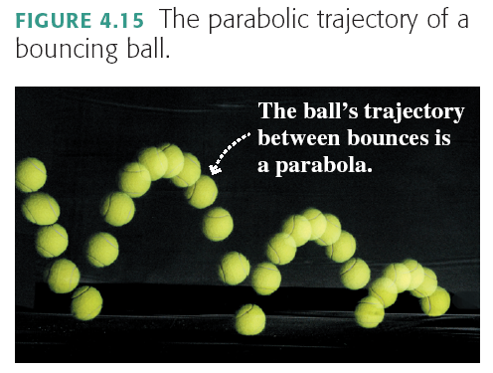
Projectile Motion

Slide 24
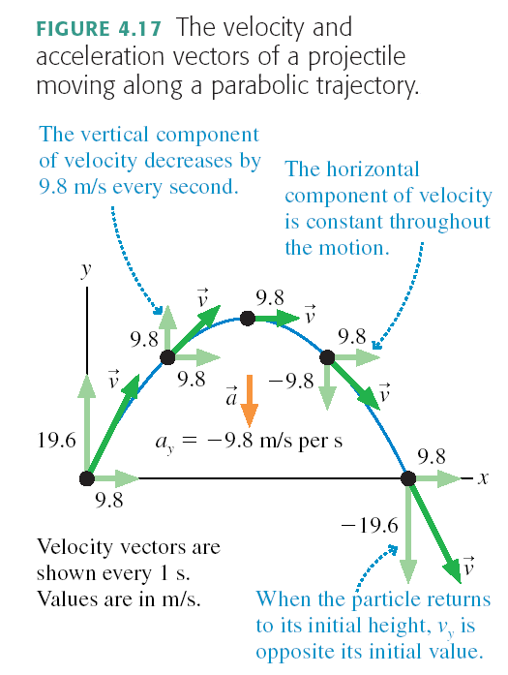

Slide 25
Projectile Motion
Projectile motion is made up of two independent motions: uniform motion at constant velocity in the horizontal direction and free-fall motion in the vertical direction. The kinematic equations that describe these two motions are

Slide 26
Clicker Question
B
A
C
A tennis ball is launched at an angle, and flies through the air in a parabolic path, as shown, A→ B → C.
At point B
the velocity is horizontal, and the speed is maximum.
the velocity is horizontal, and the speed is minimum.
the velocity is horizontal, but the speed is neither a maximum nor a minimum.
the velocity is not horizontal, but the speed is minimum.
the velocity is not horizontal, and the speed is neither a maximum or minimum.

Slide 27
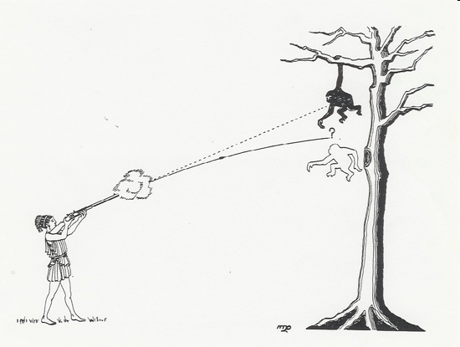
Monkey and Hunter Demonstration (and clicker question)
The classic problem: “A monkey hanging from the branch of a tree is spotted by a hunter. The monkey sees that the barrel of the gun is pointed directly at him. At the exact instant the gun is fired, the monkey lets go of the branch. Will the bullet (A) go above the monkey, (B) go below the monkey, or (C) hit the monkey?
Our demonstration uses a pressurized tennis ball launcher. The laser is aimed directly at the monkey, which is supported by an electromagnet. As the tennis ball leaves the launcher, it breaks a connection that releases the magnet.

Slide 28
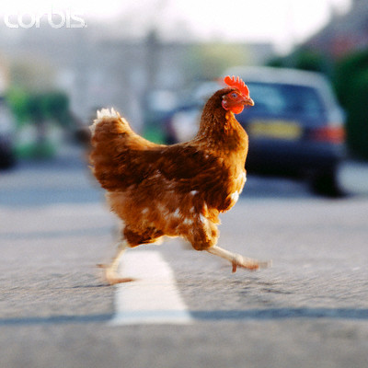
Joke: Why Did the Chicken Cross the Road?
Aristotle (330 BC):
“Because it is the nature of chickens to cross roads.”
Newton (1687):
“Because there is no external net force causing the chicken’s velocity across the road to change.”
Einstein (1905):
“Is the chicken crossing the road, or is the road moving under the chicken?”
[image downloaded 9/30/2013 from http://afgg.tumblr.com/post/3126636261/when-the-chicken-crossed-the-road ]

Slide 29
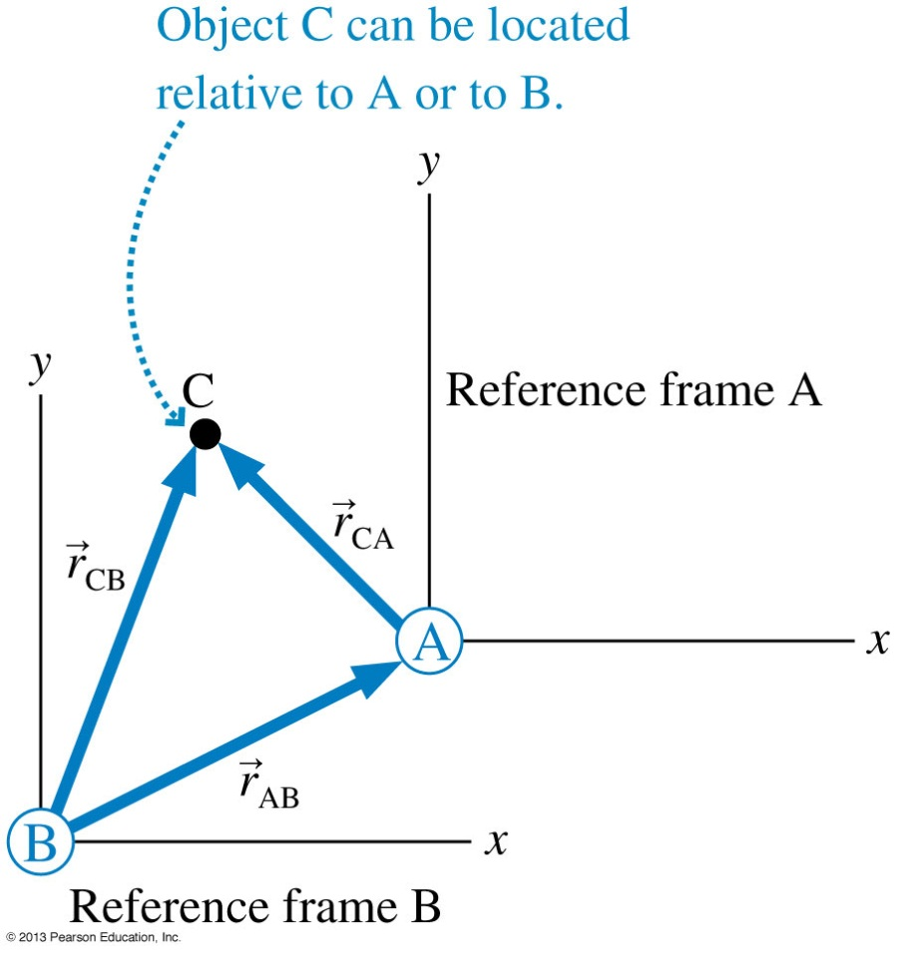
Relative Position

Slide 30
Reference Frames
Relative Velocity
Relative velocities are found as the time derivative of the relative positions.
_{CA} is the velocity of C relative to A.
_{CB} is the velocity of C relative to B.
_{AB} is the velocity of reference frame A relative to reference frame B.
This is known as the Galilean transformation of velocity.

Slide 31
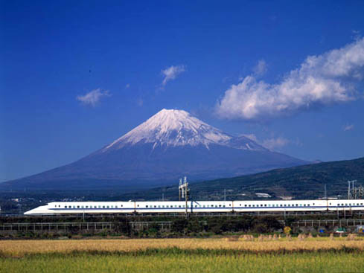
Relative Motion
Note the “cancellation”
v_{TG} = velocity of the Train relative to the Ground
v_{PT} = velocity of the Passenger relative to the Train
v_{PG} = velocity of the Passenger relative to the Ground
Also: v₁₂ = −v₂₁
v_{PG} = v_{PT} + v_{TG}
Inner subscripts disappear

Slide 32
You are running toward the right at 5 m/s toward an elevator that is moving up at 2 m/s. Relative to you, the direction and magnitude of the elevator’s velocity are
Clicker Question
down and to the right, less than 2 m/s.
up and to the left, less than 2 m/s.
up and to the left, more than 2 m/s.
up and to the right, less than 2 m/s.
up and to the right, more than 2 m/s.

Slide 33
Example 1: A passenger walks toward the front of the train at 5 m/s. The train is moving at 36 m/s. What is the speed of the passenger relative to the ground?

Slide 34
Example 2: Car A is traveling at 25.0 m/s E toward Bloor and Keele. Car B is traveling at 15.8 m/s N toward Bloor and Keele. Just before they collide, what is the velocity of car A relative to car B?

Slide 35
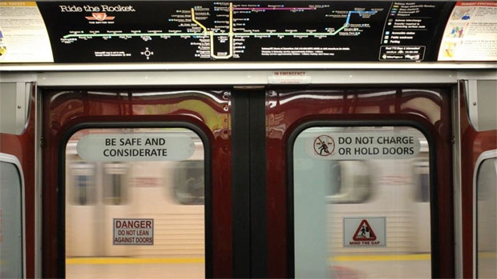
Clicker Question
You are on an Eastbound subway train going at 20 m/s.
You notice the Westbound train on the other track.
Relative to the ground, that Westbound train has a speed of 20 m/s.
What is the velocity of the Westbound train as measured by you?
40 m/s, West
20 m/s, West
zero
20 m/s, East
40 m/s, East
[image from http://www.cbc.ca/news/canada/toronto/ttc-closes-downtown-subway-loop-for-the-weekend-1.1347919 ]

Slide 36
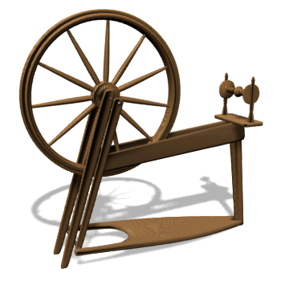
Before Class 8 on Wednesday
Please finish reading Chapter 4
Note: There is no preclass quiz due on Wednesday morning.
Something to think about: Consider a wheel that is rotating, and speeding up. Is a point on the edge of the wheel accelerating toward the centre? Is this point accelerating in the forward direction? Or is it doing both?

