Slide 1
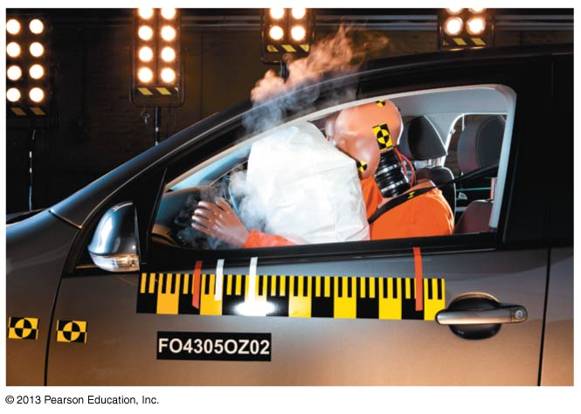
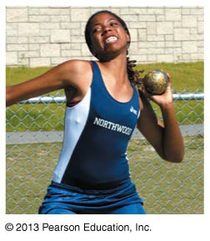
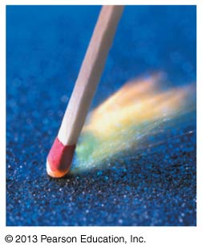
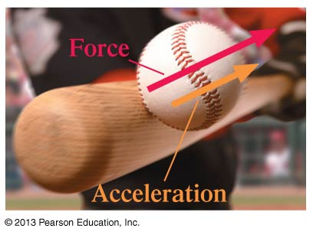
PHY131H1F - Class 9
Today, Chapter 5 “Force and Motion”:
Forces
Free Body Diagrams
Newton’s First Law
Newton’s Second Law

Slide 2
Clicker Question
You toss a ball straight up in the air.
Immediately after you let go of it, what forces are acting on the ball?
The downward force of gravity from the Earth.
An upward throwing force from your hand.
A small downward drag-force from air resistance.
1, 2 and 3
1 and 3
1 and 2
1 only
2 and 3

Slide 3
Problem Set 3 on MasteringPhysics
This was due last night at 11:59pm
957 students did the problem set by the deadline
It took a median time of 35 minutes for students to complete the problem set
The average was 98.5%.
The most difficult problem seemed to be: “A car traveling at 25.0 m/s runs out of gas while traveling up a 23.0° slope. How far up the hill will it coast before starting to roll back down?”

Slide 4
Class 9 Preclass Quiz on MasteringPhysics
This was due this morning at 8:00am
957 students submitted the quiz on time
72% of students answered correctly: An inertial reference frame is one in which Newton’s Laws are valid
85% of students answered correctly: doubling the mass for the same net force means acceleration is half as much.
90% of students answered correctly: When a body is in dynamic equilibrium, the net force acting on the body is zero.
96% of students answered correctly: The net force is the vector sum of all forces acting on a particular object.

Slide 5
Class 9 Preclass Quiz on MasteringPhysics
Some common or interesting student comments/feedback:
“I'm confused when net force should equal 0 and when it should not.”
Harlow answer: Net force is zero when the acceleration is zero.
“how an object is still in motion but have a net force of zero is a little hard to grasp.”
Harlow note: Don’t confuse velocity with acceleration!
$${\vec{F}}_{net}=m\vec{a}$$

Slide 6
Class 9 Preclass Quiz on MasteringPhysics
Some common or interesting student comments/feedback:
“The notation is different from what I was taught in high school..can I use the one I was taught?”
Harlow note: I am not particular about notations, usually. Unless by “notation” you mean something like “define North = up” – that’s not a notation, that’s just wrong.
“Are we allowed to use stick people in diagrams?”
Harlow answer: Yes!

Slide 7
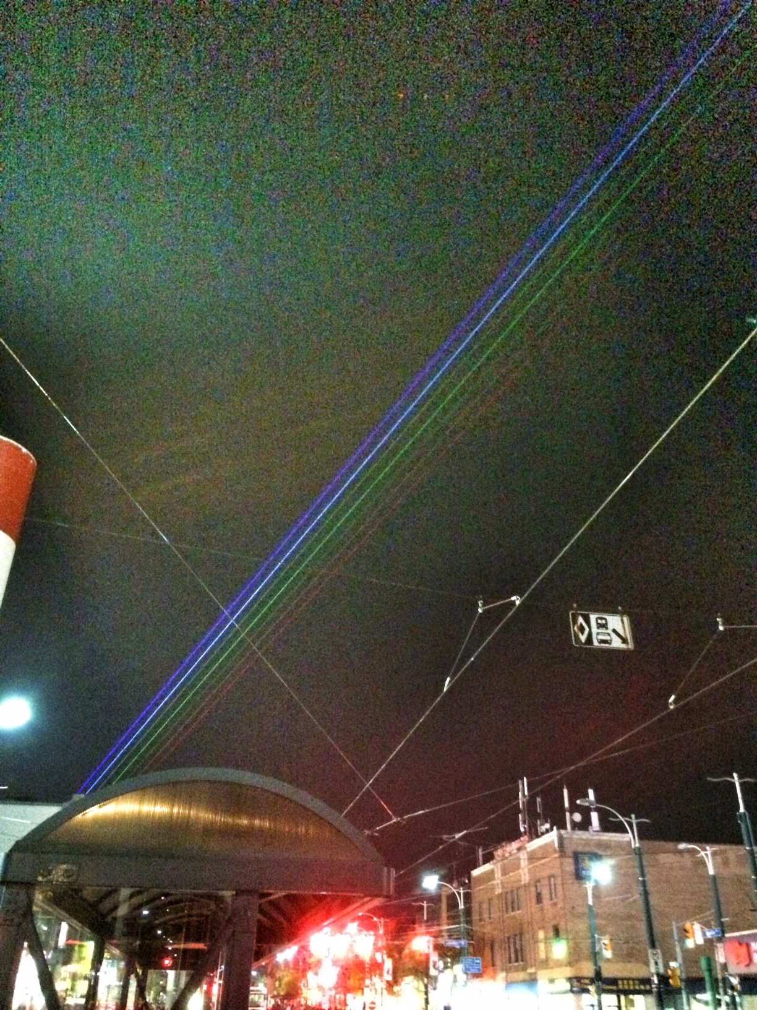
Class 9 Preclass Quiz on MasteringPhysics
“how was the nuit blanche?! have u been there?”
Yep it was pretty cool.
Lasers are “monochromatic” – they can only be exactly one frequency, or color.
There were 7 different bright lasers shining out of the CN tower over Spadina avenue. They met the horizon so it looked like a night-time rainbow!

Slide 8
Class 9 Preclass Quiz on MasteringPhysics
Some common or interesting student comments/feedback:
“finally stuff I like. I'm glad to be done with kinematics”
“I really had to FORCE myself to get through the reading.”
“All the concepts of forces presented in this section were fairly normal. No concept presented in this lecture exerted any tension on the brain and all topics were met with a net understanding. Friction is a real drag though..”
“May the force be with you”
“There is a biology midterm on Monday.”

Slide 9
Last day I asked at the end of class:
A paperback novel has a mass of 0.3 kg and slides at a constant velocity of 5 m/s, to the right. A physics textbook has a mass of 3.0 kg, and slides at a constant velocity of 5 m/s, to the right. How does the net force on the textbook compare to the net force on the novel?
ANSWER: SAME – zero!
The net force on any object is proportional to its acceleration.
In the case of these two books, they are both traveling at a constant velocity, meaning acceleration is zero.
Any friction must be offset by some pushing force, not mentioned in the question.

Slide 10
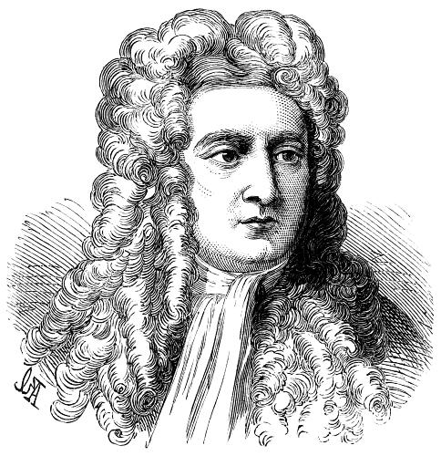
Isaac Newton
Born in 1643, the year Galileo died.
Was a “physicist, mathematician, astronomer, natural philosopher, alchemist, and theologian and one of the most influential people in human history.” (http://en.wikipedia.org/wiki/Isaac_Newton)
In Philosophiæ Naturalis Principia Mathematica, published 1687, he described universal gravitation and the three laws of motion, laying the groundwork for classical mechanics.

Slide 11
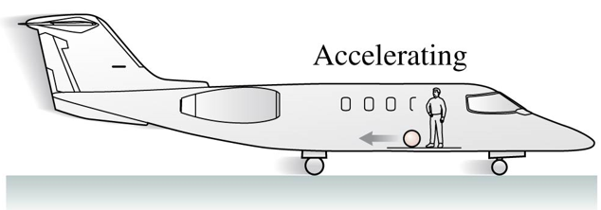
Clicker Question
You are in a plane which is accelerating forward on a runway.
Some careless person has left a tennis ball in the aisle. You notice this tennis ball is accelerating toward the back of the plane.
Newton’s Second Law states that F_{net} = ma, so there must be a net force on the tennis ball. What is the source of this backward net force?
Air resistance
The plane must be at an angle, so a component of gravity provides the net force toward the back of the plane.
The inertial force
The normal force
Newton’s second law is not valid in your reference frame.

Slide 12
SI Units
The SI unit of mass is the kilogram. What is the SI unit of weight?
m/s²
the newton
metric mass
the kilogram
the joule

Slide 13
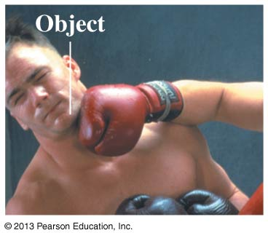
What is a force?
A force is a push or a pull on an object.
Pushes and pulls are applied to something
From the object’s perspective, it has a force exerted on it
A force is either a contact force (like normal) or a long-range force (like gravity).
The S.I. unit of force is the Newton (N)
N is not a fundamental unit; it can be broken down into fundamental units:
$$1 N=1 kg m s^{−2}$$

Slide 14
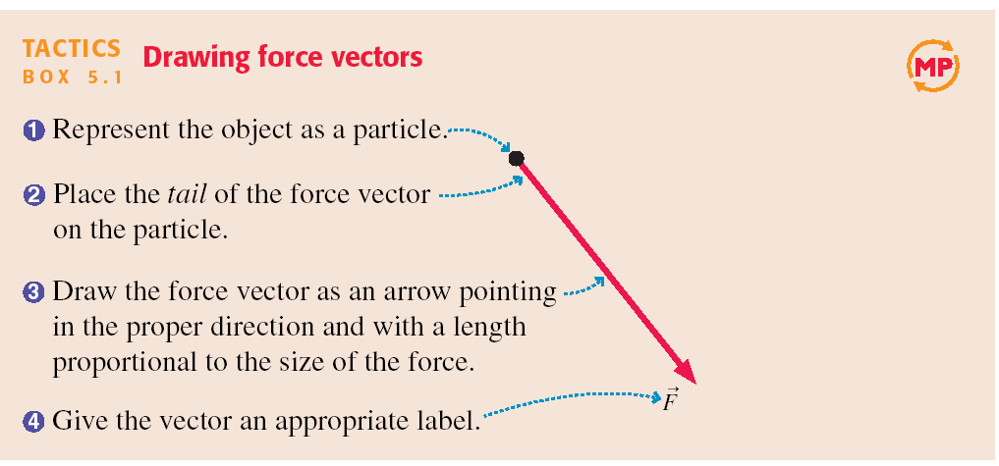
Tactics: Drawing force vectors

Slide 15
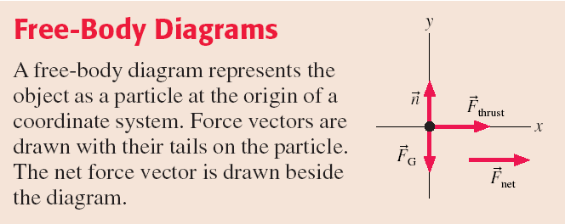

Slide 16
A Short Catalog of Forces
The forces we deal with most often in PHY131/132 are:
Gravity (F_{g} = mg)
Normal Force
Tension
Kinetic Friction ( f_{k} = μ_{k}n)
Static Friction
Spring Force
Electric
Magnetic
Thrust (like from a rocket)
Drag (fluid resistance)
Muscle

Slide 17
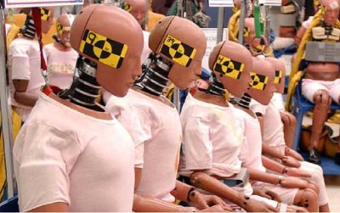
Crash test dummies model the muscles of the neck as springs

Slide 18
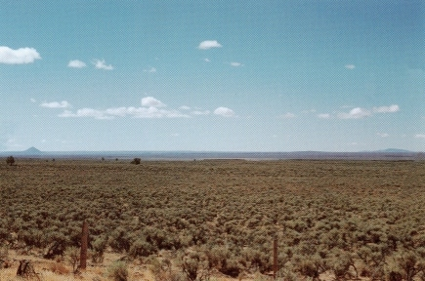
Gravity
${\vec{F}}_{G}=m\vec{g}$ when the object is near the surface of Earth
$\vec{g}=9.80\frac{N}{kg}, down$
Sometimes called “weight”
“The Earth exerts a gravity force on the angry bird.”

Slide 19
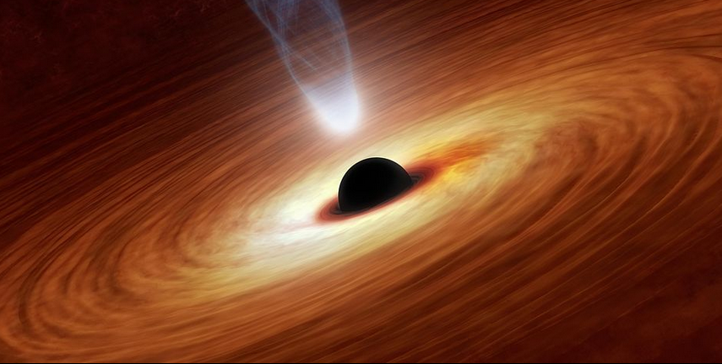
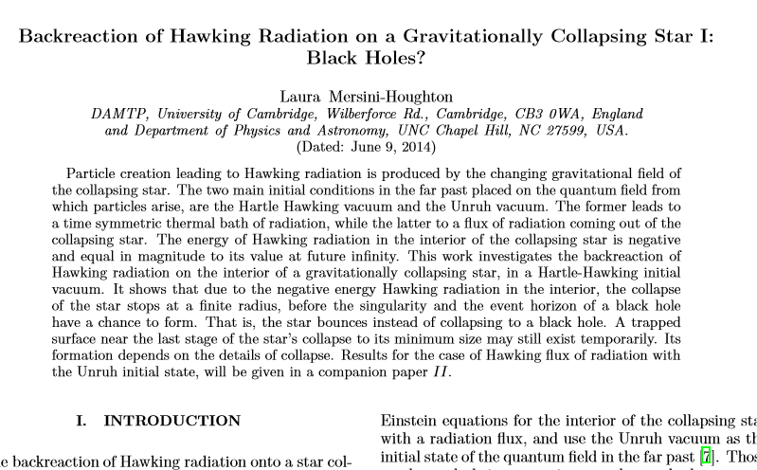
Gravity Research
There was a paper this year claiming that, mathematically speaking, black holes cannot exist.
Certainly, from an astronomer’s point of view, black holes (or something very much like them) are very prevalent and numerous in the universe!
The first black hole for which there was strong evidence was Cygnus X-1, discovered by U of T professor Tom Bolton in 1972
Since then over 100 of black holes have been discovered
http://arxiv.org/pdf/1406.1525v1.pdf

Slide 20
Normal Force
“The diving board exerts a normal force on the dog.”

Slide 21
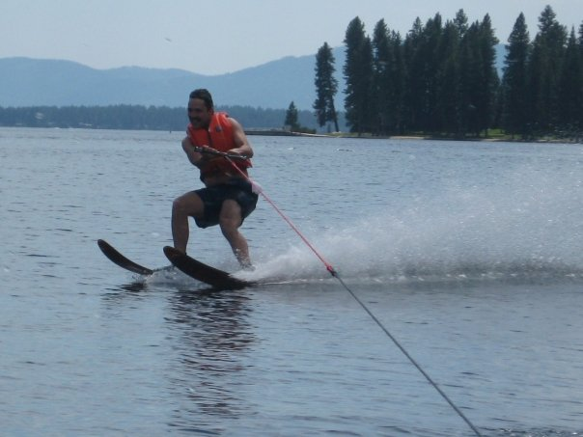
Tension
“The rope exerts a tension force on Harlow.”

Slide 22
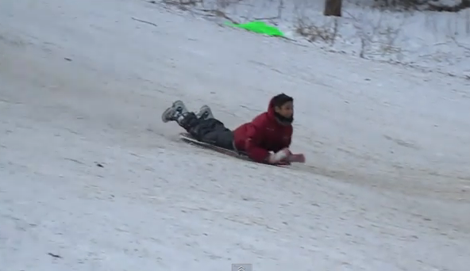
Kinetic Friction
“The ground exerts a kinetic friction force on Suleyman.”
where n is the magnitude of the normal force, and μ_{k} is a constant, which happens to be low for plastic on snow.

Slide 23
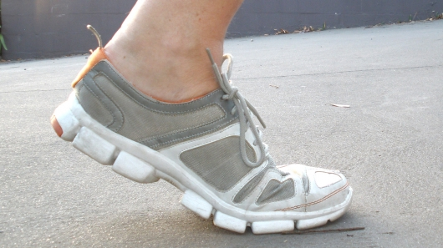
Static Friction
“The ground exerts a static friction force on the shoe.”

Slide 24
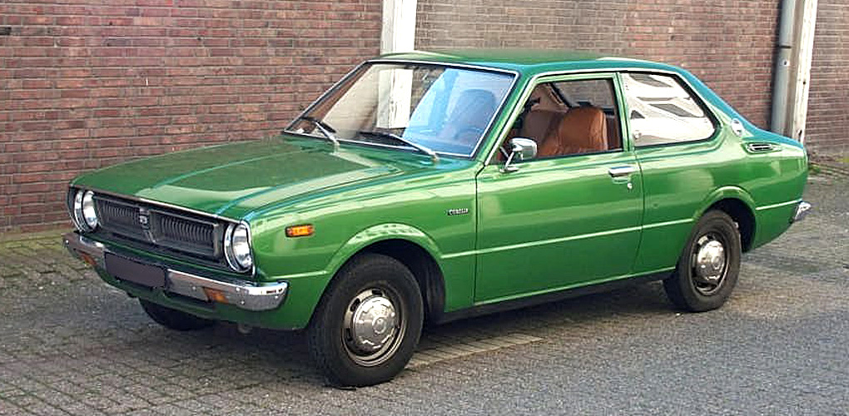
Clicker Question
A car is parked on flat, horizontal pavement.
Which of the following forces are acting on the car?
Gravity
Normal
Static friction
Both A and B
A, B and C

Slide 25
Clicker Question
The Net Force
A car is parked on flat, horizontal pavement.
The “net force” is the vector sum of all the forces on the car.
What is the direction of the net force on the car?
Up
Down
The net force is zero

Slide 26
An Even Shorter Catalog of Forces
The four fundamental forces in the universe are:
Gravity (F_{g} = mg)
Electric & Magnetic
“Strong Nuclear” – holds the nucleus together
“Weak Nuclear” – governs beta-decay
Every force you can experience is a manifestation of one or more of the above.

Slide 27
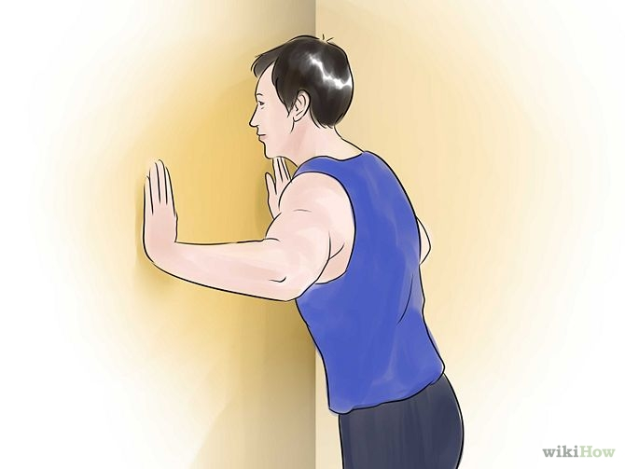
A Person Exerts a Force on A Wall
This contact force is an example of:
Gravity Force
Electric & Magnetic Force
Strong (holds nucleus together)
Weak (radioactive decay)
None of the above

Slide 28
The Fundamental Forces of Nature
The four fundamental forces of nature:
Gravity
Electromagnetism
Weak Nuclear Force
Strong Nuclear Force
Gravity is always attractive, and acts between any two objects.
Electromagnetism causes repulsion and attraction between charged particles, such as the protons and electrons in matter. This gives rise to almost all of the forces we deal with in PHY131/132: Normal, Tension, etc.
Weak and Strong Nuclear forces are important in understanding how atomic nuclei are held together and certain forms of radiation – not important for PHY131/132.

Slide 29
Quick Survey
PHY131 has 2 hours of lectures each week, plus weekly 2-hour mandatory Practicals.
PHY151 has 3 hours of lectures each week, plus weekly 3-hour mandatory Practicals.
Both are 0.5-credit courses.
Please respond to the following statement: “I would prefer it if we had more mandatory contact hours in our course.”
Strongly agree
Agree
Neutral
Disagree
Strongly disagree

Slide 30
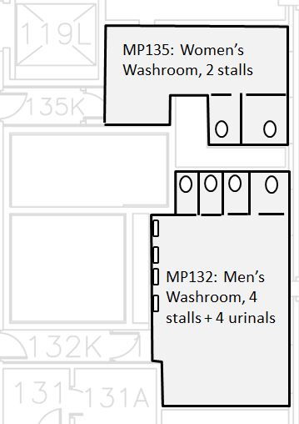
Quick Survey
Near the Practicals rooms for this course there are 2 toilets available for women, and 4 toilets plus 4 urinals available for men. In this course there are 600 women and 400 men.
I am a man and I think this is unfair
I am a woman and I think this is unfair
I am a man and I do not think this is unfair
I am a woman and I do not think this is unfair
Other / no answer
E
N
S
W

Slide 31
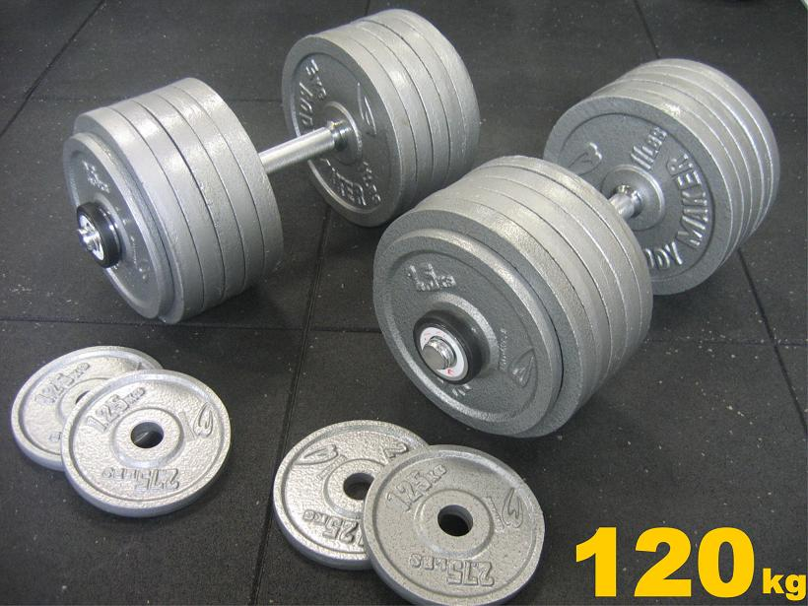
What is Mass?
Mass is a scalar quantity that describes an object’s inertia.
It describes the amount of matter in an object.
Mass is an intrinsic property of an object.
It tells us something about the object, regardless of where the object is, what it’s doing, or whatever forces may be acting on it.

Slide 32
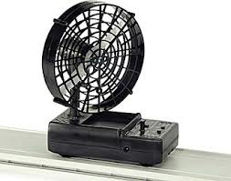
2
Newton’s Second Law
The acceleration of an object is directly proportional to the net force acting on it, and inversely proportional to its mass.

Slide 33
Clicker Question
A fan attached to a cart causes it to accelerate at 2 m/s².
Suppose the same fan is attached to a second cart with smaller mass.
The mass of the second cart plus fan is half the mass of the first cart plus fan. The acceleration of the second cart is
16 m/s².
8 m/s².
4 m/s².
2 m/s².
1 m/s².
Notes:
Answer: D

Slide 34
Projectile Motion Example
An angry bird of mass m = 0.12 kg is flying through the air. His wings are tucked in, and air resistance is negligible.
What is the acceleration of the bird?

Slide 35
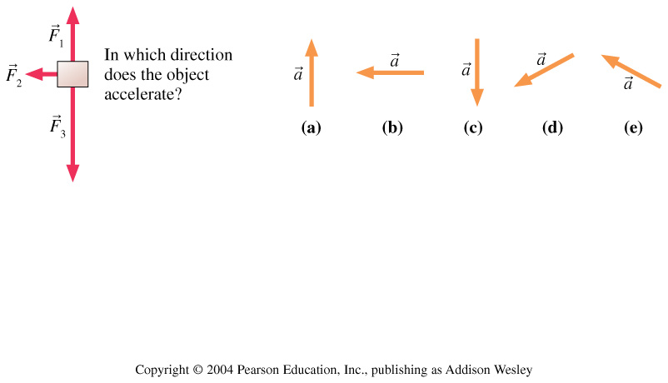
Clicker Question
Three forces act on an object. In which direction does the object accelerate?
Notes:
Answer: D

Slide 36
Mass on Frictionless Inclined Plane Example
A cart of mass m = 0.195 kg is rolling on a track that is inclined at an angle θ above the horizontal. Friction is negligible.
What is the acceleration of the cart?
θ

Slide 37
Problem Solving Strategy
Acceleration is the link between dynamics and kinematics.
From F_{net}, find a.
From a and initial conditions, find v_{x}, v_{y}, x, y.
a = 0 is the condition for equilibrium.
“static equilibrium” is when a = 0 and v = 0.
“dynamic equilibrium” is when a = 0 and v ≠ 0.
Equilibrium occurs if and only if F_{net} = 0.

Slide 38
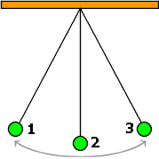
Clicker Question
A green ball swings back and forth between positions 1, 2 and 3. F_{g} is the magnitude of the force of gravity on the ball. T is the magnitude of the tension force on the ball. At the instant the ball is in position 2,
F_{g} > T
F_{g} < T
F_{g} = T

Slide 39
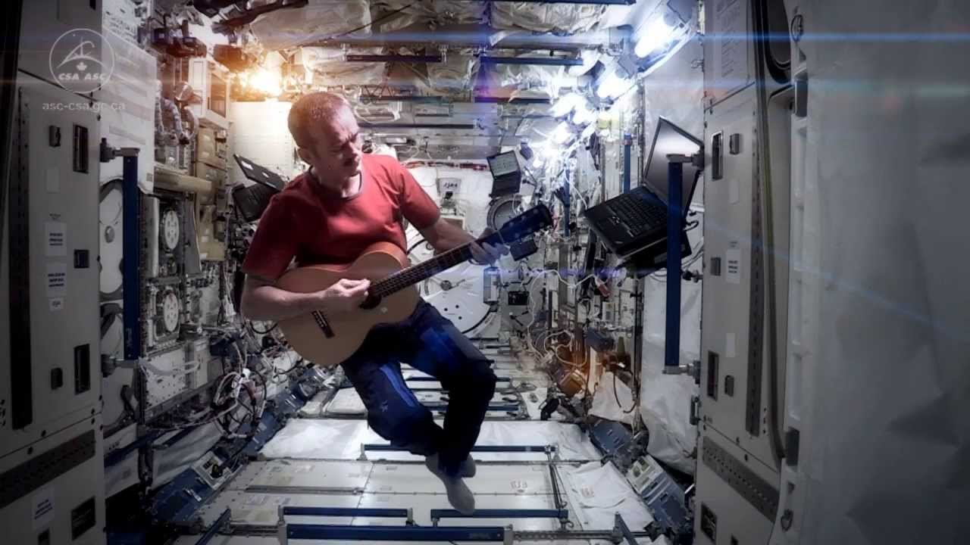
Before Class 10 on Wednesday
Please read Chapter 6 of Knight, sections 6.1 through 6.3.
Something to think about:
When astronauts are floating in a space station, are they really weightless?
Have you seen Canadian Astronaut Chris Hadfield singing a revised version of David Bowie’s “Space Oddity” on the International Space Station? http://youtu.be/KaOC9danxNo .

