Slide 1
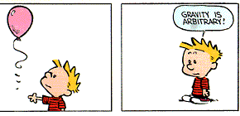
PHY131H1F - Class 10
Today, Chapter 6:
Equilibrium
Mass, Weight, Gravity
(No, it isn’t. For an explanation of buoyancy force, see Chapter 15..)

Slide 2
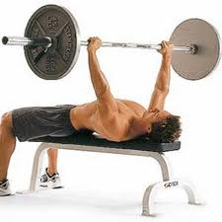
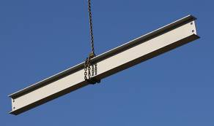
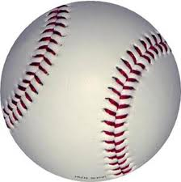
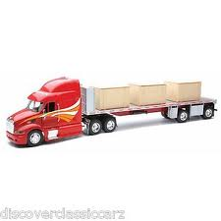
Clicker Question
Which of the following objects described below is in dynamic equilibrium?
A 100 kg barbell is held at rest over your head.
A steel beam is lifted upward at constant speed by a crane.
A baseball is flying through the air and air resistance is negligible.
A steel beam is being lowered into place. It is slowing down.
A box in the back of a truck doesn’t slide as the truck is slowing down.

Slide 3
Test 1 results
A
B
A+
C
D
F
Average test mark was 75%
44% of the class got A
22% got B
16% got C
10% got D
8% failed
25 students got 100% (ie perfect) on the test!

Slide 4
Recall: Last year’s Test 1 results (more typical…)
You may recall that last year’s test 1 average was 63%, which is much more typical.
75% is the highest midterm average for PHY131 that I recall ever having seen
I am very proud of this class. It’s gratifying to see so many students do well.
Dr. Paul Kushner, the Associate Chair of Undergraduate Studies in the Department of Physics (my boss) is alarmed that the average was 75% - this is too high based on U of T standards.
He has instructed Dr. Meyertholen and I to make Test 2 and the Final Exam more difficult in order to compensate for a “too easy” Test 1.

Slide 5
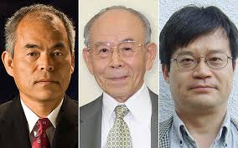
2014 Nobel Prize in Physics
Isamu Akasaki, Hiroshi Amano and Shuji Nakamura "for the invention of efficient blue light-emitting diodes which has enabled bright and energy-saving white light sources".

Slide 6
Test 1 Long Answer Partial Credit Policy
If you get the exactly correct answer, including significant figures and units, and write that answer in the box provided, and show your work in the space above the box, you should get 100% for that part.
If your final answer is wrong, then some partial credit may be awarded based on the work you showed.
To see the full solutions for Test 1, go onto the portal page under Lectures-Harlow and check it out – partial credit points are listed
Also posted are some images of marked tests, showing some examples of how partial credit was awarded.
Please look carefully through these solutions and examples before approaching Dr. Harlow with questions about partial credit. I will correct mistakes in the marking, but I will not change the marking scheme. Thanks!

Slide 7
Class 10 Preclass Quiz on MasteringPhysics
This was due this morning at 8:00am
885 students submitted the quiz on time. (Remember Class 2 when 1026 students used to get this done on time?)
73% of students answered correctly: A cyclist is riding up a hill sloped at 30 degrees at a constant velocity. The net force (due to gravity, the normal force and friction) is zero.
85% of students answered correctly: When the elevator starts accelerating upward, your weight increases.
90% of students answered correctly: On the moon an astronaut’s weight is less, but mass is the same.
92% of students answered correctly: When a 1500 kg car has a net force exerted on it of 3000 N, east, it accelerates at 2 m/s², east.

Slide 8
Class 10 Preclass Quiz on MasteringPhysics
Some common or interesting student comments/feedback:
“Ehhhh what's good was just wondering how I could see my marks on the multiple choice component of the first test. Yeyeyeyeye thanks so much. Respect. Peace.”
Harlow answer: Yes, these will also be handed back in Practicals. For Monday they are coming a bit later, though.
“I strongly agree that we should have three hours of lecture a week because that time is needed for the students who are struggling to understand and succeed!”
Harlow answer: I agree with you. Paul Kushner, the undergraduate chair of physics, does not agree. Also, according to my clicker question on Monday, most of this class disagrees as well..

Slide 9
Class 10 Preclass Quiz on MasteringPhysics
Some common or interesting student comments/feedback:
“Are our mastering physics marks for the pre-class quiz and assignments supposed to be on blackboard?”
Harlow answer: No, not yet. It’s difficult to transfer these marks, and we won’t do it until the end of the semester.
“Some of us have our practicals on Monday, which means we'll be missing it because of Thanksgiving. Do we have to make up the missed practical by going to another one, or do we not need to go to another one at all?”
Harlow answer: Don’t worry, we thought of this. Look carefully at the Practicals schedule and you will see there are just as many Mondays as the other days of the week. Short answer: Go to Practicals every week!

Slide 10
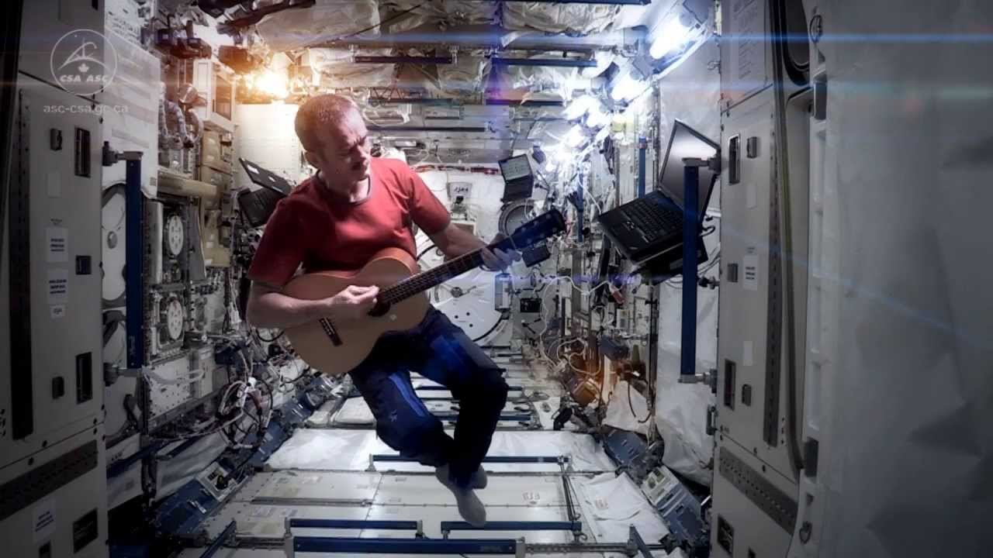
Last day I asked at the end of class:
When astronauts are floating in a space station, are they really weightless?
ANSWER: YES!
Knight’s definition of weight means the amount of force needed to support an object in your frame of reference.

Slide 11
Newton’s Laws only apply in a “inertial reference frames”. They are not valid if your reference frame is accelerating!
An inertial reference frame is one that is not accelerating.

Slide 12
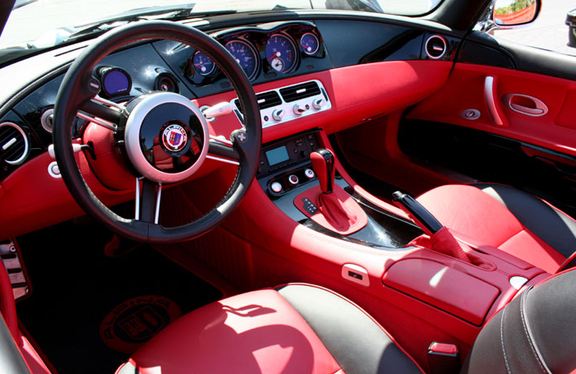
A: Inertial Reference Frame B: Not an inertial reference frame
Clicker Question
A car is driving at a steady speed up a 10° incline.
Quick quiz: inside the car, is it…

Slide 13
A: Inertial Reference Frame B: Not an inertial reference frame
Clicker Question
A car is driving at a steady speed around a curve on a level road.
Quick quiz: inside the car, is it…

Slide 14
Class 10 Preclass Quiz on MasteringPhysics
Some common or interesting student comments/feedback:
“If a car drives up the hill at a constant velocity, does it mean that in this example friction is negligible? (because if the friction was present, the car should have accelerated in the opposite direction)”
Harlow answer: No, in fact, friction is what pushes it up the hill!! Friction is in the same direction as the velocity in this case. (Think about this: if the road was perfectly frictionless, you would slide down the hill!)

Slide 15
Class 10 Preclass Quiz on MasteringPhysics
Some common or interesting student comments/feedback:
“Now every time I go up an elevator, I'll be thinking I technically gained wait as I accelerated to the 10th floor. I guess taking the stairs IS the better option... for many reasons.”
“If I go to the moon,I am gonna weigh less. GOODBYE EARTH.”
“Why would an astronaut bring her bathroom scales to space? That sounds like an unnecessary added weight to the shuttle which would cost extra fuel to transport.”
“I've been weighting for you to put my response in the power point but my cleverness is not up to your apparent standards.”
“It would make my dreadful week if you showed this to the class tomorrow. My week is dreadful cause I most likely failed the biology test”

Slide 16
Class 10 Preclass Quiz on MasteringPhysics
Some common or interesting student comments/feedback:
“why would there be a scale in the MP elevator?”
Harlow answer: So they can be used for educational purposes. Also, it’s neato.
[The entire lyrics to Eminem’s “Lose Yourself”] ???
“I was wondering whether or not this feedback is anonymous, or whether you can see who each comment is from.”
Harlow response: Yes, I can see who you are, John. I can also see who the Eminem guy is. You will get to submit anonymous feedback in the course evaluations at the end of the course.

Slide 17
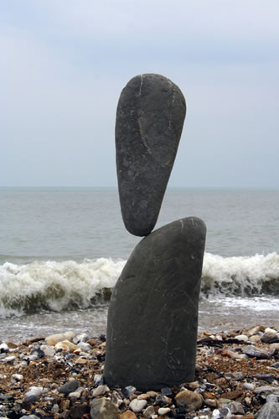
Equilibrium
An important problem solving technique is to identify when an object is in equilibrium.
An object has zero acceleration if and only if the net force on it is zero.
This is called “equilibrium”.
If an object is in vertical equilibrium (ie it is confined to a stationary horizontal surface) then (F_{net})_{y} = 0. The sum of y-components of all forces = 0.
If an object is in horizontal equilibrium (ie freefall) then (F_{net})_{x} = 0.

Slide 18
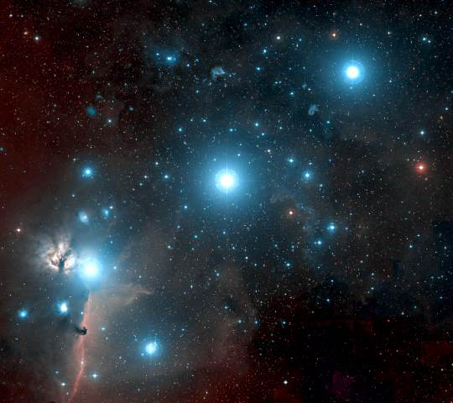
Gravity for the universe
It was Newton who first recognized that gravity is an attractive, long-range force between any two objects. Somewhat more loosely, gravity is a force that acts on mass.
When two objects with masses m₁ and m₂ are separated by distance r, each object pulls on the other with a force given by Newton’s law of gravity, as follows:
(Sometimes called “Newton’s 4th Law”, or “Newton’s Law of Universal Gravitation”)

Slide 19
Gravity Example
A mass, m, rests on the surface a giant spherical rock which is floating in space.
The giant rock has a mass of 6 × 10²⁴ kg and a radius of 6400 km.
What is the force of gravity on the mass due to the giant rock?
Can you think of a good name for this giant rock?

Slide 20
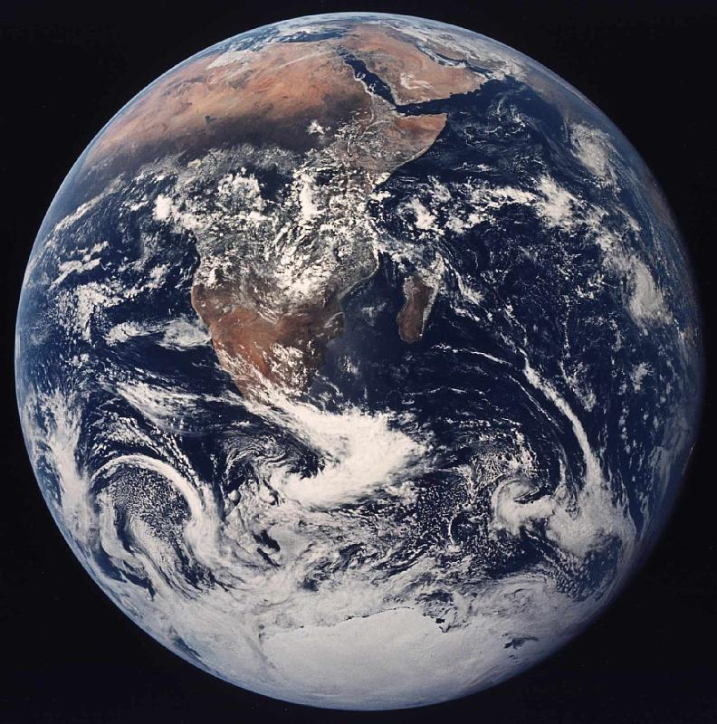
Gravity for Earthlings
If you happen to live on the surface of a large planet with radius R and mass M, you can write the gravitational force more simply as:
where the quantity g is defined to be:
At sea level, g = 9.83 m/s².
At 39 km altitude, g = 9.71 m/s².

Slide 21
Gravity: F_{G} = mg is just a short form!
and
are the same equation, with different notation!
The only difference is that in the second equation we have assumed that m₂ = M (mass of the earth) and r ≈ R (radius of the earth).

Slide 22
Class 10 Preclass Quiz on MasteringPhysics
Some common or interesting student comments/feedback:
“The most confusing part in this chapter is the gravity force, what is the capital G represent?”
Harlow answer: Capital G is 6.67 x 10⁻¹¹, a universal constant.
“I am just wondering is that the formula Fg=mg can be placed in all situation, not only on earth, but also on other planet?”
Harlow answer: Yes, you can use it, but g will be different for different planets. For example, g = 1.6 m/s2 on the moon.

Slide 23
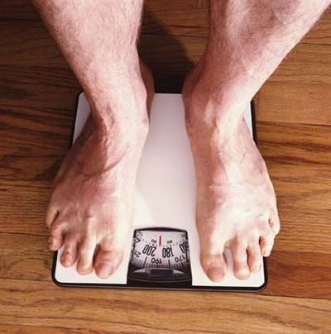
Weight ≠ Weight ??!?
Physicists do not all agree on the definition of the word “weight”!
Sometimes “weight” means the exact same thing as “force of gravity”. That is not how Randall Knight uses the word.
In Knight, “weight” means the magnitude of the upward force being used to support an object.
If the object is at rest or moving at a constant velocity relative to the earth, then the object is in equilibrium. The upward supporting force exactly balances the downward gravitational force, so that weight = mg.

Slide 24
Clicker Question
When I stand on a scale in my bathroom it reads 185 pounds. 2.2 pounds = 9.8 Newtons, so this means the upward force on my feet when I am standing still is 185 lbs (9.8 N / 2.2 lbs) = 824 N.
If I ride an elevator which is accelerating upward at 1.5 m/s², what is the upward force on my feet?
With no calculations, take a wild guess from this list:
824 N
950 N
698 N
0 N
–824 N

Slide 25
Knight’s Definition of weight
Eq. 6.10, page 147:

Slide 26
Class 10 Preclass Quiz on MasteringPhysics
Some common or interesting student comments/feedback:
“Why the spring scale normally show how many kilograms we are instead of showing how many N we are? since it weight out weight instead of our mass.”
Harlow answer: That’s a great question! The scale actually measures the upward normal force on your feet, which is in Newtons. The manufacturers then assume the scale is being used on the surface of the earth, so they divide by 9.8 and display the weight in “kilograms” (Even though it’s actually Newtons divided by 9.8)
“Is my weight and mass the same (assuming I'm on Earth)? People say they want to find their weight but I've never heard someone say that they want to find their mass.”
Harlow answer: In physics, weight and mass are not the same.. But people can be sloppy when they speak.

Slide 27
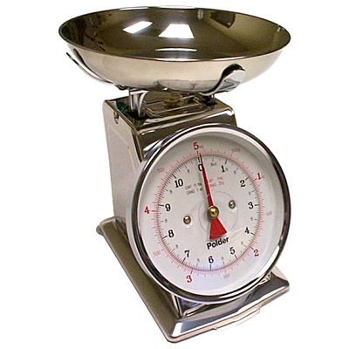
Spring scale on an elevator
Clicker Question
You are attempting to pour out 1.0 kg of flour, using a kitchen scale on an elevator which is accelerating upward at 1.5 m/s².
The amount of flour you pour will be
too much.
too little.
the correct amount.
$$\vec{a}$$

Slide 28
Pan balance on an elevator
Clicker Question
You are attempting to pour out 100 g of salt, using a pan balance on an elevator which is accelerating upward at 1.5 m/s². Will the amount of salt you pour be
Too much
Too little
The correct amount
$$\vec{a}$$

Slide 29
Self-adjusting forces
Gravity, F_{G}, has an equation for it which predicts the correct magnitude (it’s always mg here on Earth).
Normal force, Tension and Static friction are all self-adjusting forces: there are no equations for these!!
Normal force is whatever is needed to keep the object from crashing through the surface.
Tension is whatever is needed to keep the string or rope from breaking.
Static friction is whatever is needed to keep the object from slipping along the surface.
In all these cases, you must draw a free-body diagram and figure out by using equilibrium and Newton’s 2nd law what the needed force is.

Slide 30
Getting the piano on the truck
A piano has a mass of 225 kg.
What force is required to push the piano up a frictionless ramp at a constant velocity into the truck? Assume the ramp is 3.00 m long and the floor of the truck is 1.00 m high?
A piano has a mass of 225 kg.
What force is required to push the piano upwards at a constant velocity as you lift it into the back of a truck?

Slide 31
Getting the piano on the truck
A piano has a mass of 225 kg.
What force is required to push the piano up a frictionless ramp at a constant velocity into the truck? Assume the ramp is 3.00 m long and the floor of the truck is 1.00 m high?

Slide 32
Clicker Question
Bob stands under a low concrete arch, and presses upwards on it with a force of 100 N. Bob’s mass is 82 kg. He is in equilibrium. What is the total normal force of the ground on Bob? (Note that 82 × 9.8 = 800.)
800 N, upward
800 N, downward
900 N, upward
700 N, upward
900 N, downward

Slide 33
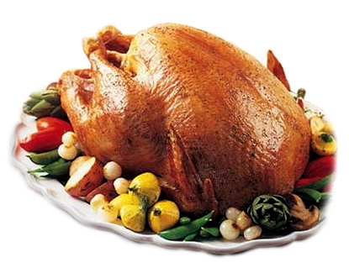
Before Class 11 next Wednesday
Please finish reading Chapter 6
Problem Set 4 is due Sunday night.
Please read the rest of Knight Chapter 6.
Something to think about:
Does friction always slow things down? Can friction ever speed things up?
Happy Thanksgiving!

