Slide 1
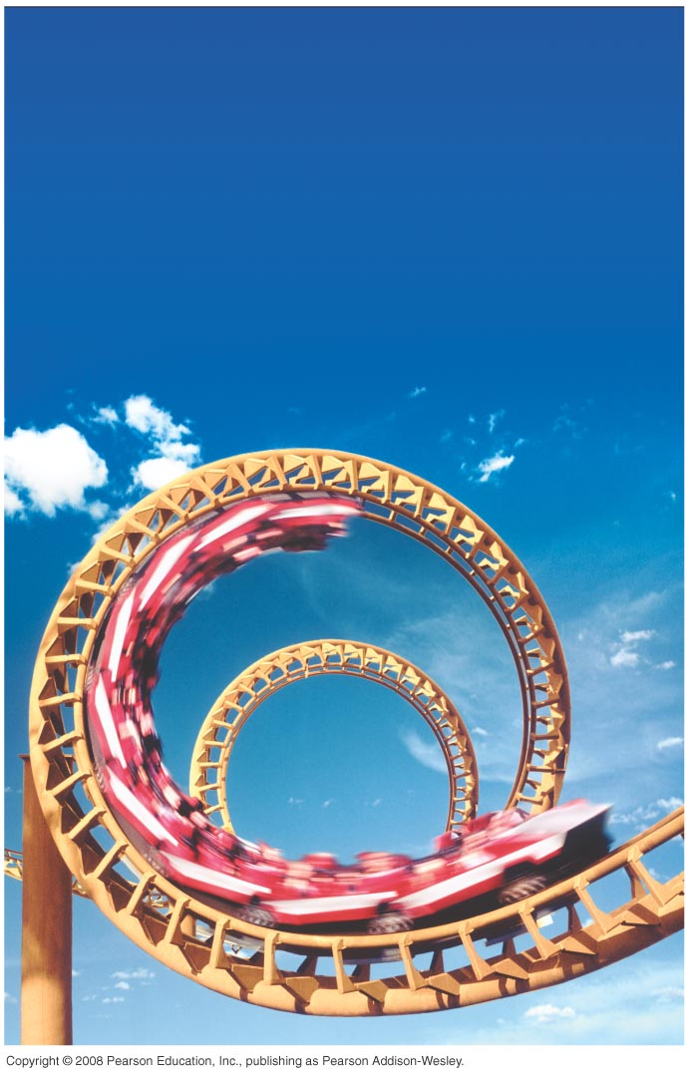
PHY131H1F - Class 13 Harlow’s Last Class this semester ☹ on Monday Prof. Meyertholen takes over! ☺
Today, starting Chapter 8:
Dynamics in Two Dimensions
Dynamics of Uniform Circular Motion
Banked Curves
Orbits

Slide 2
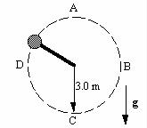
Clicker Question
Last day at the end of class I asked:
A ball is whirled on a string in a vertical circle. As it is going around, the tension in the string is
greatest at the top of the motion
constant.
greatest at the bottom of the motion
greatest somewhere in between the top and bottom.

Slide 4
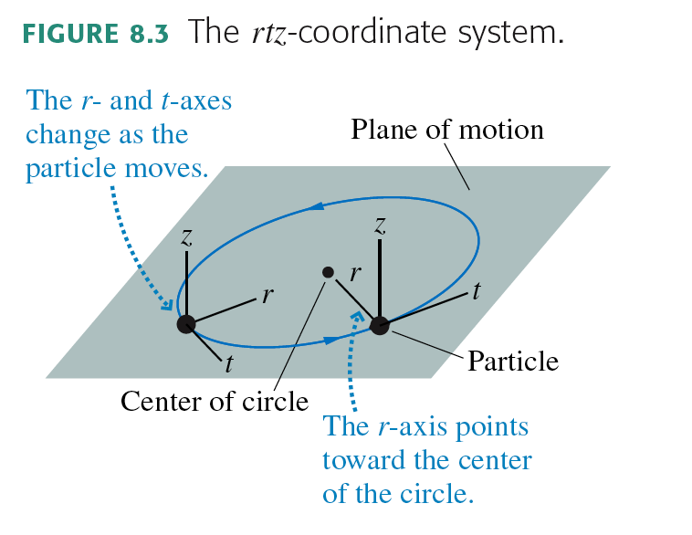
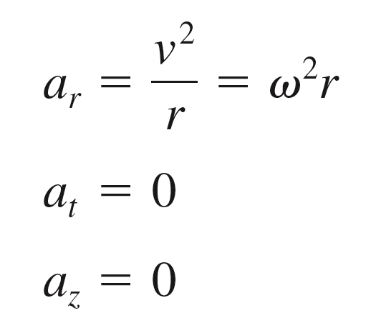
Uniform Circular Motion

Slide 5
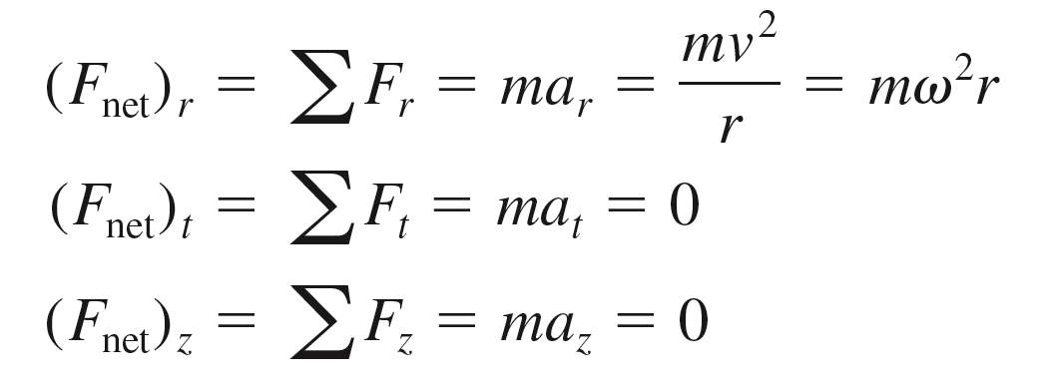
Dynamics of Uniform Circular Motion

Slide 6
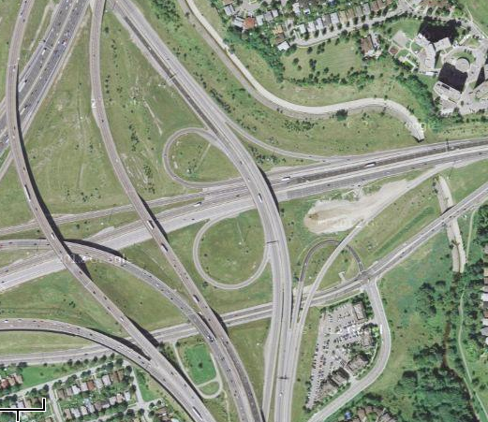
Every curve has a radius
r = 730 m
r = 75 m
r = 410 m
Intersection of Highway 427
And Highway 401

Slide 7
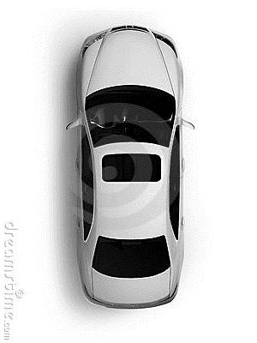
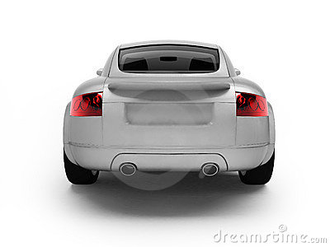
Unbanked Curve
Clicker Question
Top View
r
Back View
Gravity
Normal
Kinetic Friction
Static Friction
Rolling Friction
What horizontal force acts on the car to keep it on the curved path?

Slide 8
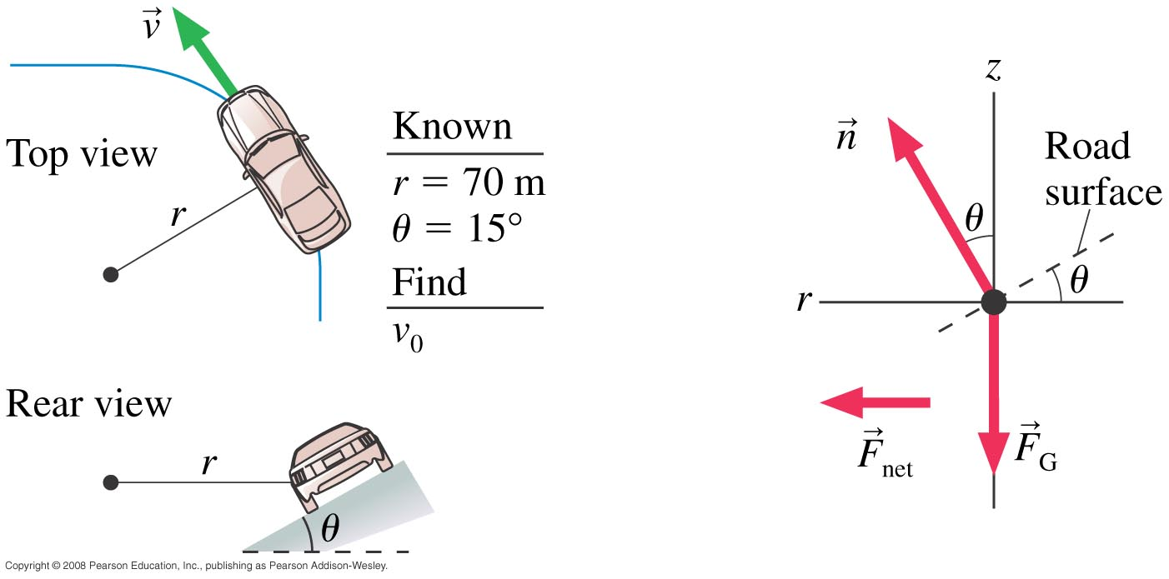
Banked Curve Example 8.5, pg. 197
A highway curve of radius 70.0 m is banked at a 15° angle. At what speed v₀ can a car take this curve without assistance from friction?

Slide 9
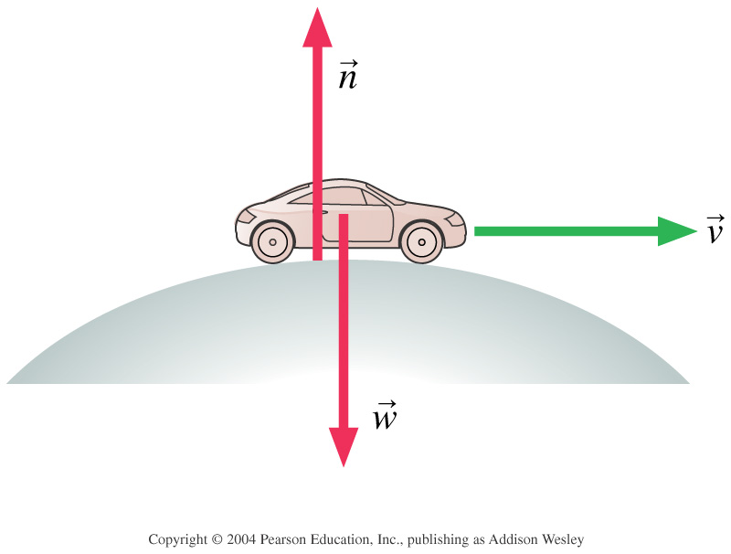
Clicker Question
A car is rolling over the top of a hill at speed v. At this instant,
n > F_{G}.
n < F_{G}.
n = F_{G}.
We can’t tell about n without knowing v.
Notes:
STT7.4
Answer: B

Slide 10
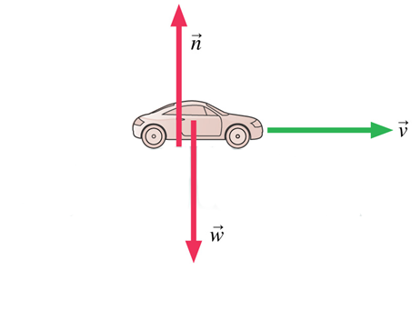
Clicker Question
A car is driving at the bottom of a valley at speed v. At this instant,
n > F_{G}.
n < F_{G}.
n = F_{G}.
We can’t tell about n without knowing v.
Notes:
STT7.4
Answer: B

Slide 11
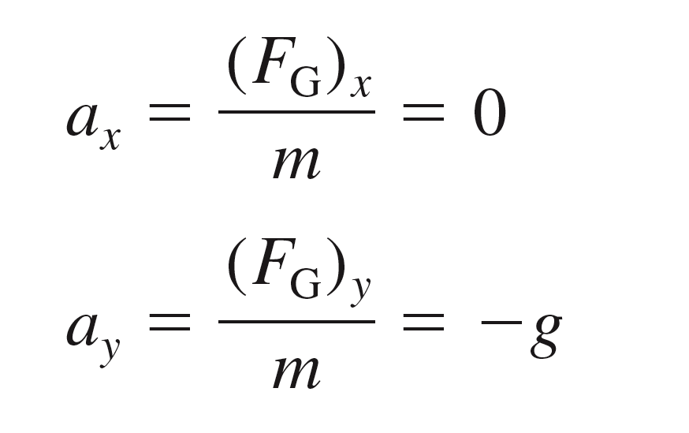
Projectile Motion
In the absence of air resistance, a projectile has only one force acting on it: the gravitational force, F_{G} = mg, in the downward direction. If we choose a coordinate system with a vertical y-axis, then
The vertical motion is free fall, while the horizontal motion is one of constant velocity.

Slide 12
A girl throws a ball in a horizontal direction (dashed line). After the ball leaves the girl’s hand, 1.0 seconds later it will have fallen
Clicker Question
A. 9.8 meters.
4.9 meters below the dashed line.
less than 4.9 meters below the straight-line path.
more than 4.9 meters below the straight-line path.

Slide 13
The Curvature of the Earth
Earth surface drops a vertical distance of 5 meters for every 8000 meters tangent to the surface.

Slide 14
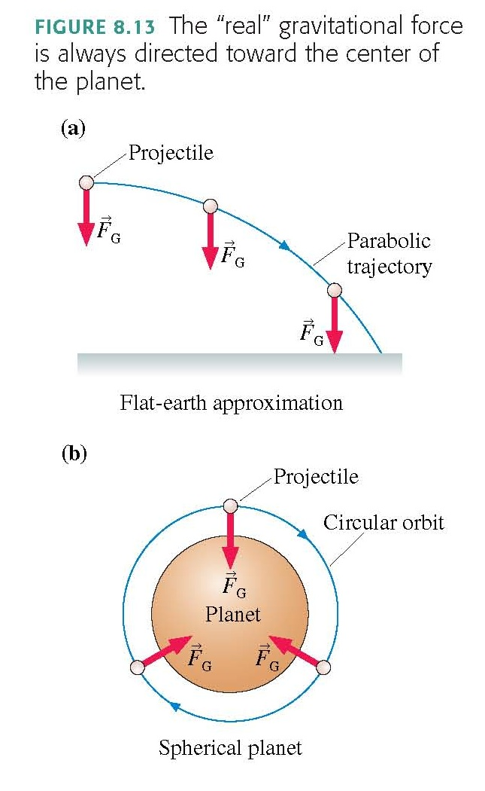

Slide 15
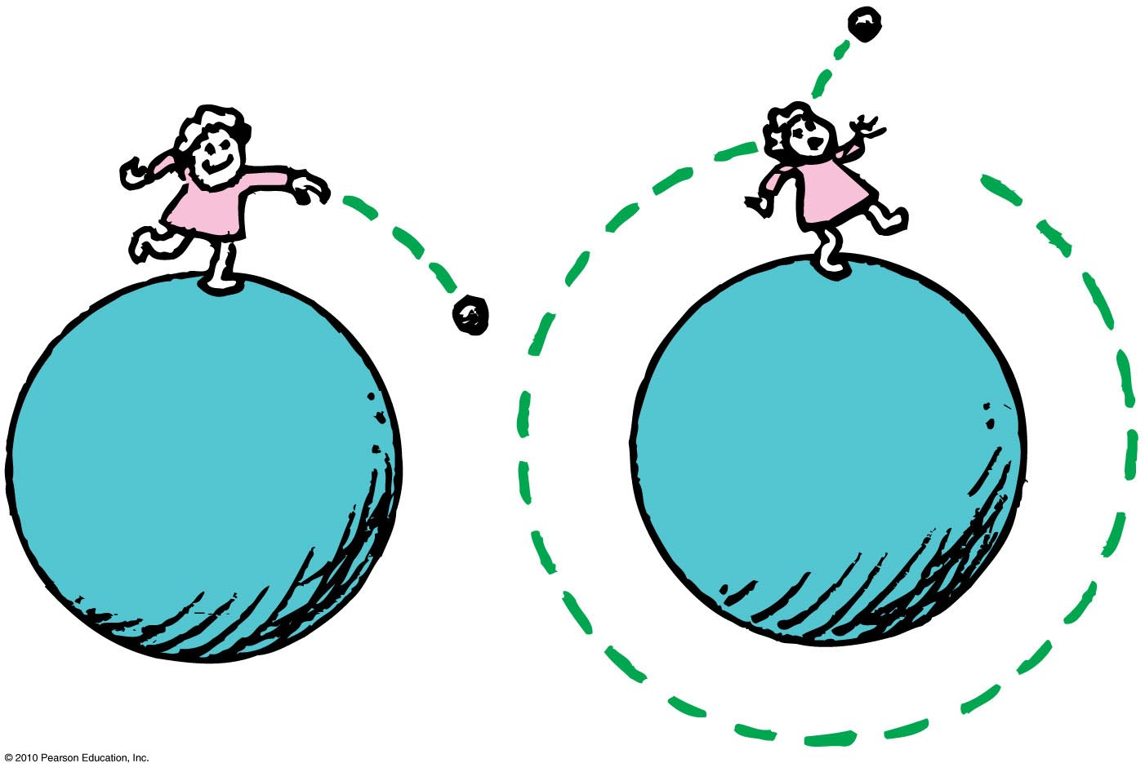
Circular Satellite Orbits
Satellite in circular orbit
Speed
must be great enough to ensure that its falling distance matches Earth’s curvature.
is constant—only direction changes.
is unchanged by gravity.

Slide 16
Example
How fast would you have to drive in order to be “weightless” – ie, no normal force needed to support your car?
How long would it take to drive around the world at this speed?

Slide 17
Circular Orbits
An object moving in a circular orbit of radius r at speed v_{orbit} will have centripetal acceleration of
That is, if an object moves parallel to the surface with the speed
then the free-fall acceleration provides exactly the centripetal acceleration needed for a circular orbit of radius r.
An object with any other speed will not follow a circular orbit.

Slide 18
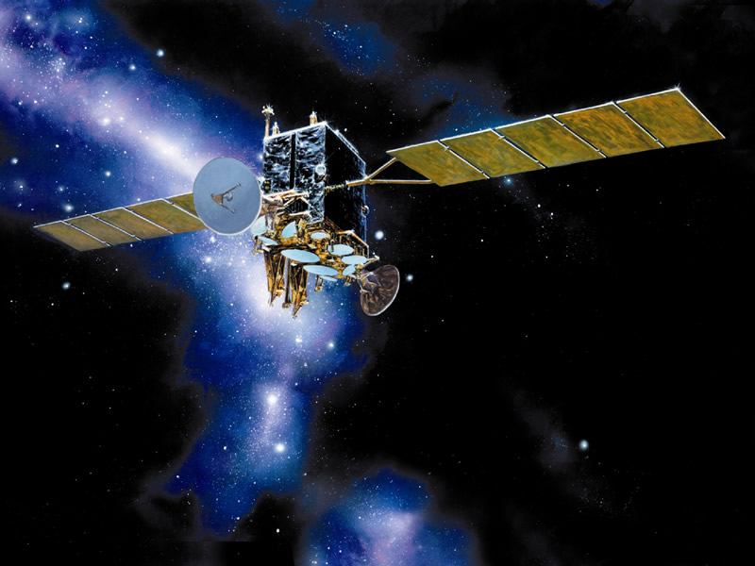
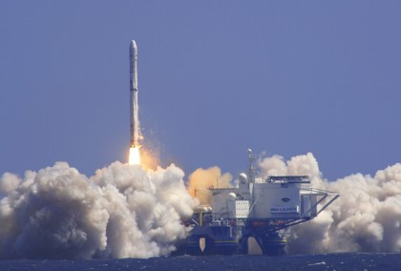
Why are communications satellites typically launched with rockets to heights of more than 100 km?
Clicker Question
To get outside Earth’s gravitational pull so the satellite doesn’t fall down
To get closer to the Sun in order to collect more solar power
To get above the Earth’s atmosphere in order to avoid air resistance
To get away from radio interference on Earth
Image from http://www.defenseindustrydaily.com/special-report-the-usas-transformational-communications-satellite-system-tsat-0866/
Image from http://www.zatznotfunny.com/2009-02/sirius-xm-headed-for-bankruptcy/ ]

Slide 19
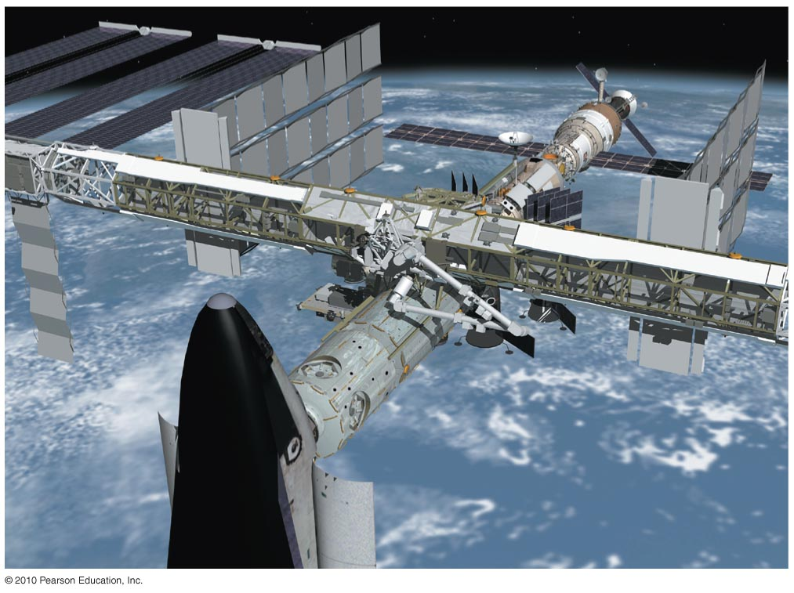
Circular Satellite Orbits
Positioning: beyond Earth’s atmosphere, where air resistance is almost totally absent
Example: Low-earth orbit communications satellites are launched to altitudes of 150 kilometers or more, in order to be above air drag
But even the ISS, as shown, experiences some air drag, which is compensated for with periodic upward boosts.

Slide 20
Before Class 14 on Monday
Please read the rest of Knight Chapter 8, and/or watch the Pre-Class Video, now on portal
MasteringPhysics Problem Set 6 is due on Monday evening.
It’s been a lot of fun – you are an excellent class!
I’ll be back! You will see me again in January for PHY132!
I hope you keep coming to my office hours T12-1 and F10-11 – I’d love to help!
The next test is Nov. 11 on Chs. 4-10, which includes forces, momentum and energy
And I will definitely see you at the Final Exam Dec. 15 2:00pm!
Image from http://wifflegif.com/tags/211457-i-ll-be-back-gifs

