Slide 1
PHY132 Introduction to Physics II Class 4 – Outline:
Ch. 21, sections 21.5-21.8
Wave Interference
Constructive and Destructive Interference
Thin-Film Optical Coatings →
Interference in 2 and 3 Dimensions
Beats

Slide 2
Class 4 Preclass Quiz on MasteringPhysics
This was due this morning at 8:00am
671 students submitted the quiz on time
There were 3 multiple choice questions, worth 1 point each, and a feedback question worth 0 points.
Originally the feedback question was worth 1 point but that was a mistake by me. I’ve fixed it now. The preclass quiz for today is out of 3.

Slide 3
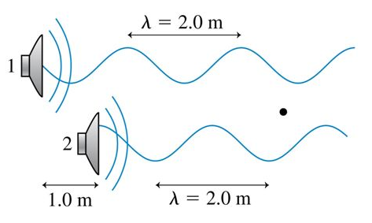
Class 4 Preclass Quiz on MasteringPhysics
Two loudspeakers emit sound waves with the same wavelength and the same amplitude. The waves are shown displaced, for clarity, but assume that both are traveling along the same axis. At the point where the dot is,
48% of students got: The interference is somewhere between constructive and destructive.

Slide 4
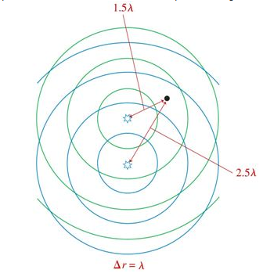
Class 4 Preclass Quiz on MasteringPhysics
Two in-phase sources emit sound waves of equal wavelength and intensity.
80% of students got: The interference is constructive.

Slide 5
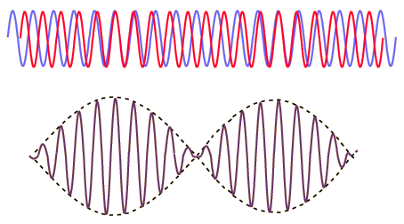
Class 4 Preclass Quiz on MasteringPhysics
Two sound waves of nearly equal frequencies are played simultaneously. What is the name of the acoustic phenomenon you hear if you listen to these two waves?
87% of students got: Beats.

Slide 6
Class 4 Preclass Quiz – Student Comments…
“Interference in 2 and 3 dimensions – how to find the nodal lines”
“If two speakers emit sound waves that interfere completely destructively, do they make a sound?”
“What's the difference between phi and phi sub-zero?”
“why does amplitude diminish as you get further from the source?”

Slide 7
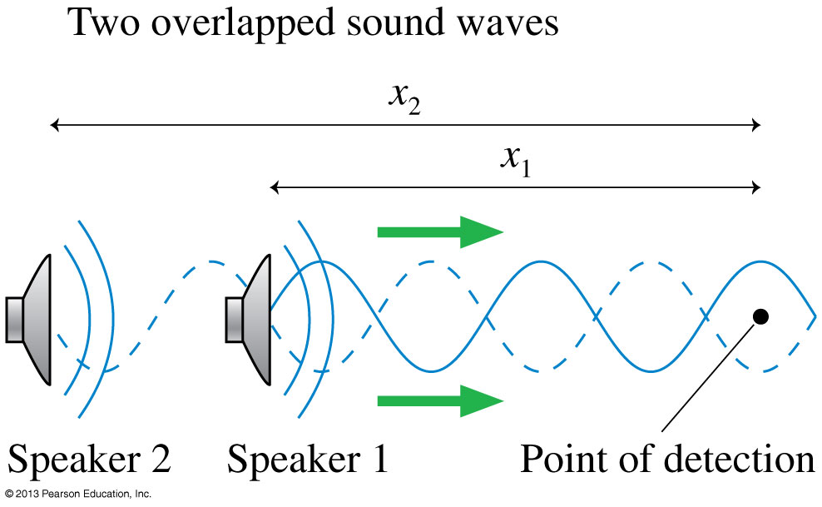
Wave Interference
The pattern resulting from the superposition of two waves is called interference. Interference can be
constructive, meaning the disturbances add to make a resultant wave of larger amplitude, or
destructive, meaning the disturbances cancel, making a resultant wave of smaller amplitude.

Slide 8
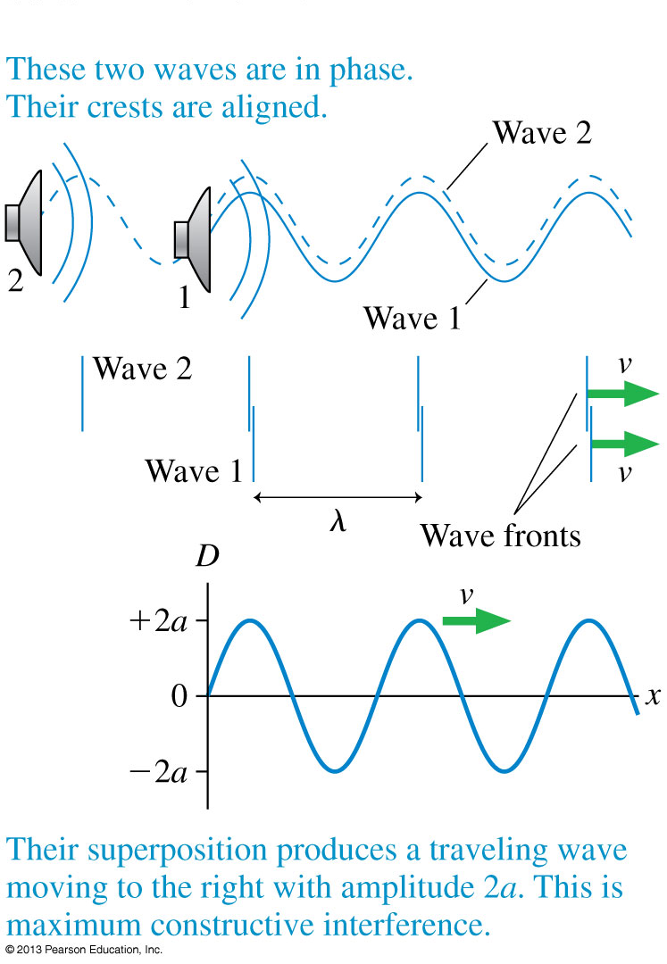
Wave Interference
D₁ = a sin(kx₁ − ωt + φ₁₀)
D₂ = a sin(kx₂ − ωt + φ₂₀)
D = D₁ + D₂
The two waves are in phase, meaning that
D₁(x) = D₂(x)
The resulting amplitude is A = 2a for maximum constructive interference.

Slide 9
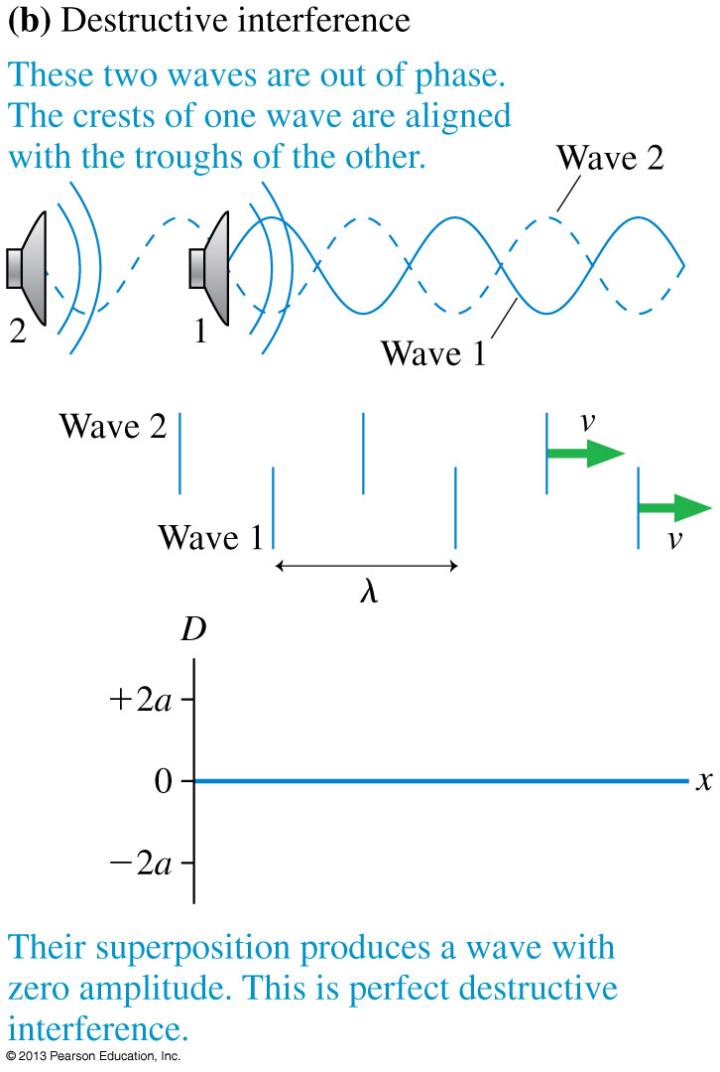
Wave Interference
The two waves are out of phase, meaning that
D₁(x) = −D₂(x).
The resulting amplitude is A = 0 for perfect destructive interference.

Slide 10
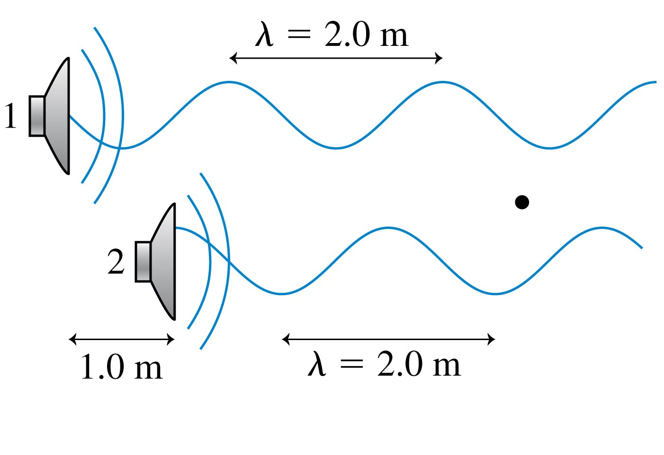
Clicker Question 1
Two loudspeakers emit sound waves with the same wavelength and the same amplitude. Which of the following would cause there to be destructive interference at the position of the dot?
Move speaker 2 forward (right) 1.0 m.
Move speaker 2 forward (right) 0.5 m.
Move speaker 2 backward (left) 0.5 m.
Move speaker 2 backward (left) 1.0 m.
Nothing. Destructive interference is not possible in this situation.
Notes:
10

Slide 11
The Mathematics of Interference
The Mathematics of Interference
As two waves of equal amplitude and frequency travel together along the x-axis, the net displacement of the medium is:
The amplitude depends on the phase difference

Slide 12
The Mathematics of Interference
The Mathematics of Interference
The amplitude has a maximum value A = 2a if cos(Δφ/2) = ±1.
This is maximum constructive interference, when:
where m is an integer.
Similarly, perfect destructive interference is when:

Slide 13
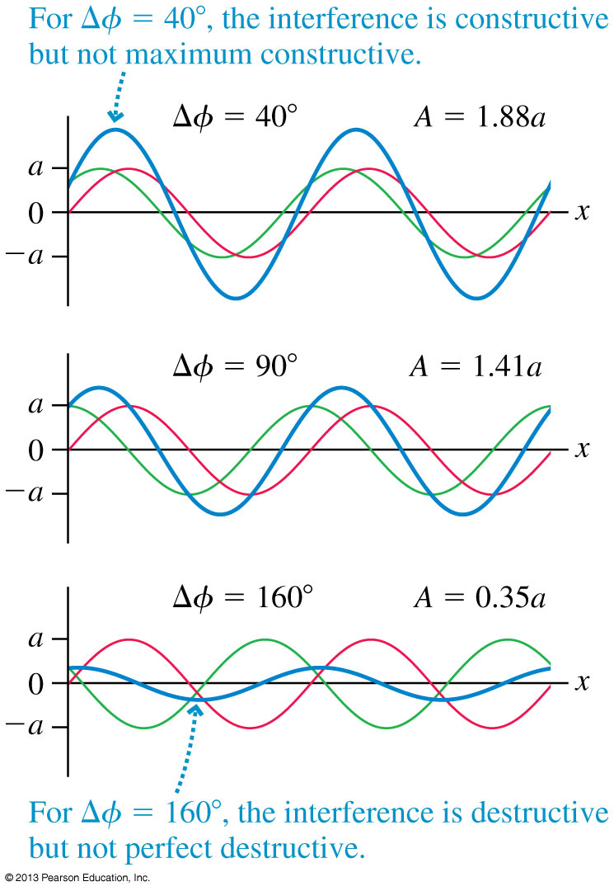
The Mathematics of Interference
It is entirely possible, of course, that the two waves are neither exactly in phase nor exactly out of phase.
(as we learned from today’s pre-class quiz!)

Slide 14
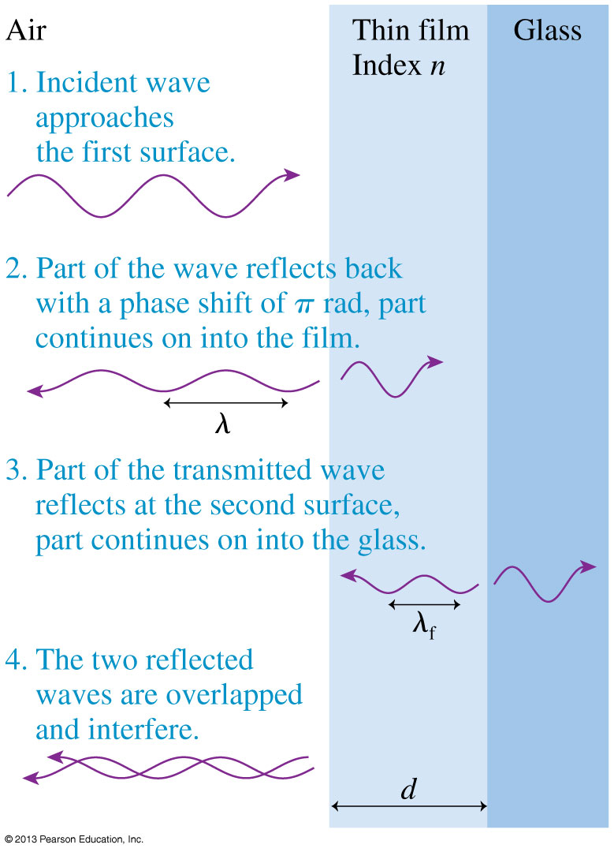
Thin-Film Optical Coatings
Thin transparent films, placed on glass surfaces, such as lenses, can control reflections from the glass.
Antireflection coatings on the lenses in cameras, microscopes, and other optical equipment are examples of thin-film coatings.

Slide 15
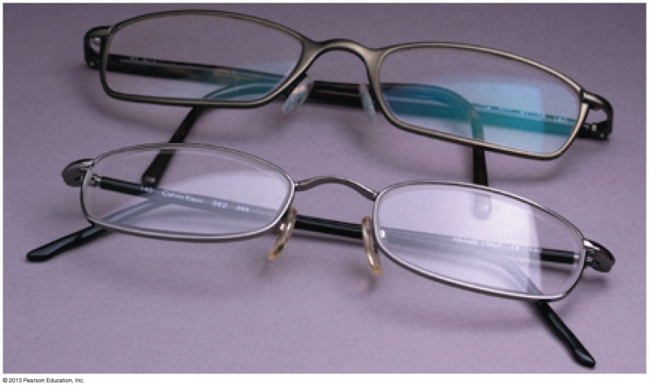
Application: Thin-Film Optical Coatings
The phase difference between the two reflected waves is:
where n is the index of refraction of the coating, d is the thickness, and λ is the wavelength of the light in vacuum or air.
For a particular thin-film, constructive or destructive interference depends on the wavelength of the light:

Slide 16
Example
A thin coating of Magnesium Flouride (MgF₂) is deposited on the surface of some eyeglasses which have an index of refraction of 1.6. The MgF₂ has an index of refraction of 1.38. What is the minimum thickness of the coating so that green light of wavelength 500 nm has minimal reflectance?

Slide 17
Class 4 Preclass Quiz – Student Comments…
“I wear glasses with antireflection coating, but when I hold mine up to white light, one can see purple light reflected off (and a little bit of blue?). Does that mean the coating on my glasses is of a thickness that destructs light in the orange-yellow wavelength best?”
Harlow Answer: Yes. Note that there is always a lambda in the equation for thickness of a thin film coating, so it is always designed for a particular wavelength or colour.

Slide 18
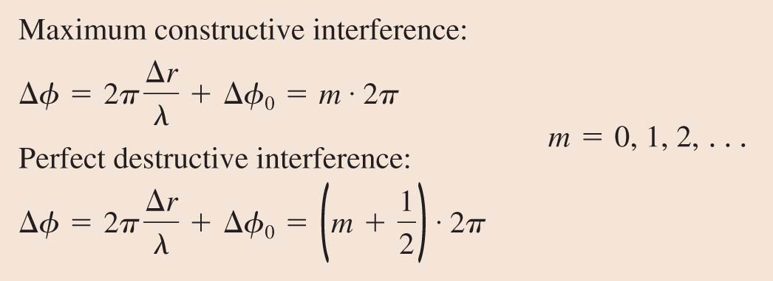
Interference in Two and Three Dimensions
The mathematical description of interference in two or three dimensions is very similar to that of one-dimensional interference. The conditions for constructive and destructive interference are
where Δr is the path-length difference.

Slide 19
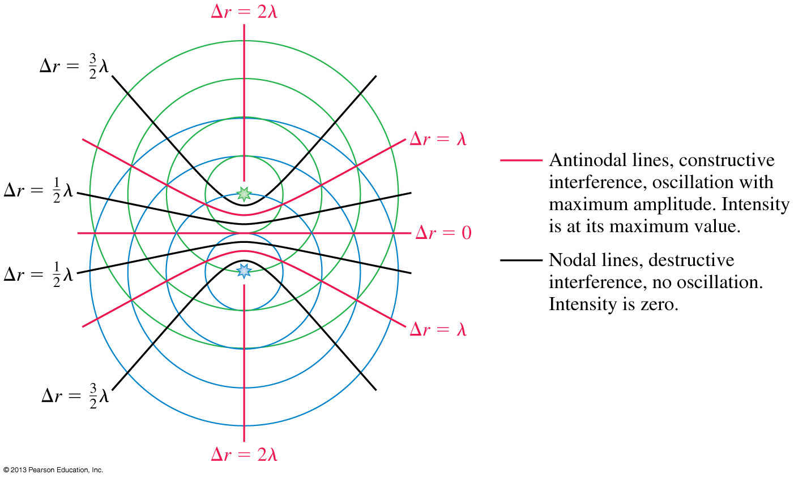
Interference in Two and Three Dimensions

Slide 20
Two speakers, A and B, are “in phase” and emit a pure note with a wavelength 2 m. The speakers are side-by-side, 3 m apart. Point C is 4 m directly in front of speaker A.
Example
Will a listener at point C hear constructive or destructive interference?

Slide 21
Two speakers, A and B, are “in phase” and emit a pure note with a wavelength 2 m. The speakers are side-by-side, 3 m apart. Point C is 4 m directly in front of speaker A.
Clicker Question 3
How many wavelengths are between Speaker A and Point C?
0.5
1.0
1.5
2.0
2.5

Slide 22
Two speakers, A and B, are “in phase” and emit a pure note with a wavelength 2 m. The speakers are side-by-side, 3 m apart. Point C is 4 m directly in front of speaker A.
Clicker Question 4
How many wavelengths are between Speaker B and Point C?
0.5
1.0
1.5
2.0
2.5

Slide 23
Two speakers, A and B, are “in phase” and emit a pure note with a wavelength 2 m. The speakers are side-by-side, 3 m apart. Point C is 4 m directly in front of speaker A.
Clicker Question 5
At point C, what is the path difference between the sounds received from speakers A and B, as measured in wavelengths?
0.5 B. 1.0 C. 1.5
D. 2.0 E. 2.5

Slide 24
Two speakers, A and B, are “in phase” and emit a pure note with a wavelength 2 m. The speakers are side-by-side, 3 m apart. Point C is 4 m directly in front of speaker A.
Clicker Question 6
At point C, there will be
Constructive interference
Destructive interference

Slide 25
Class 4 Preclass Quiz – Student Comments…
“So that's why it's called ‘Beats’ by Dr.Dre. Two identical frequencies from both sides of the headphones.”
“I was wondering, a demo was done last semester in physics with the penguin metronomes, which were at first out of phase and then over time came in-phase with one another. Is that related to the concept of beats in any way?”
“When I was playing in a orchestra, we always tuned the instruments before we played. If we were out of tune, it sounded pretty ugly, and now I understand the physics behind it. BEATS!”

Slide 26
Beats
Periodic variations in the loudness of sound due to interference
Occur when two waves of similar, but not equal frequencies are superposed.
Provide a comparison of frequencies
Frequency of beats is equal to the difference between the frequencies of the two waves.
[image from http://hyperphysics.phy-astr.gsu.edu/hbase/sound/beat.html ]

Slide 27
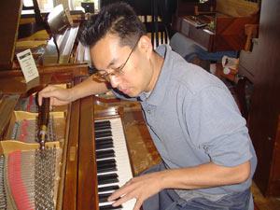
Beats
Applications
Piano tuning by listening to the disappearance of beats from a known frequency and a piano key
Tuning instruments in an orchestra by listening for beats between instruments and piano tone

Slide 28
Suppose you sound a 1056-hertz tuning fork at the same time you strike a note on the piano and hear 2 beats/second. What is the frequency of the piano string?
Clicker Question 7
1054 Hz
1056 Hz
1058 Hz
Either A or C
Either A, B or C
Notes:
B. downward.

Slide 29
Suppose you sound a 1056-hertz tuning fork at the same time you strike a note on the piano and hear 2 beats/second. You tighten the piano string very slightly and now hear 3 beats/second. What is the frequency of the piano string?
Clicker Question 8
1053 Hz
1056 Hz
1059 Hz
Either A or C
Either A, B or C
Notes:
B. downward.

Slide 30
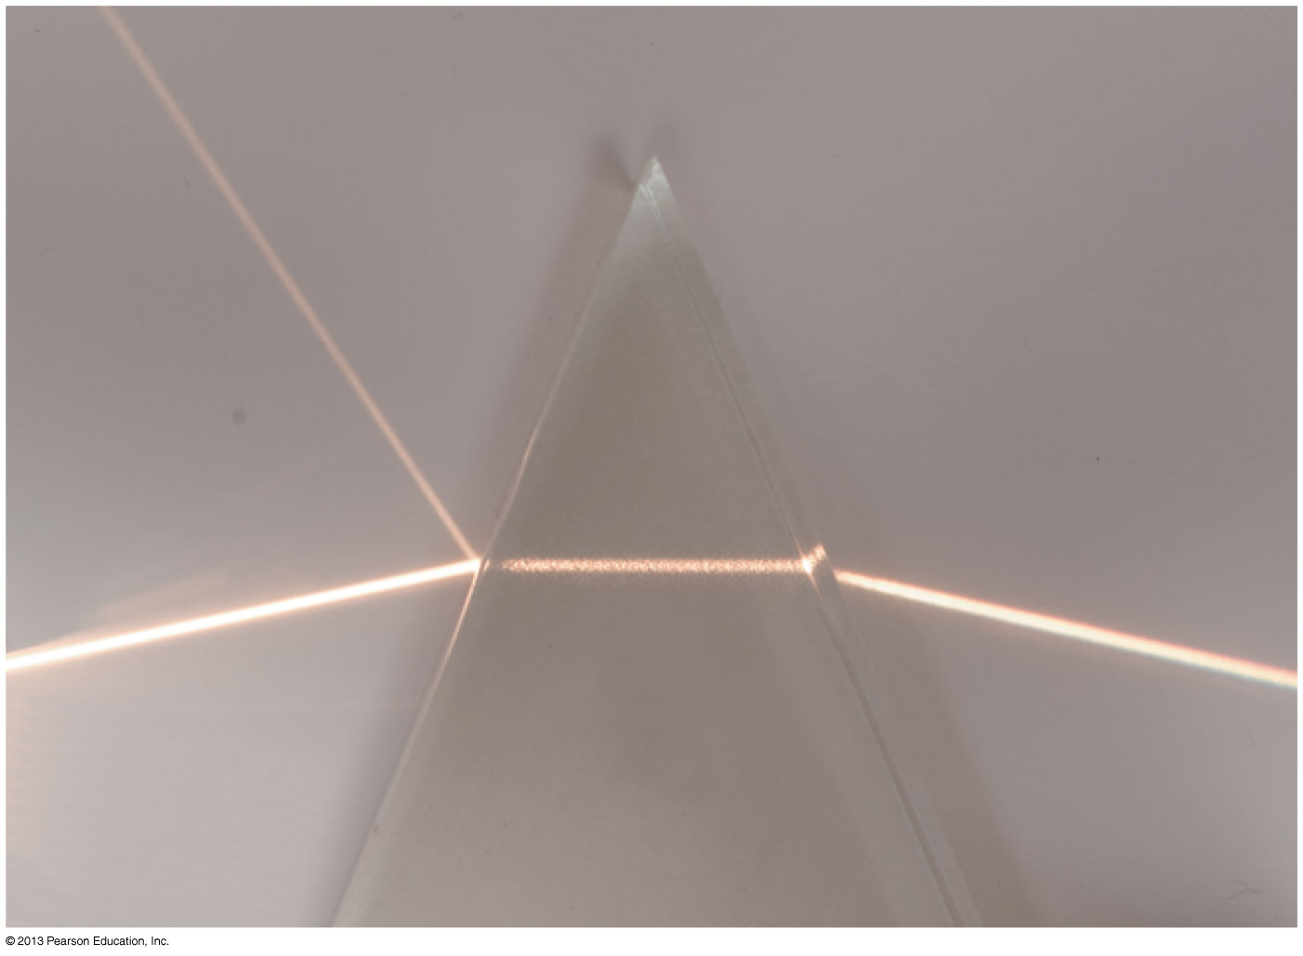
Before Class 5 on Monday
Complete Problem Set 1 on MasteringPhysics due Sunday at 11:59pm on Chs. 20, 21. This is a rather long one so definitely get started early!
Please read Knight Ch. 23, sections 23.1-23.5
Please do the short pre-class quiz on MasteringPhysics by Monday morning at the latest.
Something to think about: Is it possible to see a ray of light if it does not actually enter your eye?

