Slide 1
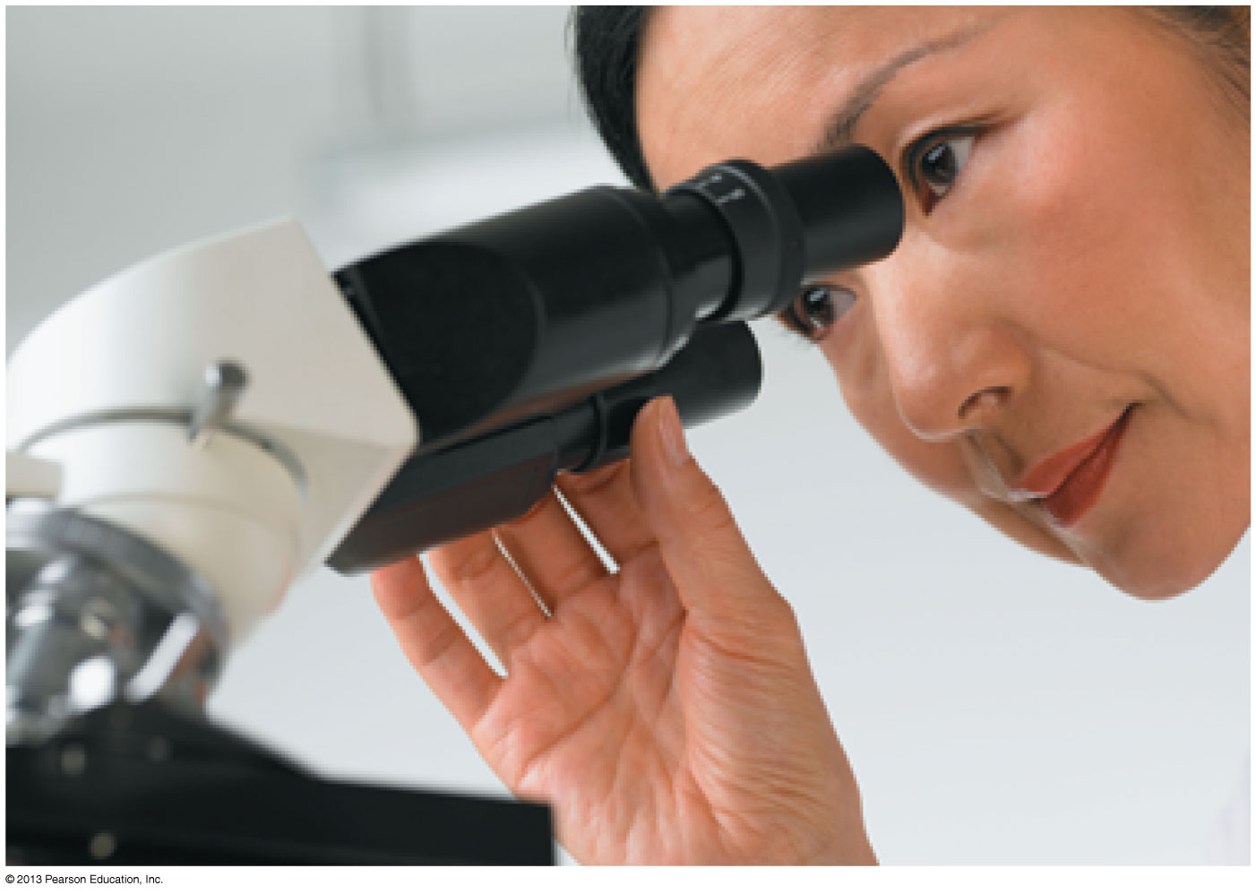
PHY132 Introduction to Physics II Class 7 – Outline:
Ch. 24
Lenses in Combination
The Camera
Vision
Magnifiers

Slide 2
Class 7 Preclass Quiz on MasteringPhysics
This was due this morning at 8:00am
662 students submitted the quiz on time
98% got: Lens power is measured in units of Diopters. (This is actually review; I mentioned this in class last week.)
81% got: The magnification of a simple magnifier is
So you can increase the magnification by decreasing f.
90% got: If the near point of your eye is at 75 cm, you are farsighted. (Hyperopia)

Slide 3
Class 7 Preclass Quiz – Student Comments…
“Do we need to do know all the equations for these different magnifier for the test?”
Harlow answer: If it’s in your reading and you can’t derive it, then you should put the equation on your aid sheet. That’s what the aid sheet is for!
“Why is there chromatic aberration with white light not being able to see a clear image?”
Harlow answer: If you look at the lensmaker’s formula, you will see that the focal length is dependent on the index of refraction, n. For glass, n depends on frequency so in fact the focal length of a lens depends on frequency. White light is a mixture of all frequencies so the image is always a bit blurry.

Slide 4
Class 7 Preclass Quiz – Student Comments…
“Understanding that I wear contacts because my eyeballs are too long was an interesting revelation.... Also that the size of the telescope, unless we find some other method, will continue to increase forever and ever so we can see further.”
“thank you for giving the lecture on after image when you did. The timing was perfect, because it helped me disprove an opposing argument in my philosophy paper. Thank you!”

Slide 5
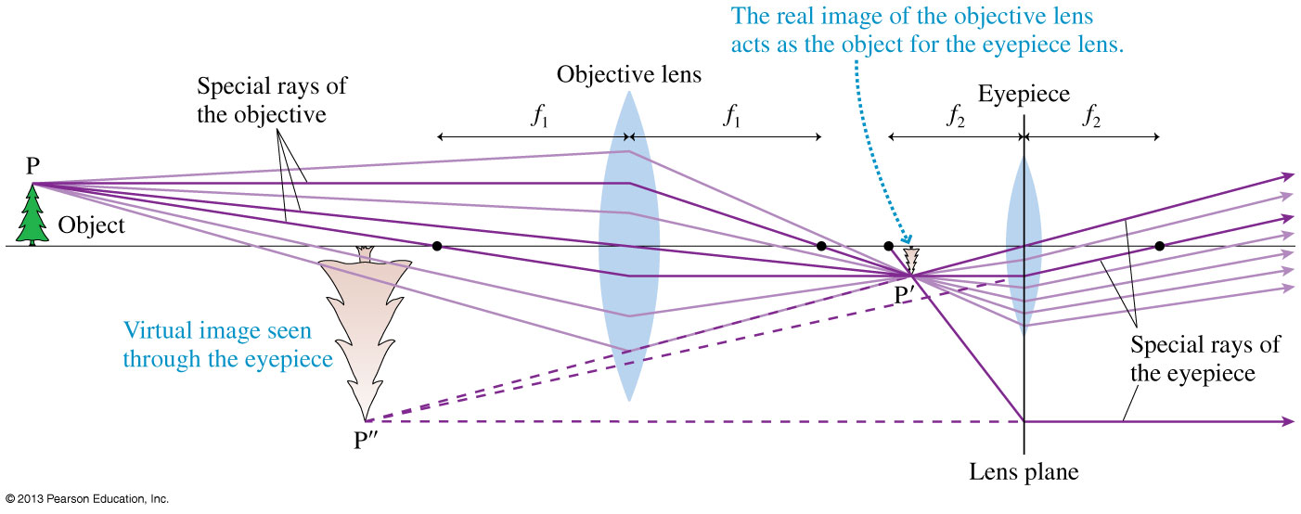
Lenses in Combination
The analysis of multi-lens systems requires only one new rule: The image of the first lens acts as the object for the second lens.
Below is a ray-tracing diagram of a simple astronomical telescope.

Slide 6
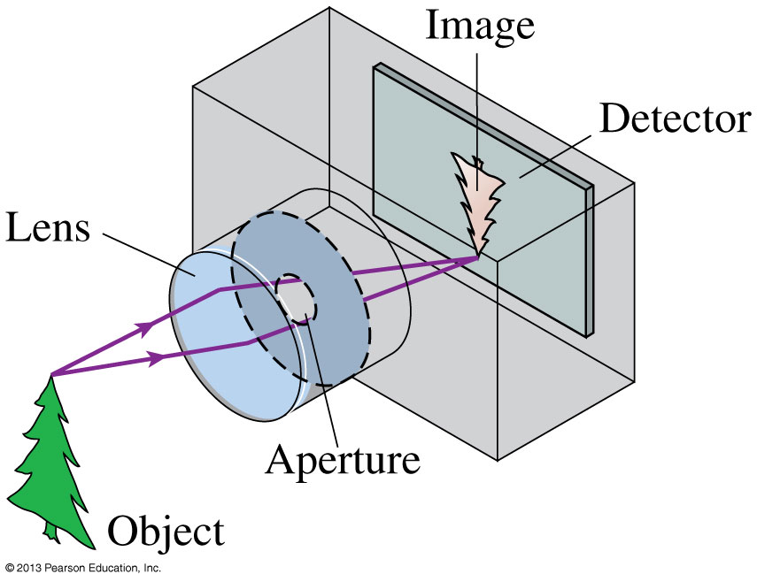
The Camera
A camera “takes a picture” by using a lens to form a real, inverted image on a light-sensitive detector in a light-tight box.
We can model a combination lens as a single lens with an effective focal length (usually called simply “the focal length”).
A zoom lens changes the effective focal length by varying the spacing between the converging lens and the diverging lens.

Slide 7
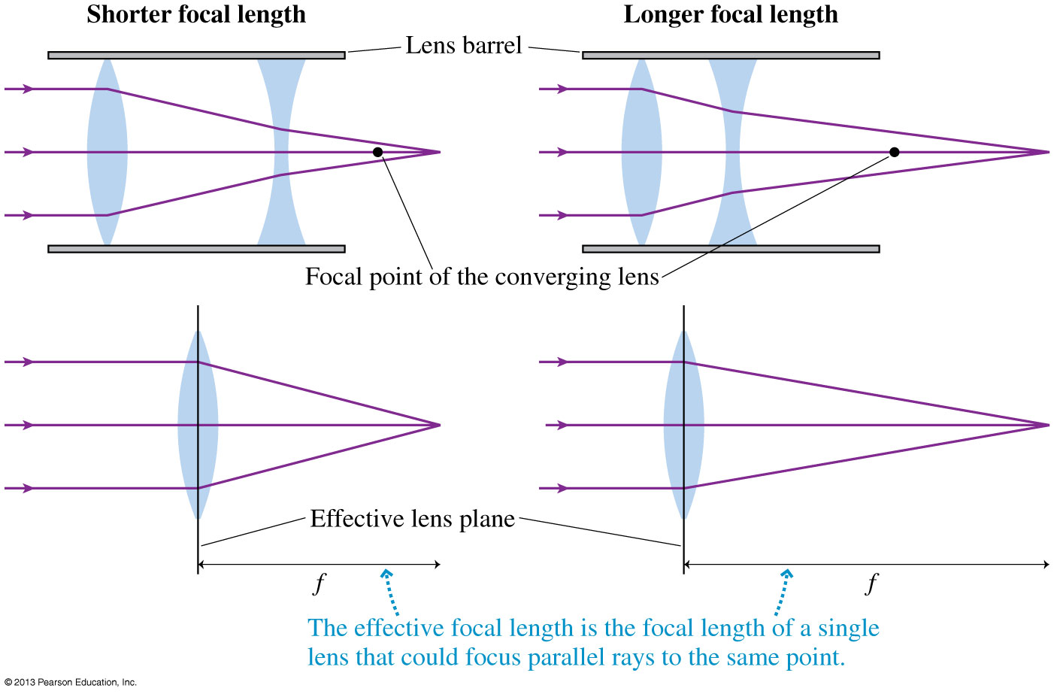
A Simple Camera Lens Is a Combination Lens

Slide 8
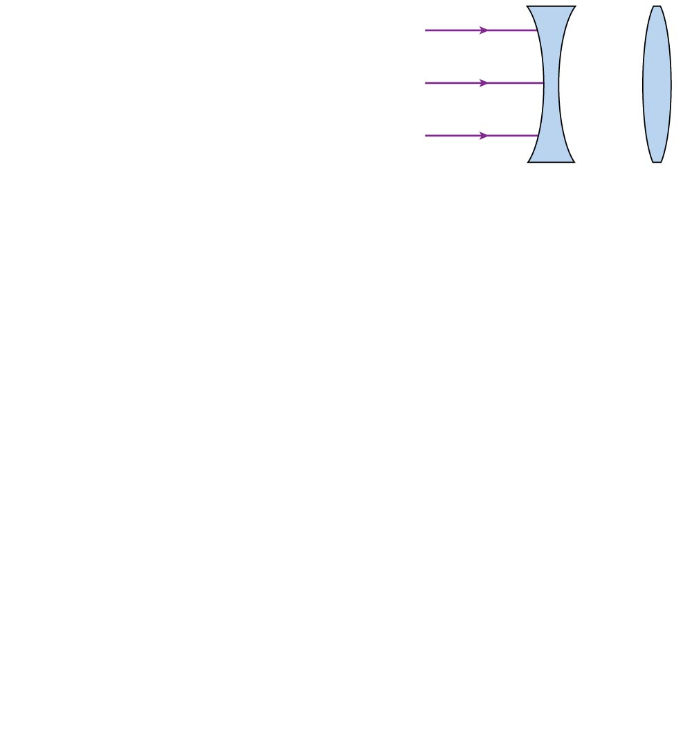
The parallel light rays will be focused at a point _______ the second lens than would light focused by the second lens acting alone.
closer to
the same distance from
farther from
Notes:
8
Answer: C

Slide 9
Zoom Lenses
When cameras focus on objects that are more than 10 focal lengths away (roughly s > 20 cm for a typical digital camera), the object is essentially “at infinity” and s' ≈ f .
The lateral magnification of the image is
The magnification is much less than 1, because s >> f, so the image on the detector is much smaller than the object itself.
More important, the size of the image is directly proportional to the focal length of the lens.

Slide 10
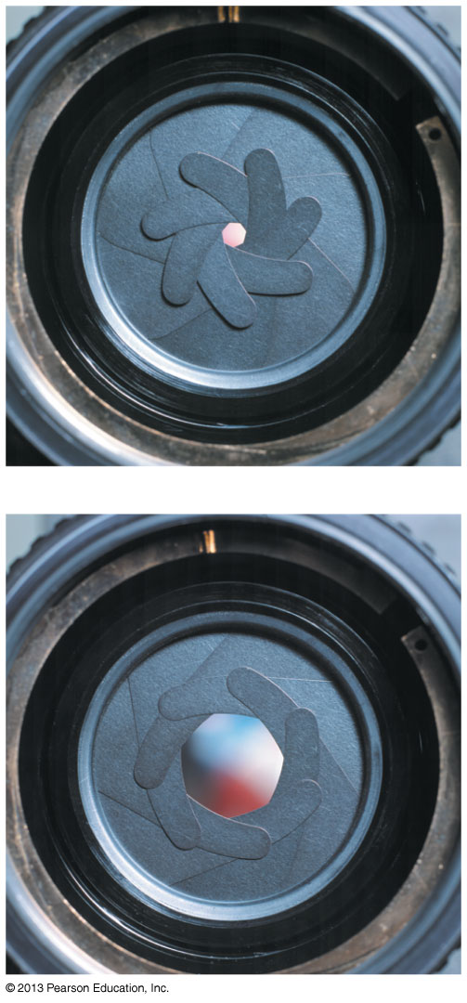
Controlling the Exposure
The amount of light passing through the lens is controlled by an adjustable aperture, shown in the photos.
The aperture sets the effective diameter D of the lens.
The light-gathering ability of a lens is specified by its f-number, defined as
The light intensity on the detector is related to the lens’s f-number by

Slide 11
QuickCheck 24.2
If the f-number of a camera lens is doubled, say from F4.0 to F8.0, that means the diameter of the lens aperture is
Quadrupled (increased by a factor of 4).
Doubled (increased by a factor of 2).
Halved (decreased by a factor of 2).
Quartered (decreased by a factor of 4).
Notes:
11

Slide 12
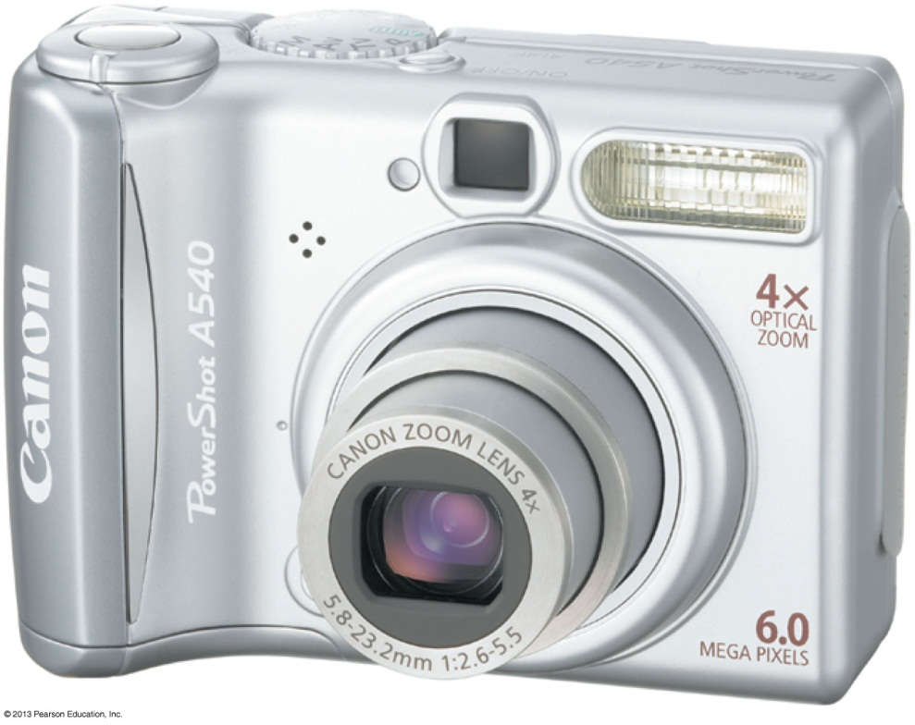
Controlling the Exposure
Focal length and f-number information is stamped on a camera lens.
This lens is labeled 5.8−23.2 mm 1:2.6−5.5.
The first numbers are the range of focal lengths.
They span a factor of 4, so this is a 4 × zoom lens.
The second numbers show that the minimum f-number ranges from f/2.6 (for the f = 5.8 mm focal length) to f/5.5 (for the f = 23.2 mm focal length).

Slide 13
QuickCheck 24.3
A camera gives a proper exposure when set to a shutter speed of 1/250 s at f-number F8.0. The photographer wants to change the shutter speed to 1/1000 s to prevent motion blur. To maintain proper exposure, she should also change the f-number to
F2.0.
F4.0.
F8.0.
F16.
F32.
Notes:
13

Slide 14
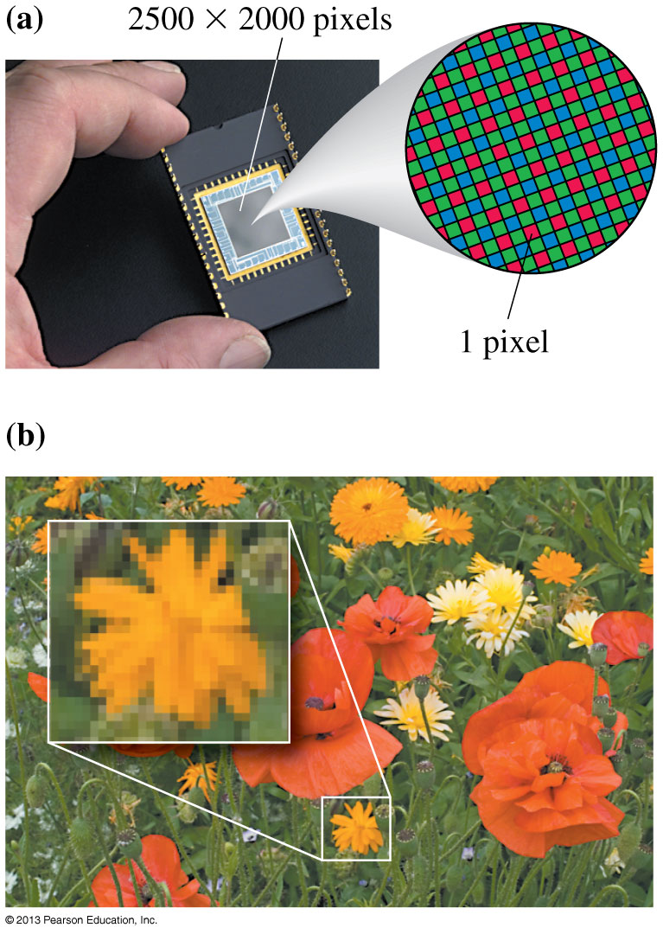
The Detector
Figure (a) shows a CCD “chip.”
To record color information, different pixels are covered by red, green, or blue filters.
The pixels are so small that the picture looks “smooth” even after some enlargement.
As you can see in figure (b), sufficient magnification reveals the individual pixels.

Slide 15
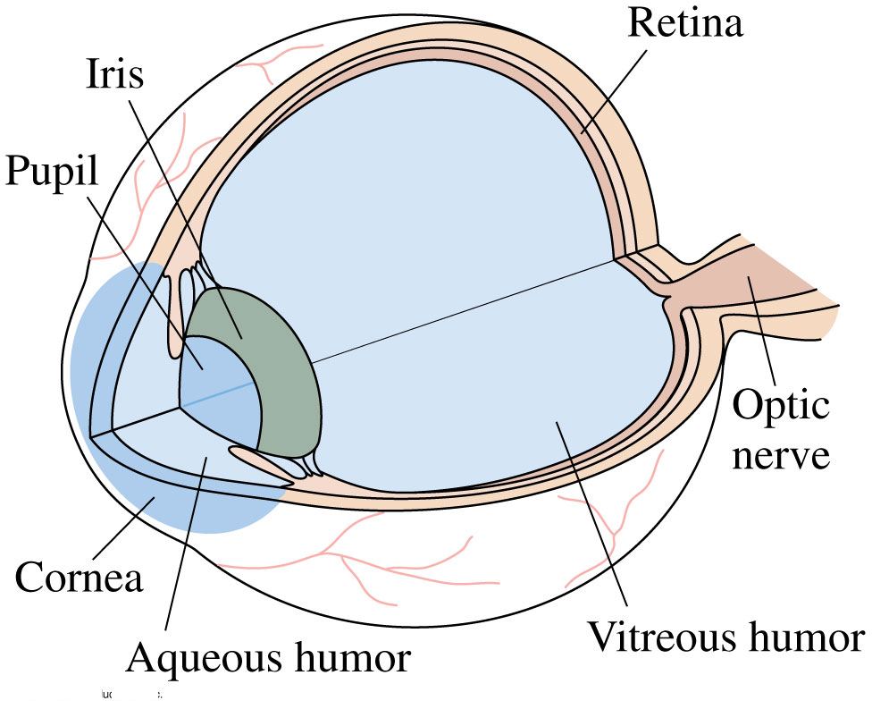
Vision
The human eye is roughly spherical, about 2.4 cm in diameter.
The transparent cornea and the lens are the eye’s refractive elements.
The eye is filled with a clear, jellylike fluid called the aqueous humor and the vitreous humor.

Slide 16
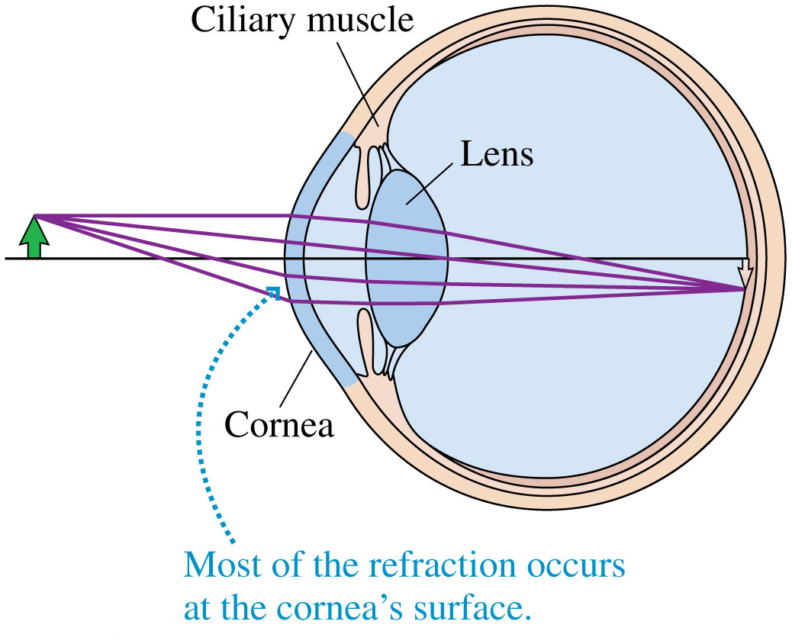
Vision
The indices of refraction of the aqueous and vitreous humors are 1.34, only slightly different from water.
The lens has an average index of 1.44.
The pupil, a variable-diameter aperture in the iris, automatically opens and closes to control the light intensity.
The f-number varies from roughly f/3 to f/16, very similar to a camera!

Slide 17
Focusing and Accommodation
The eye focuses by changing the focal length of the lens by using the ciliary muscles to change the curvature of the lens surface.
Tensing the ciliary muscles causes accommodation, which decreases the lens’s radius of curvature and thus decreases its focal length.

Slide 18
Class 7 Preclass Quiz – Student Comments…
“If farsightedness and nearsightedness depends on the shape of the eye, how does people that are not born farsighted or nearsighted become farsighted or nearsighted? Does their eyeball change shape? Parents always say that watching too much television will make your eyes nearsighted. How does television make you nearsighted?”
Harlow answer (keep in mind, I am not an optometrist): When you relax your eye, your lens has its lowest power and you are focusing on the most distant objects. To look at nearby objects, you must increase the focussing power by squishing the lens. Too much long term squishing can reduce the flexibility of your lens to spring back to unsquished.

Slide 19
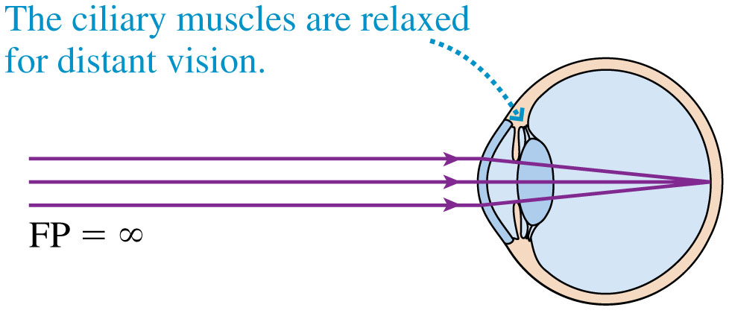
Focusing and Accommodation
The farthest distance at which a relaxed eye can focus is called the eye’s far point (FP).
The far point of a normal eye is infinity; that is, the eye can focus on objects extremely far away.

Slide 20
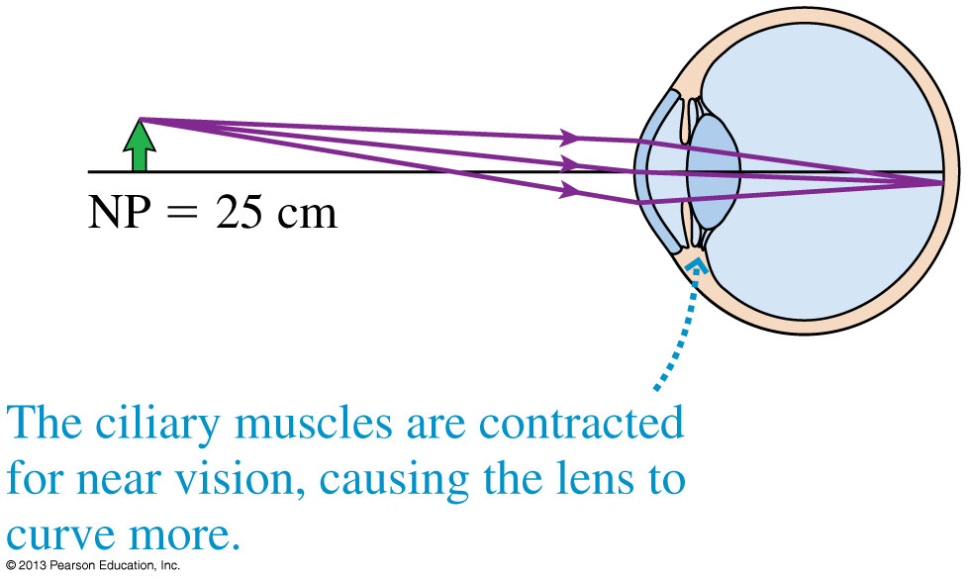
Focusing and Accommodation
The closest distance at which an eye can focus, using maximum accommodation, is the eye’s near point (NP).

Slide 21
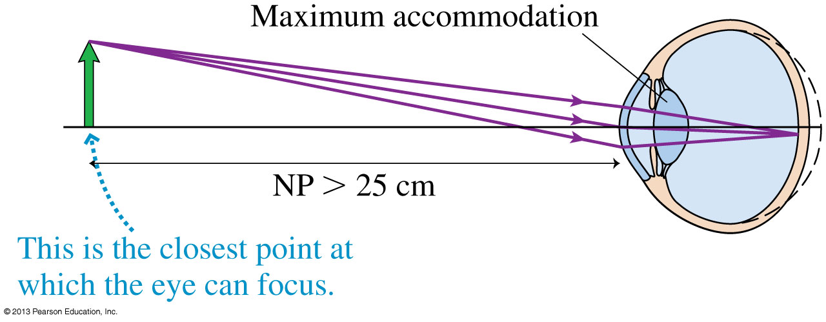
Hyperopia
A person who is farsighted can see faraway objects (but even then must use some accommodation rather than a relaxed eye), but his near point is larger than 25 cm, often much larger, so he cannot focus on nearby objects.

Slide 22
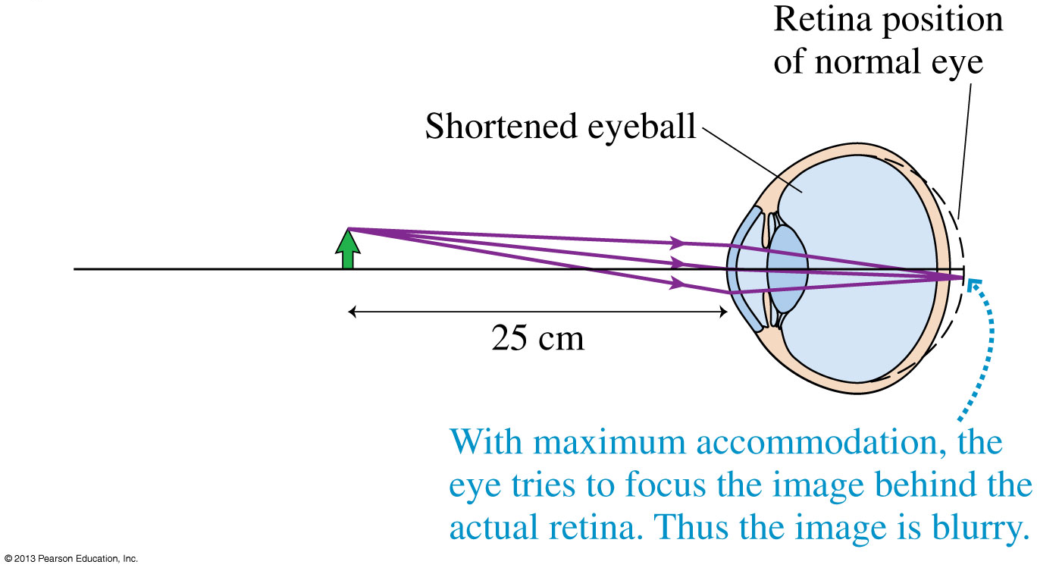
Hyperopia
The cause of farsightedness — called hyperopia — is an eyeball that is too short for the refractive power of the cornea and lens.

Slide 23
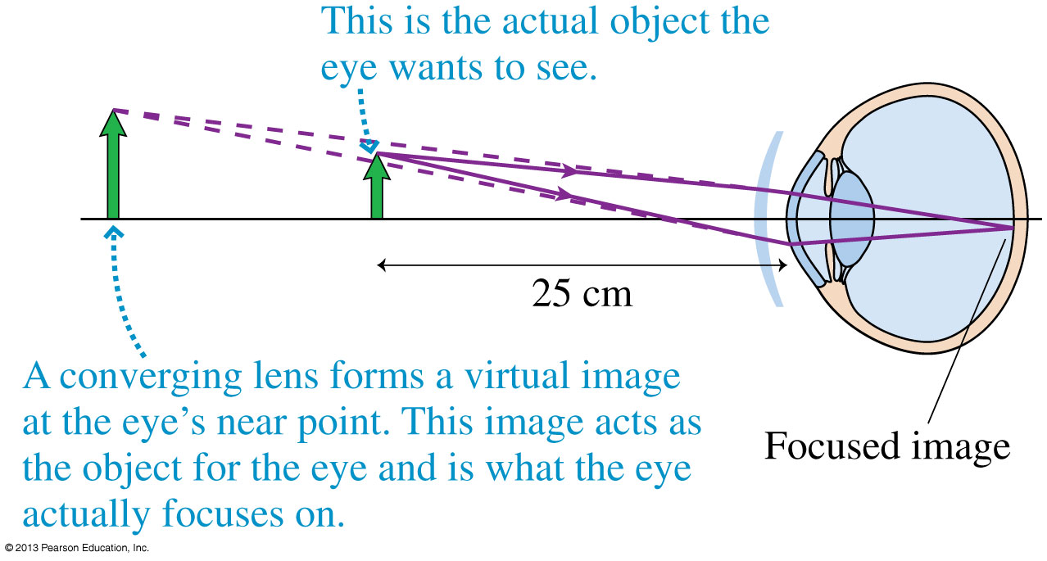
Hyperopia
With hyperopia, the eye needs assistance to focus the rays from a near object onto the closer-than-normal retina.
This assistance is obtained by adding refractive power with the positive (i.e., converging) lens.

Slide 24
Ch.24 Problem 12.
Ramon has contact lenses with the prescription +2.0 D.
What eye condition does Ramon have, and what is his near point without the lenses?

Slide 25
Announcement
Test 1 is Tuesday Feb. 4th from 6:00-7:30pm.
Room To Be Announced
If you have a conflict with the above time, the alternate sitting will be from 4:30-6:00pm on Tuesday Feb. 4th
To register, students should submit the Alternate Sitting Registration Form, available now in the PHY132S Portal course menu.
The location will be emailed on Jan. 31 to the people who have registered.
You have until Jan. 30 at 4:00pm to do it (the form will not be available after).

Slide 26
Lecture Participation Reminder
For each lecture beginning with class 2, one participation point is awarded for clicking any answer (right or wrong) for each physics question we ask.
At the end of the semester, only 85% of the clicker questions we ask are counted for your lecture participation mark.
The in-class clicker mark will count for 2% of the total course mark.
If, for example, you only answer 80% of the clicker questions this semester, you will receive (80/85)*2% = 1.88%.
If you must miss classes and you are worried about losing marks, please provide me with documentation, medical or otherwise, and I will excuse these absences.

Slide 27
Lecture Participation Reminder
You are not allowed to vote with another student’s clicker, or ask another student to vote for you.
Doing so is an academic offense called “impersonation”, and will be dealt with by the Office of Student Academic Integrity (OSAI)
If a student is caught using more than one clicker or i-clicker GO account, the minimum penalty is a 2% reduction in mark for the course.
Additional penalties could include a further letter grade reduction in course mark, a 3-year mark on your transcript, and a 12 month suspension from U of T.

Slide 28
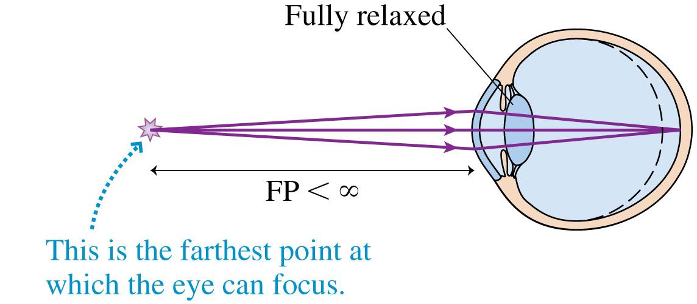
Myopia
A person who is nearsighted can clearly see nearby objects when the eye is relaxed (and extremely close objects by using accommodation), but no amount of relaxation allows her to see distant objects.

Slide 29
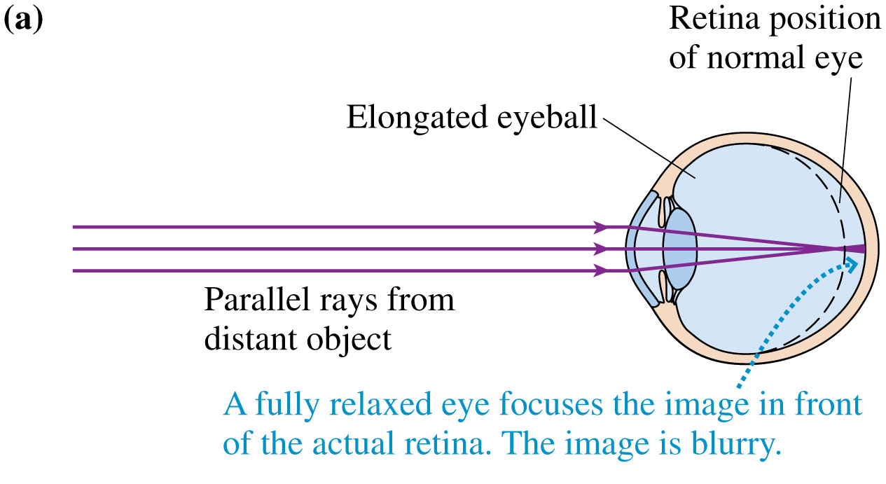
Myopia
Nearsightedness—called myopia—is caused by an eyeball that is too long.
Rays from a distant object come to a focus in front of the retina and have begun to diverge by the time they reach the retina.

Slide 30
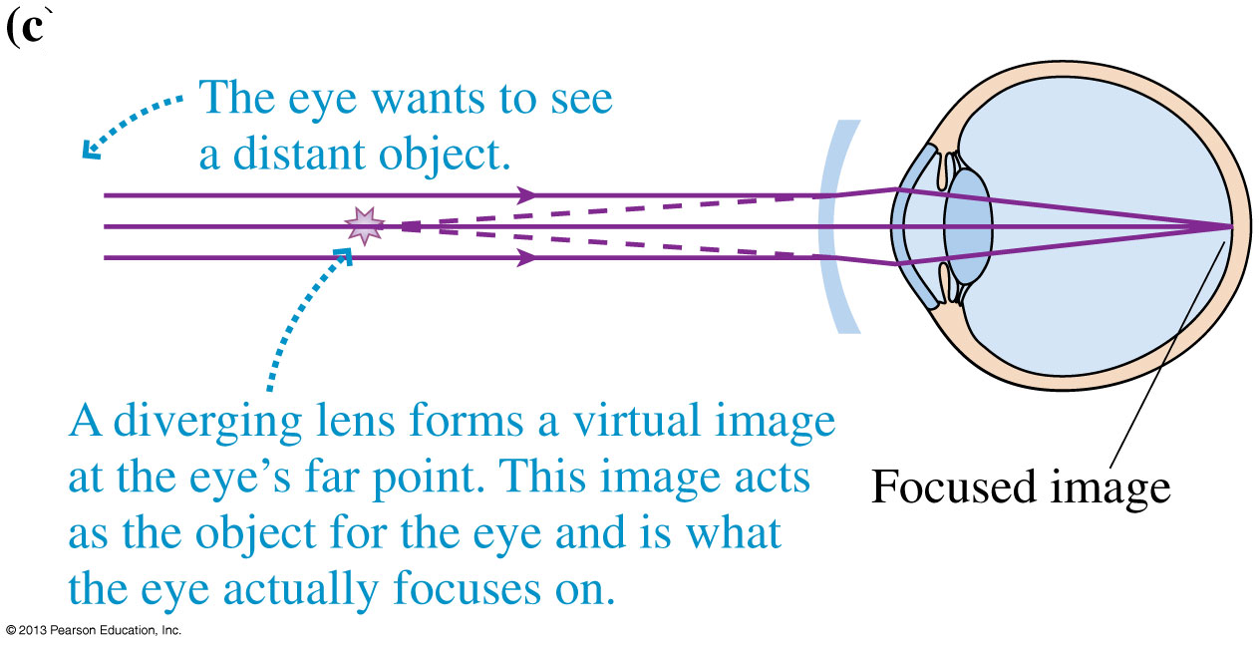
Myopia
To correct myopia, we needed a diverging lens to slightly defocus the rays and move the image point back to the retina.

Slide 31
Crossing the street
You are crossing the street, and you look to your left. You either see Car A or Car B. What do you think is the difference?
B
A
Car B is bigger
Car B is closer
It is impossible to tell without further information

Slide 32
Optical Systems That Magnify
The easiest way to magnify an object requires no extra optics at all; simply get closer!
Closer objects look larger because they subtend a larger angle θ, called the angular size of the object.

Slide 33
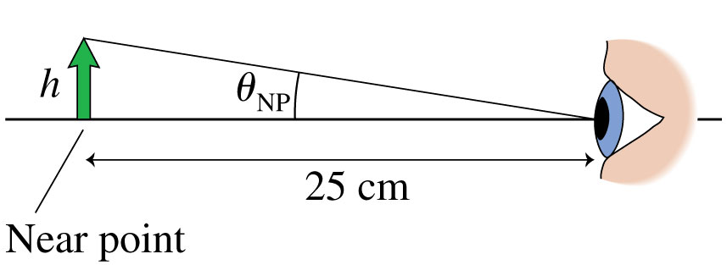
Optical Systems That Magnify
You can’t keep increasing an object’s angular size because you can’t focus on the object if it’s closer than your near point, which is ≈ 25 cm.
The maximum angular size viewable by your unaided eye is:

Slide 34
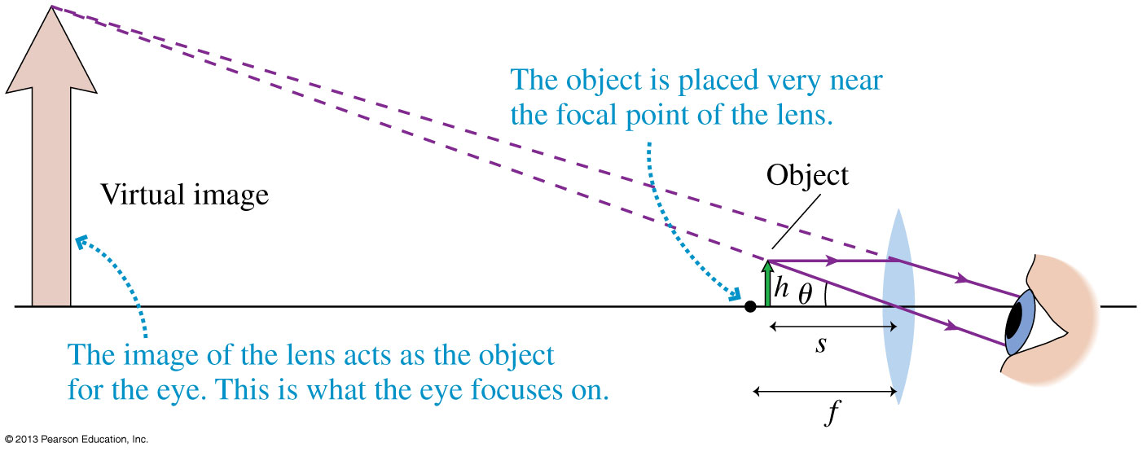
The Magnifier
Suppose we view an object of height h through a single converging lens.
If the object’s distance from the lens is less than the lens’s focal length, we’ll see an enlarged, upright image.
Used in this way, the lens is called a magnifier.

Slide 35
The Magnifier
When using a magnifier, your eye sees a virtual image subtending an angle θ = h/s.
If we place the image at a distance s′ ≈ ∞ the object distance is s ≈ f, so:
Angular magnification is the ratio of the apparent size of the object when using a magnifying lens rather than simply holding the object at your near point: M = θ/θ_{NP}
Combining these equations, we find the angular magnification of a magnifying glass is:

Slide 36
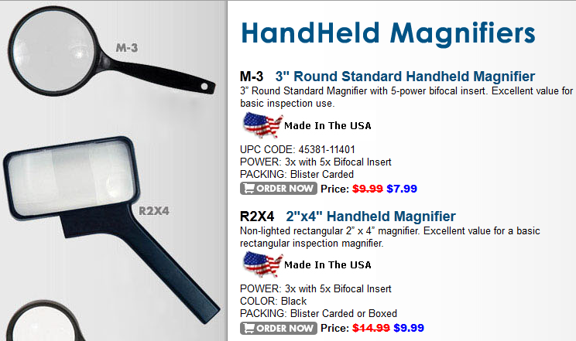
www.magnifier.com
What is the focal length of a magnifier which has “POWER 3x”?
3cm
8 cm
16 cm
25 cm

Slide 37
Before Class 8 on Wednesday
Please read Knight Pgs. 720-736: Ch. 25, sections 25.1-25.4
Please do the short pre-class quiz on MasteringPhysics by tomorrow night.
Something to think about: If you rub a balloon on your head, it becomes negatively charged. Where does this charge come from? Does your hair also become negative, or does your hair become positive?

