Slide 1
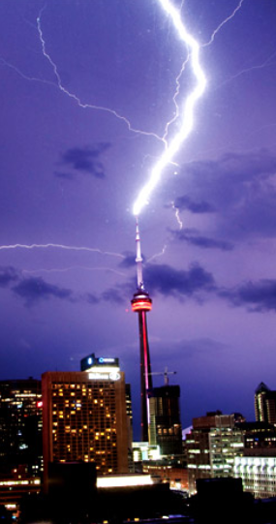
PHY132 Introduction to Physics II Class 8 – Outline:
Microscopes, Telescopes
Ch. 25, sections 25.1-25.4
Developing a Charge Model
Electric Charge
Insulators and Conductors
Coulomb's Law
[Photo by David He Aug. 9, 2009. http://www.flickr.com/photos/davidymhe/3809482563/ ]

Slide 2
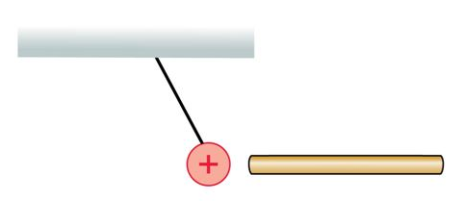
Class 8 Preclass Quiz on MasteringPhysics
62.3% got: A rod attracts a positively charged ball. The rod is either negative or neutral.

Slide 3
Class 8 Preclass Quiz on MasteringPhysics
The two oppositely charged metal spheres in the figure have equal quantities of charge. They are brought into contact with a neutral metal rod.
What is the final charge state of each sphere and of the rod?
80% got: Both the spheres and the rod are neutral.

Slide 4
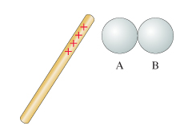
Class 8 Preclass Quiz on MasteringPhysics
Metal spheres A and B in the figure are initially neutral and are touching. A positively charged rod is brought near A, but not touching.
Is A now positive, negative, or neutral?
61% got: A is negative.

Slide 5
Class 8 Preclass Quiz – Student Comments…
“Is a conductor's natural tendency to equilibrate its charge?”
Harlow answer: Yes! Like charges repel, so they tend to spread out as far away from each other as they can when in a conductor, leaving the centre neutral and only the surfaces charged.
“This is my first winter. Could you please explain what causes winter static?”
Harlow answer: The water molecule is easily polarized, and so it can absorb and carry away static charge build-up. In the summer, the humidity in the air is much higher, so there is less static build-up. In the winter the air is dry, so there is more static charge build-up.

Slide 6
Class 8 Preclass Quiz – Student Comments…
“Can you post past-year’s tests?”
Harlow answer: Okay. On Lectures-Harlow page near the bottom now there are links to my Test 1’s that I gave in 2009 and 2010. There are also solutions, and for the 2010 test youtube videos of me carefully going through all the solutions.

Slide 7
The Microscope
A microscope, whose major parts are shown in the next slide, can attain a magnification of up to 1000× by a two-step magnification process.
A specimen to be observed is placed on the stage of the microscope, directly beneath the objective, a converging lens with a relatively short focal length.
The objective creates a magnified real image that is further enlarged by the eyepiece.

Slide 8
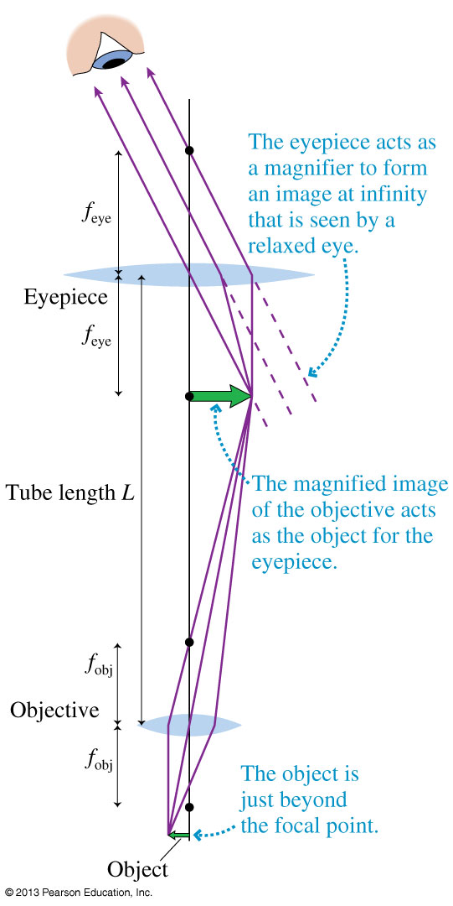
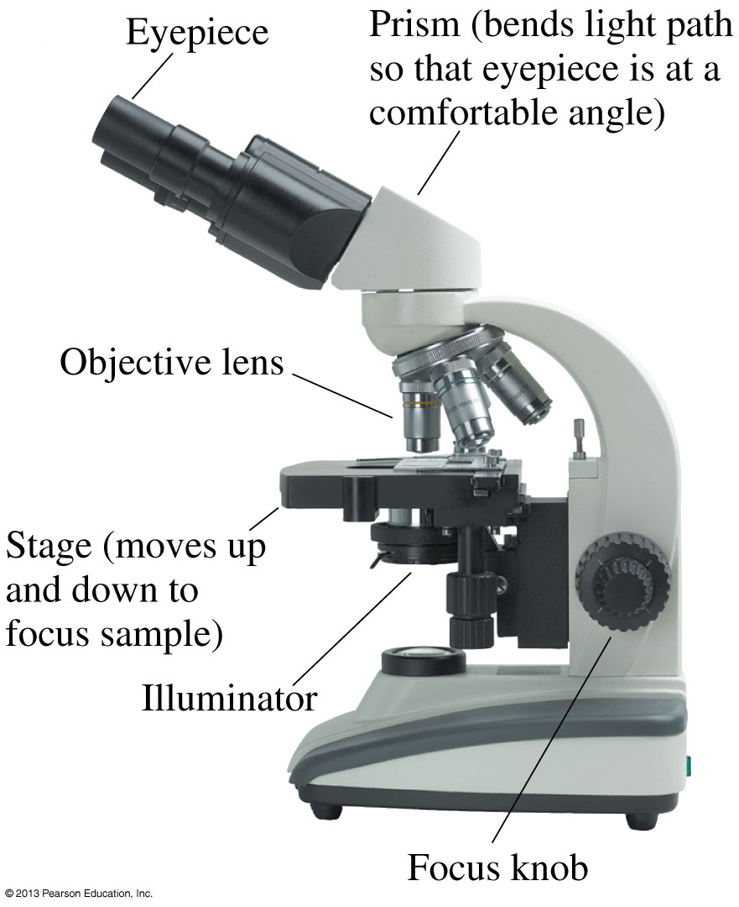
The Microscope

Slide 9
The Microscope
The lateral magnification of the objective is:
Together, the objective and eyepiece produce a total angular magnification:
The minus sign shows that the image seen in a microscope is inverted.
Most biological microscopes are standardized with a tube length L = 160 mm.

Slide 10
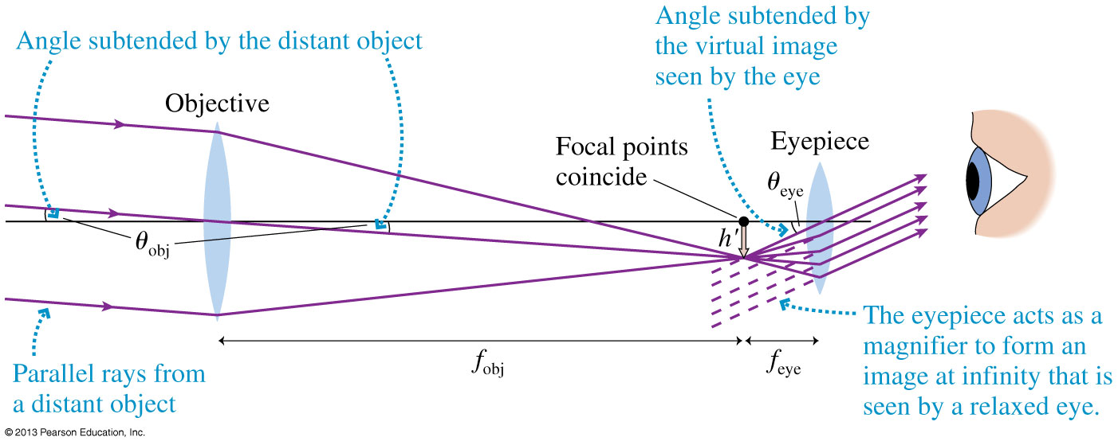
A Refracting Telescope

Slide 11
The Telescope
A simple telescope contains a large-diameter objective lens which collects parallel rays from a distant object and forms a real, inverted image at distance s' = f_{obj}.
The focal length of a telescope objective is very nearly the length of the telescope tube.
The eyepiece functions as a simple magnifier.
The viewer observes an inverted image.
The angular magnification of a telescope is:

Slide 12
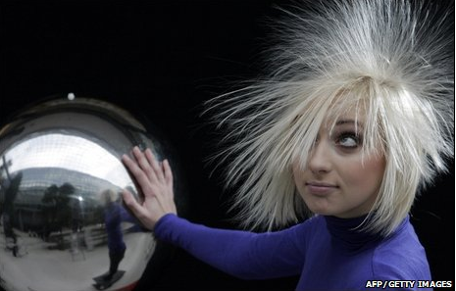
And now for something completely different: Electrostatics
Electrical Forces and Charges
Conservation of Charge
Coulomb’s Law
Conductors and Insulators
Image from http://news.bbc.co.uk/2/hi/in_pictures/7847290.stm

Slide 13
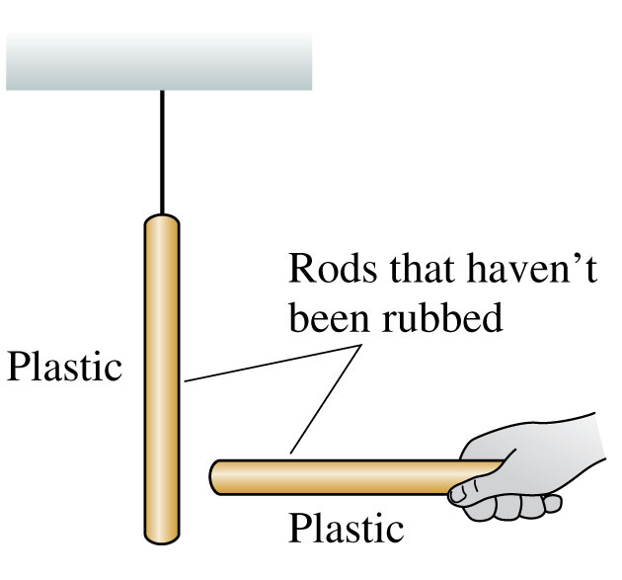
Discovering Electricity: Experiment 1
Take a plastic rod that has been undisturbed for a long period of time and hang it by a thread.
Pick up another undisturbed plastic rod and bring it close to the hanging rod.
Nothing happens to either rod.
No forces are observed.
We will say that the original objects are neutral.

Slide 14
Discussion Question
Rub two plastic rods with wool.
Hang one from a string
Place the other near it.
What will happen?
Nothing: no force observed
The hanging rod will be repelled, and move to the left
The hanging rod will be attracted, and move to the right

Slide 15
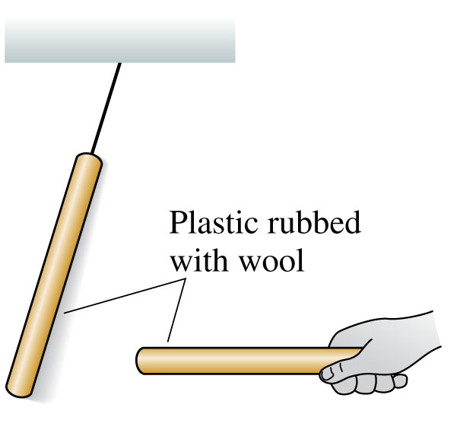
Discovering Electricity: Experiment 2 Conclusion
There is a long-range repulsive force, requiring no contact, between two identical objects that have been charged in the same way.

Slide 16
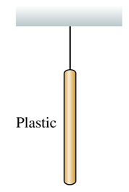
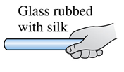
Discussion Question
Rub a plastic rod with wool, and hang it from a string.
Rub a glass rod with silk, and place it near the hanging rod.
What will happen?
Nothing: no force observed
The hanging rod will be repelled, and move to the left
The hanging rod will be attracted, and move to the right

Slide 17
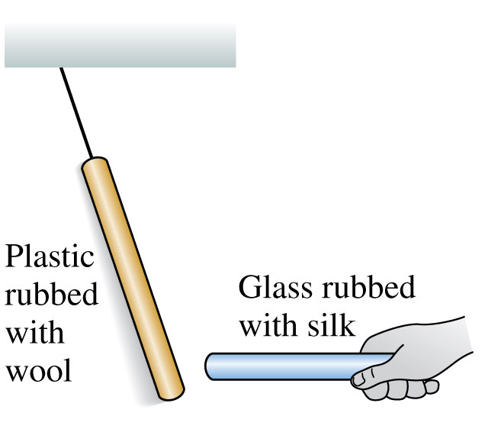
Discovering Electricity: Experiment 3 Conclusion
These particular two types of rods are different materials, charged in a somewhat different way, and they attract each other rather than repel.

Slide 18
Discussion Question
Rub two plastic rods with wool, hang one from a string, place the other near it so it repels the hanging rod.
What happens if you increase the distance between the two rods?
Nothing: no change in force
The repulsive force will decrease
The repulsive force will increase

Slide 19
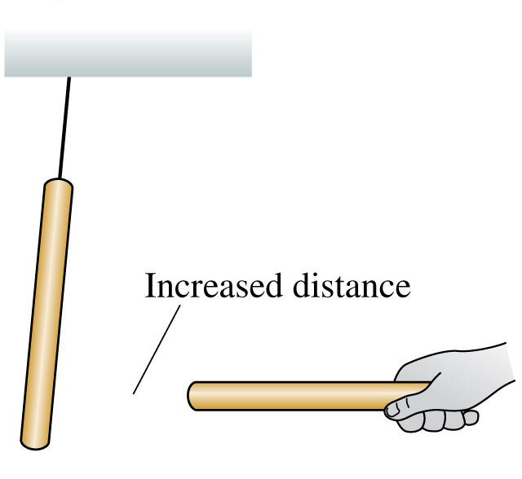
Discovering Electricity: Experiment 4 Conclusion
The force between two charged objects depends on the distance between them; the greater the distance, the less the force.

Slide 20
Discussion Question
Hang a neutral object from a string.
Rub a glass rod with silk, and place it near the hanging object.
What will happen?
Neutral Object
Nothing: no force observed
The hanging object will be repelled, and move to the left
The hanging object will be attracted, and move to the right

Slide 21
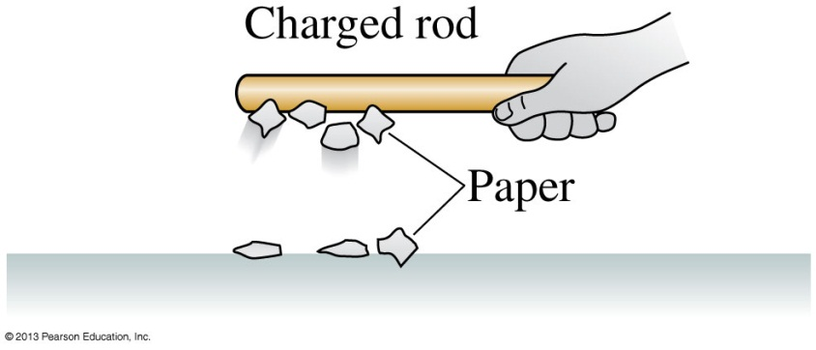
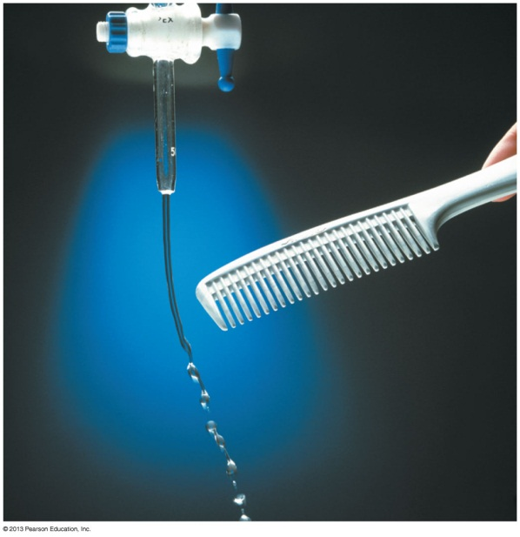
Discovering Electricity: Experiment 5 Conclusion
Neutral pieces of paper leap up and stick to a charged glass rod.
A neutral stream of water bends toward a charged plastic comb.
There is an attractive force between a charged object and a neutral (uncharged) object.

Slide 22
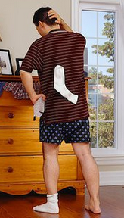
In Class Discussion Question
A sock has just come out of the dryer. You hypothesize that the sock might have a positive charge.
To test your hypothesis, which of the following experiments would work?
See if the sock attracts a negatively charged plastic rod.
See if the sock repels a positively charged glass rod.
Either A or B would work.
(Compare with Stop To Think 25.1 from your reading.)
Notes:
STT25.1
Answer: B

Slide 23
Charge Polarization

Slide 24
Charge Polarization
When two small electrically charged objects are brought together, opposites attract and sames repel.
When the objects have finite size and one of them is neutral or has very little charge on it, it will become polarized.
The resulting force is always attractive. Both positive and negative objects tend to attract neutral objects due to charge polarization.

Slide 25
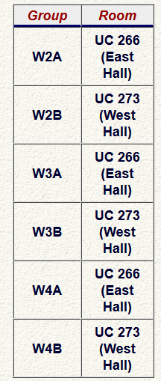
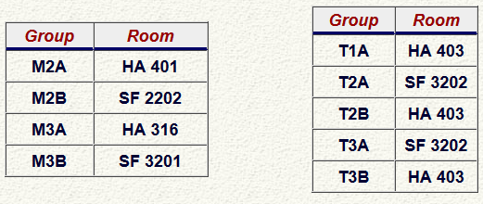
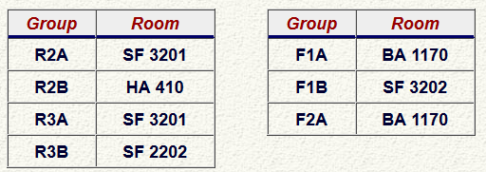
Test 1 is Tuesday Feb. 4th from 6:00-7:30pm.
Room is based on your Practical Group.

Slide 26
Announcement
Test 1 is Tuesday Feb. 4th from 6:00-7:30pm.
It’s not too late to register for the alternate sitting if you have a time-conflict.
The alternate sitting will be from 4:30-6:00pm on Tuesday Feb. 4th
To register, students should submit the Alternate Sitting Registration Form, available now in the PHY132S Portal course menu.
The location will be emailed on Jan. 31 to the people who have registered.
You have until Jan. 30 (tomorrow!) at 4:00pm to do it (the form will not be available after).

Slide 27
What will Tuesday evening’s test cover?
Test 1 is on:
Knight Chs. 20, 21, 23, 24 and 25 .
The midterm test will have:
8 multiple-choice questions
2 unrelated long-answer problems counting for a total of 16 marks, which will be graded in detail; part marks may be awarded, but only if you show your work.

Slide 28
Test 1 on Tuesday Evening
Please bring:
Your student card.
A calculator without any communication capability.
A single, original, handwritten 8 1/2 × 11 inch sheet of paper on which you may have written anything you wish, on both sides. You may also type it if you wish, but it must be prepared by you. No photocopies.
A ruler

Slide 29
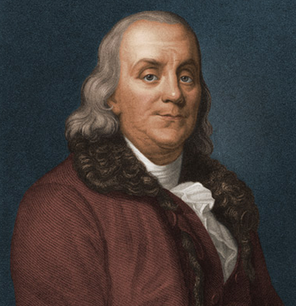
Benjamin Franklin (1706-1790)
Recognized that there were two types of electric charge.
When a glass rod was rubbed with silk, it became charged in one way; Franklin called this “positive”
When a piece of amber was rubbed with animal fur, it became charged in the opposite way; Franklin called this “negative”.

Slide 30
Electric Force
When two objects have electric charges, there is a long-range force between them called the electric force.
The rule for the electric force is:
Opposite charges attract one another;
like charges repel.

Slide 31
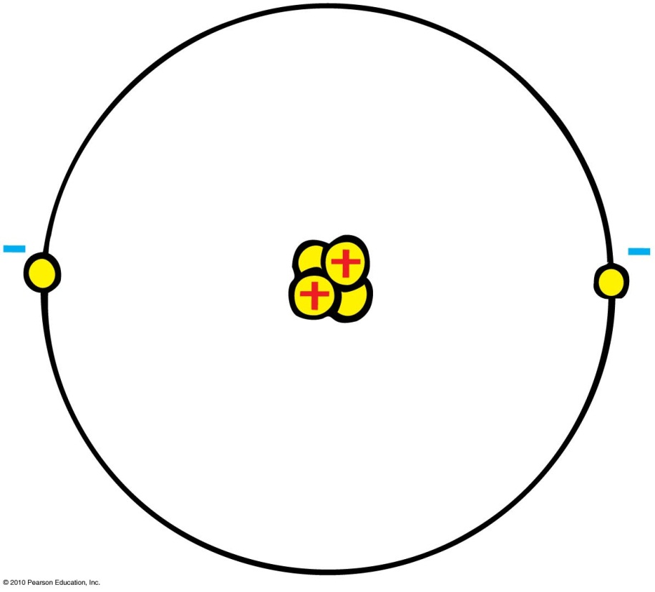
20th Century Discovery: Atomic Structure
Protons
Positive electric charges
Repel positives, but attract negatives
Electrons
Negative electric charges
Repel negatives, but attract positives
Neutrons
No electric charge
“neutral”

Slide 32
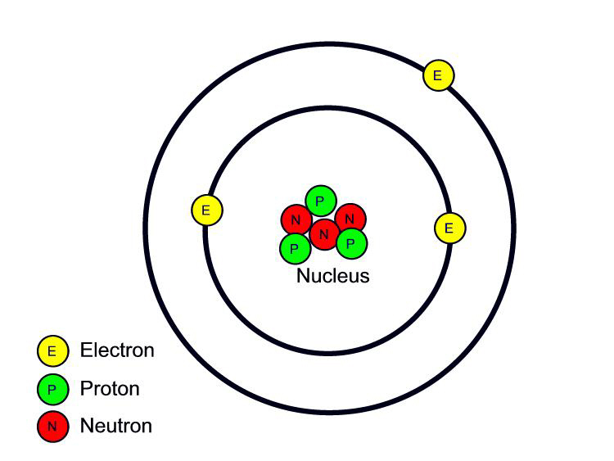
Fundamental facts about atoms
1. Every atom is composed of a positively charged nucleus surrounded by negatively charged electrons.
2. Each of the electrons in any atom has the same quantity of negative charge and the same mass.
Lithium Atom
Net charge = 0
[Image retrieved Jan.10, 2013 from http://www.safetyoffice.uwaterloo.ca/hse/radiation/rad_sealed/matter/atom_structure.htm ]

Slide 33
Fundamental facts about atoms
3. Protons and neutrons compose the nucleus. Protons are about 1800 times more massive than electrons, but each one carries an amount of positive charge equal to the negative charge of electrons. Neutrons have slightly more mass than protons and have no net charge.
Lithium Atom
Net charge = 0
[Image retrieved Jan.10, 2013 from http://www.safetyoffice.uwaterloo.ca/hse/radiation/rad_sealed/matter/atom_structure.htm ]

Slide 34
Fundamental facts about atoms
4. Atoms usually have as many electrons as protons, so the atom has zero net charge.
Lithium Atom
Net charge = 0
[Image retrieved Jan.10, 2013 from http://www.safetyoffice.uwaterloo.ca/hse/radiation/rad_sealed/matter/atom_structure.htm ]

Slide 35
An “Ion” is a charged atom
Positive ion — an atom which has lost one or more of its electrons, and so has a positive net charge.
Negative ion — an atom which has gained one or more electrons, and so has a negative net charge.

Slide 36
When you rub a glass rod with silk, the glass rod becomes positively charged. (As per Benjamin Franklin’s definition of “positive”.) What is going on here?
Electric Force and Charges
CHECK YOUR NEIGHBOR
The silk is adding electrons to the glass.
The silk is adding protons to the glass.
The silk is removing electrons from the glass.
The silk is removing protons from the glass.
The frictional force is generating positive charge within the glass.
Notes:
A. positive.

Slide 37
When you rub a plastic rod with fur or wool, the plastic rod becomes negatively charged. (As per Benjamin Franklin’s definition of “negative”.) What is going on here?
Electric Force and Charges
CHECK YOUR NEIGHBOR
The fur or wool is adding electrons to the plastic.
The fur or wool is adding protons to the plastic.
The fur or wool is removing electrons from the plastic.
The fur or wool is removing protons to the plastic.
The frictional force is generating positive charge within the plastic.
Notes:
A. positive.

Slide 38
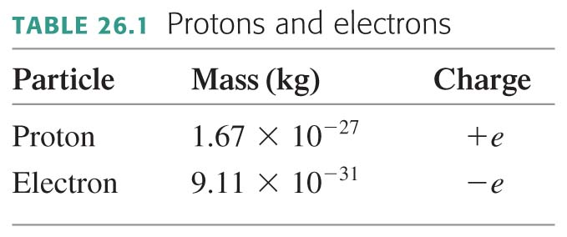
Any object has net charge, q:
where N_{p} and N_{e} are the number of protons and electrons contained in the object.
The process of removing or adding an electron from the electron cloud of an atom is called ionization.
An atom with fewer electrons than protons is called a positive ion. An atom with more electrons than protons is called a negative ion.

Slide 39
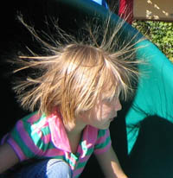
Electrons in an atom
Innermost—attracted very strongly to oppositely charged atomic nucleus
Outermost—attracted loosely and can be easily dislodged
Examples:
When rubbing a comb through your hair, electrons transfer from your hair to the comb. Your hair has a deficiency of electrons (positively charged).
When rubbing a glass rod with silk, electrons transfer from the rod onto the silk and the rod becomes positively charged.
[image from http://www.sciencebuddies.org/blog/2011/02/the-shock-of-static-electricity.php ]

Slide 40
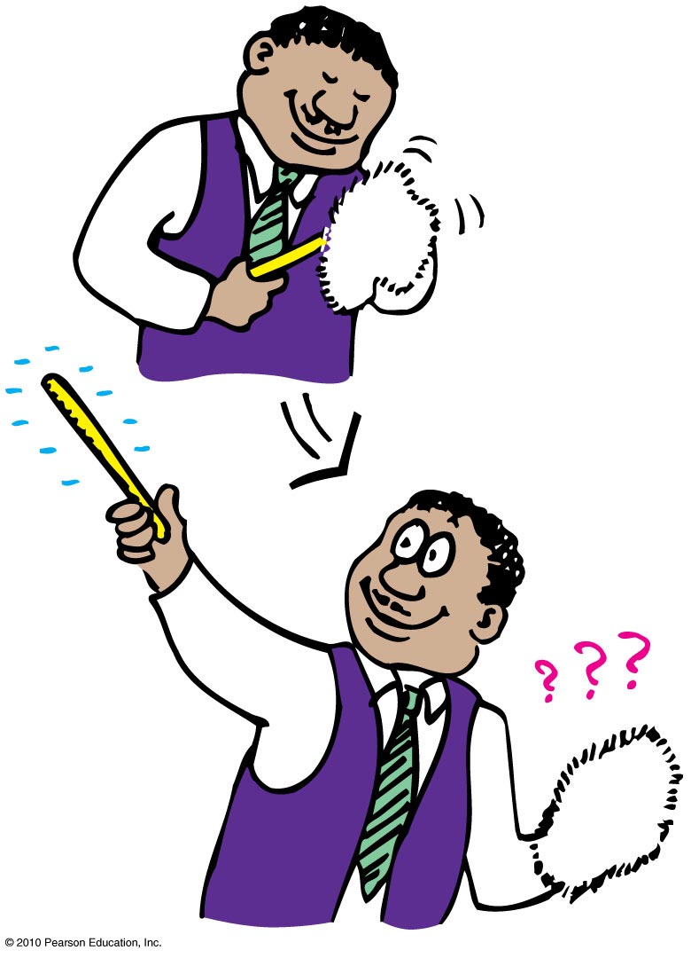
Conservation of Charge
In any charging process, no electrons are created or destroyed. Electrons are simply transferred from one material to another.

Slide 41
Recall: Discovering Electricity: Experiment 4
The force between two charged objects depends on the distance between them.

Slide 42
Coulomb’s Law
$$q_{1}$$
$$d$$
$$q_{2}$$
The magnitude of the force, F, between two point charges depends on the product of their charges, and the distance between them.
In equation form:
k = 9×10⁹ Nm²/C²
Unit of charge is coulomb, C
Similar to Newton’s law of gravitation for masses
Underlies the bonding forces between molecules
Electrical forces may be either attractive or repulsive.
Gravitational forces are only attractive.
$$F=k\frac{q_{1}q_{2}}{d^{2}}$$

Slide 43
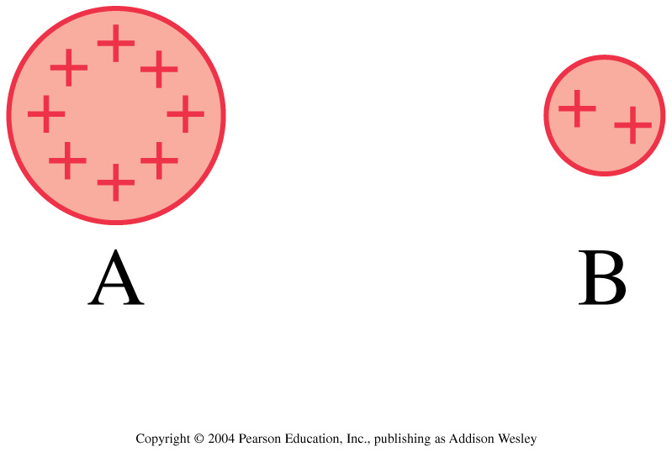
Discussion question.
Charges A and B exert repulsive forces on each other. q_{A} = 4q_{B}. Which statement is true?
F_{A on B} > F_{B on A}
F_{A on B} < F_{B on A}
F_{A on B} = F_{B on A}
Notes:
STT25.4

Slide 44
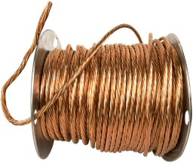
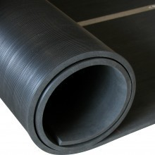
Conductors and Insulators
Conductors: Materials in which one or more of the electrons in the outer shell of its atoms are not anchored to the nuclei of particular atoms but are free to wander in the material
Example: Metals such as copper and aluminum
Insulators: Materials in which electrons are tightly bound and belong to particular atoms and are not free to wander about among other atoms in the material, making them flow
Example: Rubber, glass

Slide 45
When you buy a water pipe in a hardware store, the water isn’t included. When you buy copper wire, electrons
Conductors and Insulators
CHECK YOUR NEIGHBOR
A. must be supplied by you, just as water must be supplied for a water pipe.
are already in the wire.
may fall out, which is why wires are insulated.
None of the above.
Notes:
B. are already in the wire.

Slide 46
Before Class 9 on Monday
Problem Set 3 on MasteringPhysics due Sunday at 11:59pm, Chs. 24, 25
For Monday please read Pgs. 736-756
Ch. 25, section 25.5 Ch. 26, sections 26.1 and 26.2
Please do the short pre-class quiz on MasteringPhysics by Monday morning.
Something to think about: What is the electric field? Is it real, or is just something that people made up?

