Slide 1
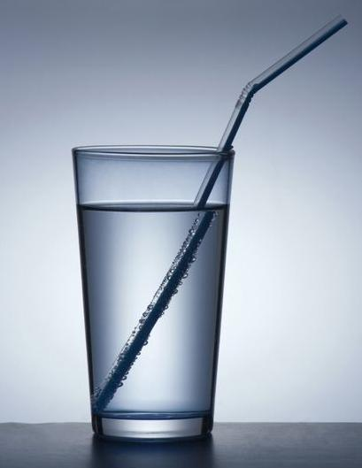
PHY132 Introduction to Physics II
Class 6 – Outline:
Ch. 23, sections 23.1-23.5
Reflection
Refraction
Total Internal Reflection
Image Formation
Colour and Dispersion
http://physics.tutorvista.com/light/index-of-refraction.html

Slide 2
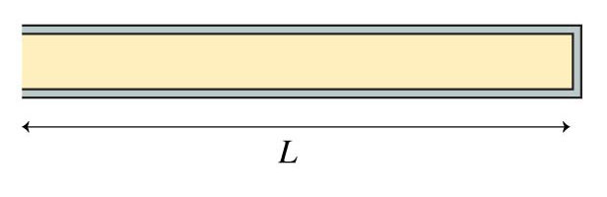
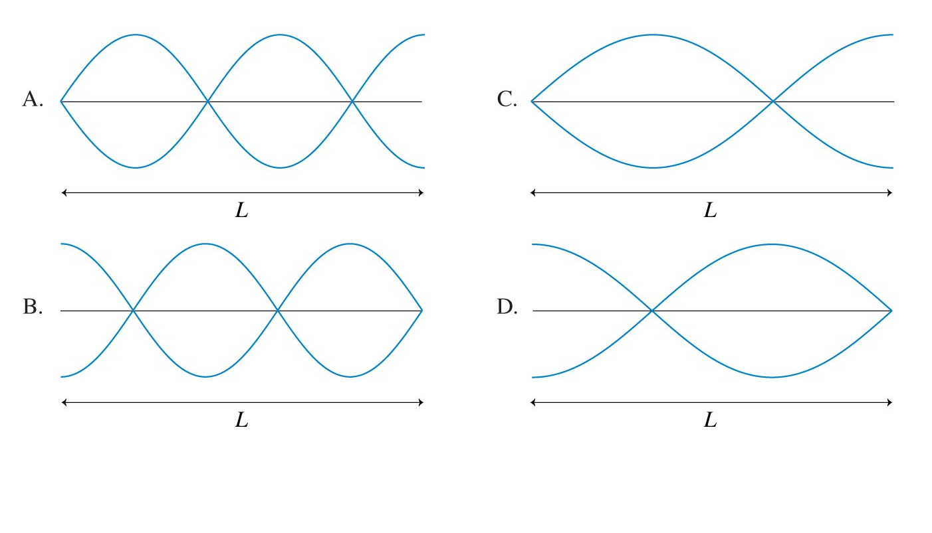
Review Clicker Question!! Do you remember?
An open-closed tube of air of length L has the closed end on the right. Which is the displacement graph of the m = 5 standing wave in this tube?
Notes:
2

Slide 3
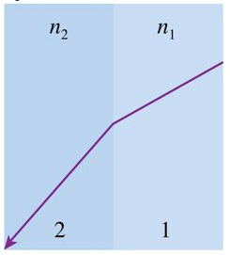
Class 6 Preclass Quiz on MasteringPhysics
This was due this morning at 8:00am
636 students submitted the quiz on time
94% got:“Specular Reflection” is reflection by a flat, smooth object. The “law of reflection” is obeyed.
69% got: “Dispersion” is when the index of refraction varies slightly with wavelength.
59% of students got: Whenever the ray bends away from the normal, it means the waves are speeding up. That means n₂ < n₁.
65% got: there is only a critical angle (for possible total internal reflection) when n₂ < n₁.

Slide 4
Class 6 Preclass Quiz – Student Comments…
“curious to whether total internal reflection can work for other rays aside from the visible light spectrum.”
Harlow answer: Yes! In fact, that is how X-ray telescopes work. The speed of X-rays in glass is actually slightly higher than in a vacuum, so when X-rays are incident at a grazing angle, you can make them reflect.
“Can you tell if a surface will have more reflection vs refraction?”
Harlow answer: Yes, but it’s beyond the scope of this course (it’s called “Fresnel Equations” if you want to wiki it..)

Slide 5
Class 6 Preclass Quiz – Student Comments…
“What is the difference between delta phi naught and delta phi? I know that delta phi naught is the phase difference of the sources and delta phi is the phase difference of the waves, but what does that mean conceptually?”
Harlow answer: "phase" ϕ is the argument of the sine or cosine function.
So, for the wave equation, ϕ = kx −ωt + ϕ₀. Every time ϕ changes by an integer multiple of 2π, the wave returns to the same state.
I think on a practicals problem sheet during the first week there was a typo, refering to ϕ₀ as the "phase". That is more properly called the "phase constant". It is one of the four constants that describe a sinusoidal wave: A, k, ω and ϕ₀.

Slide 6
Where to get help
Your classmates: go on Piazza.com, form a study group, hang out in MP125, etc
Your two graduate student TAs. Learn their email address, office hours, and office location.
Me. After class + MP121B office hours are T12, F10, email [Note I am away Friday Jan.23]
Professor Meyertholen, MP129A office hours are M2, F11-12
The Physics Drop-In Centre in MP125, back corner MTWR 12-3, F11-2
Academic Success Centre in Koffler 1st floor, inside the Career Centre

Slide 7
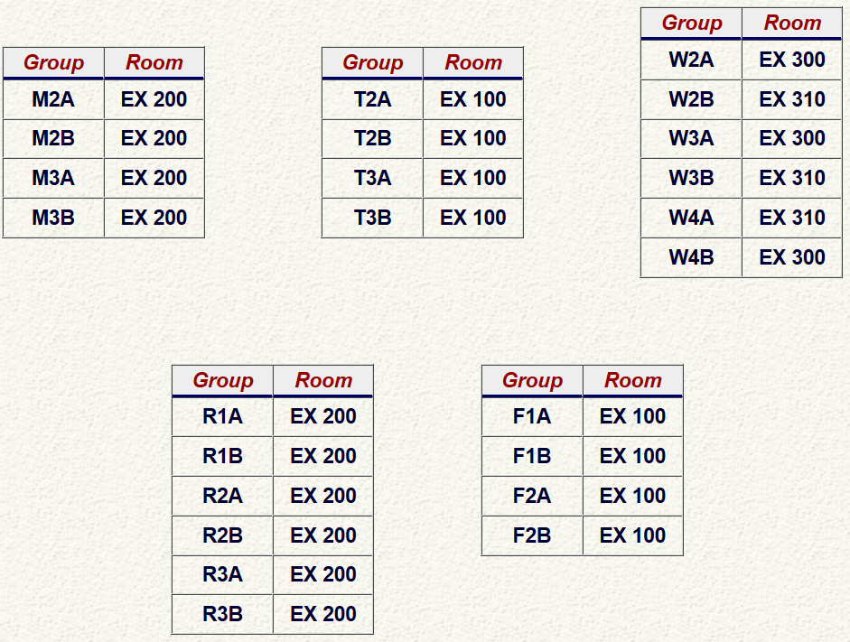
Announcement
Test 1 is Tuesday Jan. 27th from 6:00-7:30pm.
Room is based on your Practicals group

Slide 8
Announcement
Test 1 is Tuesday Jan. 27th from 6:00-7:30pm.
If you have a conflict with the regular sitting, the alternate sitting will be from 4:30-6:00pm on Tuesday Jan. 27th
  To register, students should submit the Alternate Sitting Registration Form, available now in the PHY132S Portal course menu.
  The location will be emailed no later than Jan. 26 to the people who have registered.
  You have until Jan. 22 at 4:00pm to do it (the form will not be available after).
There are only two sittings – you must attend one or the other!

Slide 9
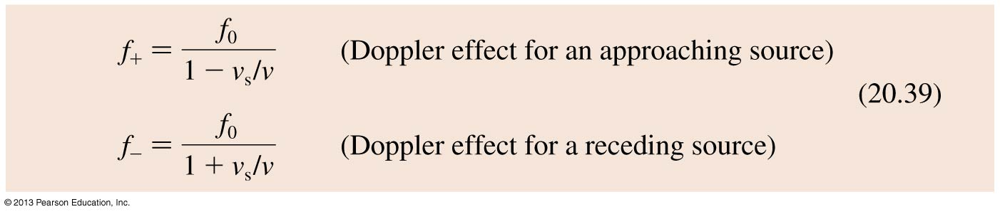
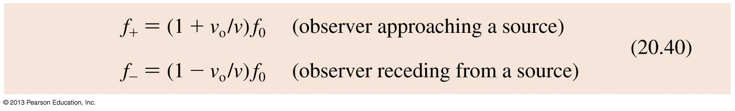
Review: The Doppler Effect
The frequencies heard by a stationary observer when the sound source is moving at speed v₀ are
The frequencies heard by an observer moving at speed v₀ relative to a stationary sound source emitting frequency f₀ are

Slide 10
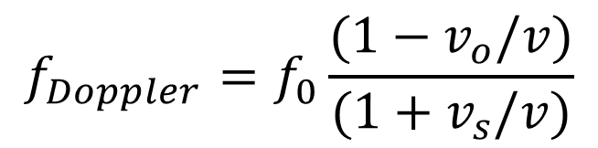
Review: The Doppler Effect
If both the source, and the observer are moving, you have to combine these equations.
The general equation is:
$$f_{Doppler}=f_{0}\frac{(1−v_{o}/v)}{(1+v_{s}/v)}$$
Here you must use the sign convention that v_{s} is positive if the source is receding and negative if the source is approaching.
Also v_{o} is positive if the observer is receding from the source, and negative if the observer is approaching the source.

Slide 11
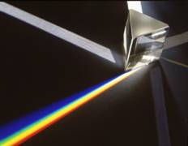
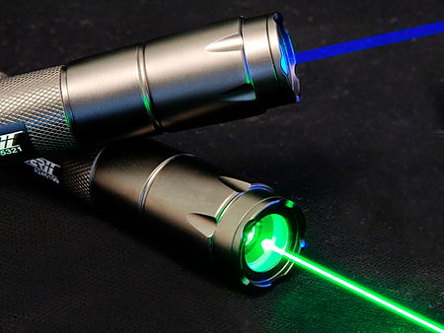
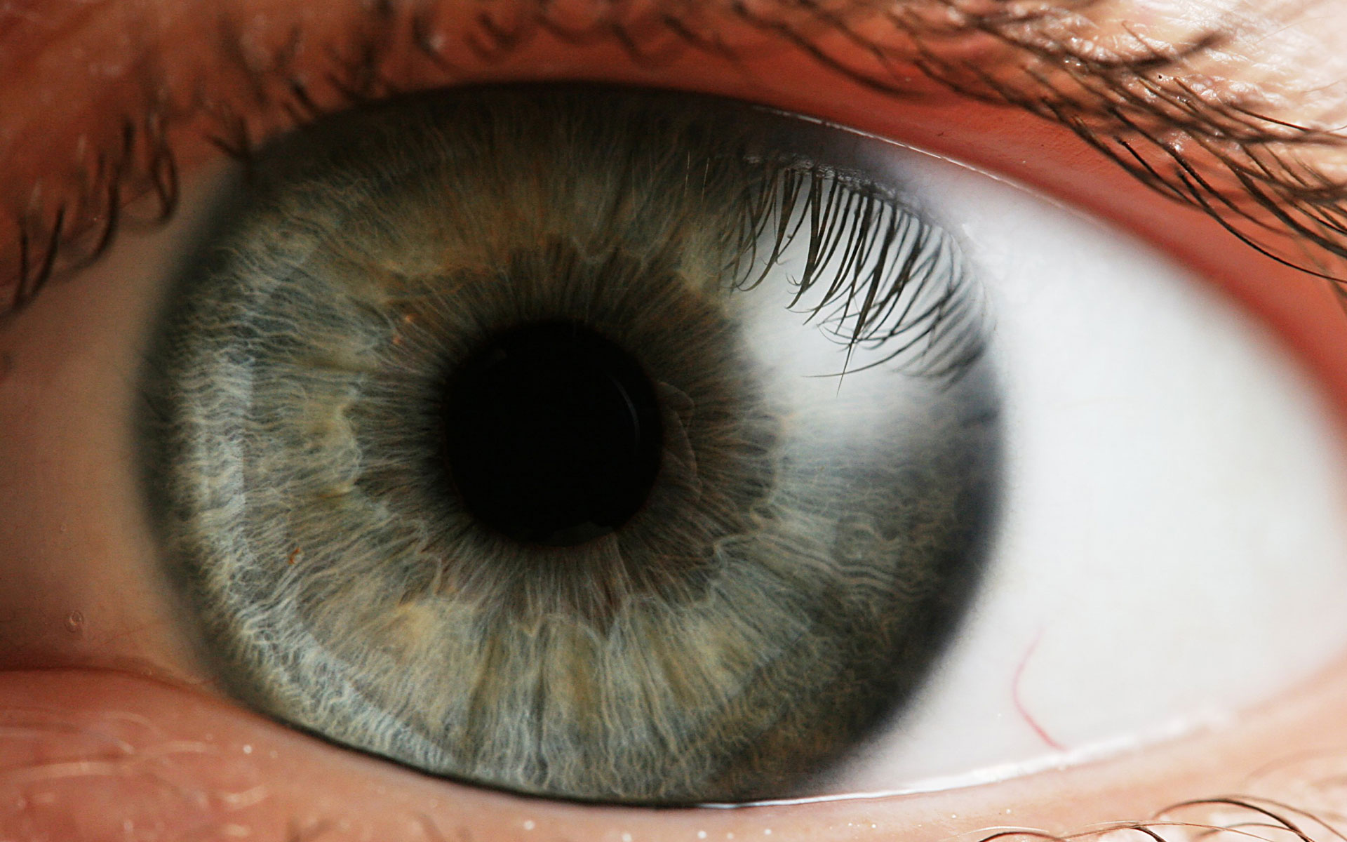
What is light?
Light is an electromagnetic wave – and is highly useful in our everyday life!

Slide 12
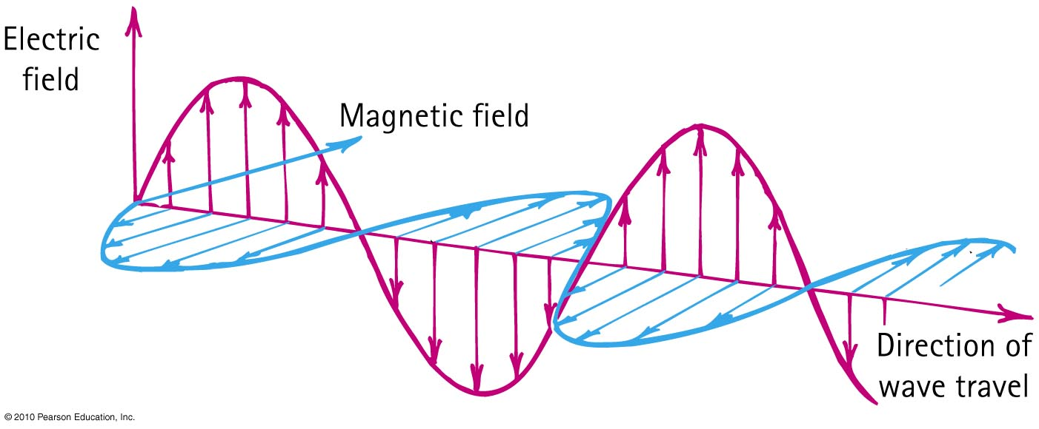
Electromagnetic Waves
The electric and magnetic fields of an electromagnetic wave are perpendicular to each other and to the direction of motion of the wave.

Slide 13
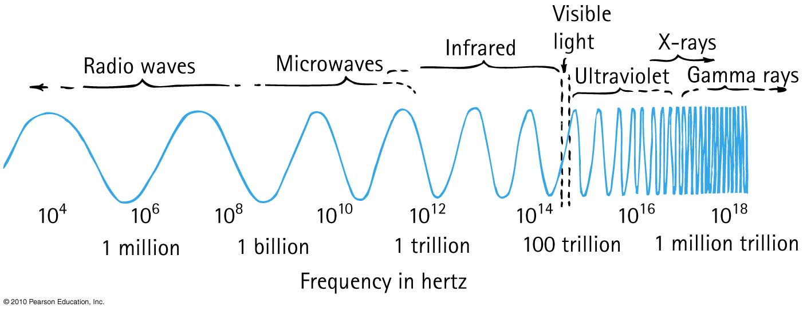
Electromagnetic Spectrum
In a vacuum, all electromagnetic waves move at the same speed
We classify electromagnetic waves according to their frequency (or wavelength)
Light is one kind of electromagnetic wave

Slide 14
If a certain material is “transparent” (ie, not opaque), what does this mean?
Electromagnetic Waves
CHECK YOUR NEIGHBOUR
Electromagnetic waves of all frequencies can pass straight through it
Electromagnetic waves of all frequencies are reflected from its surface
Electromagnetic waves of all frequencies are absorbed throughout its volume
Electromagnetic waves of a certain frequency can pass straight through it

Slide 15
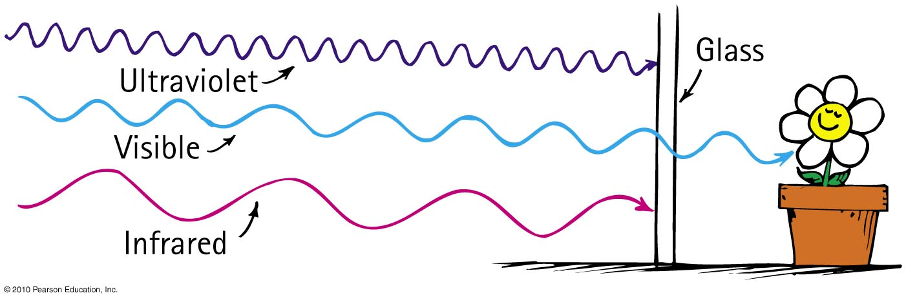
Transparent Materials
Glass blocks both infrared and ultraviolet, but it is transparent to visible light.

Slide 16
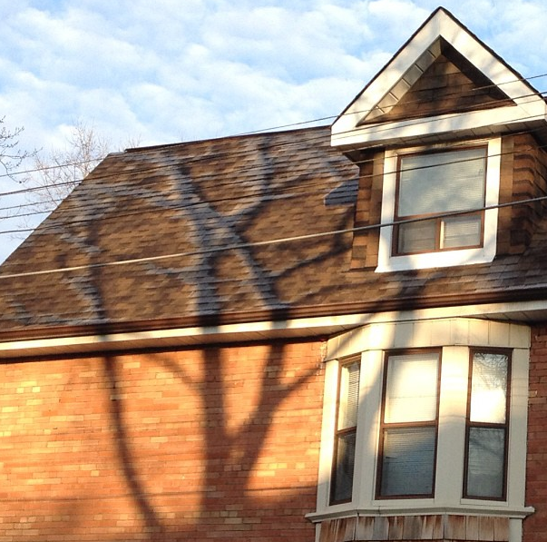
Opaque Materials
Most things around us are opaque—they absorb light without re-emitting it.
Vibrations given by light to their atoms and molecules are turned into random kinetic energy—into internal energy.
These materials become slightly warmer.

Slide 17
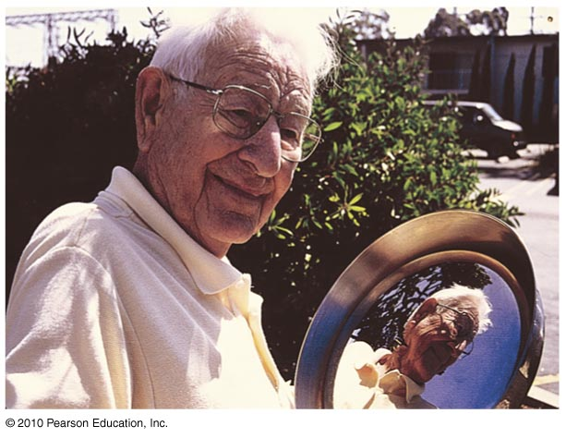
Opaque Materials
Metals
Light shining on metal forces free electrons in the metal into vibrations that emit their own light as reflection.

Slide 18
Which reflects more light, a white piece of paper or a black piece of paper?
Reflection
CHECK YOUR NEIGHBOUR
Black
White
About the same

Slide 19
Which reflects more light, a white piece of paper or a mirror?
Reflection
CHECK YOUR NEIGHBOUR
White Paper
Mirror
About the same

Slide 20
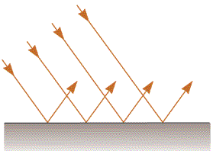
Specular Reflection
Mirrors
The surface is flat at distance scales near or above the wavelength of light
It looks “shiny”, and you can see images in it.

Slide 21
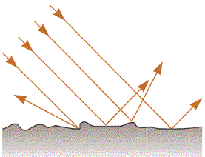
Diffuse Reflection
White Paper
The surface is rough at distance scales near or above the wavelength of light
Almost all surfaces reflect in this way!

Slide 22
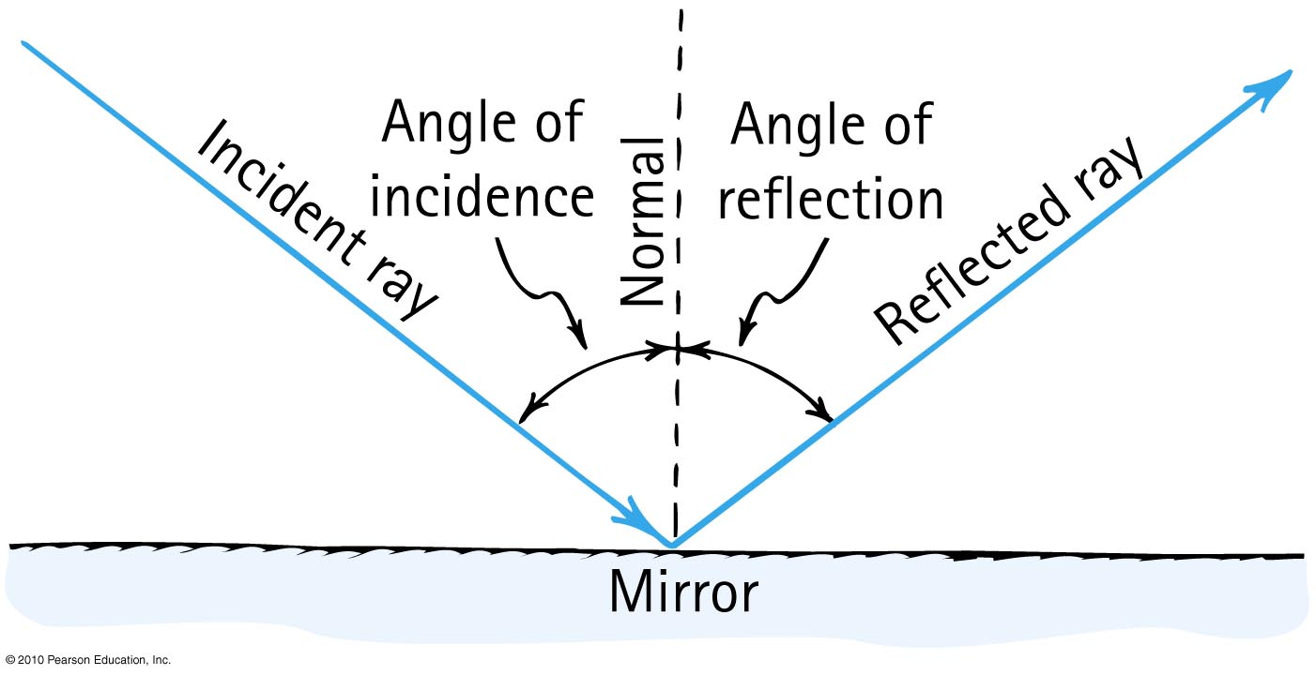
Law of Specular Reflection
The angle of reflection equals the angle of incidence.

Slide 23
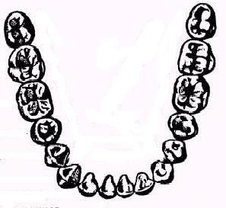
A dentist uses a mirror to look at the back of a second molar (A).
Next, she wishes to look at the back of a lateral incisor (B), which is 90° away.
By what angle should she rotate her mirror?
Mirror
A
B
A. 90°
B. 45°
C. 180°

Slide 24
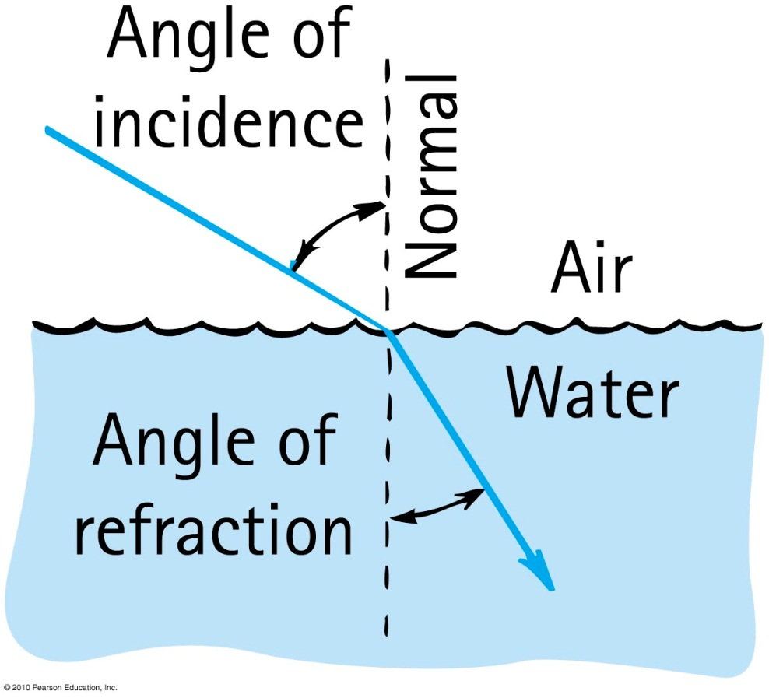
Refraction
When light bends in going obliquely from one medium to another, we call this process refraction.

Slide 25
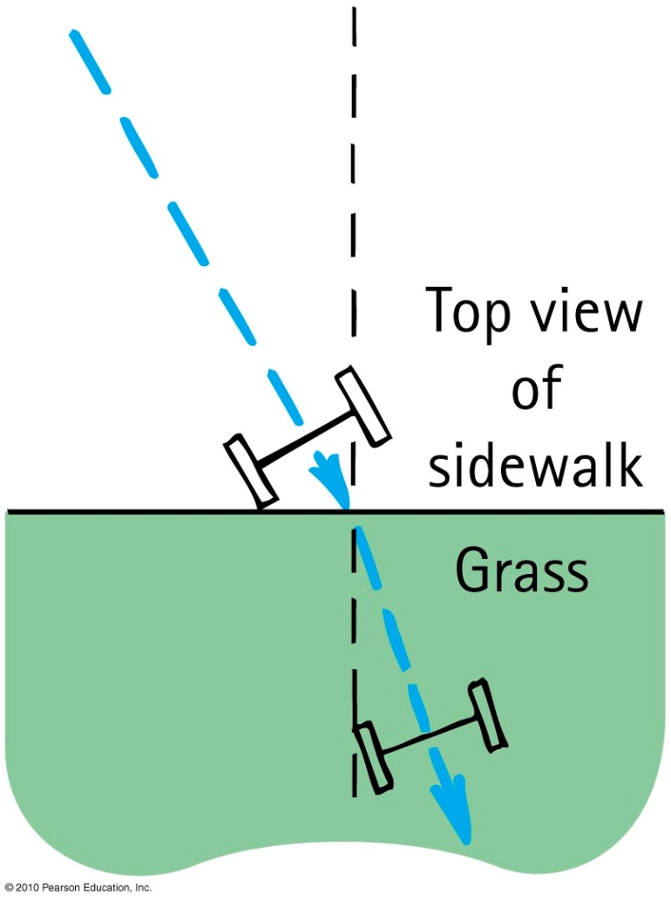
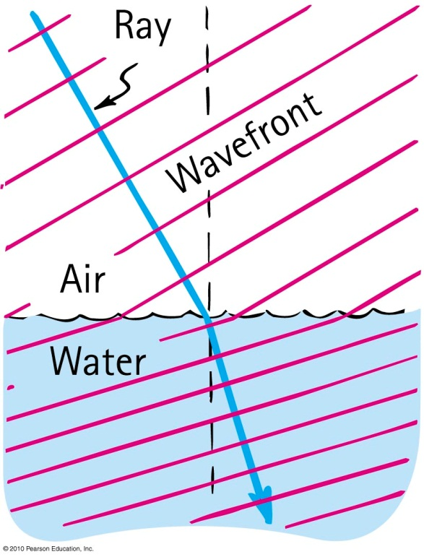
Cause of Refraction
Bending of light when it passes from one medium to another
Caused by change in speed of light

Slide 26

1
A soldier wants to get from point 1 to Point 2 in the shortest amount of time. Marching through mud is much slower than marching on dry land. Which might be the best path?
Dry Land
C
A
B
Mud
Dry Land
2

Slide 27
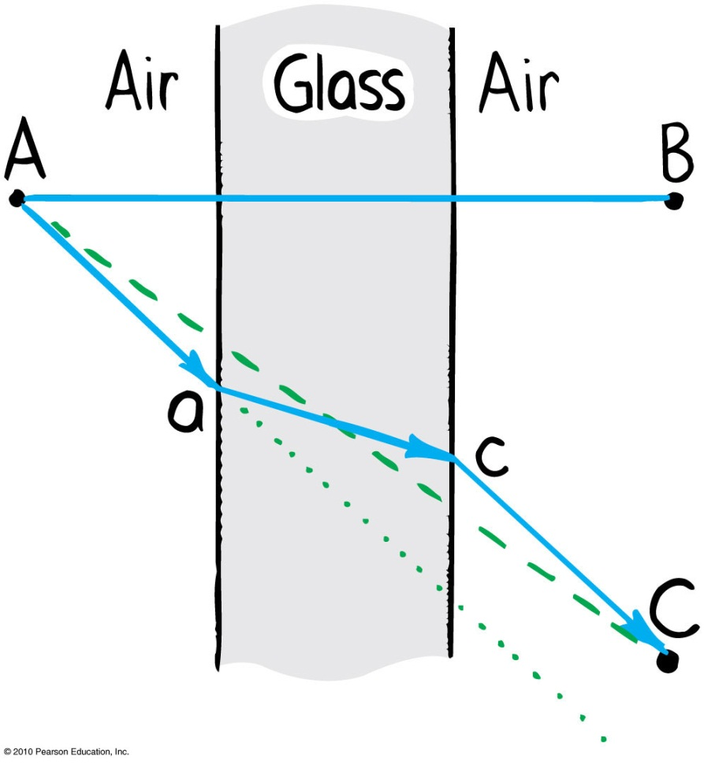
Refraction
  Light travels slower in glass than in air, so it minimizes the time it spends in the glass.

Slide 28
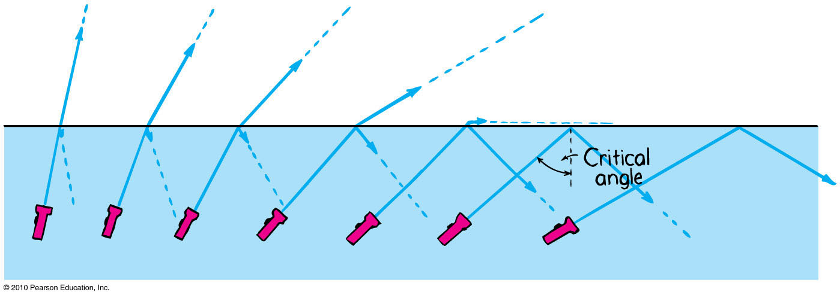
Total Internal Reflection
Total reflection of light traveling within a medium that strikes the boundary of another medium at an angle at, or greater than, the critical angle

Slide 29
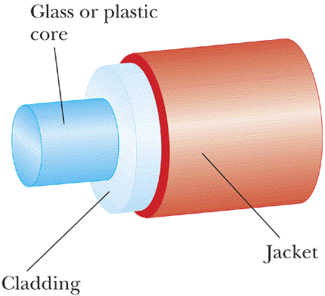
An Optical Fibre
Speed of light in cladding is higher than speed of light in core.

Slide 30
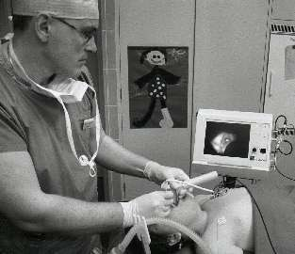
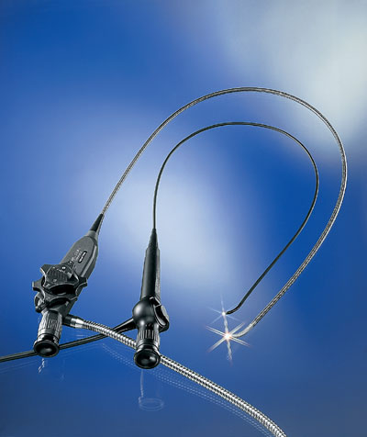
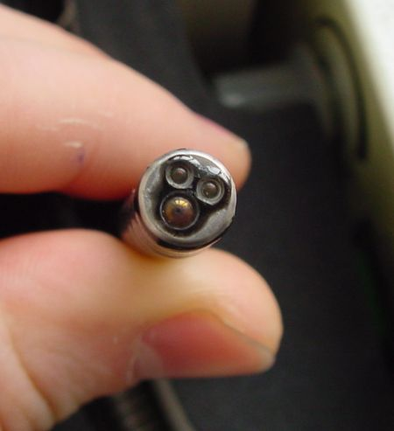
Medical Fibrescopes
Video-laryngoscopy with a flexible fiberscope

Slide 31
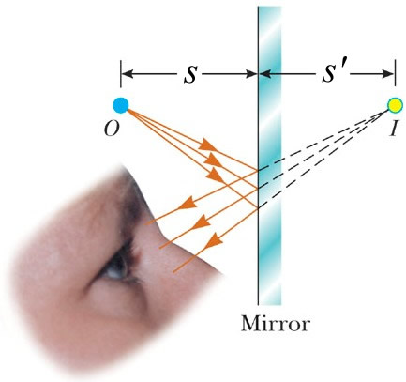
Virtual Image Formation
No light rays actually pass through or even near the image, so it is “virtual”.

Slide 32
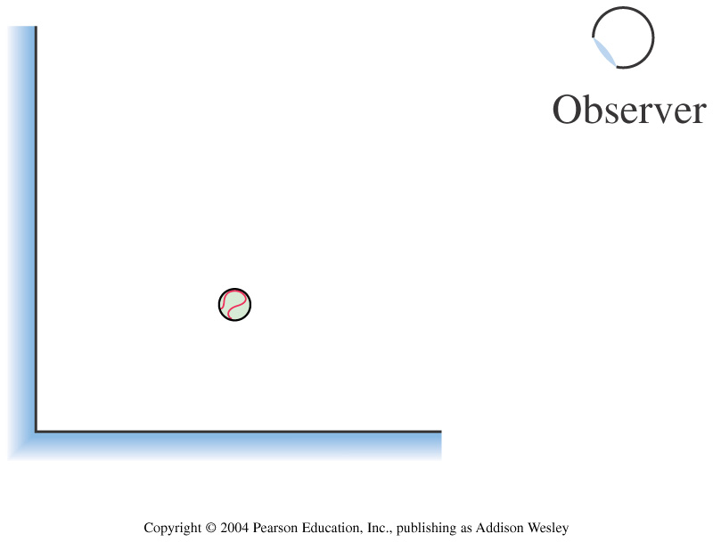
Two plane mirrors form a right angle. How many images of the ball can the observer see in the mirrors?
1
2
3
4

Slide 33
air
water
A fish swims below the surface of the water. An observer sees the fish at:
A. a greater depth than it really is.
B. its true depth.
C. a smaller depth than it really is.

Slide 34
air
water
A fish swims directly below the surface of the water. An observer sees the fish at:
A. a greater depth than it really is.
B. its true depth.
C. a smaller depth than it really is.

Slide 35
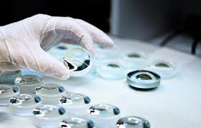
Before Class 7 on Monday
Please read Knight Pgs. 670-686: Ch. 23, sections 23.6-23.8
Don’t forget Problem Set 2 due on Sunday night!
Something to think about: What is the difference between a converging and diverging lens? Which type can be used to focus sunlight onto a piece of paper and burn a hole?

