Slide 1
PHY132 Introduction to Physics II Class 8 – Outline:
Ch. 25, sections 25.1-25.4
Developing a Charge Model
Electric Charge
Insulators and Conductors
Coulomb's Law
[Photo by David He Aug. 9, 2009. http://www.flickr.com/photos/davidymhe/3809482563/ ]

Slide 2
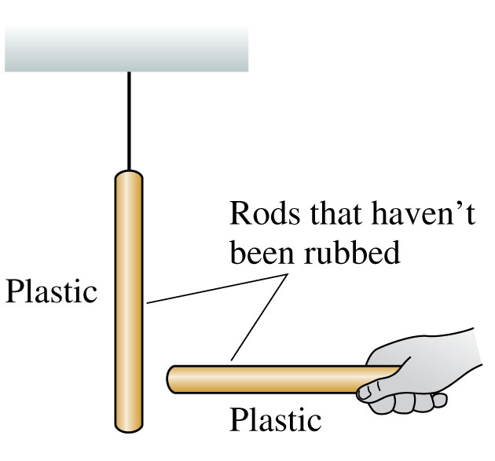
Discovering Electricity: Experiment 1
Take a plastic rod that has been undisturbed for a long period of time and hang it by a thread.
Pick up another undisturbed plastic rod and bring it close to the hanging rod.
Nothing happens to either rod.
No forces are observed.
We will say that the original objects are neutral.

Slide 3
Discussion Question
Rub two plastic rods with wool.
Hang one from a string
Place the other near it.
What will happen?
Nothing: no force observed
The hanging rod will be repelled, and move to the left
The hanging rod will be attracted, and move to the right

Slide 4
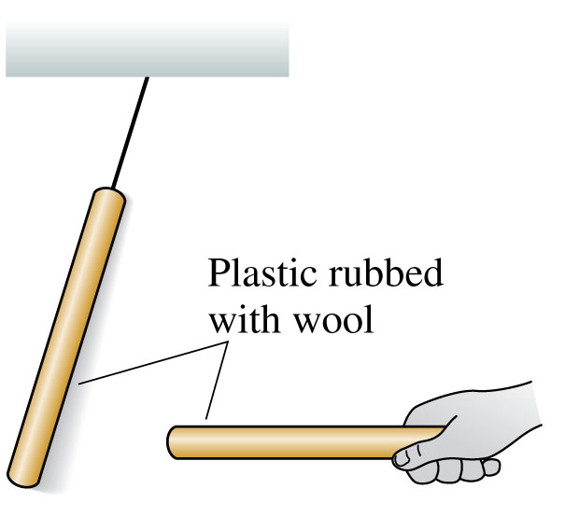
Discovering Electricity: Experiment 2 Conclusion
There is a long-range repulsive force, requiring no contact, between two identical objects that have been charged in the same way.

Slide 5
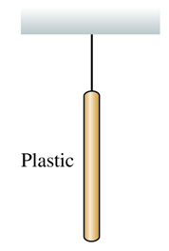
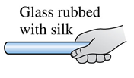
Discussion Question
Rub a plastic rod with wool, and hang it from a string.
Rub a glass rod with silk, and place it near the hanging rod.
What will happen?
Nothing: no force observed
The hanging rod will be repelled, and move to the left
The hanging rod will be attracted, and move to the right

Slide 6
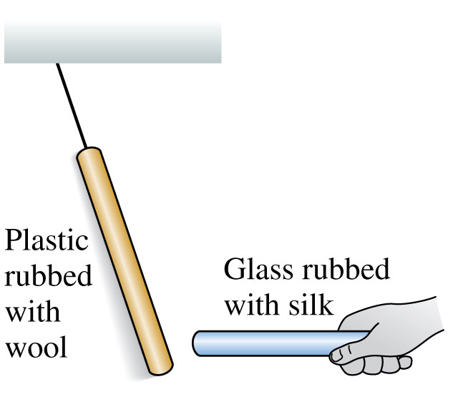
Discovering Electricity: Experiment 3 Conclusion
These particular two types of rods are different materials, charged in a somewhat different way, and they attract each other rather than repel.

Slide 7
Discussion Question
Rub two plastic rods with wool, hang one from a string, place the other near it so it repels the hanging rod.
What happens if you increase the distance between the two rods?
Nothing: no change in force
The repulsive force will decrease
The repulsive force will increase

Slide 8
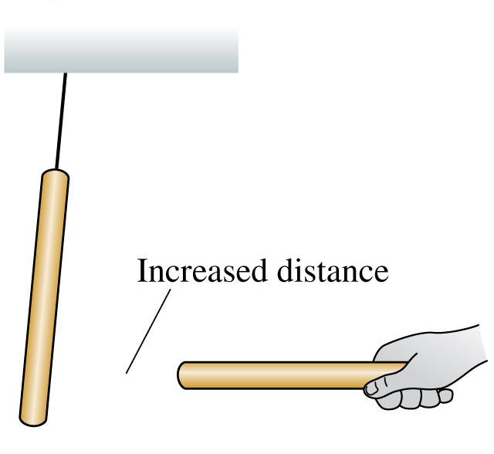
Discovering Electricity: Experiment 4 Conclusion
The force between two charged objects depends on the distance between them; the greater the distance, the less the force.

Slide 9
Discussion Question
Hang a neutral object from a string.
Rub a glass rod with silk, and place it near the hanging object.
What will happen?
Neutral Object
Nothing: no force observed
The hanging object will be repelled, and move to the left
The hanging object will be attracted, and move to the right

Slide 10
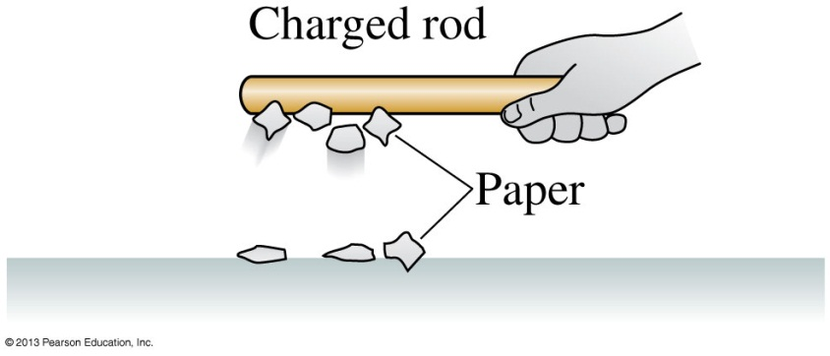
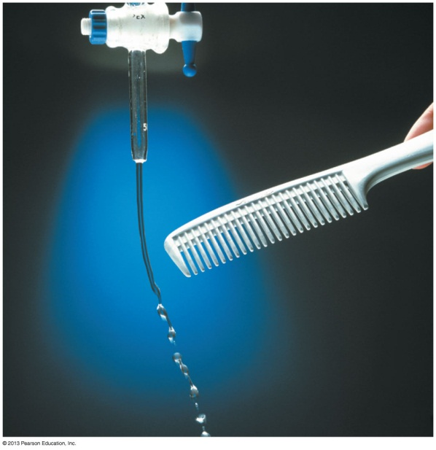
Discovering Electricity: Experiment 5 Conclusion
Neutral pieces of paper leap up and stick to a charged glass rod.
A neutral stream of water bends toward a charged plastic comb.
There is an attractive force between a charged object and a neutral (uncharged) object.

Slide 11
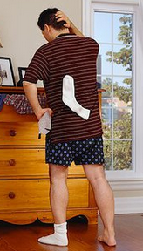
In Class Discussion Question
A sock has just come out of the dryer. You hypothesize that the sock might have a positive charge.
To test your hypothesis, which of the following experiments would work?
See if the sock attracts a negatively charged plastic rod.
See if the sock repels a positively charged glass rod.
Either A or B would work.
(Compare with Stop To Think 25.1 from your reading.)
Notes:
STT25.1
Answer: B

Slide 12
Charge Polarization

Slide 13
Charge Polarization
When two small electrically charged objects are brought together, opposites attract and sames repel.
When the objects have finite size and one of them is neutral or has very little charge on it, it will become polarized.
The resulting force is always attractive. Both positive and negative objects tend to attract neutral objects due to charge polarization.

Slide 14
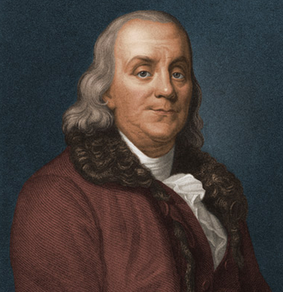
Benjamin Franklin (1706-1790)
Recognized that there were two types of electric charge.
When a glass rod was rubbed with silk, it became charged in one way; Franklin called this “positive”
When a piece of amber was rubbed with animal fur, it became charged in the opposite way; Franklin called this “negative”.

Slide 15
Electric Force
When two objects have electric charges, there is a long-range force between them called the electric force.
The rule for the electric force is:
Opposite charges attract one another;
like charges repel.

Slide 16
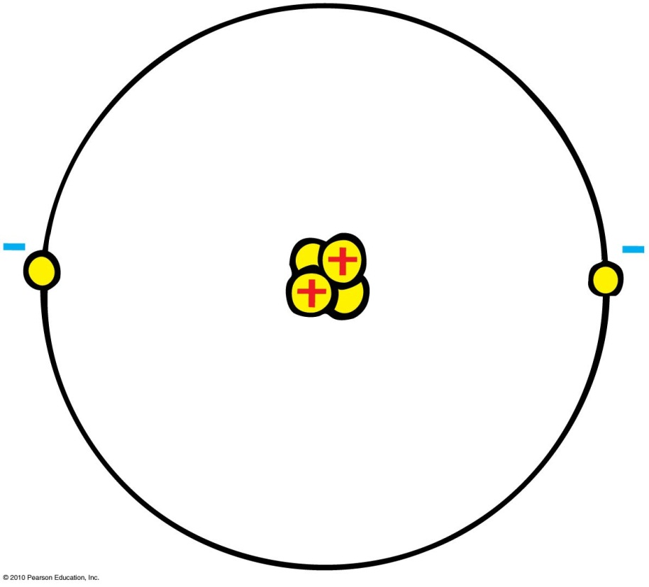
20th Century Discovery: Atomic Structure
Protons
Positive electric charges
Repel positives, but attract negatives
Electrons
Negative electric charges
Repel negatives, but attract positives
Neutrons
No electric charge
“neutral”

Slide 17
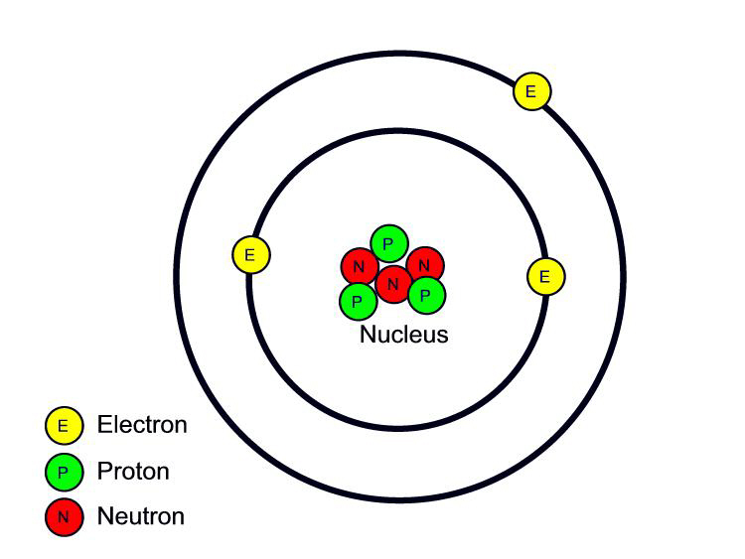
Fundamental facts about atoms
1. Every atom is composed of a positively charged nucleus surrounded by negatively charged electrons.
2. Each of the electrons in any atom has the same quantity of negative charge and the same mass.
Lithium Atom
Net charge = 0
[Image retrieved Jan.10, 2013 from http://www.safetyoffice.uwaterloo.ca/hse/radiation/rad_sealed/matter/atom_structure.htm ]

Slide 18
Fundamental facts about atoms
3. Protons and neutrons compose the nucleus. Protons are about 1800 times more massive than electrons, but each one carries an amount of positive charge equal to the negative charge of electrons. Neutrons have slightly more mass than protons and have no net charge.
Lithium Atom
Net charge = 0
[Image retrieved Jan.10, 2013 from http://www.safetyoffice.uwaterloo.ca/hse/radiation/rad_sealed/matter/atom_structure.htm ]

Slide 19
Fundamental facts about atoms
4. Atoms usually have as many electrons as protons, so the atom has zero net charge.
Lithium Atom
Net charge = 0
[Image retrieved Jan.10, 2013 from http://www.safetyoffice.uwaterloo.ca/hse/radiation/rad_sealed/matter/atom_structure.htm ]

Slide 20
An “Ion” is a charged atom
Positive ion — an atom which has lost one or more of its electrons, and so has a positive net charge.
Negative ion — an atom which has gained one or more electrons, and so has a negative net charge.

Slide 21
When you rub a glass rod with silk, the glass rod becomes positively charged. (As per Benjamin Franklin’s definition of “positive”.) What is going on here?
Electric Force and Charges
CHECK YOUR NEIGHBOR
The silk is adding electrons to the glass.
The silk is adding protons to the glass.
The silk is removing electrons from the glass.
The silk is removing protons from the glass.
The frictional force is creating new protons within the glass.

Slide 22
When you rub a plastic rod with fur or wool, the plastic rod becomes negatively charged. (As per Benjamin Franklin’s definition of “negative”.) What is going on here?
Electric Force and Charges
CHECK YOUR NEIGHBOR
The fur or wool is adding electrons to the plastic.
The fur or wool is adding protons to the plastic.
The fur or wool is removing electrons from the plastic.
The fur or wool is removing protons to the plastic.
The frictional force is creating new electrons within the plastic.
Notes:
A. positive.

Slide 23
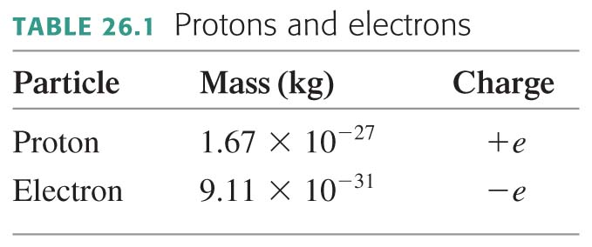
Any object has net charge, q:
where N_{p} and N_{e} are the number of protons and electrons contained in the object.
The process of removing or adding an electron from the electron cloud of an atom is called ionization.
An atom with fewer electrons than protons is called a positive ion. An atom with more electrons than protons is called a negative ion.

Slide 24
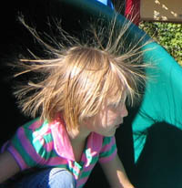
Electrons in an atom
Innermost—attracted very strongly to oppositely charged atomic nucleus
Outermost—attracted loosely and can be easily dislodged
Examples:
When rubbing a comb through your hair, electrons transfer from your hair to the comb. Your hair has a deficiency of electrons (positively charged).
When rubbing a glass rod with silk, electrons transfer from the rod onto the silk and the rod becomes positively charged.
[image from http://www.sciencebuddies.org/blog/2011/02/the-shock-of-static-electricity.php ]

Slide 25
Conservation of Charge
In any charging process, no electrons are created or destroyed. Electrons are simply transferred from one material to another.

Slide 26
Recall: Discovering Electricity: Experiment 4
The force between two charged objects depends on the distance between them.

Slide 27
Coulomb’s Law
$$q_{1}$$
$$d$$
$$q_{2}$$
The magnitude of the force, F, between two point charges depends on the product of their charges, and the distance between them.
In equation form:
k = 9×10⁹ Nm²/C²
Unit of charge is coulomb, C
Similar to Newton’s law of gravitation for masses
Underlies the bonding forces between molecules
Electrical forces may be either attractive or repulsive.
Gravitational forces are only attractive.
$$F=k\frac{q_{1}q_{2}}{d^{2}}$$

Slide 28
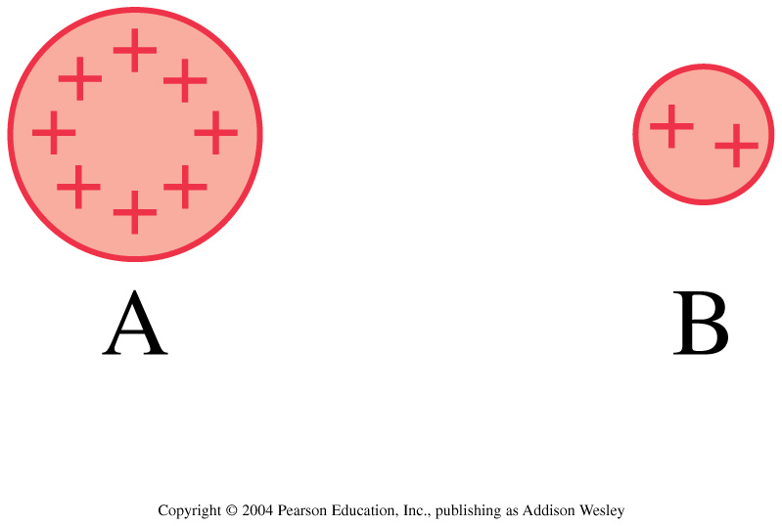
Discussion question.
Charges A and B exert repulsive forces on each other. q_{A} = 4q_{B}. Which statement is true?
F_{A on B} > F_{B on A}
F_{A on B} < F_{B on A}
F_{A on B} = F_{B on A}
Notes:
STT25.4

Slide 29
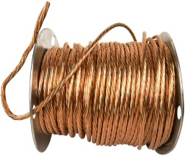
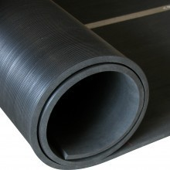
Conductors and Insulators
Conductors: Materials in which one or more of the electrons in the outer shell of its atoms are not anchored to the nuclei of particular atoms but are free to wander in the material
Example: Metals such as copper and aluminum
Insulators: Materials in which electrons are tightly bound and belong to particular atoms and are not free to wander about among other atoms in the material, making them flow
Example: Rubber, glass

Slide 30
When you buy a water pipe in a hardware store, the water isn’t included. When you buy copper wire, electrons
Conductors and Insulators
CHECK YOUR NEIGHBOR
A. must be supplied by you, just as water must be supplied for a water pipe.
are already in the wire.
may fall out, which is why wires are insulated.
None of the above.

Slide 31
Before Class 9 on Monday
Problem Set 3 on MasteringPhysics due Sunday at 11:59pm, Chs. 24, 25
For Monday please read Pgs. 736-756
Ch. 25, section 25.5 Ch. 26, sections 26.1 and 26.2
Please do the short pre-class quiz on MasteringPhysics by Monday morning.
Something to think about: What is the electric field? Is it real, or is just something that people made up?

