Slide 1
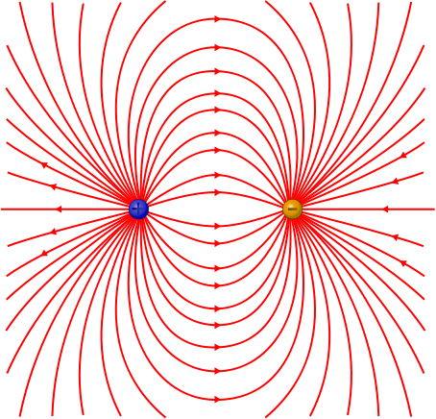
PHY132 Introduction to Physics II Class 9 – Outline:
Finishing off chapter 25, Starting chapter 26..
The Field Model
The Electric Field of a Point Charge, and many point charges

Slide 2
Fun with Charge Conservation!!!
Identical metal spheres are initially charged as shown.
Spheres P and Q are touched together and then separated.
Then spheres Q and R are touched together and separated.
Afterward the charge on sphere R is
–1 nC or less.
–0.5 nC.
0 nC.
+0.5 nC.
+1.0 nC or more.
Notes:
2

Slide 3
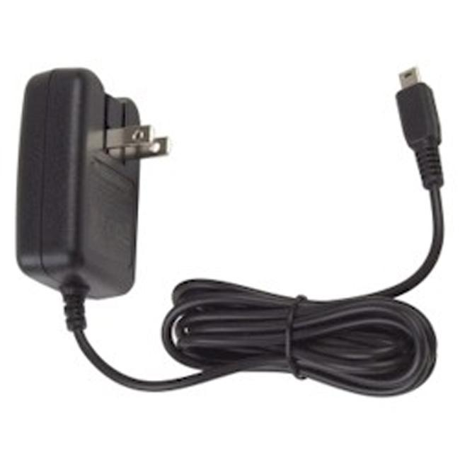
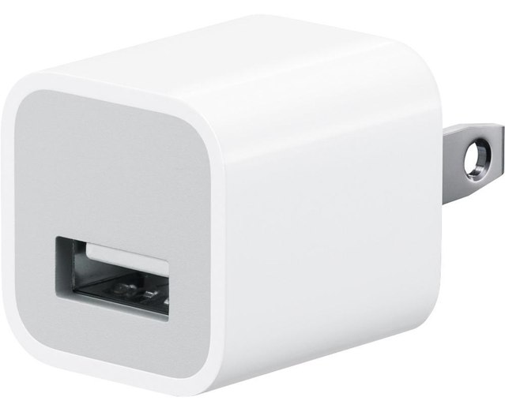
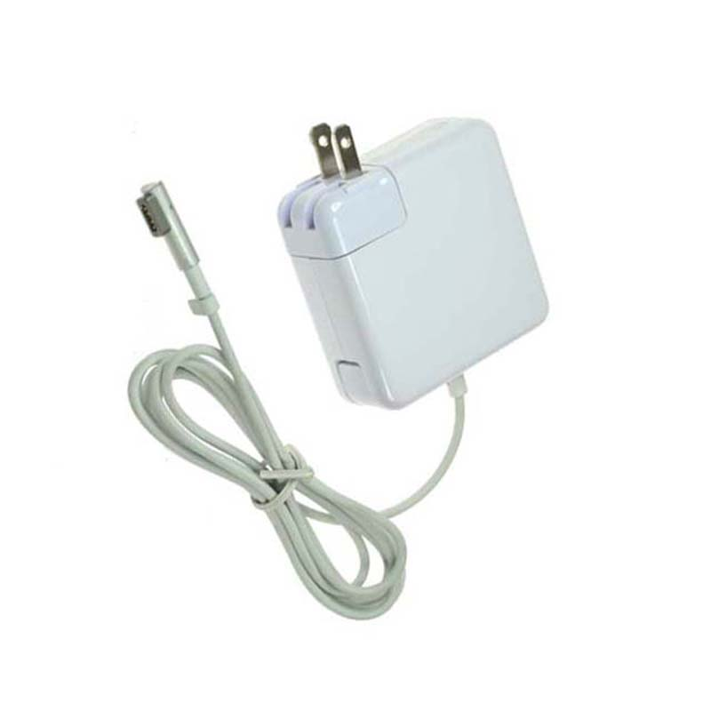
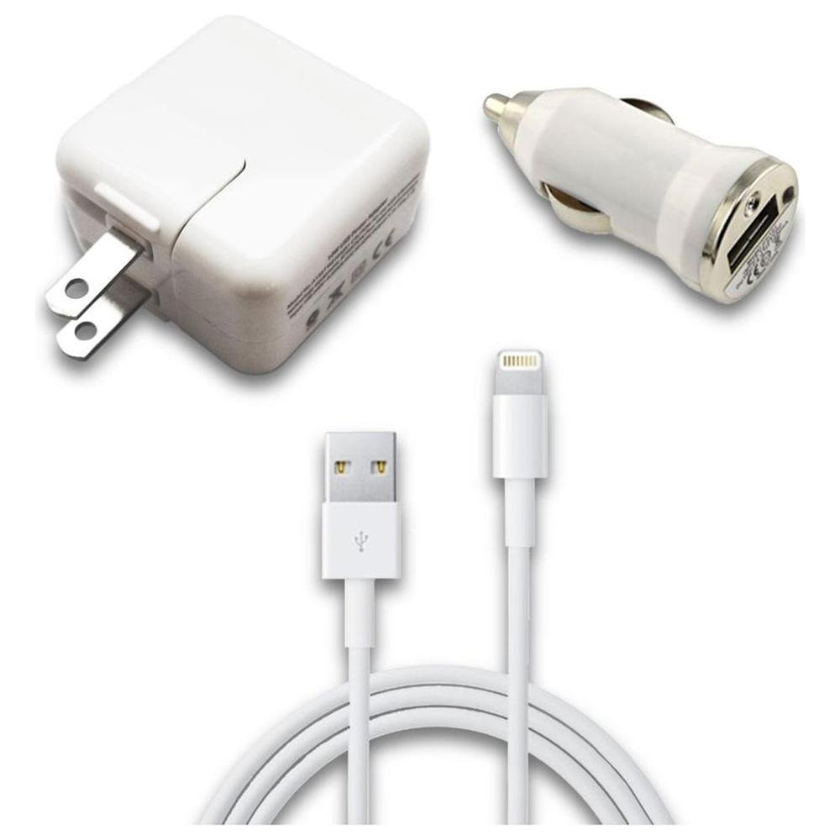
What is electric current?
It’s something to do with the electrons moving through the metal wires.
What is voltage?
It’s what pushes the current.

Slide 4
Our goal:
Circuits and
Ohm’s Law.
How do we get there?
Electric Charge, q
Electric Force, F
Electric Field, E
Electric Potential, V
Current and Ohm’s Law:
You are here
$$current=\frac{voltage}{resistance}$$

Slide 5
Coulomb’s Law, and The Permittivity Constant
We can make many future equations easier to use if we rewrite Coulomb’s law in a somewhat more complicated way.
Let’s define a new constant, called the permittivity constant ₀:
∋
Rewriting Coulomb’s law in terms of ₀ gives us:
∋

Slide 6
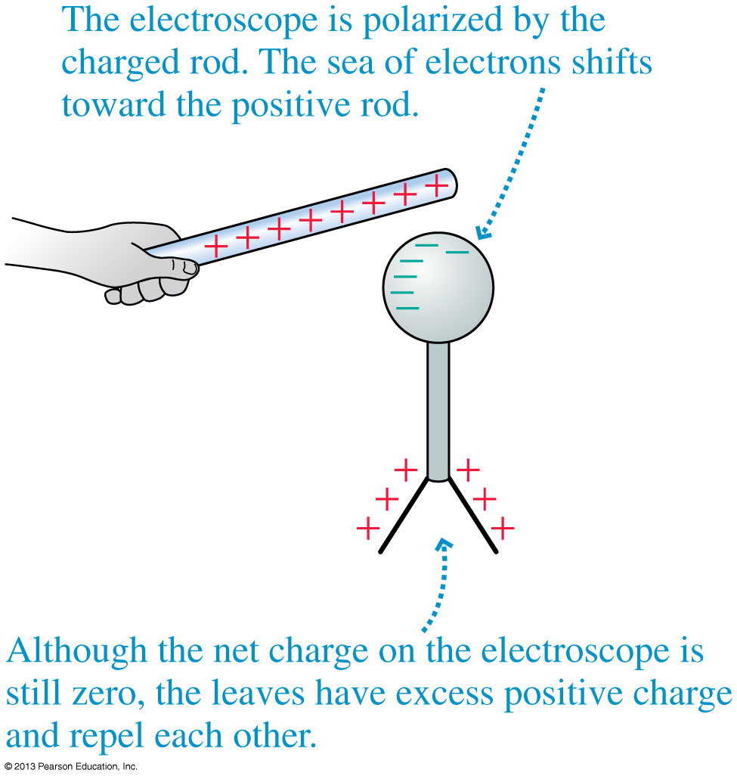
Charge Polarization
Charge polarization produces an excess positive charge on the leaves of the electroscope, so they repel each other.
Because the electroscope has no net charge, the electron sea quickly readjusts once the rod is removed.

Slide 7
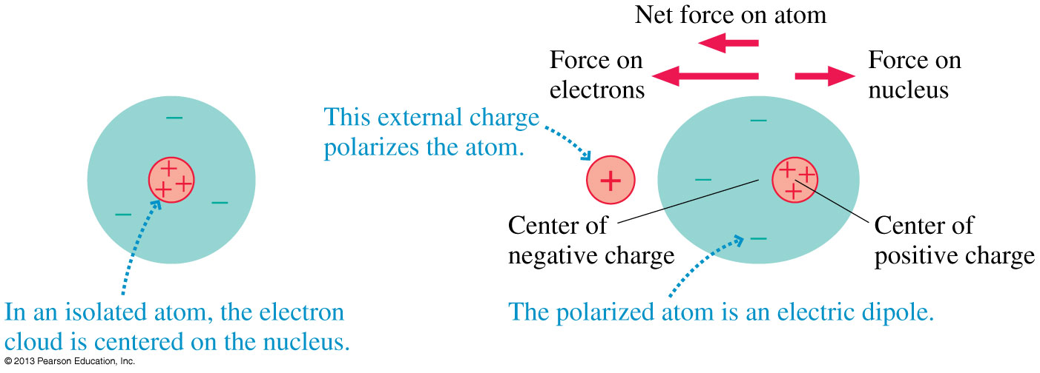
The Electric Dipole
Even a single atom can become polarized.
The figure below shows how a neutral atom is polarized by an external charge, forming an electric dipole.
Atom all alone:

Slide 8
The Electric Dipole
Even a single atom can become polarized.
The figure below shows how a neutral atom is polarized by an external charge, forming an electric dipole.
Atom near + charge:

Slide 9
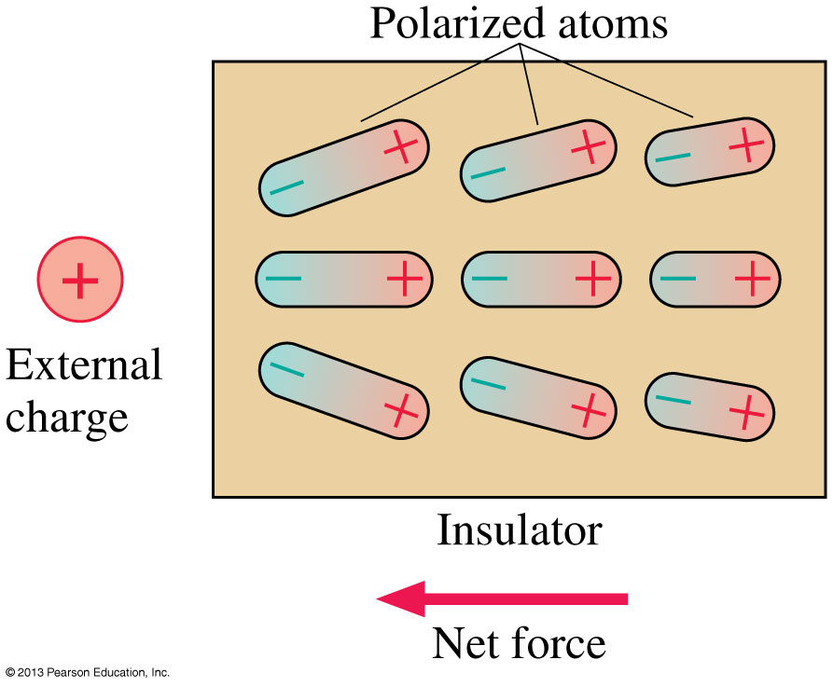
The Electric Dipole
When an insulator is brought near an external charge, all the individual atoms inside the insulator become polarized.
The polarization force acting on each atom produces a net polarization force toward the external charge.

Slide 10
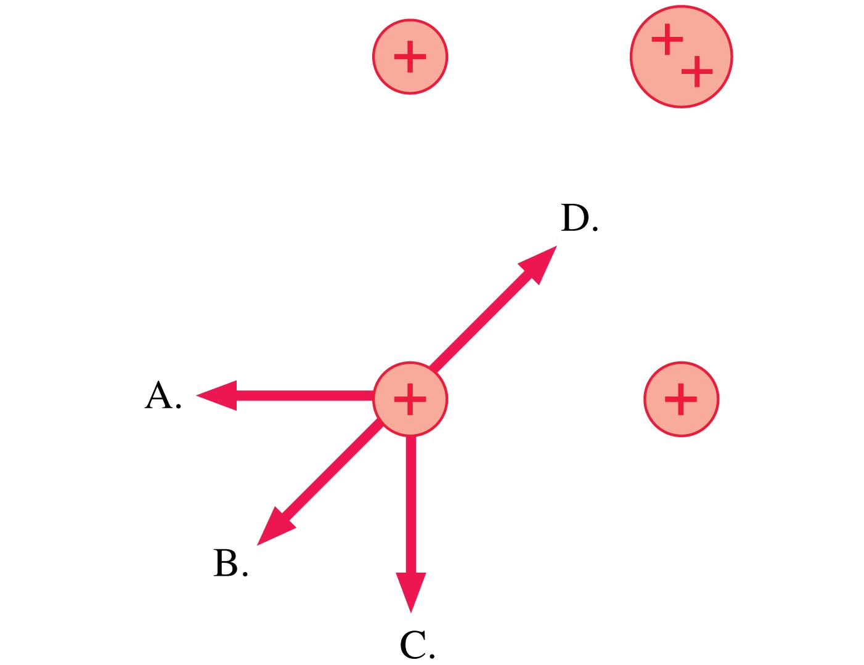
Thinking about Electric Force
Which is the direction of the net force on the charge at the lower left?
E. None of these.
Notes:
10

Slide 11
QuickCheck 25.11
Thinking about Electric Force
The direction of the force on charge –q is
Up.
Down.
Left.
Right.
The force on –q is zero.
Notes:
11

Slide 12
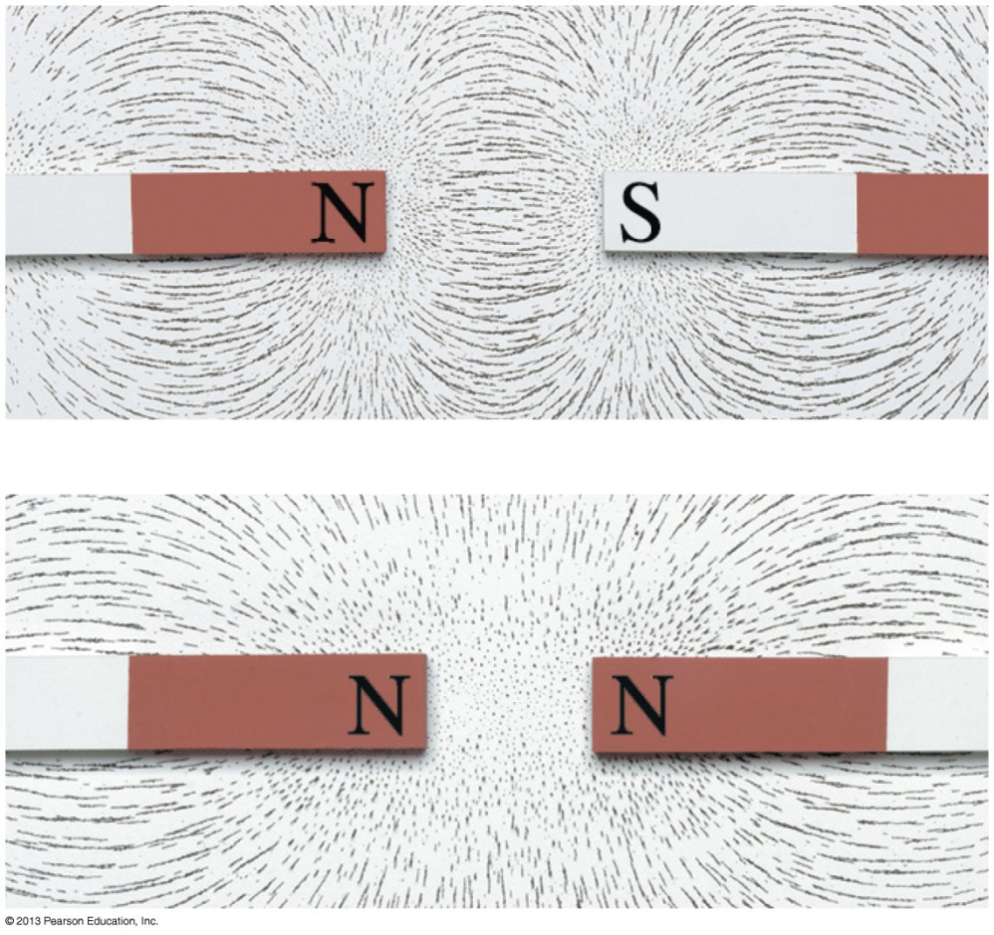
The Field Model
The photos show the patterns that iron filings make when sprinkled around a magnet.
These patterns suggest that space itself around the magnet is filled with magnetic influence.
This is called the magnetic field.
The concept of such a “field” was first introduced by Michael Faraday in 1821.

Slide 13
The Field Model
A field is a function that assigns a vector to every point in space.
The alteration of space around a mass is called the gravitational field.
Similarly, the space around a charge is altered to create the electric field.

Slide 14
The Electric Field
A charged particle with charge q at a point in space where the electric field is experiences an electric force:
If q is positive, the force on the particle is in the direction of .
The force on a negative charge is opposite the direction of .
The units of the electric field are N/C. The magnitude E of the electric field is called the electric field strength.

Slide 15
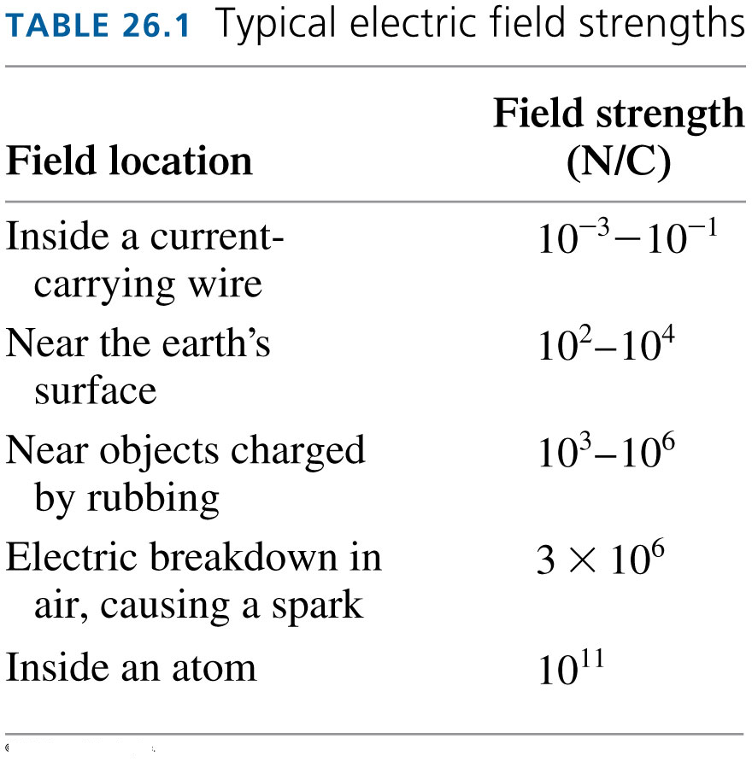

Slide 16
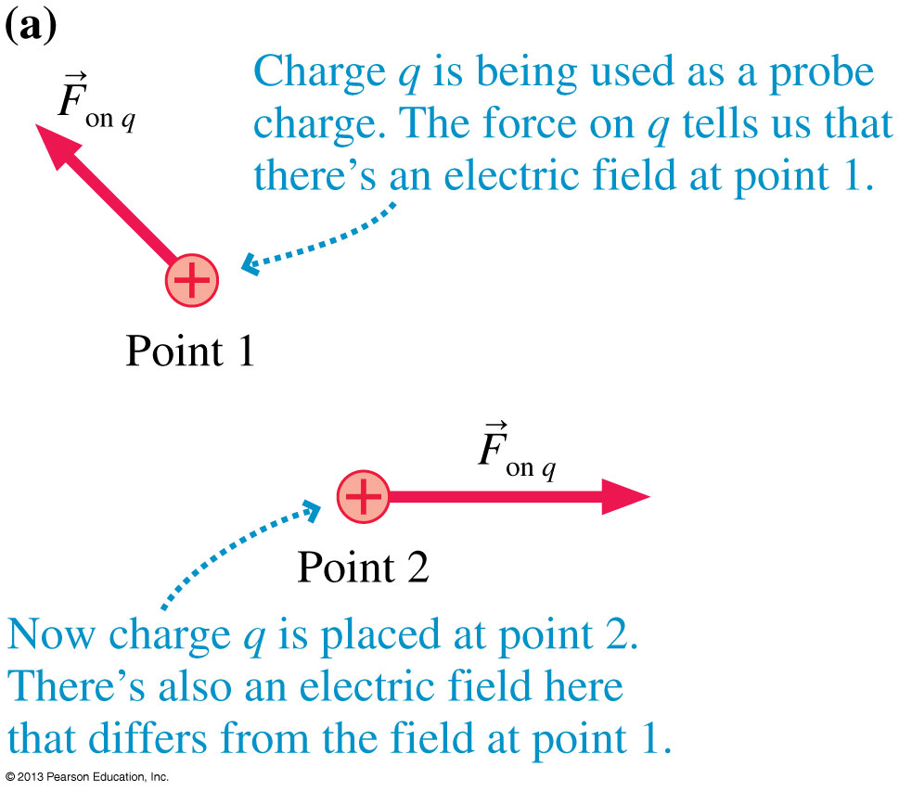
The Electric Force

Slide 17
The Electric Field

Slide 18
Example.
A 0.10 g honeybee has an electric charge.
There is a natural electric field near the earth’s surface of 100 N/C, downward.
What electric charge would the bee have to have to hang suspended in the air, without even flapping her wings?

Slide 19
The Electric Field of a Point Charge
The electric field at a distance r away from a point charge, q, is given by:

Slide 20
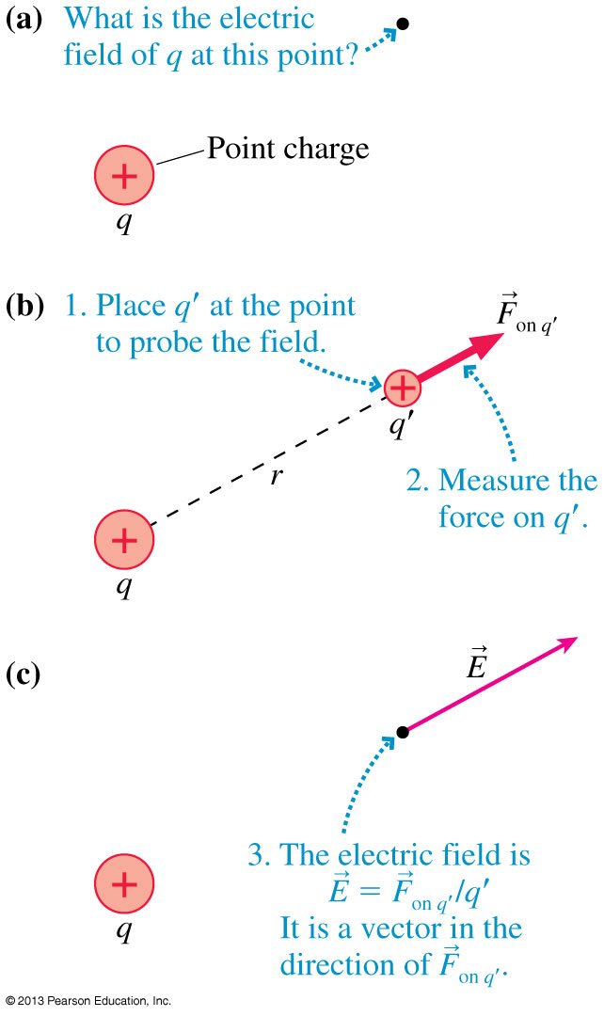
The Electric Field of a Point Charge

Slide 21
The Electric Field of a Point Charge

Slide 22
The Electric Field of a Point Charge

Slide 23
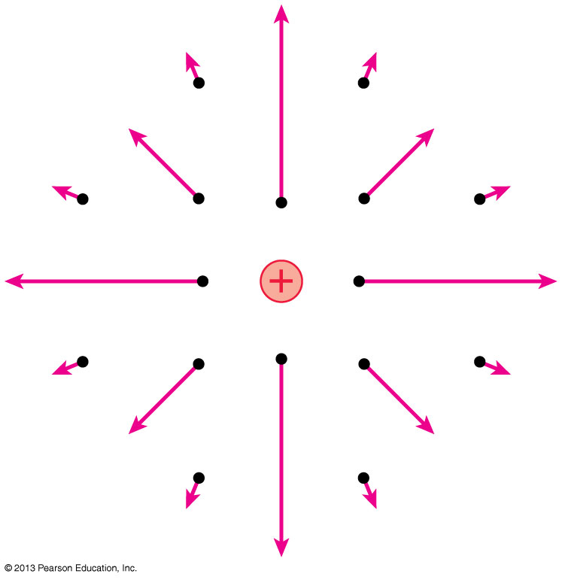
The Electric Field of a Point Charge
If we calculate the field at a sufficient number of points in space, we can draw a field diagram.
Notice that the field vectors all point straight away from charge q.
Also notice how quickly the arrows decrease in length due to the inverse-square dependence on r.

Slide 24
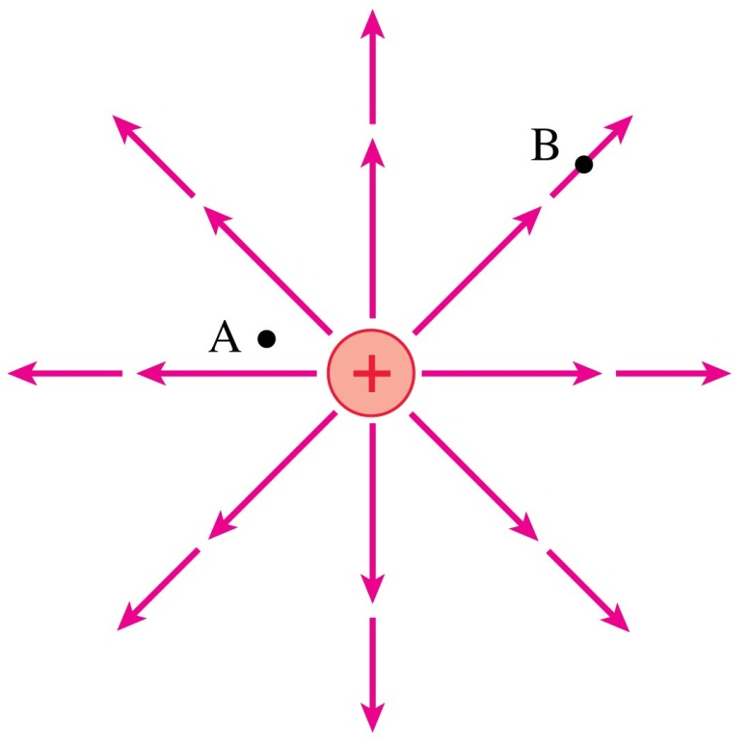
QuickCheck 25.12
At which point is the electric field stronger?
Point A.
Point B.
Not enough information to tell.
Notes:
24

Slide 25
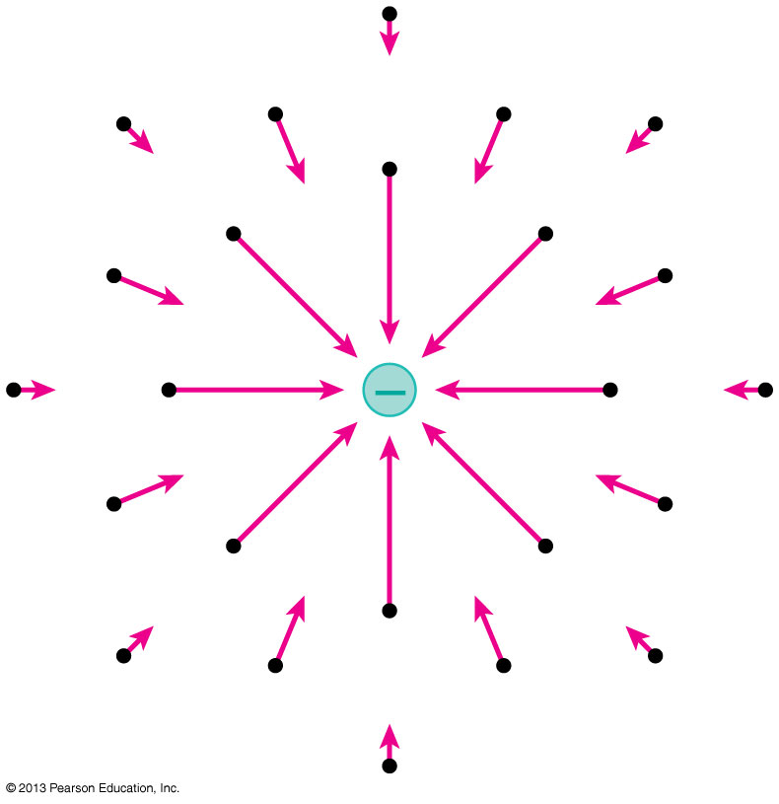
The Electric Field of a Point Charge
Using unit vector notation, the electric field at a distance r from a point charge q is:
A negative sign in front of a vector simply reverses its direction.
The figure shows the electric field of a negative point charge.

Slide 26
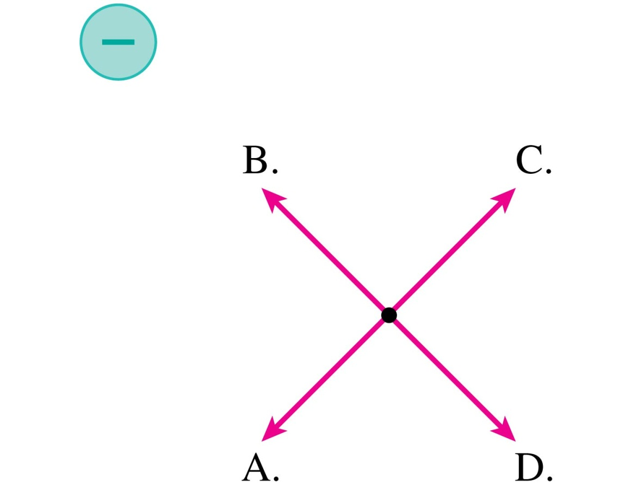
QuickCheck 25.14
Which is the electric field at the dot?
E. None of these.
Notes:
26

Slide 27
The Electric Field of Multiple Point Charges
Suppose the source of an electric field is a group of point charges q₁, q₂, …
The net electric field E_{net} at each point in space is a superposition of the electric fields due to each individual charge:

Slide 28
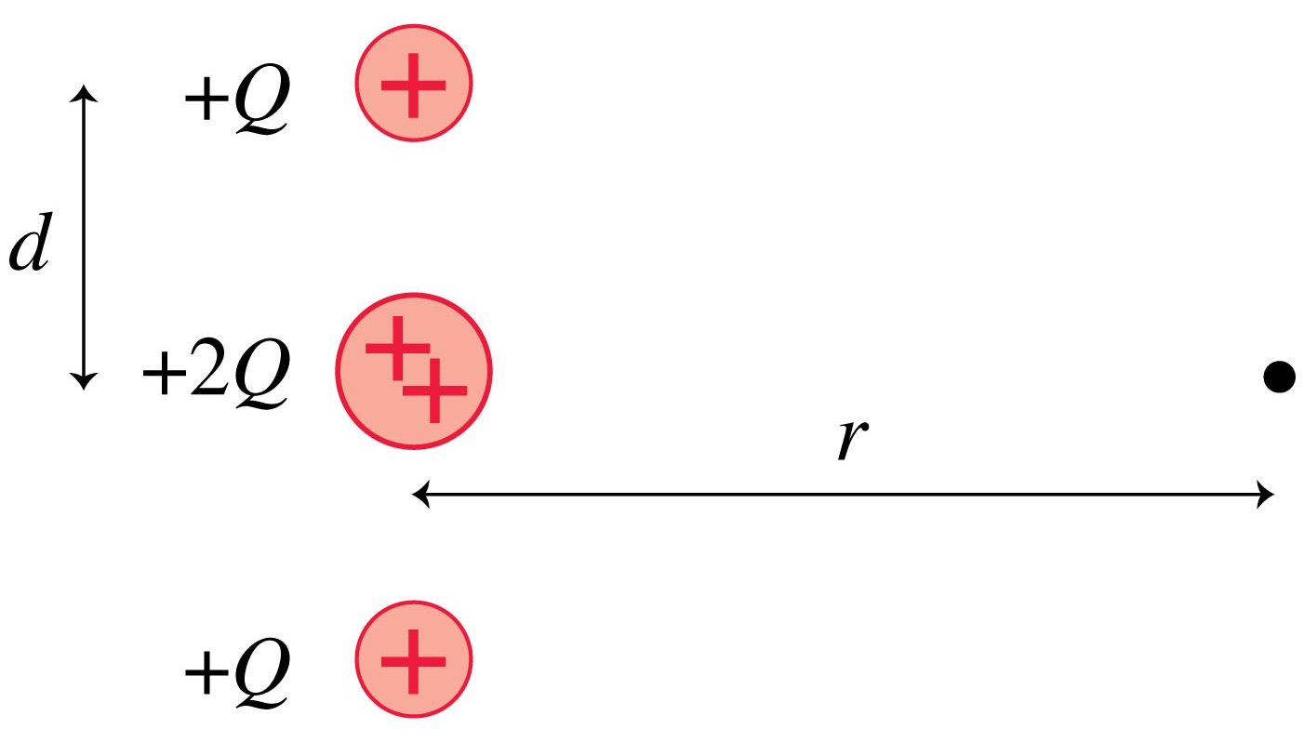
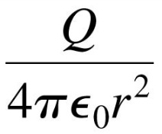
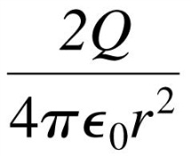
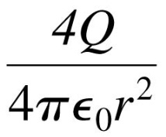
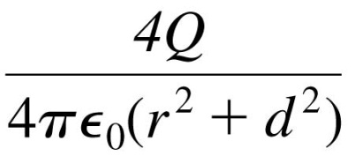
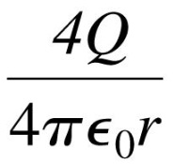
QuickCheck 26.3
When r >> d, the electric field strength at the dot is
A.
B.
C.
D.
E.
Notes:
28

Slide 29
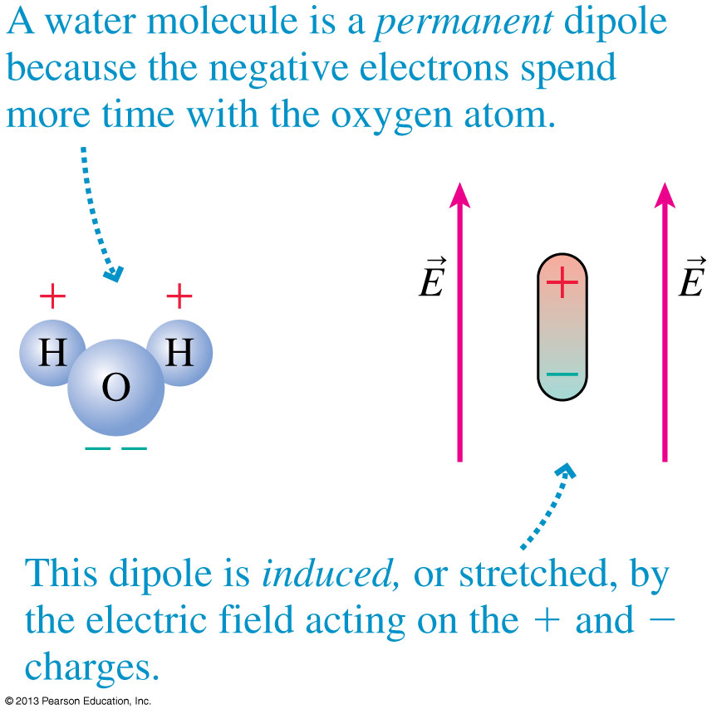
Electric Dipoles
Two equal but opposite charges separated by a small distance form an electric dipole.
The figure shows two examples.

Slide 30
The Dipole Moment
It is useful to define the dipole moment p, shown in the figure, as the vector:
The SI units of the dipole moment are C m.

Slide 31
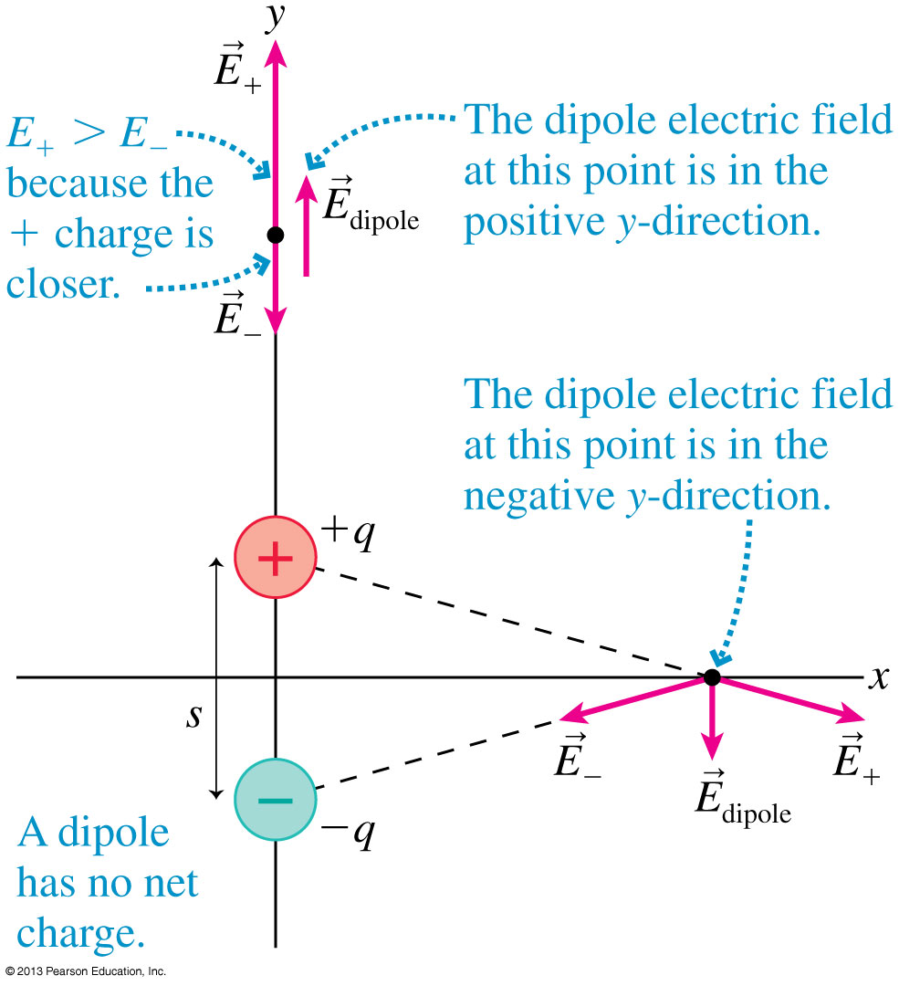
The Dipole Electric Field at Two Points

Slide 32
The Electric Field of a Dipole
The electric field at a point on the axis of a dipole is:
where r is the distance measured from the center of the dipole.
The electric field in the plane that bisects and is perpendicular to the dipole is
This field is opposite to the dipole direction, and it is only half the strength of the on-axis field at the same distance.

Slide 33
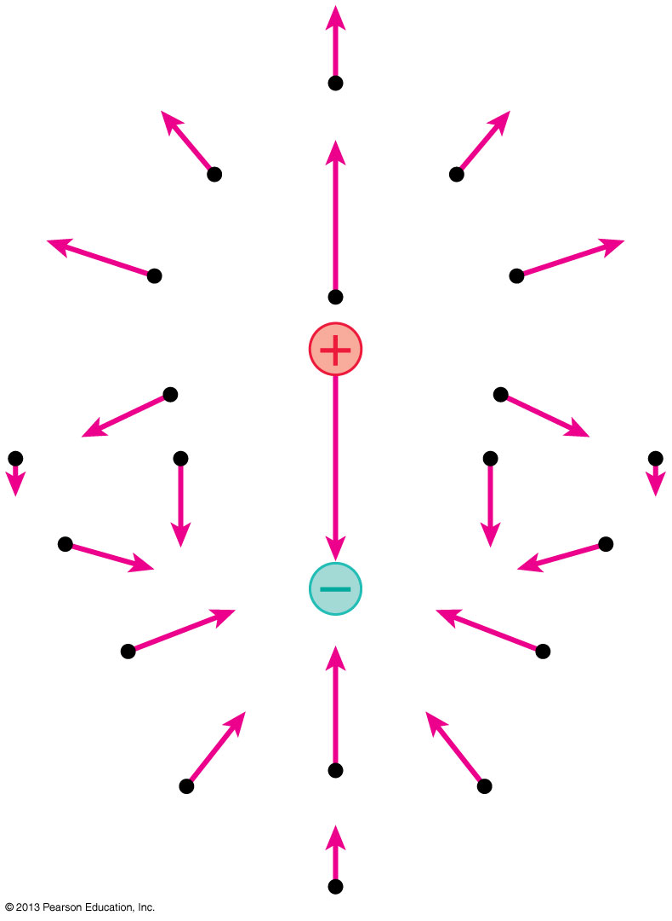
The Electric Field of a Dipole
This figure represents the electric field of a dipole as a field-vector diagram.

Slide 34
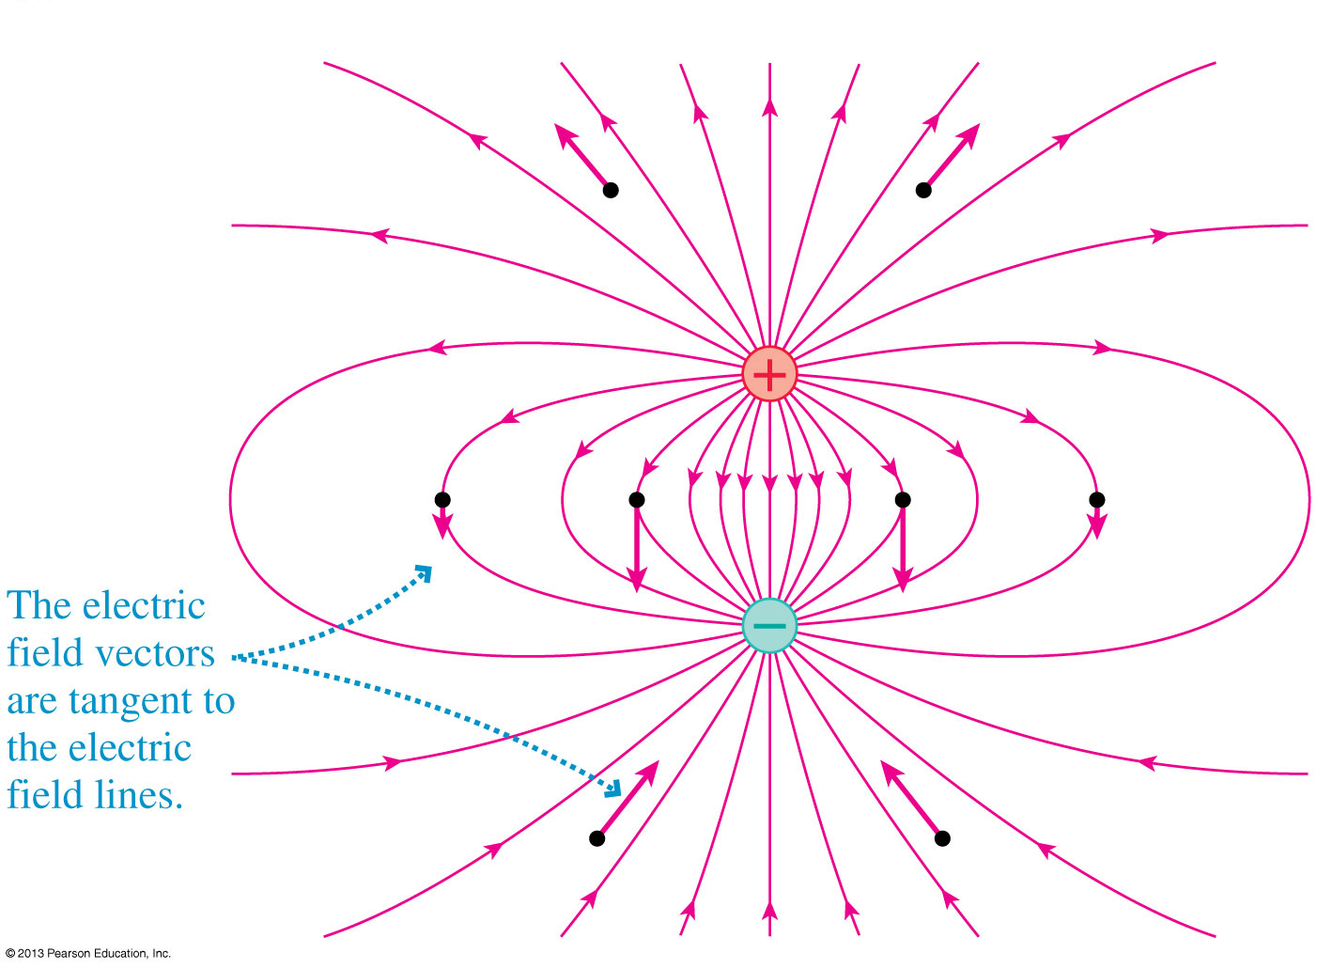
The Electric Field of a Dipole
This figure represents the electric field of a dipole using electric field lines.

Slide 35
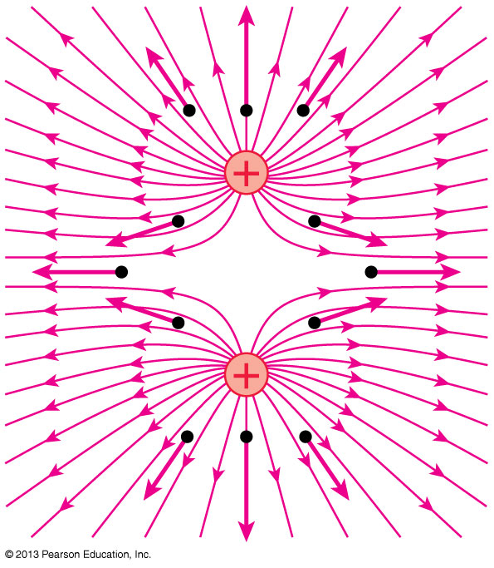
The Electric Field of Two Equal Positive Charges
This figure represents the electric field of two same-sign charges using electric field lines.

Slide 36
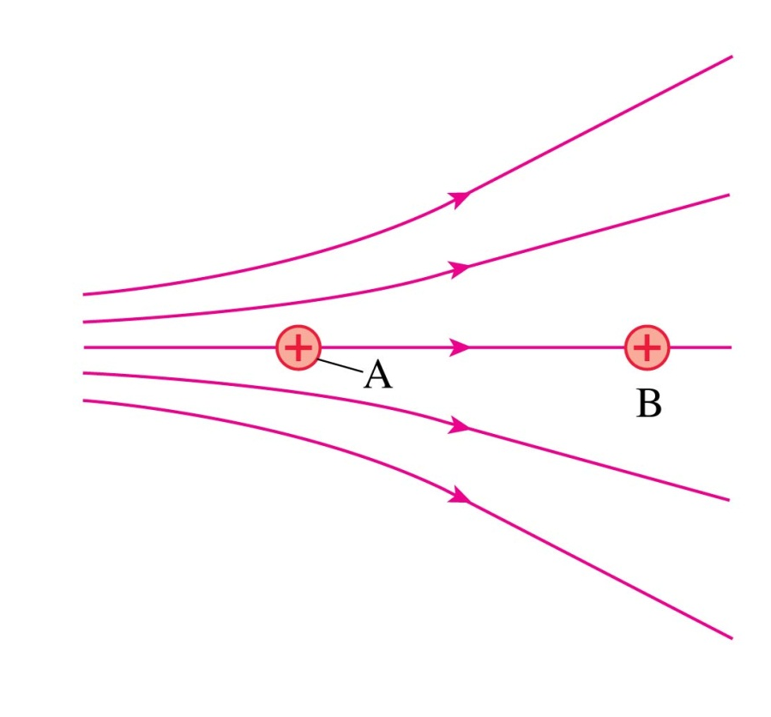
QuickCheck 26.4
Two protons, A and B, are in an electric field. Which proton has the larger acceleration?
Proton A.
Proton B.
Both have the same acceleration.
Notes:
36

Slide 37
Before Class 10 on Wednesday
Please read over the rest of Chapter 26, or at least watch the pre-class video.
Please complete the pre-class quiz due on Wednesday morning.
Something to think about or google: Does lightning go up or down? If the ground is neutral and the cloud-cover is positive, can lightning be the electrons jumping up to the clouds?

