Slide 1
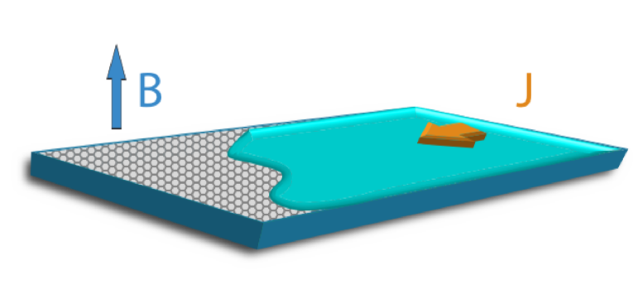

Electron hydrodynamics
Thomas Scaffidi
University of Toronto
Department of Physics Colloquium
Sept 26th 2019

Slide 2
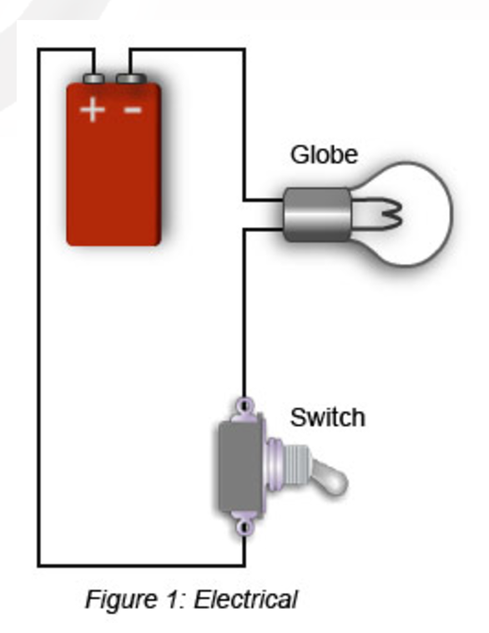
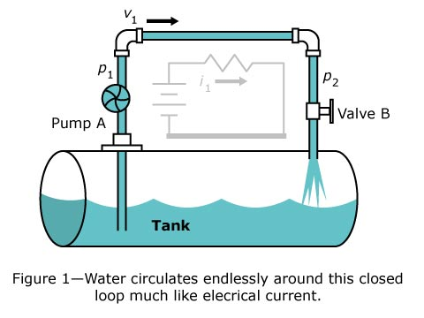
Could it finally be true?
?

Slide 3
Electric conduction versus water flow
Metal
Water
Resistance arises through external scattering due to the lattice (impurities, phonons,…)
Resistance arises through internal scattering (viscosity)

Slide 4
Outline
Electron hydrodynamics – What and why?
Viscous Fermi liquids
Using magnetic fields to detect viscous effects
Conclusion and outlook

Slide 5
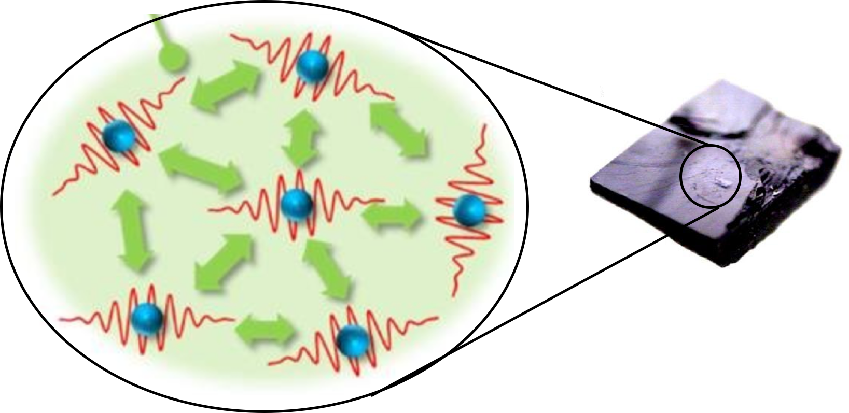
Correlated electrons
Hydrodynamics
Electron hydrodynamics
Can quantum mechanics constrain hydrodynamics?
Can quantum mechanics enrich hydrodynamics?

Slide 6
Correlated electrons
Hydrodynamics
Electron hydrodynamics
Can quantum mechanics constrain hydrodynamics?
Can quantum mechanics enrich hydrodynamics?

Slide 7
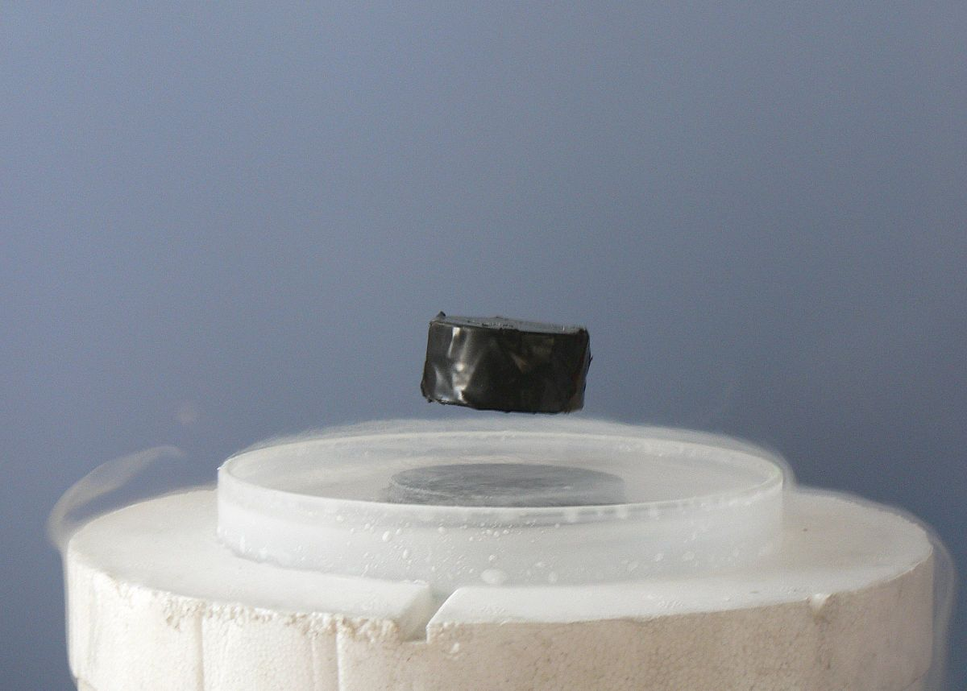
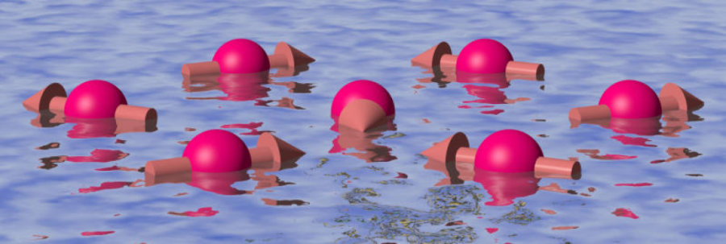
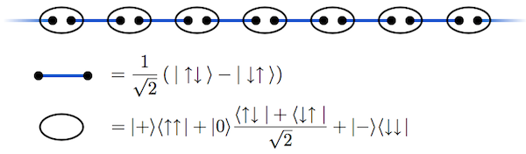
“More is different” [Anderson ‘72]
…
Spin liquids
Topological phases
Superconductors

Slide 8
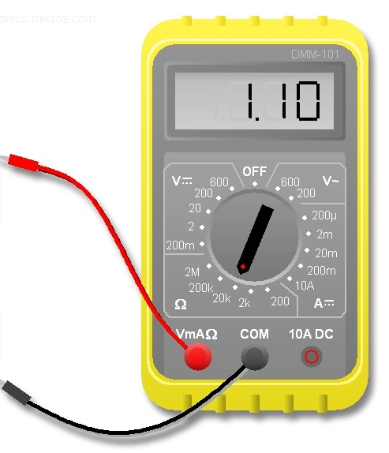
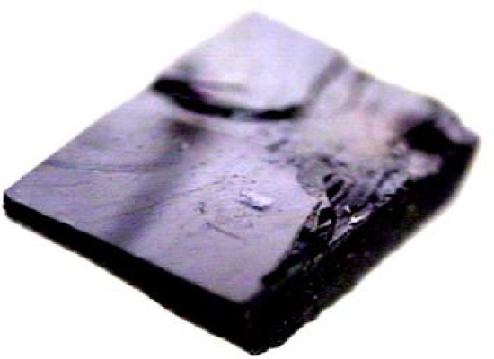

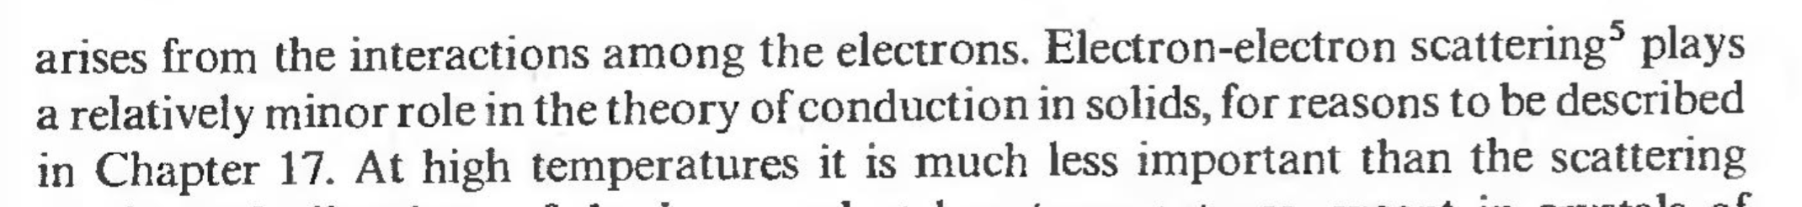
Conventional metallic transport [Drude 1900]
Mean free time of electrons, set by defects and vibrations of the lattice

Slide 9
Correlated electrons
Hydrodynamics
Electron hydrodynamics
Can quantum mechanics constrain hydrodynamics?
Can quantum mechanics enrich hydrodynamics?

Slide 10
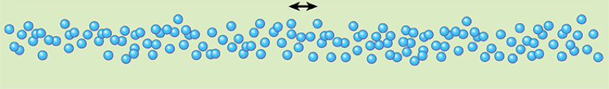
Hydrodynamics
Universal description of fluids based on conserved quantities: momentum, energy, charge,…
Works at length/time scales much larger than the microscopic ones
mean free path (internal scattering)
Wavelength of perturbation

Slide 11
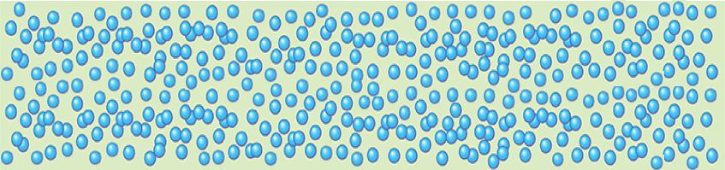
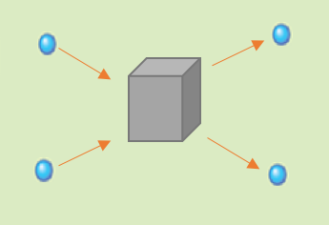
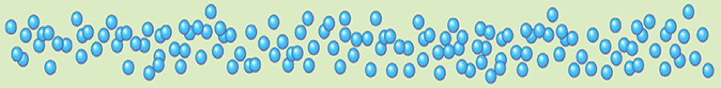

Viscous fluid description based on momentum conservation
Microscopics
Hydrodynamics
Navier-Stokes
Notes:
Internal collisions conserve total momentum. We can therefore define a density of momentum (or equivalently a local average velocity) for each small hydrodynamic cell, which has a size of order l. One can then study the dynamics of this coarse-grained local velocity field. There are two dominant terms: the first one is the average external force per unit volume applied to the system at that point. The second one is internal to the fluid and arises from collisions between particles. These collisions create a diffusion of momentum, which leads to viscosity.

Slide 12
Correlated electrons
Hydrodynamics
Electron hydrodynamics
Can quantum mechanics constrain hydrodynamics?
Can quantum mechanics enrich hydrodynamics?

Slide 13
Can quantum mechanics constrain hydrodynamics?
…
Classically
Quantum mechanically
Viscosity can take any value
[Kovtun, Son, Starinets, PRL 2005]
Conjectured fundamental bound based on holography.

Slide 14
Correlated electrons
Hydrodynamics
Electron hydrodynamics
Can quantum mechanics constrain hydrodynamics?
Can quantum mechanics enrich hydrodynamics?

Slide 15
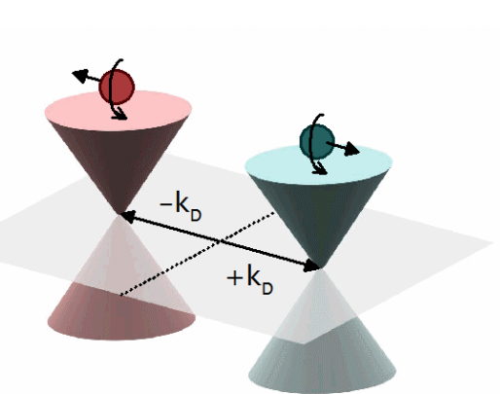
Can quantum mechanics enrich hydrodynamics?
For electrons in a solid:
Relativistic fluids: graphene, Weyl semimetals,…
Topological effects:
Berry phase, Hall viscosity,…

Slide 16
Correlated electrons
Hydrodynamics
Electron hydrodynamics
Can quantum mechanics constrain hydrodynamics?
Can quantum mechanics enrich hydrodynamics?

Slide 17
Outline
Electron hydrodynamics – What and why?
Viscous Fermi liquids
Using magnetic fields to detect viscous effects
Conclusion and outlook

Slide 18
Hydrodynamic flow of electrons possible if…
Momentum-conserving mean free path (“internal scattering”):
e-e scattering
Sample size
Momentum-relaxing mean free path (“external scattering”):
Impurities
Phonons
W
[Gurzhi 1963] [Spivak, Kivelson 2006] [Hruska, Spivak 2011] [Andreev Kivelson Spivak 2011] [Torre,Tomadin,Geim,Spivak 2011] [Levitov Falkovich 2016] many more papers...

Slide 19
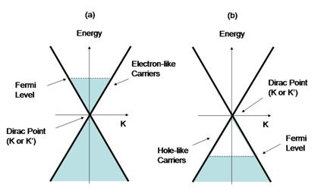
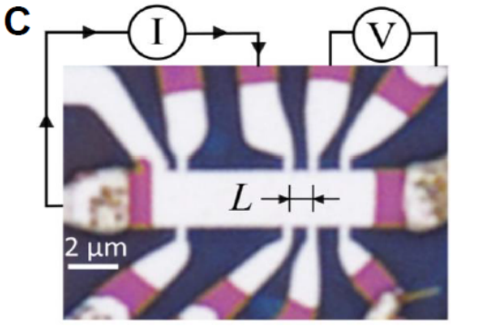
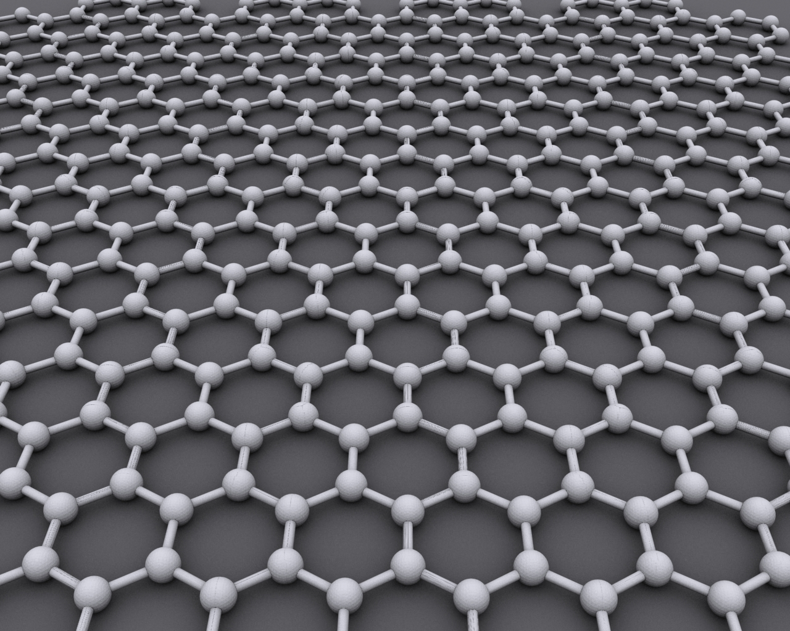
Which materials?
Strong interactions, not too low T
Mesoscopic samples
Clean samples, not too high T
~ 1um
~ 10 um
~ 100 um
2D electron gases [de Jong, Molenkamp] (1994)
PdCoO2 (high mobility layered metal) (2016)
Graphene [Bandurin et al] [Crossno et al] (2016)
Bandurin et al, Science 351, 1055-1058 (2016)

Slide 20
Three regimes
Ohmic
Viscous
Diffuse-Ballistic
“Knudsen flow”

Slide 21
Viscous fluid
Microscopics
Hydrodynamics
Navier-Stokes
Notes:
Internal collisions conserve total momentum. We can therefore define a density of momentum (or equivalently a local average velocity) for each small hydrodynamic cell, which has a size of order l. One can then study the dynamics of this coarse-grained local velocity field. There are two dominant terms: the first one is the average external force per unit volume applied to the system at that point. The second one is internal to the fluid and arises from collisions between particles. These collisions create a diffusion of momentum, which leads to viscosity.

Slide 22
Viscous electronic fluid
Microscopics
Hydrodynamics
Notes:
Internal collisions conserve total momentum. We can therefore define a density of momentum (or equivalently a local average velocity) for each small hydrodynamic cell, which has a size of order l. One can then study the dynamics of this coarse-grained local velocity field. There are two dominant terms: the first one is the average external force per unit volume applied to the system at that point. The second one is internal to the fluid and arises from collisions between particles. These collisions create a diffusion of momentum, which leads to viscosity.

Slide 23
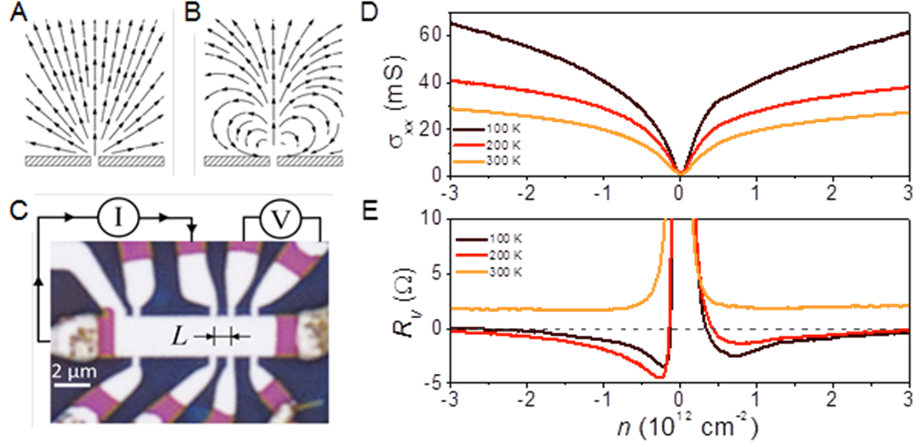
Two regimes
If term dominates
If term dominates
Viscous
Ohmic
Non-local relation between current and electric field!

Slide 24
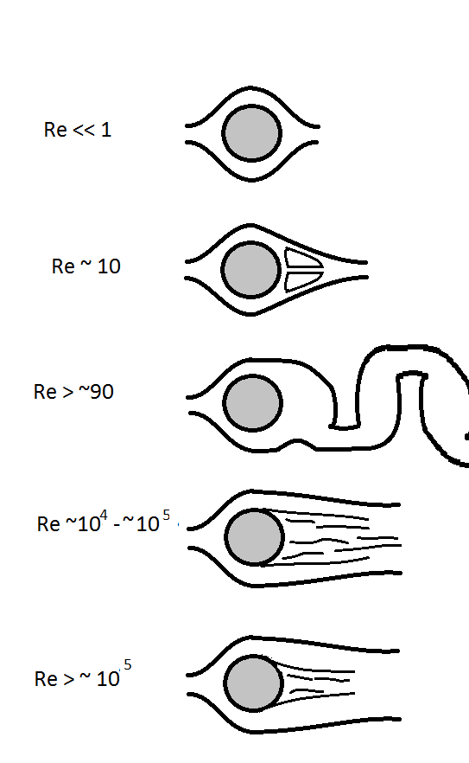
Where did the convection term go?
Today:

Slide 25
Outline
Electron hydrodynamics – What and why?
Electron hydrodynamics in good metals
Using magnetic fields to detect hydro effects
Conclusion and outlook

Slide 26
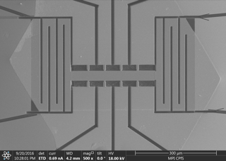
How to identify hydro effects?
  [TS et al, PRL ‘17]
Idea: Look at finite size corrections to transport coefficients
Problem: how to distinguish from ballistic effects?
Solution: use magnetic field
W
300 μm

Slide 27
Navier-Stokes under magnetic field
Add B field
Lorentz force
Hall viscosity

Slide 28
A tale of two viscosities
Shear viscosity
Hall viscosity
Probed by
Probed by

Slide 29
A tale of two viscosities
Shear viscosity
Hall viscosity
Probed by
Probed by

Slide 30
Hydrodynamic solution
  [TS et al, PRL ‘17]
Result from Boltzmann theory for a charged Fermi liquid:

Slide 31
Navier-Stokes is not enough
In theory:
Navier-Stokes
In practice:
Kinetic theory

Slide 32
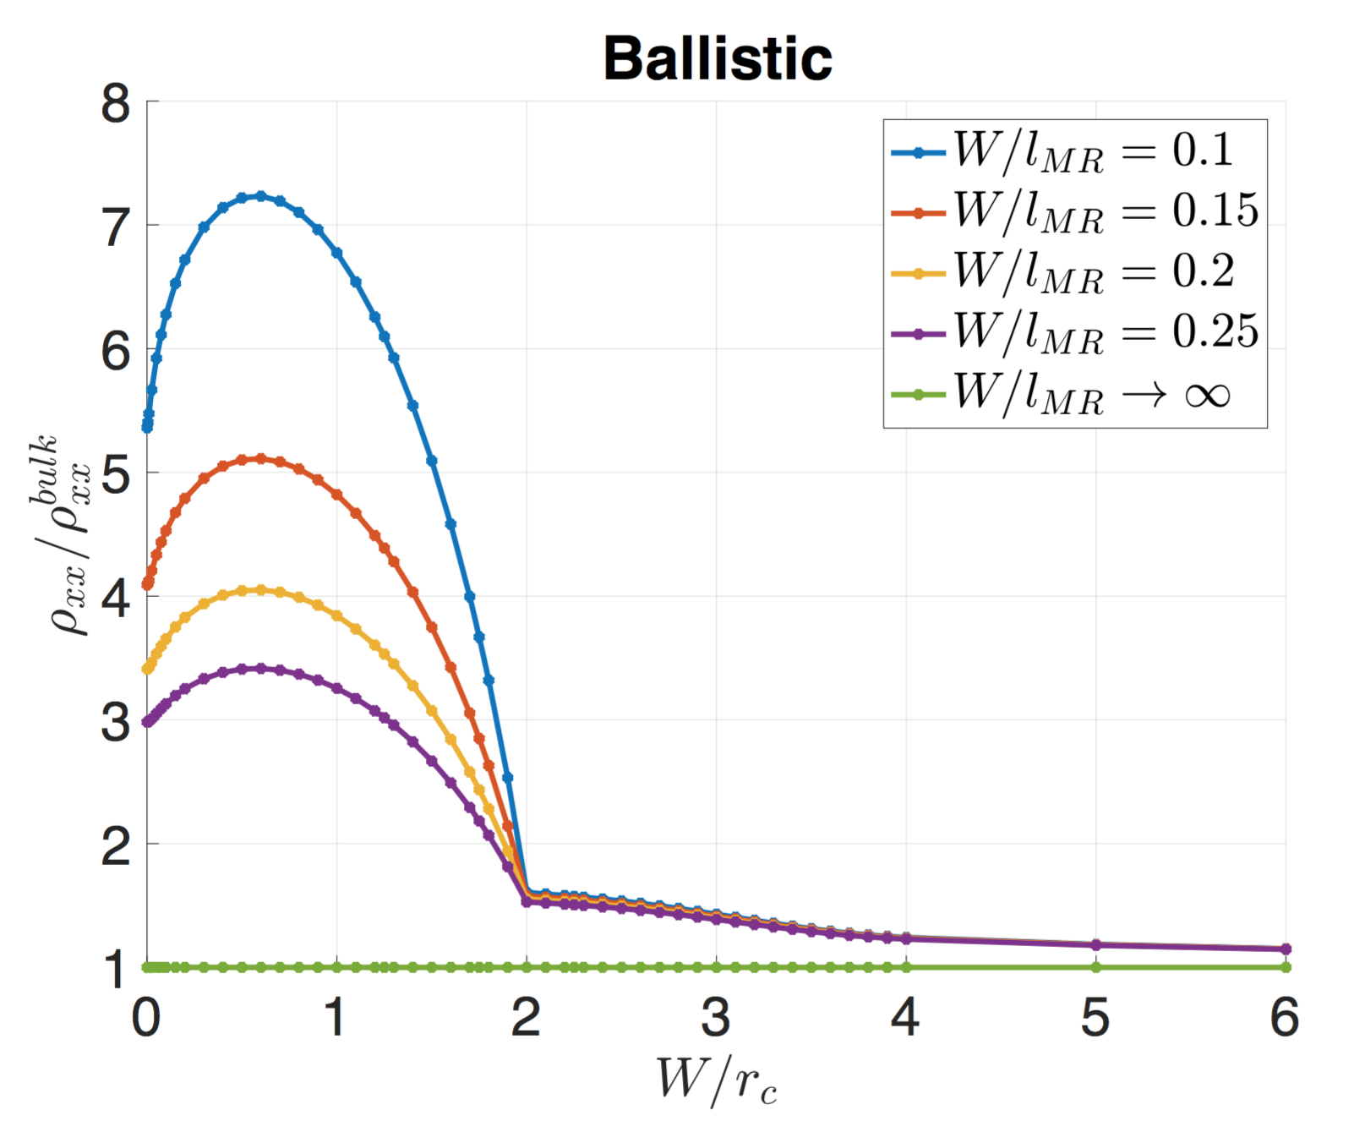
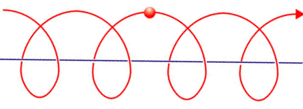
Results of Boltzmann-hydro: magnetoresistance

Slide 33
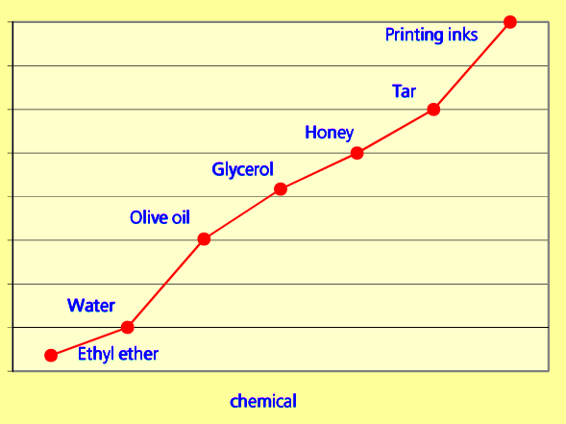
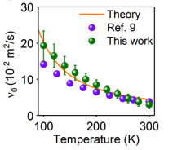
Measurement of shear viscosity in graphene
[Bandurin et al Science (2016)] [Berdyugin et al, Science 2018]
1
10⁻¹
x Electrons in graphene at T=200K
10⁻²
10⁻³
Kinematic viscosity ( m²·s⁻¹)
10⁻⁴
10⁻⁵
10⁻⁶

Slide 34
A tale of two viscosities
Shear viscosity
Hall viscosity
Probed by
Probed by

Slide 35
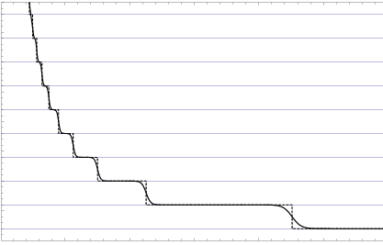
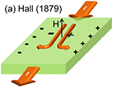
Historical perspective on Hall effect
Classical Hall Effect [Hall 1879]
Quantum Hall Effect [von Klitzing 1980]
Classical Viscous Hall Effect
Quantum Viscous Hall Effect

Slide 36
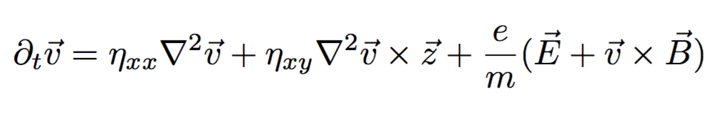
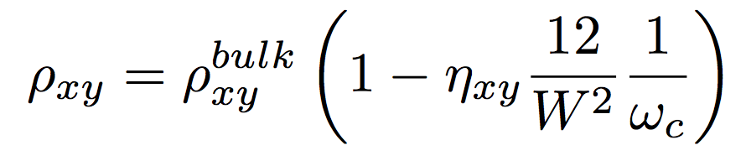
Hall resistivity => Hall viscosity
  [TS et al, PRL ‘17]
W
Hall viscosity can be measured by looking at finite-size effects in Hall resistivity

Slide 37
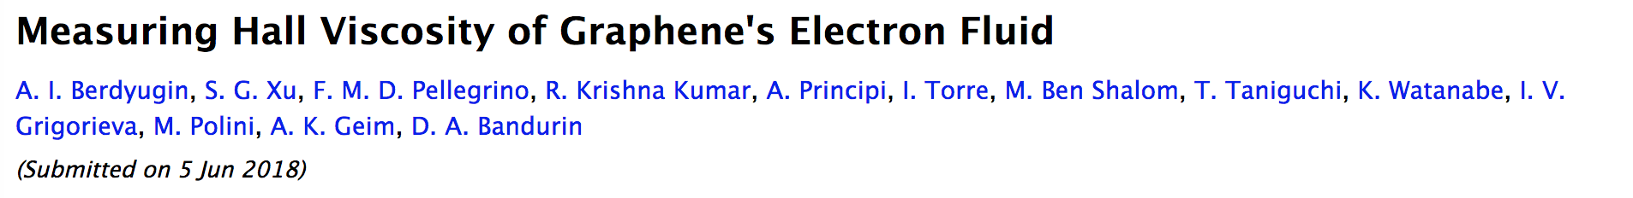
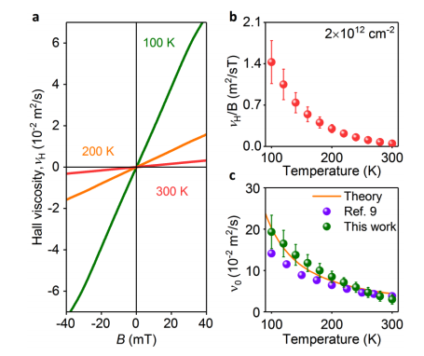
Science 2018

Slide 38
Last part of the talk: local properties
So far we’ve only discussed quantities that are averaged over the cross section of the channel
What about their spatial dependence? Any smoking gun features of hydro?
Naïvely, yes:
Ohmic
Hydro

Slide 39
Last part of the talk: local properties
So far we’ve only discussed quantities that are averaged over the cross section of the channel
What about their spatial dependence? Any smoking gun features of hydro?
Naïvely, yes:
But:
Ohmic
Hydro
Ballistic

Slide 40
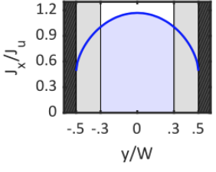
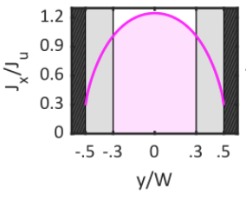
Magnetic fields are useful again:
Ballistic
Hydro
Current density

Slide 41
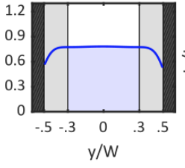
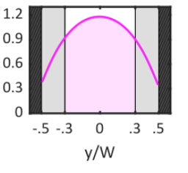
Magnetic fields are useful again:
Ballistic
Hydro
Current density
Hall electric field

Slide 42

Magnetic fields are useful again:
Ballistic
Hydro
Current density
Hall electric field

Slide 43
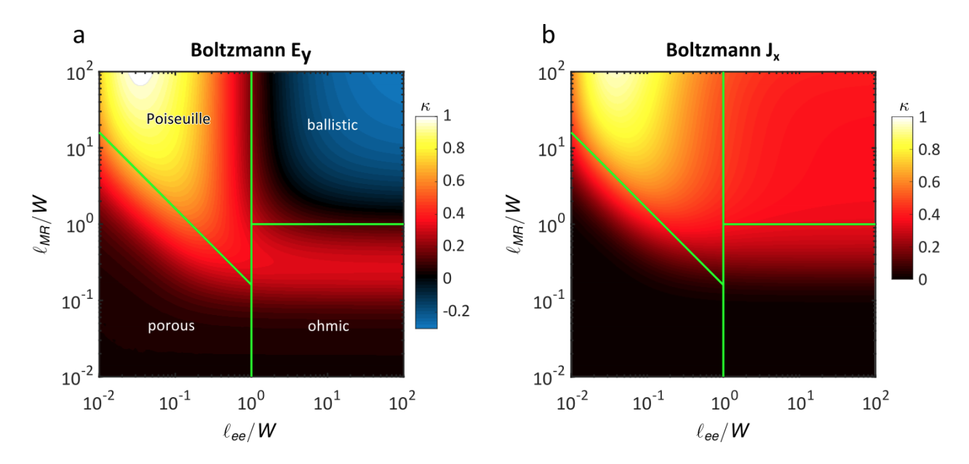
“Phase diagram” based on profile curvature
Hall electric field
Current

Slide 44
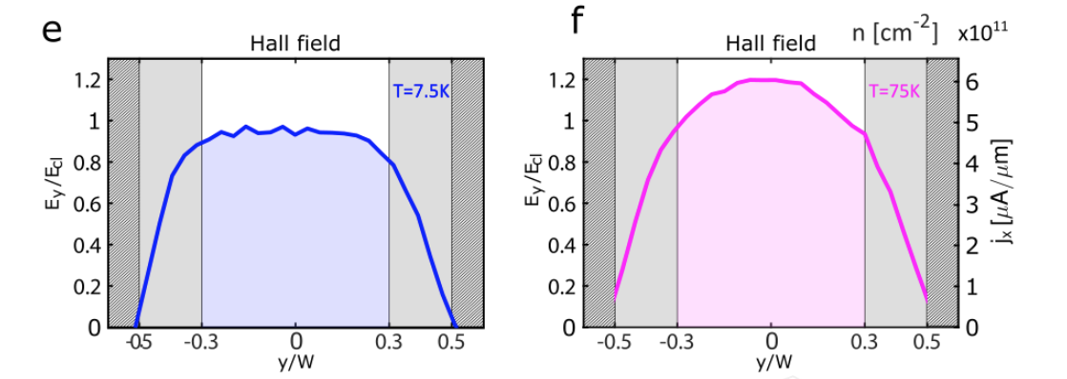
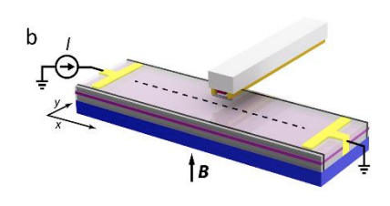
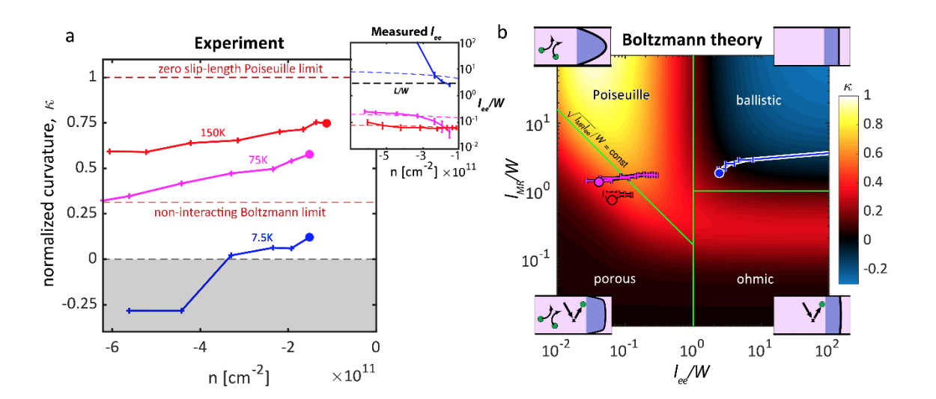
First visualization of hydrodynamic flow of electrons
Single-electron transistor
[J.A. Sulpizio^{1†}, L. Ella^{1†}, A. Rozen^{1†}, J. Birkbeck^{2,3}, D.J. Perello^{2,3}, D. Dutta¹, M. Ben-Shalom^{2,3,4}, T. Taniguchi⁵, K. Watanabe⁵, T. Holder¹, R. Queiroz¹, A. Stern¹, TS, A.K. Geim^{2,3}, and S. Ilani, arXiv:1905.11662, to appear in Nature (2019) ]

Slide 45
Acknowledgements
References
[TS, Nandi, Schmidt, Mackenzie, and Moore, Phys. Rev. Lett. 118, 226601]
[Holder, Queiroz, TS, Silberstein, Rozen, Sulpizio, Ella, Ilani, Stern, arXiv:1901.08546]
[J.A. Sulpizio^{1†}, L. Ella^{1†}, A. Rozen^{1†}, J. Birkbeck^{2,3}, D.J. Perello^{2,3}, D. Dutta¹, M. Ben-Shalom^{2,3,4}, T. Taniguchi⁵, K. Watanabe⁵, T. Holder¹, R. Queiroz¹, A. Stern¹, TS, A.K. Geim^{2,3}, and S. Ilani, arXiv:1905.11662, to appear in Nature (2019) ]
  UC Berkeley: Joel Moore
  MPI Dresden: Nabhanila Nandi, Burkhard Schmidt, Philip Moll, Pallavi Kushwaha, Andrew Mackenzie
  Weizmann institute: Tobias Holder, Raquel Queiroz, Navot Silberstein, Asaf Rozen, Joseph A. Sulpizio, Lior Ella, Shahal Ilani, Ady Stern
  Thanks for your attention!

Slide 46
Reynolds number?

Slide 47
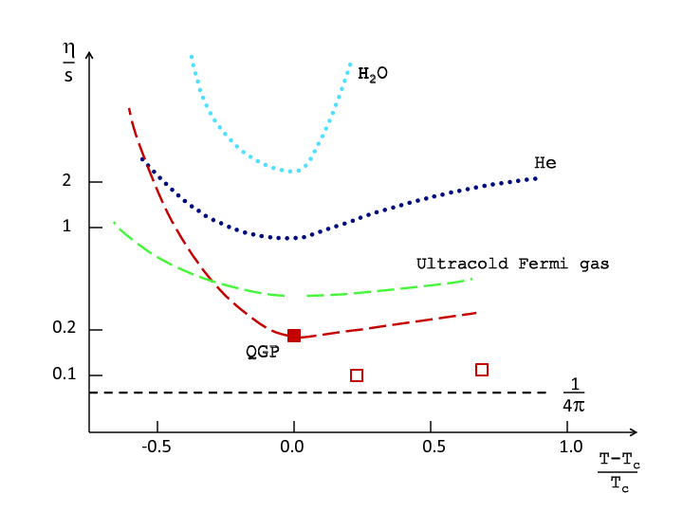
Bound on viscosity
[Kovtun, Son, Starinets, PRL 2005]
Three arguments
  Class of strongly interacting QFTs with gravity dual saturate this bound
  Empirical evidence:
  Extrapolation of kinetic theory

Slide 48
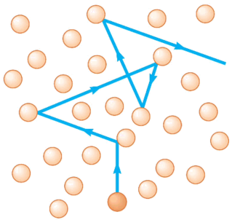
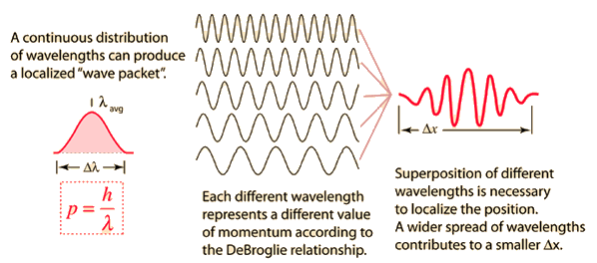
Bound on viscosity
[Kovtun, Son, Starinets, PRL 2005]

Slide 49
Bound on viscosity
Quantum
Classical

