Slide 1
Alternatives to Ordered phases
At Zero temperature
Meigan Aronson
Stewart Blusson Quantum Matter Institute
Department of Physics and AStronomy
University of British COlumbia

Slide 2


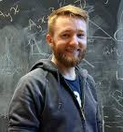




Hallas and Aronson Joint Group
Quantum Materials Discovery Lab
Meigan Aronson
Alannah Hallas
???
Jannis Maiwald
Dalmau Reig i Plessis
Xi Yang Li
Graham Johnstone
Joern Bannies
TBD

Slide 3
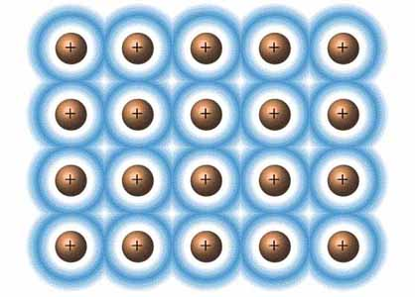
Interacting Conduction Electrons

Slide 4
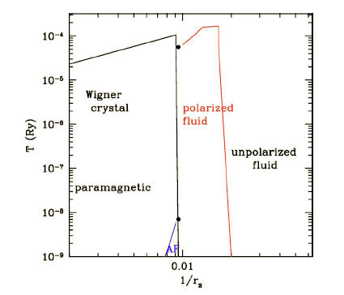
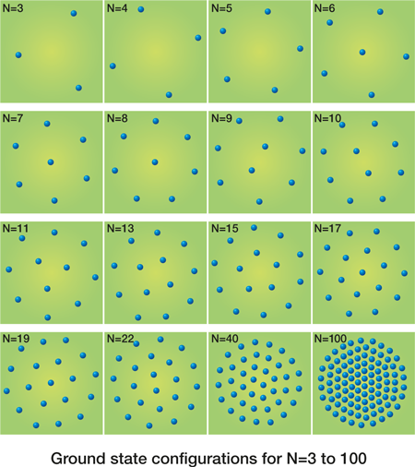
Electronic Interactions: Ordering of Charge and Spin
Coulomb interactions in
(low density) electron gas
Candido 2004
Peeters 2009
Increasing electron density
Localization of electron charge: Wigner lattice
Minimize potential energy by maximizing distance between electrons.
Spatial ordering of electron spin: ferromagnetic order (polarized fluid)

Slide 5
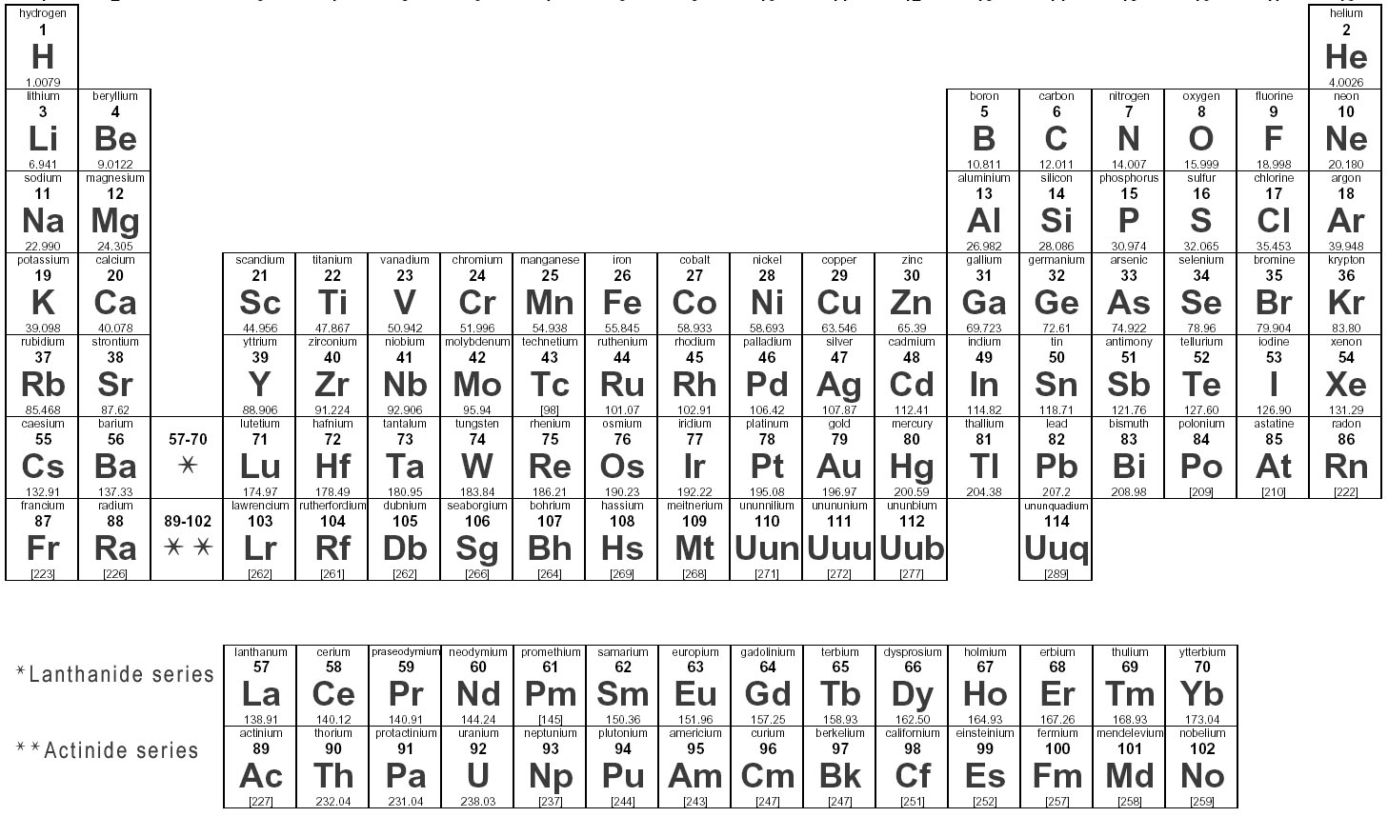
Origin of Interactions: Partially filled d- and f- shells in Elements
Magnetic, localized
Nonmagnetic, superconducting
Transitional: depends on compound
(after J. L. Smith 1985)
Most neutral atoms in the gas phase have partially filled shells, hence magnetic moments.
Initially, strong hybridization of d- and f- orbitals into bands: nonmagnetic metals.
d- and f- electron wave functions shrink as shell fills: electronic localization, magnetism.

Slide 6
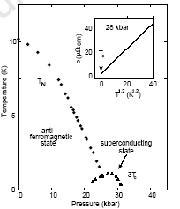
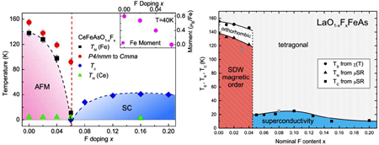
Magnetic Order vs Superconductivity in Correlated Electron Systems
Heavy Electron Intermetallics
Cuprates
CePd₂Si₂
Mathur 1998
AF
SC
Organic Conductors
Iron pnictides
(Jaccard 2001)

Slide 7

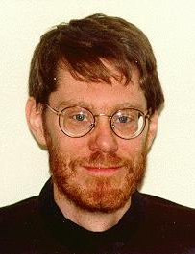
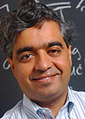
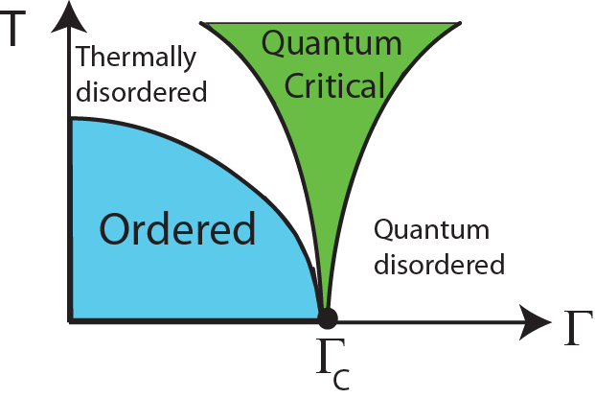
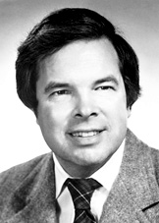

Quantum Critical Points (QCPs) Separate Different Phases at T=0
P, B, x
…..one can also think about a phase transition in a zero-temperature system which occurs when, say, a coupling constant reaches a certain threshold. In this case, none of the fluctuation modes have thermal energies, and their statistics will be highly nonclassical.
------- John Hertz 1976

Slide 8
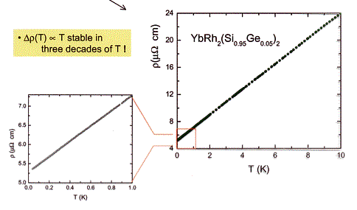
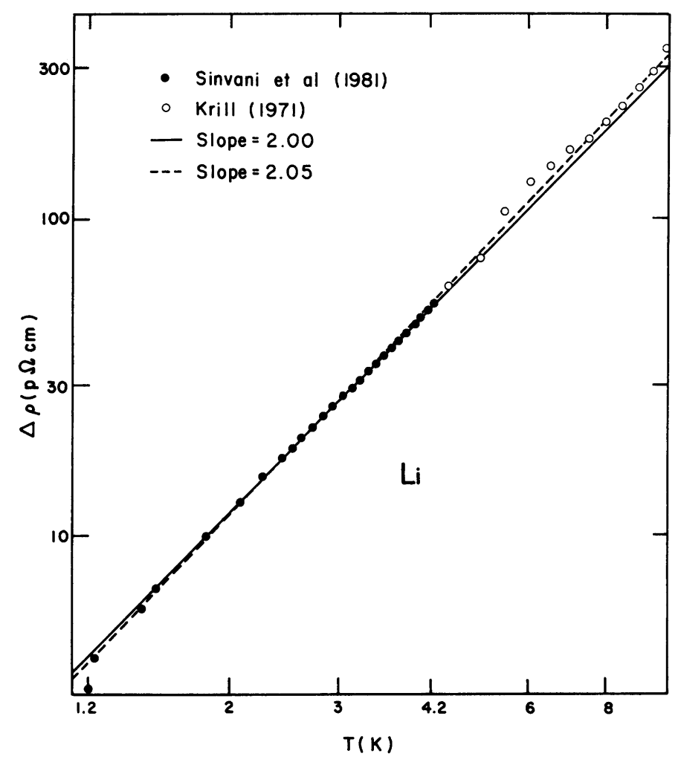
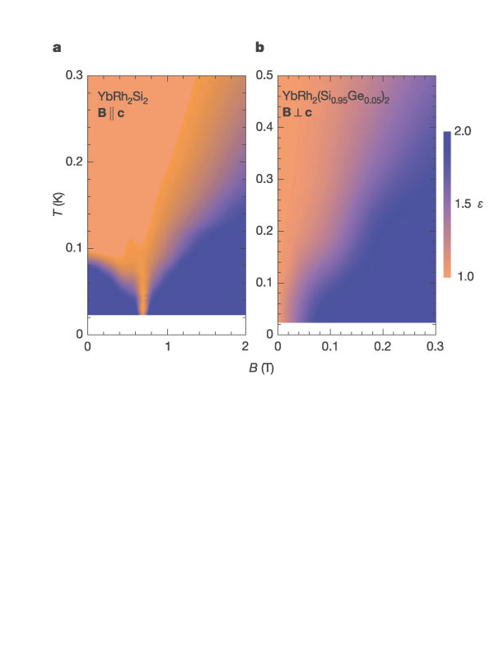
YbRh₂Si₂: An Unconventional Metal near the Quantum Critical Point
T(K)
nFL
FL
FL
ρ=ρ₀+aT^{n}
Steglich 2002
B_{QCP}
Unconventional metal near QC point (B=B_{QCP}, T<10 K)
YbRh₂Si₂: Non-Fermi liquid metal ρ~ρ₀+aT
Simple metal (Li): Fermi liquid metal ρ~ρ_{o}+AT²
Near QCP: unconventional metals are the disordered states from which
new ordered states emerge.
(Custers 2003)
ρ−ρ₀
Li
T²(K²)

Slide 9
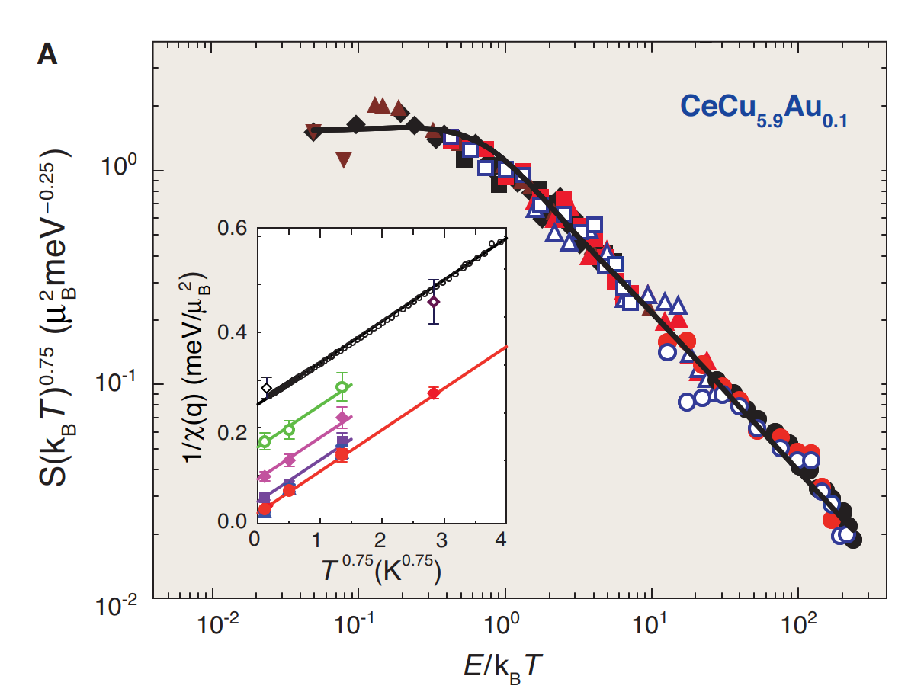
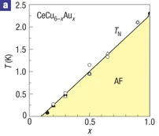
CeCu_{6-x}Au_{x}: Quantum Critical Fluctuations Scaled by Temperature
Schroder 2000
X_{QCP}=0.1
Inelastic neutron scattering experiments find that the dynamical susceptibility χ”=χ”(E/T), but in a Fermi liquid χ”=χ”(E/E_{F}).
The only relevant energy scale for these quantum critical fluctuations is temperature itself.

Slide 10
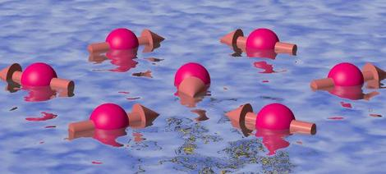
A Quantum Spin Liquid Near A QCP?
A Quantum Spin Liquid is a system with magnetic moments where
there are no broken symmetries.
It is a new state of matter found as T→0.
-The moments do not break translational symmetries, like a liquid.
-There is no magnetic order, which is suppressed by quantum fluctuations.
-It is not a paramagnet. Interactions lead to long-ranged entanglement of the wave functions.
The low energy properties of a Quantum Spin Liquid are related to effects such as:
-Quantum fluctuations
-Quantum entanglement
-Quantum coherence
-The topology of the quantum wave function.
The signature properties of a Quantum Spin Liquid are not fully known, but they include:
-Nonlocal and topological excitations.
-Fractionalized excitations.
QSL ground states may be topologically protected, suggesting possible role as qubits in quantum information applications.

Slide 11
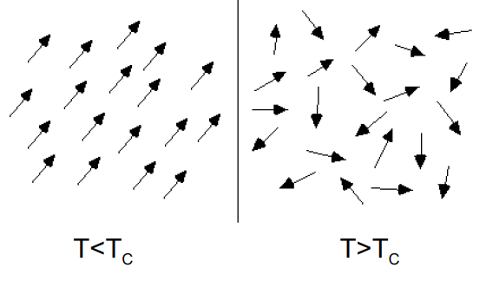
How to Discover a Quantum Spin Liquid?
Thermal
Fluctuations
T
T_{N}
Quantum
Fluctuations
Γ (x,P,B)
Γ_{QCP}
Ferromagnet (ordered)
Paramagnet (disordered)
Ordering is a consequence of interactions J among moments: k_{B}T_{C,N} ~ zS(S+1) |J|
If J→0, the range of temperatures where you would see QC behavior shrinks as T_{C}→0.
Accessing a Quantum Critical Point Γ_{QCP} (T_{N}=0): Approaches for maximizing quantum fluctuations to disrupt order.
-Low Dimensionality
-Frustrated or Competing Interactions
-Singlet Formation (dimerization)
In metals, reducing the strength of correlations can destabilize magnetic moments (Kondo effect, Mott transition), weakening magnetic order.

Slide 12
Geometrical Frustration: Balance of Competing Interactions
1
2
3
4
5
6
Triangular Lattice with AF near-neighbor interactions is inherently frustrated.
Huge ground state degeneracy → quantum fluctuations may be strong
Competing exchange interactions often lead to magnetic order.
A need to find new candidates for QSL.

Slide 13
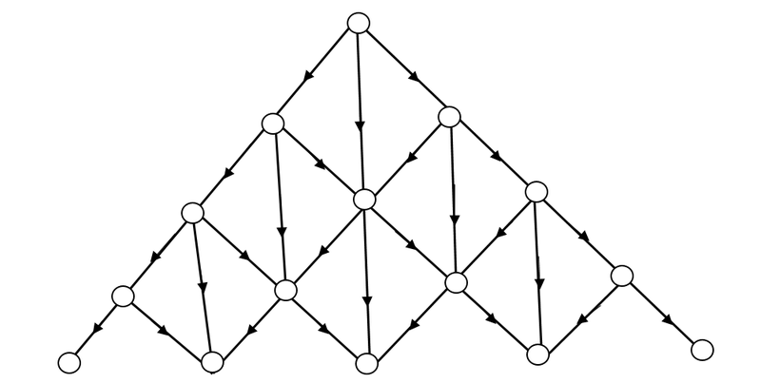
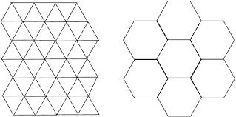
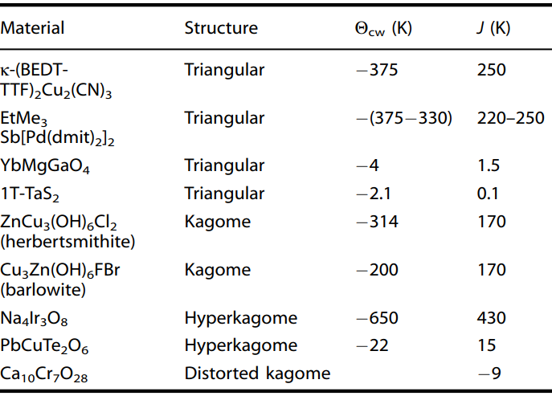
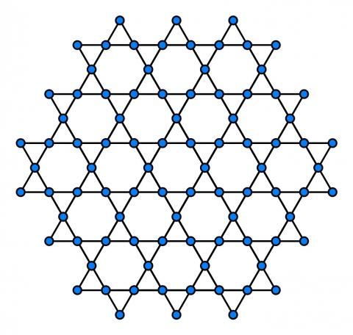
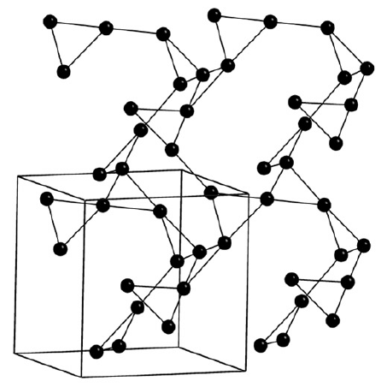
A wealth of lattices with triangular motifs where frustration is important
Kagome
Hyper-Kagome

Slide 14
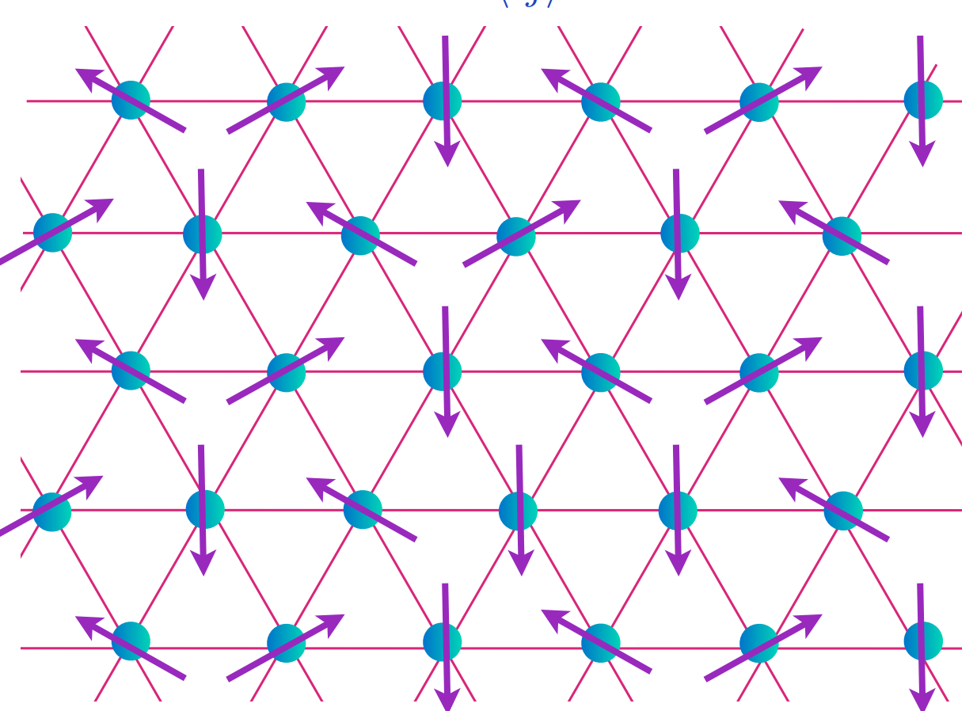
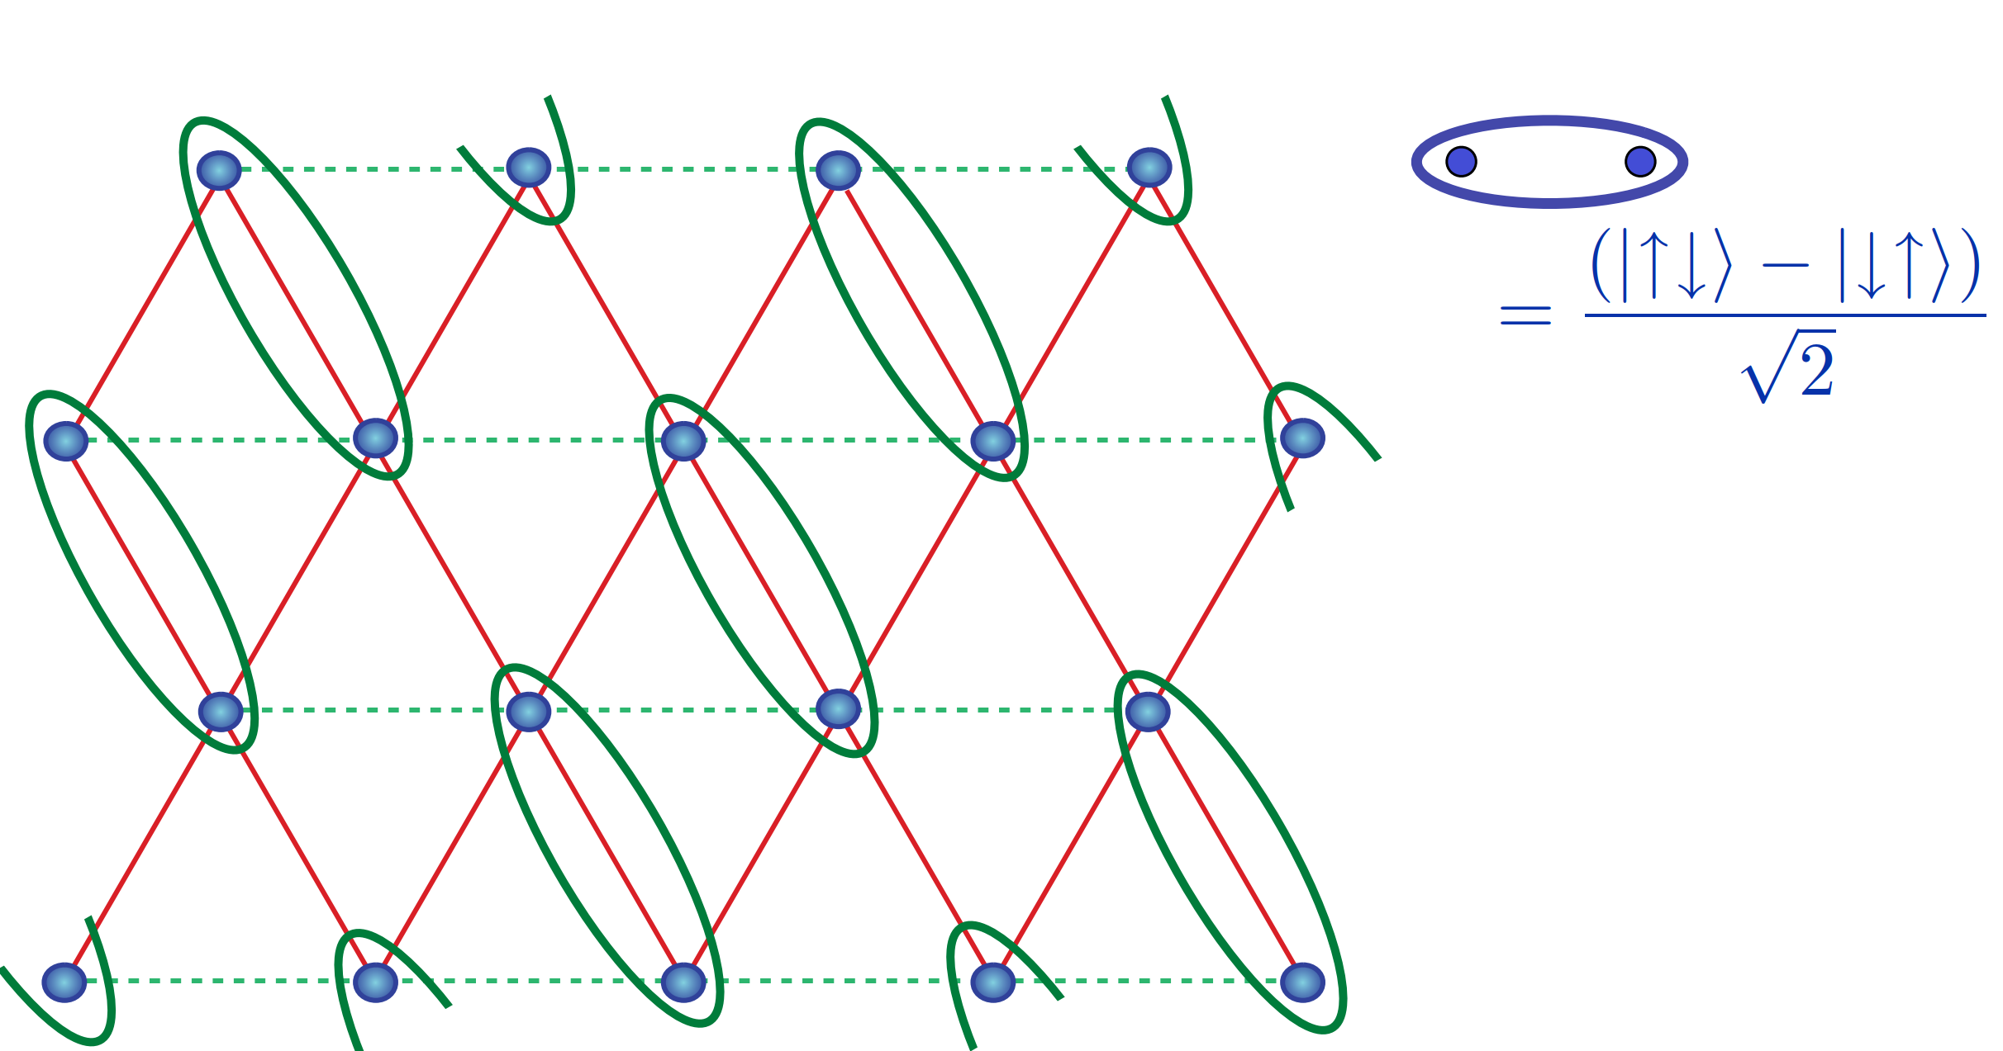
Conventional Magnetic Order vs Valence Bond State
Noncollinear spins with Neel order. Broken rotational and time reversal symmetries.
Valence Bond State. Broken rotational symmetry, time reversal symmetry remains unbroken.
Fazekas and Anderson 1974
Heisenberg Spins
Ising Spins (Read 1991)
J_{ring}/J (Motrunich 2005)
Quantum Critical Point

Slide 15
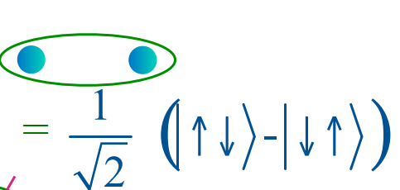
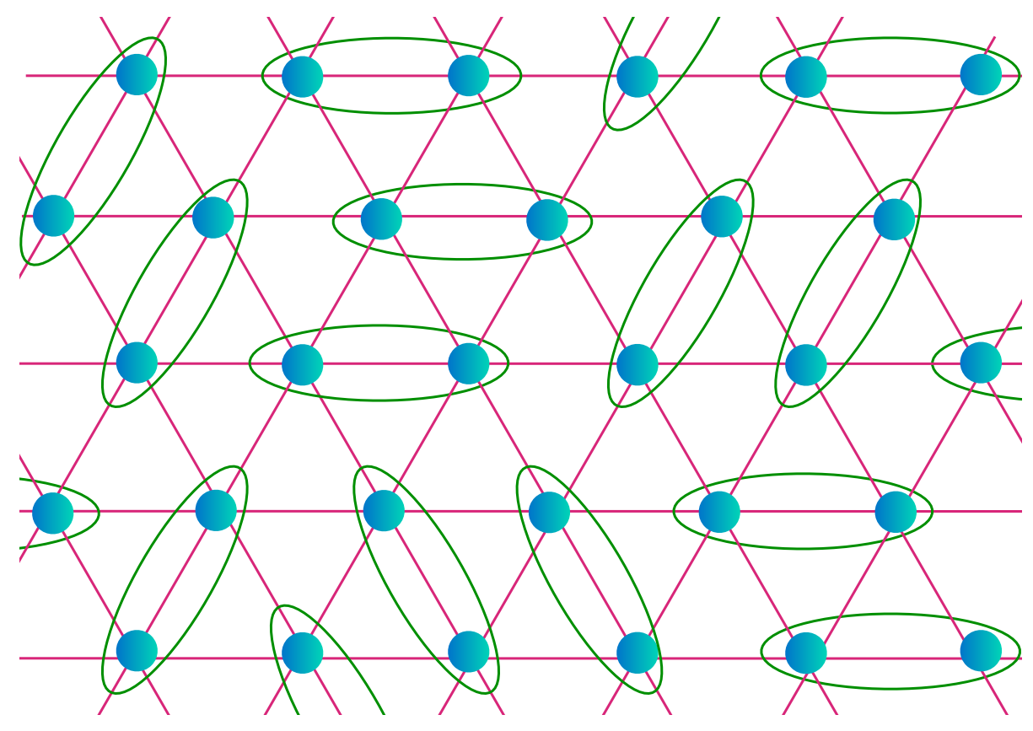
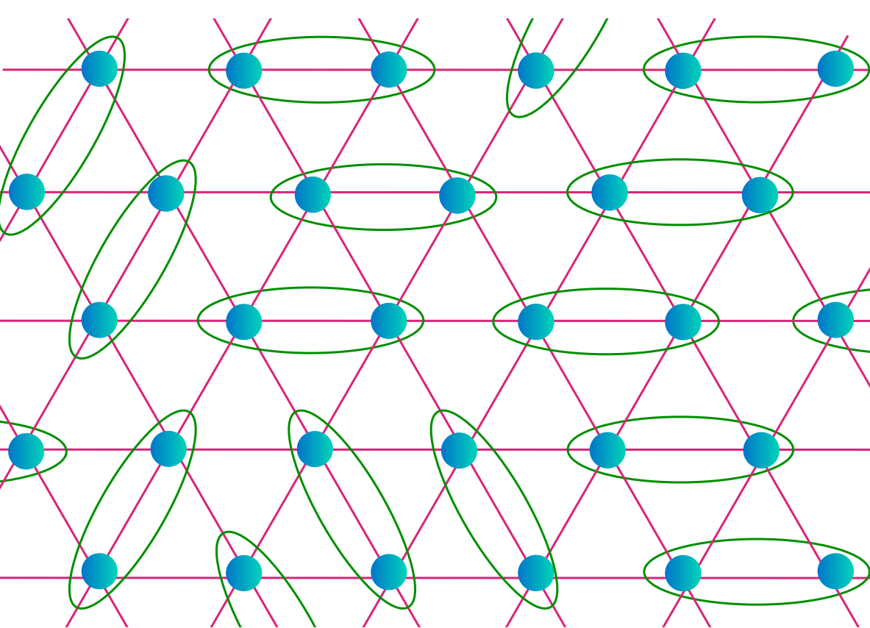
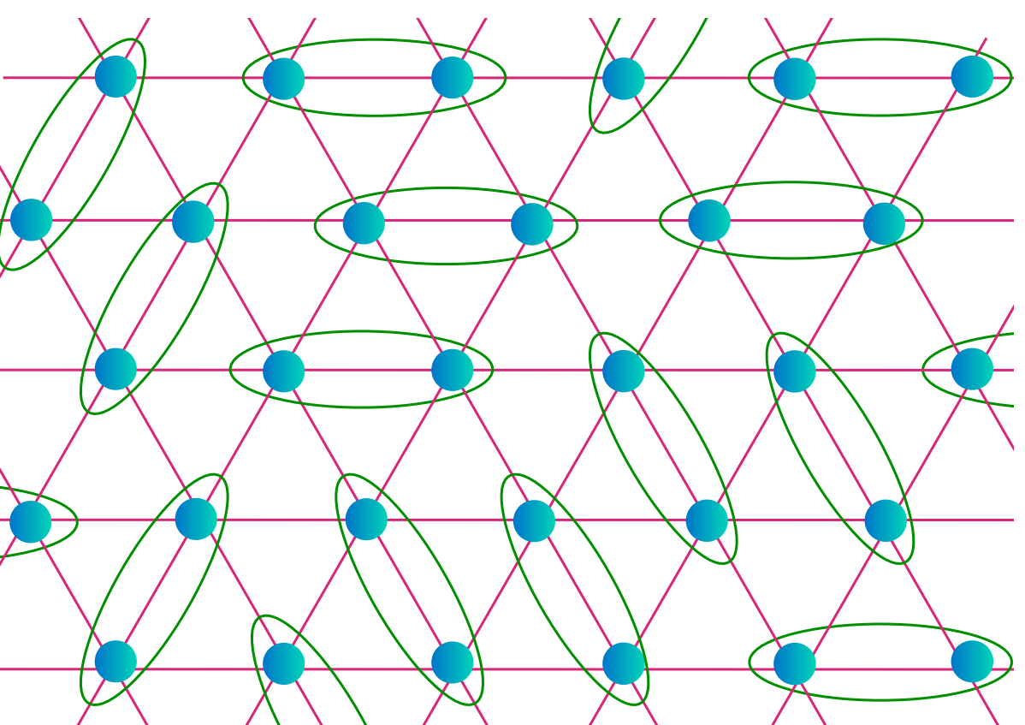
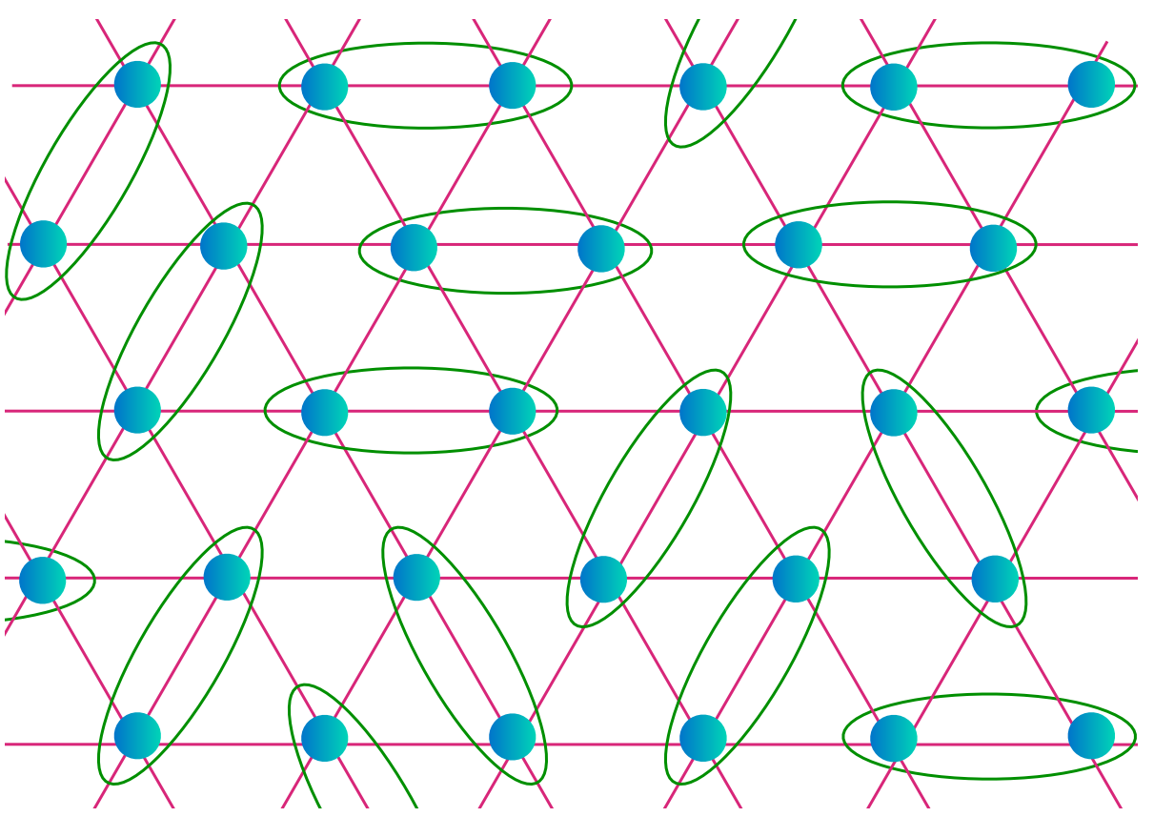
Singlets in Valence Bond State vs Quantum Spin Liquid
+
+
+
+….
Fazekas and Anderson 1974
Valence Bond State. Broken rotational symmetry, time reversal symmetry remains unbroken.
Spin liquid: no broken symmetries, massively entangled.

Slide 16
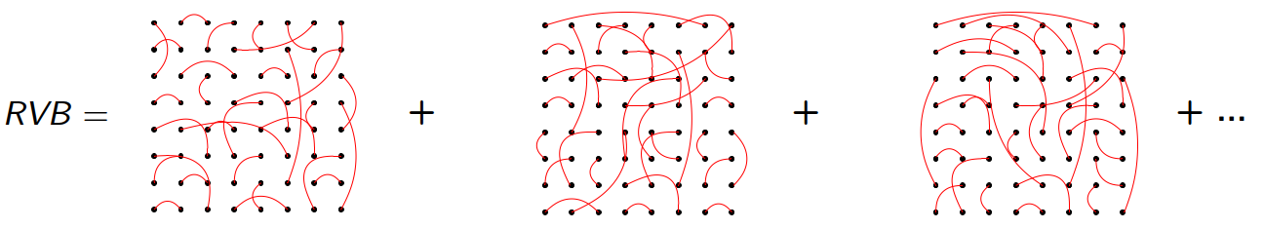
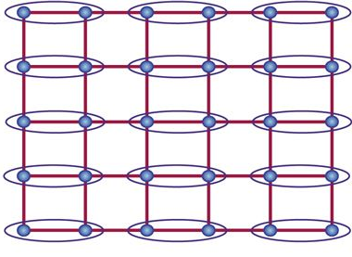
Long Ranged Entanglement Required for Quantum Spin Liquid
An electron with charge e, spin S=1/2 on each lattice site
Each singlet: two charges e, S=0 singlet (|↑↓> - |↓↑>)/√2
P. W. Anderson 1972
Valence Bond Solid
Resonating Valence Bond State
+
+
+ …
Short Ranged Interactions
Broken rotational and translational symmetries
Long Ranged Entanglement of Singlets
No broken symmetries
At present, there are no viable Hamiltonians known that produce a Quantum Spin Liquid from RVB-like states.
Higher order interactions may tend to drive ordered configurations.
Different moment types, lattice symmetries, interaction types. QSL still an open question.

Slide 17
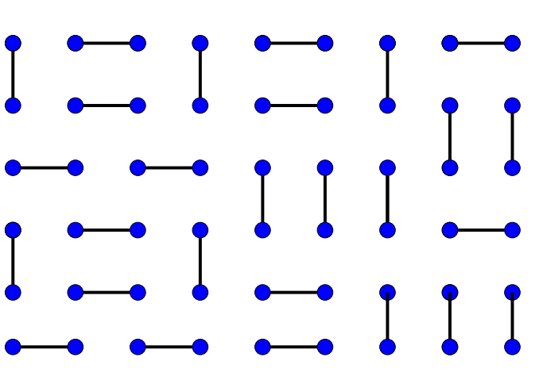
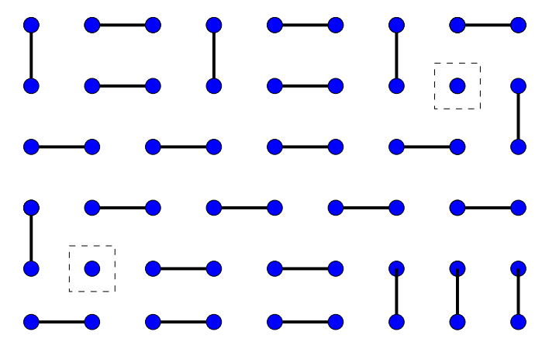
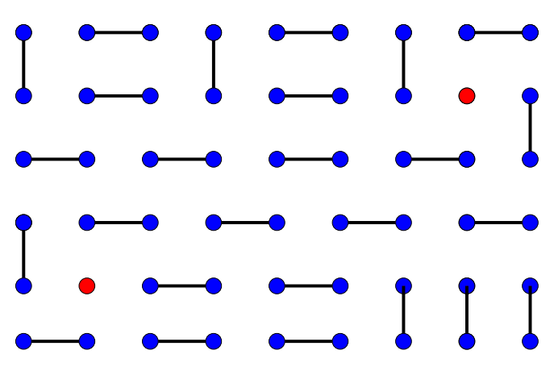
Composite Electrons: Resonant Valence Bond State on a Square Lattice
Ground State: Superposition of Singlets with
Long-ranged entanglement
Excited State: Break a Dimer Bond
Remove two charges: hole doping
Two quasiparticles created, but
no new charge. Each quasiparticle
S=1/2. They are spinons.
Two delocalized holes form singlet S=0.
Together, holes have charge -2e
This quasiparticle is a holon.
Long-ranged entanglement of the electron wavefunction produces new excitations with spin, charge, and orbital associated
with individual electrons.
Resonating Valence Bond (RVB) state envisaged as normal state for unconventional superconductors (Anderson 1987).
The holons allow charge to be mobile in the RVB state, and their quantum entanglement would lead to superconductivity.

Slide 18
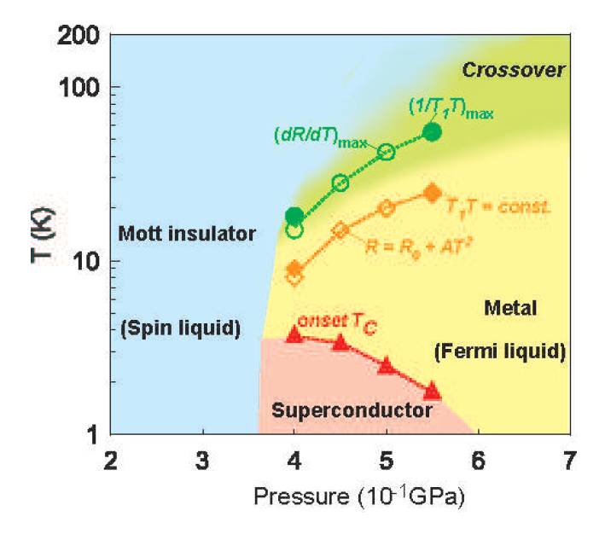
Frustrated Magnetism + Unstable Moments → New Phases
Organic Conductor
κ-(ET)₂Cu₂(CN)₃
Kurosaki 2018
Virtually all of the geometrically frustrated and low dimensional materials that are quantum spin liquids are insulating.
Introducing mobile charge that could lead to unconventional superconductivity is generally unsuccessful.
If metallic analogs of insulating systems with strong quantum fluctuations can be found, initial evidence suggests that proximity to an electronic instability such as the Mott transition may lead to new phases ,perhaps unconventional superconductivity.
What new ordered and disordered states will be found if magnetic moments themselves can be controlled?
Our research seeks new systems where the magnetism of d- and f-electrons is in transition, as is their ability to order.

Slide 19
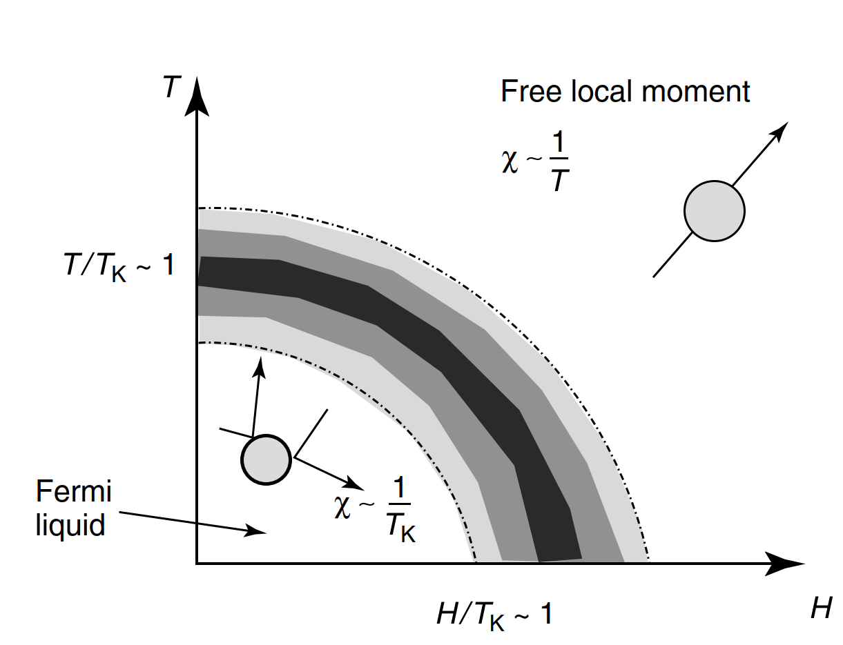
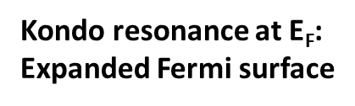
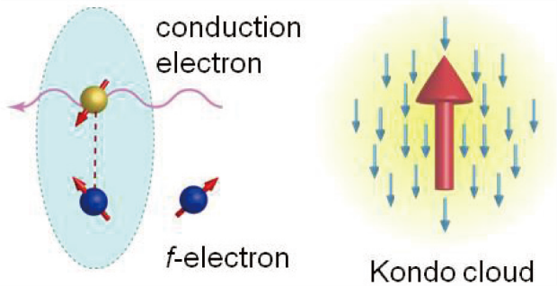
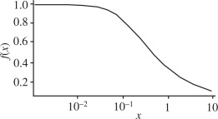
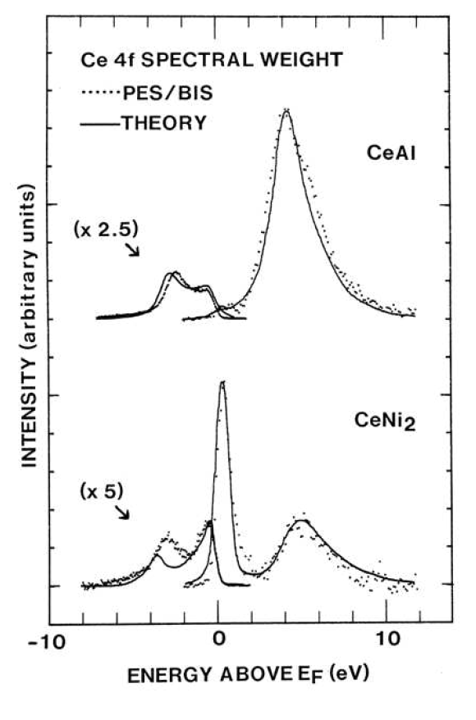
Electronic Delocalization: Kondo Compensation of Magnetic Moments
T<<T_{K}
Kondo singlet complete
Nonmagnetic metal χ~1/T_{K}
T~T_{K}
Kondo singlet forms
χ/χ₀
T>>T_{K}
Paramagnet
χ~1/T
T/T_{K}
Due to exchange coupling, the conduction electrons of a metal and the localized
f- or d- electron moments form a S=0 singlet.
The Kondo effect has a characteristic scale T_{K}, separating paramagnetism
(T>>T_{K}) and nonmagnetic metal (T<<T_{K}).
The Kondo effect effectively delocalizes the magnetic d- or f-electron, and the
formation of the Kondo resonance increases the number of states contained in
The Fermi surface.
k_{B}T_{K}

Slide 20
Ground States with Localized or Delocalized d or f-electrons
J’
Temperature
T_{K}=0
T_{K}>>T_{C}
Magnetic Order
Localized electrons
No order (Fermi Liquid)
Delocalized electrons
J’
Small FS
f-electrons excluded
QCP
Large FS
f-electrons included
Two ways to create a Quantum Critical Point where T_{C}→0:
-frustrate magnetic interactions (no change in Fermi surface volume) Could happen in metals or insulators
-destroy the ordering moment (possible change in Fermi surface volume) Can only happen in metals

Slide 21
A Global Phase Diagram for Correlated Electron Systems?
Q
Spin Liquid
T=0
Small FS
Q_{QCP}
Q. Si, (2010)
P. Coleman & A. Nevidomskyy, (2010)
SC?
Quantum Fluctuations
Magnetic Order
Spin Liquid
Small
FS
Large
FS
Large FS
Γ (P,x)
Γ_{QCP}
Increasing quantum fluctuations Q suppress T=0 magnetic order:
-Low dimensionality
-Geometrical frustration: triangular, Kagome, pyrochlore lattices.
- Dimerization: Shastry-Sutherland lattice.
Additional interplay of electronic delocalization Γ and order in correlated metals (Kondo and Mott Physics).
A need for new metallic and geometrically frustrated compounds to compare to benchmark insulators.

Slide 22
Strong fluctuations in low-dimensional magnets
Mermin-Wagner Theorem:
``In one and two dimensions, continuous symmetries cannot be broken at nonzero temperatures in
systems with sufficiently short-ranged interactions.’’
a ± ξ
a ± ξ
a ± ξ
A chain with nearest –neighbor interactions J
n
n+1
n+2
Since the atoms fluctuate independently:
Relative fluctuation between near neighbor atoms (n,n+1), or (n=1,n+2): ~ξ
Relative fluctuation between second neighbor atoms n, n+2: √2 ξ
The fluctuations become increasingly uncorrelated with the distance between atoms in one-dimensional systems. Correlations are short-ranged as in a liquid or gas, and do not persist on long length scales, as needed to drive a true phase transition.

Slide 23
Fractionalized Excitations in Spin S=1/2 Chain: Spinons
Flip one spin relative to AF background (ΔS=1) `magnon’
AF state is restored by generation of two spinons that propagate. Each carries half of flipped spin, so spinon S=1/2
Spinons: a fundamental excitation with S=1/2, charge = 0.
Spinons are found in spin chains, and in certain frustrated lattices.
The spinon carries the spin of the electron, but not its charge. It is `part of an electron’, ie a fractionalized particle.
The spinons are confined on chains, since the energy cost for the spinons grows linearly with their separation.
Spinon spectra can be studied using inelastic neutron scattering, as well as angle-resolved photoemission.

Slide 24
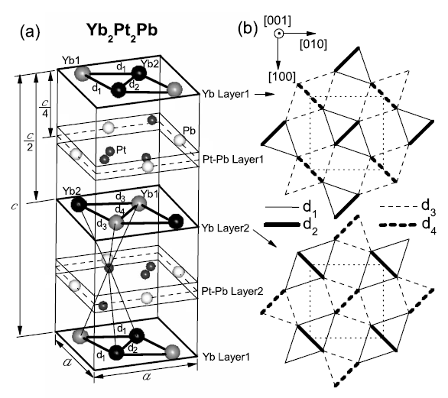
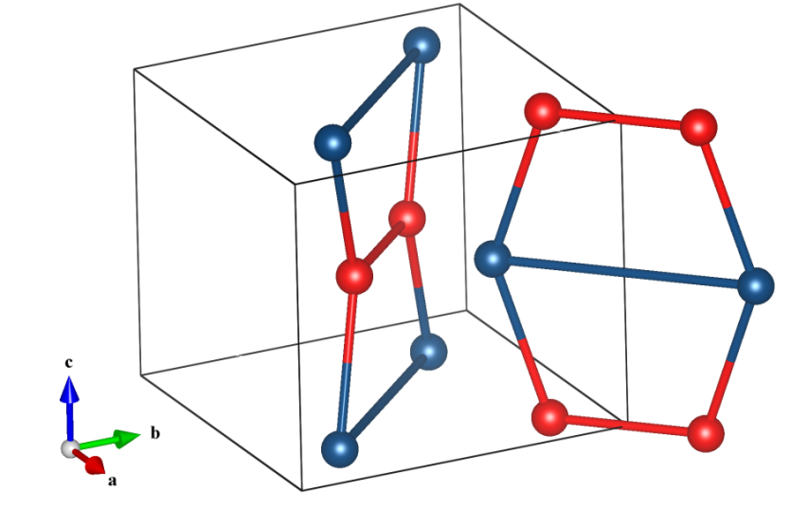
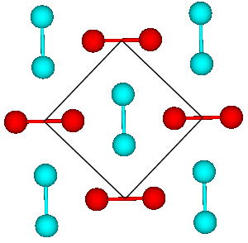

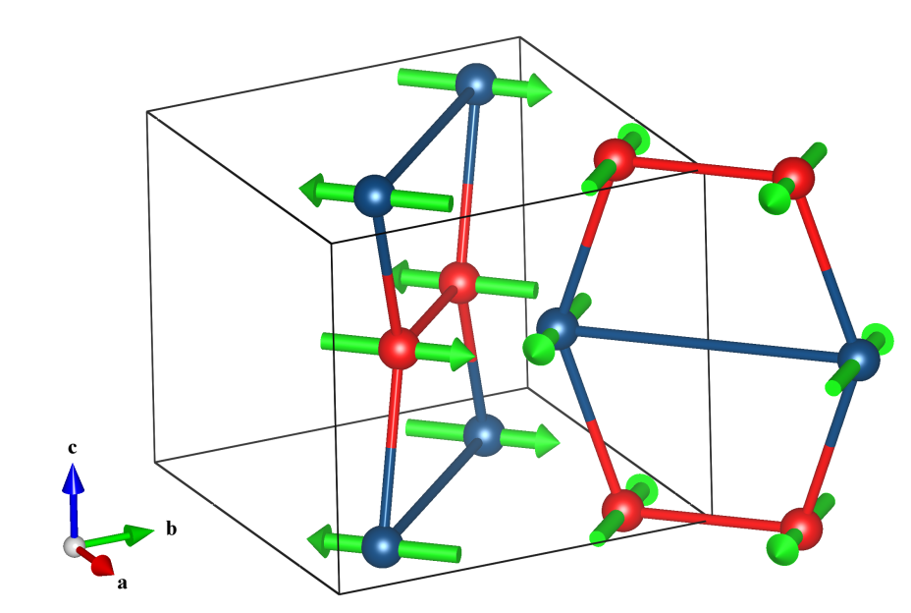

Yb₂Pt₂Pb: Spinons in Metallic Chains of Yb³⁺ Moments
3.965 Å
3.889 Å
3.51 Å
3.545 Å
(Pöttgen 1999)
c-axis
q_{AF}⁺=(0.2,0.2,0) rlu
d₃
d₂
Yb³⁺ moments with j_{Z}=±7/2 doublet ground states form planes of orthogonal dimers in the Shastry-Sutherland Lattice (SSL).
Planes stack with closest Yb-Yb distance along c-axis: One dimensional magnetic system ``orthogonal spin ladders’’
Yb₂Pt₂Pb is an excellent metal, with weak coupling between conduction electrons, Yb moments. Small Fermi surface?
q_{AF}⁻=(0.2,-0.2,0)rlu
d₄
Weakly coupled Spin ladders
d₁
d₁=3.545 Å
d₂=3.965 Å
d₃=3.889 Å
d₄=3.510 Å

Slide 25
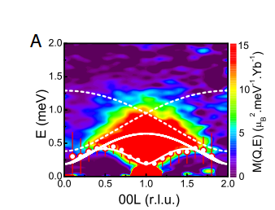
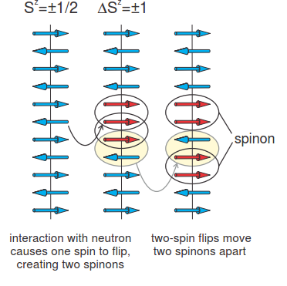
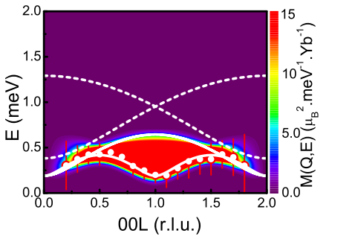

Yb₂Pt₂Pb: Fractionalized Quantum Excitations
Wu et al 2016
T=0.1 K, B=0
Dispersing excitations along (00L): continuum of fractionalized S=1/2 quantum excitations .
Gapped, dispersionless excitations in the HHL (SSL) plane: excitations are confined to one-dimensional ladder rails.
Excitations have characteristic spinon dispersion expected for spin S=1/2 Ising-Heisenberg XXZ Hamiltonian:

Slide 26
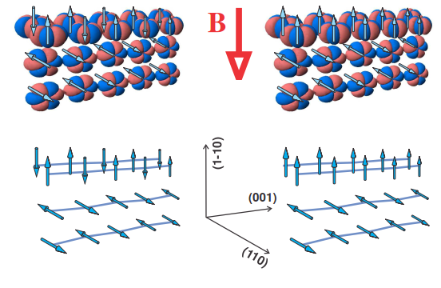
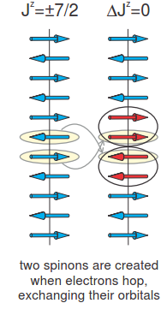


The Spinon Bandwidth: an Emergent Energy Scale
Doublet ground state |±7/2> = α↑|7/2> + α↓|-7/2>
Interactions that are bilinear in J (Zeeman, Heisenberg-Dirac exchange, dipolar) can only change quantum number Δm_{J}=± 1,
so they have no matrix elements that would allow transitions within ground state wavefunction, which require Δm_{J}=7.
Yb³⁺ moment: a 4f hole with orbital momentum L=3, |m_{L}|=3 and 6-fold symmetry around J quantization axis.
A consequence of large energy scales: spin-orbit coupling, crystal fields, Coulomb interactions.
Orbital exchange: the permutation of neighboring electron orbitals |m_{J1},m_{J2}> and |m_{J2},m_{J1}> with equal weights, driven
by orbital overlap.
m_{L}=3
m_{L}=-3
m_{L}=3
m_{L}=3
Hopping allowed
|Δm_{J}|=7
Hopping blocked

Slide 27
A Global Phase Diagram for Correlated Electron Systems?
Q
Spin Liquid
T=0
Small FS
Q_{QCP}
Q. Si, (2010)
P. Coleman & A. Nevidomskyy, (2010)
SC?
Quantum Fluctuations
Magnetic Order
Spin Liquid
Small
FS
Large
FS
Large FS
Γ (P,x)
Γ_{QCP}
Yb₂Pt₂Pb: a one-dimensional, metallic, spin liquid with localized moments

Slide 28



Ti₄MnBi₂: Mn Moment Formation in a 1-D Chain?
b
Cr,Mn,Fe,Co
Bi
Ti
Richter 1997
7.5 Å
a
Well separated chains of Mn ions encased in Ti and Bi tubes:
Mn-Mn spacing: Interchain: 7.5Å Intrachain: 2.4 Å
Naturally located near moment formation in correlated band (Coey 2010)?
d_{Mn-Mn} ≤ 2.4 Å ➔ nonmagnetic band (U/4t<1)
2.5 Å ≤ d_{Mn-Mn} ≤ 2.8 Å ➔ emerging Mn moment, antiferromagnetic order
d_{Mn-Mn} ≥ 2.9 Å ➔ Localized Mn moments, ferromagnetic order (U/4t>1)

Slide 29


ARPES: 1D dimensional Fermi Surface in Ti₄MnBi₂
Γ
Γ+<1-10>
Γ
Γ+<1-10>
Utsuji 2013
45 K

Slide 30

Ti₄MnBi₂: Quantum fluctuations from 1D and/or moment collapse?
Pandey 2020
μ_{eff}=1.79 μ_{B}/Mn (S=1/2)
θ=-9.3 K (AF)
Curie-Weiss moment: μ_{CW}=1.79 μ_{B}/Mn (S=1/2) Low spin configuration.
Strong fluctuations make Mn valence and spin state ill-defined: broad band (-2.5eV to 2.5 eV).
Density of states dominated by Ti d-states, moderate correlations: D^{γ}(E_{F})~3.4D(E_{F})^{DFT}
Mn d_{x}2_{-y}², d_{xy} orbitals are spin polarized. AF order observed T_{N}~1.9 K, but entropy is only ~10% of Rln2.

Slide 31
A Global Phase Diagram for Correlated Electron Systems?
Q
Spin Liquid
T=0
Small FS
Q_{QCP}
Q. Si, (2010)
P. Coleman & A. Nevidomskyy, (2010)
SC?
Quantum Fluctuations
Magnetic Order
Spin Liquid
Small
FS
Large
FS
Large FS
Γ (P,x)
Γ_{QCP}
Yb₂Pt₂Pb: a one-dimensional, metallic, spin liquid with localized moments Small FS
Ti₄MnBi₂: a one-dimensional, metallic, (near) spin liquid with weak, itinerant moments Large FS

