Slide 1
The Topology and Morphology of Bicontinuous Interfaces
  Y-W. Kwon, K. Thornton* and P.W. Voorhees
  Department of Materials Science and Engineering
  Northwestern University
  *University of Michigan

Slide 2
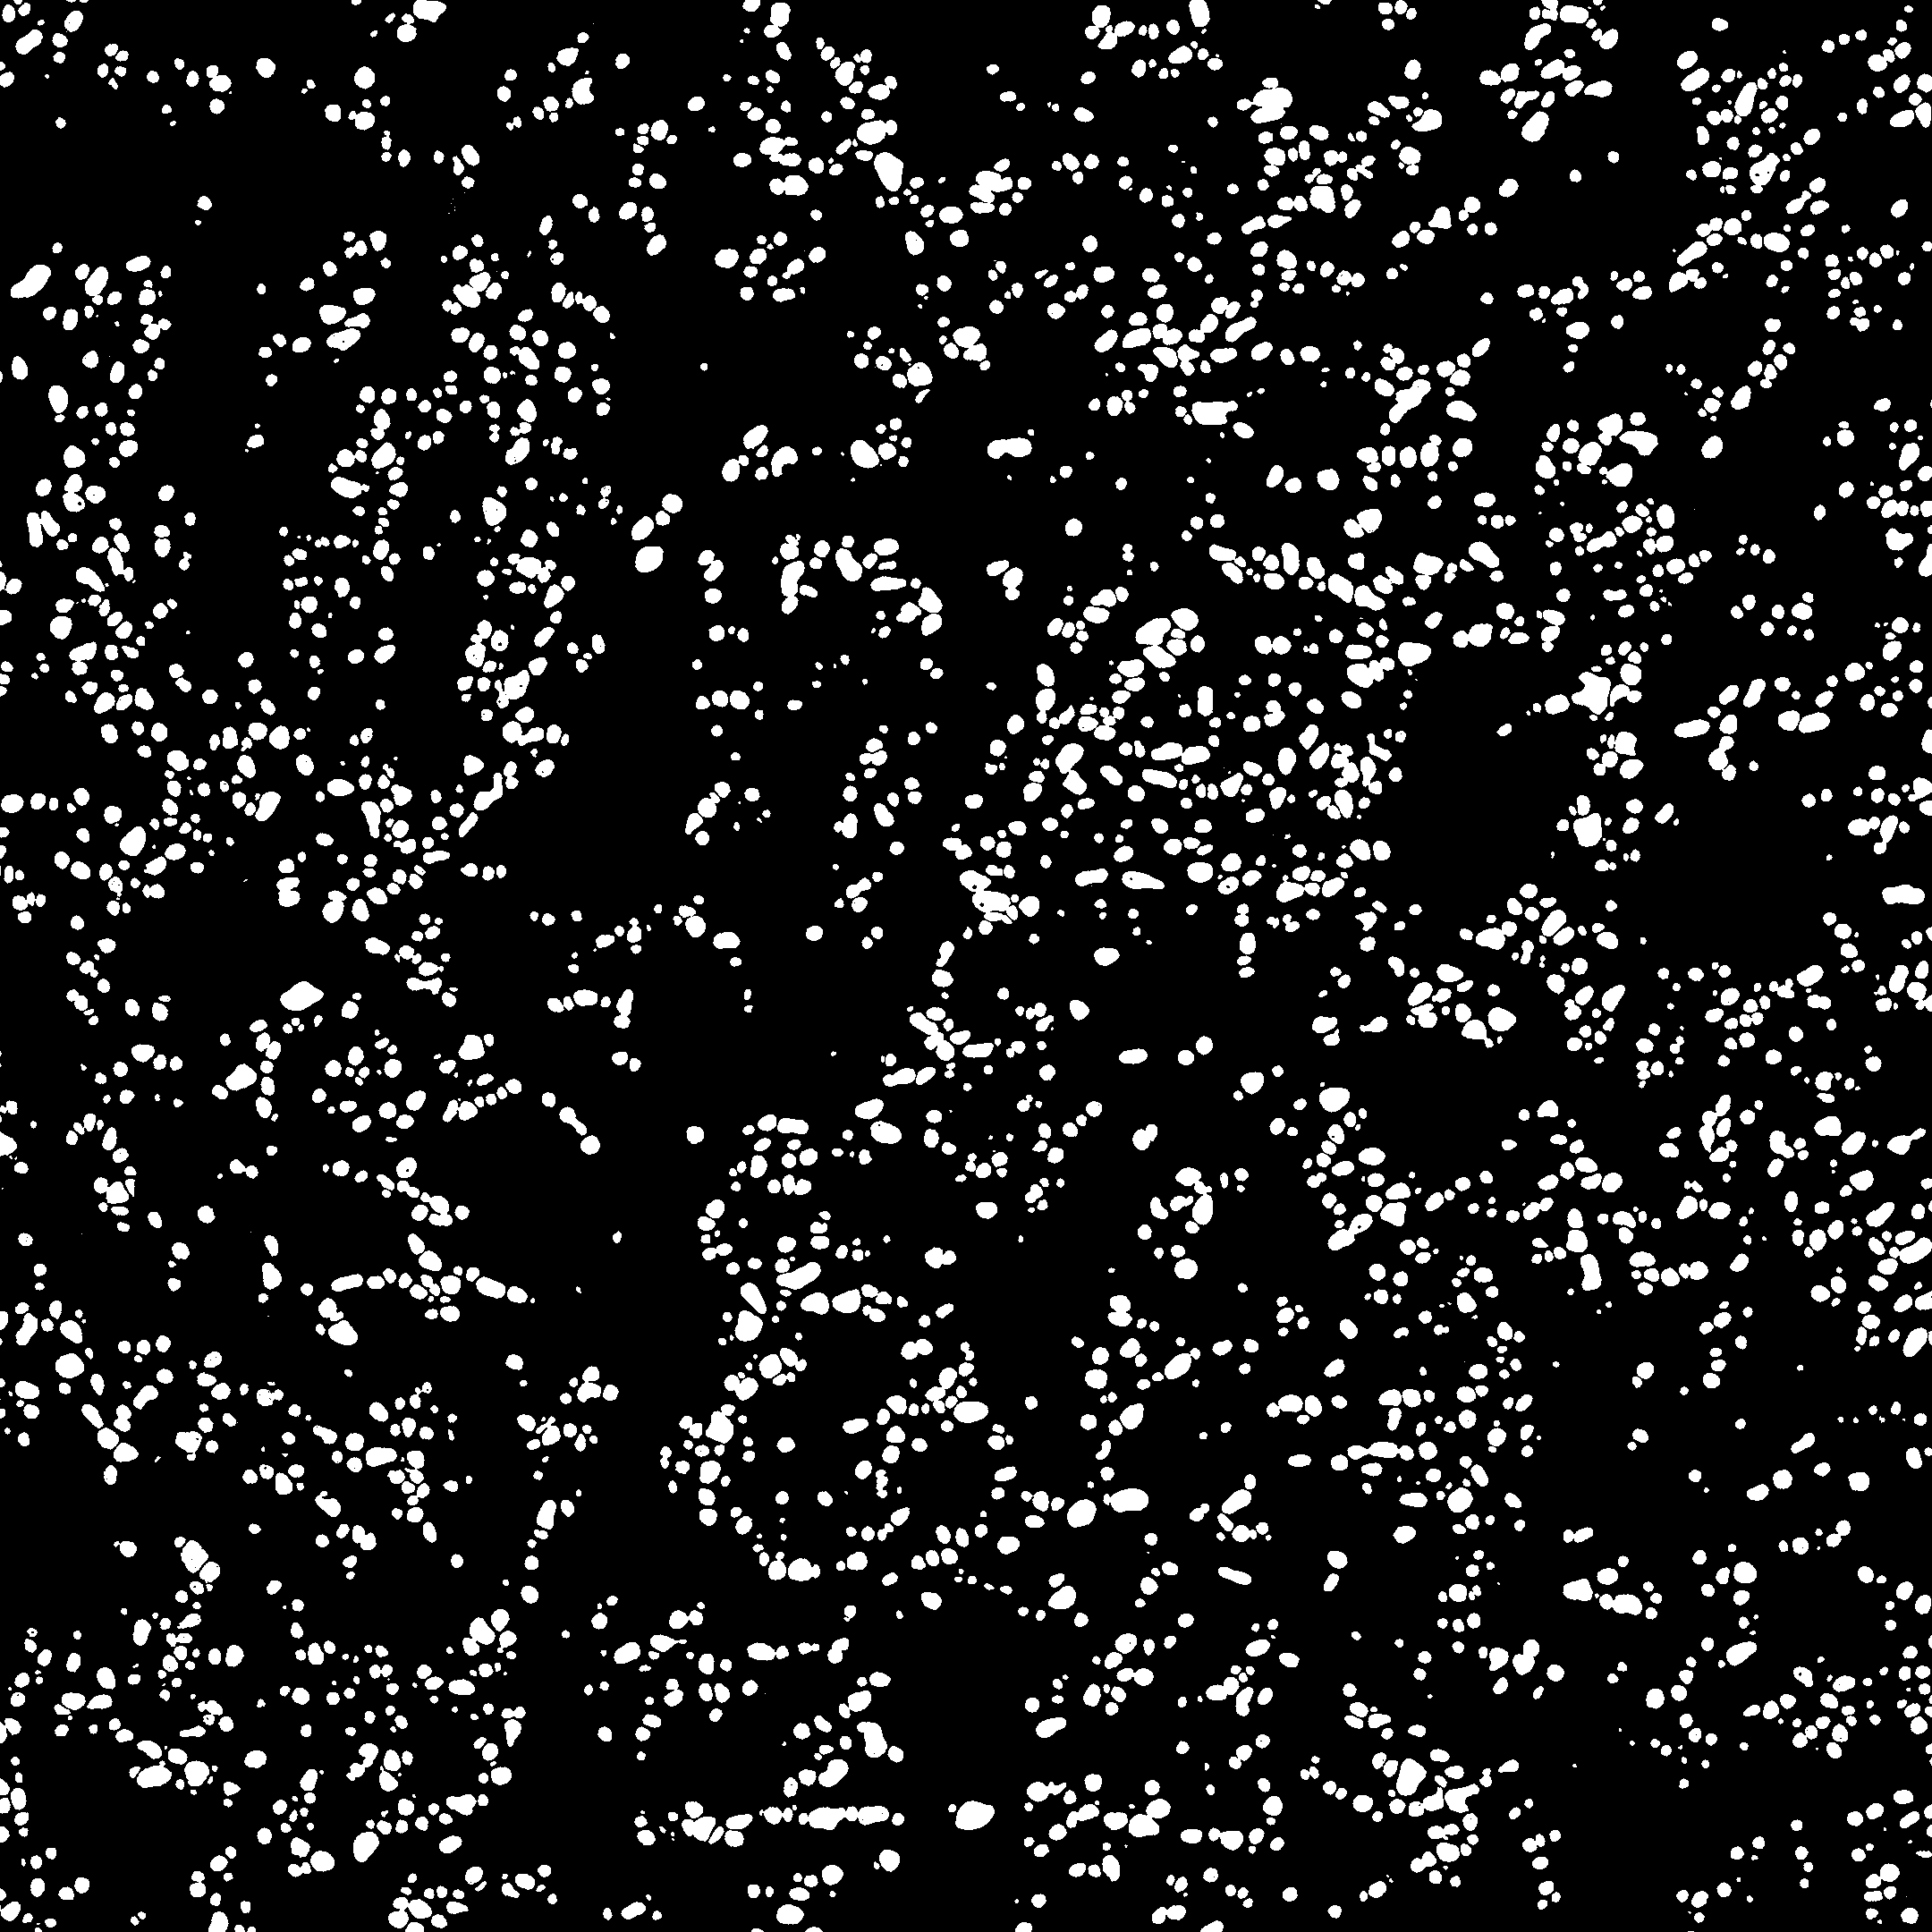
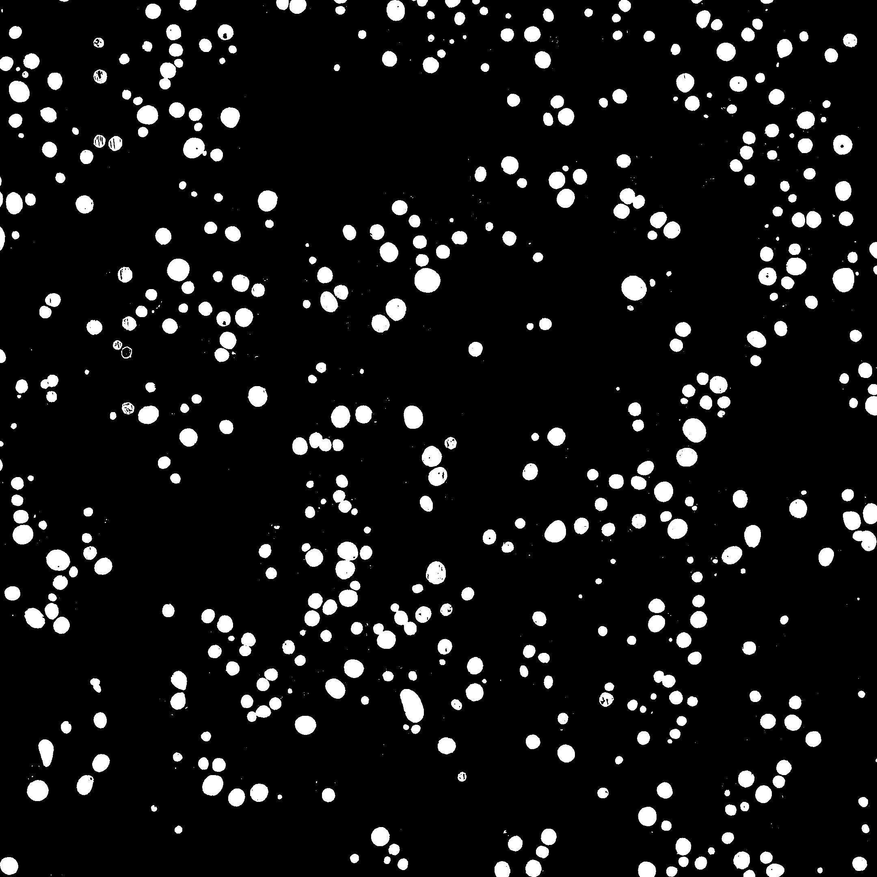


Coarsening: Spherical Particles
Solid Sn particles in a Pb-Sn eutectic liquid
375 μm
375 μm
t = 0 hr t = 0.6 hr t = 24 hr
375 μm
(Alkemper, Snyder and PWV, 1999)

Slide 3
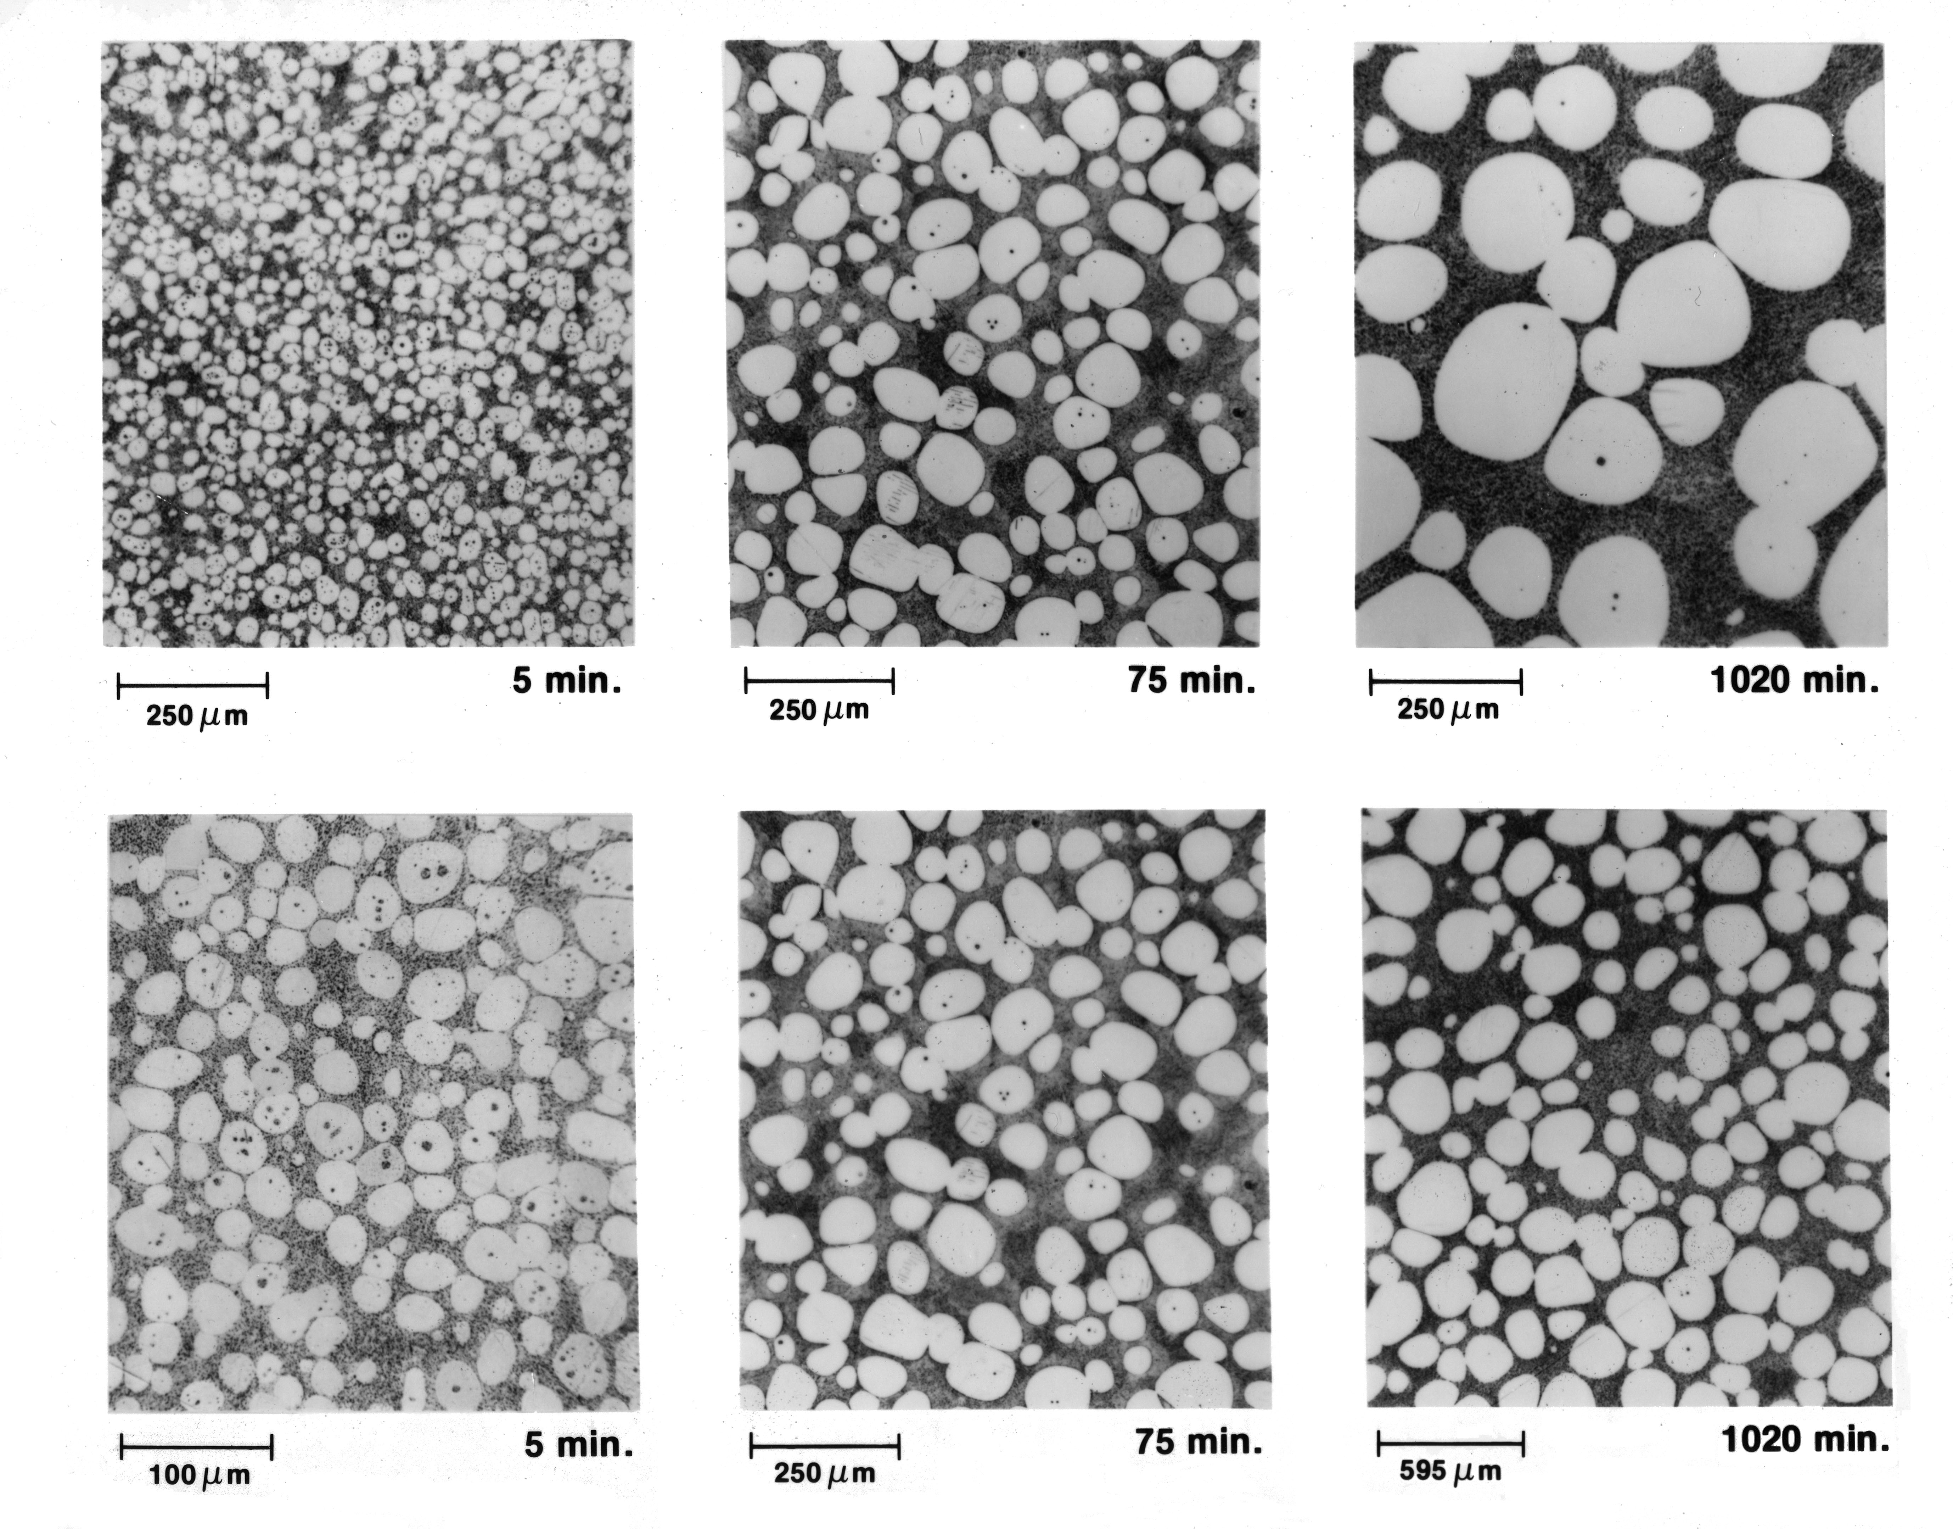
Ripening: Spherical Particles
Solid Sn particles in a Pb-Sn eutectic liquid
(Hardy and PWV, 1988)

Slide 4
Ripening: Spherical Particles
Solid Sn particles in a Pb-Sn eutectic liquid
Scaled by
<R(t)>
(Hardy and PWV, 1988)

Slide 5
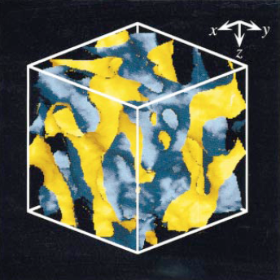
Topologically Complex Interfaces
polybutadiene and
poly(styrene-ran-butadiene) blend
Jinnai et al., Phys. Rev. Lett., 78 2248 (1997)
Fe-Al alloy
Metals Handbook, 1973

Slide 6
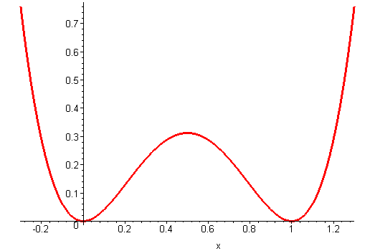

Cahn-Hilliard Equation
α
f
α
β
Temperature
Composition

Slide 7
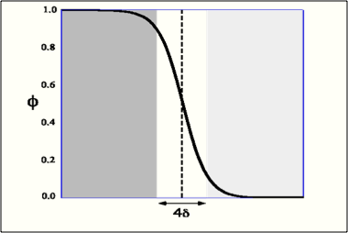
Equilibrium Order Parameter Distribution
Minimize F with the constraint that two phases are present:
f

Slide 8




Cahn-Hilliard Equation
Diffusion flux is given by:
The chemical potential is:
Mass conservation:
Thus:

Slide 9

Cahn-Hilliard: Sharp Interface Limit
In the limit δH <<1:
diffusion in the bulk:
at the interface between the two phases:
(Novick-Cohen, Caginalp, Mcfadden,
Cahn,…)
Diffusional interactions between interfaces

Slide 10
Order-Disorder Transformations
f

Slide 11


Allen-Cahn/Ginzburg-Landau Equation
The chemical potential is:
Order parameter not conserved!
Thus:

Slide 12
Allen-Cahn/Ginzburg-Landau :
Sharp Interface Limit
In the limit the interface width goes to zero one obtains:
(Allen and Cahn)
No diffusional interactions between interfaces

Slide 13
Computations
Begin with random noise in the order parameter
Volume fraction of each phase is 0.5
Phases with different order parameters appear, grow, and coarsen
Hδ << 1
Explicit finite difference
Parallel code, typically run over 32 processors
Need large systems and long times:
  Cahn Hilliard: 512³ grid
  Allen-Cahn/Ginzburg-Landau: 1024³ grid
  Typical AC/LG run generates about 0.5 TB of data

Slide 14
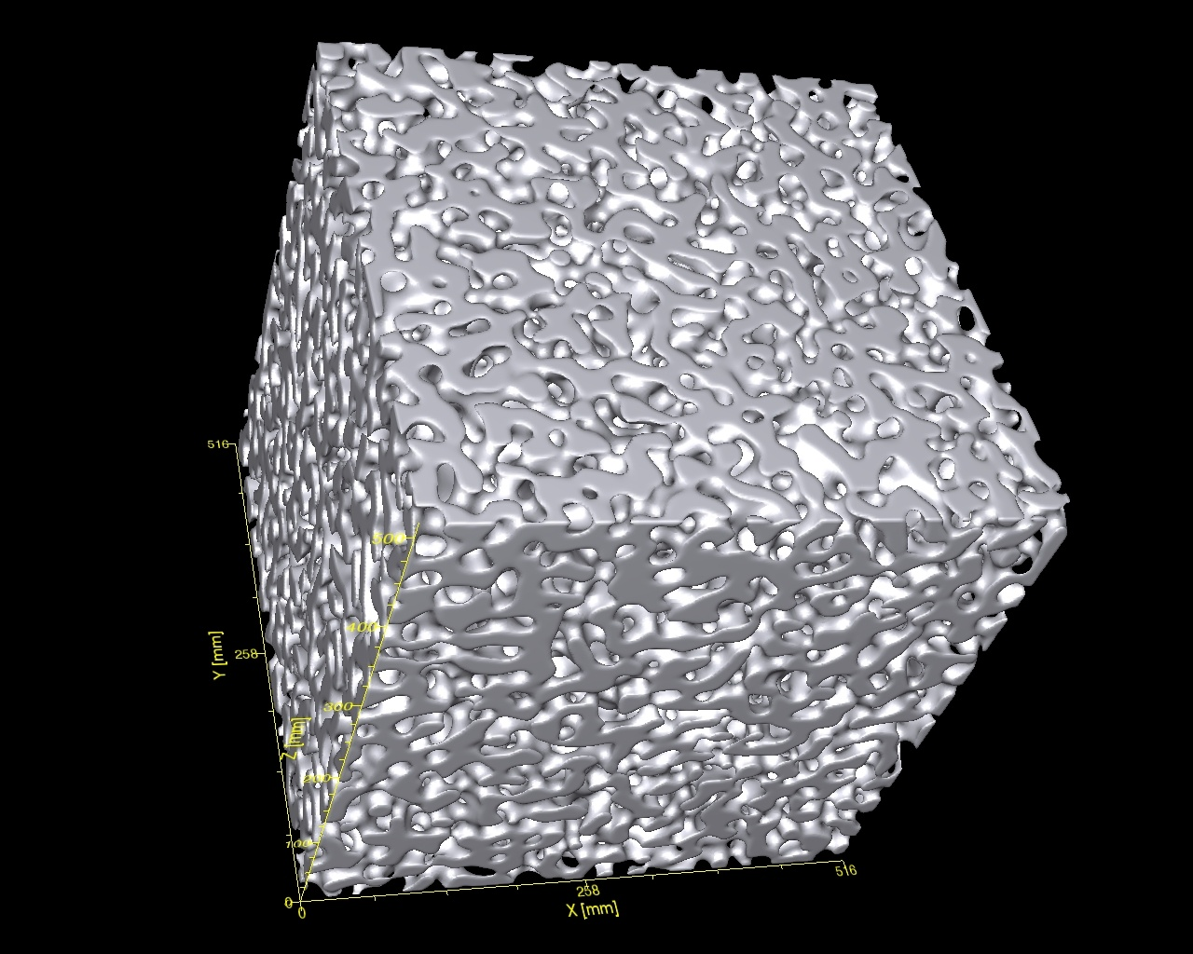
Cahn-Hilliard t = 5000

Slide 15
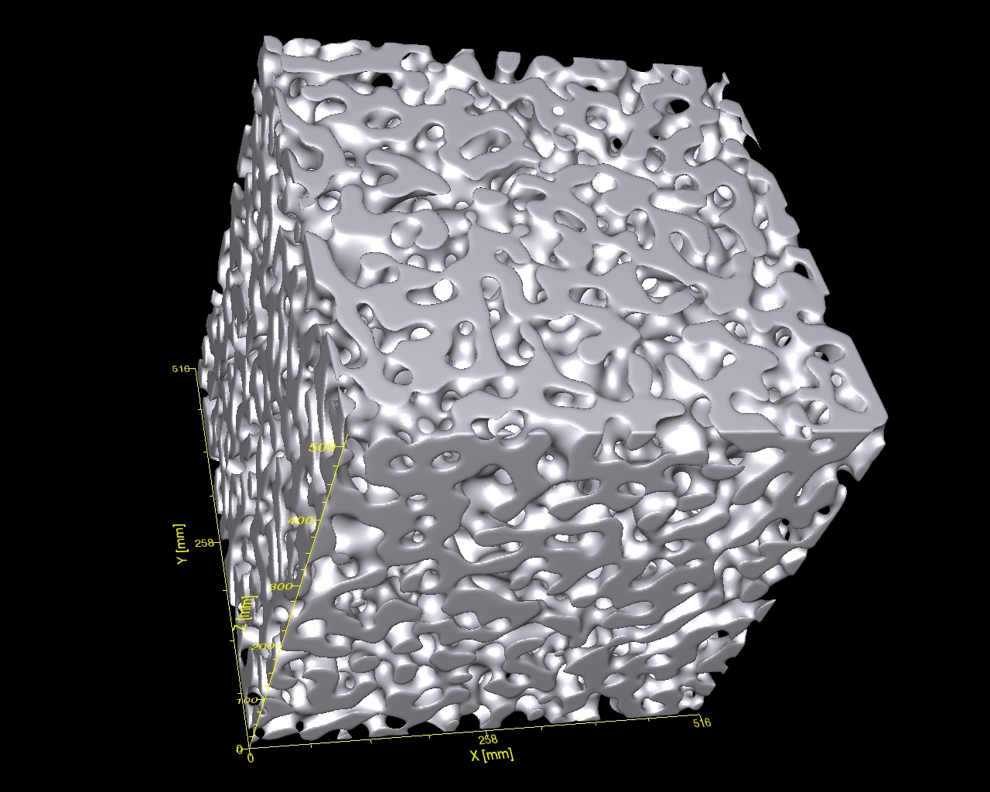
Cahn-Hilliard t = 14000

Slide 16
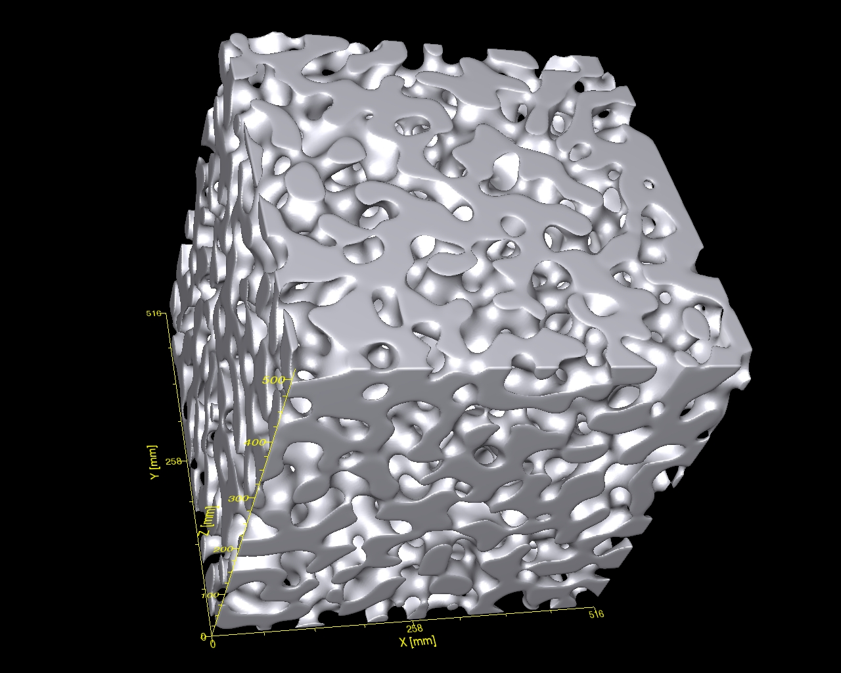
Cahn-Hilliard t = 32000

Slide 17
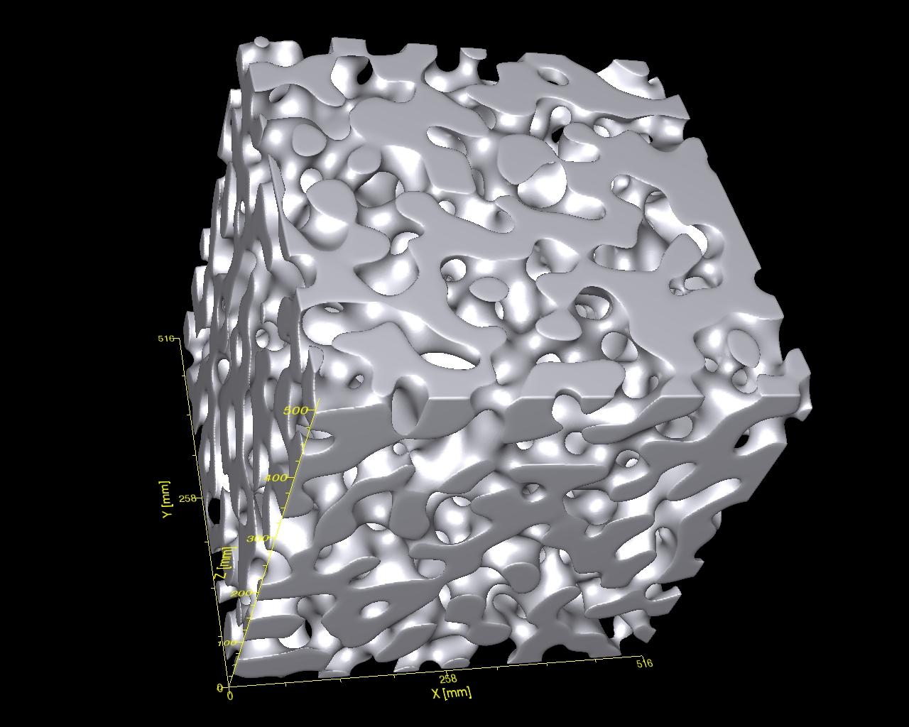
Cahn-Hilliard t = 59000

Slide 18
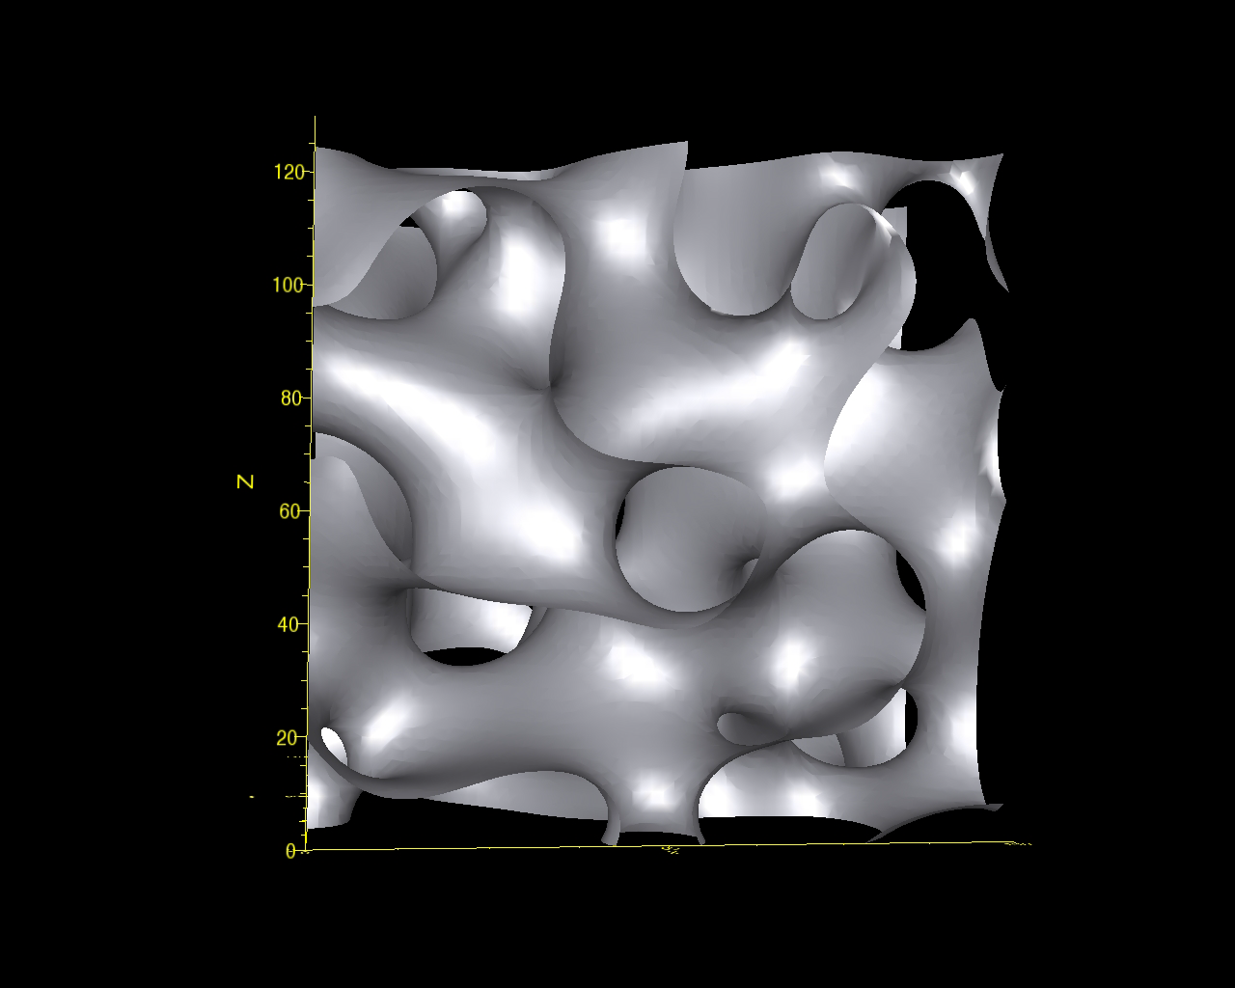
Cahn-Hilliard t = 59000

Slide 19
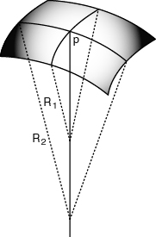
Principle Curvatures
κ₁ = 1/R₁
κ₂ = 1/R₂
κ₂ > κ₁
H = (κ₁ + κ₂)/2
K = κ₁κ₂

Slide 20
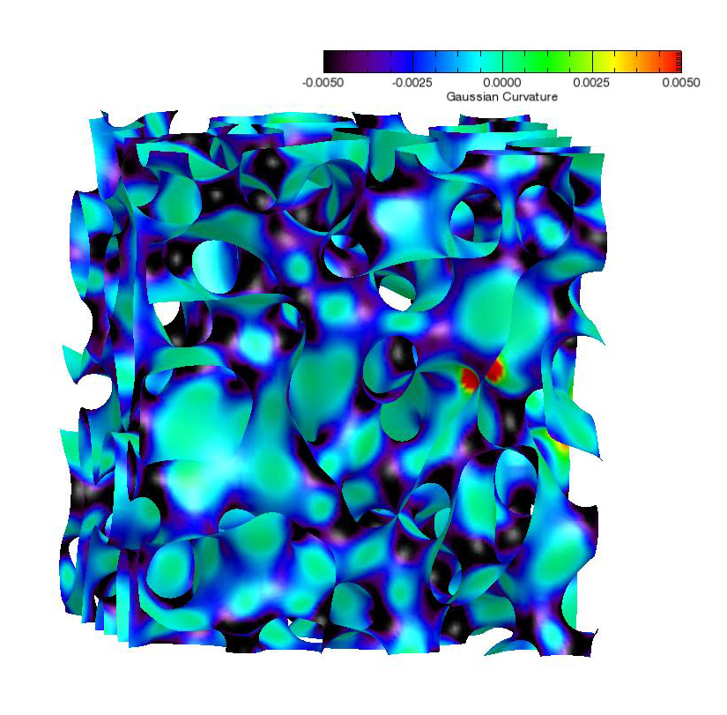
Cahn-Hilliard: Gaussian Curvature

Slide 21
Principle Curvatures
κ₁ = 1/R₁
κ₂ = 1/R₂
κ₂ > κ₁
H = (κ₁ + κ₂)/2
K = κ₁κ₂

Slide 22
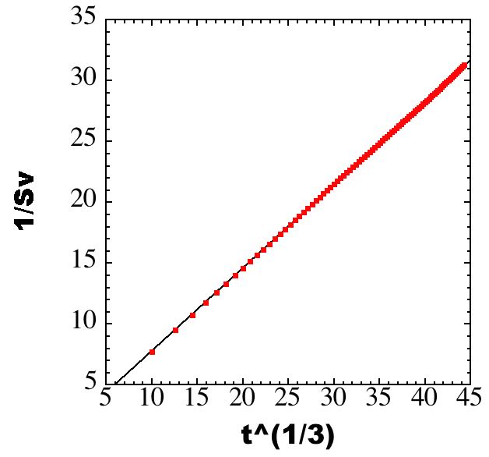
Cahn-Hilliard – Length Scale
t=87000
t=59000
1/S_{v}
t=32000
t=14000
t=5000
t^{1/3}

Slide 23
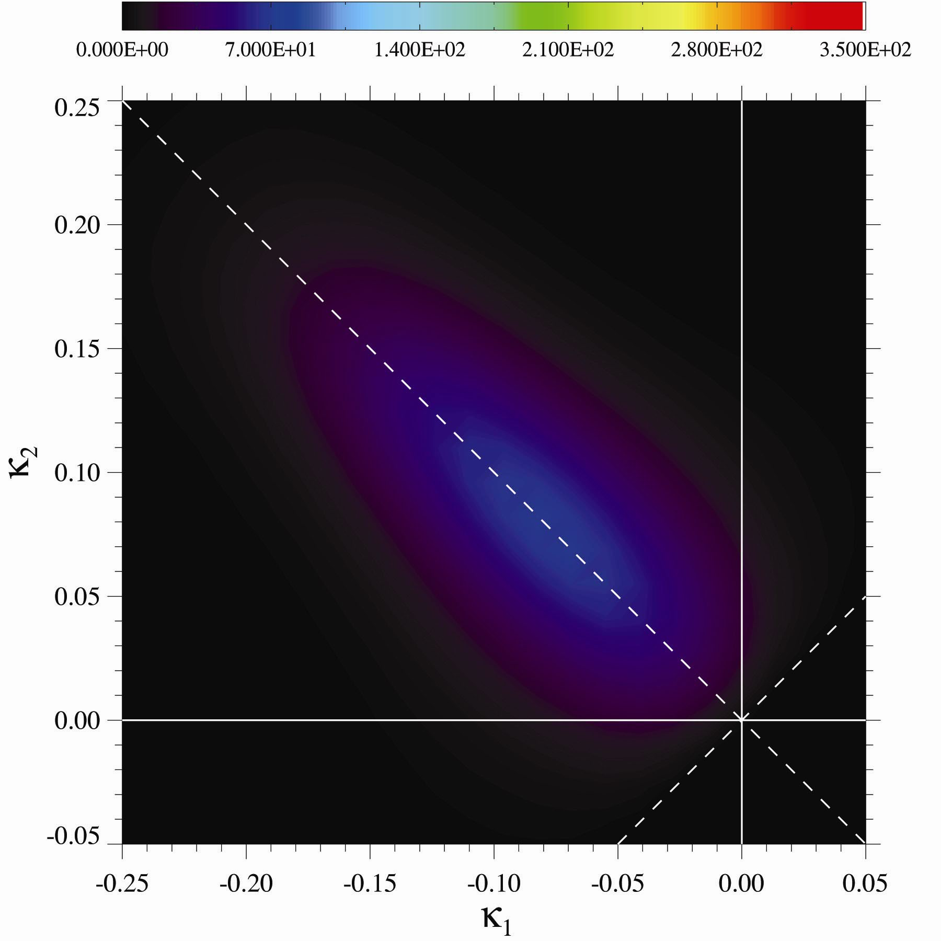
Cahn-Hilliard Unscaled ISD t = 5000

Slide 24
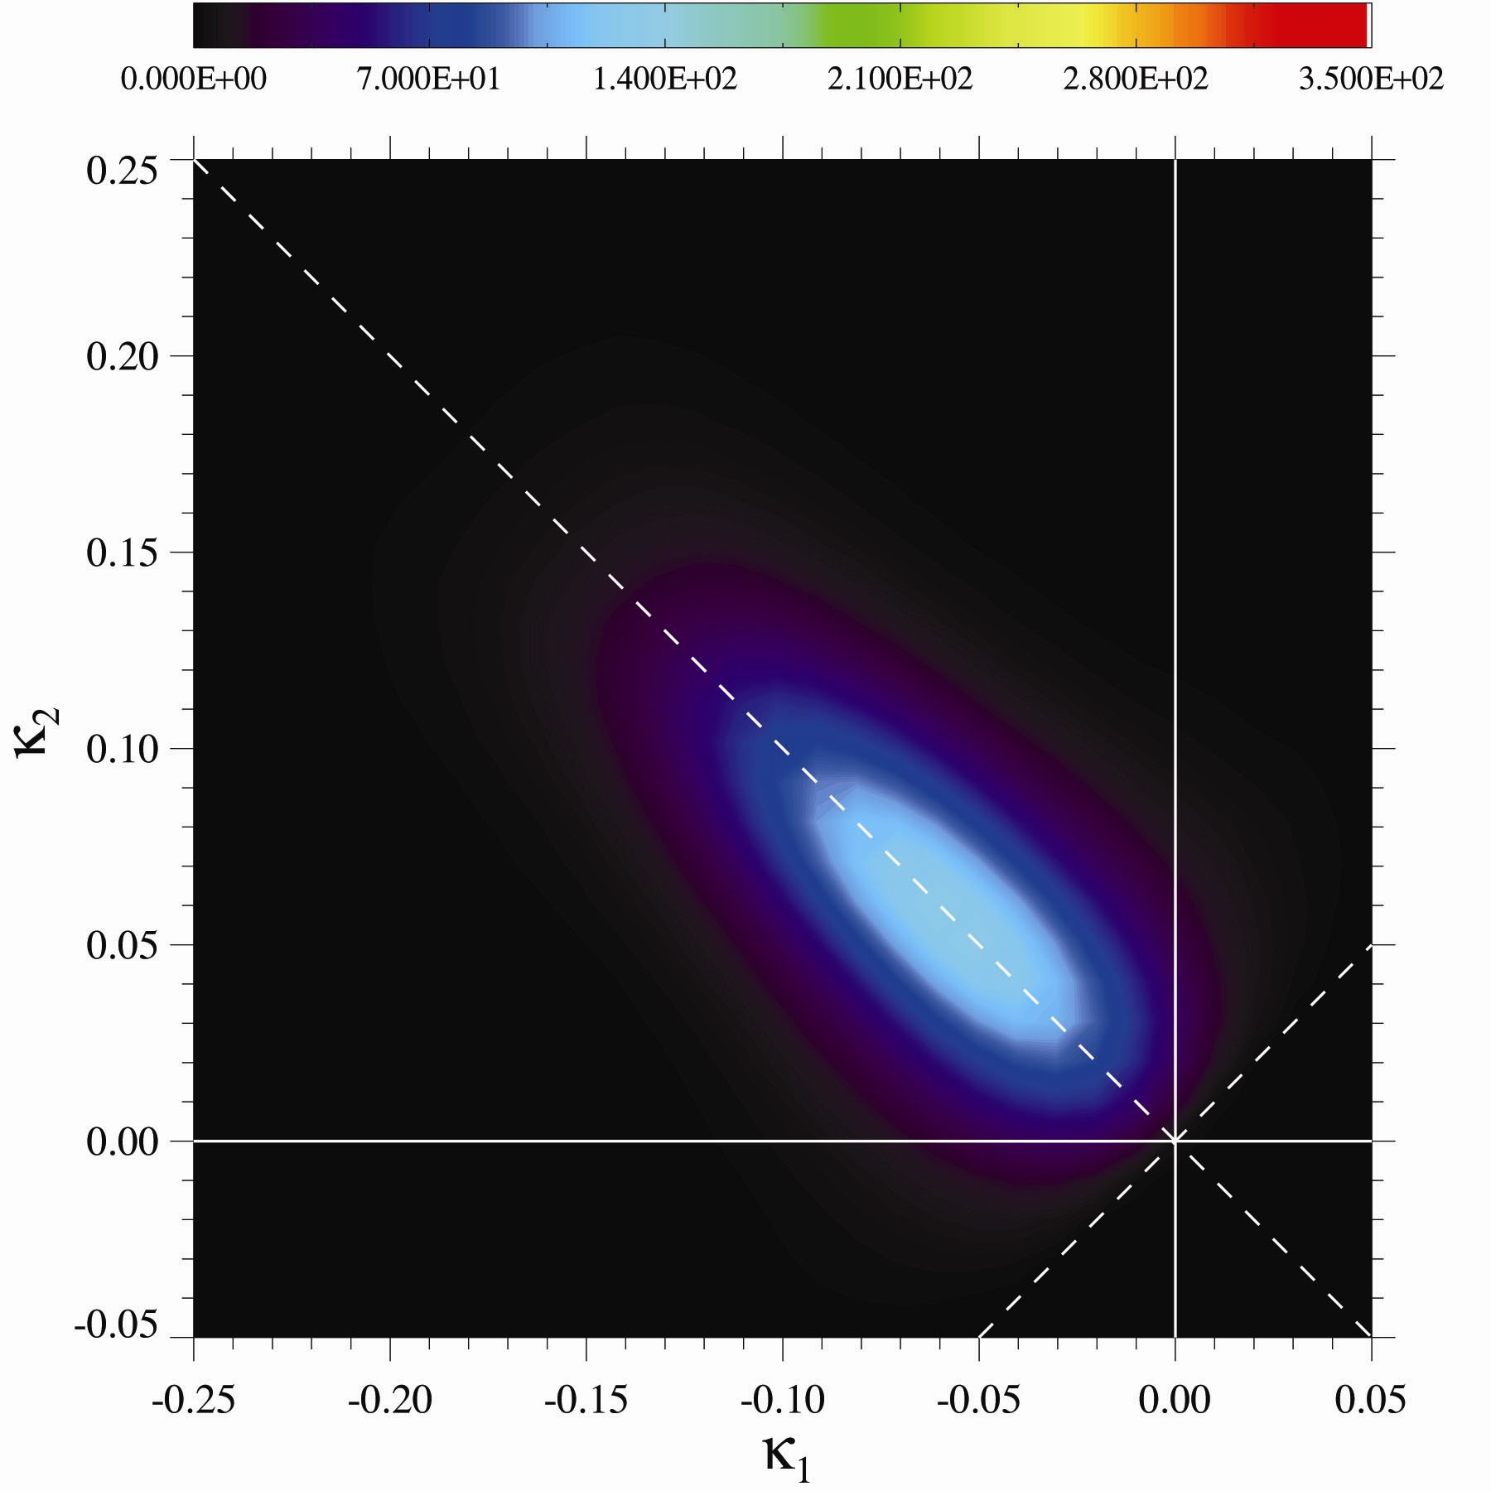
Cahn-Hilliard Unscaled ISD t = 14000

Slide 25
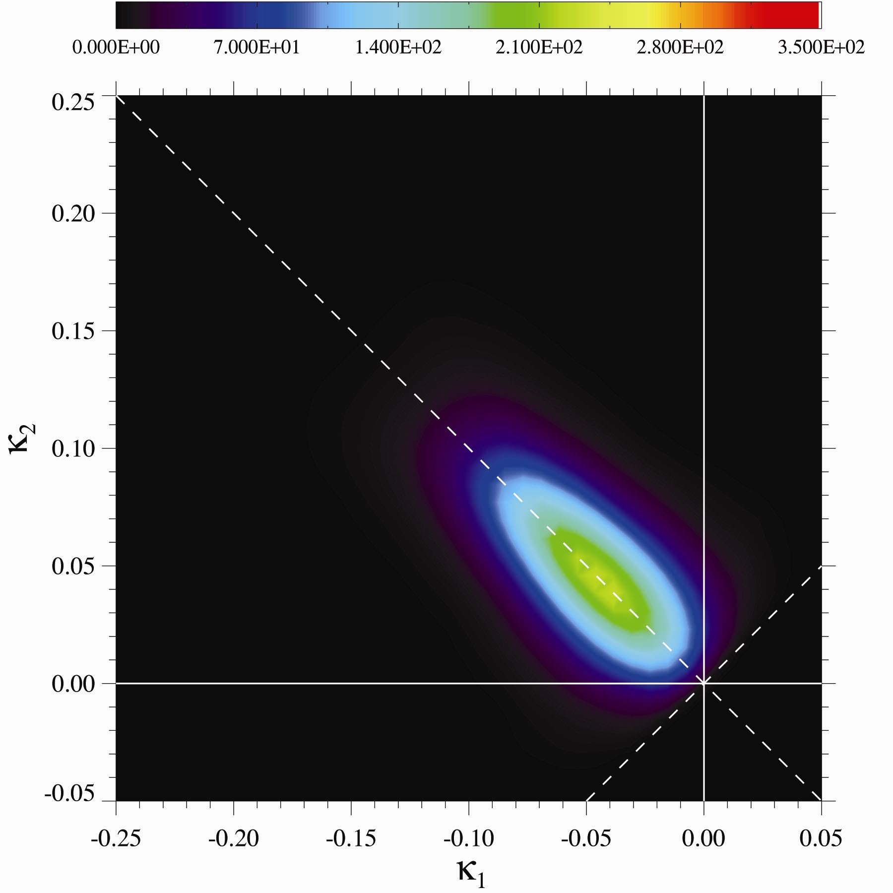
Cahn-Hilliard Unscaled ISD t = 32000

Slide 26
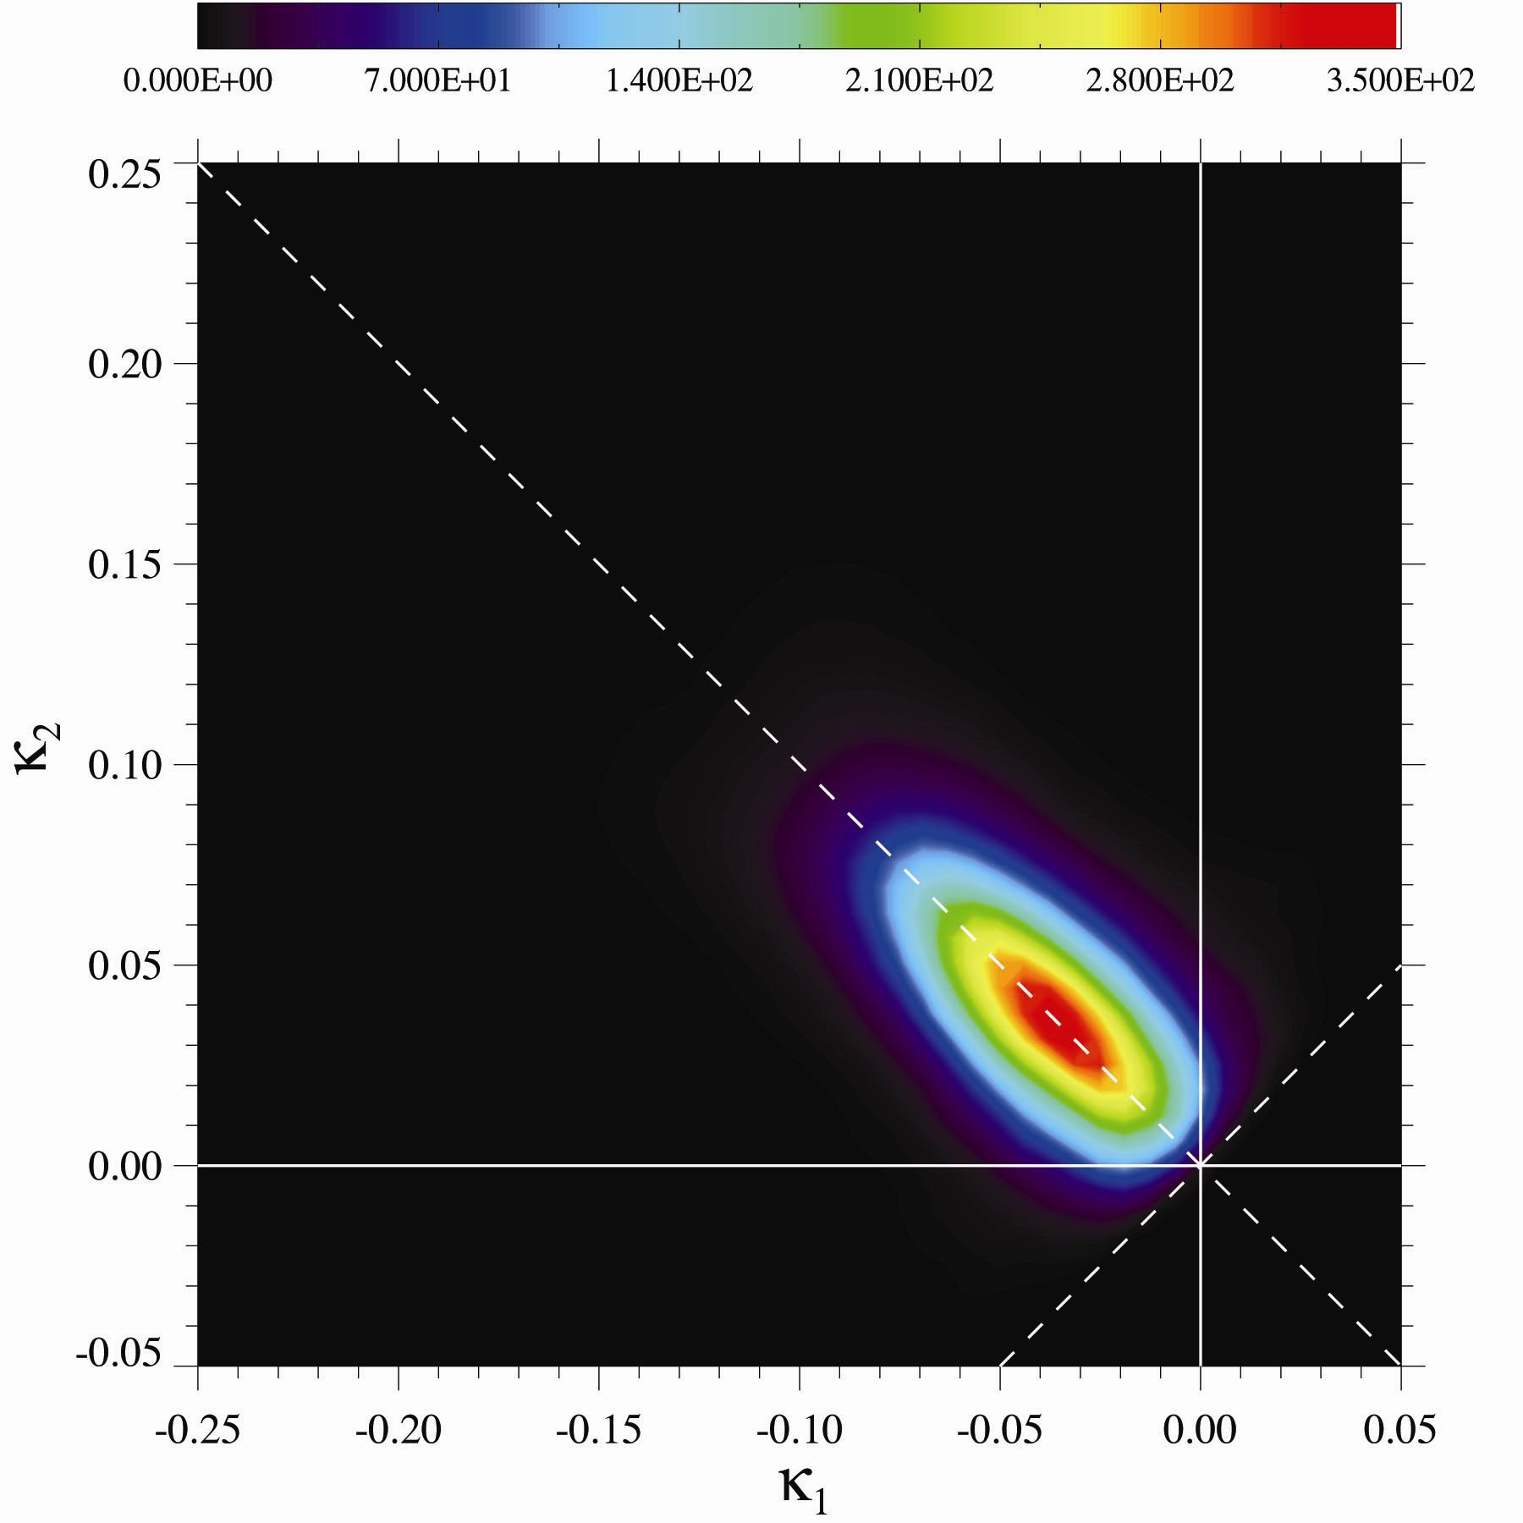
Cahn-Hilliard Unscaled ISD t = 59000

Slide 27
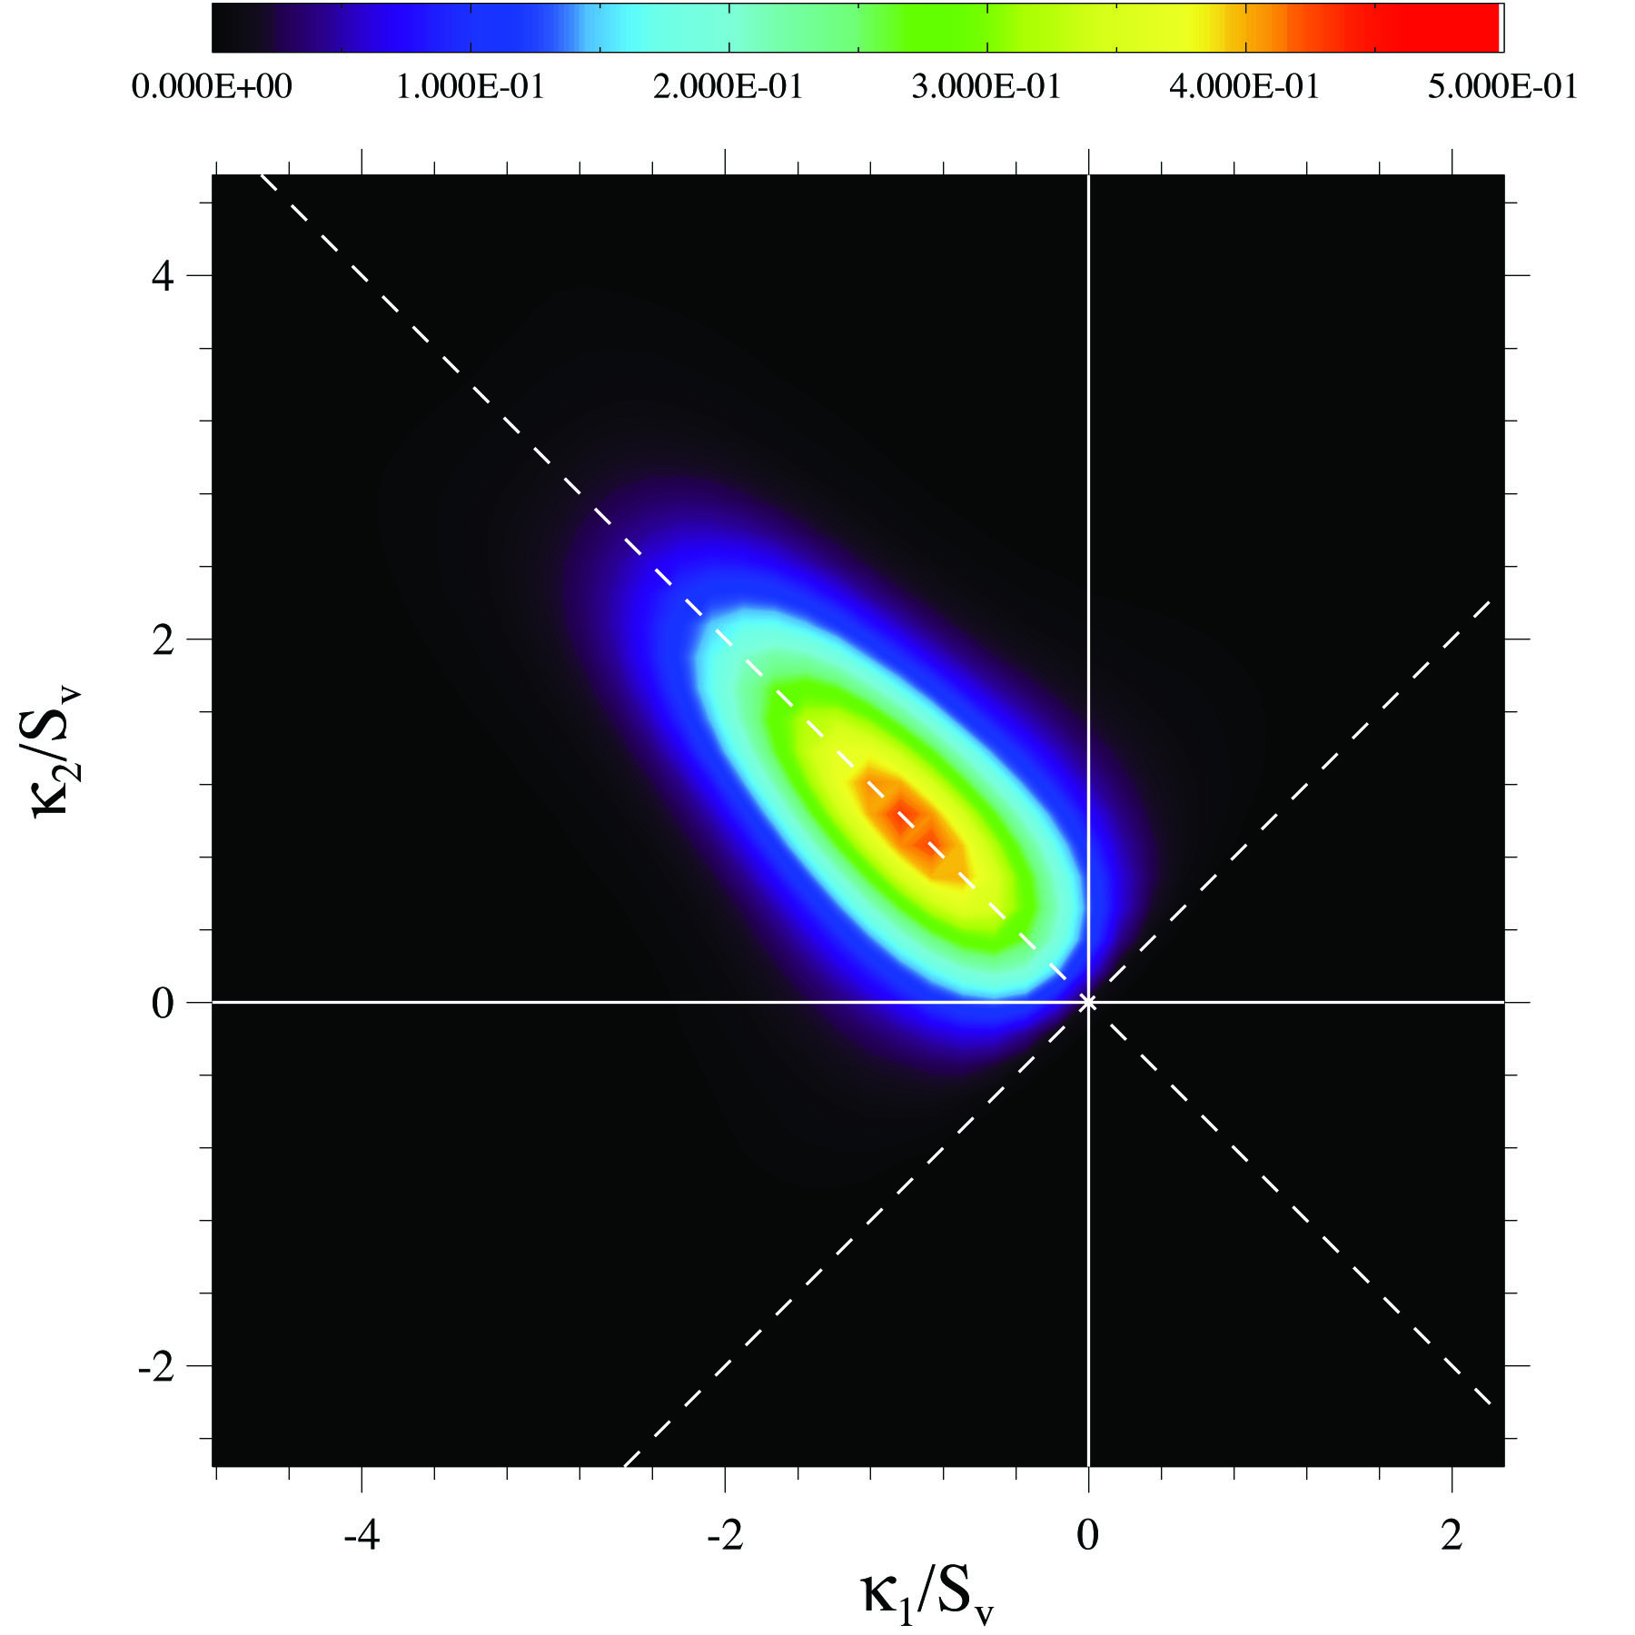
Cahn-Hilliard Scaled ISD t = 5000

Slide 28

Cahn-Hilliard Scaled ISD t = 14000

Slide 29

Cahn-Hilliard Scaled ISD t = 32000

Slide 30

Cahn-Hilliard Scaled ISD t = 59000

Slide 31

Cahn-Hilliard Scaled ISD t = 87000

Slide 32
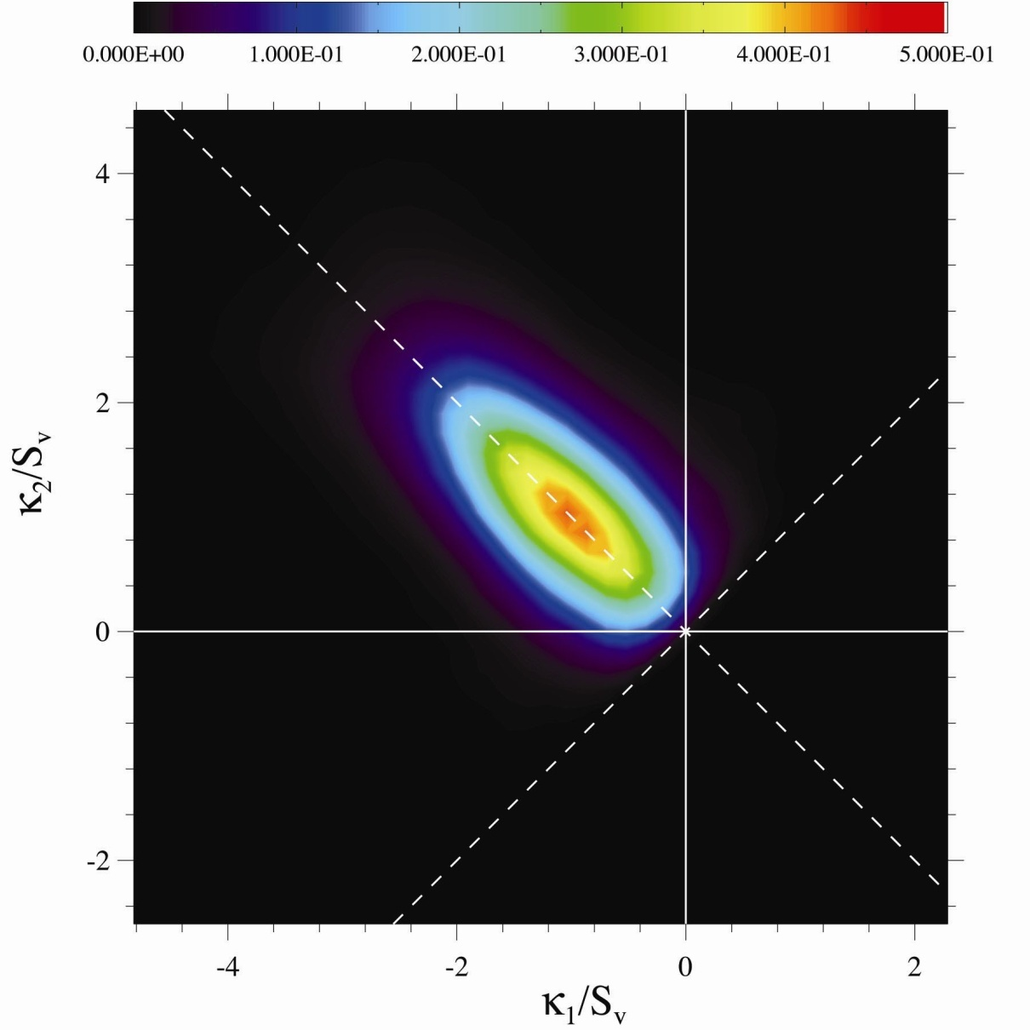
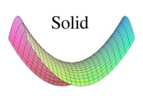
Cahn-Hilliard t = 59000
H=0

Slide 33
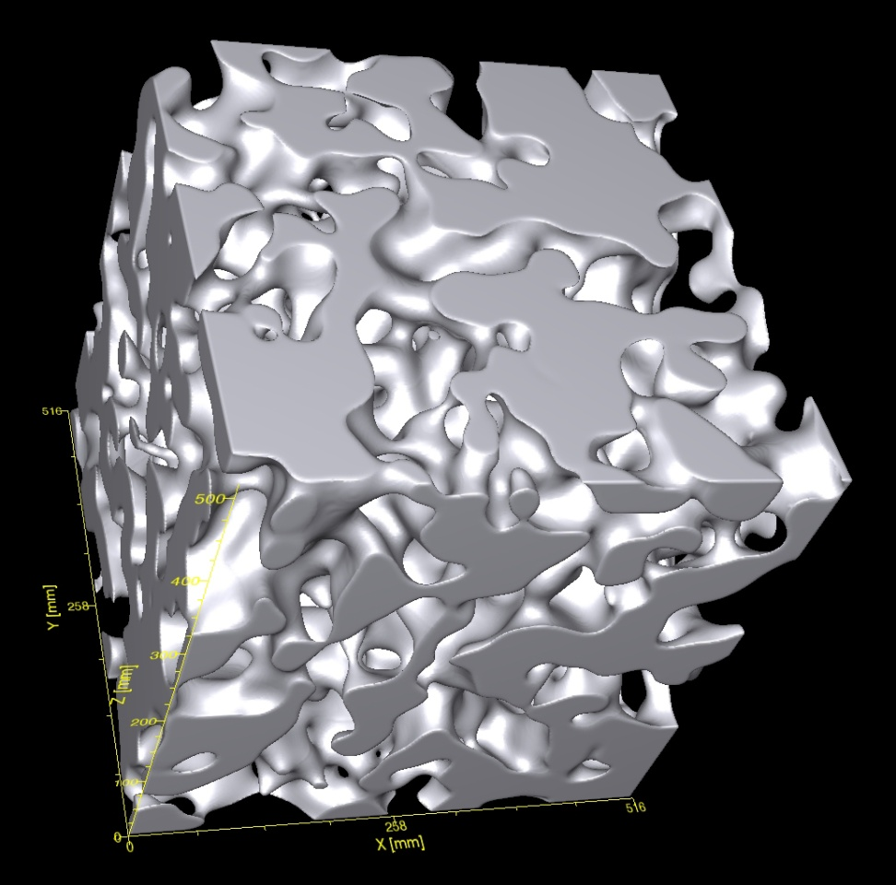
Interfacial Morphologies
Cahn-Hilliard
Allen-Cahn/Ginzburg-Landau

Slide 34

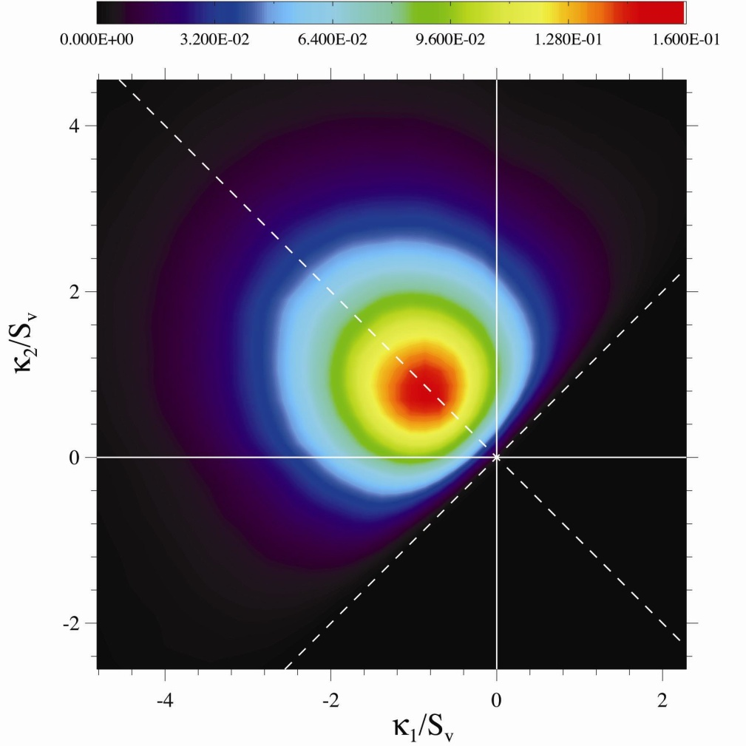
Scaled Interface Shape Distributions
H_{m}
H_{m}
Cahn-Hilliard
Allen-Cahn/Ginzburg-Landau

Slide 35
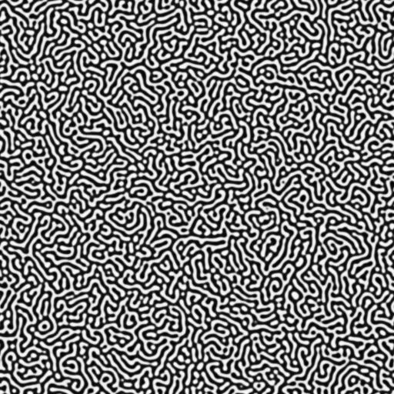
Off-Critical Quenches: 2D φ = 48%

Slide 36
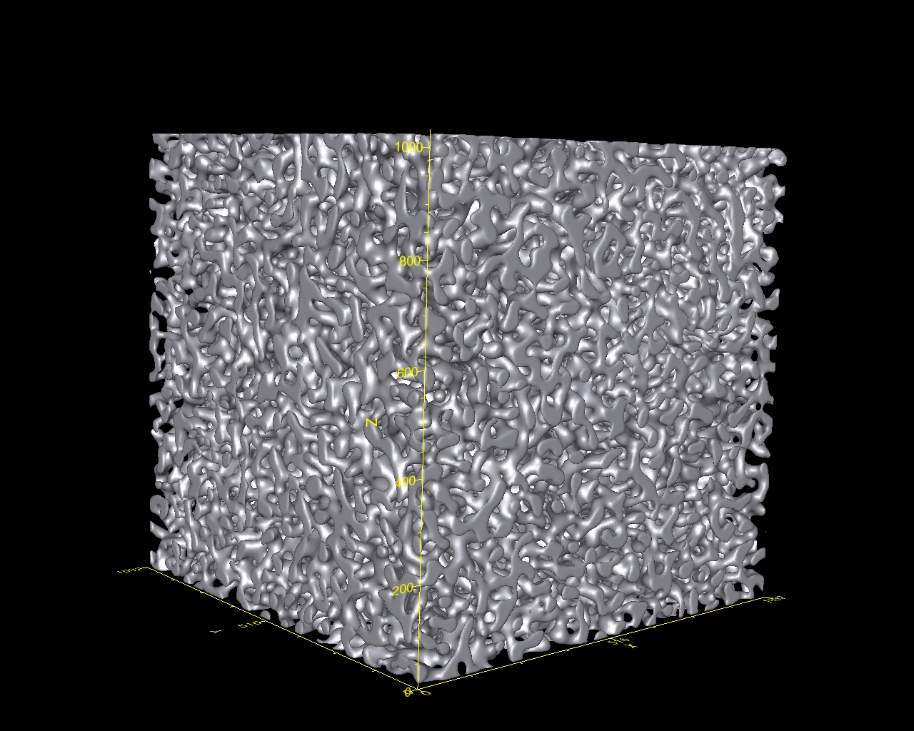
Off-Critical Quenches: 3D φ = 36%
t = 25600, S_{v}⁻¹ = 32

Slide 37
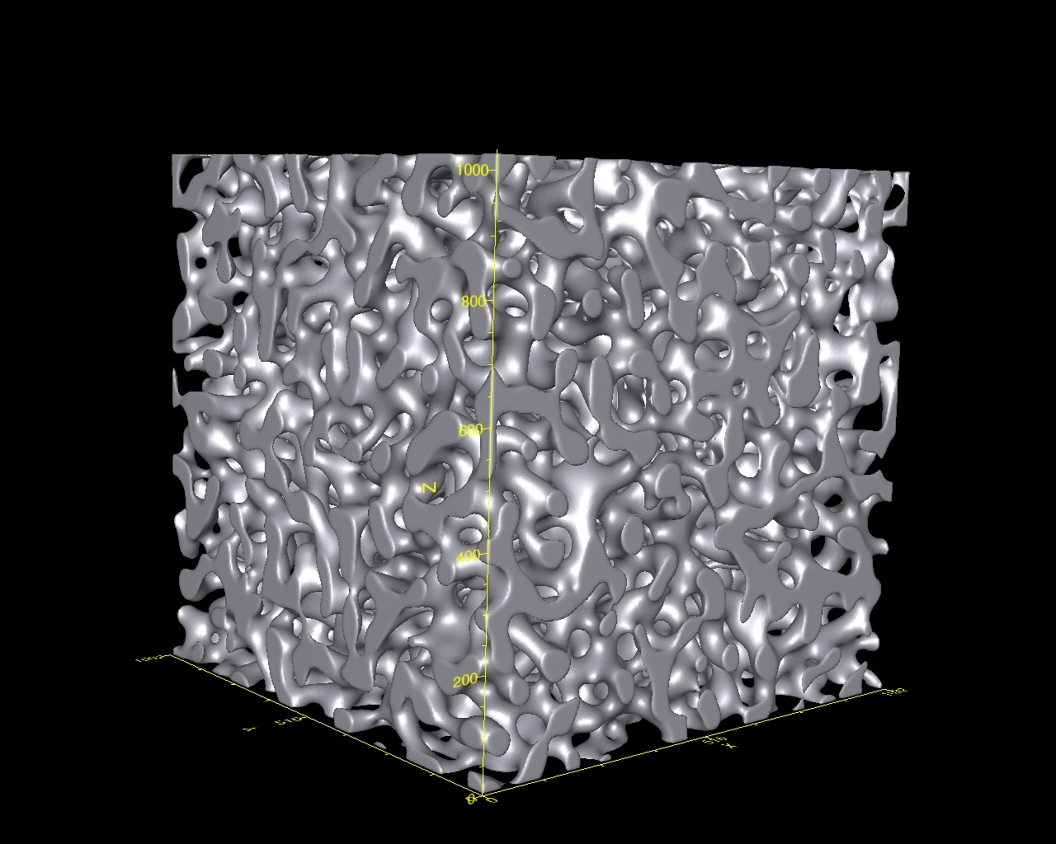
Off-Critical Quenches: 3D φ = 36%
t =179200, S_{v}⁻¹ = 58

Slide 38
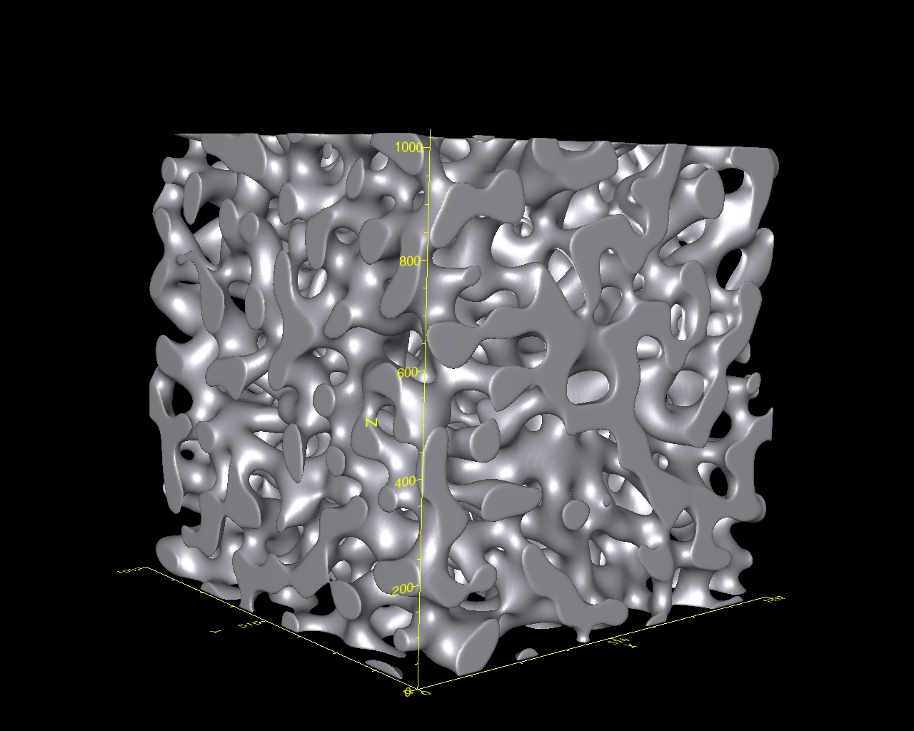
Off-Critical Quenches: 3D φ = 36%
t =640000, S_{v}⁻¹ = 85

Slide 39
φ = 36%
φ = 40%
φ = 50%

Slide 40
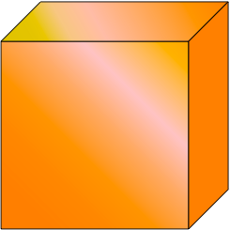

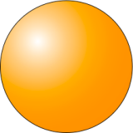
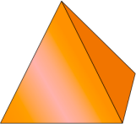
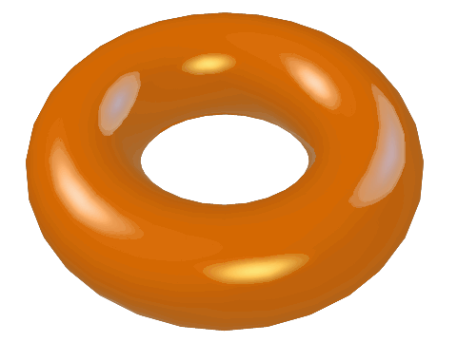
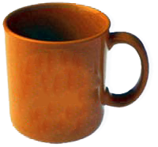
Topology
Topologically two structures are equivalent if one structure can be deformed to the other shape so long as it is not severed or joined to itself
X
X

Slide 41







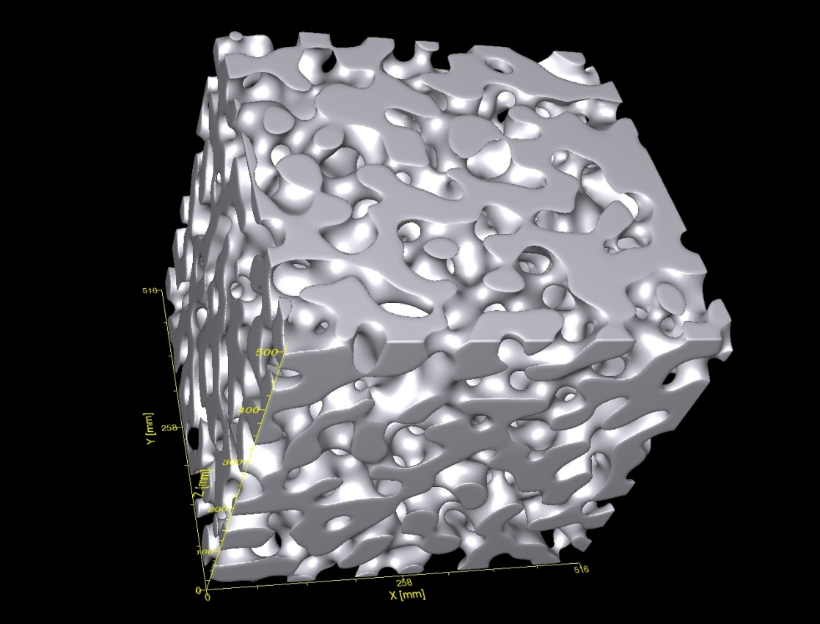

Genus
There are many definitions of the genus:
X
X
g is the number of handles
For a bicontinuous structure:

Slide 42
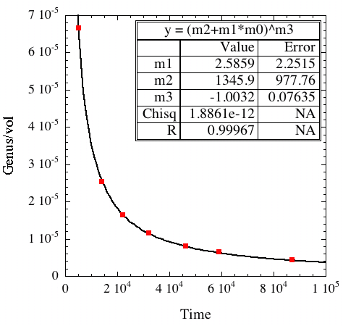
Cahn-Hilliard: Genus, φ = 0.5

Slide 43
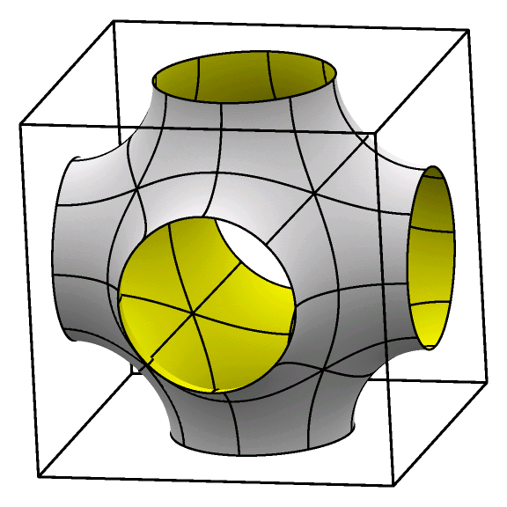
Genus

Slide 44
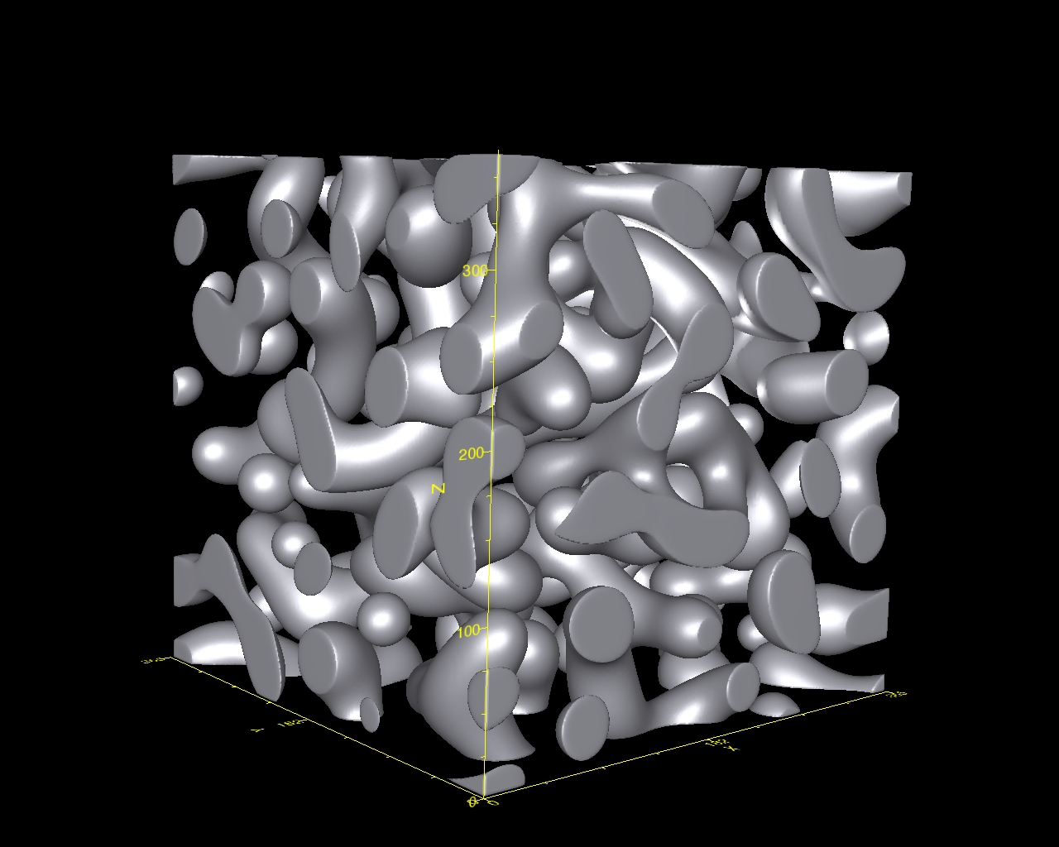
Off-Critical Quenches: 3D φ = 30%
t = 25600

Slide 45
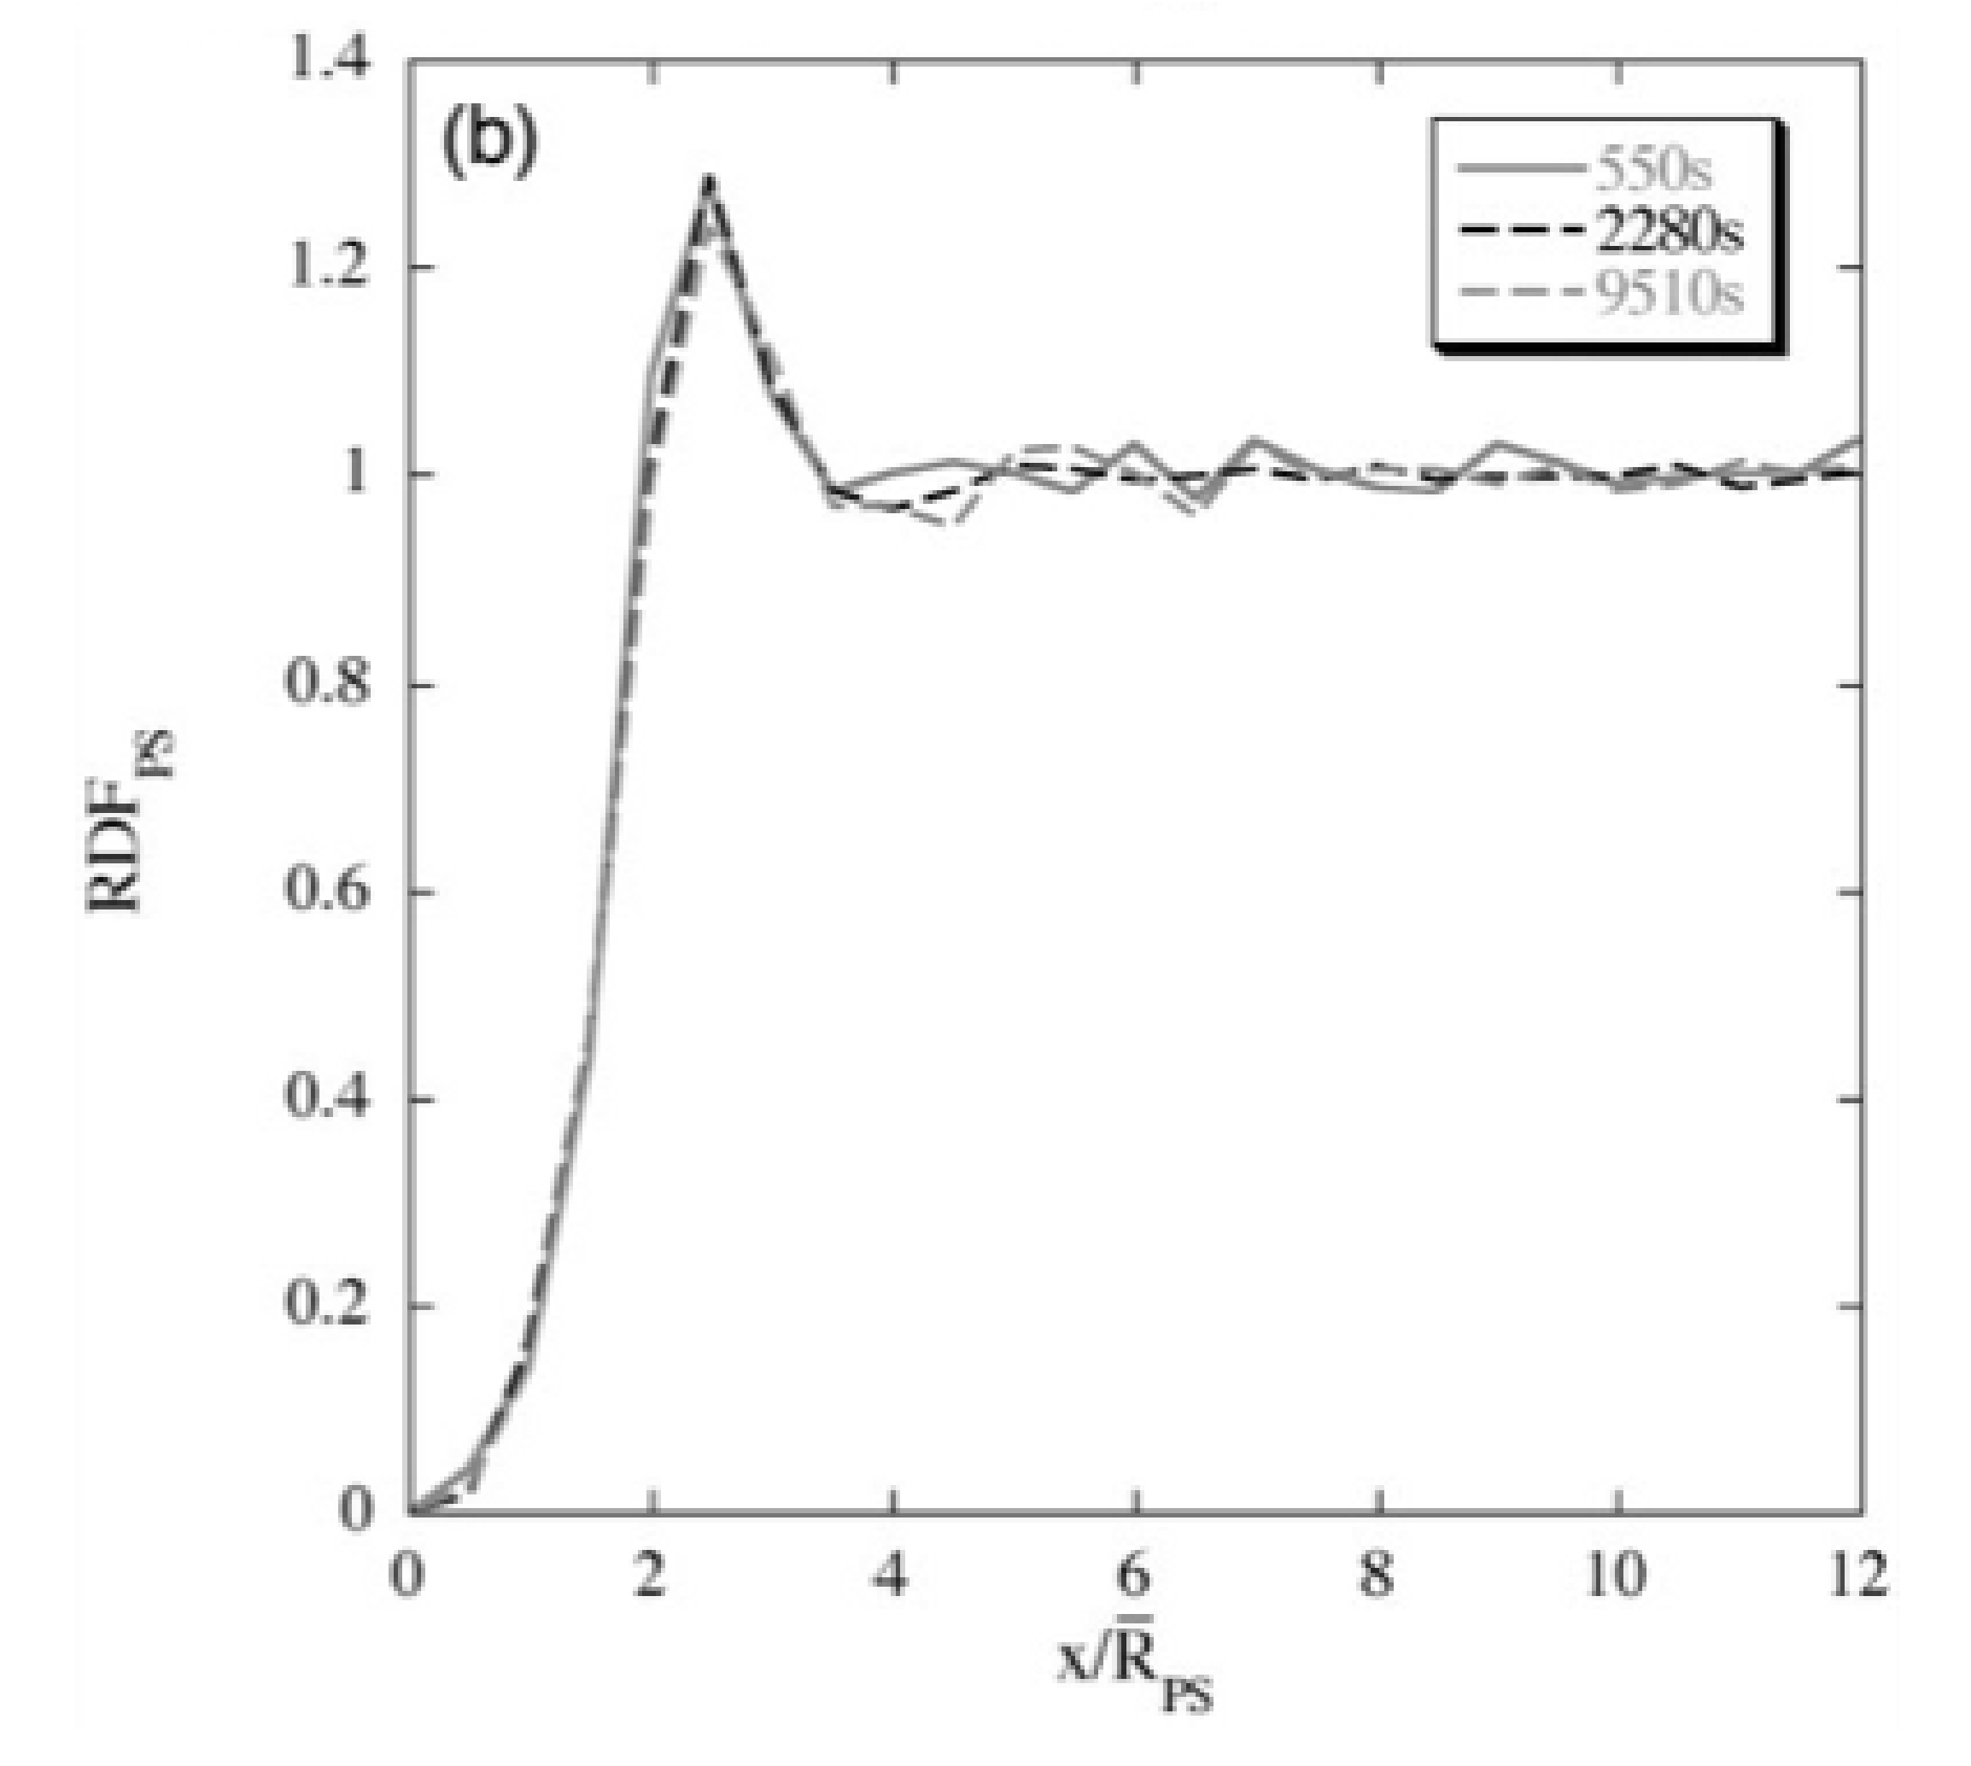
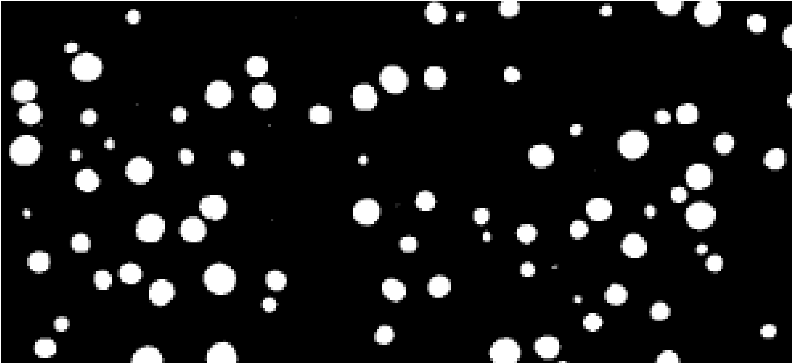

Spatial Correlations
Straightforward in systems of spherical particles
  Can be done on 2D section
Measure with Radial Distribution Function
  Probability goes to 1 at long distances
Notes:
RDF=\frac{No.\ particles\ per\ area\ in\ spherical\ shell}{Overall\ particle\ density}

Slide 46
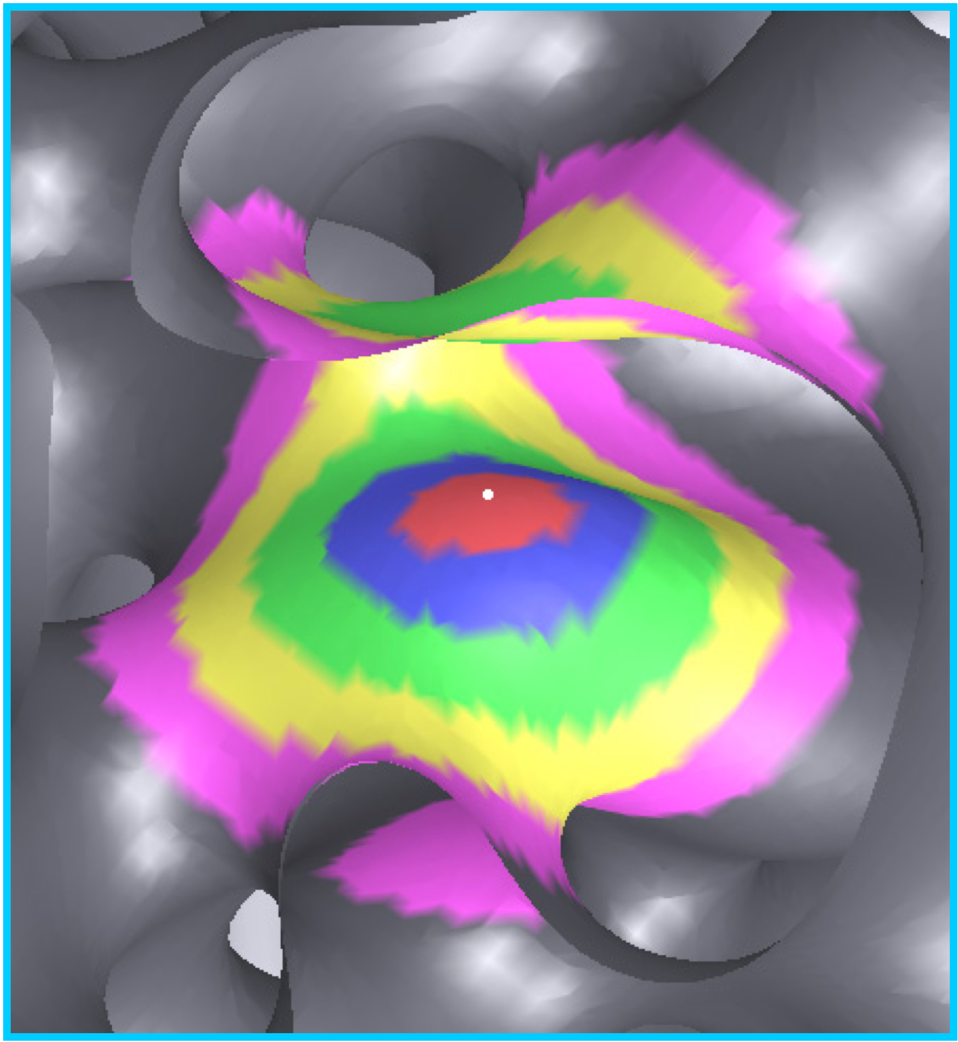
Radial Distribution Function
Looking only at correlation of mean curvature, H
Calculated for a series of concentric shells
  Shell width is 1/3 Sv⁻¹
Calculate for >80,000 initial H1 points for all values of curvature

Slide 47
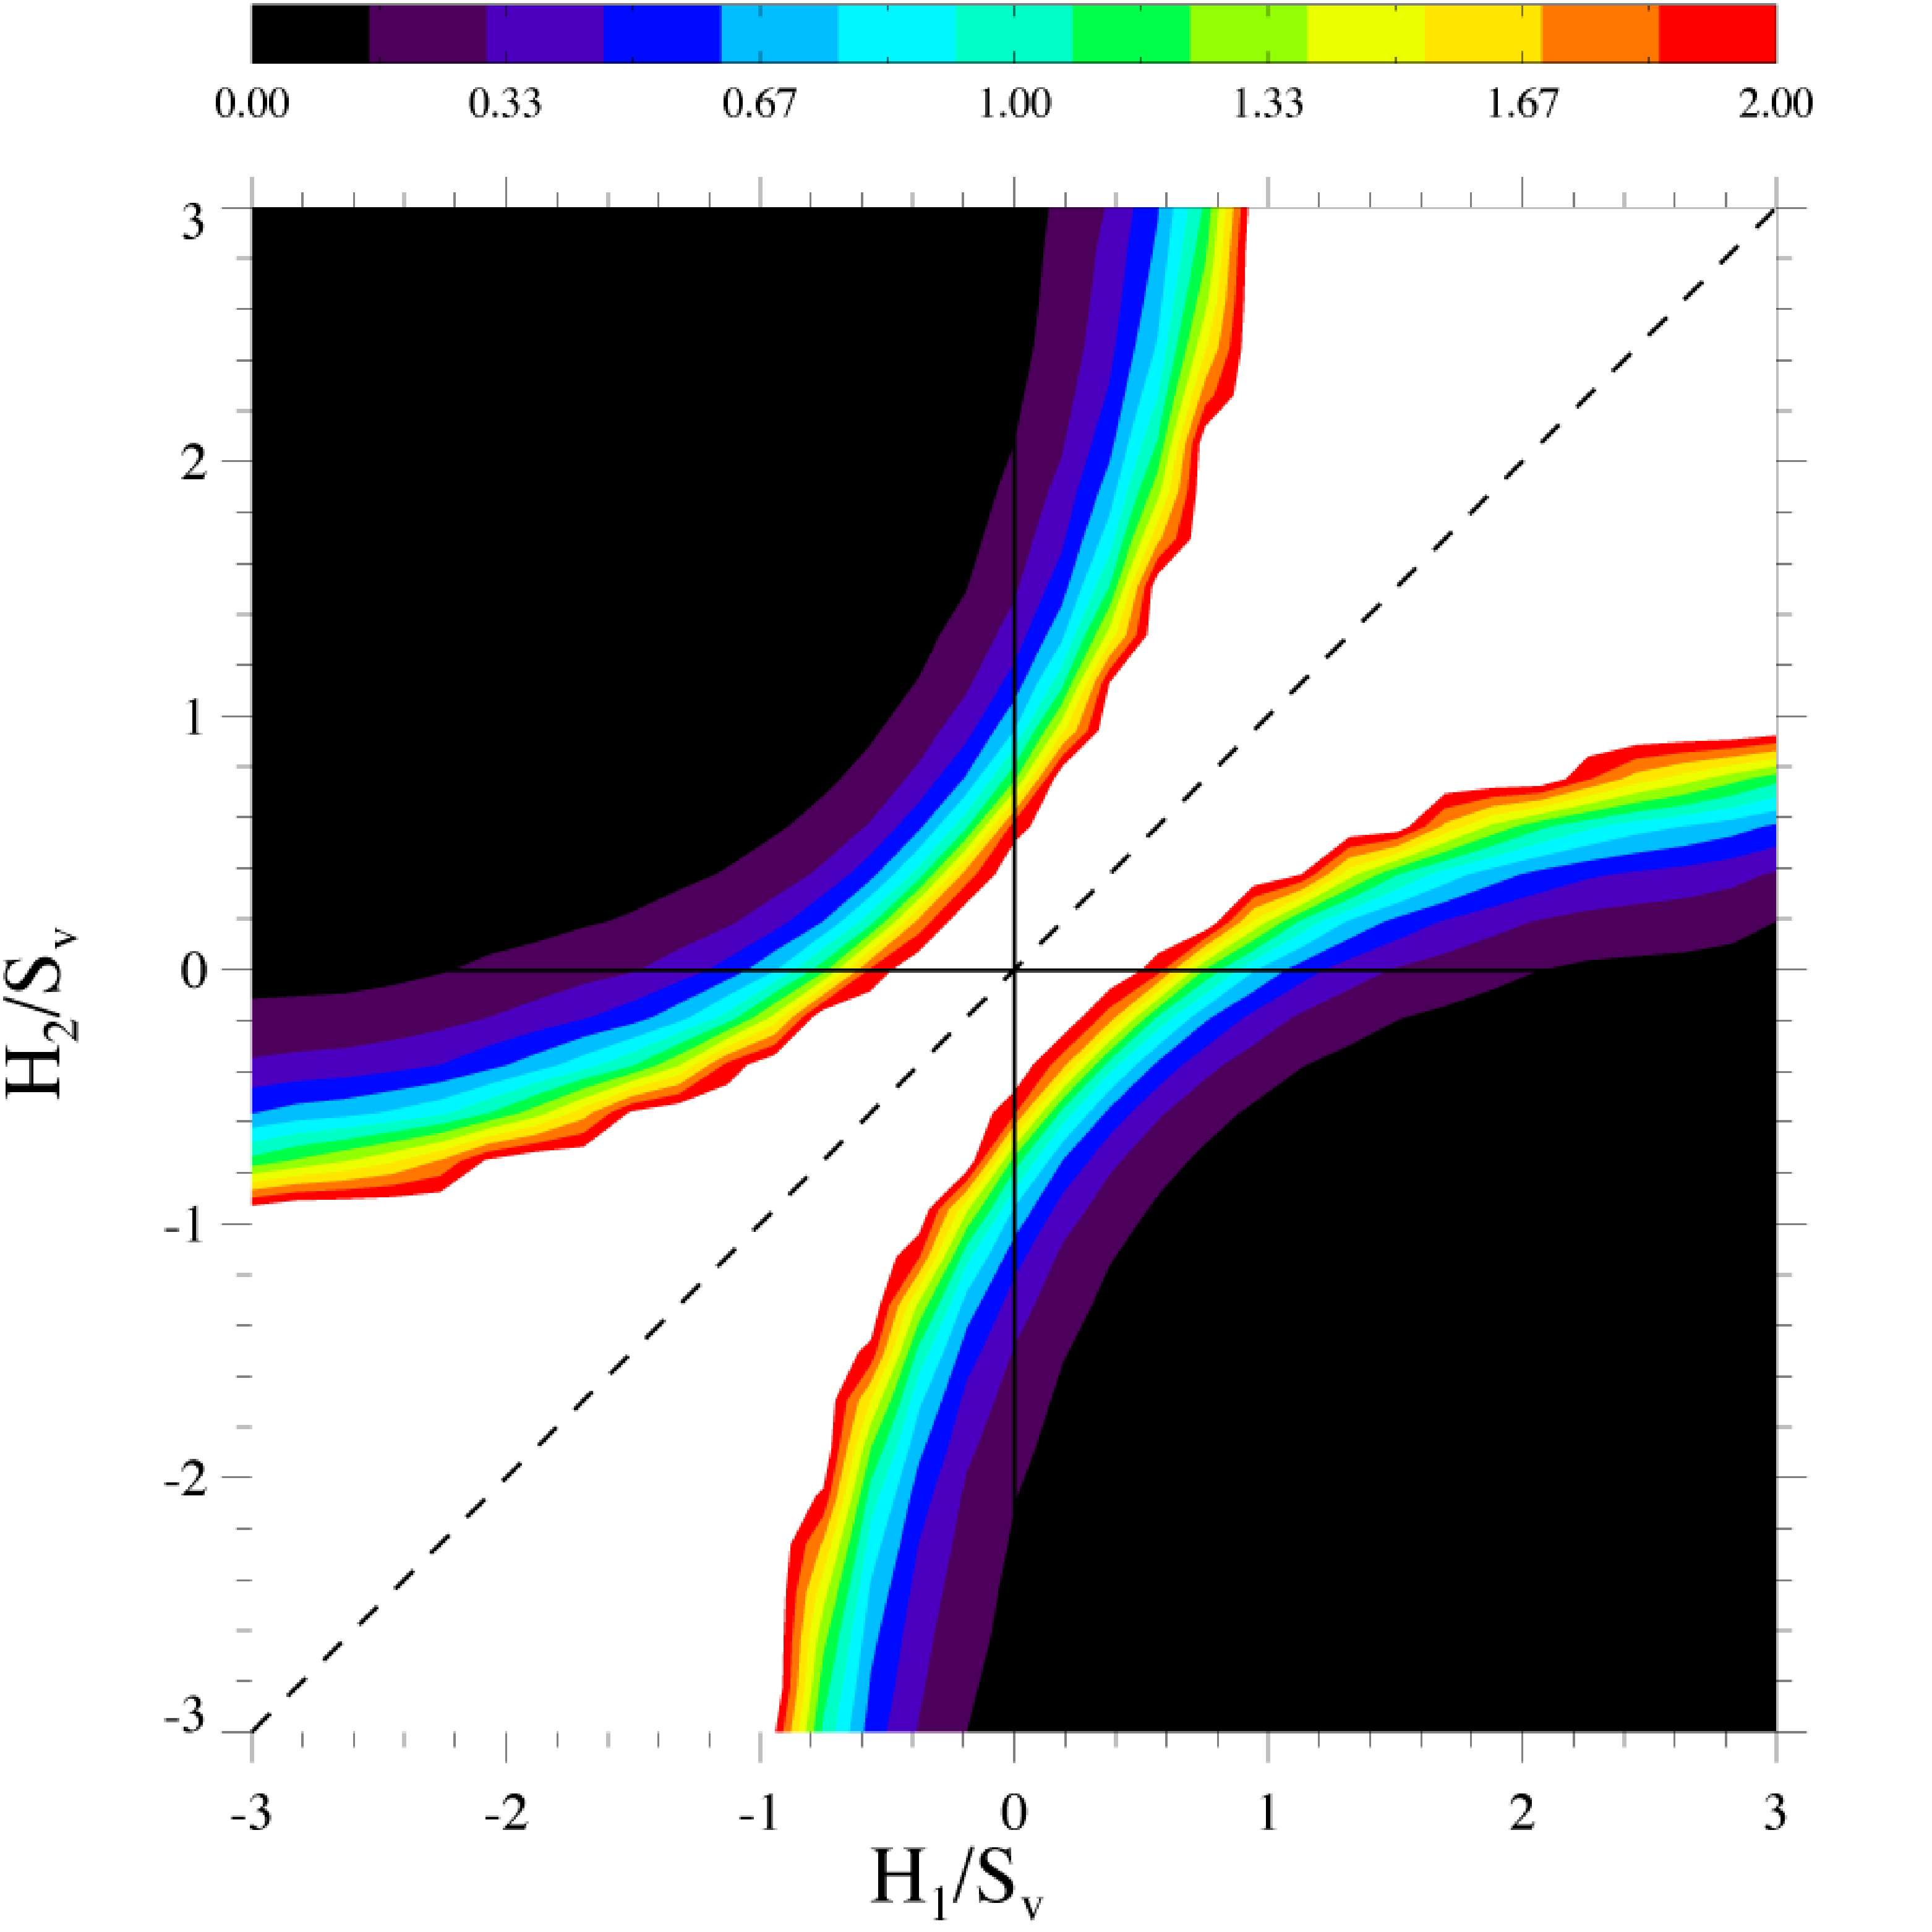
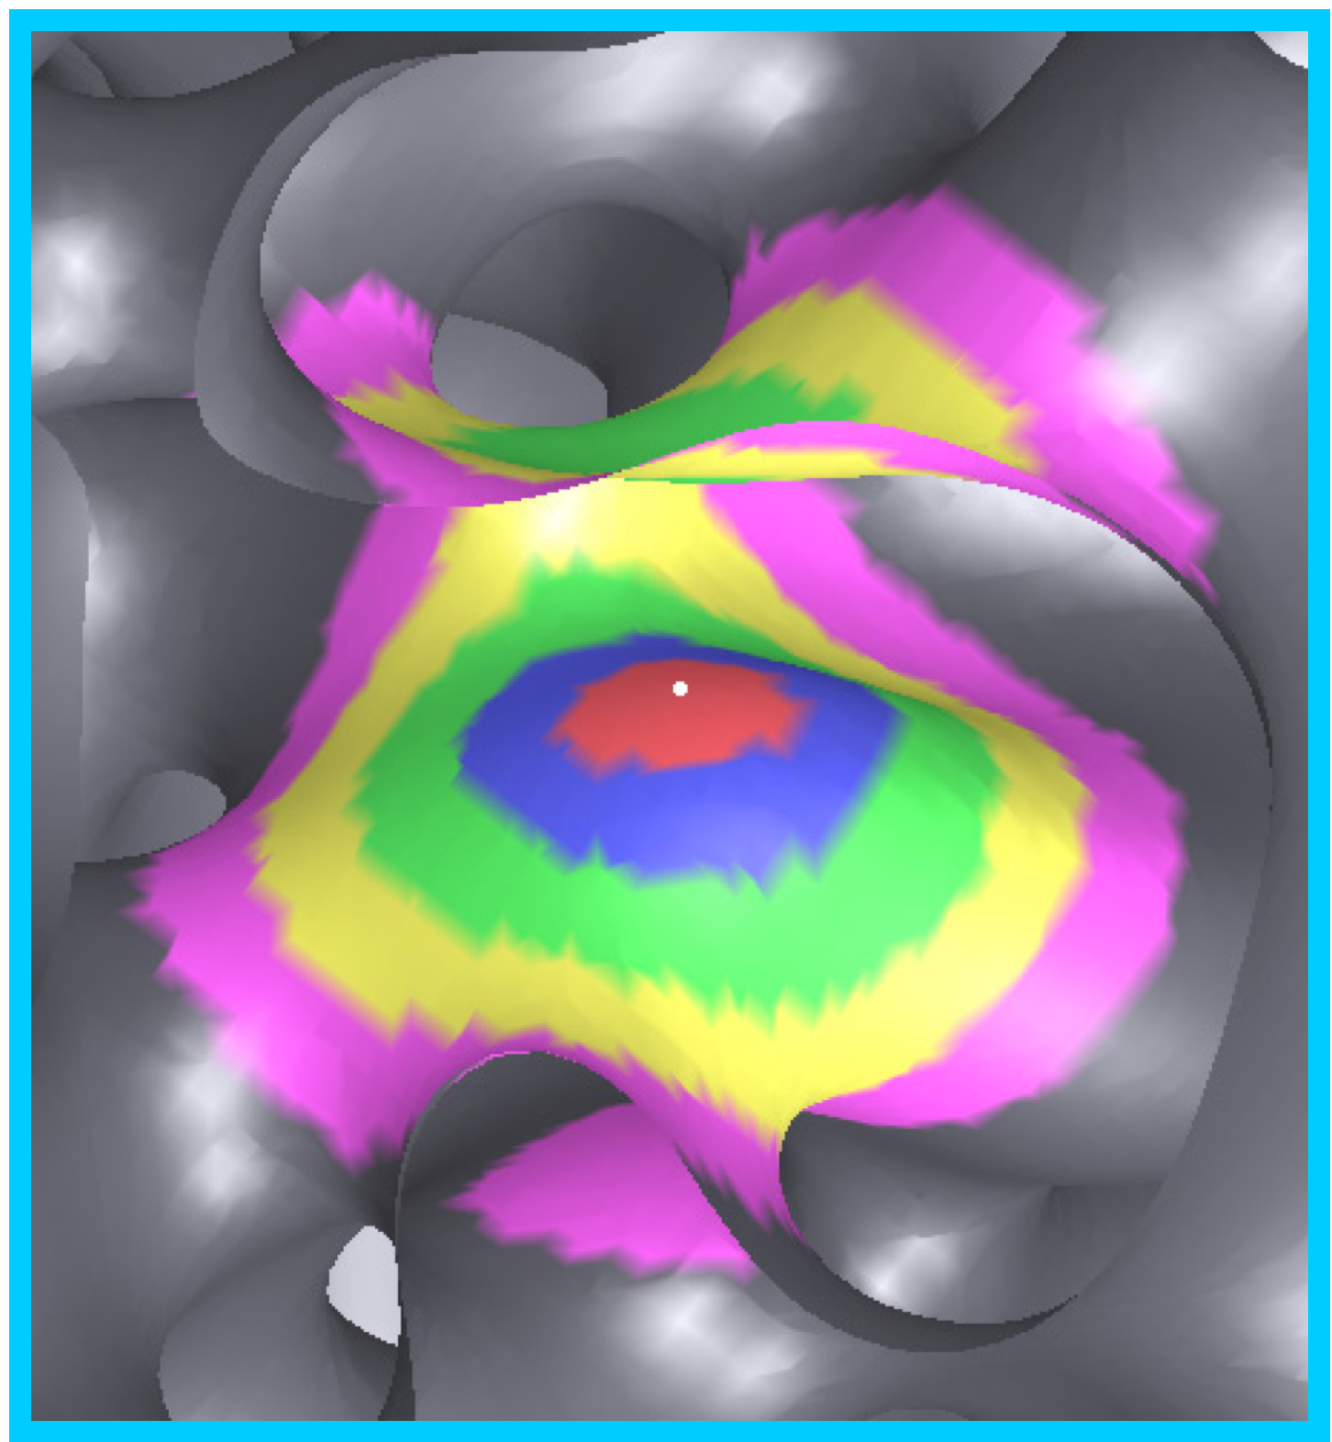
Nonconserved Structure
Shell 1

Slide 48
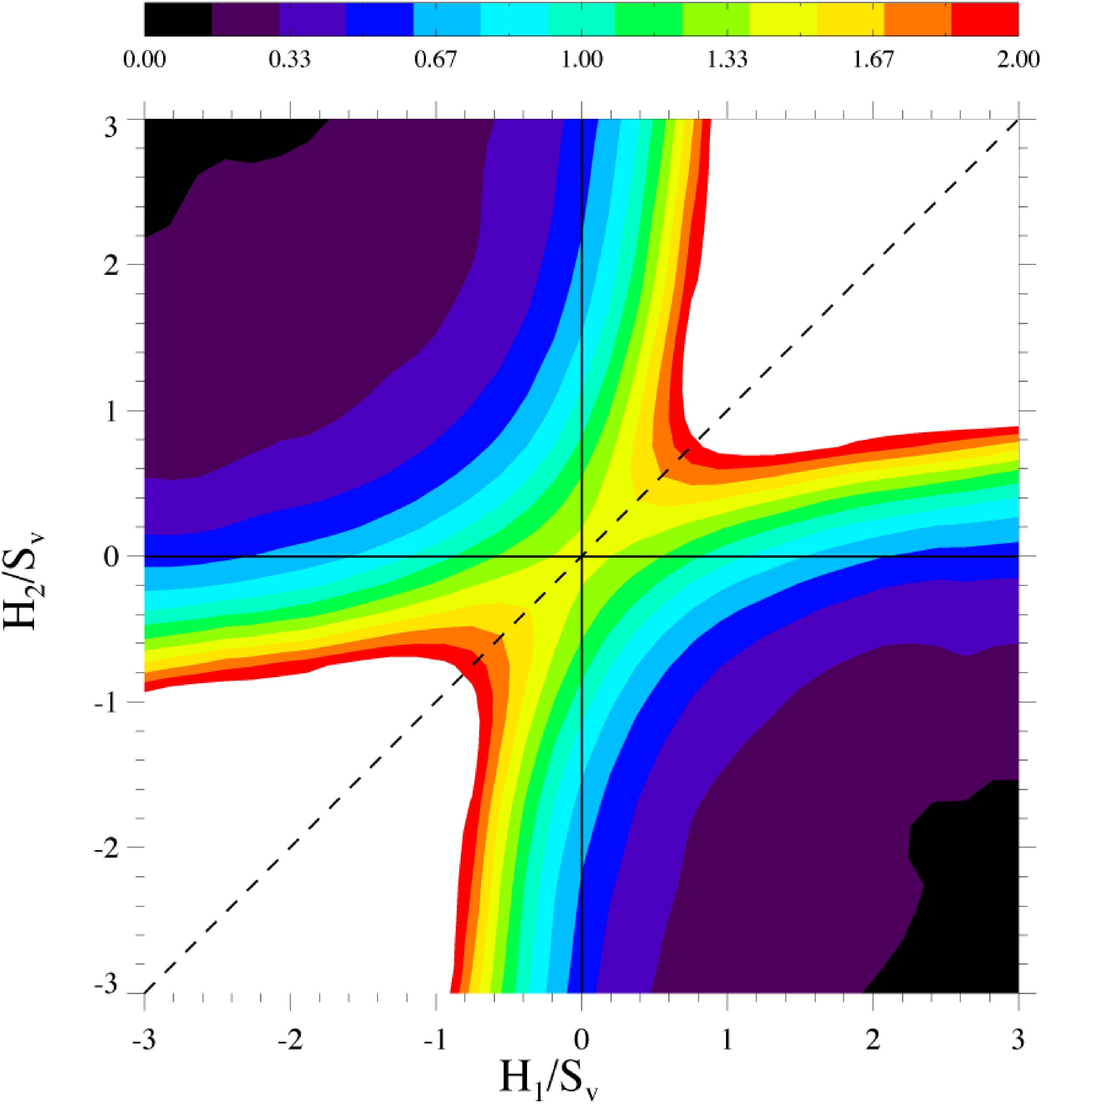
Nonconserved Structure
l = 2/3 Sv⁻¹

Slide 49
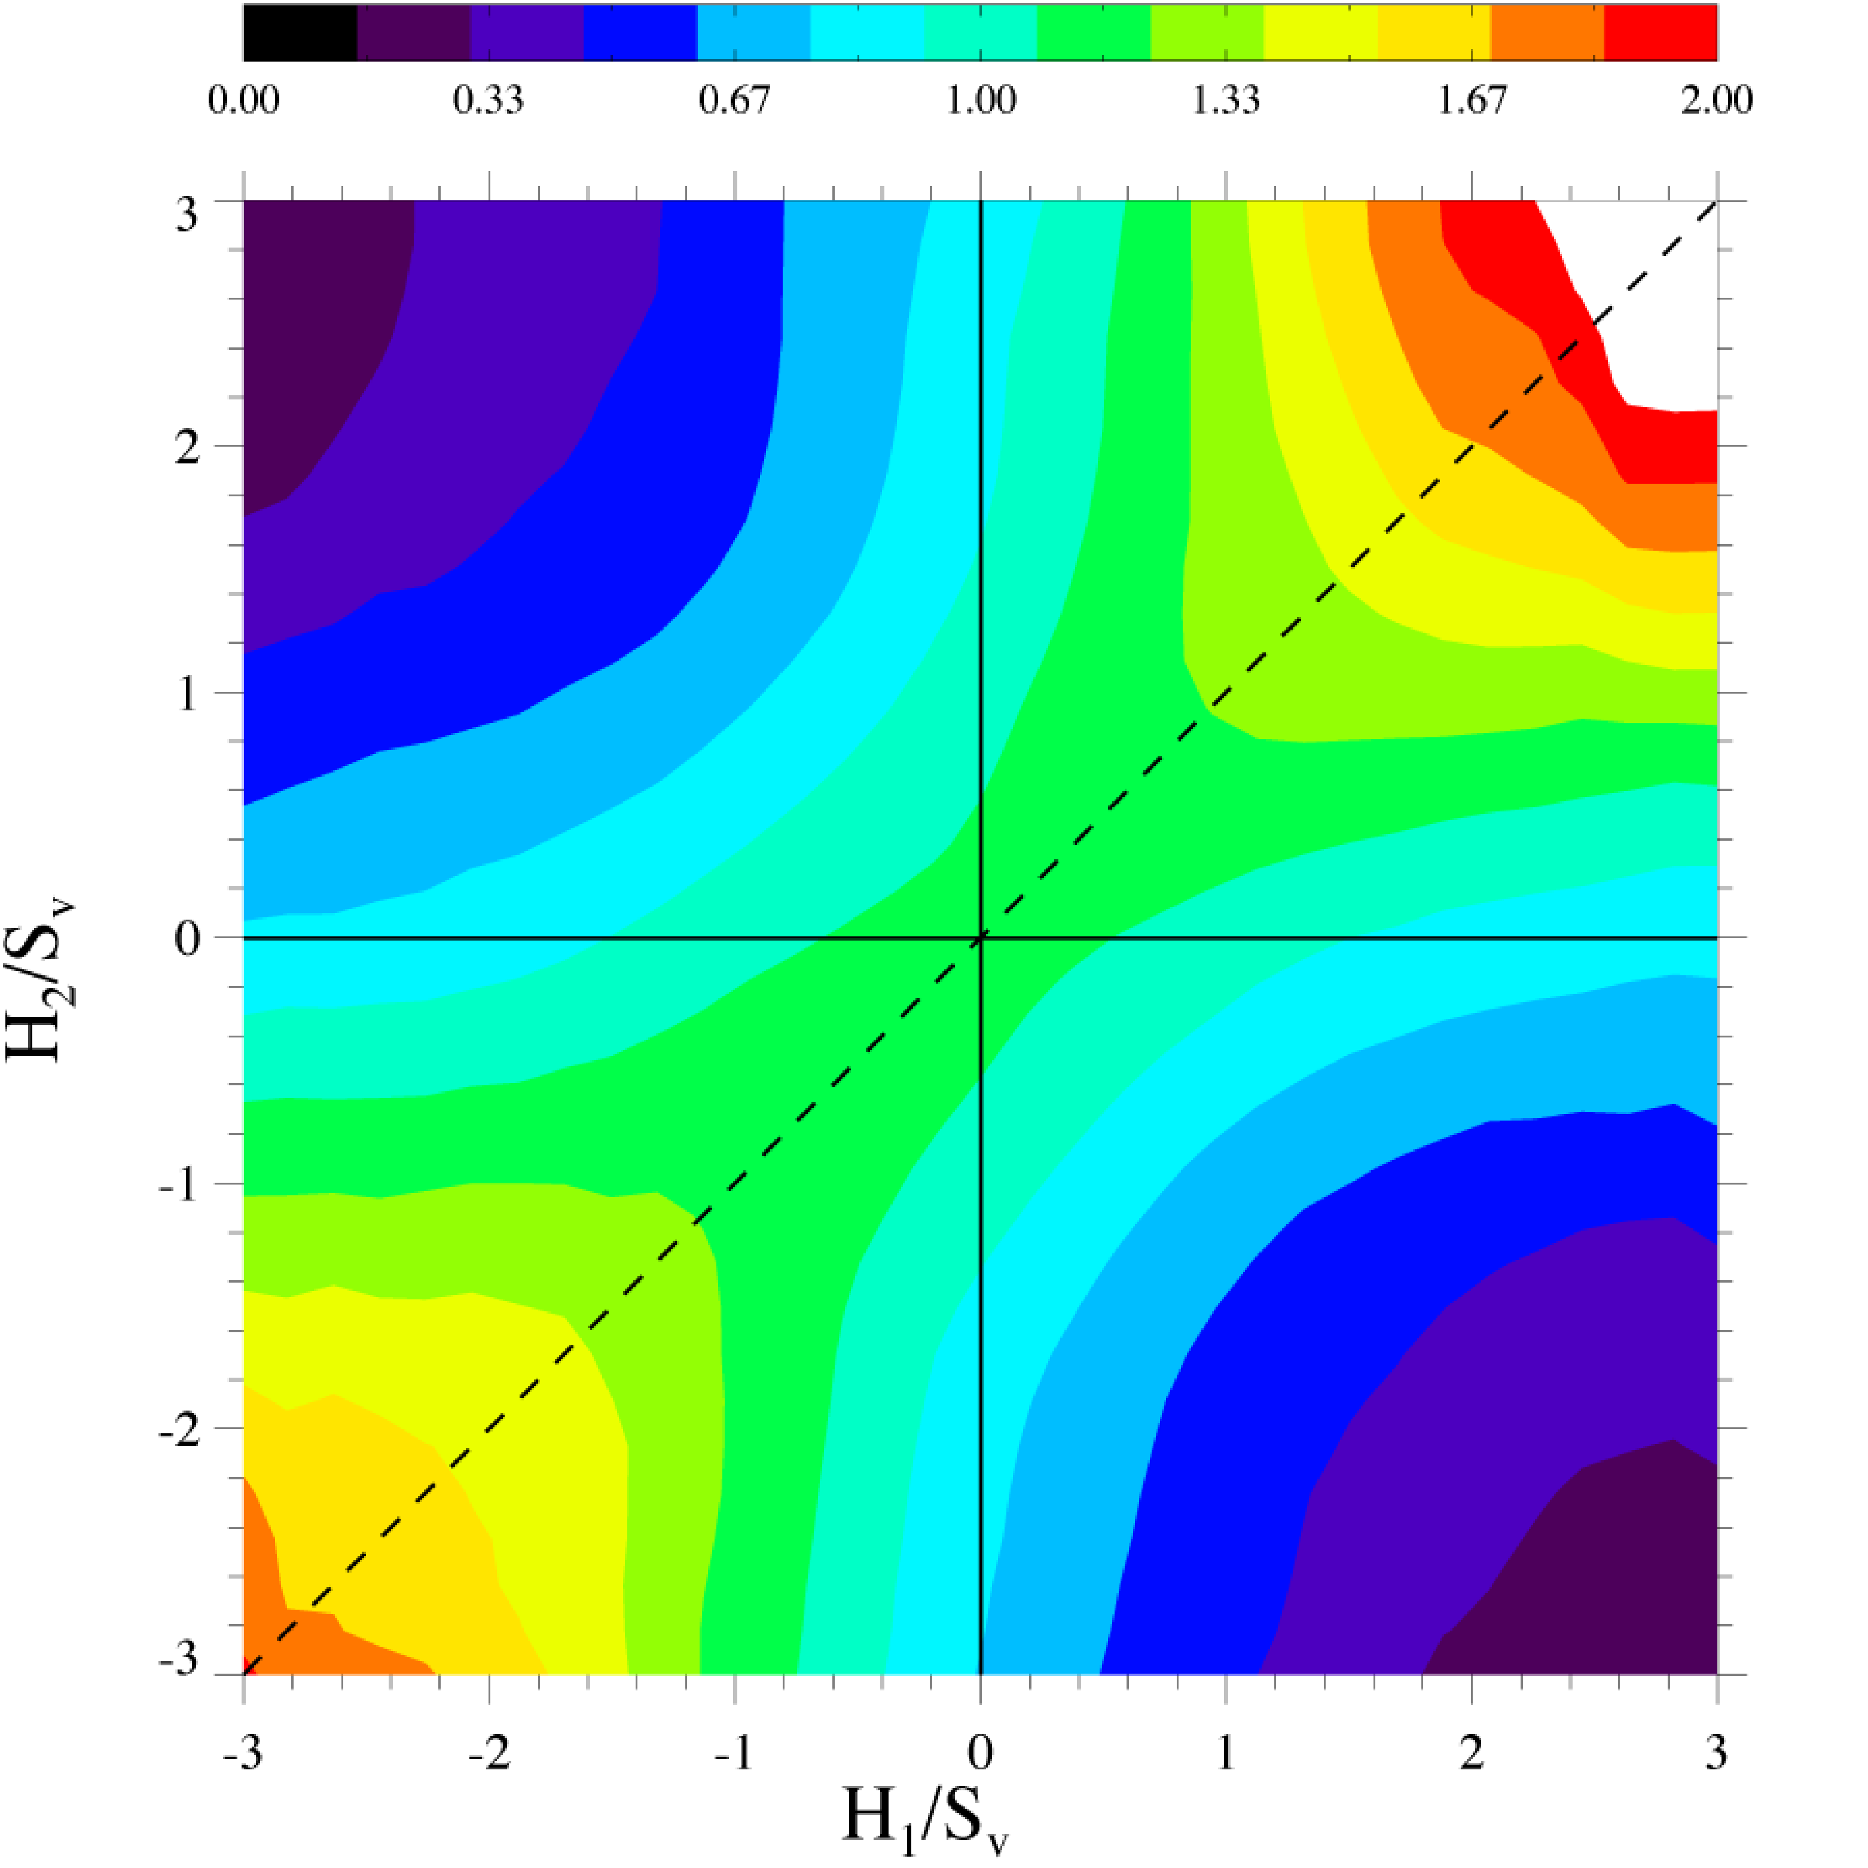
Nonconserved Structure
l = Sv⁻¹

Slide 50
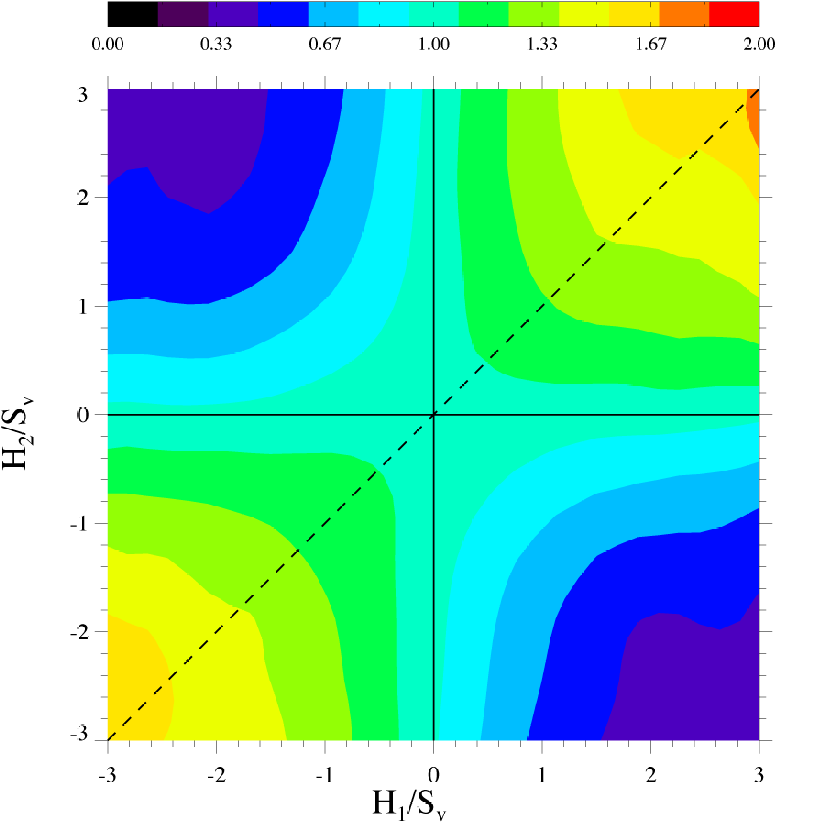
Nonconserved Structure
l = 4/3 Sv⁻¹

Slide 51
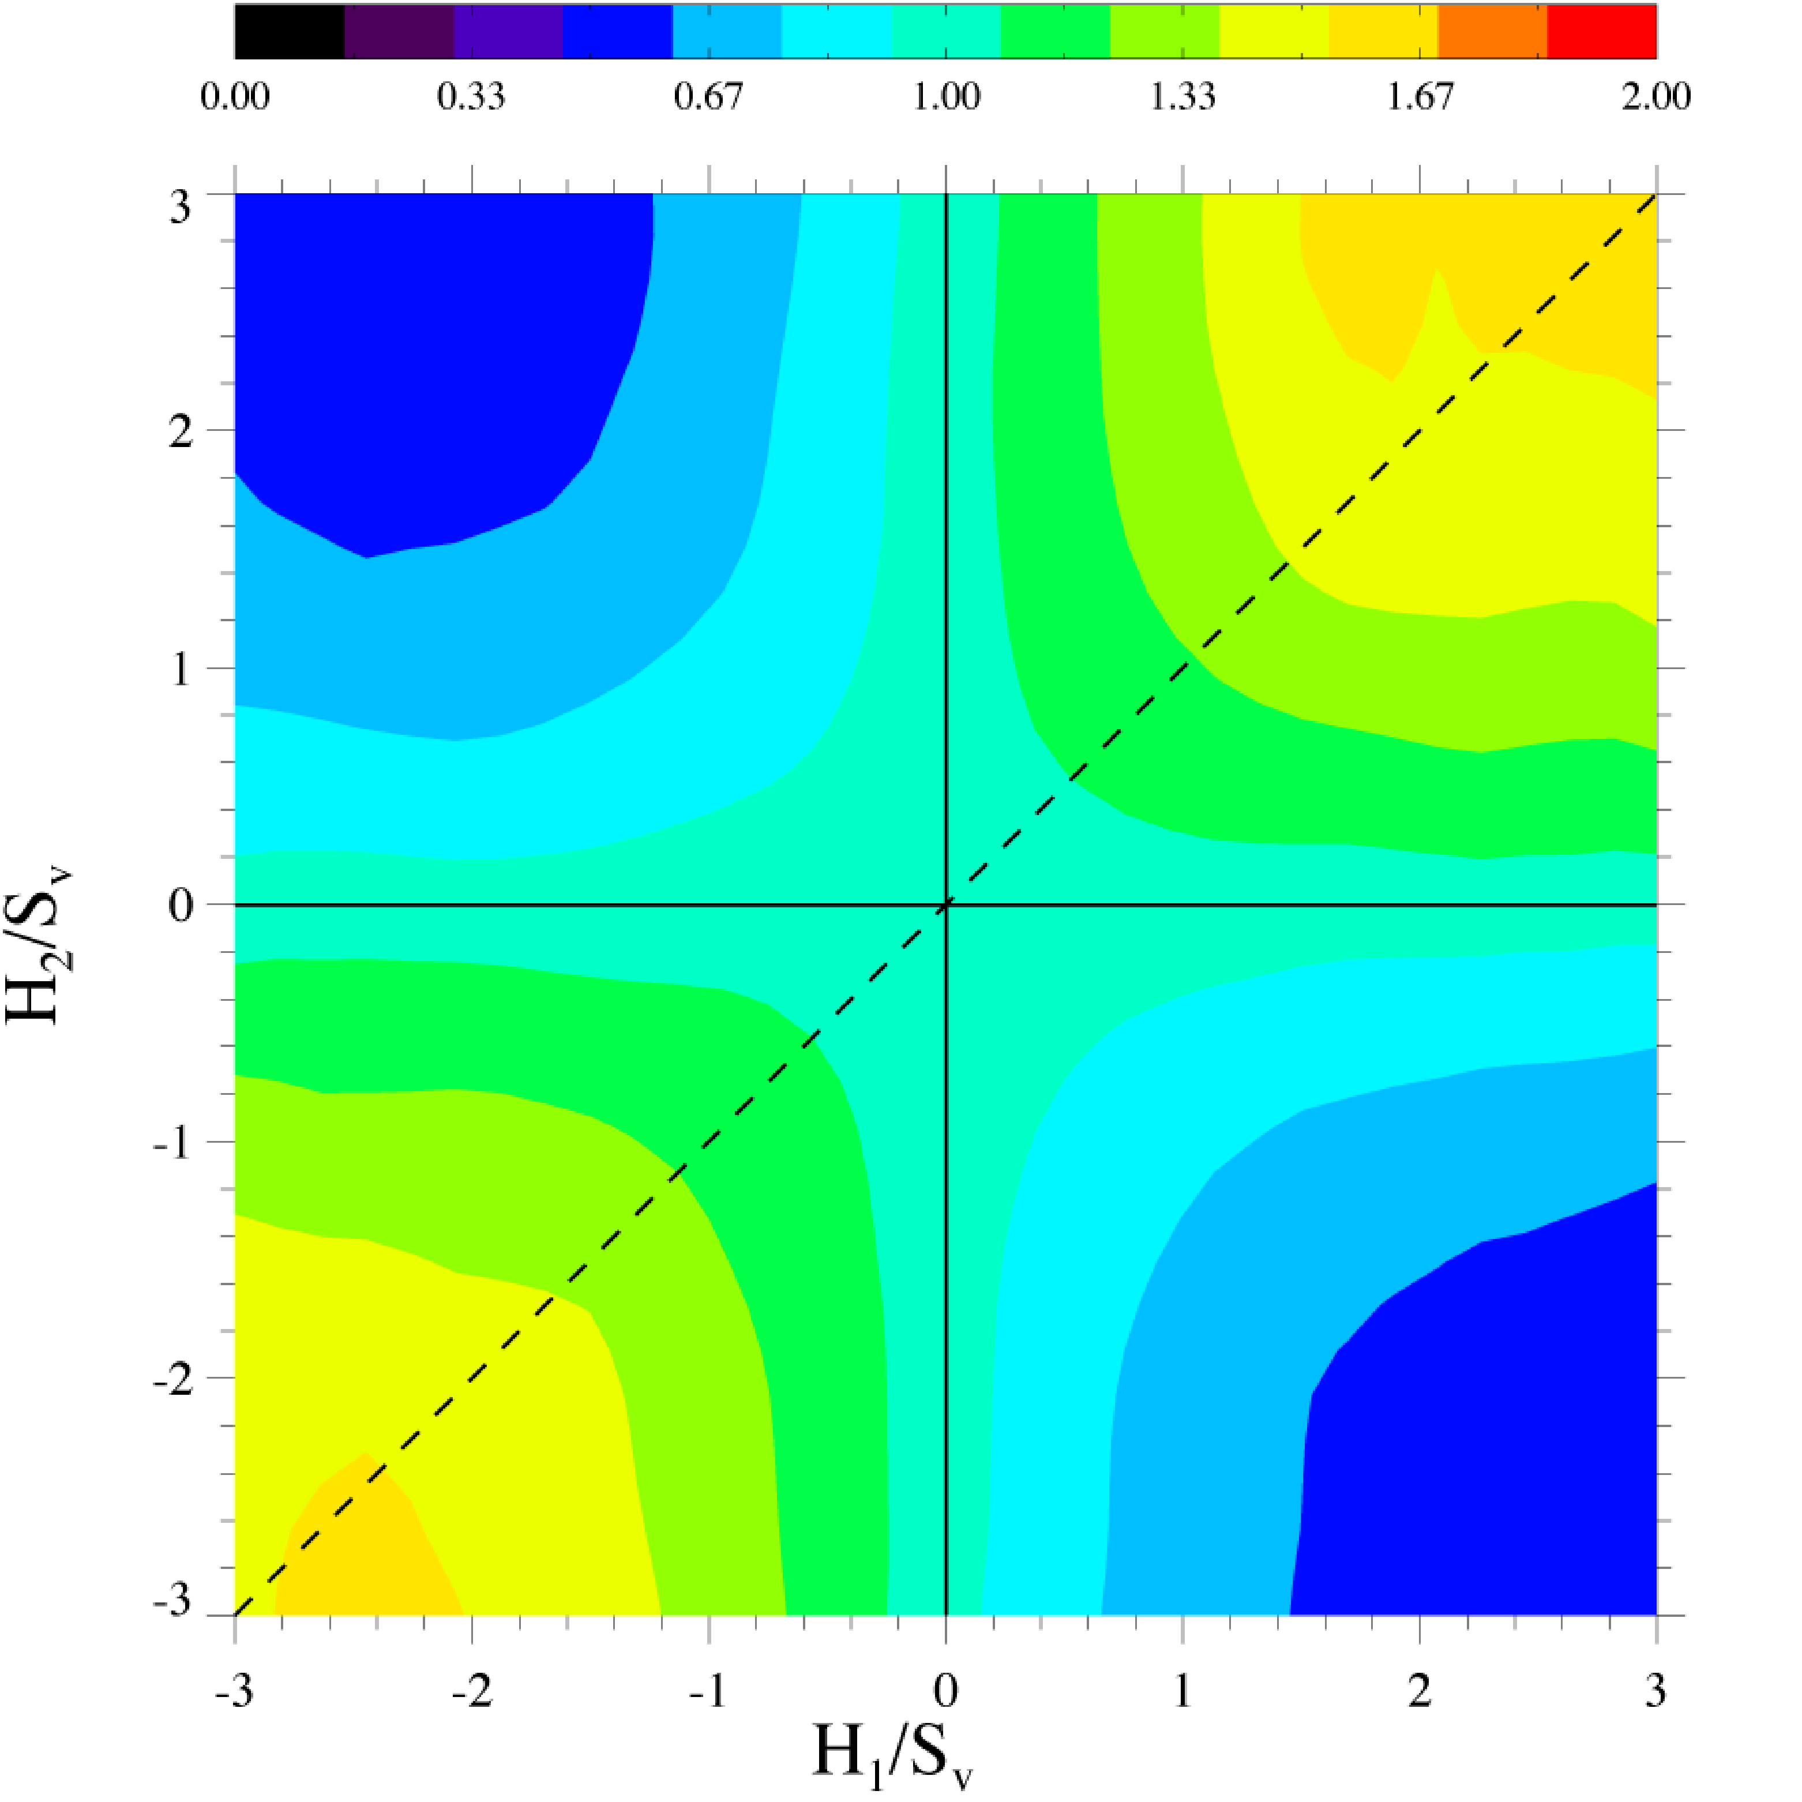
Nonconserved Structure
l = 5/3 Sv⁻¹

Slide 52
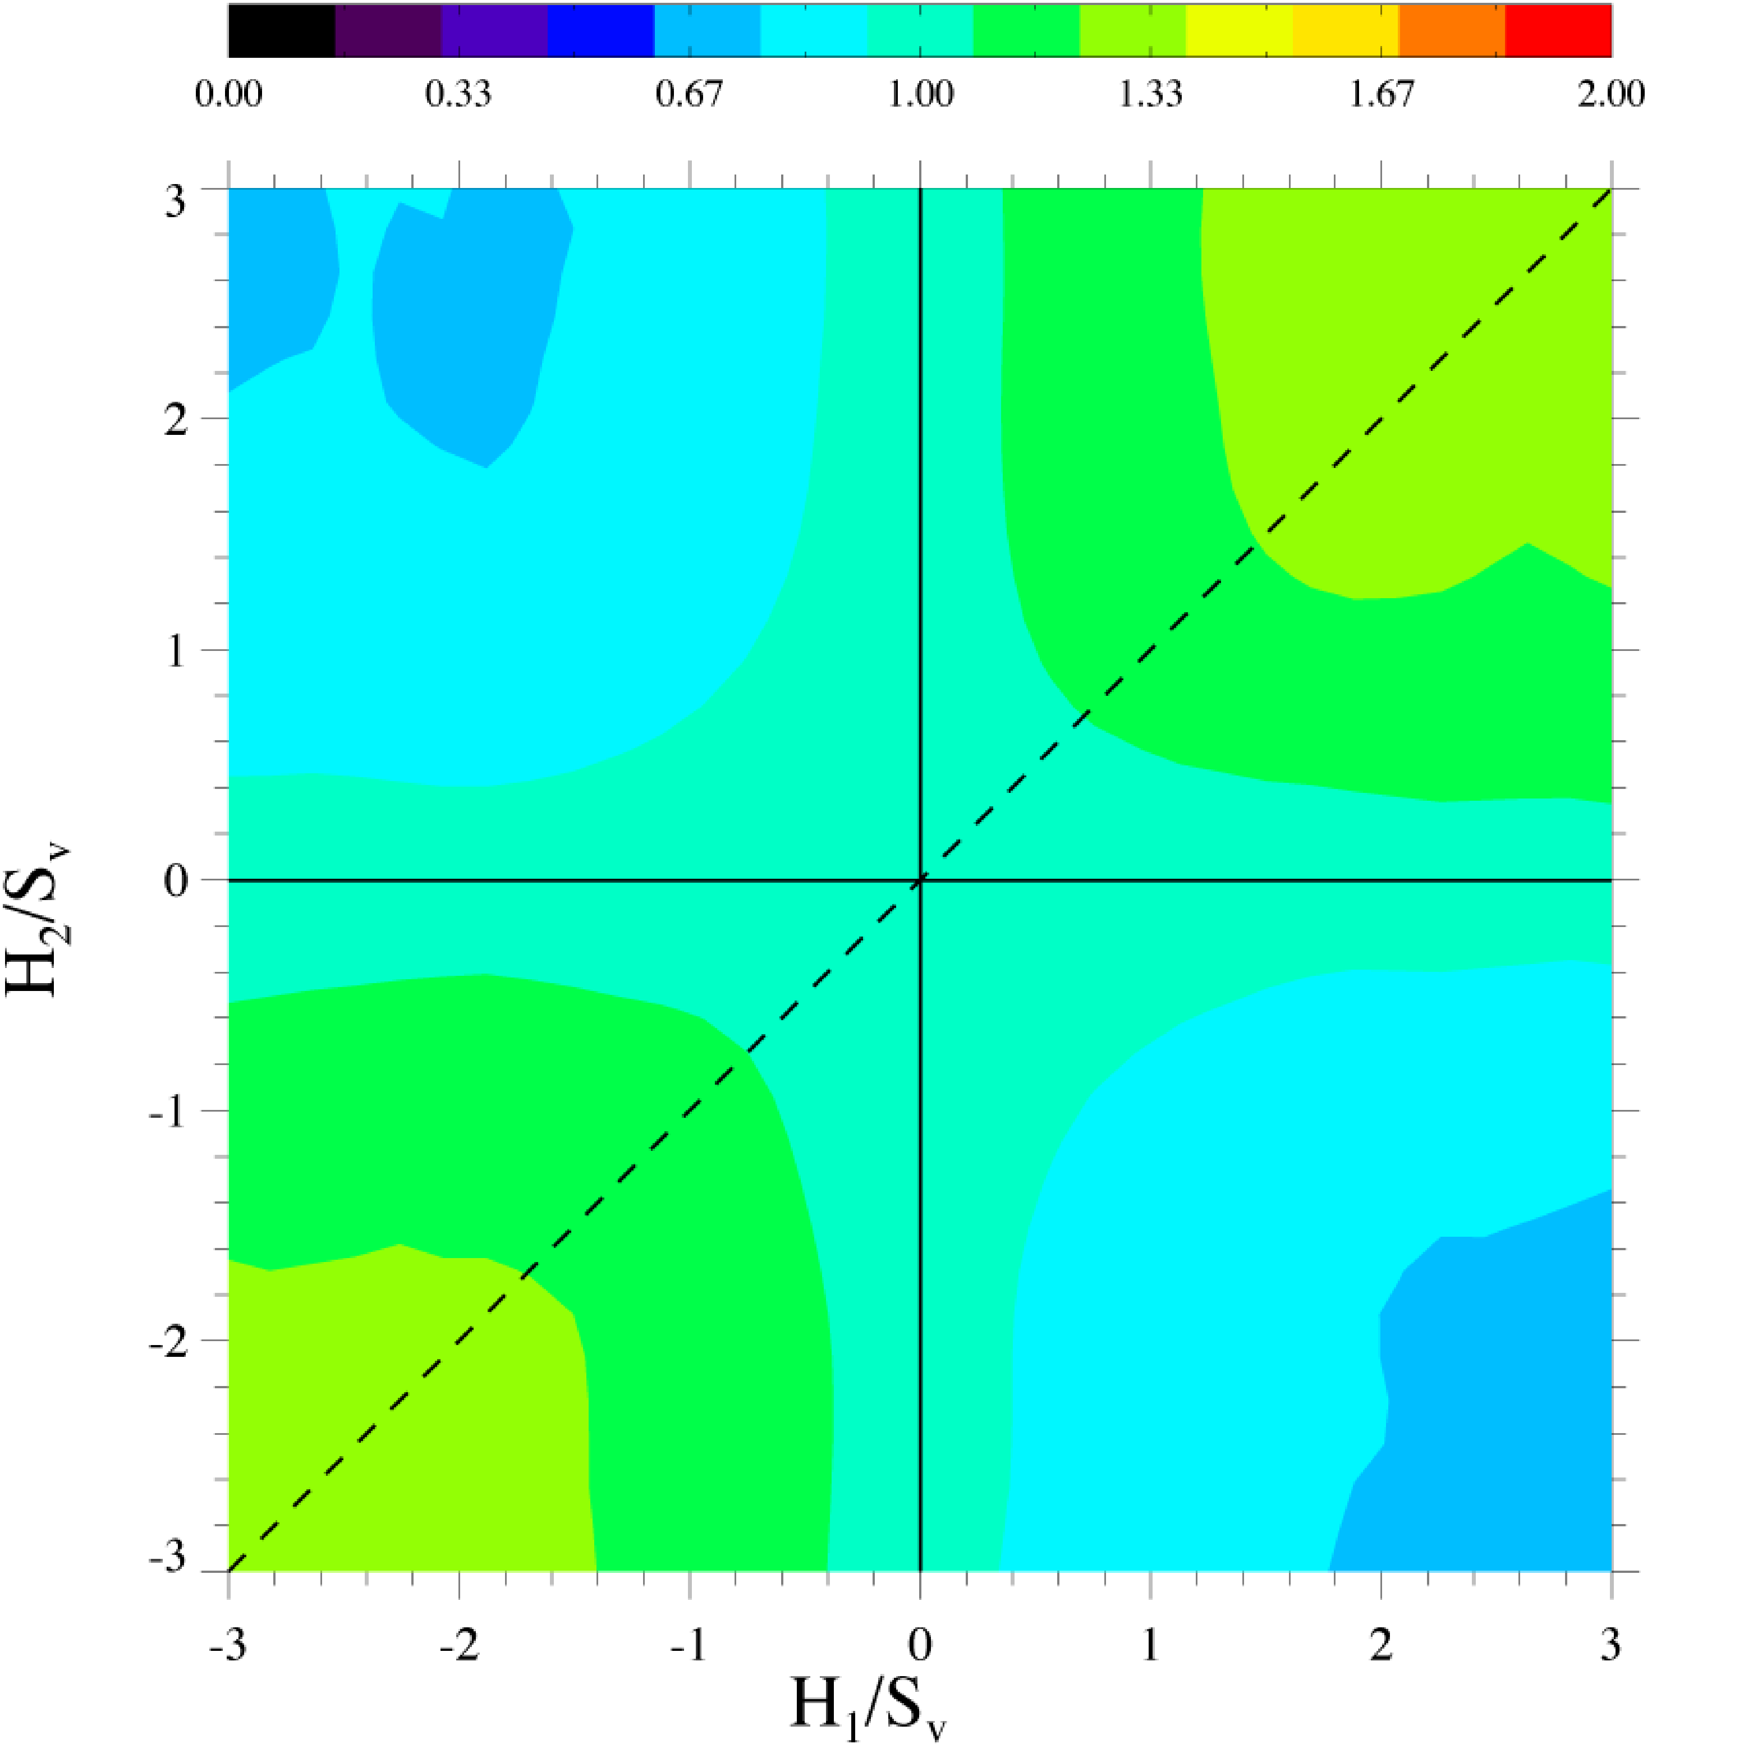
Nonconserved Structure
l = 2Sv⁻¹

Slide 53
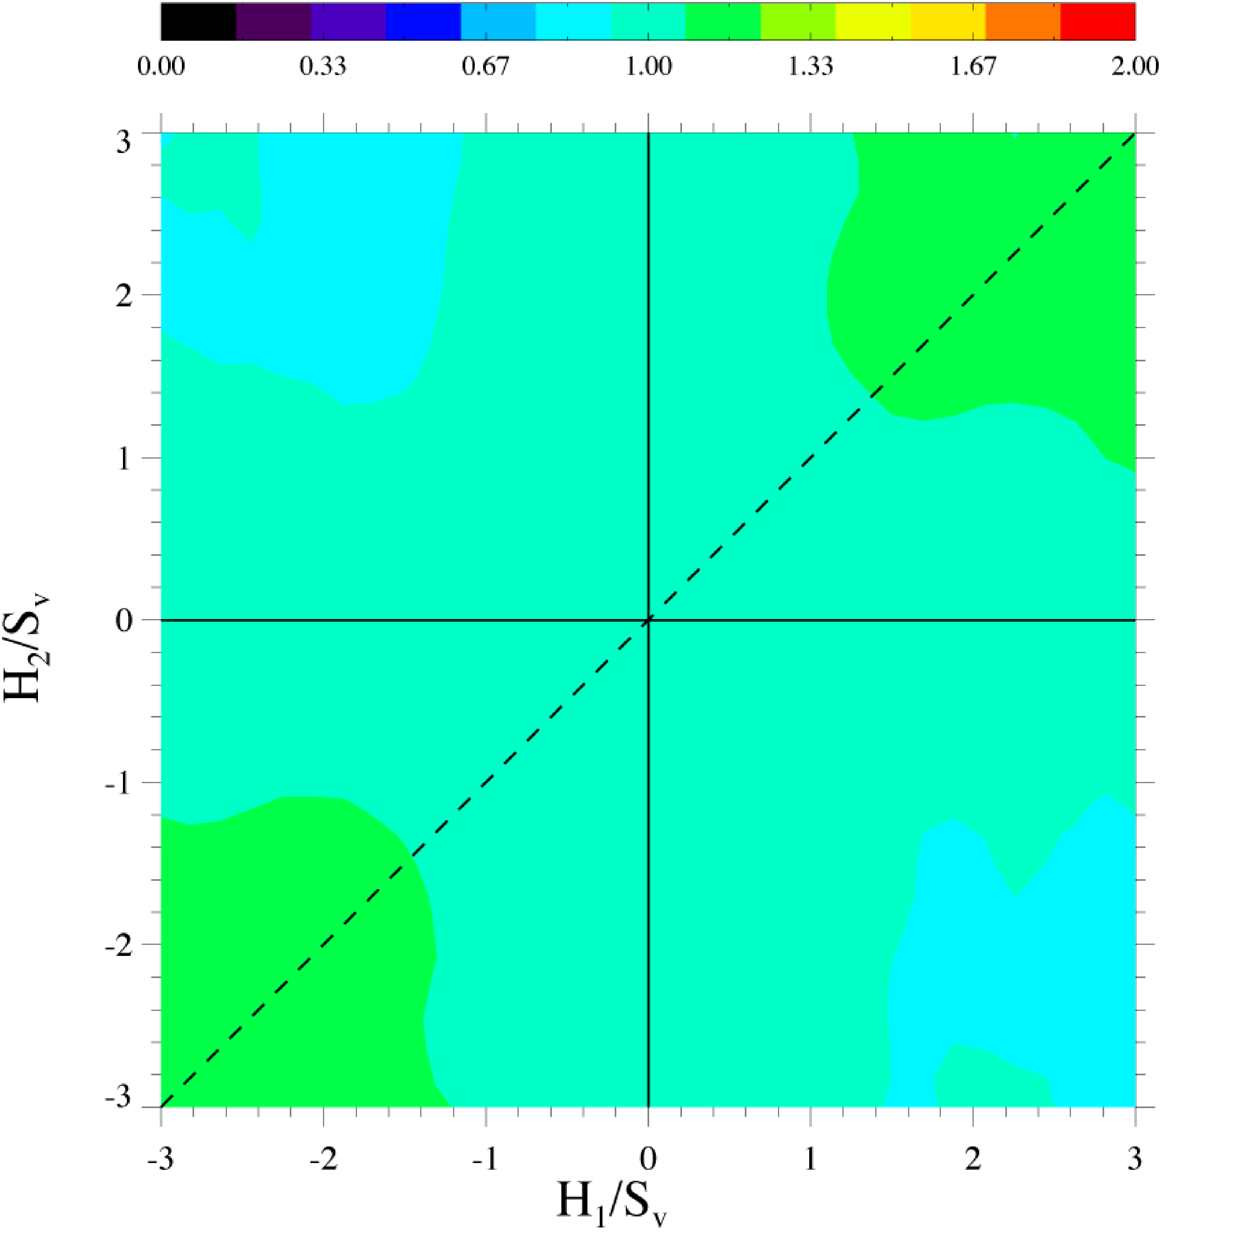
Nonconserved Structure
l = 7/3 Sv⁻¹

Slide 54
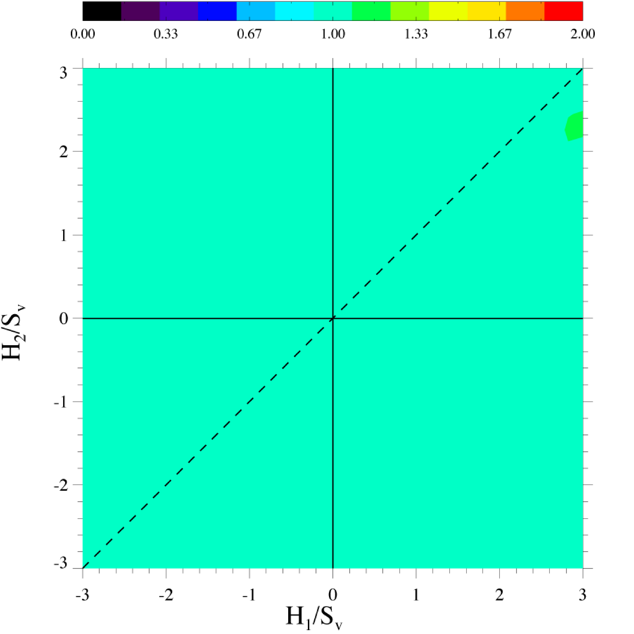
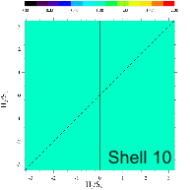
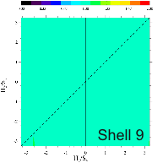
Nonconserved Structure
l = 8/3 Sv⁻¹

Slide 55



Nonconserved Struct. Dictated by Morphology
2x CL

Slide 56






Conserved Structure
l = n/3 Sv⁻¹
1
2
3
4
5
6

Slide 57




Conserved Structure
l = n/3 Sv⁻¹
4
6
8
10
12
15

Slide 58



Conserved Struc. Dictated by Diffusion
l =4/3 S_{v}⁻¹

Slide 59
Conclusions
Scaling of the interfacial structures exists during coarsening following spinodal decomposition and phase ordering in 3D but not in 2D
Bicontinuous structures are possible at volume fractions as low as 36%
Morphology is a function of volume fraction and whether or not the order parameter is conserved
The scaled topology is nearly independent of volume fraction and whether the order parameter is conserved or nonconserved
Bicontinuous nature of the structure introduces spatial correlations
Correlations in the conserved case affected by diffusion

