Slide 1
Colloidal quantum dot optoelectronic devices
Ted Sargent
University of Toronto

Slide 2
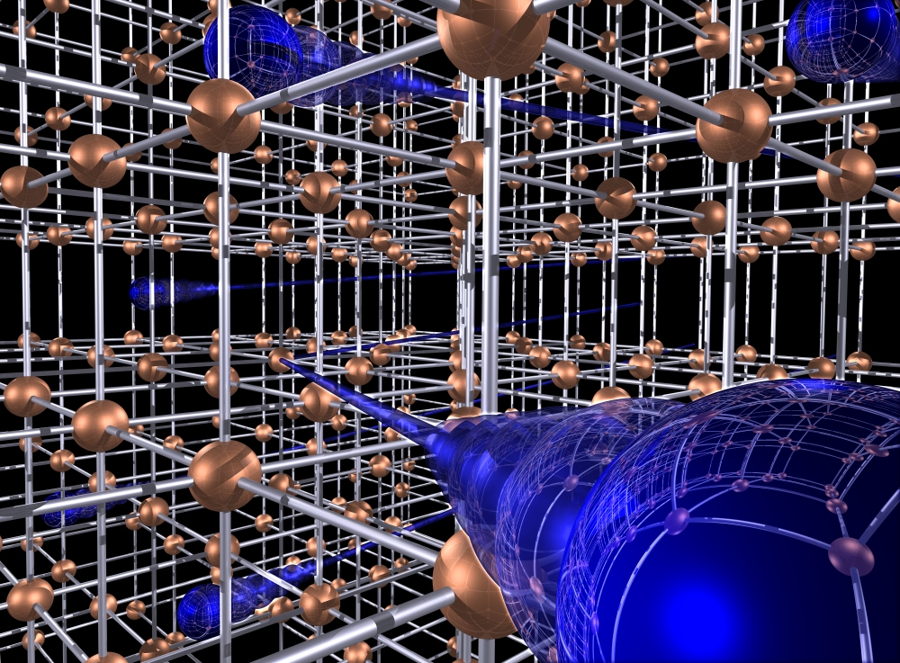

Slide 3
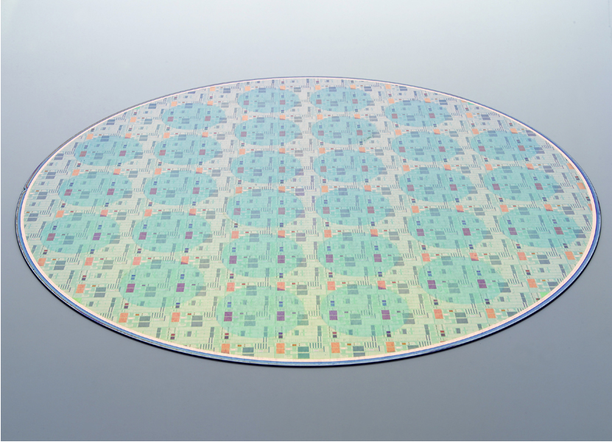

Slide 4

Notes:
Plants convert photons – the fundamental quantum bundles of energy that make up light – into stored chemial energy.
They are efficient enough to have produced our entire stockpile of fossil fuels.
The stored chemical energy began as solar energy. Plants stored it.
How much did it cost? A whole lot of photons, a whole lot of water. But:
No billion-dollar nanofabrication facility
No perfect crystals cooked at 1000 degrees
Nothing rigid, clean, or pure.
Well, there was a bit of perfection: the repeat units that make up the plant’s photosynthetic apparatus are exquisitely designed to harvest the sun’s energy.
Photosynthesis is done by molecules. Nature is brilliant at making each molecule perfect and identical – and evolution is brilliant at evolving these molecules over time to be more effiient.
But while the building bloks are perfect, each leaf is distinct.
Nature is a paradox: perfect, identical pieces of lego – atoms and molecules – used to build an infinite variety of forms and functions.
Like the finite, mundane set of letters Shakespeare turned into literature.
Like the twelve notes J. S. Bach turned into enchantment.

Slide 5
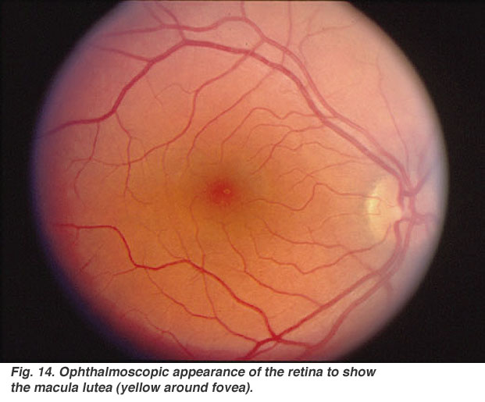
Notes:
Our eye has much in common.
Compared to a crystal, it looks like a mess.
But it can detect as few as five photons. That lightbult is emitting one billion billion photons every second.
The human eye is very sensitive but can we see a single photon? The answer is that the sensors in the retina can respond to a single photon. However, neural filters only allow a signal to pass to the brain to trigger a conscious response when at least about five to nine arrive within less than 100 ms. If we could consciously see single photons we would experience too much visual "noise" in very low light, so this filter is a necessary adaptation, not a weakness.

Slide 6
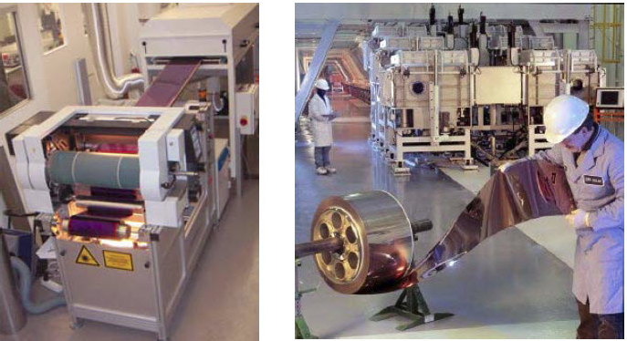

Slide 7
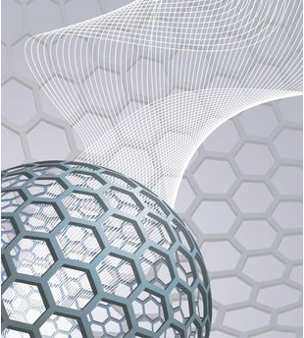

Slide 8
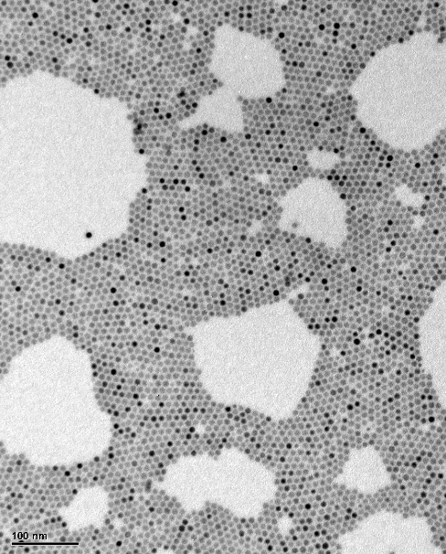
Notes:
Though they’re cheap and easy to make, the particles are perfect enough. They’re pretty much the same size – to within an atom’s thickness.

Slide 9
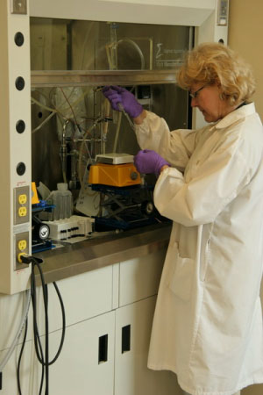
Notes:
Here’s Larissa Levina making semiconductor particles.
Doesn’t look much like a silicon fab. It takes a few syringes, a fumehood, some purple gloves.
You can cover a square meter of area with Larissa’s particles for a few dollars.

Slide 10
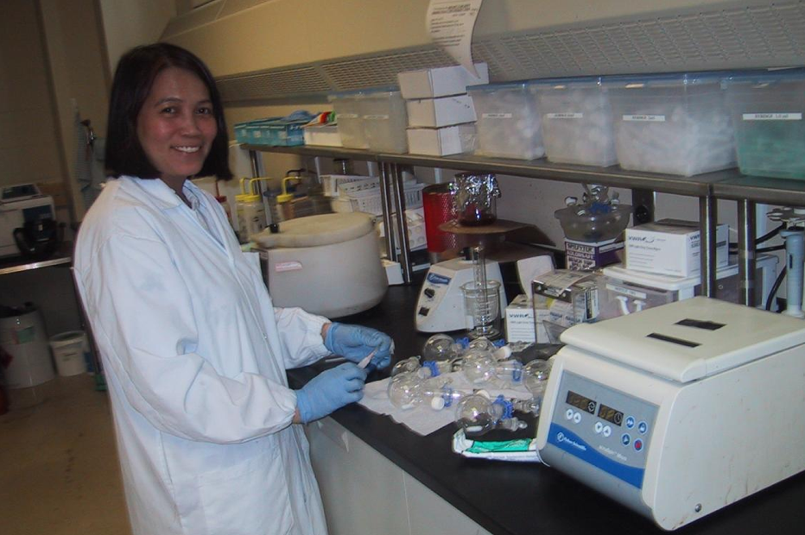

Slide 11
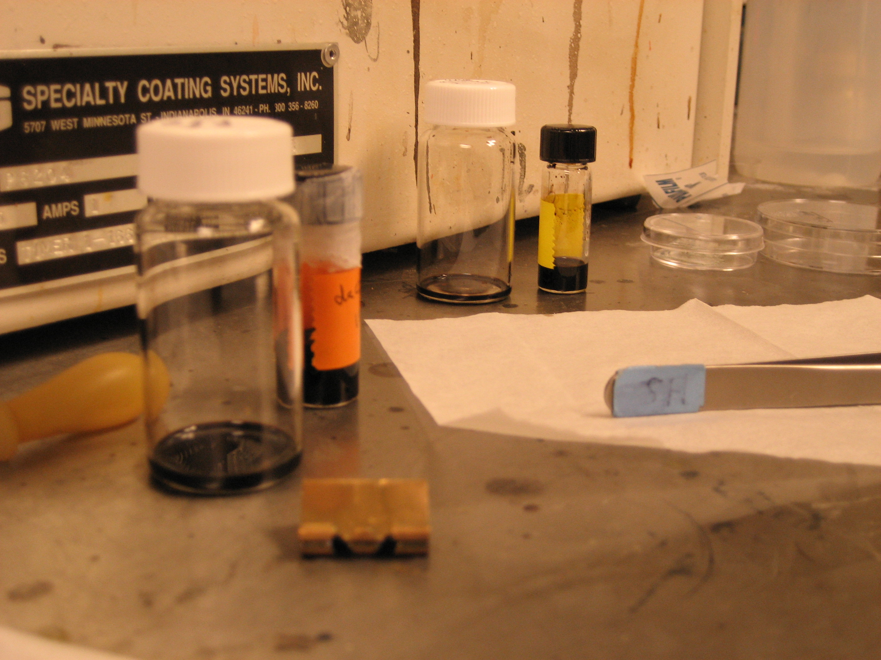

Slide 12
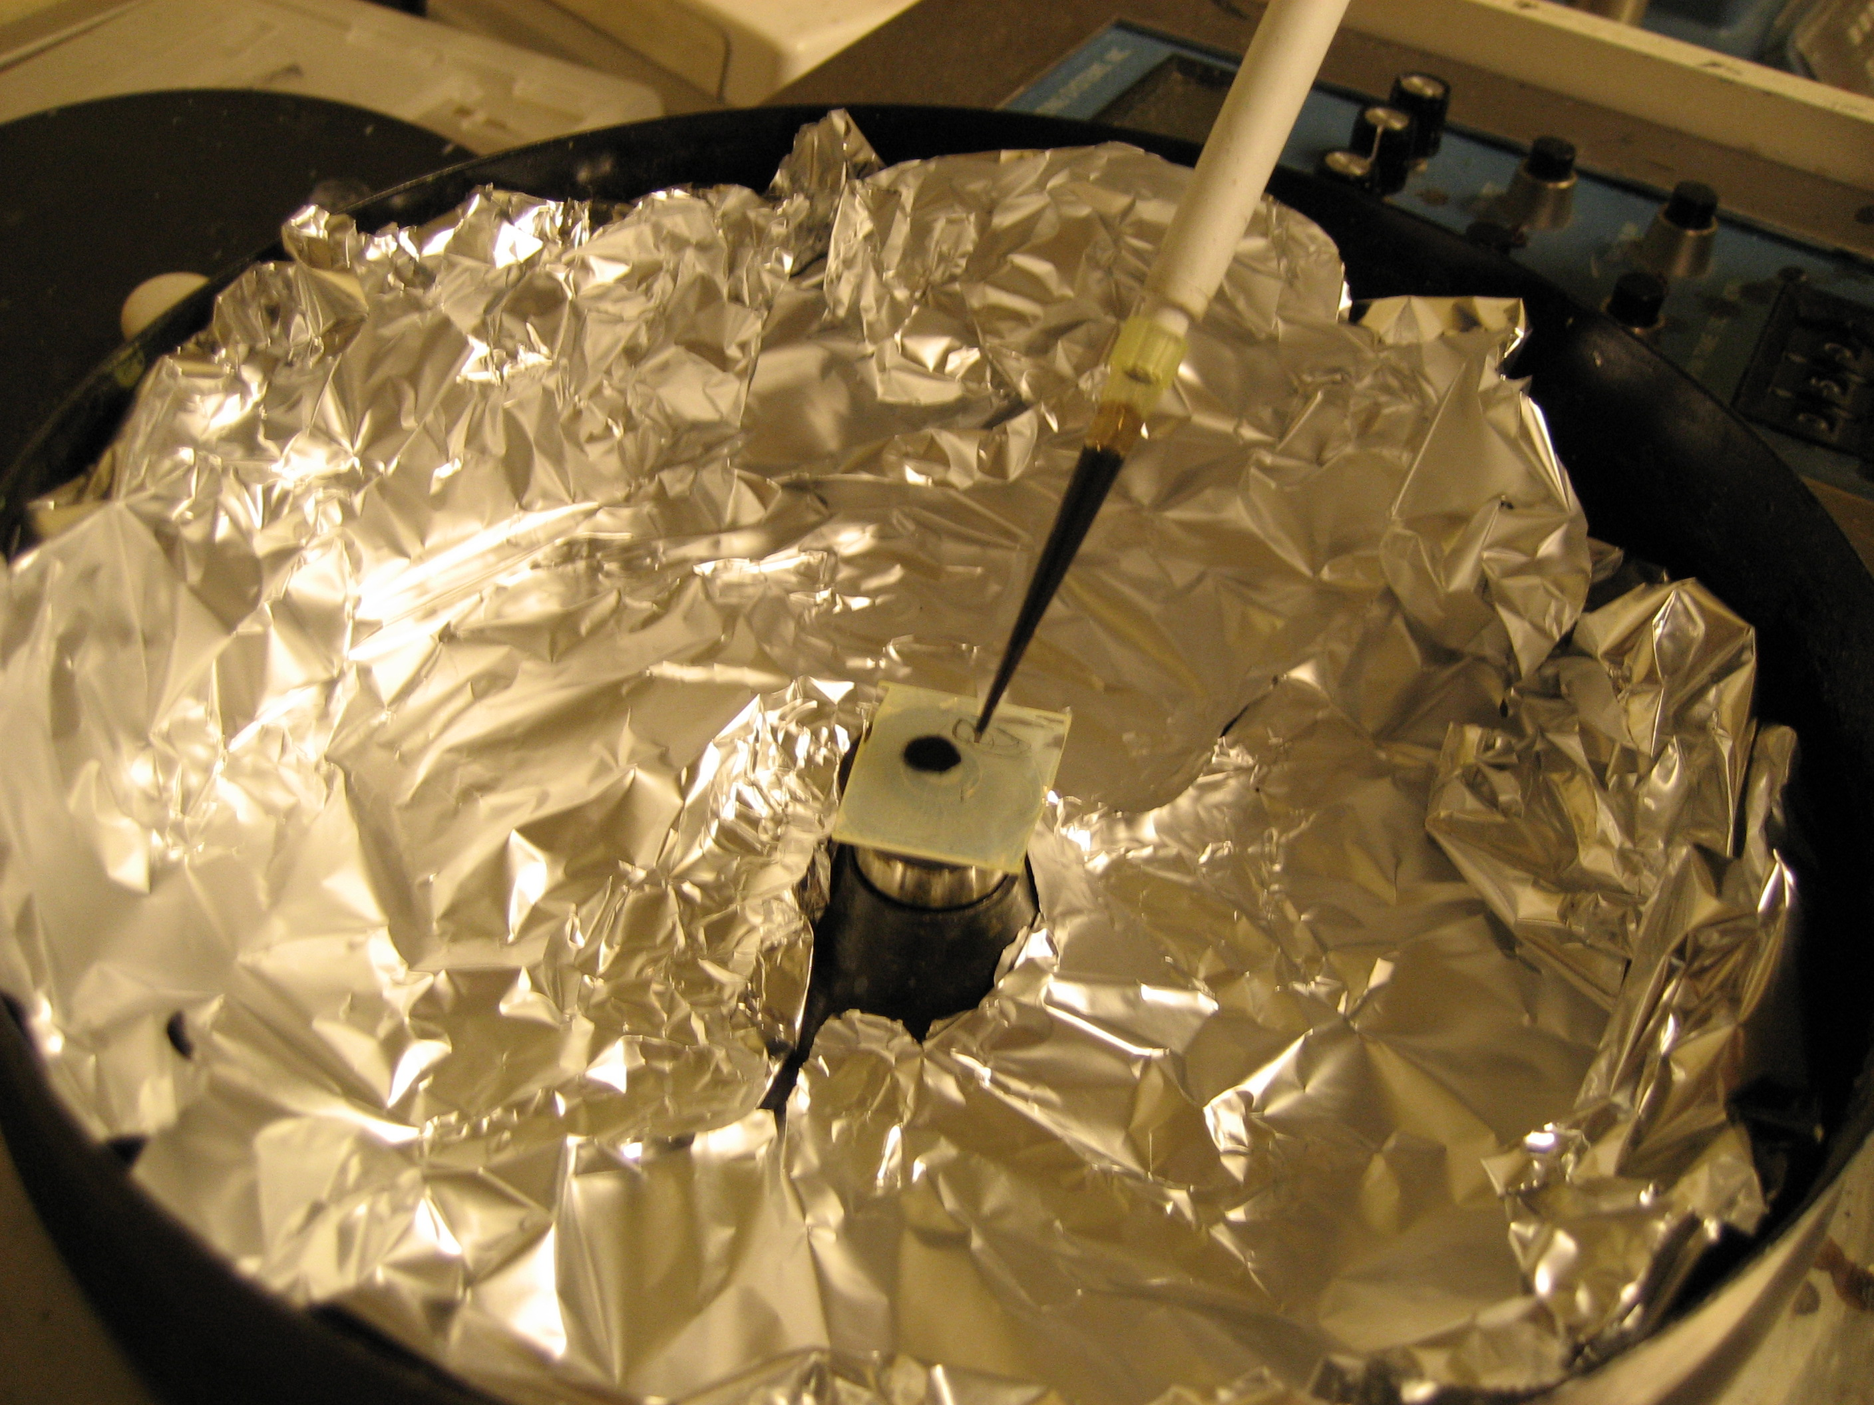

Slide 13
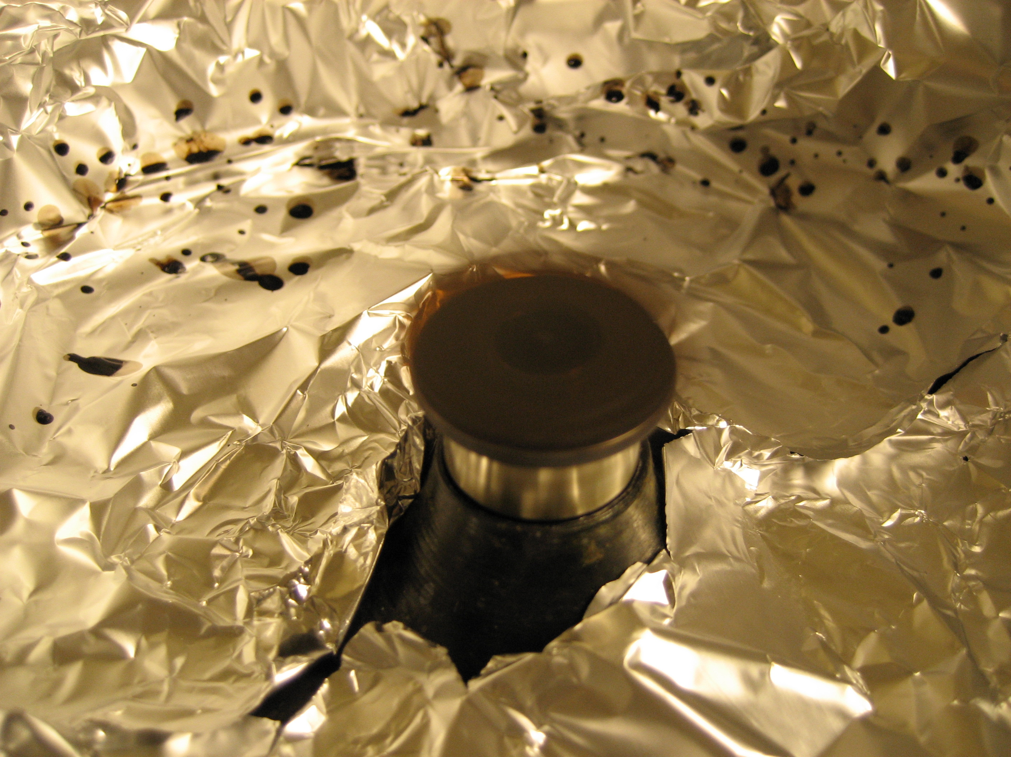

Slide 14
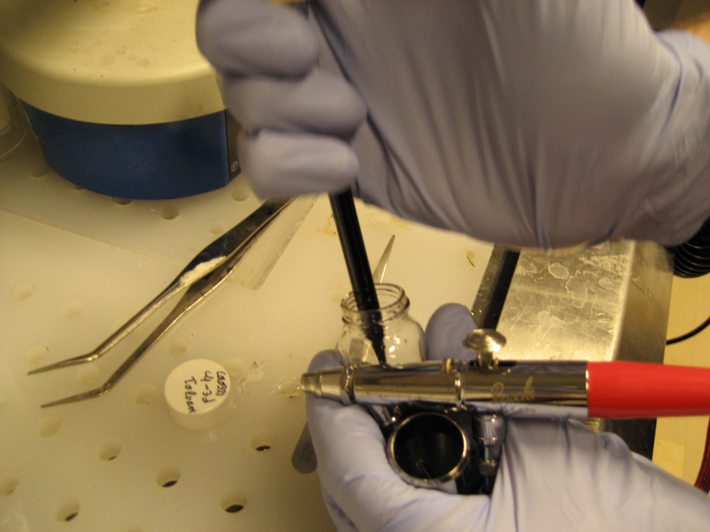

Slide 15
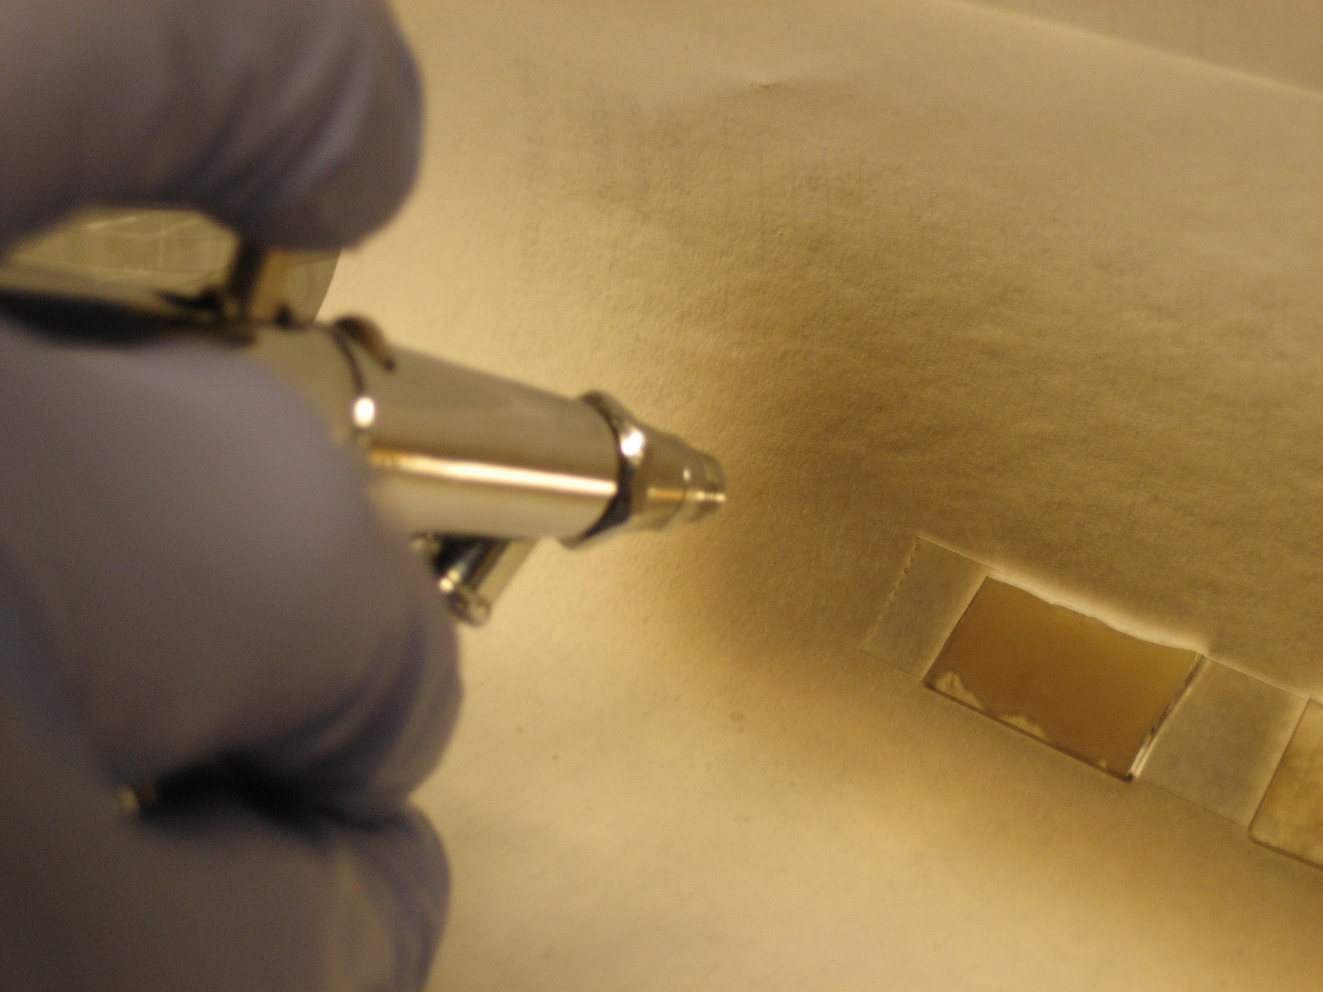

Slide 16
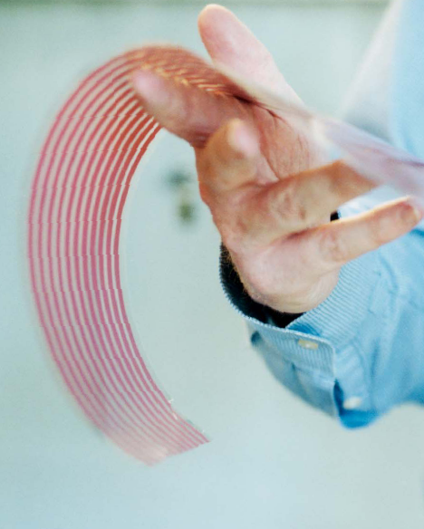

Slide 17


Slide 18



Slide 19
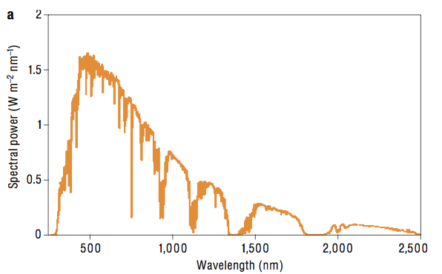
Half of the sun’s power reaching the earth
lies in the infrared

Slide 20
Multijunction concept
AM1.5g Spectrum
680 nm
1070 nm
1750 nm
Gap 1
Gap 2
Gap 3
Notes:
Motivation: 3GPV
achieve high efficiencies at low costs
development of PV technologies competitive with fossil fuels
Quantum dots
soft material: solution processible
one material system for all band gaps in multijunction cell
novel phenomena: multiple exciton generation?
challenges: high surface area, surface passivation

Slide 21
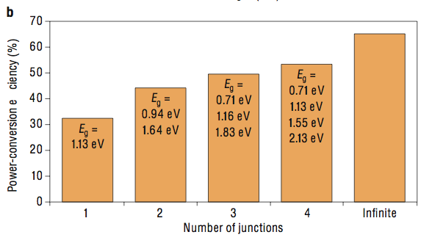
IR PV is therefore required in efficient solar harvesting ... ...even in a single-juntion cell
Two canonical IR wavelengths to watch:
~ 1.5 um (lowest-gap junction in optimal 3-junction cell)
~ 1 um (optimal single-gap junction; and middle junction in optimal 3-junction)

Slide 22
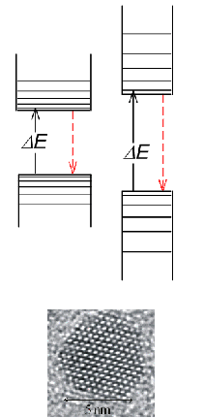
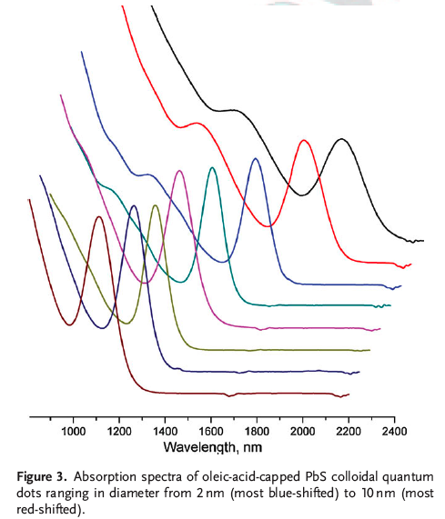
Strategy must therefore: (1) Address IR+Vis; (2) Be widely tunable

Slide 23
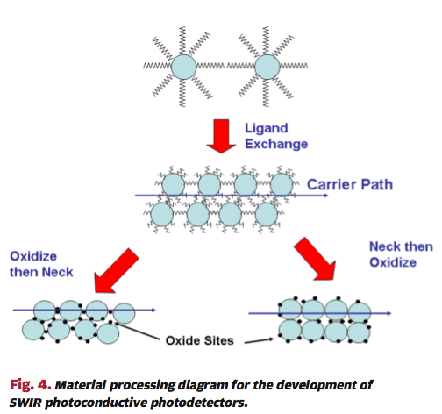
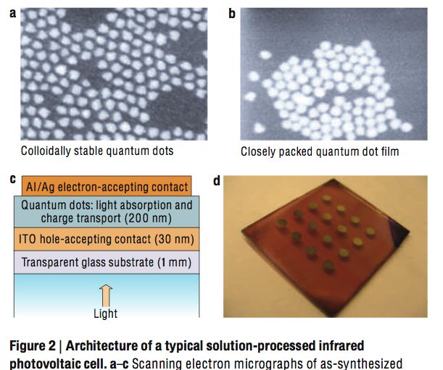

Slide 24
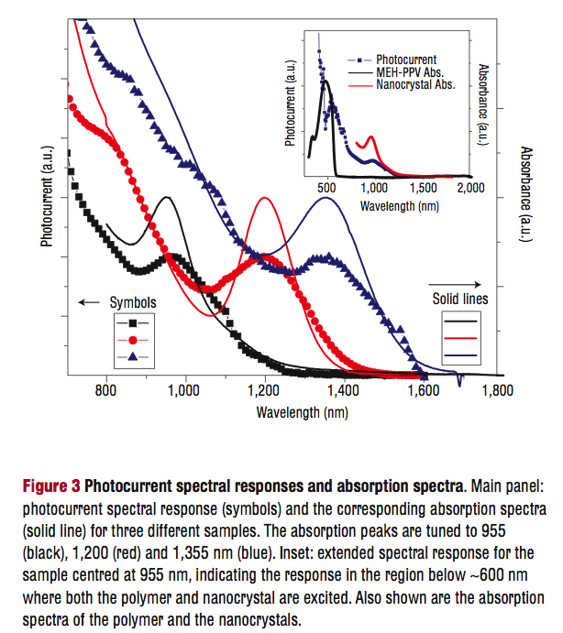
nature materials 2005 LETTERS

Slide 25
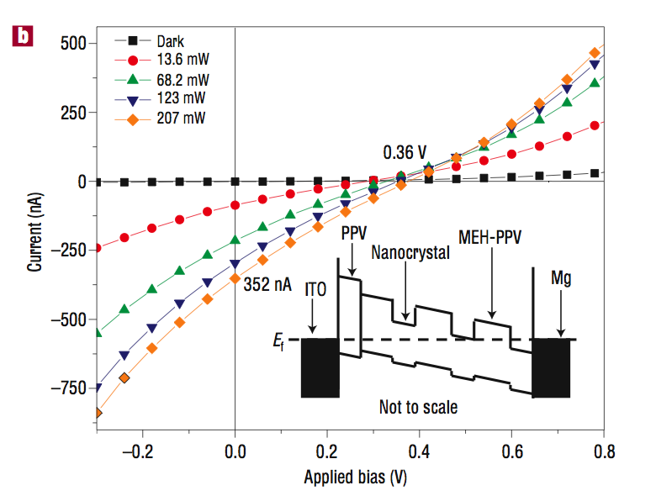

Slide 26
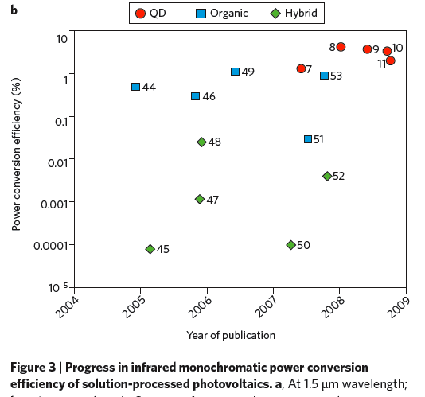
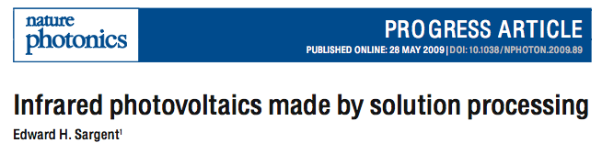
12% mono-PCE goal to support 10% AM1.5 target

Slide 27
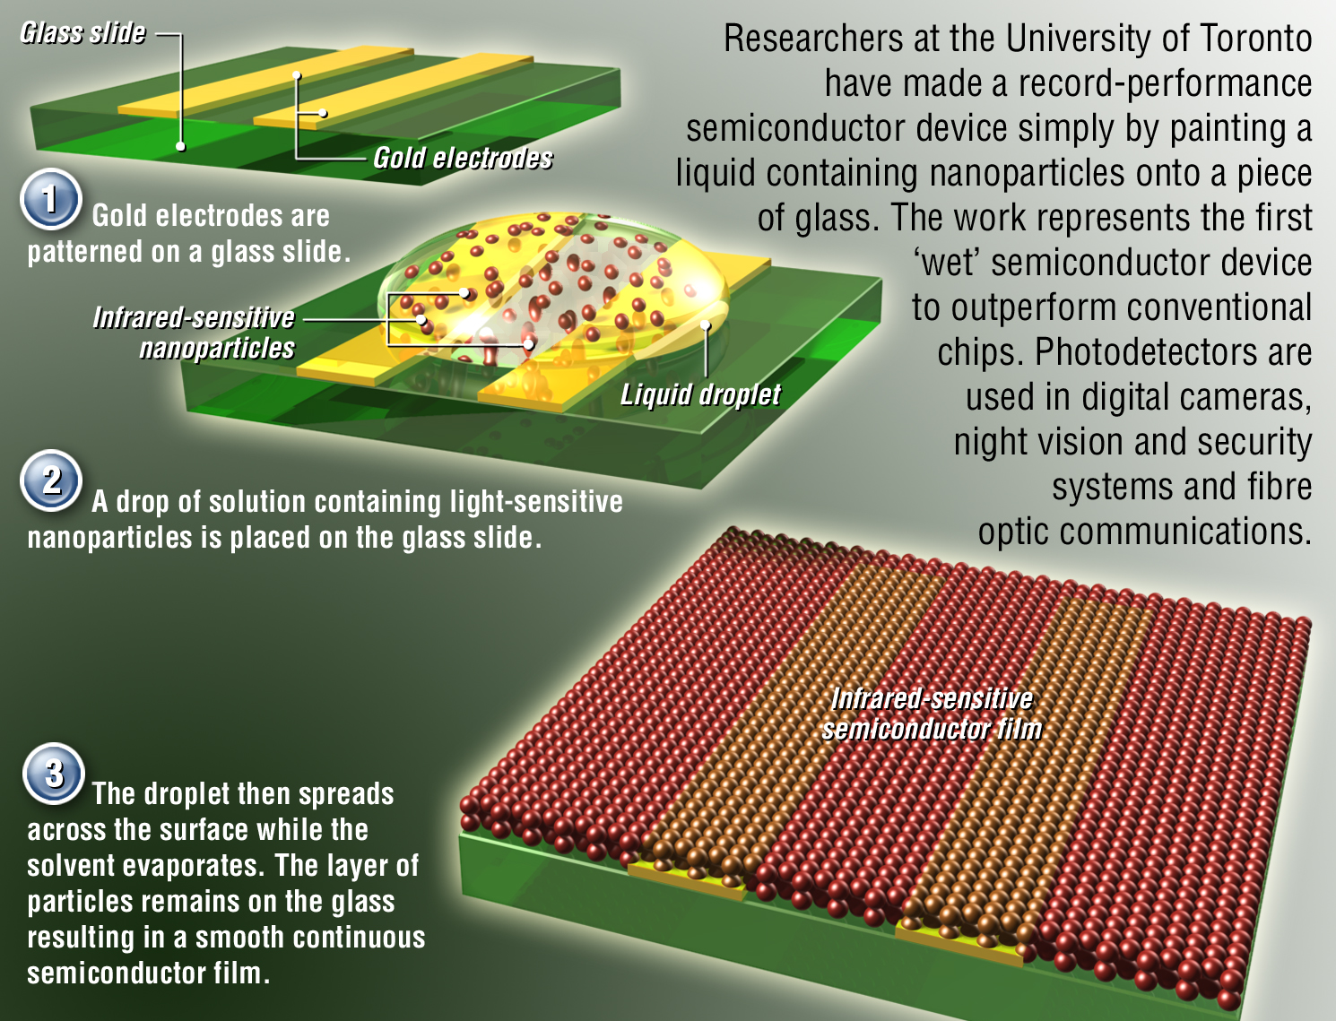
Notes:
We used made infrared photodetectors using solution-processing. The devices were based on colloidal quantum dots synthesized in our labs. We spin-coated an interdigitated electrode on a glass slide to form a photoconductive photodetector. The devices exhibited sensitivies – measure via D*, the normalized detectivity used as figure of merit in IR photodetector sensitivity – in the 10^13 Jones. Epitaxially-grown devices based on InGaAs have room-temperature D* values in the 10^12 Jones.
The work represents the first solution-processed electronic device to outperform its epitaxial counterpart. In the words of Nature’s Editor’s Notes introducing our paper:
Editor's Summary
13 July 2006
A practical solution
The best electronic and optoelectronic devices are built via semiconductor crystal growth on a single-crystal substrate. Over 100 papers have been published in recent years in Nature on alternative devices, produced instead from the solution phase. They have some advantages over conventional crystalline semiconductor devices: ease of fabrication, physical flexibility and - most important - low cost. The problem was the poor electronic performance of solution-processed devices, compared with single-crystal counterparts. But that could change now: a team from the University of Toronto reports that one such system - colloidal quantum dots of lead sulphide - can actually outperform the state-of-the-art crystalline alternative.

Slide 28
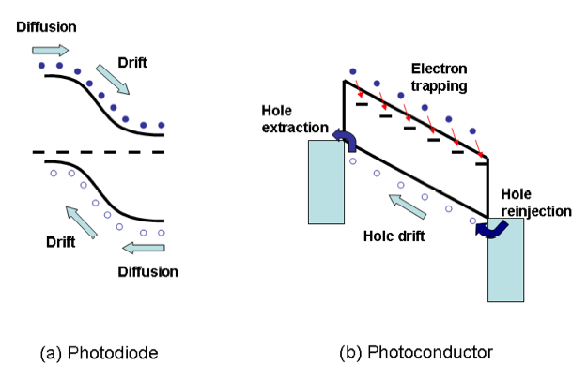
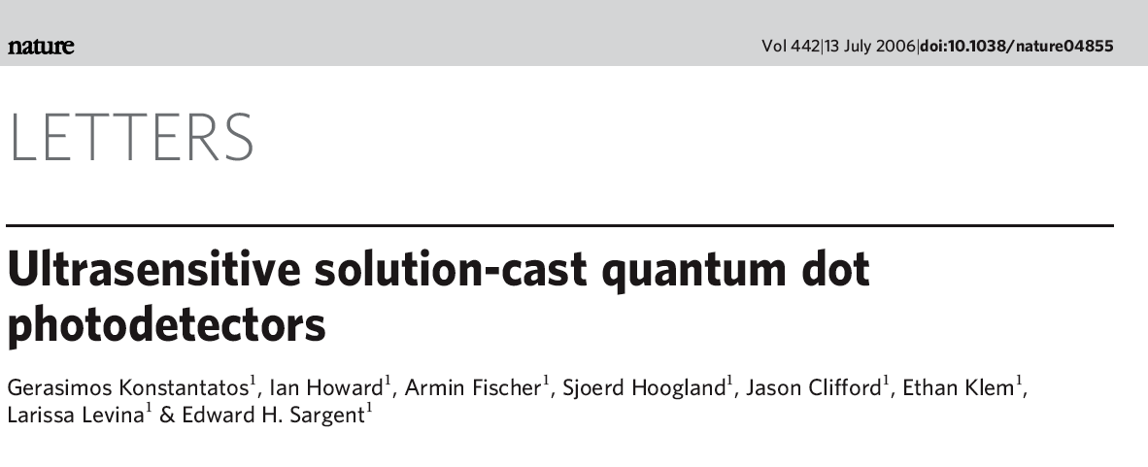

Slide 29
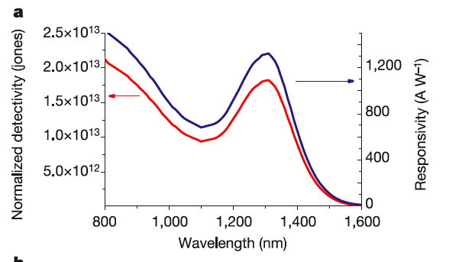

Slide 31
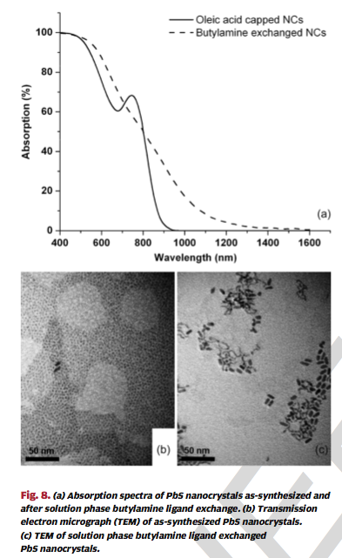

Slide 32
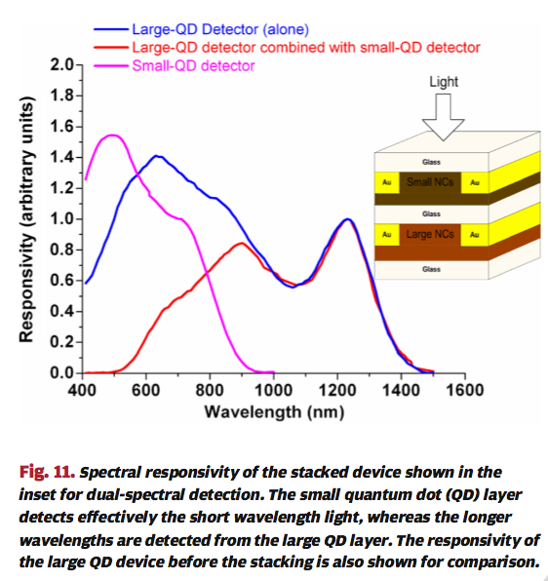

Slide 33
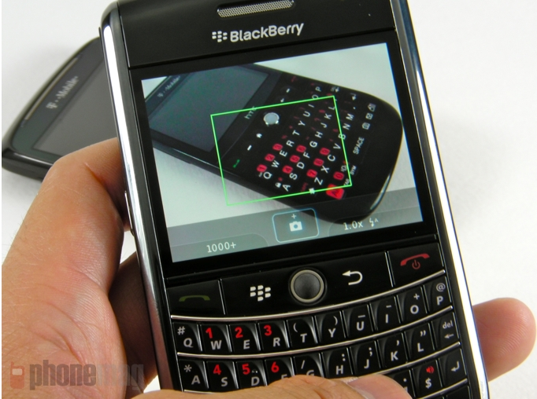
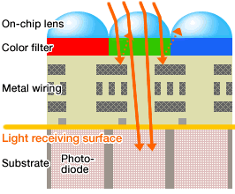

Slide 34

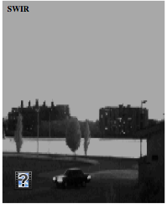
NIR

Slide 35
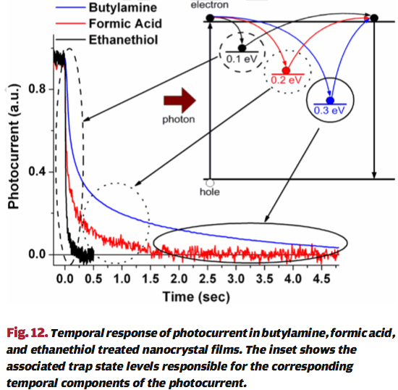
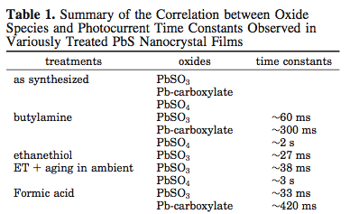

Slide 36
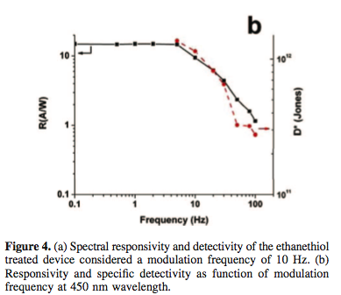
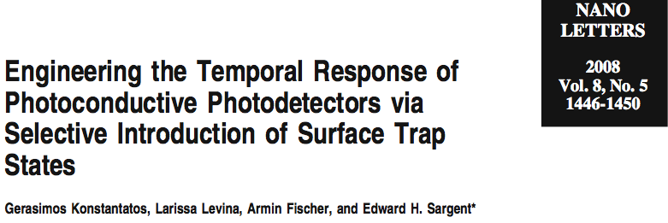

Slide 37
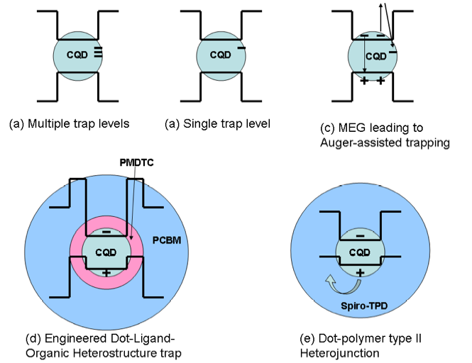

Slide 38
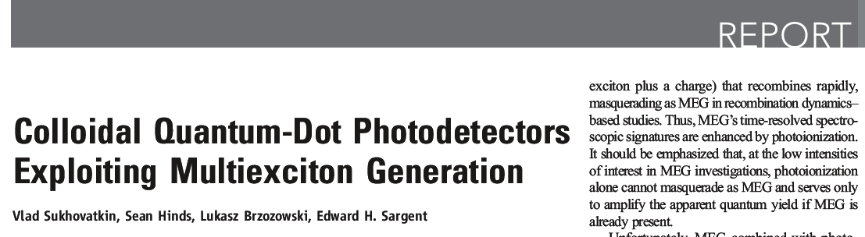
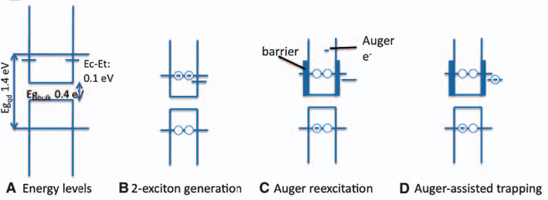

Slide 39
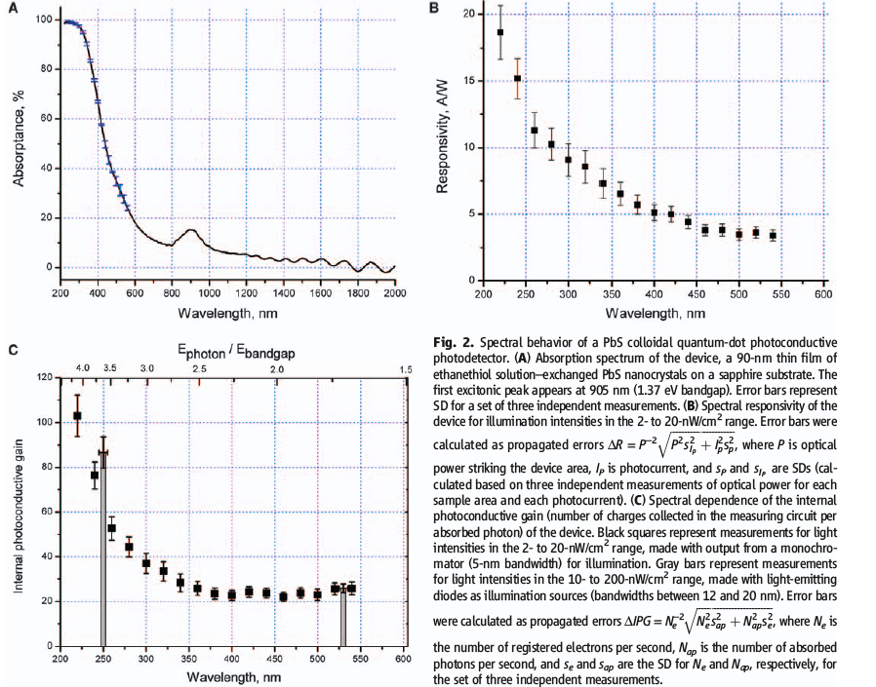

Slide 40
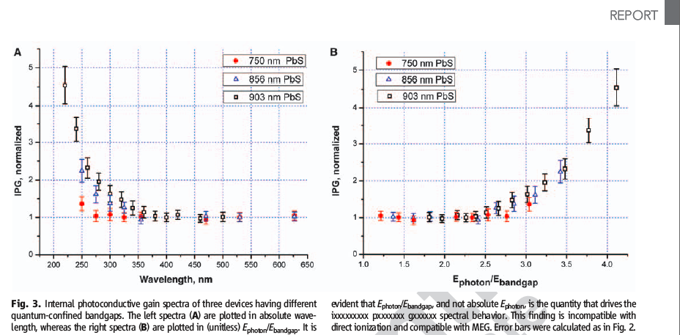

Slide 41
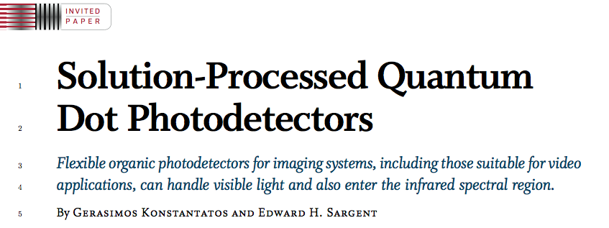
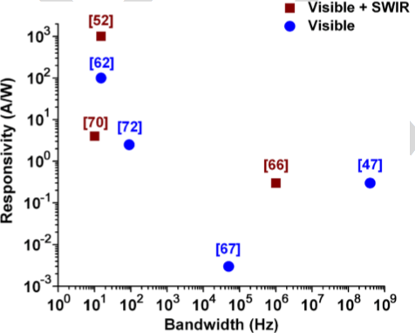
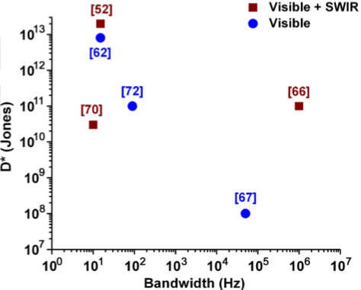

Slide 42
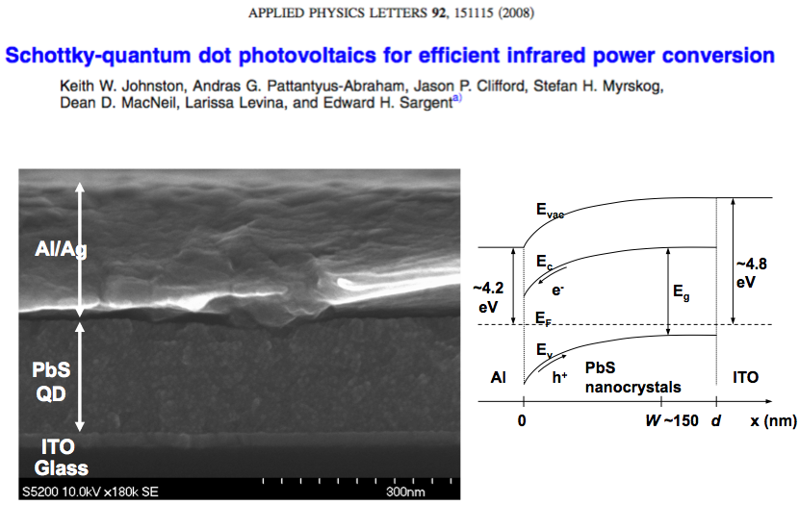
Slide credit: Andras Pattantyus-Abraham

Slide 43
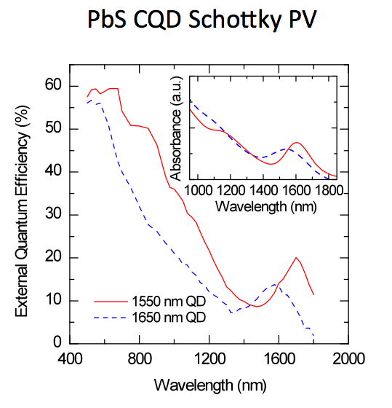
Slide credit: Andras Pattantyus-Abraham

Slide 44
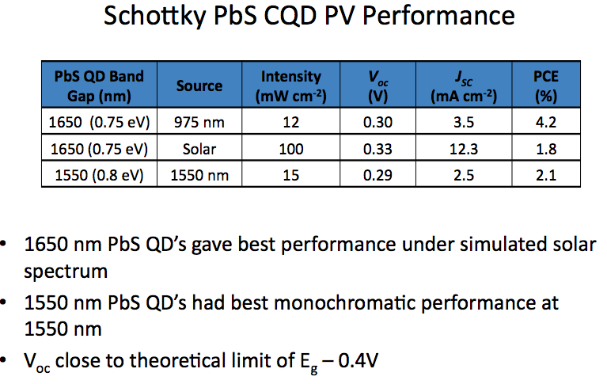
Slide credit: Andras Pattantyus-Abraham

Slide 45
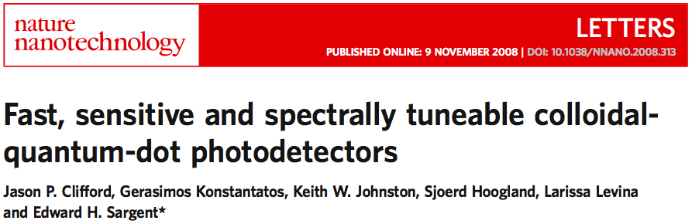
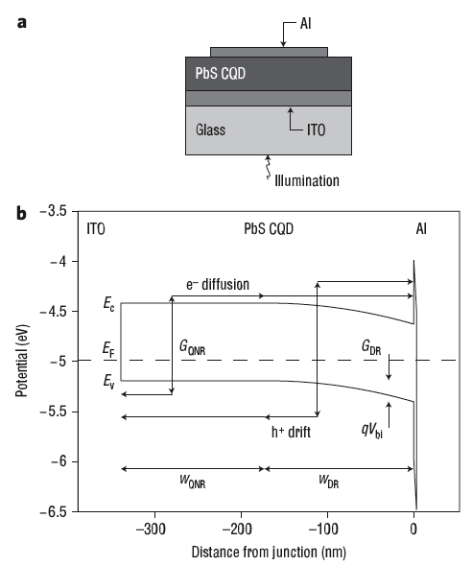


Slide 46


Slide 47





Slide 48


Transport considerations fail to explain > 4x EQE and 1.5x Voc improvements

Slide 49


Looking elsewhere
Thiols passivate recombination centers leading to higher dissociation efficiency

Slide 50

Break the absorption-extraction compromise:
Increase both carrier mobilities

Slide 51


Break the absorption-extraction compromise:
Build a bulk heterojunction

Slide 52

Break the absorption-extraction compromise:
Enhance absorption per unit length

Slide 53
Harvest multiple excitons in a PV device

Slide 54





Use abundant, nontoxic materials

Slide 55









The Team Today
Kyle Kemp Vahid Raeesi
Ghada Koleilat Leyla Soleymani
Illan Kramer Jiang Tang
Damir Jamakosmanovic
Elenita Palmiano Remi Wolowiec
Jeannie Ing

