Slide 1
How networked tools
are changing science
Michael Nielsen

Slide 2
How many people
know what a blog is?

Slide 3
How many people
read blogs?

Slide 4
How many people
run a blog?

Slide 5
How many people
read blogs...
... but won’t admit it
in polite company?

Slide 6
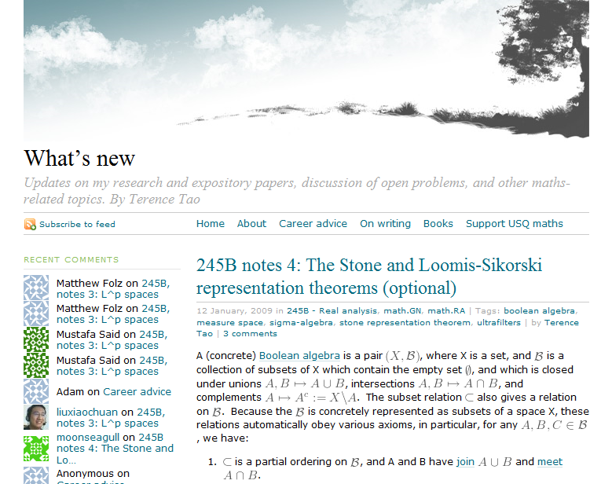

Slide 7

Terence Tao

Slide 8
Fields Medal (2006)

Slide 9
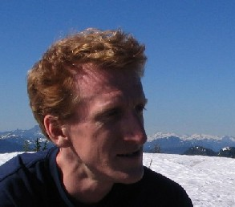
Green-Tao Theorem

Slide 10
Exist arbitrarily long
arithmetic progressions
of primes

Slide 11
118 posts in 2008

Slide 12
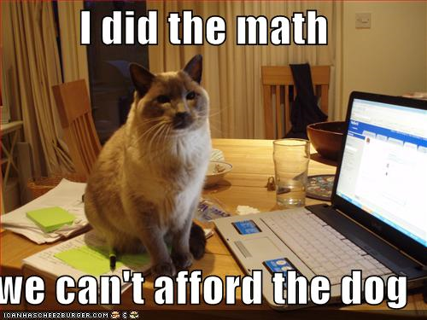

Slide 13
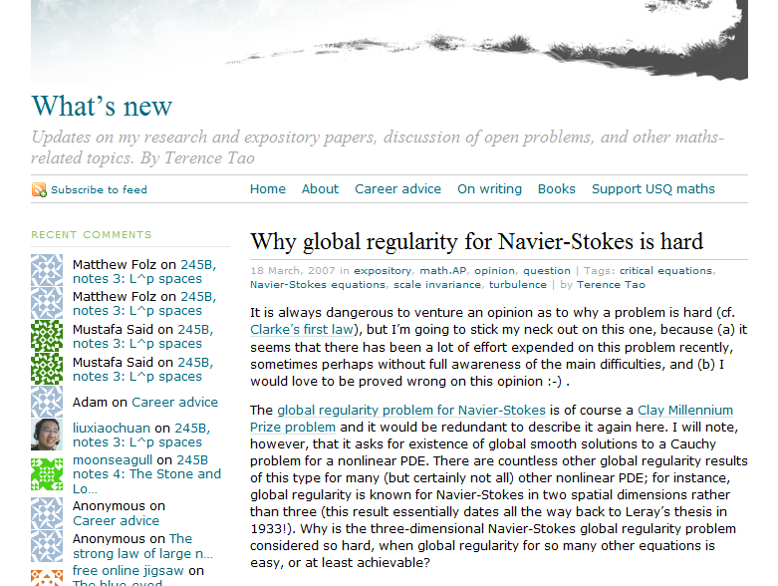

Slide 14
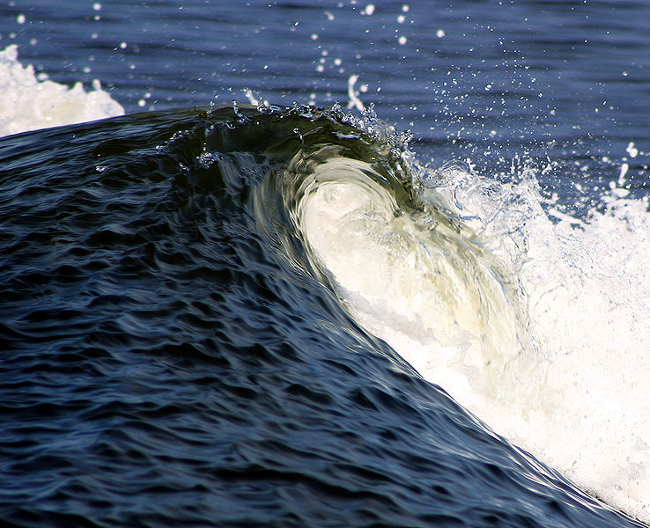

Slide 15


Slide 16
difficult to
understand

Slide 17
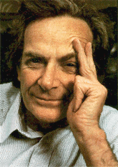
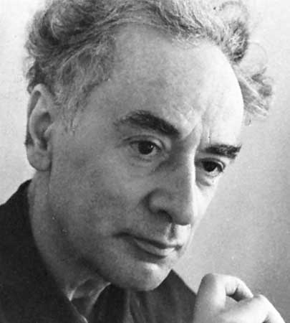
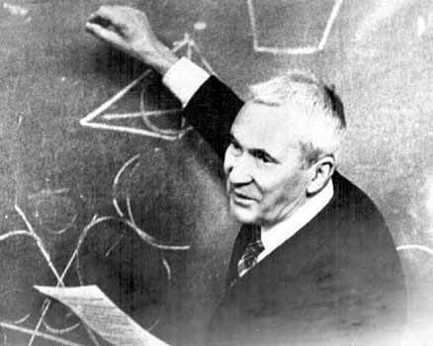

Slide 18
limited success

Slide 19
Clay Millenium
Prize Problems

Slide 20
Global existence of
smooth solutions to
Navier-Stokes

Slide 22
not a talk about the
Navier-Stokes equations

Slide 23
flavour

Slide 24
starts with a brief explanation

Slide 25
In 2d, the solution is known!

Slide 26
Why is it so much harder in 3d?

Slide 27
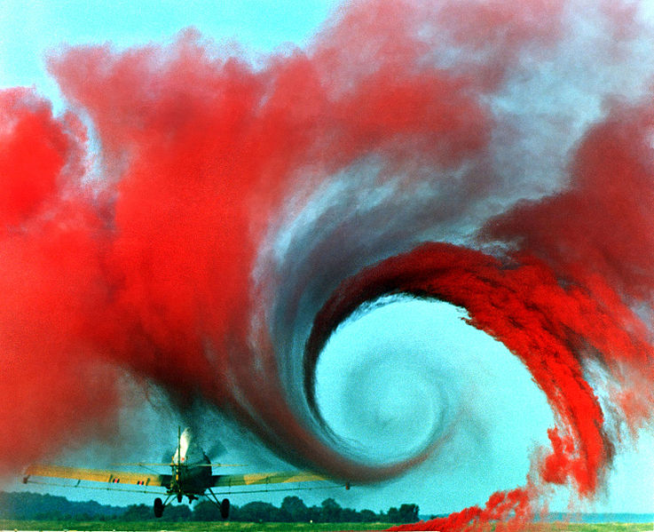
turbulence

Slide 28
supercriticality

Slide 29
invariants to control
the behaviour at all
length scales

Slide 30
known invariants
get weaker at shorter
length scales

Slide 31
Describes the three broad
strategies of attack on proving existence results for
nonlinear PDEs

Slide 32
supercriticality is a
severe problem

Slide 33
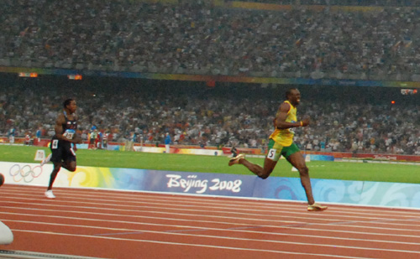

Slide 34
known invariants

Slide 35
surveys

Slide 36
critiques

Slide 37
known attempts on the problem

Slide 38
6 ways

Slide 39
attacking the problem

Slide 40
clever perspectives

Slide 41
insightful observations

Slide 42
ideas

Slide 43
chat

Slide 45
willing to share
their best thinking

Slide 46
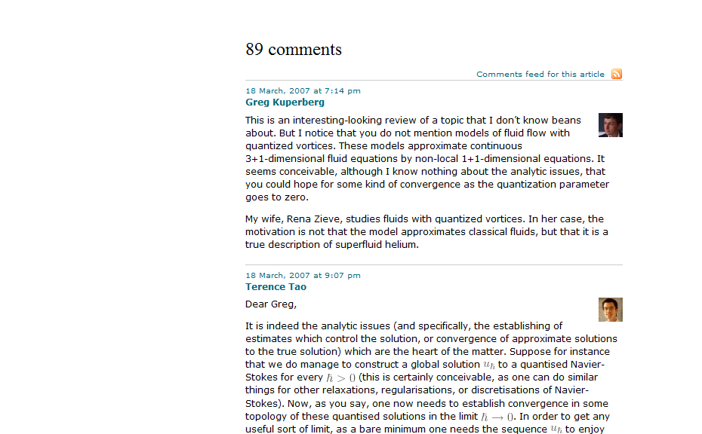
89 comments

Slide 47

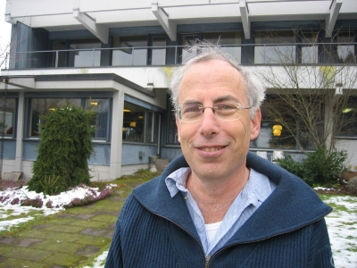
Greg Kuperberg
Gil Kalai

Slide 48
batting ideas back and forth

Slide 49
sharing insights of their own

Slide 50
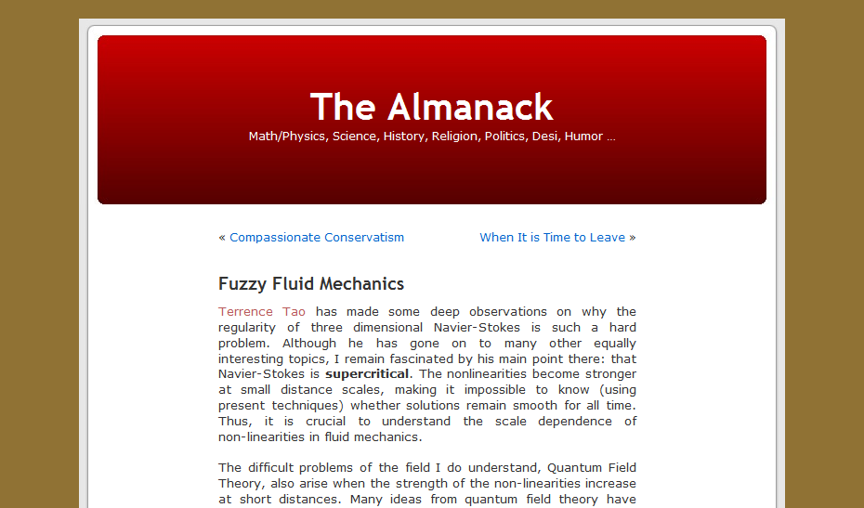
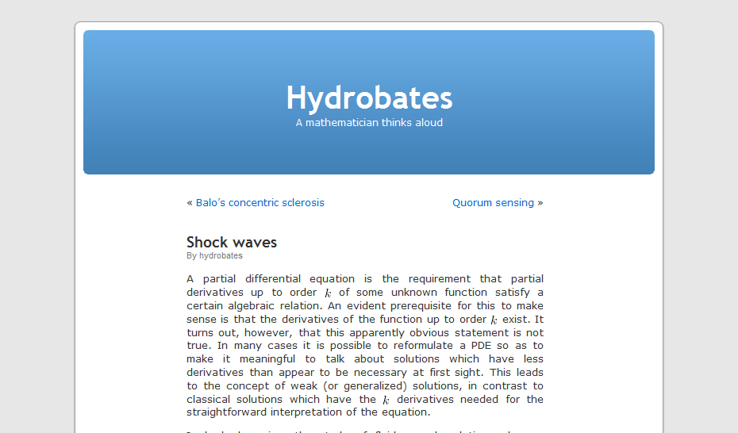
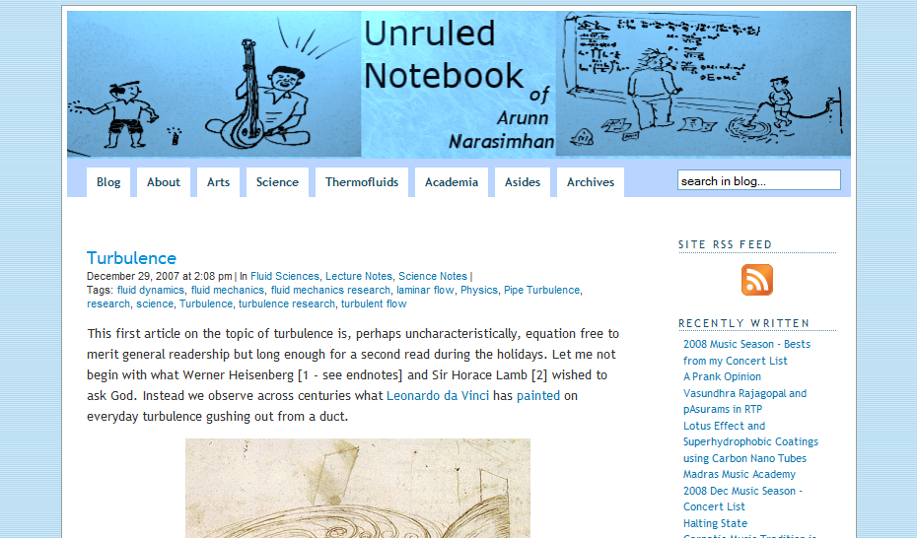

Slide 51
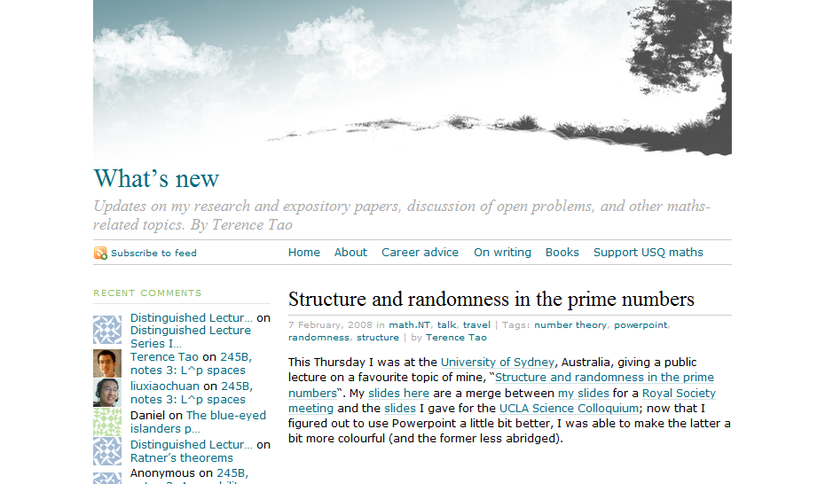
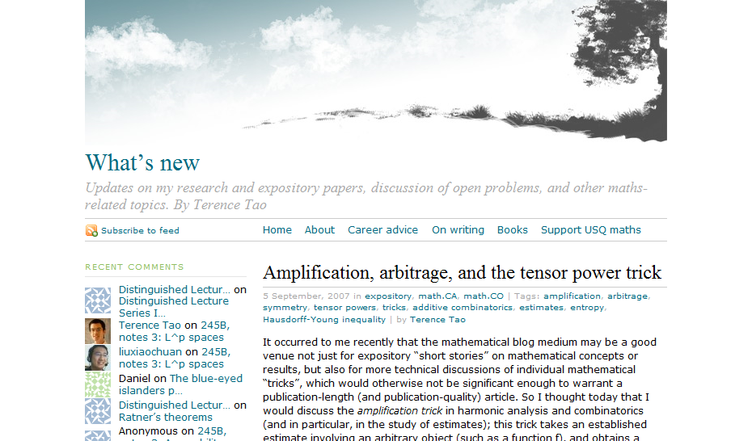
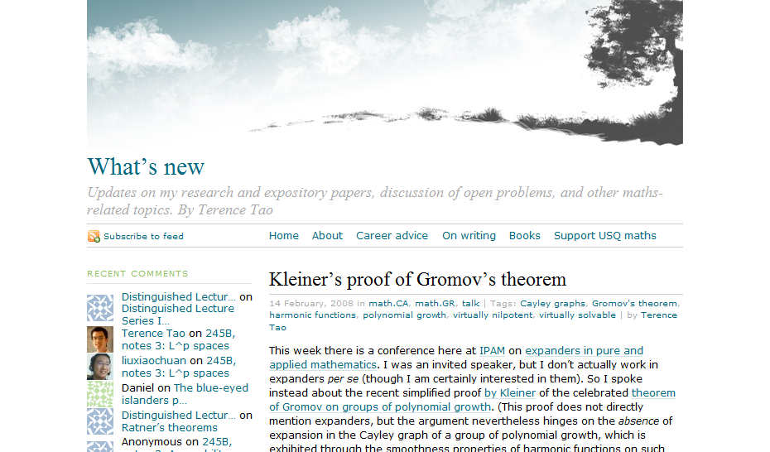
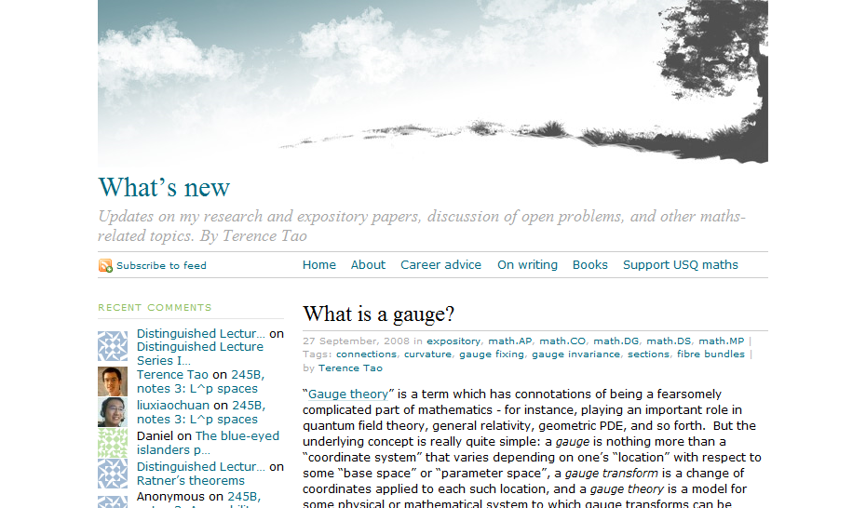

Slide 52
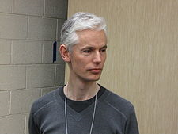
Tim Gowers

Slide 53
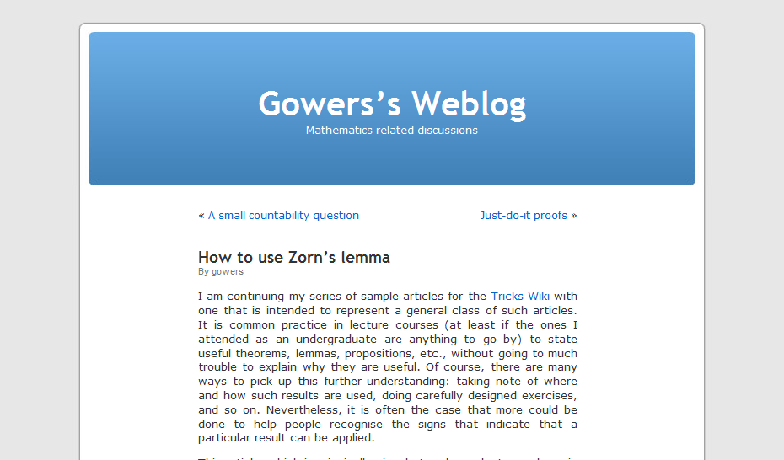
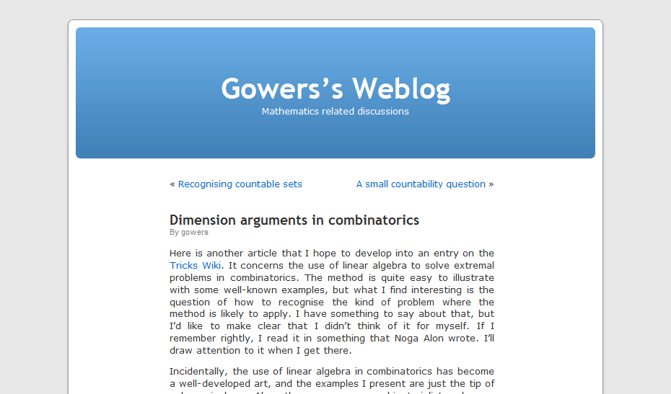
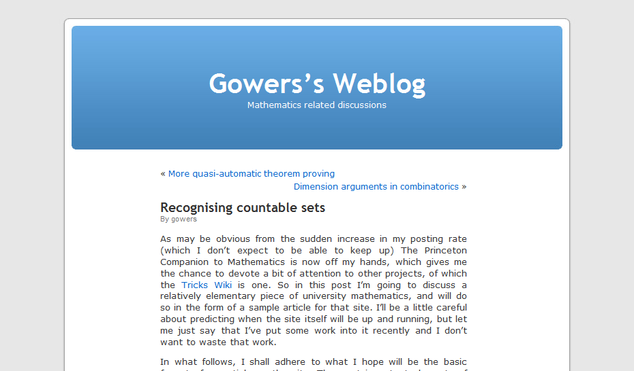
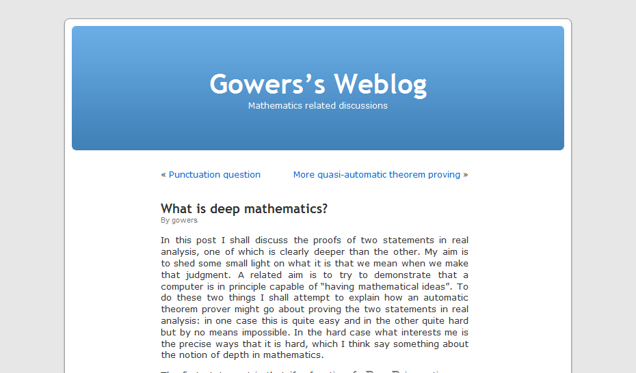

Slide 54
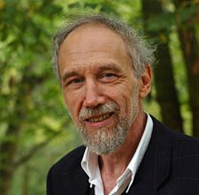
Alain Connes

Slide 55
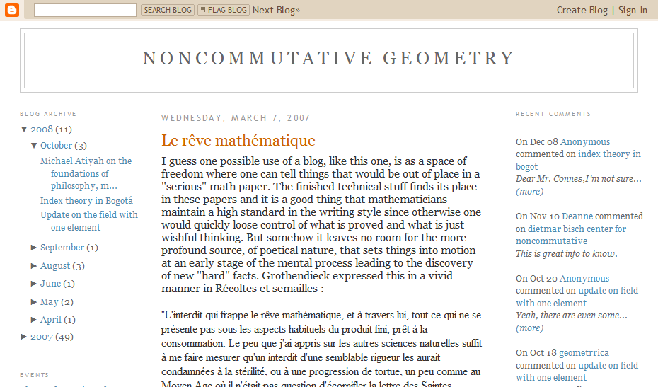

Slide 56
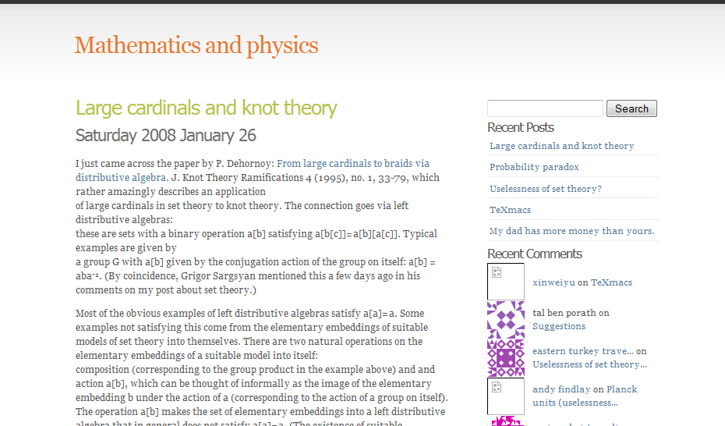
Richard Borcherds

Slide 57
4 of 42 living Fields
medallists have blogs

Slide 58
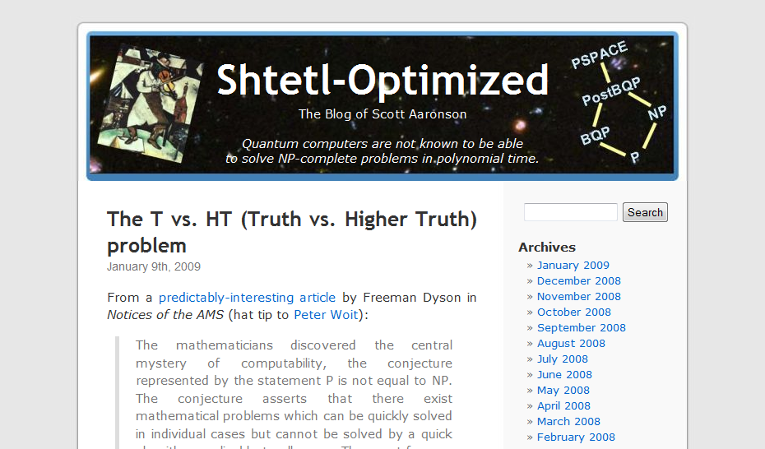
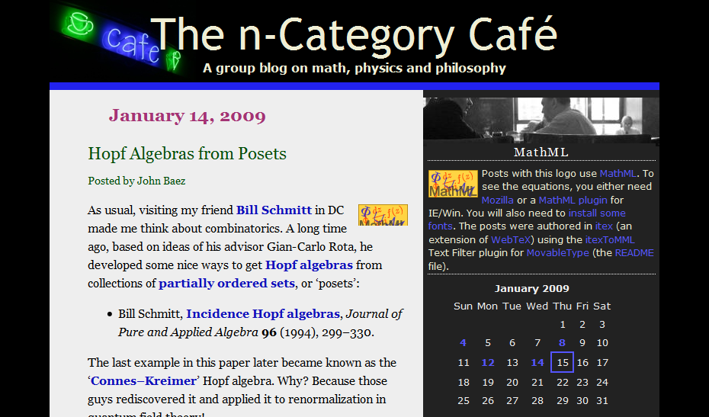
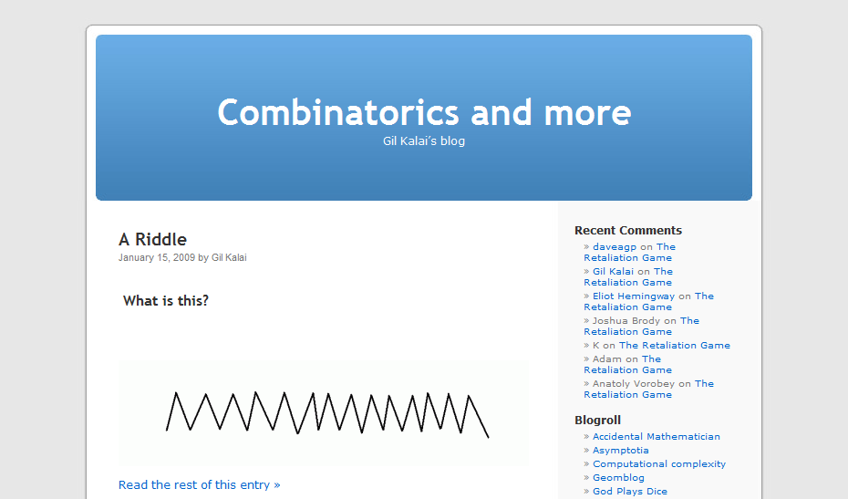

Slide 59
Blogging is...

Slide 60
informal

Slide 61
rapid-fire

Slide 62
could not be published in
a conventional way

Slide 63
small, striking insights

Slide 64
thoughts on general
approach to a problem

Slide 65
too small to be published

Slide 66

seeds of later progress

Slide 67
scale up
scientific conversation

Slide 68
widely distributed

Slide 69
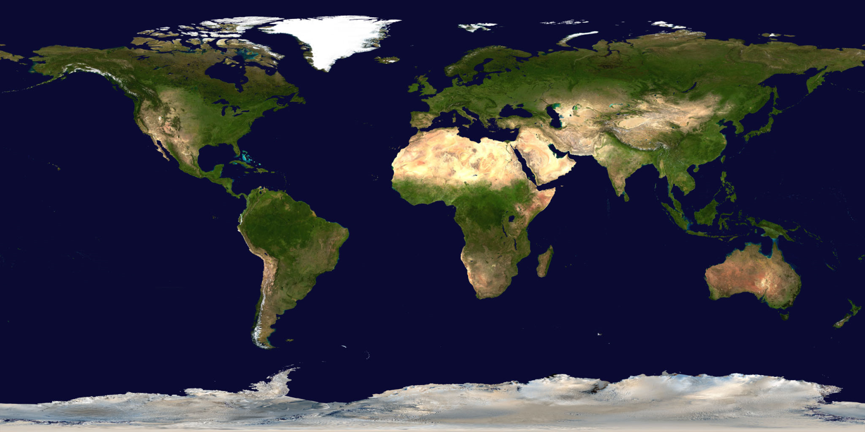
space

Slide 70
time
2009
2010
2011
2012
2013

Slide 71
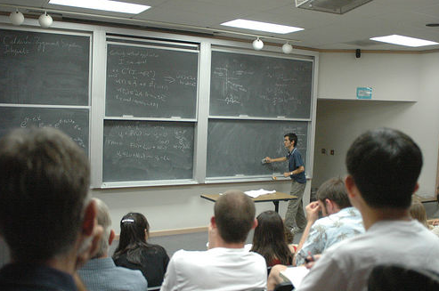

Slide 72
contribute the
best insights back

Slide 73
making scientific conversation searchable

Slide 74
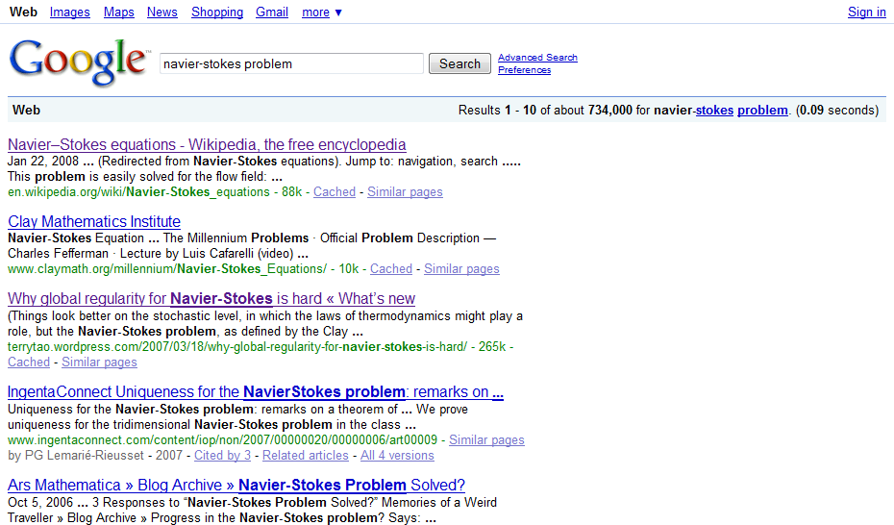

Slide 75
makes it easy for future mathematicians to benefit

Slide 76
Shouldn’t the best papers
be at the top of the
Google rankings?

Slide 77
The ranking should reflect the significance...
... regardless of
whether it’s a paper, a
blog post, or some other form.

Slide 79
good conversation

Slide 80
insightful colleague

Slide 81
worth more than reading
the classic papers

Slide 82
as search engines become
better personalized...
... search results will
better reflect your interests

Slide 83
blogs are just the beginning...

Slide 84
open notebook science

Slide 85
Systematically put all their ideas online
Systematically put all data online
Provide ways of filtering

Slide 86
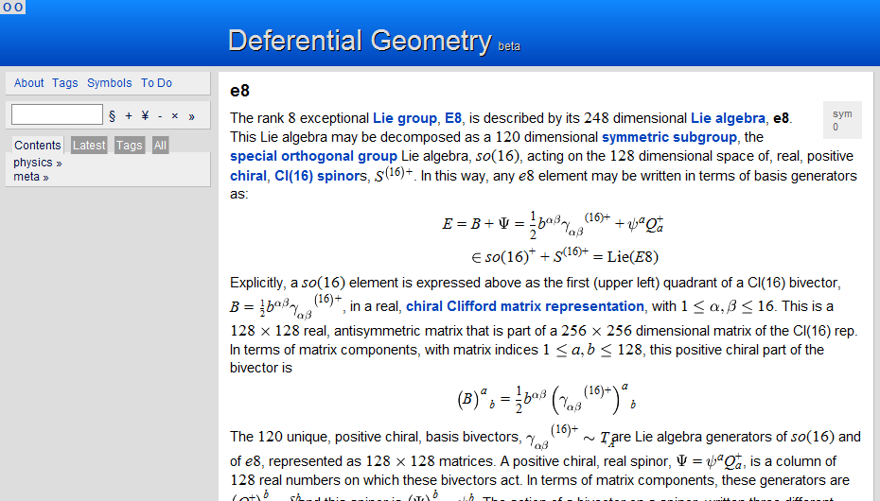
Garrett Lisi’s wiki

Slide 87
“my brain online”

Slide 88
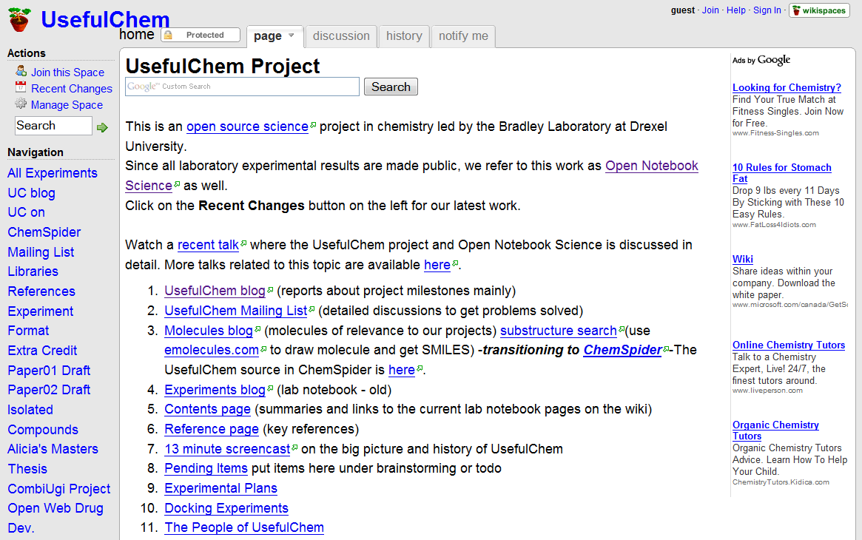
Jean-Claude Bradley

Slide 89
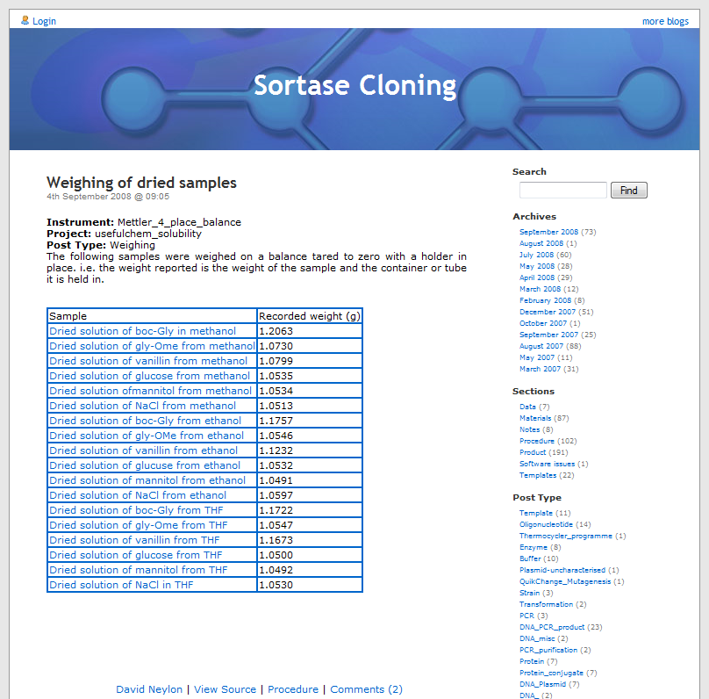
Cameron Neylon

Slide 90
Lab equipment that automatically posts to the web

Slide 91
Machine readable
Data mining
Automated inference

Slide 92
extreme openness

Slide 93
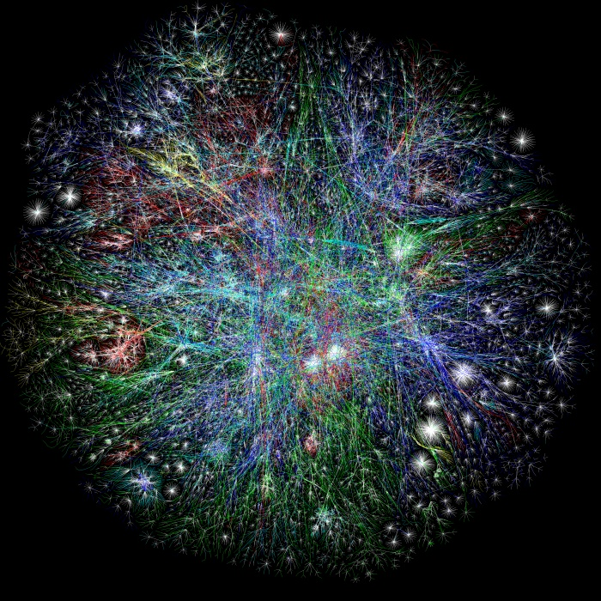
01100
11010
01100
11010
Labs
opinions
data
questions
ideas
folk knowledge

Slide 94
information not on the network can’t do any good

Slide 95
extreme openness takes seriously the idea that the best
person to build on scientific
work may not be the original discover

Slide 96
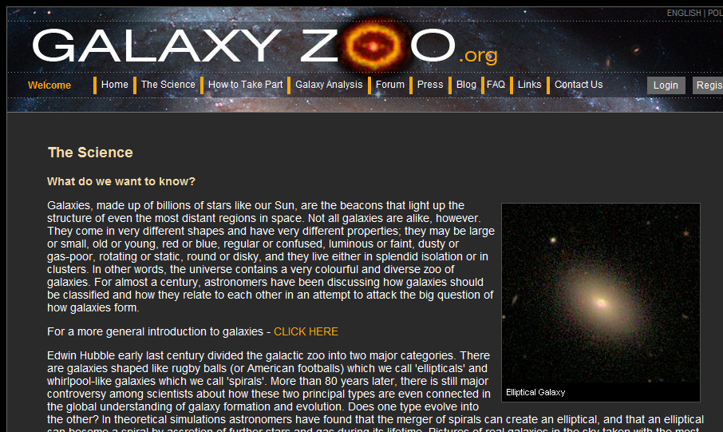

Slide 97
uses Galaxy data from
the Sloan Digital Sky Survey

Slide 98
train volunteers

Slide 99
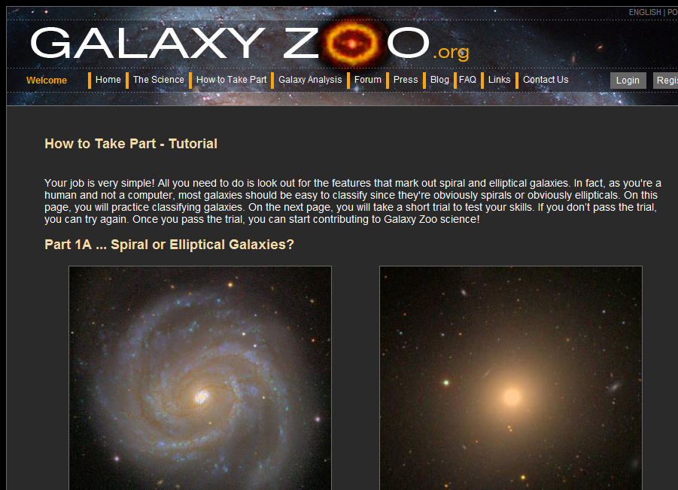

Slide 100
more than 80,000 volunteers

Slide 101
have classified more than
10 million galaxies

Slide 102
goal is redundant classification
(> 20 people / galaxy)

Slide 103
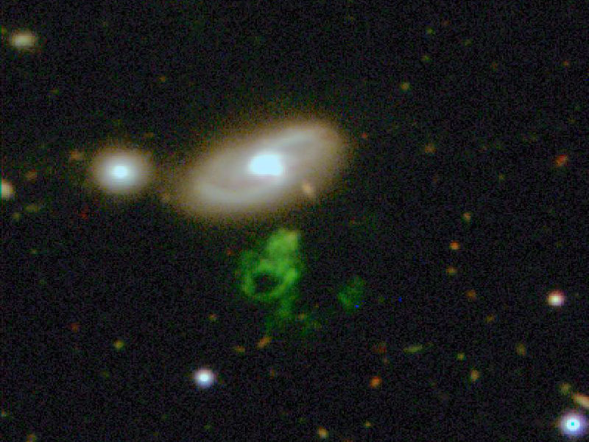
Hanny’s “voorwerp”

Slide 104
blogs, open notebooks etc enable filtered access to...
... new information sources
... new conversation

Slide 105
restructuring of
expert attention

Slide 106
expert attention is the ultimate scarce resource in science...
... the more efficiently
it can be allocated, the
faster science will progress

Slide 107
markets are an excellent
way to efficiently allocate
scarce resources

Slide 108
online markets
in expert attention

Slide 109
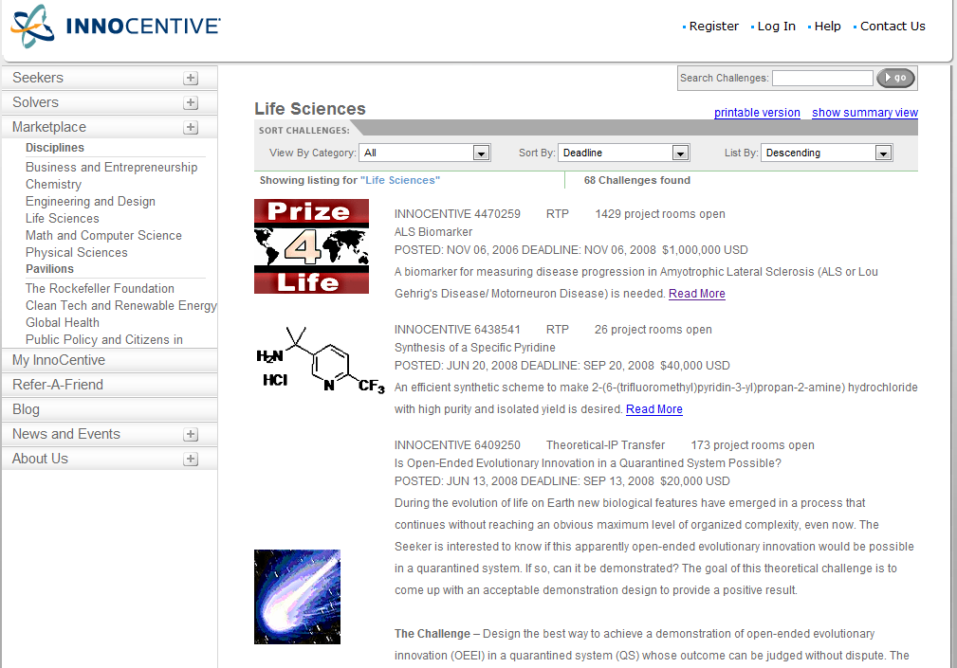

Slide 110
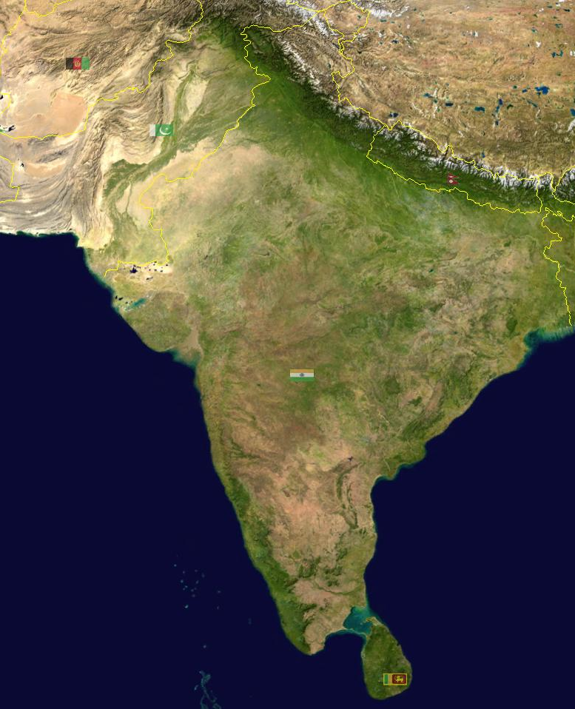

Slide 111
ASSET India Foundation

Slide 112
2 million
women involved in
prostitution in India

Slide 113
help at-risk girls escape

Slide 114


Slide 115
Delhi
Kolkata
Hyderabad
Bangalore
Chennai

Slide 116
electricity

Slide 117
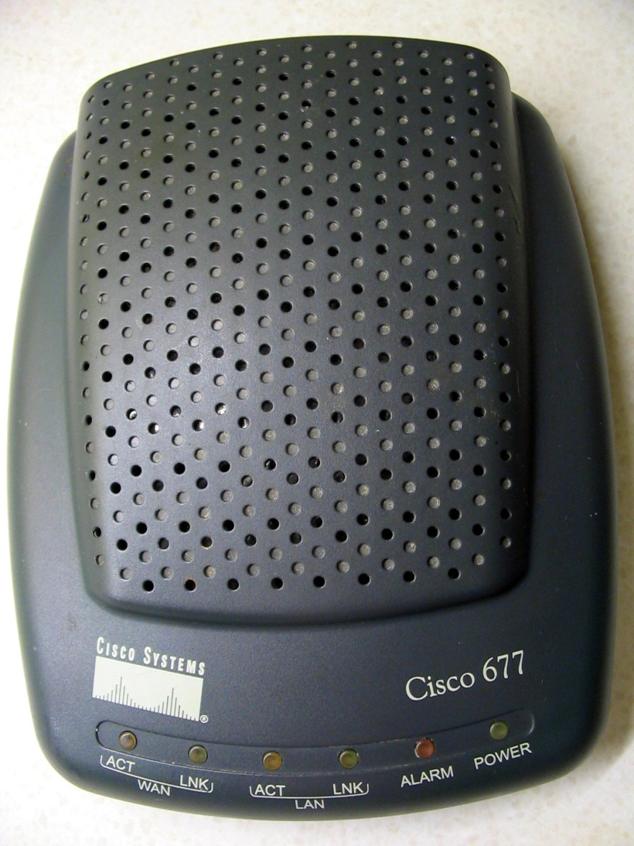

Slide 118
low cost

Slide 119


Slide 121
didn’t yet exist

Slide 122
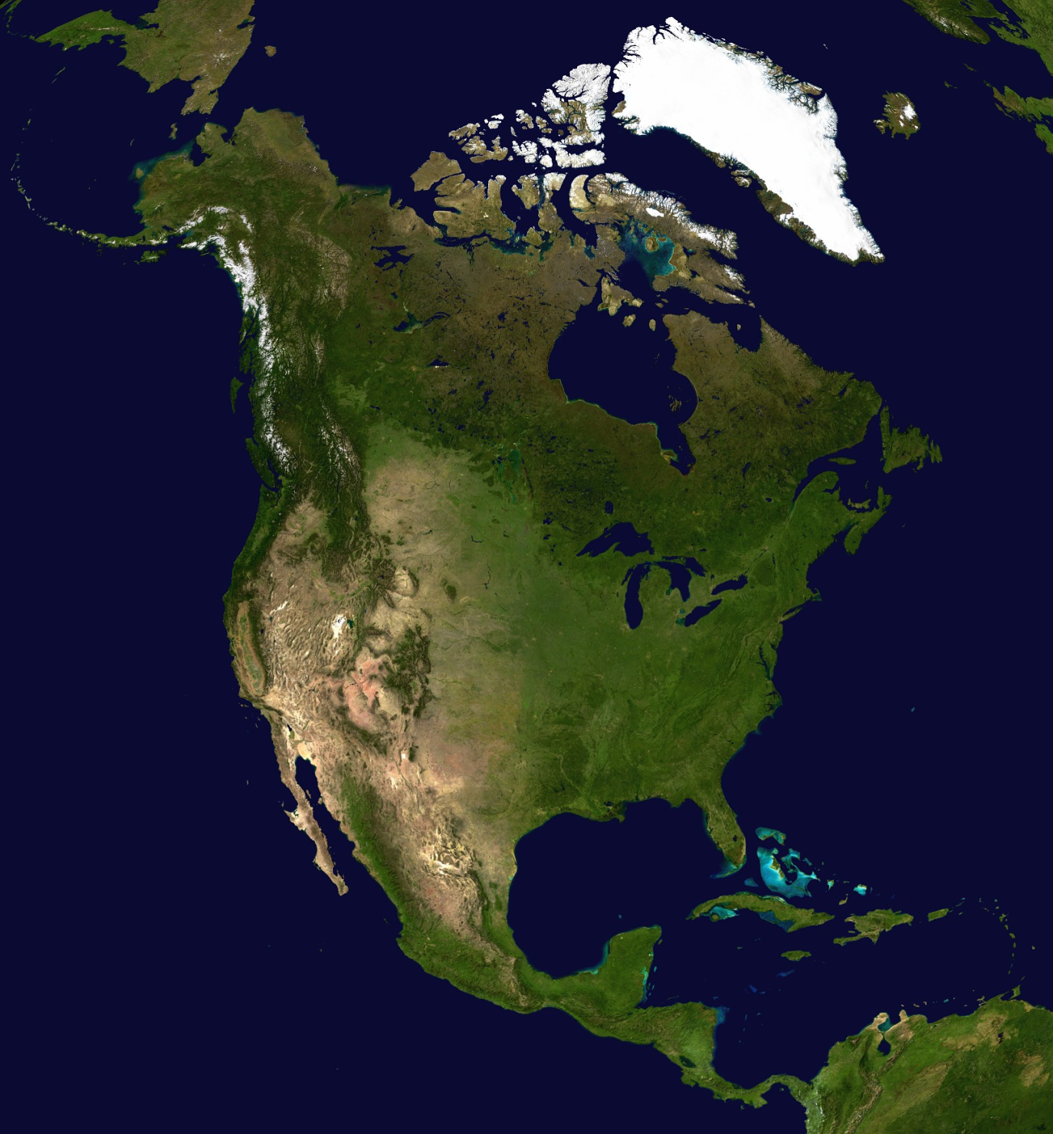
Waltham

Slide 123
online market
in expert attention

Slide 124
Eli Lilly, Proctor and Gamble, ...

Slide 125
“Challenges”

Slide 126
scientific research problem

Slide 127
prize for solution

Slide 129
160,000 people

Slide 130
175 countries

Slide 131
200 Challenges solved

Slide 132

ASSET
Rockefeller
Foundation

Slide 133
ASSET
Rockefeller
Foundation
low cost

Slide 134
ASSET
Rockefeller
Foundation

Slide 135

ASSET
Rockefeller
Foundation

Slide 136

ASSET
$20k prize
Rockefeller
Foundation
InnoCentive

Slide 137
400 people
downloaded the Challenge
InnoCentive

Slide 138
27 submitted solutions
InnoCentive

Slide 139

Zacary Brown
InnoCentive

Slide 140
31-year old
software engineer
from Texas
InnoCentive

Slide 141
ASSET
Design for low cost solar powered wireless router
InnoCentive
$20k

Slide 142
being prototyped at the University of Arizona

Slide 143
Aren’t all these new forms
of contribution just a
distraction?

Slide 144
Should you blog...
... when you could
be writing papers?

Slide 145
Should you contribute
to Wikipedia...
... when you could
be writing grants?

Slide 146
Why should you share your ideas...
... when other people
might build on your ideas,
without giving you credit?

Slide 147
In the short term, these
are all important questions

Slide 148
integrating with existing goals

Slide 149
gradual changes...
... how we assess scientific work
... how we assess scientists
... incentives

Slide 150
Such changes have happened...
... think of the preprint
arXiv and SPIRES / Citebase

Slide 151
But over the long term...

Slide 152


Slide 153
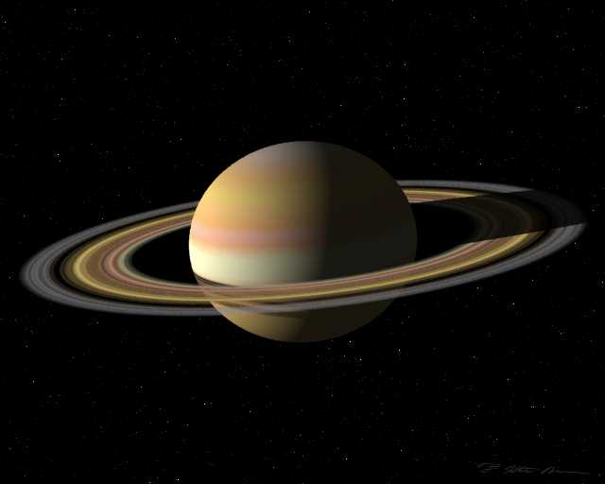

Slide 154
Did he share this discovery?

Slide 155
No

Slide 156
that kind of sharing of
scientific discovery
was unimaginable

Slide 157
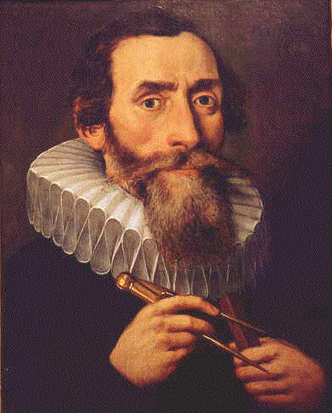
Galileo sent an anagram to Kepler

Slide 158
smaismrmilmepoetaleumibunenugttauiras

Slide 159
“I have discovered Saturn three-formed”

Slide 160
enabled Galileo to claim priority

Slide 161
without revealing the discovery

Slide 162
Galileo could not conceive of a
world in which it made sense for
him to freely share his discovery

Slide 163
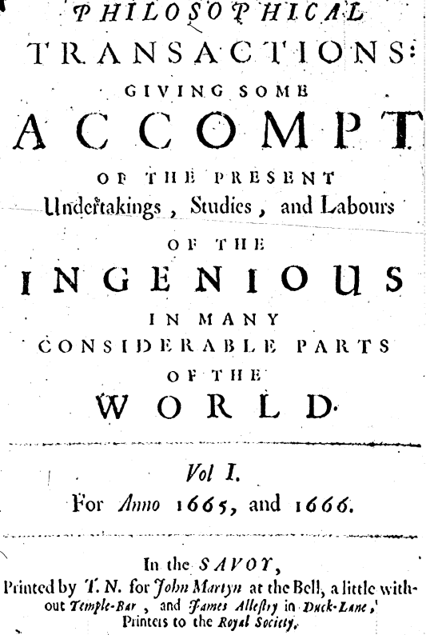
the first journals did not appear
until more than 20 years after
Galileo’s death

Slide 164
journals took decades to establish
themselves as a legitimate means of
sharing discoveries

Slide 165
parallel to online media today

Slide 166
hoard clever observations and questions,
insights that might one day mature
into a full-fledged paper

Slide 167
experimentalists hoard data

Slide 168
cannot conceive of a world in which it makes sense to share all that information

Slide 169
over the short term, things
will only change slowly

Slide 170
but over the long term,
major change is inevitable

Slide 171
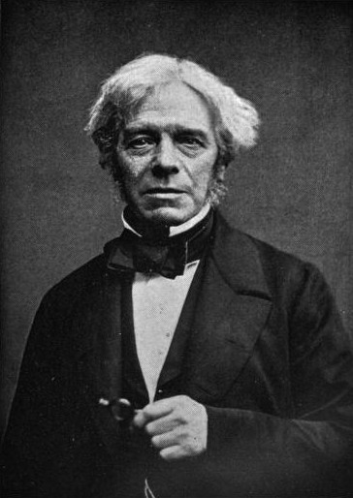
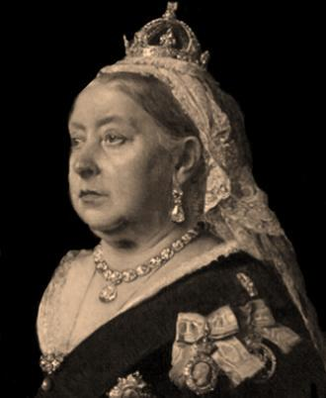
Michael
Faraday
Queen
Victoria
“of what use is electricity?”

Slide 172
“Of what use is a newborn baby?”

Slide 173
Blogs, wikis, open notebooks, InnoCentive
and the like aren’t the end of online
innovation...
... they’re just a beginning

Slide 174
far more powerful tools

Slide 175
scale up scientific conversation

Slide 176
scale up scientific collaboration

Slide 177
change the
architecture of
expert attention

