Slide 1
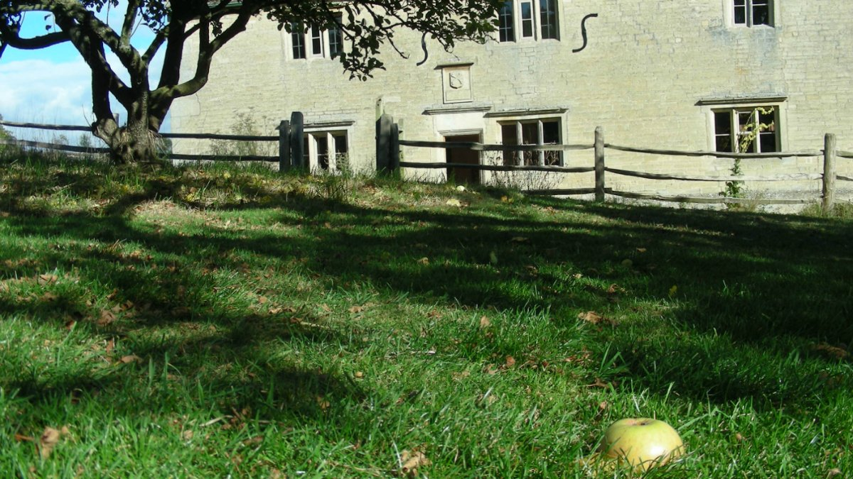
PHY131H1F - Class 13
Outline for Today:
Newton’s Law of Universal Gravitation
The Gravitational Field
Orbital Motion
Gravitational Potential Energy
Under the Flower of Kent apple tree in the Woolsthorpe Manor orchard in England

Slide 2
Hello!
My name is Jason Harlow, and I’ll be your physics teacher for the rest of this semester.
I graduated from U of T with a Specialist in Physics and Astronomy in 1993
I got my Ph.D. in Astronomy and Astrophysics from Penn State University in 2000
I’ve been a Teaching Faculty here at U of T since 2004.
I discovered a star as an undergraduate, my facebook page is harlowphysics and my twitter account is @jasonjbharlow

Slide 3
Gravity
It was Newton who first recognized that gravity is an attractive, long-range force between any two objects.
When two objects have masses m₁ and m₂ and centers are separated by distance r, each object attracts the other with a force given by Newton’s law of gravity, as follows:
$$m_{2}$$
$$m_{1}$$
$$F$$
$$F$$
$$r$$
where $G=6.67×{10}^{−11} N m^{2} {kg}^{−2}$ is the Gravitational constant (the same everywhere in the universe).

Slide 4
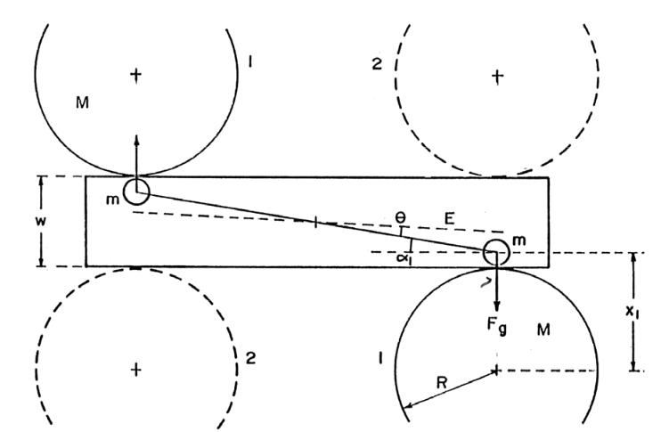
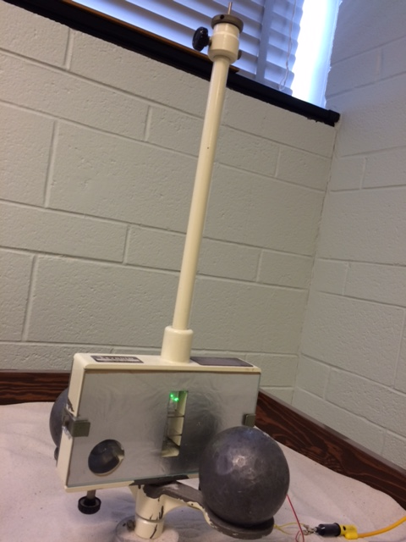
Cavendish Experiment
Done in second year labs (PHY224H1).
You end up measuring a force of about 10⁻⁸ N (10 nano-Newtons!) which is equivalent to the weight of 0.1 μg.
But it is doable in less than 2 weeks.

Slide 5
Gravity Example
A mass, m₁, sits at the surface a giant spherical rock which is floating in space.
The giant rock has a mass of m₂ = 6 × 10²⁴ kg and a radius of 6400 km.
What is the force of gravity on the mass due to the giant rock, in terms of m₁?
Can you think of a good name for this giant rock?
$$m_{2}$$
$$m_{1}$$

Slide 6
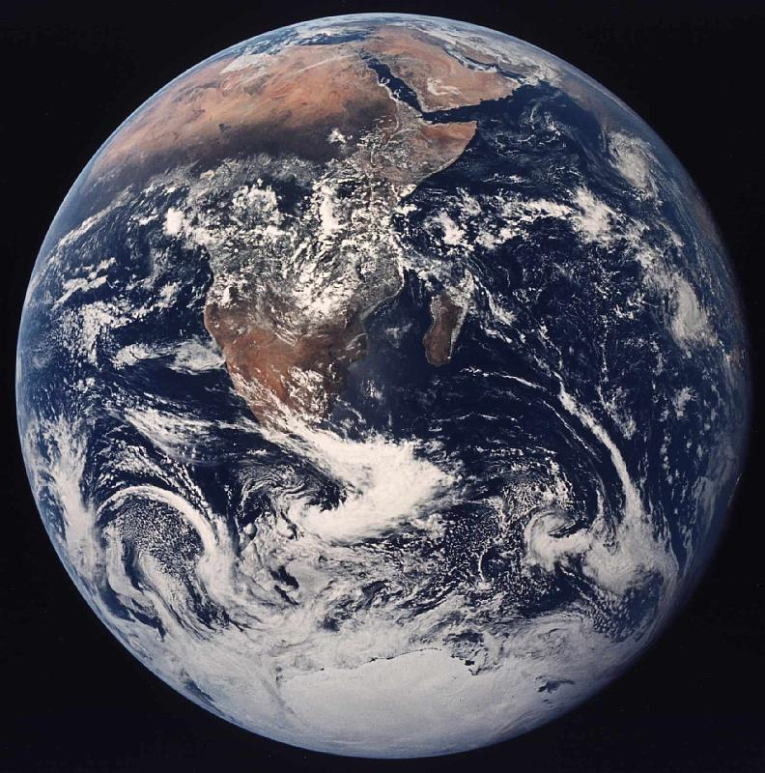
Gravity for Earthlings
If you happen to live on the surface of a large planet with radius R and mass M, you can write the gravitational force more simply as:
$${\vec{F}}_{G}=\left(m\text{g}, \text{straight} \text{down}\right) \left(\text{gravitational} \text{forc}e\right)$$
where the quantity g is defined to be:
$$\text{g}=\frac{GM}{R^{2}}$$
At sea level, g = 9.83 m/s².
At 39 km altitude, g = 9.71 m/s².

Slide 7
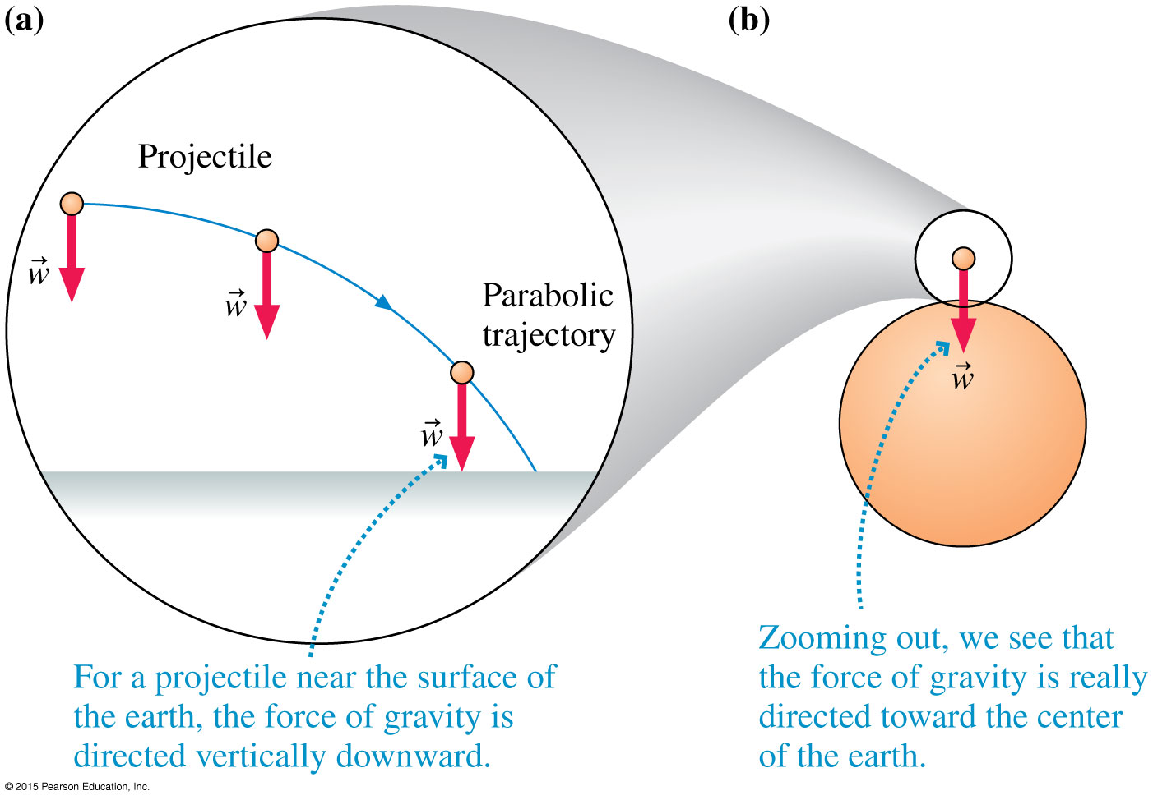
So far in this course, we have been using a “flat earth approximation” in which projectile paths are parabolas.

Slide 8
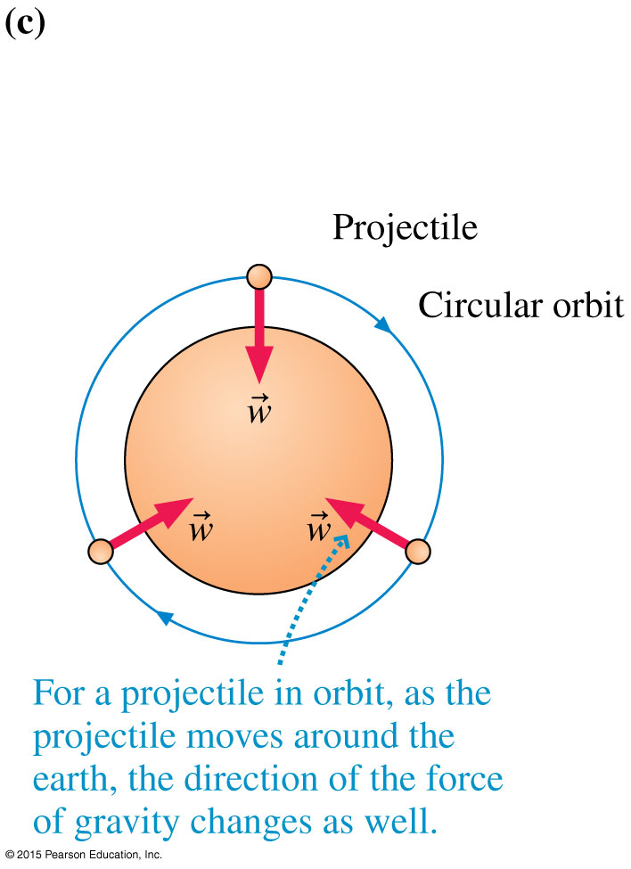
Orbital Motion
If the launch speed of a projectile is sufficiently large, there comes a point at which the curve of the trajectory and the curve of the earth are parallel.
Such a closed trajectory is called an orbit.
An orbiting projectile is in free fall.

Slide 9
Learning Catalytics Question 1
Astronaut Randy Bresnik (Twitter @AstroKomrade) is currently living on the International Space Station, which orbits at 370 km above the surface of the Earth (low earth orbit).
Assuming Randy has not changed his mass since moving to space, what is the force of gravity on Randy?
Zero
The same as the force of gravity on him while he was on earth.
A little bit less than the force of gravity on him while he was on earth.
Not exactly zero, but much, much less than the force of gravity on him while he was on earth.

Slide 10
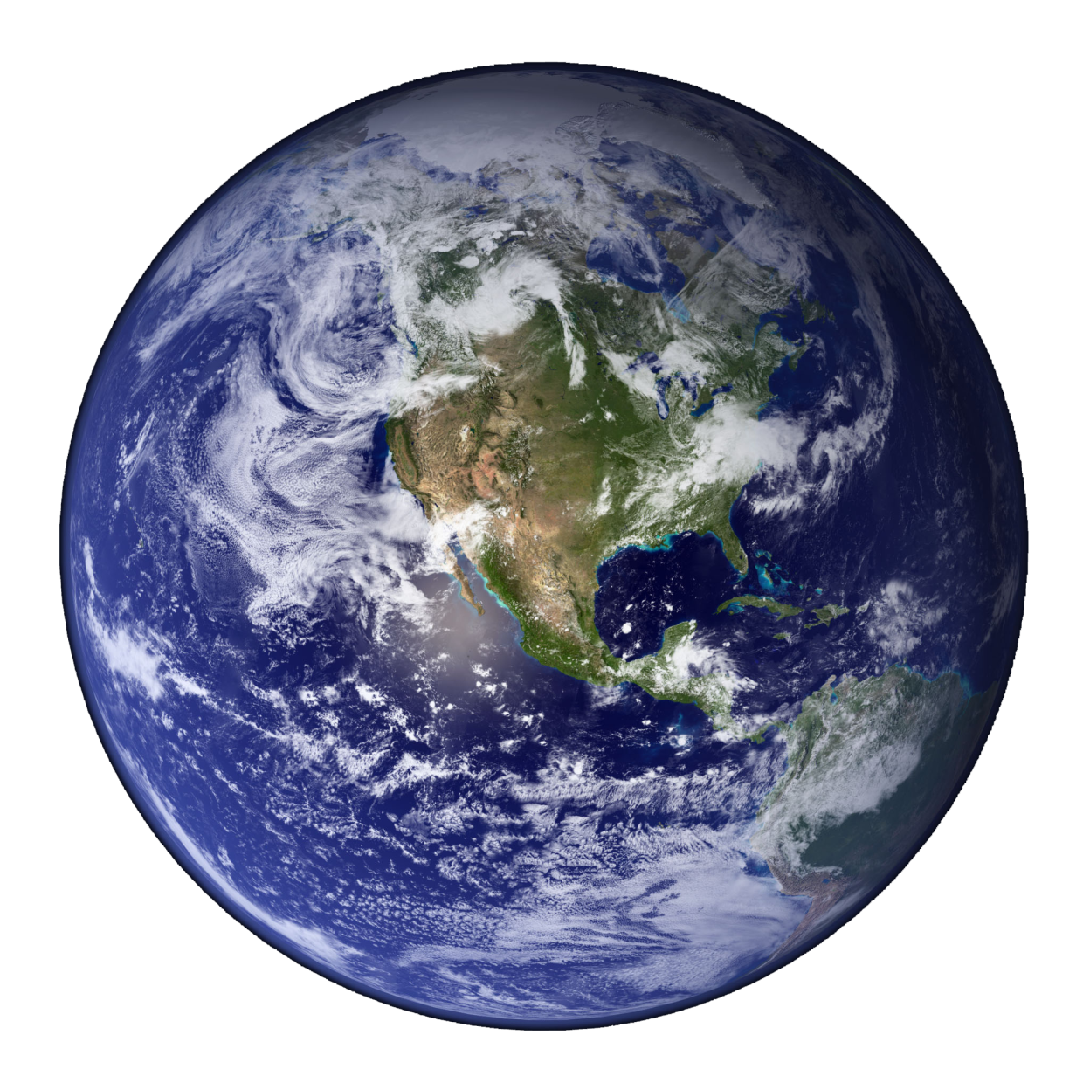
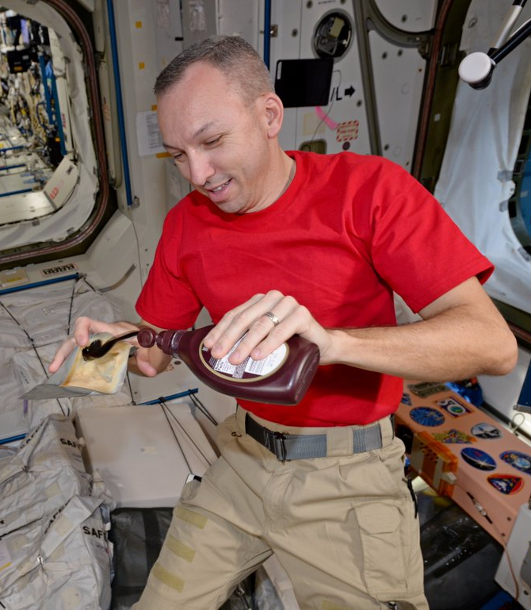
International Space Station
Orbit is drawn to scale
Randy feels weightless because he is in freefall!
Radius of the Earth: 6400 km, g = 9.8 m/s²
Altitude of Space Station: 370 km, g = 8.9 m/s² (about 10% less)

Slide 11
Example
How fast would you have to drive in order to be “weightless” – ie, no normal force needed to support your car?

Slide 12
Circular Orbits
An object moving in a circular orbit of radius r at speed v_{orbit} will have centripetal acceleration of
$$a_{r}=\frac{{(v_{orbit})}^{2}}{r}=\text{g}$$
That is, if an object moves parallel to the surface with the speed
$$v_{orbit}=\sqrt{r\text{g}}$$
then the free-fall acceleration provides exactly the centripetal acceleration needed for a circular orbit of radius r.
Near the surface of the Earth, this speed is about 8 km/s.
An object with any other speed will not follow a circular orbit.

Slide 13
It costs upwards of $100 million to launch a communications satellite. What is the main reason why big companies do this?
Learning Catalytics Question 2
To get outside Earth’s gravitational pull so the satellite doesn’t fall down
To get closer to the Sun in order to collect more solar power
To get away from air resistance so they can move fast and not burn up
To get away from radio interference on Earth
To get far enough so they can communicate with the entire Earth at one time

Slide 14
Circular Satellite Orbits
Positioning: beyond Earth’s atmosphere, where air resistance is almost totally absent
Example: Low-earth orbit communications satellites are launched to altitudes of 150 kilometers or more, in order to be above air drag
But even the ISS, as shown, experiences some air drag, which is compensated for with periodic upward boosts.

Slide 15
The state of physics around 1650…
In 1609 Galileo started observing the sky with a telescope.
Around that same time, Kepler was investigating careful observations of the apparent positions of planets in the sky.
It was determined that planets orbit the Sun, and that Earth was the third planet out from the Sun.
Kepler noted that the shapes of the orbits of all the planets were not quite circles, but actually ellipses.

Slide 16
How to draw an Ellipse

Slide 17
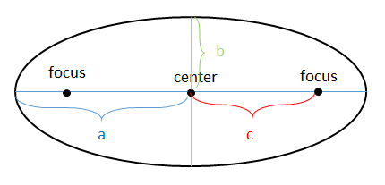
An ellipse is a mathematical shape.
The furthest distance from the centre of an ellipse to its edge is called the “semi-major axis” a.
The eccentricity, e = c/a, tells you how squished the orbit is.
A circle is a special case of an ellipse, when e = 0.
$$\frac{x^{2}}{a^{2}}+\frac{y^{2}}{b^{2}}=1$$

Slide 18
Kepler’s Laws of Planetary Motion
Planets, asteroids and comets move in orbits whose shapes are ellipses, with the sun at one focus of the ellipse. (Planetary orbits normally have low eccentricity: almost circular.)
A line drawn between the sun and a planet sweeps out equal areas during equal intervals of time. (They go faster when they are closer to the sun.)
The square of a planet’s orbital period is proportional to the cube of the semimajor-axis length. (T ² = C r³, where C is some constant.)

Slide 19
Newton’s Laws
Kepler’s Laws are empirical, like Hooke’s Law, or the equation for kinetic friction or drag. They were written down in order to describe the observations. Kepler did not know “why” the planets moved in this way.
Many scientists at the time, including Edmund Halley, believed that there was some kind of force from the Sun pulling the planets, asteroids and comets toward it.
In 1687 Isaac Newton published one simple theory which explained all of Kepler’s laws, as well as motion observed here on Earth:
The 3 Newton’s Laws you already learned, plus:
“Newton’s Law of Gravity”

Slide 20
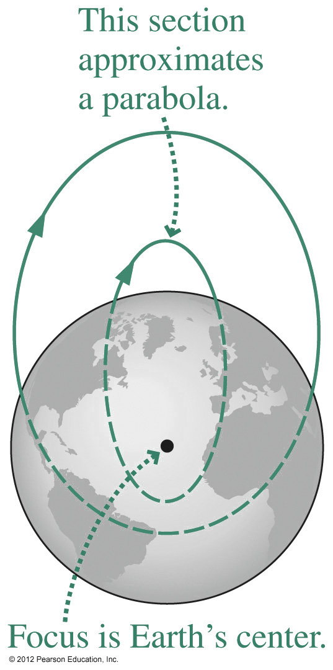
Projectile Motion and Orbits
The “parabolic” trajectories of projectiles near Earth’s surface are actually sections of elliptical orbits that intersect Earth.
The trajectories are parabolic only in the approximation that we can neglect Earth’s curvature and the variation in gravity with distance from Earth’s center.

Slide 21
Gravitational Potential Energy
When two isolated masses m₁ and m₂ interact over large distances, they have a gravitational potential energy of
where we have chosen the zero point of potential energy at r = ∞, where the masses will have no tendency, or potential, to move together.
Note that this equation gives the potential energy of masses m₁ and m₂ when their centers are separated by a distance r.

Slide 22
Energy and Orbits
By our definition of zero point at infinity, U is always negative.
K is always positive.
The sign of the total energy E = K + U determines the type of orbit an object:
E < 0: The object is in a bound, elliptical orbit.
Special cases include circular orbits and the straight-line paths of falling objects.
E > 0: The orbit is unbound and hyperbolic.
E = 0: The borderline case gives a parabolic orbit.

Slide 23
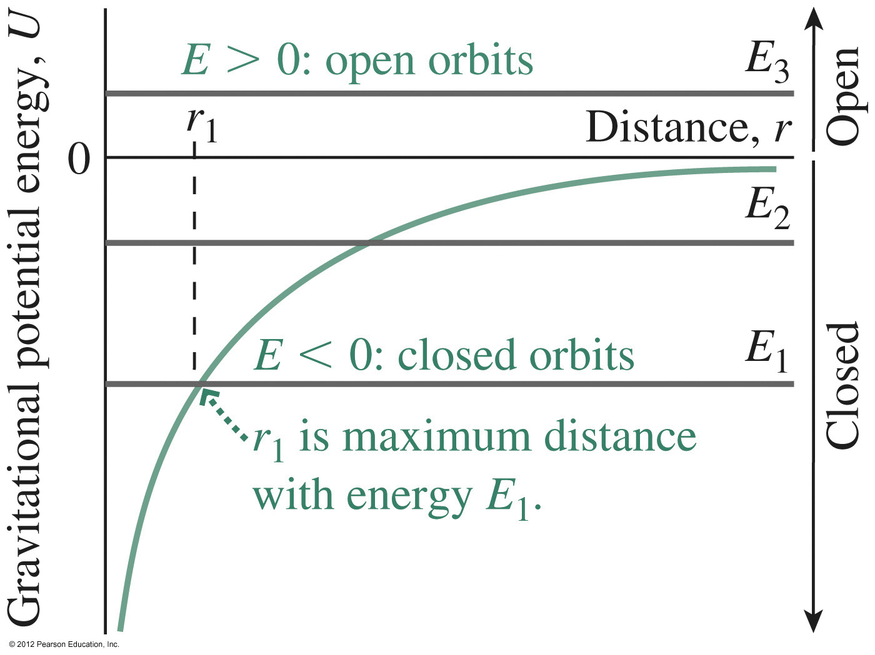
Energy and Orbits

Slide 24
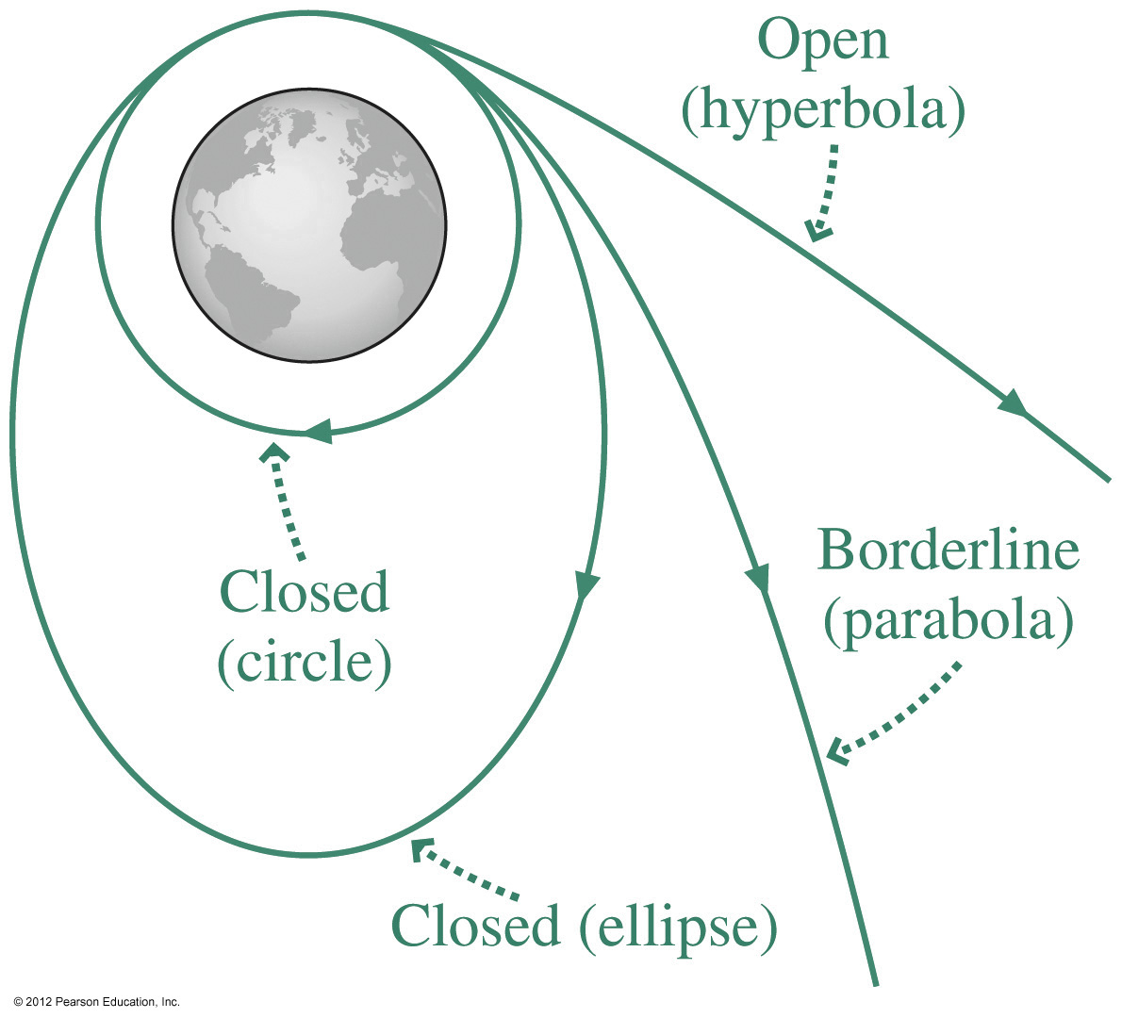
Energy and Orbits

Slide 25
There is a saying, “What goes up must come down.” Is this always true? How fast must you throw an object upwards so that it never comes down?
ANSWER:
When the total energy = 0, then, as r approaches infinity, K will approach zero. This is “escape speed”:

Slide 26
Escape speed.
The escape speed near the Earth’s surface is about 11 km/s.
If the Earth’s radius was less than 9 mm, then the escape speed would be greater than 300,000 km/s, which is greater than the speed of light.
Since nothing can travel faster than light, nothing would be able to escape the Earth’s surface, and the Earth would be what astronomers call a black hole.

Slide 27
Before Class 14 on Monday
Remember MasteringPhysics.com Homework 6 on Ch.7 is due Monday by 11:59pm.
Please read the first two sections of Chapter 9 on Center of Mass and Conservation of Momentum and/or watch the Preclass 14 Video
Something to think about: How is it possible to clear the bar in a high jump if your center of mass does not reach to the height of the bar?

