Slide 1
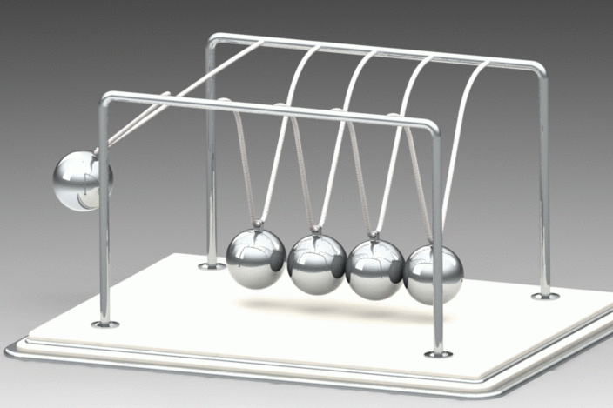
PHY131H1F - Class 15
Today, we are finishing Chapter 9 on Momentum:
Impulse and Momentum
Energy in Collisions
[image from https://grabcad.com/library/newton-s-cradle-assembly-1 ]
Totally Inelastic Collisions
Elastic Collisions

Slide 2
Where is the centre of mass of a solid semicircle?
Notes:
2
Answer: D

Slide 3
Notes:
3
Answer: D

Slide 4
Last day I asked at the end of class:
Consider the two integrals below. What’s the difference?
Impulse (Ch.9)
This is the force integrated over time, which gives the change in momentum. [Units: kg m / s]
$$\vec{J}=\int{\vec{F}dt}$$
Work (Ch. 6)
This is the force integrated over distance, which gives the change in energy. [Units: Joules]
$$W=\int{\vec{F}∙d\vec{r}}$$

Slide 5
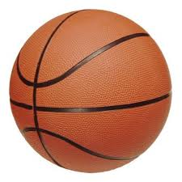
$\vec{p}=m\vec{v}$ means $p_{x}=mv_{x}$ and $p_{y}=mv_{y}$.
y
x
A basketball with mass 0.1 kg is traveling down and to the right with v_{xi} = +5 m/s, and v_{yi} = –5 m/s.
It hits the horizontal ground, and then is traveling up and to the right with v_{xf} = +5 m/s, and v_{yf} = +4 m/s.
LC Question 1 What is the change in the x-component of the ball’s momentum?
LC Question 2 What is the change in the y-component of the ball’s momentum?
Before:
After:

Slide 6
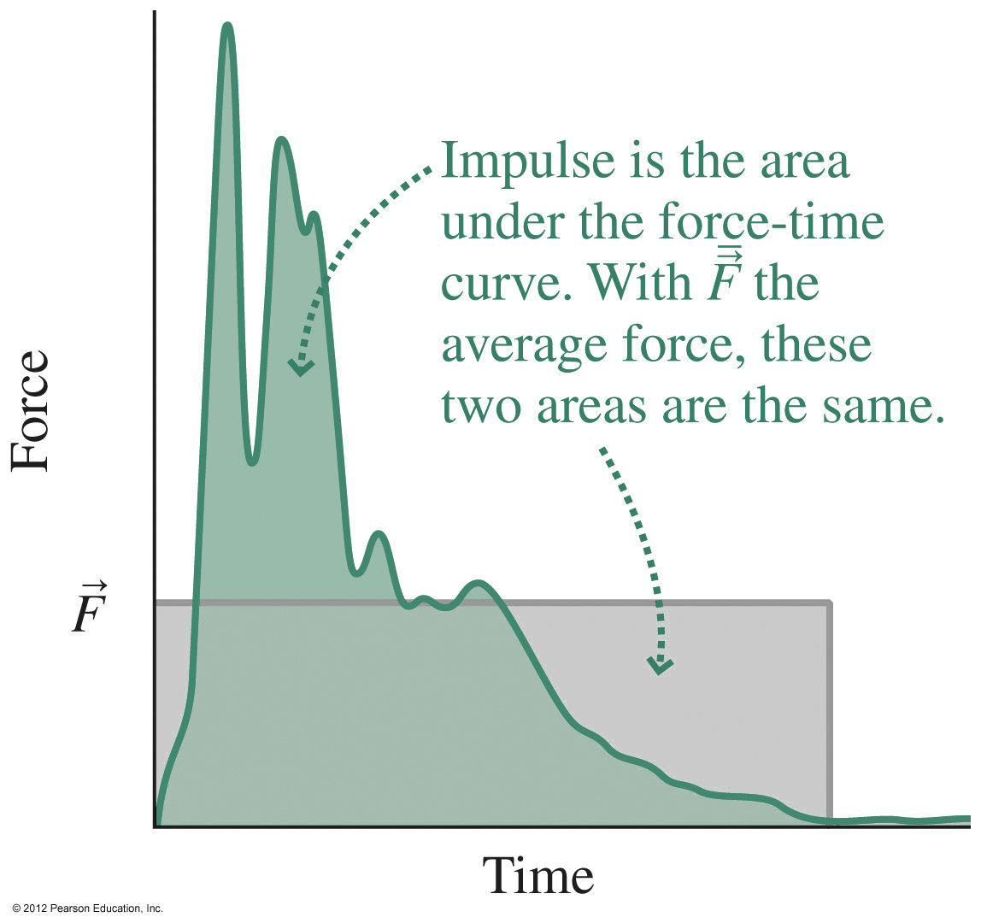
Impulse
The impulse upon a particle is:
$$J_{x}=\int_{t_{1}}^{t_{2}}{F_{x}dt}$$
$$J_{y}=\int_{t_{1}}^{t_{2}}{F_{y}dt}$$
Impulse has units of N s, but you should be able to show that N s are equivalent to kg m/s.
The impulse-momentum theorem states that the change in a particle’s momentum is equal to the impulse on it:
$${∆p}_{x}=J_{x}$$
$${∆p}_{y}=J_{y}$$

Slide 7
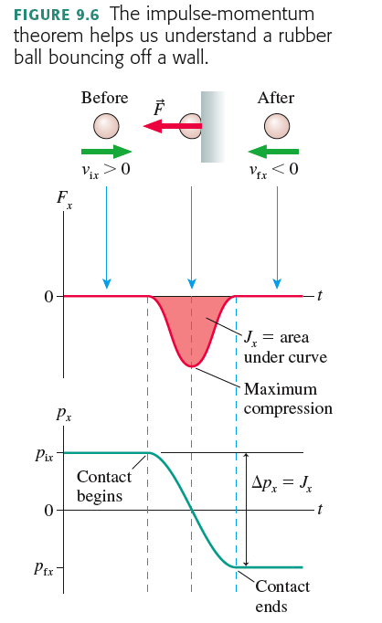

Slide 8
A 0.50 kg cart rolls to the right at +1.2 m/s.
It collides with a force sensor.
A plot of force versus time (with positive force defined as towards the right) gives an area of –1.0 N s.
What is the velocity of the cart immediately after the collision?
Notes:
8
Answer: D

Slide 9
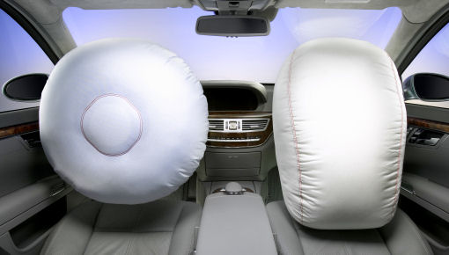
Image from http://images.thecarconnection.com/med/25-years-of-the-airbag_100223157_m.jpg
Consider a car accident in which a car, initially traveling at 50 km/hr, collides with a large, massive bridge support.
The car comes to an abrupt stop.
Why is it better to hit the airbag as opposed to the hard plastic steering wheel or dashboard?
ANSWER:
The people must reduce their momentum from mv to zero. This requires a force applied over some amount of time. If the time is very short, the force must be very large (ie hitting steering wheel).
If the person hits the airbag, this squishes during impact, lengthening the time of the stop. If the stopping process takes longer, then the maximum force is less.

Slide 10
Learning Catalytics Question 3
A 100 g rubber ball and a 100 g damp cloth are dropped on the floor from the same height. They both are traveling at the same speed just before they hit the floor.
The rubber ball bounces, the damp cloth does not.
Which object receives a larger upward impulse from the floor?
They receive equal impulses.
The damp cloth receives a larger impulse.
The rubber ball receives a larger impulse.
Notes:
STT9.2

Slide 11
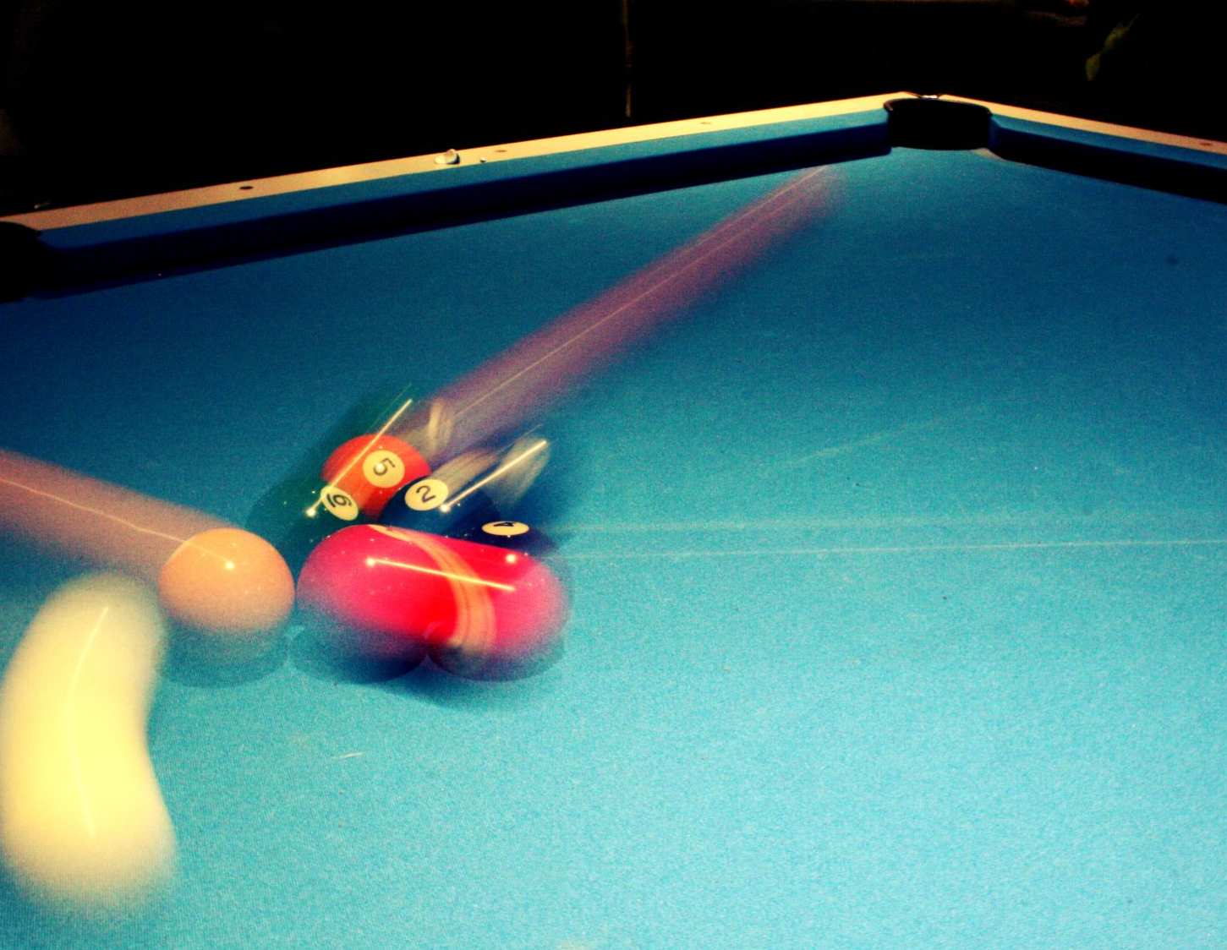
Elastic Collisions
All quick collisions conserve momentum, because external forces are usually negligible during the collision compared to the collision forces themselves.
Often, in collisions, kinetic energy after is less than kinetic energy before. That’s because energy is used up in deforming or heating the colliding objects.
If kinetic energy is conserved, the collision is said to be elastic.

Slide 12
Elastic Collision in 1 Dimension when ball 2 is initially at rest.
Consider a head-on, perfectly elastic collision of a ball of mass m₁ having initial velocity v_{1i}, with a ball of mass m₂ that is initially at rest.
$$v_{1i}$$
Before:
During:
After:
$$K_{i}$$
1
2
During the collision energy is stored as elastic potential energy.
1
2
$$v_{1f}$$
$$v_{2f}$$
1
2
$$K_{f}=K_{i}$$
The balls’ velocities after the collision are v_{1f} and v_{2f}.

Slide 13
Elastic Collision in 1 Dimension when ball 2 is initially at rest.
Momentum conservation: $m_{1}v_{1f}+m_{2}v_{2f}=m_{1}v_{1i}$
Kinetic energy conservation: ${\frac{1}{2}m}_{1}{v_{1f}}^{2}+{\frac{1}{2}m}_{2}{v_{2f}}^{2}={\frac{1}{2}m}_{1}{v_{1i}}^{2}$
There are two equations, and two unknowns: v_{1f} and v_{2f}. Solving for the unknowns gives:
Eq. 9.15:
$$v_{1f}=\frac{m_{1}−m_{2}}{m_{1}+m_{2}}v_{1i}$$
(Elastic collision with ball 2 initially at rest.)
$$v_{2f}=\frac{2m_{1}}{m_{1}+m_{2}}v_{1i}$$

Slide 14
Elastic Collision in 1 Dimension when ball 2 is initially at rest.
Eq. 9.15
$$v_{1f}=\frac{m_{1}−m_{2}}{m_{1}+m_{2}}v_{1i}$$
(Elastic collision with ball 2 initially at rest.)
$$v_{2f}=\frac{2m_{1}}{m_{1}+m_{2}}v_{1i}$$
These equations come in especially handy, because you can always switch into an inertial reference frame in which ball 2 is initially at rest!

Slide 15
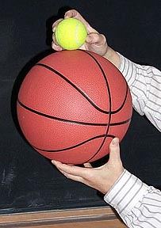
Demonstration and Example
A 0.50 kg basketball and a 0.05 kg tennis ball are stacked on top of each other, and then dropped from a height of 0.82 m above the floor.
How high does the tennis ball bounce?
Assume all perfectly elastic collisions.

Slide 16
Segment 1: freefall of both balls as they fall, v_{i} = 0.
Segment 2: Elastic collision of basketball with floor. Tennis ball continues downward, unaffected.
Segment 3: Elastic collision of upward moving basketball (1) with downward moving tennis ball (2).
Segment 4: freefall of upward moving tennis ball.
2
1

Slide 17
Demonstration and Example
Divide motion into segments.
Segment 1: free-fall of both balls from a height of h = 0.82 m. Use conservation of energy: U_{f} + K_{f} = U_{i} + K_{i}
0 + ½ m v_{f}² = mgh + 0
v_{f} = ±[2gh]^{½} = −4.0 m/s, for both balls.
Segment 2: basketball bounces elastically with the floor, so its new velocity is +4.0 m/s.

Slide 18
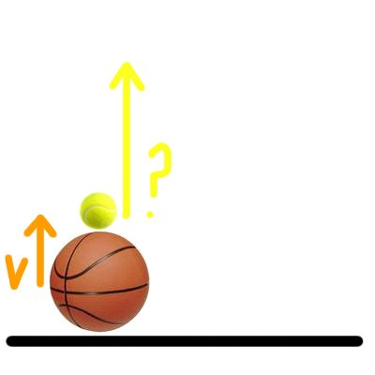
Demonstration and Example
Segment 3: A 0.50 kg basketball moving upward at 4.0 m/s strikes a 0.05 kg tennis ball, initially moving downward at 4.0 m/s.
Their collision is perfectly elastic.
What is the speed of the tennis ball immediately after the collision?

Slide 19
A 0.50 kg basketball moving upward at 4.0 m/s strikes a 0.05 kg tennis ball, initially moving downward at 4.0 m/s.
Their collision is perfectly elastic. What is the speed of the tennis ball immediately after the collision?

Slide 20
Demonstration and Example
Segment 4: freefall of tennis ball on the way up. v_{i2} = +10.5 m/s.
Use conservation of energy: U_{f} + K_{f} = U_{i} + K_{i}
mgh + 0 = 0 + ½ m v_{i}²
h = v_{i}²/(2g) = 5.6 m.
So the balls were dropped from 0.82 m, but the tennis ball rebounds up to 5.6 m! (Assuming no energy losses.)

Slide 21
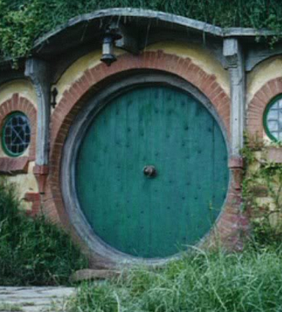
Before Class 16 next Monday Nov. 13
Complete Problem Set 7 on Chapters 8 and 9 by Monday Nov.13 at 11:59pm.
Read the first 3 sections of Chapter 10 and/or watch the Preclass 16 video.
Have a great Reading Week!
Something to think about: Why is a door easier to open when the handle is far from the hinge, and more difficult to open when the handle is in the middle?
?!
[image from http://s693.photobucket.com/user/rorimac/media/Shire_dg7.jpg.html ]

