Slide 1
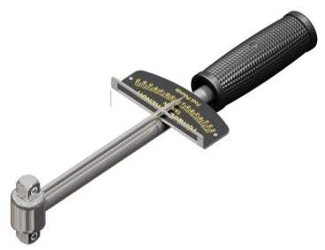
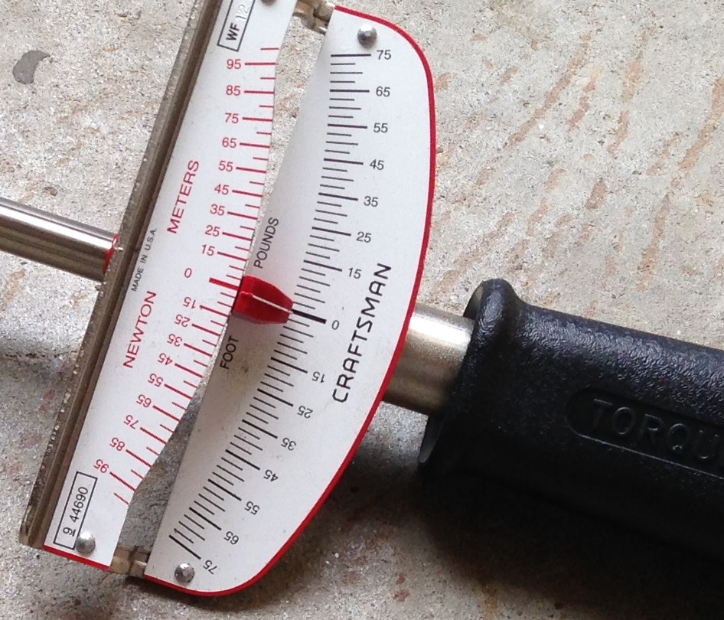
PHY131H1F - Class 16
Today I will talk about stuff that will not be on tomorrow’s midterm, but will be on the final exam on Dec. 13:
10.1 Angular Velocity and Acceleration
10.2 Torque
10.3 Rotational Inertia and the Analog of Newton’s Law
This is a torque wrench.

Slide 2
Term Test 2 Info
The second term test is tomorrow, Tue., Nov. 14, 6:10pm -7:30pm (80 minutes). The room is based on the first letter of your family name:
A - K: EX100
L - Ti: EX200
Tj - Y: EX300
Z: EX310
To further help you understand what room you need to go to, you can look up under "My Grades" to find the room under the column Test 2 Room Assignments.
Alternate sitting students have received a separate email letting you know the room and time.

Slide 3
Term Test 2 Info
Testable material is:
Chapters 6 - 9 of Wolfson
Classes 9 - 15, from Oct.11-Nov.1, inclusive
Practicals 4 - 7 and Homeworks 4 - 7, from Oct.10-Nov.13, inclusive, including the “PHY131 Uncertainty Propagation Summary” which is used in all Practical activities in which you do measurements.

Slide 4
Term Test 2 Info
The format will be the same as for test 1. There will be 8 multiple choice questions, worth 2 points each, plus two free-form problems worth 6 points each, for which you must write out your reasoning.
Aids allowed: A calculator with no communication ability (programmable calculators and graphing calculators are okay). A single hand-written aid-sheet prepared by the student, no larger than 8.5”x11”, written on both sides. A hard-copy English translation dictionary. A ruler.
Please be sure to bring your T-Card, as invigilators will be collecting signatures and checking your photo-ID.

Slide 5
Midterm Test 2 - hints
Don’t be late. If you’re very early, just wait outside the room.
Spend the first 2 or 3 minutes skimming over the entire test from front to back before you begin. Look for the easy problems that you have confidence to solve first.
Before you answer anything, read the question very carefully. The most common mistake is misreading the question!
Manage your time; if you own a watch, bring it. 10 problems over 80 minutes means an average of about 8 minutes per problem.
You CANNOT HAVE YOUR PHONE with you or in your pocket at a test or exam at U of T – you must store it in your backpack at the edge of the room, or in a special bag underneath your desk

Slide 6
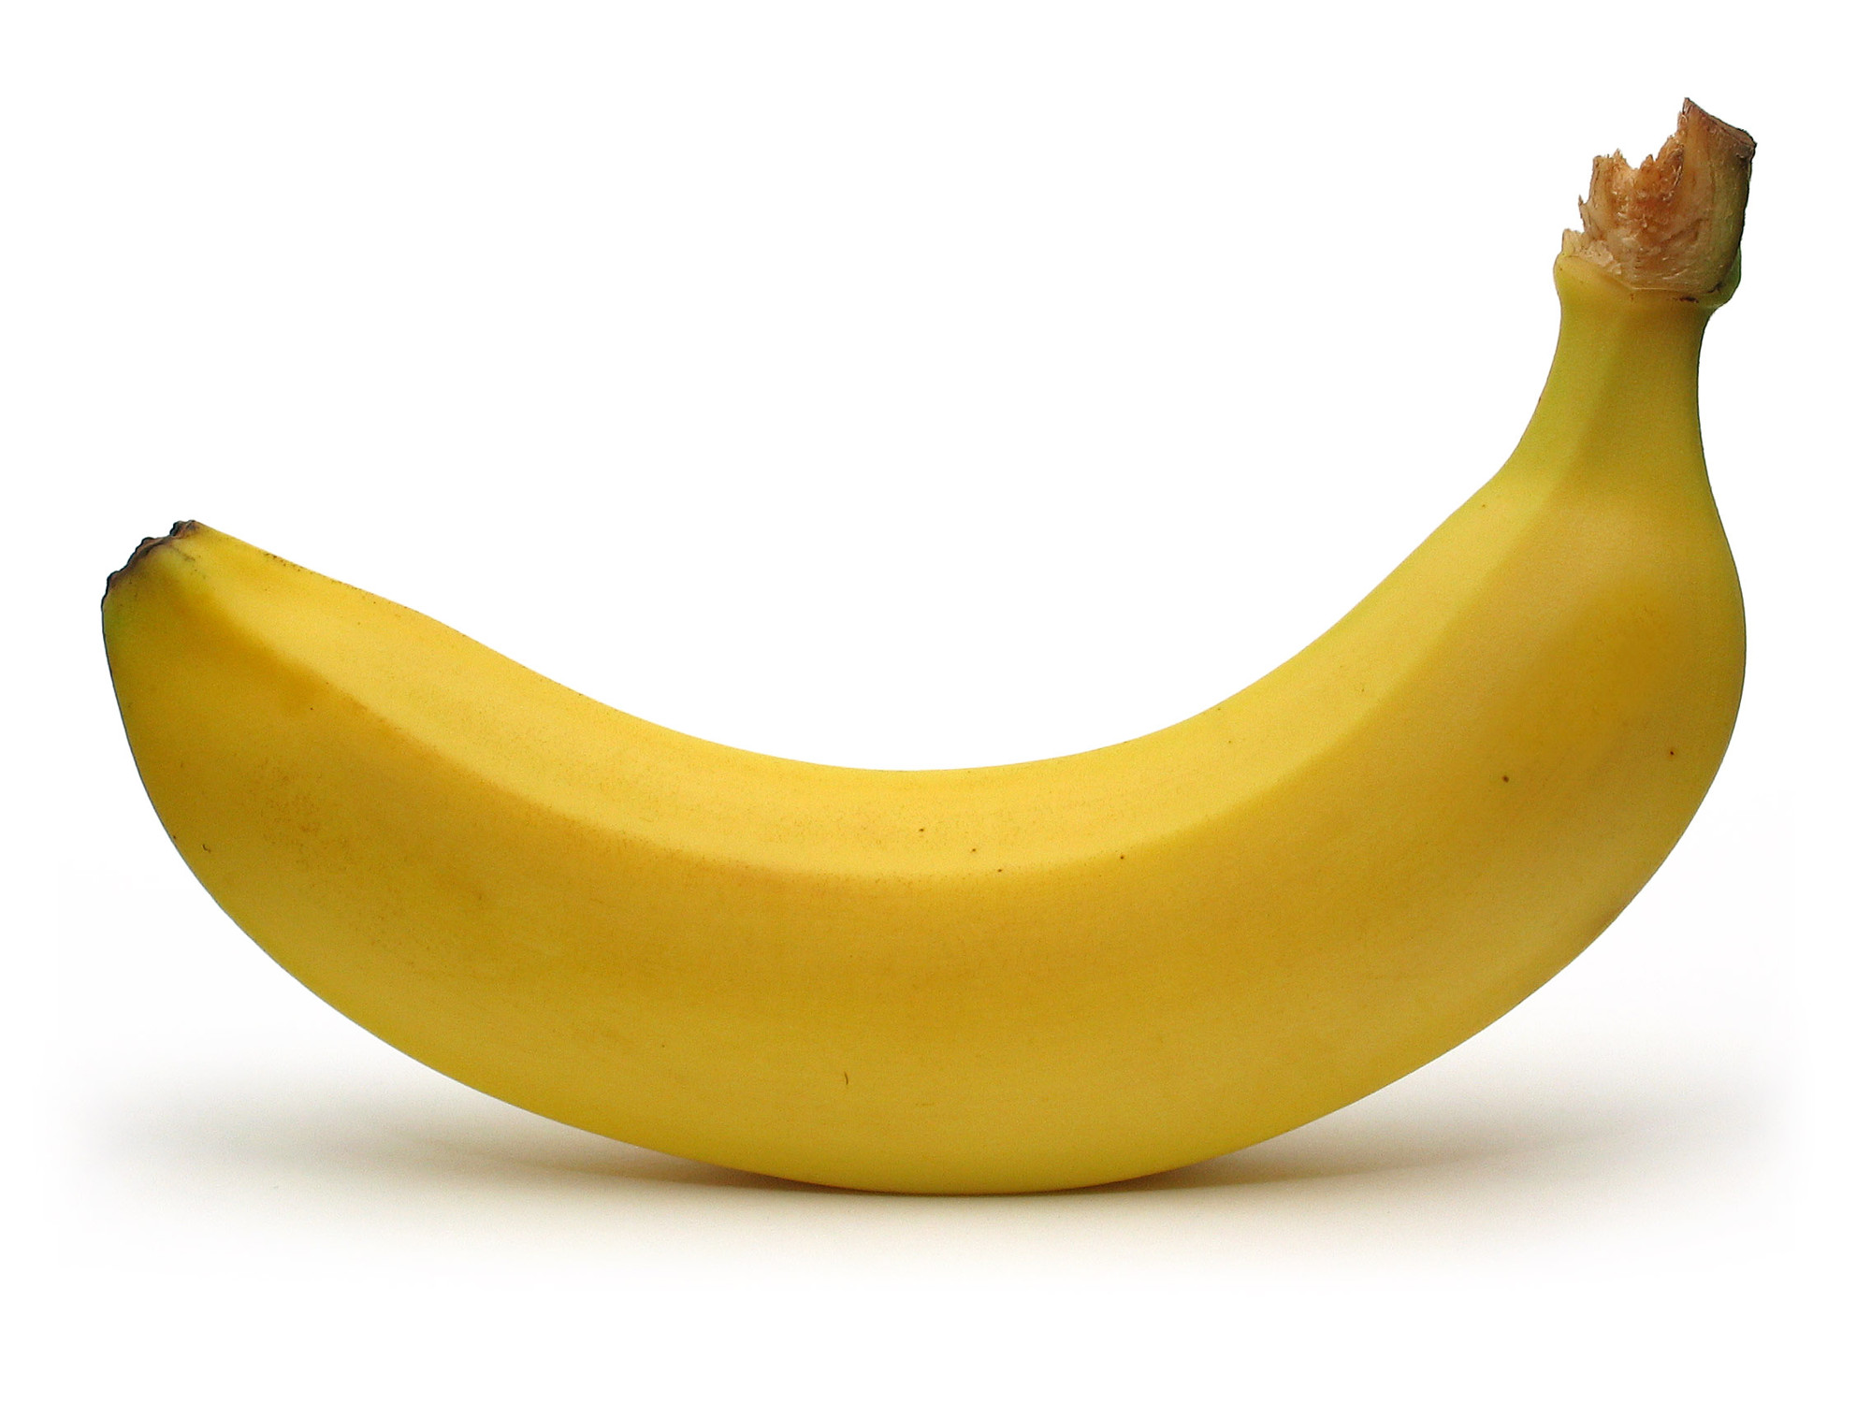
Midterm Test 1 – more hints!
Some of the multiple choice are conceptual and can be answered in less than 2 minutes.. Maybe do these ones first?
If you start a longer problem but can't finish it within about 10 minutes, leave it, make a mark on the edge of the paper beside it, and come back to it after you have solved all the easier problems.
When you are in a hurry and your hand is not steady, you can make little mistakes; if there is time, do the calculation twice and obtain agreement.
Bring a snack or drink.
Don't leave a test early! You might spend the first half getting 95% of the marks you're going to get, and the second half getting the other 5%, but it's still worth it.

Slide 7
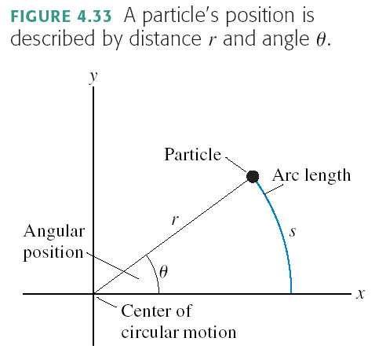
Chapter 10 begins with…. Angular Position
$$s=rθ$$
NOTE: This equation only works if θ is measured in radians.

Slide 8
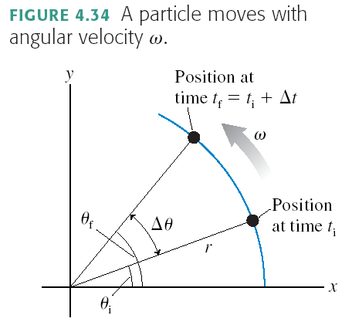
Angular Velocity

Slide 9
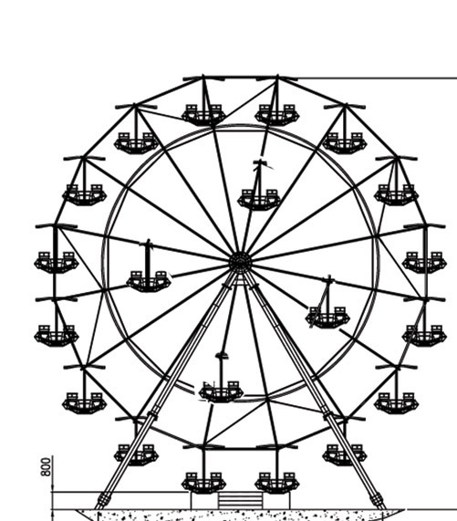
Learning Catalytics Question :
A carnival has a Ferris wheel where some seats are located halfway between the center and the outside rim. Compared with the seats on the outside rim, the inner cars have
Smaller angular speed and greater tangential speed
Greater angular speed and smaller tangential speed
The same angular speed and smaller tangential speed
Smaller angular speed and the same tangential speed
The same angular speed and the same tangential speed

Slide 10
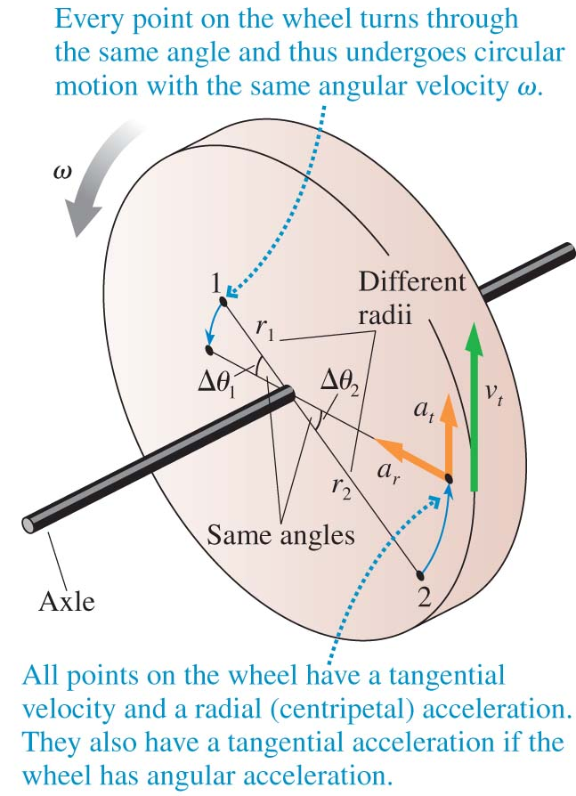
Rigid Body Rotation
Angular velocity is
The units of ω are rad/s.
If the rotation is speeding up or slowing down, its angular acceleration is
The units of α are rad/s².
All points on a rotating rigid body have the same ω and the same α.

Slide 11
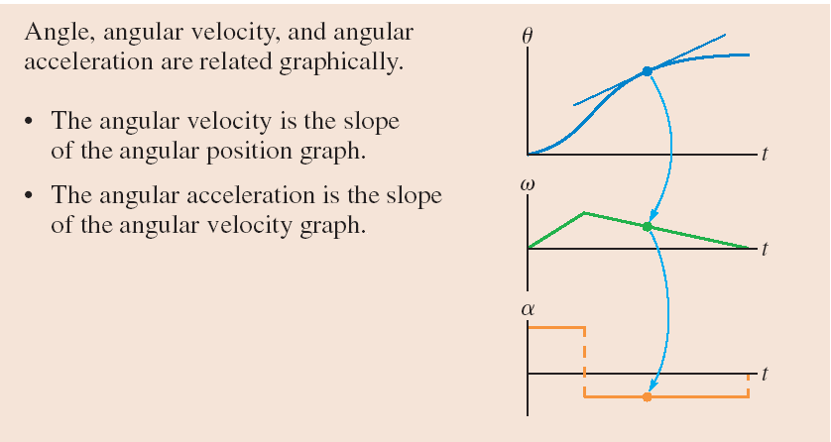
Arc length: $s=θr$
Tangential velocity: $v_{t}=ωr$
Tangential acceleration: $a_{t}=αr$

Slide 12
Rotational Kinematics
Linear
Rotational Analogy
s (or x or y) specifies position.
Velocity:
Acceleration:
θ is angular position. The S.I. Unit is radians, where 2π radians = 360°.
Angular velocity:
Angular acceleration:

Slide 13
Radians are the Magical Unit!
Radians appear and disappear as they please in your equations!!!
They are the only unit that is allowed to do this!
Example:
1 rad
$$v_{t}=ωr$$

Slide 14
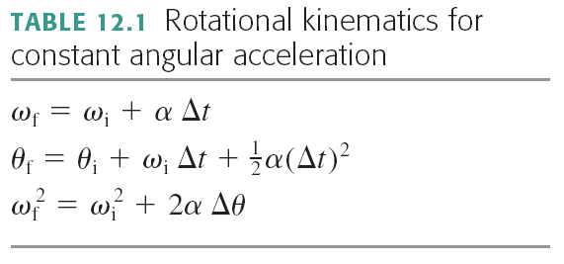
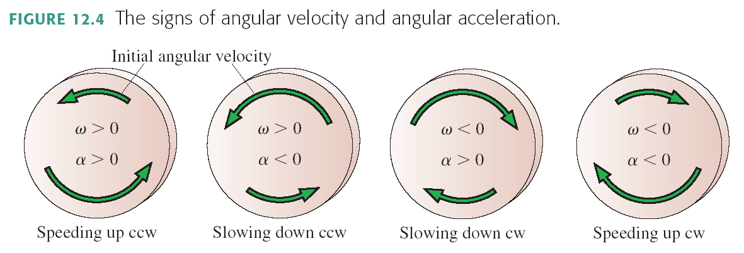
Rotational Kinematics

Slide 15
Last day I asked at the end of class:
Why is a door easier to open when the handle is far from the hinge, and more difficult to open when the handle is in the middle?
ANSWER:
Torque is the rotational analog of force:
Force causes things to accelerate along a line.
Torque causes things to have angular acceleration.
Torque = Force × Lever Arm
Lever arm is the distance between where you apply the force and the hinge or pivot point.
Putting the handle further from the hinge increases your lever arm, therefore it increases your torque for the same applied force.

Slide 16
Rotational Dynamics
Linear
Rotational Analogy
x
v_{x}
a_{x}
Force: F_{x}
Mass: m
θ
ω
α
Torque: τ
Rotational Inertia: I
Newton’s Second Law:

Slide 17
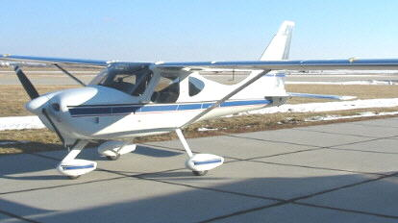
Example
The engine in a small airplane is specified to have a torque of 60.0 N m. This engine drives a propeller whose rotational inertia is 13.3 kg m². On start-up, how long does it take the propeller to reach 200 rpm?

Slide 18
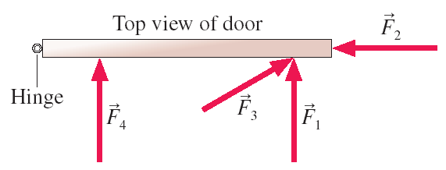
Torque
Consider the common experience of pushing open a door. Shown is a top view of a door hinged on the left. Four pushing forces are shown, all of equal strength. Which of these will be most effective at opening the door?
F₁
F₂
F₃
F₄

Slide 19
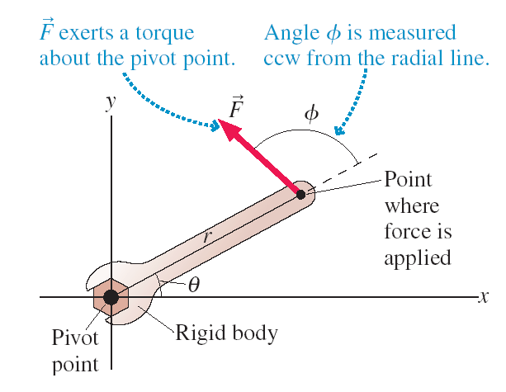
Torque
The effectiveness of a force at causing a rotation is called torque. Torque is the rotational equivalent of force. We say that a torque is exerted about the pivot point.

Slide 20
Torque
Mathematically, we define torque τ (Greek tau) as
SI units of torque are N m.
English units are foot-pounds.

Slide 21
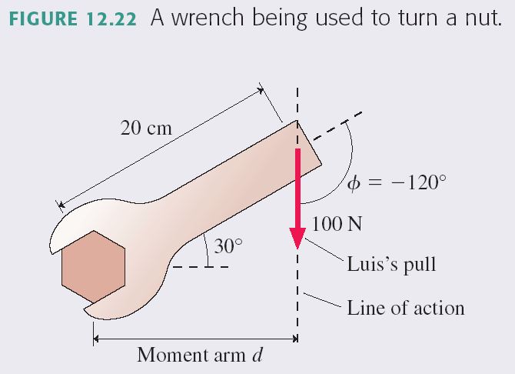
Example
Luis uses a 20 cm long wrench to turn a nut. The wrench handle is tilted 30° above the horizontal, and Luis pulls straight down on the end with a force of 100 N. How much torque does Luis exert on the nut?

Slide 22
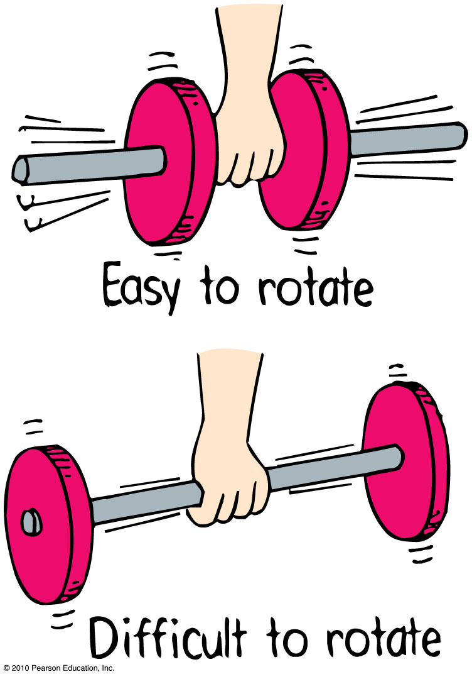
Rotational Inertia
Depends upon:
mass of object.
distribution of mass around axis of rotation.
The greater the distance between an object’s mass concentration and the axis, the greater the rotational inertia.

Slide 23
Rotational Inertia
Consider a body made of N particles, each of mass m_{i}, where i = 1 to N. Each particle is located a distance r_{i} from the axis of rotation. For this body made of a countable number of particles, the rotational inertia is:
The units of rotational inertia are kg m². An object’s rotational inertia depends on the axis of rotation.
For a continuous distribution of mass (uncountably high number of particles), you must use an integral to compute rotational inertia:
$$I=\int{r^{2}dm}$$

Slide 24
Which dumbbell has the larger rotational inertia about the midpoint of the rod? The connecting rod is massless.
R
2R
m
m
m/2
m/2
A
B
Dumbbell A.
Dumbbell B
Their rotational inertias are the same.

Slide 25
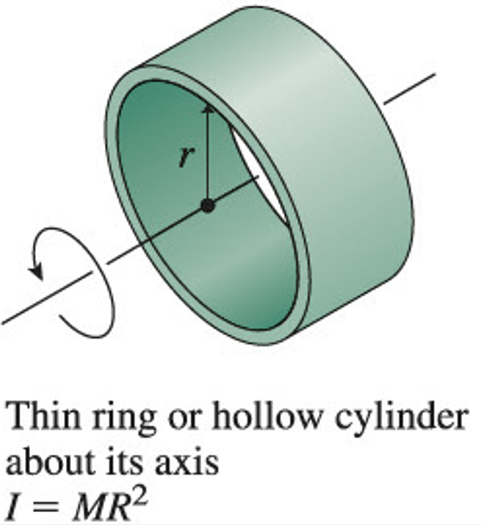
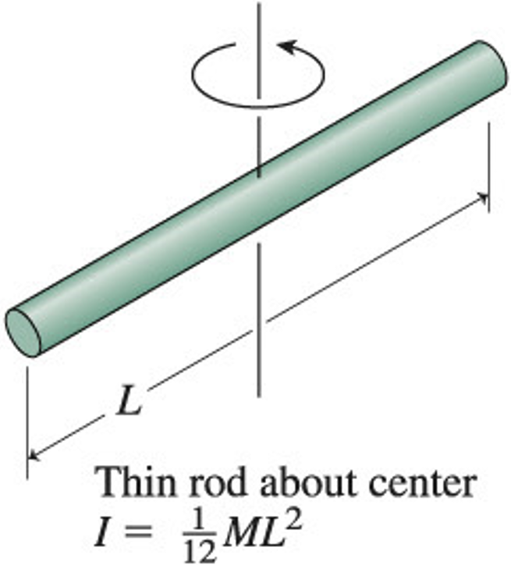
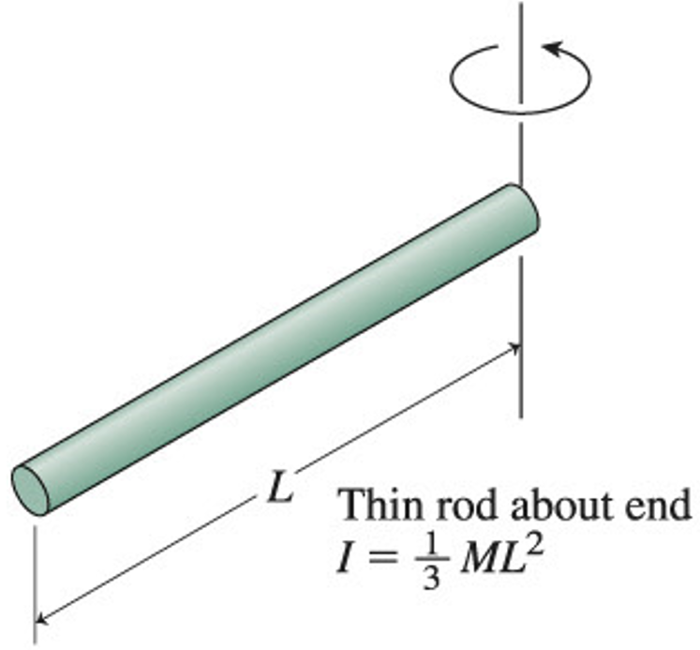
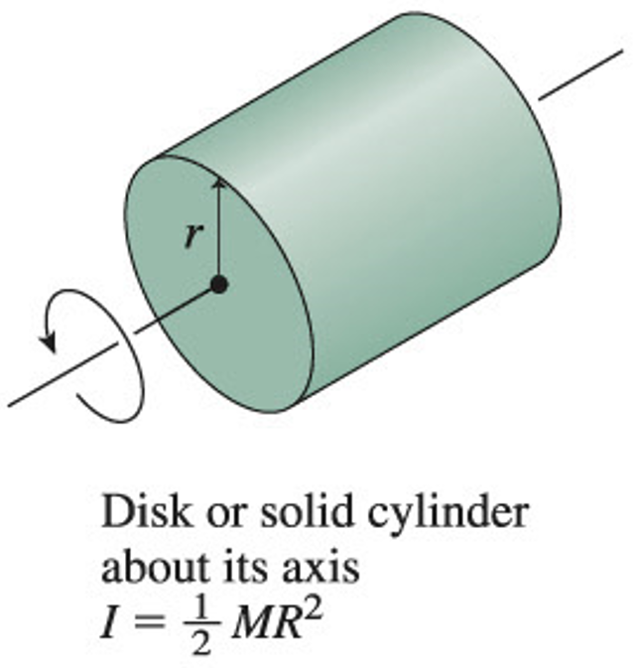
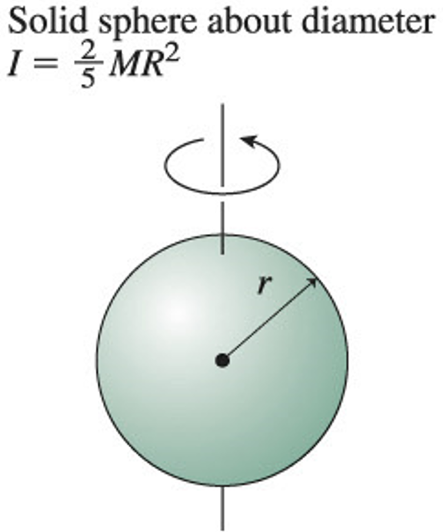
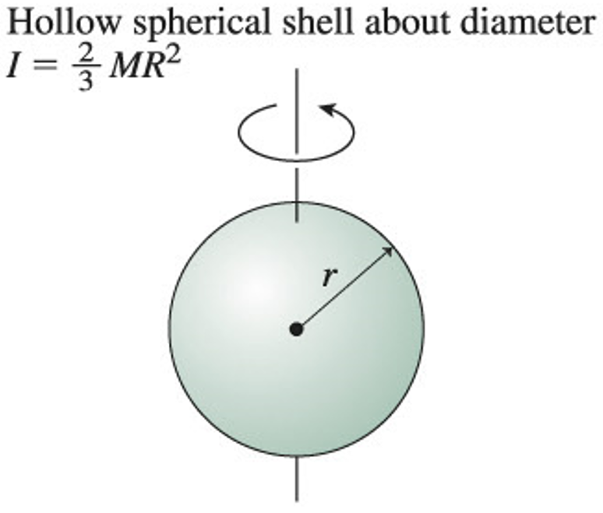

Slide 26
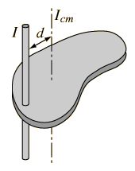
The Parallel-Axis Theorem
Suppose you know the rotational inertia of an object when it rotates about axis through center of mass: I_{cm}
You can find the rotational inertia when it is rotating about another axis, which is a distance d away from the center of mass:
I = I_{cm} + Md ²

Slide 27
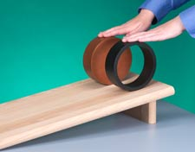
Before Class 17 on Wednesday
Remember, there are Practicals this week!
For Wednesday please finish reading Chapter 10, and/or watch the preclass 17 video.
Yes there is a preclass quiz on Learning Catalytics due Wednesday at 8:00am sorry about that – you can do it any time tomorrow…
Something to think about:
A hoop and a disk are both released from rest at the top of an incline. They both roll without slipping. Which reaches the bottom first? Why?

