Slide 1
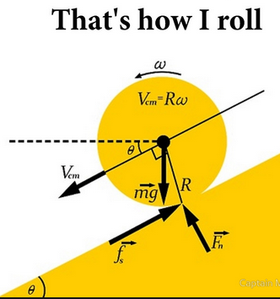
PHY131H1F - Class 17
Today:
Finishing Chapter 10:
Rolling Without Slipping
Rotational Energy

Slide 2
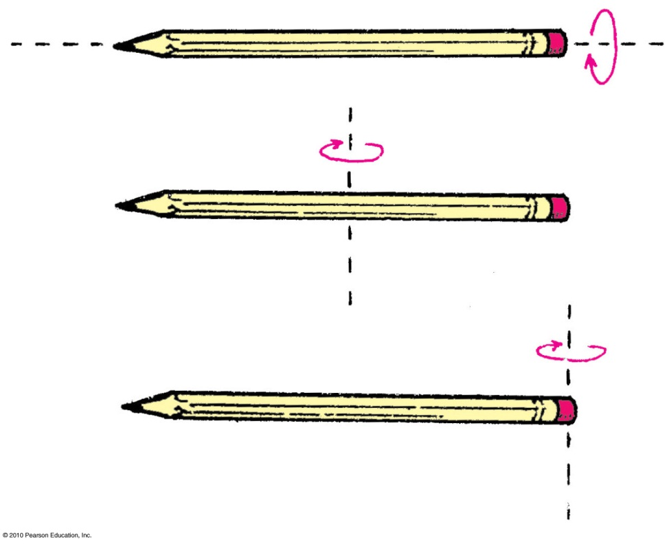
Learning Catalytics Question 1
Which pencil has the largest rotational inertia?
The pencil rotated around an axis passing through it.
The pencil rotated around a vertical axis passing through centre.
The pencil rotated around vertical axis passing through the end.

Slide 3
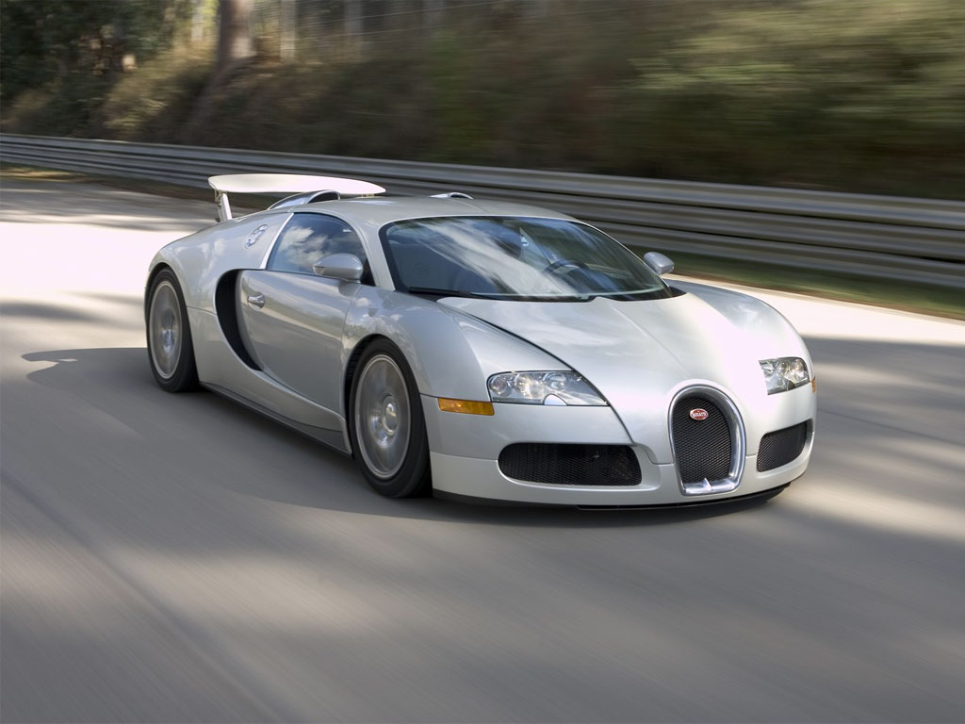
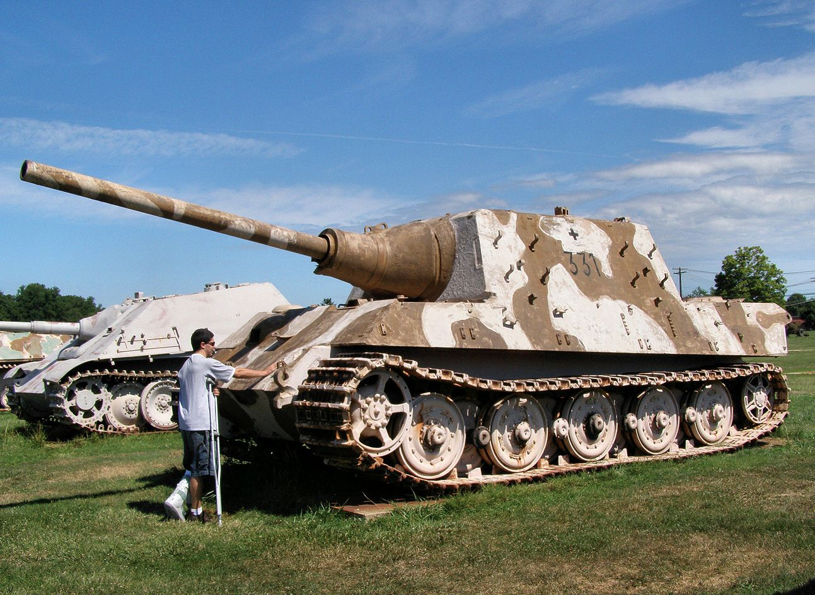
10.5: Rolling without slipping
No matter what the speed, four points on this car are always at rest!
Which points? The bottoms of the four tires!
A wheel rolls much like the treads of a tank.
The bottom of the wheel is at rest relative to the ground as it rolls.

Slide 4
Rolling without slipping
S frame: the ground
S’ frame: the axle
ω
The wheel rotates with angular speed ω.
The tangential speed of a point on the rim is v = ωr, relative to the axle.
In “rolling without slipping”, the axle moves at speed v. This is the S’ frame.

Slide 5
Rolling without slipping
$S′$ frame: the axle is at rest
$S$ frame: the ground is at rest
1
1
4
2
4
2
3
3
$\vec{V}$ is the velocity of the axle relative to the ground.

Slide 6
Rolling without slipping
ω
v = ωr
The wheel rotates with angular speed ω.
The axle moves with linear speed v = ωr., where r is the radius of the wheel.
If your car is accelerating or decelerating or turning, it is static friction of the road on the wheels that provides the net force which accelerates the car

Slide 7
Rolling without slipping Doc Cam Demo

Slide 8
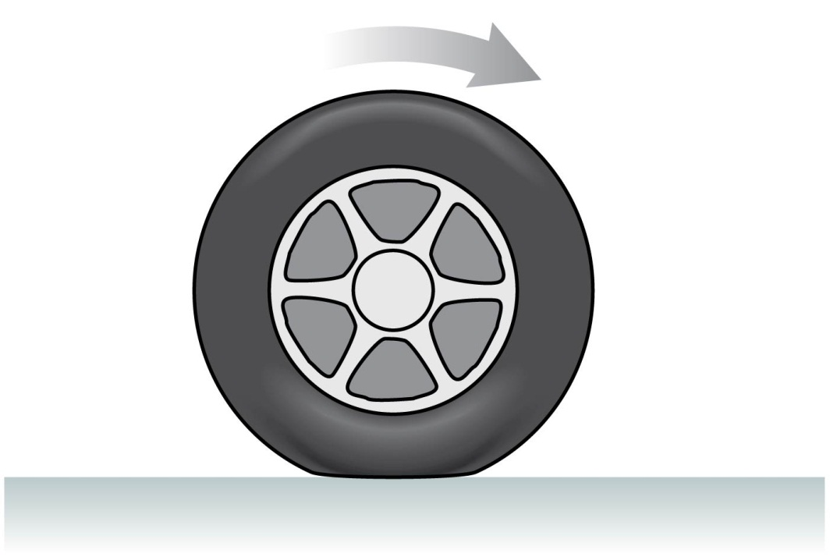
Rolling Without Slipping
Under normal driving conditions, the portion of the rolling wheel that contacts the surface is stationary, not sliding
In this case the speed of the centre of the wheel is:
$$v=\frac{C}{T}$$
where C = circumference [m] and T = Period [s]

Slide 9
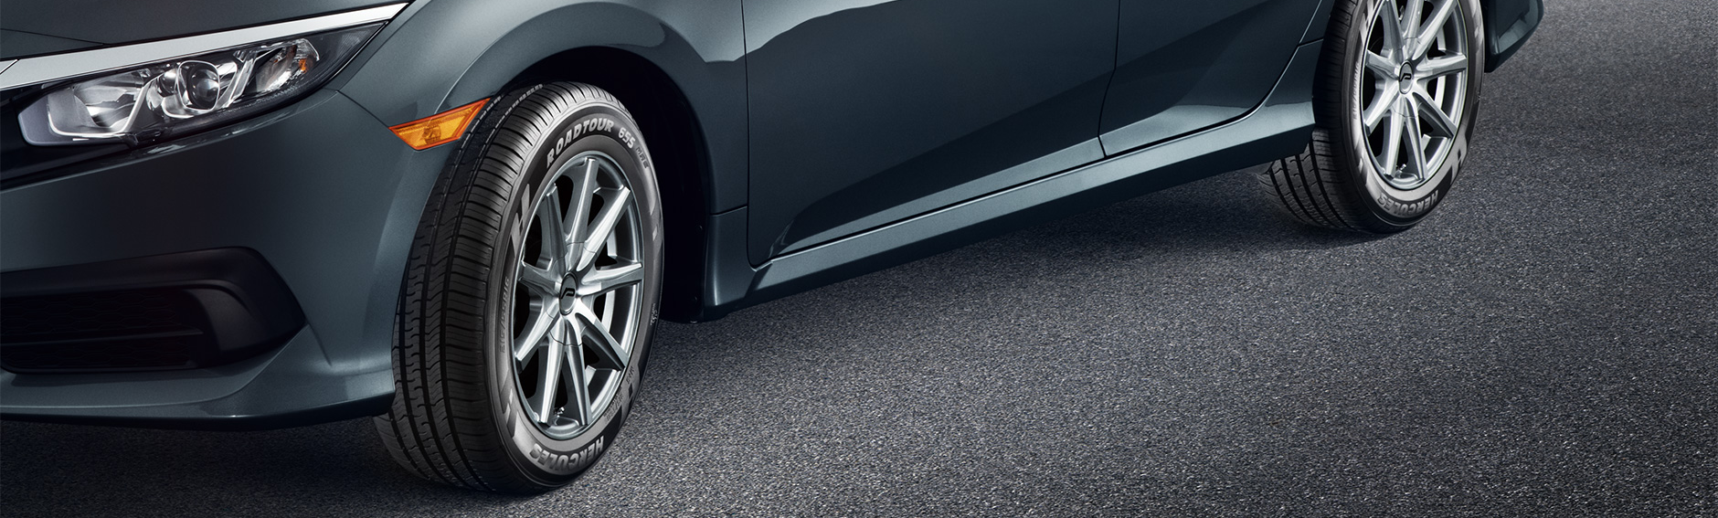
Example
The circumference of the tires on your car is 0.9 m.
The onboard computer in your car measures that your tires rotate 10 times per second.
What is the speed as displayed on your speedometer?

Slide 10
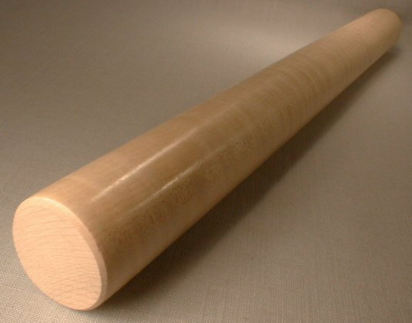
The “Rolling Without Slipping” Constraints
When a round object rolls without slipping, the distance the axis, or centre of mass, travels is equal to the change in angular position times the radius of the object.
s = θR
The speed of the centre of mass is
v = ωR
The acceleration of the centre of mass is
a = αR

Slide 11
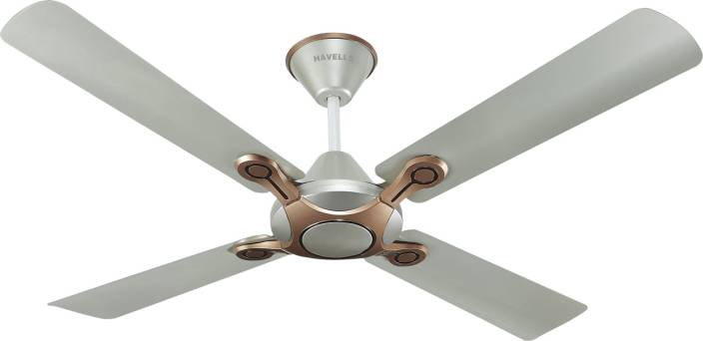
Rotational Kinetic Energy
A rotating rigid body has kinetic energy because all atoms in the object are in motion. The kinetic energy due to rotation is called rotational kinetic energy.

Slide 12
Example: A 0.50 kg basketball rolls along the ground at 1.0 m/s. What is its total kinetic energy (linear plus rotational)? [Note that the rotational inertia of a hollow sphere is I = 2/3 MR².]

Slide 13
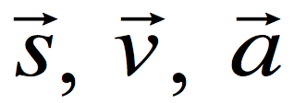
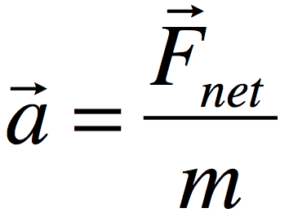
Linear / Rotational Analogy
Linear
Rotational Analogy
, ,
Force:
Mass: m
θ, ω, α
Torque: τ
Rotational Inertia: I
Newton’s 2nd law:
Kinetic energy:

Slide 14
Summary of some Different Types of Energy:
Kinetic Energy due to linear motion of centre of mass: K = ½ mv²
Gravitational Potential Energy U_{g} = mgh
Spring Potential Energy: U_{s} = ½ kx²
Rotational Kinetic Energy: K_{rot} = ½ Iω²
Thermal Energy: ΔE_{th} (often created by kinetic friction)
An object can possess any or all of the above.
One way of transferring energy to or out of an object is work:
Work done by a constant force: W = Frcosθ

Slide 15
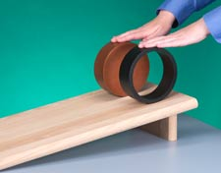
Learning Catalytics Q2
A hoop and a disk are both released from rest at the top of an incline. They both roll without slipping. Which reaches the bottom first? Shall we vote?
A: hoop wins
B: disk wins
C: tie
Don’t forget: Nature is not a democracy!

Slide 16
Learning Catalytics Q3. A solid disk is released from rest and rolls without slipping down an incline. A box is released from rest and slides down a frictionless incline of the same angle. Which reaches the bottom first?
A: disk wins
B: box wins
C: tie

Slide 17
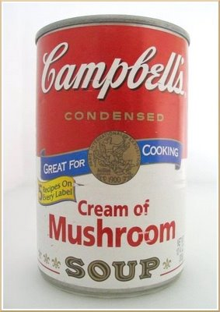
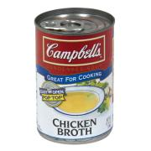
Compare and Contrast Soup Cans
About same mass
About same radius and shape
Thick paste, so when this can is rolling, the contents rotate along with the can as one solid object, like a solid cylinder
Low viscosity liquid, so the can itself rolls while the liquid may just “slide” along.

Slide 18
Learning Catalytics Q4
Two soup cans begin at the top of an incline, are released from rest, and allowed to roll without slipping down to the bottom. Which will win?
Predict:
Cream of Mushroom will win
Chicken Broth will win
Both will reach the bottom at about the same time.

Slide 19
Cream of Mushroom soup must rotate, like a solid disk.
Chicken broth can slide down without rotating while the can rotates around it.

Slide 20
What is the acceleration of a slipping object down a ramp inclined at angle θ? [assume no friction]

Slide 21
What is the acceleration of a solid disk rolling down a ramp inclined at angle θ? [assume rolling without slipping]

Slide 23
What is the acceleration of a hoop rolling down a ramp inclined at angle θ? [assume rolling without slipping]

Slide 24
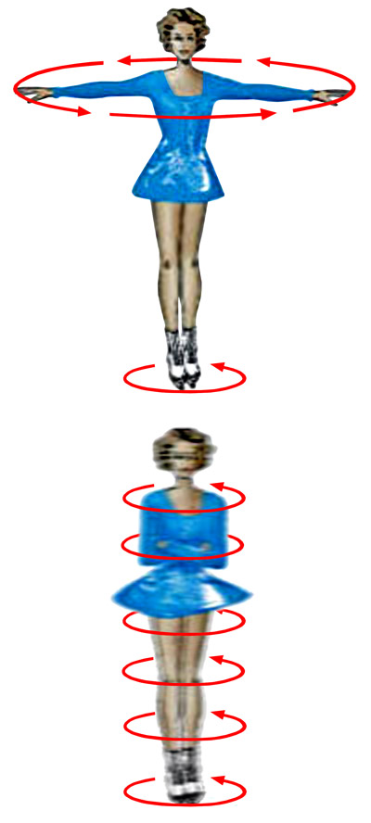
Before Class 18 on Monday
The reading is all of Chapter 11 on Rotational Vectors and Angular Momentum.
Please read the chapter and/or watch the Preclass 18 Video.
Something to think about: When a figure-skater starts a spin and brings in her arms, she spins even faster. Why?
Image from http://www.daviddarling.info/encyclopedia/A/angular_momentum.html

