Slide 1
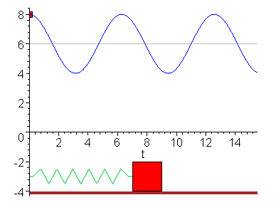
PHY131H1F - Class 20
Today:
Today, Chapter 13:
General Periodic Oscillations
Special case: Simple Harmonic Motion
Animation from http://www.uni-saarland.de/fak7/knorr/homepages/patrick/theorex/MapleScripts/oscillations/forced_oscillations1.html

Slide 2
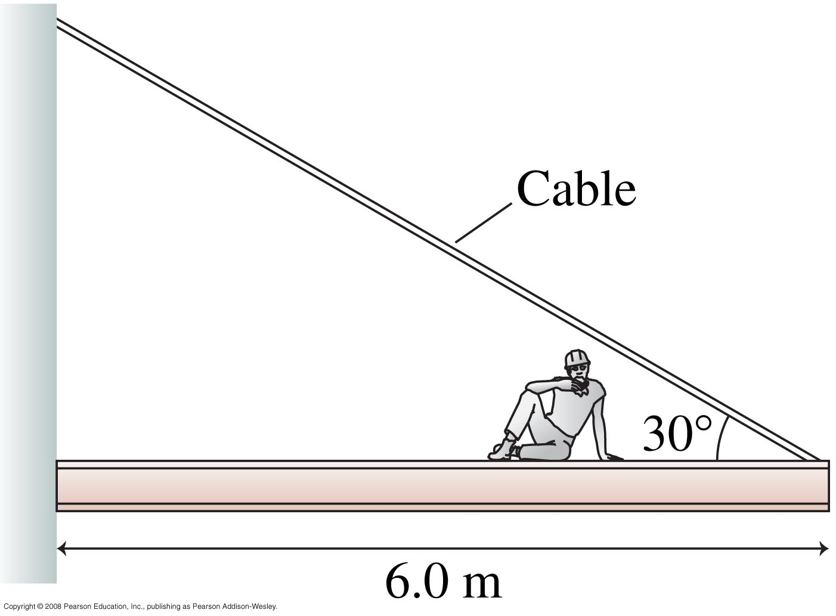
Learning Catalytics Question 1
A construction worker of mass m_{w} sits 2.0 m from the end of a steel beam of mass m_{b}, as shown.
The tension in the Cable is T
The wall exerts a normal force, n on the beam, and an upward force, F₁.
Define +x = to the right, +y = up, and the pivot is the point where the beam touches the wall.
What is the normal force, n?
F₁
T
n
6.0 m
m_{w}g
m_{b}g

Slide 3
Learning Catalytics Question 2
A construction worker of mass m_{w} sits 2.0 m from the end of a steel beam of mass m_{b}, as shown.
The tension in the Cable is T
The wall exerts a normal force, n on the beam, and an upward force, F₁.
Define +x = to the right, +y = up, and the pivot is the point where the beam touches the wall.
What is the force, F₁?
F₁
T
n
6.0 m
m_{w}g
m_{b}g

Slide 4
Bonus Point for Over 65% Course Evaluation Response Rate
An essential component of our commitment to teaching excellence is the regular evaluation of courses by students.
On Nov. 24 you were sent an email by course.evaluations@utoronto.ca to evaluate PHY131H1F.
It only takes 10 or 15 minutes to answer the questions and enter your typed thoughts about the course.
Your answers and thoughts are anonymous, but are very important to me and Brian.
I promise you that when the results become available to us in January, Brian and I will read every comment and scrutinize the responses to see if it can help us improve the course or my teaching in the future.

Slide 5
Bonus Point for Over 65% Course Evaluation Response Rate
The end of the evaluation period for this semester is Thursday December 7 at 11:59PM.
If, by the end of the course evaluation period, at least 65.00% of the students enrolled in this course have completed the course evaluations, then every student in the course will have 1% bonus added to their final course mark.
If fewer than 65.00% of students complete the course evaluations by the deadline, then no bonus point will be added for any student.
Results so far (as of today):
Invited: students
Responded: students
Response Rate: %

Slide 6
Last day I asked
A spring with a mass attached to it is stretched and released. When the spring returns to equilibrium, is the mass moving?
Answer: Yes! It is not accelerating, but it is moving at that moment. Inertia then carries it past equilibrium to the other side. After passing equilibrium, the acceleration is opposite the velocity, so it slows down, eventually turning around.

Slide 7
Period, frequency, angular frequency
The time to complete one full cycle, or one oscillation, is called the period, T.
The frequency, f, is the number of cycles per second. Frequency and period are related by
The oscillation frequency f is measured in cycles per second, or Hertz.
We may also define an angular frequency ω in radians per second, to describe the oscillation.

Slide 8
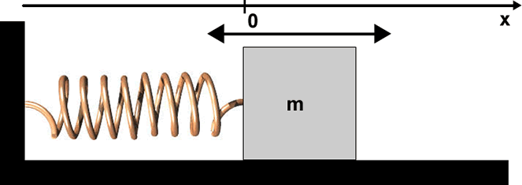
The Spring-Mass System
The force exerted on the mass by the spring: F = −k x (Hooke’s Law)
F = m a (Newton’s Second Law)
Combine to form a differential equation:

Slide 9
Solving S.H.M.

Slide 10
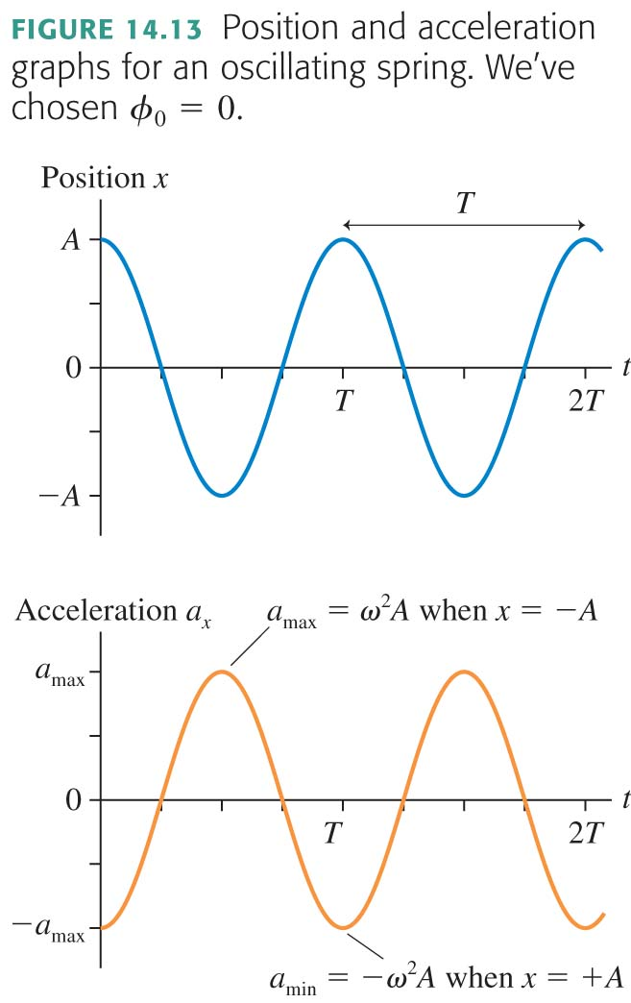

Slide 11
Simple Harmonic Motion
If the initial position of an object in SHM is not A, then we may still use the cosine function, with a phase constant ϕ₀ measured in radians.

Slide 12
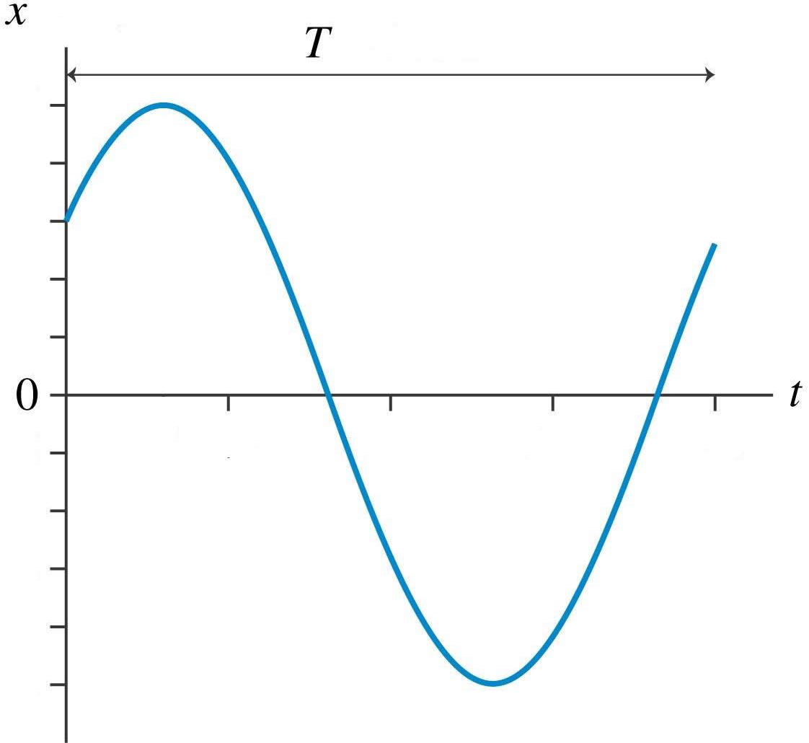
Simple Harmonic Motion (SHM)

Slide 13
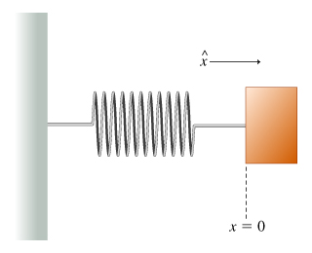
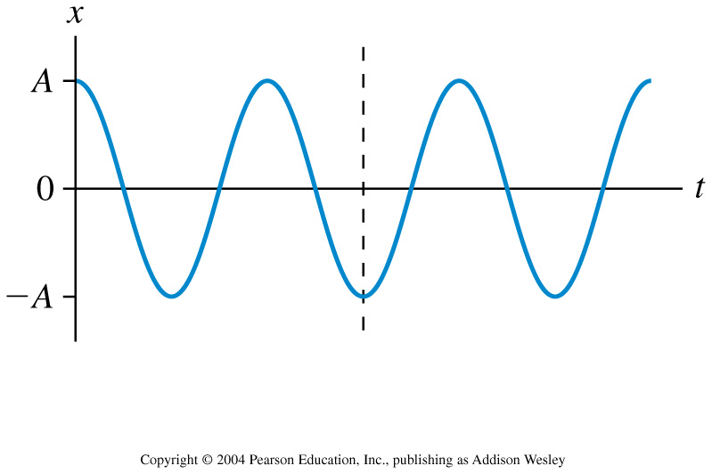
Learning Catalytics Question 3
This is the position graph of a mass on a spring. What can you say about the velocity and the force at the instant indicated by the dotted line?
Notes:
STT14.4

Slide 14
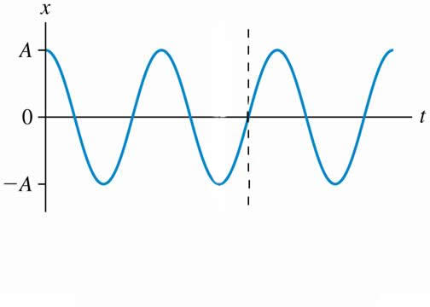
Learning Catalytics Question 4
This is the position graph of a mass on a spring. What can you say about the velocity and the force at the instant indicated by the dotted line?
Notes:
STT14.4

Slide 15
What is ϕ₀?
Learning Catalytics Question 5

Slide 16
S.H.M. notes.
The frequency, f, is set by the properties of the system. In the case of a mass m attached to a spring of spring-constant k, the frequency is always
A and ϕ₀ are set by the initial conditions: x₀ (initial position) and v₀ (initial velocity).
A turns out to be related to the total energy of the spring oscillator system: E = ½ k A².

Slide 17
Learning Catalytics Question 6
Which of the following quantities in the description of simple harmonic motion is not determined by the initial position and velocity of the mass?
Notes:
Answer: B

Slide 18
Learning Catalytics Question 7
A mass is oscillating on a spring in S.H.M. When it passes through its equilibrium point, an external “kick” suddenly decreases its speed, but then it continues to oscillate. As a result of this slowing, the frequency of the oscillation
Notes:
Answer: C

Slide 19
Vertical Mass on a Spring

Slide 20
Vertical Mass on a Spring

Slide 21
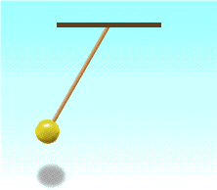
Before Class 21 on Wednesday
Please finish reading Chapter 13 on Oscillations, and/or watch the Preclass Video 21.
Problem Set 9 on Chapters 10 and 11 is due tonight at 11:59pm.
Something to think about over the weekend: If you double the mass of a mass on a spring, how does this change the frequency? If you double the mass of a swinging pendulum, how does this change the frequency? What is the difference here?

