Slide 1
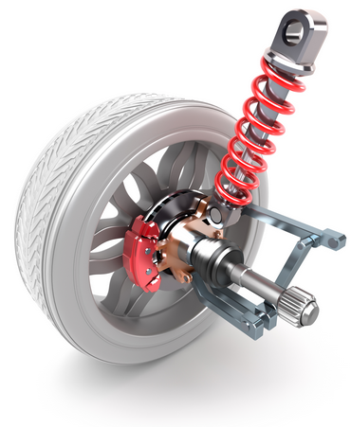
PHY131H1F - Class 21
Today:
Today, finishing Chapter 13:
Simple Pendulum
Circular motion and S.H.M.
Energy in S.H.M.
Damped Harmonic Motion
Driven Oscillations and Resonance.
From http://www.cavatoyota.com/blog/what-are-shock-absorbers/ :
To test your vehicle’s shock absorbers, simply push down on the each corner of the vehicle and observe its bounce. The vehicle should bounce up and return to its center resting position. If it continues to bounce, the shock absorber should be replaced.

Slide 2
What is the net torque on this pendulum?

Slide 3
Suppose we restrict a pendulum’s oscillations to small angles (< 10°). Then we may use the small angle approximation sin θ ≈ θ, where θ is measured in radians. The net torque on the mass is
$$Στ=I\frac{d^{2}θ}{dt^{2}}=−mgLθ$$
So the simple harmonic motion equation for θ as a function of time is:
$$\frac{d^{2}θ}{dt^{2}}=−\frac{mgL}{I}θ$$
The solution to this is $θ=A\cos{(ωt+φ_{0})}$, where A and $φ_{0}$ are arbitrary, and the frequency of oscillations (in rad/s) is:
$$ω=\sqrt{\frac{mgL}{I}}$$
But the rotational inertia of a point mass m a distance L from the rotation axis is I = mL², so
$$ω=\sqrt{\frac{g}{L}}$$

Slide 4
Learning Catalytics Question 1
Two pendula have the same length, but different mass. The force of gravity, F=mg, is larger for the larger mass. Which will have the longer period?
A. the larger mass
B. the smaller mass
C. neither

Slide 5
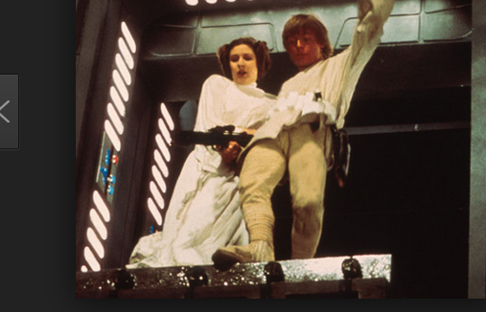
Example.
Luke and Leia have a combined mass of 120 kg and both grasp a rope of length 30 m that is attached to a beam above them. The beam is half-way across a 10 m horizontal gap, and they want to swing across. If they start from rest and swing down and up, just reaching the other side, how long does this take?

Slide 7
Mass on Spring versus Pendulum
 | Mass on a Spring | Pendulum
Condition for S.H.M. | Small oscillations (Hooke’s Law is obeyed) | Small angles
Angular frequency
Period

Slide 8
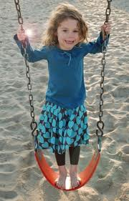
Learning Catalytics Question 2
A person swings on a swing. When the person sits still, the swing oscillates back and forth at its natural frequency. If, instead, the person stands on the swing, the natural frequency of the swing is
A. greater
B. the same
C. smaller

Slide 9
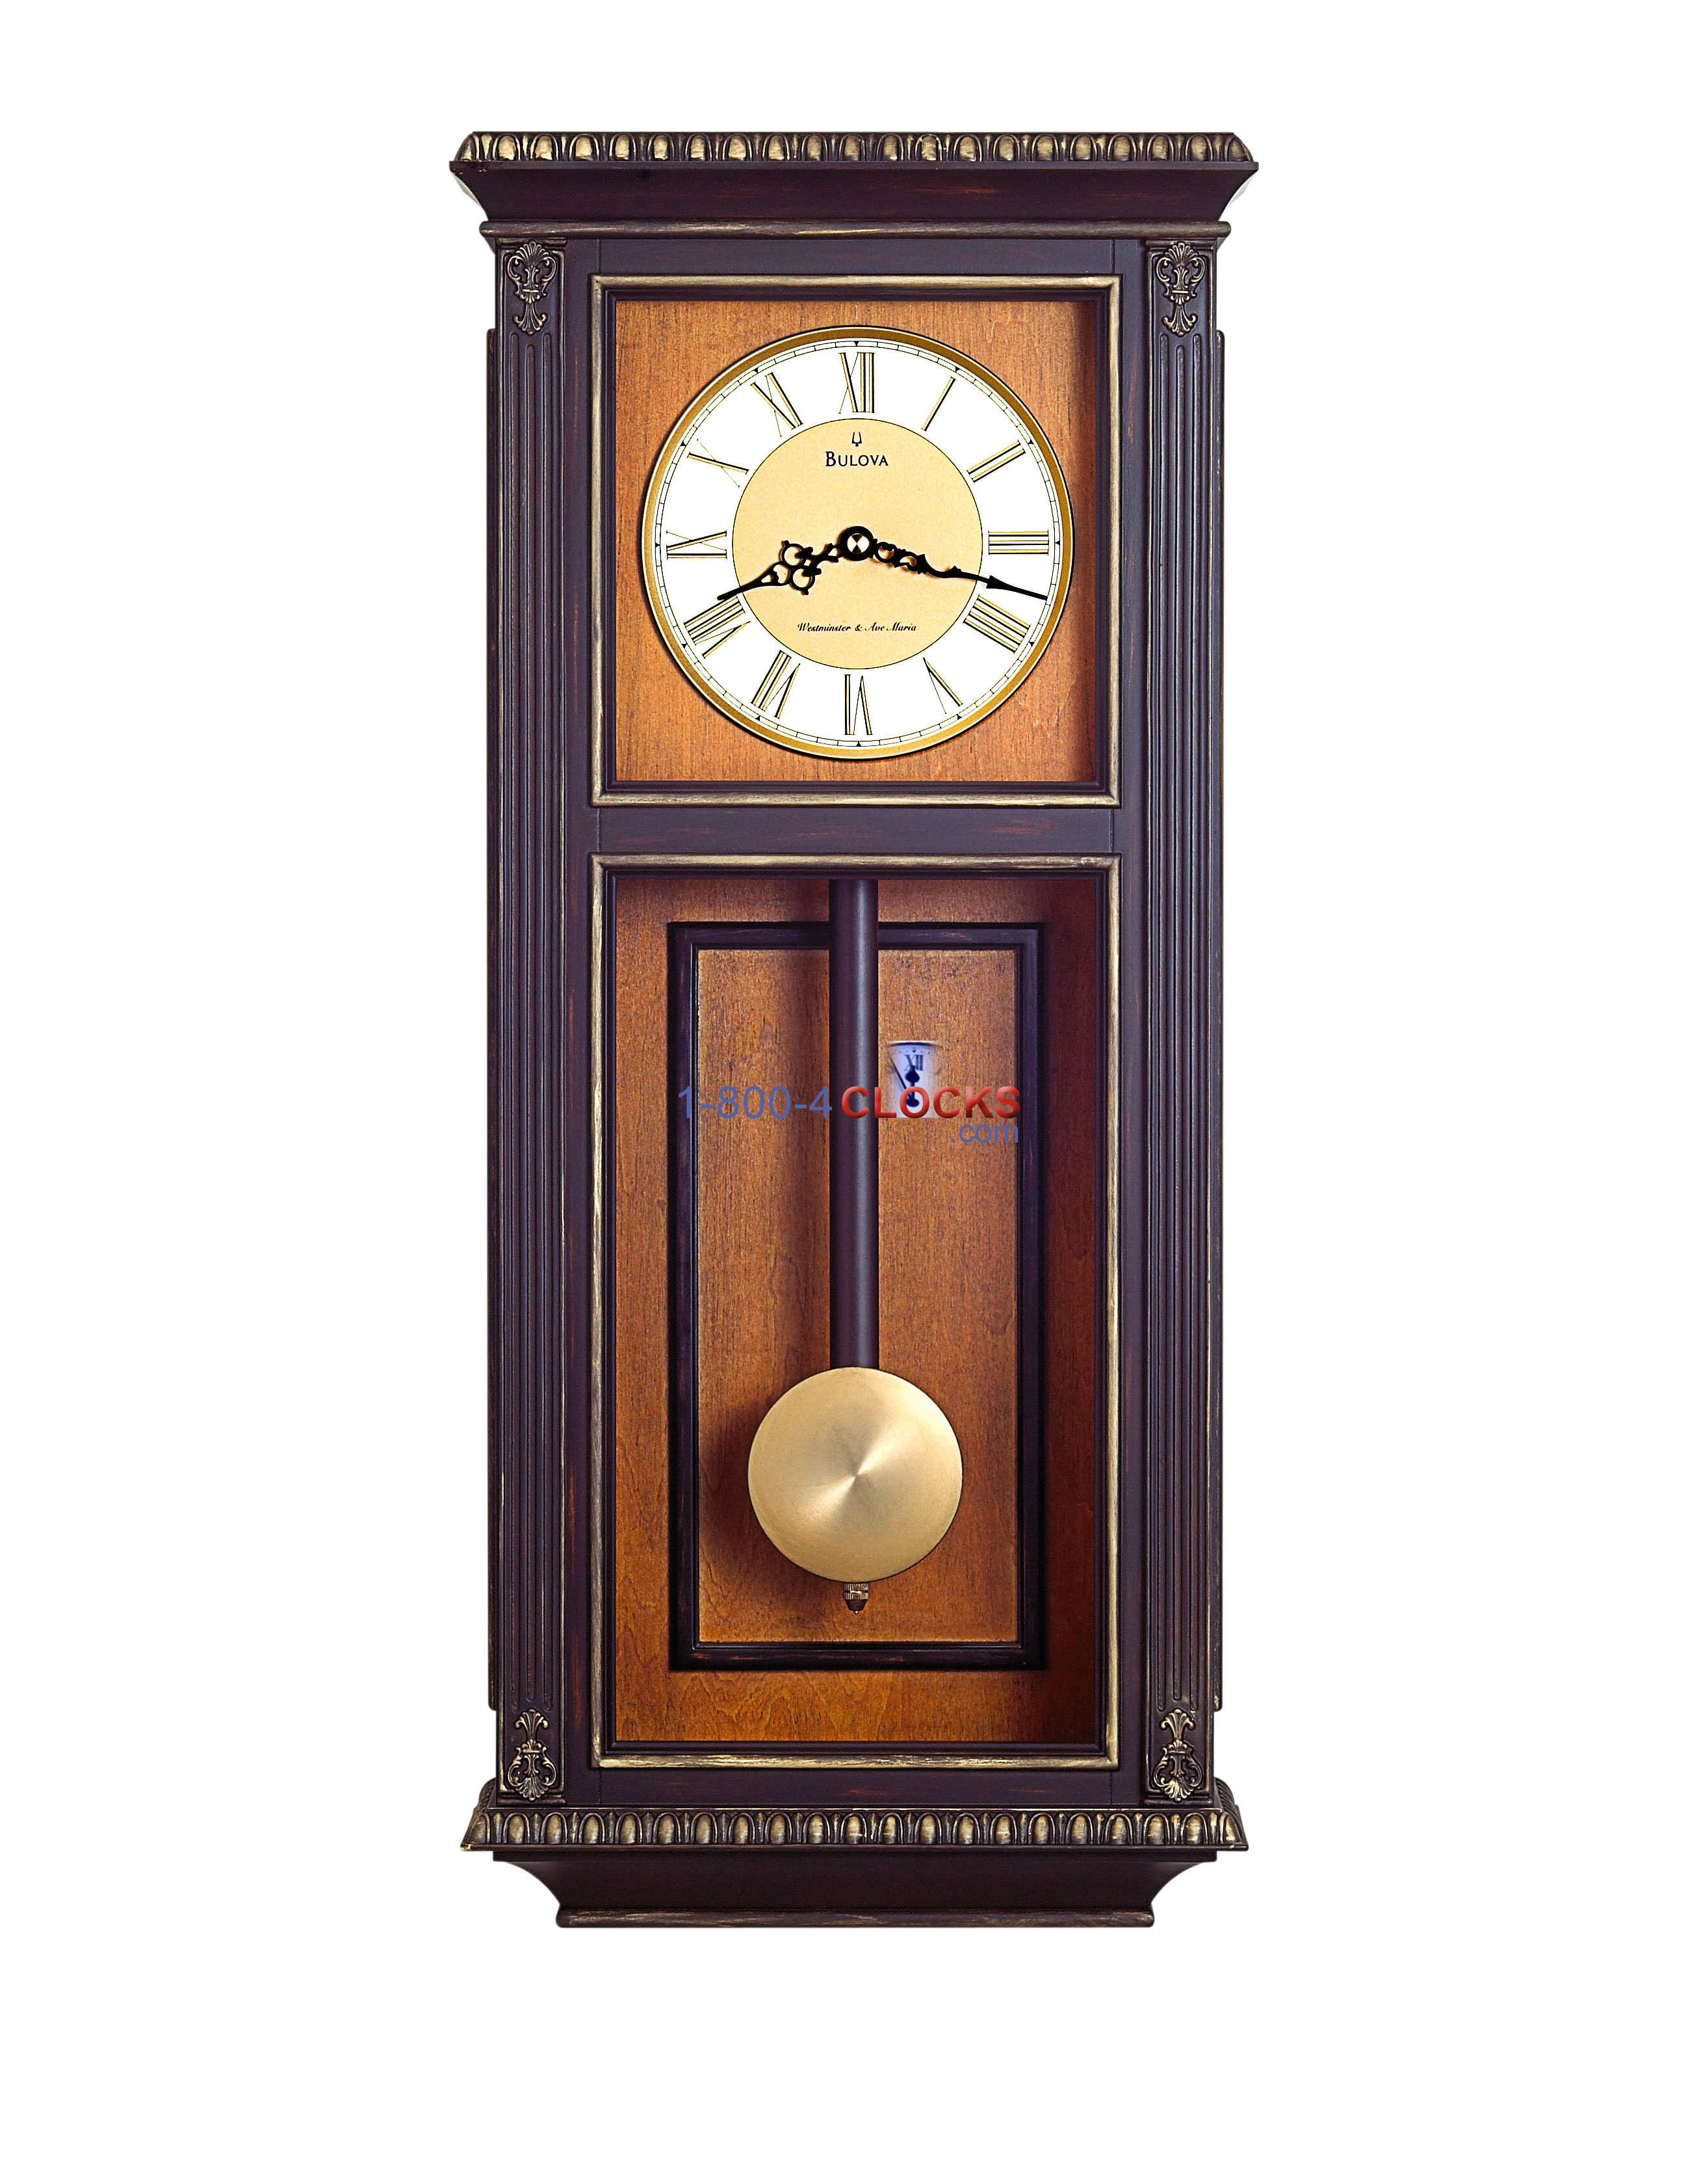
Learning Catalytics Question 3
A grandfather clock at high altitudes runs
A. fast.
B. slow.
C. normally as it does at sea level.
Image from https://www.1-800-4clocks.com/Bulova-Vickery-Wall-Chimes-Clock_C4329_CUV

Slide 10
Uniform Circular Motion
Simple Harmonic Motion

Slide 11
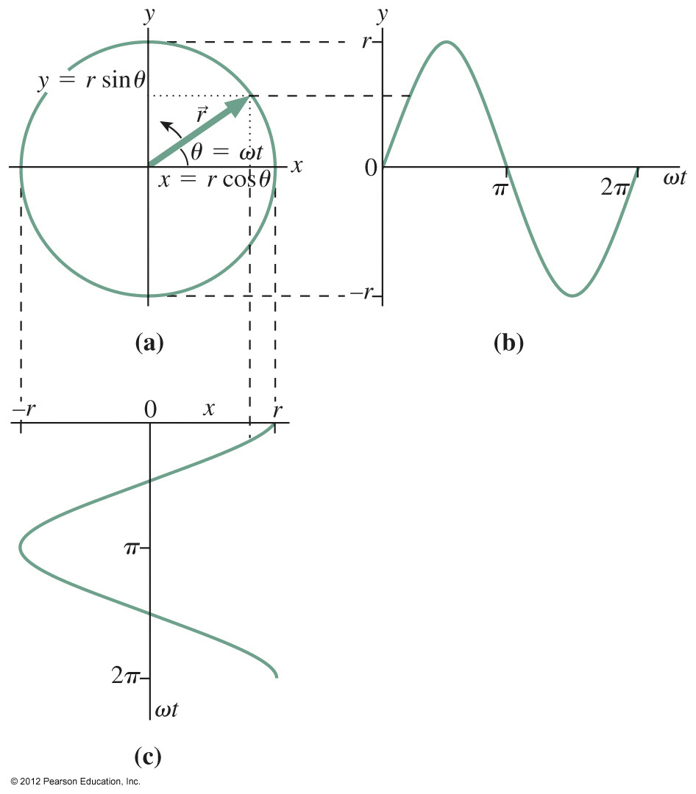
Notes:
Chapter 13, Figure 13.17

Slide 12
Energy of a mass on a spring

Slide 13
equilibrium

Slide 15
Simple Harmonic Motion (SHM)
If the net force on an object is a linear restoring force (ie a mass on a spring, or a pendulum with small oscillations), then the position as a function of time is related to cosine:
Cosine is a function that goes forever, but in real life, due to friction or drag, all oscillations eventually slow down.

Slide 17
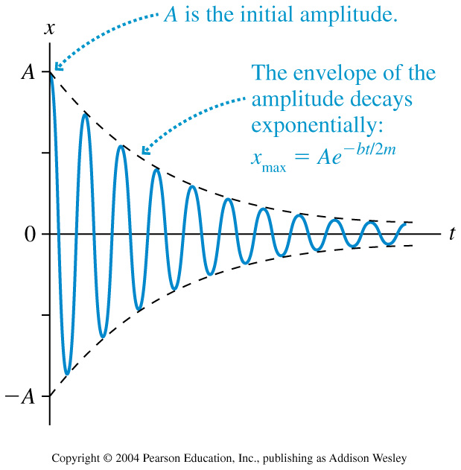
Damped Oscillations
When a mass on a spring experiences the force of the spring as given by Hooke’s Law, as well as a drag force of magnitude |D|=bv, the solution is

Slide 18
Example 13.6.
A car’s suspension acts like a mass-spring system with m = 1200 kg and k = 5.8 × 10⁴ N/m. Its shock absorbers provide a damping constant of b = 230 kg/s. After the car hits a bump in the road, how many oscillations will it make before the amplitude drops to half its initial value?

Slide 19
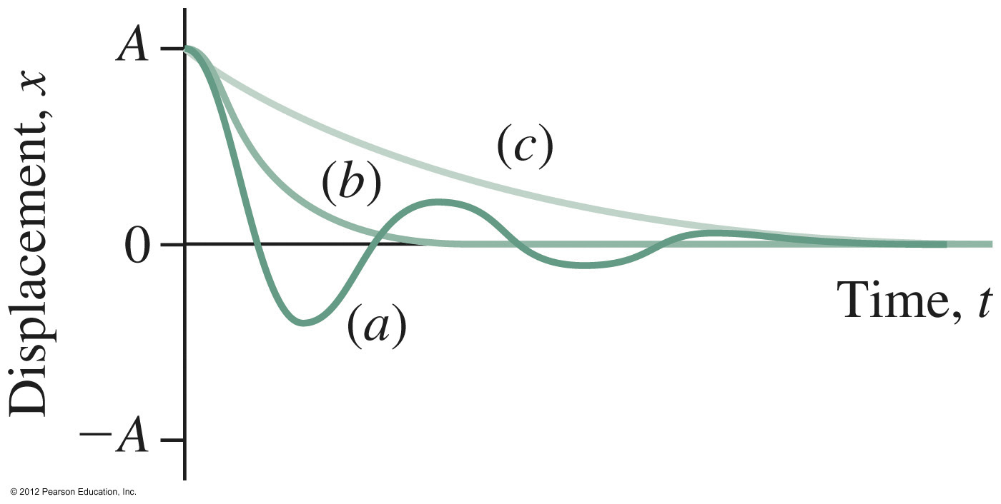
Damped Harmonic Motion
underdamped
critically damped, and
overdamped oscillations.

Slide 20
Driven Oscillations and Resonance
Consider an oscillating system that, when left to itself, oscillates at a frequency f₀. We call this the natural frequency of the oscillator.
Suppose that this system is subjected to a periodic external force of frequency f_{ext}. This frequency is called the driving frequency. Driven systems oscillate at f_{ext}.
The amplitude of oscillations is generally not very high if f_{ext} differs much from f₀.
As f_{ext} gets closer and closer to f₀, the amplitude of the oscillation rises dramatically.

Slide 21
14.8 Externally Driven Oscillations
Resonance!

Slide 22
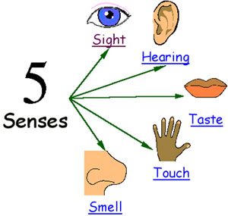
Before Class 22 on Monday
If you haven’t done it, please check your utoronto email, respond to the course_evaluations email and evaluate this course!
Please start reading Chapter 14 on Waves and/or watch the Preclass 22 video. Note that we will only cover the first seven sections of chapter 14 for this course (No Doppler shift)
Something to think about over the weekend: Two of the five senses depend on waves in order to work: which two?
Image from http://freger.weebly.com/the-five-senses.html

