Slide 1
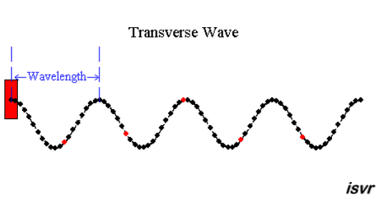
PHY131H1F - Class 22
Today:
Today, we start the last chapter of this course: Ch.14 on Waves
Wave Properties
Waves on a string
Wave Power and Intensity
Sound Waves
Animation from http://resource.isvr.soton.ac.uk/spcg/tutorial/tutorial/Tutorial_files/Web-basics-nature.htm

Slide 2
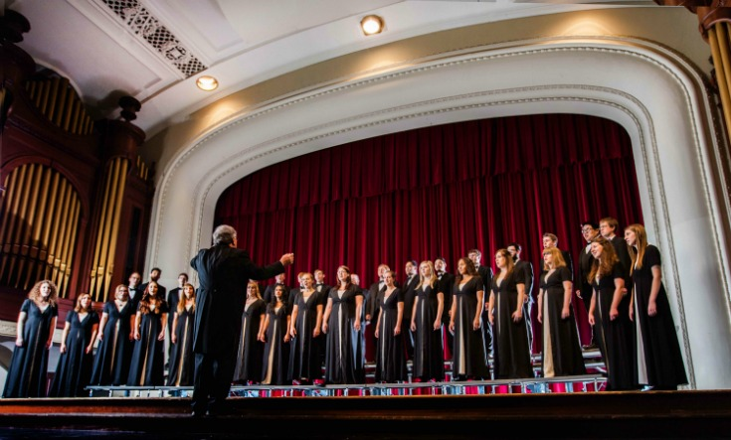
Announcements
BILL: Ah. Music lover, eh?
BRIDE: He's fond of music.
BILL: Aren't we all?
Next semester I’ll be teaching PHY207H1S “Physics of Music” for the first time.
The Practicals Coordinator for PHY131, Dr. Sealfon, has arranged a musical demonstration for Wednesday morning at 11:10am. It will consist of about 10 minutes of choir and organ music, with some Fast Fourier Transform software to illustrate the overtones present in a large theatre like Convocation Hall.

Slide 3
Reading Question 16.4
Learning Catalytics Question 1
The constant, k, introduced in Section 14.2 on Wave Math is
The Boltzman’s constant, with units: J/K.
The Coulomb constant, with units: N m²/c².
The spring constant, with units: N/m.
The wave number, with units: rad/m.
Notes:
3
Answer: D

Slide 4
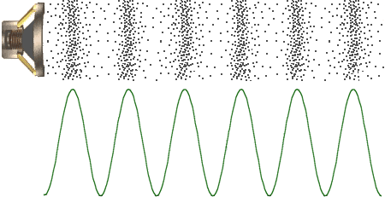
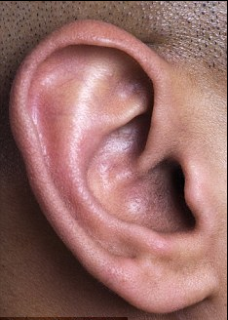
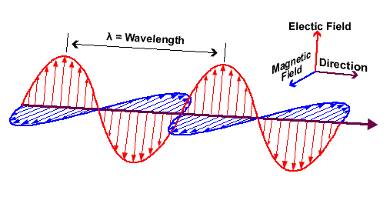
Last day I asked
Two of the five senses depend on waves in order to work: which two?
Answer: Sight and Sound!
Sound is a pressure wave which travels through the air.
Light is a wave in the electric and magnetic fields.

Slide 5
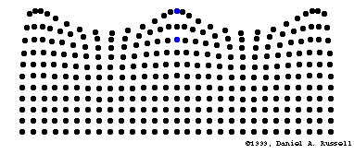
Chapter 14. Wave Motion
A vibration is a periodic linear motion of a particle about an equilibrium position.
When many particles vibrate and carry energy through space, this is a wave. A wave extends from one place to another.
Examples are:
water waves
light, which is an electromagnetic wave
sound
[image from https://webspace.utexas.edu/cokerwr/www/index.html/waves.html ©1999 by Daniel A. Russell ]

Slide 6
Amplitude and Wavelength
Amplitude
distance from the midpoint to the crest or to the trough
Wavelength
distance from the top of one crest to the top of the next crest, or distance between successive identical parts of the wave

Slide 7
Wave speed
Describes how fast a disturbance moves through a medium
Related to frequency and wavelength of a wave
Example:
A wave with wavelength 1 meter and frequency of
1 Hz has a speed of 1 m/s.
Wave speed = frequency × wavelength

Slide 8
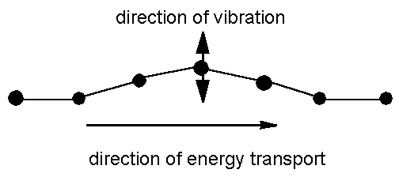
Transverse waves
Medium vibrates perpendicularly to direction of energy transfer
Side-to-side movement
Example:
Vibrations in stretched strings of musical instruments
[image from http://www.maths.gla.ac.uk/~fhg/waves/waves1.html ]

Slide 9
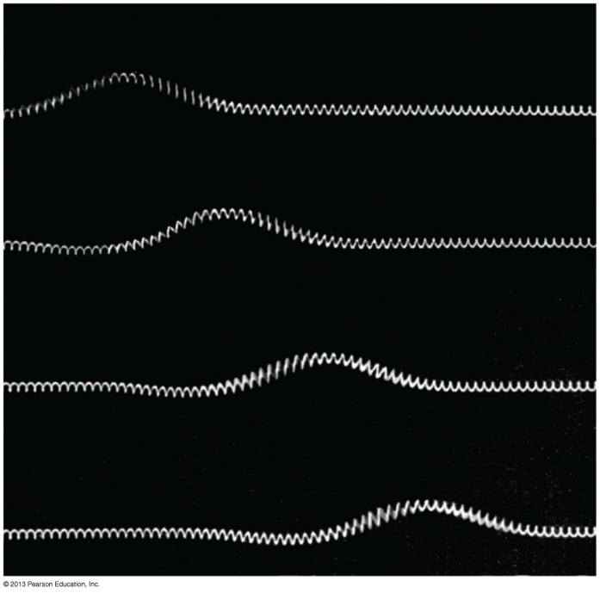
Transverse waves
The speed of transverse waves on a string stretched with tension F is:
$$v=\sqrt{\frac{F}{μ}}$$
Where μ is the string’s mass-to-length ratio, also called the linear density:
Units: [kg/m]

Slide 10
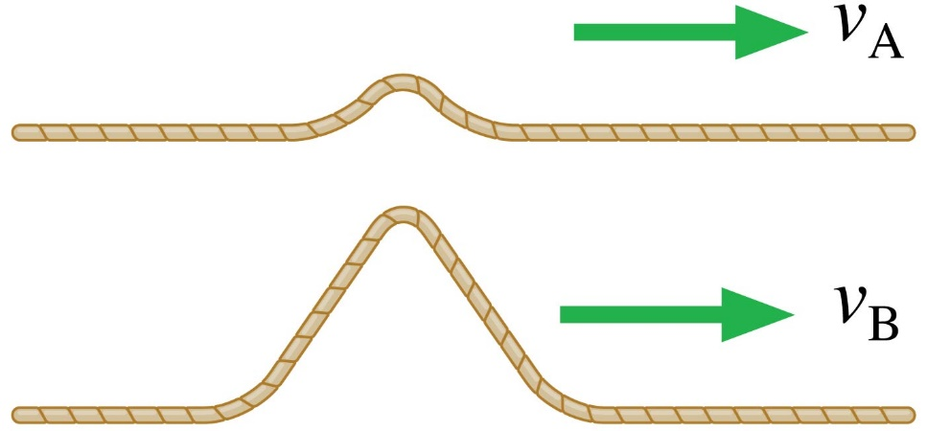
Learning Catalytics Question 2
These two wave pulses travel along the same stretched string, one after the other. Which is true?
v_{A} > v_{B}
v_{B} > v_{A}
v_{A} = v_{B}
Not enough information to tell.
Notes:
10

Slide 11
Pre-class 22 Quiz from This Morning

Slide 12
Learning Catalytics Question 3
For a wave pulse on a string to travel twice as fast, the string tension must be
Increased by a factor of 4.
Increased by a factor of 2.
Decreased to one half its initial value.
Decreased to one fourth its initial value.
Not possible. The pulse speed is always the same.
Notes:
12

Slide 13
Pre-class 22 Quiz from This Morning

Slide 14
Example.
An 80 kg climber hangs from a rope, 20 m below a rocky overhang. The rope has a linear density of 37 g/m.
Approximately how long would it take a transverse pulse to travel the length of the rope from the climber to the overhang?

Slide 15
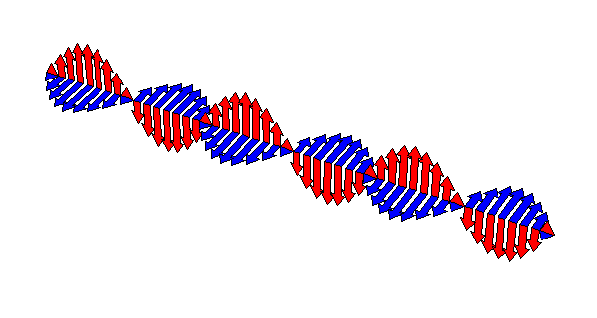
Transverse Waves Maxwell’s Theory of Electromagnetic Waves
A changing electric field creates a magnetic field, which then changes in just the right way to recreate the electric field, which then changes in just the right way to again recreate the magnetic field, and so on.
This is an electromagnetic wave.
It travels at 300,000 km/s.

Slide 16
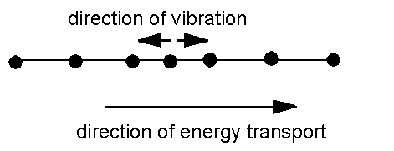
Longitudinal waves
Medium vibrates parallel to direction of energy transfer
Backward and forward movement consists of
compressions (wave compressed)
rarefactions (stretched region between compressions)
Example: sound waves in solid, liquid, gas
[image from http://www.maths.gla.ac.uk/~fhg/waves/waves1.html ]

Slide 17
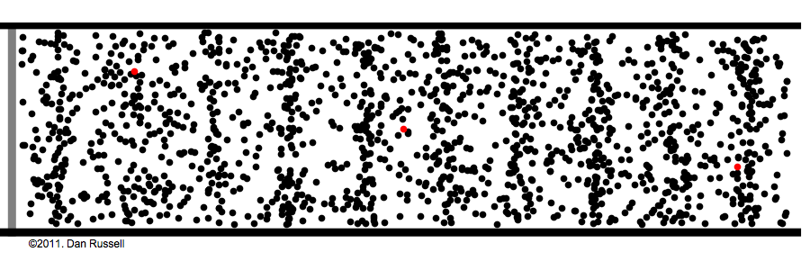
Longitudinal Waves
Sound is a longitudinal wave.
Compression regions travel at the speed of sound.
In a compression region, the density and pressure of the air is higher than the average density and pressure.

Slide 18
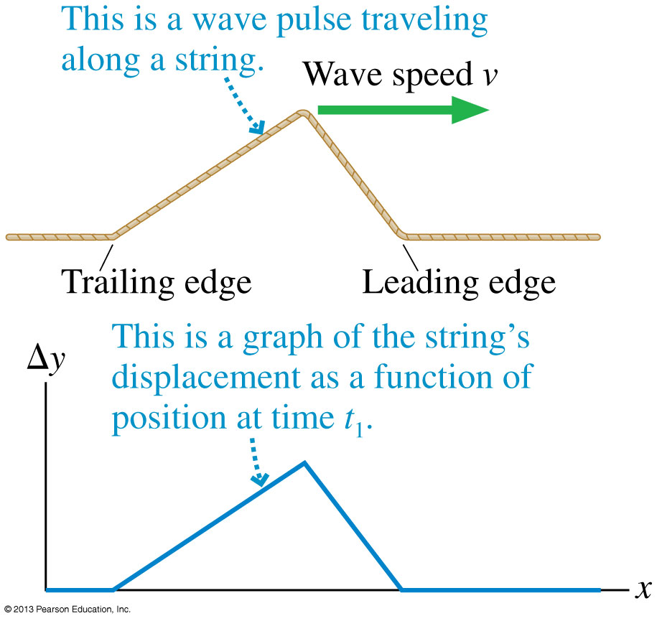
Snapshot Graph
A graph that shows the wave’s displacement as a function of position at a single instant of time is called a snapshot graph.
For a wave on a string, a snapshot graph is literally a picture of the wave at this instant.

Slide 19
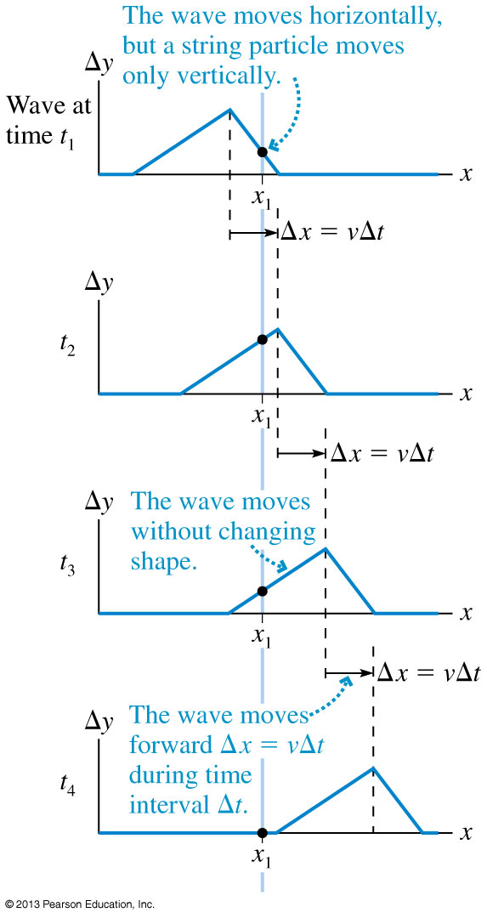
One-Dimensional Waves
The figure shows a sequence of snapshot graphs as a wave pulse moves.
These are like successive frames from a movie.
Notice that the wave pulse moves forward distance Δx = vΔt during the time interval Δt.
That is, the wave moves with constant speed.

Slide 20
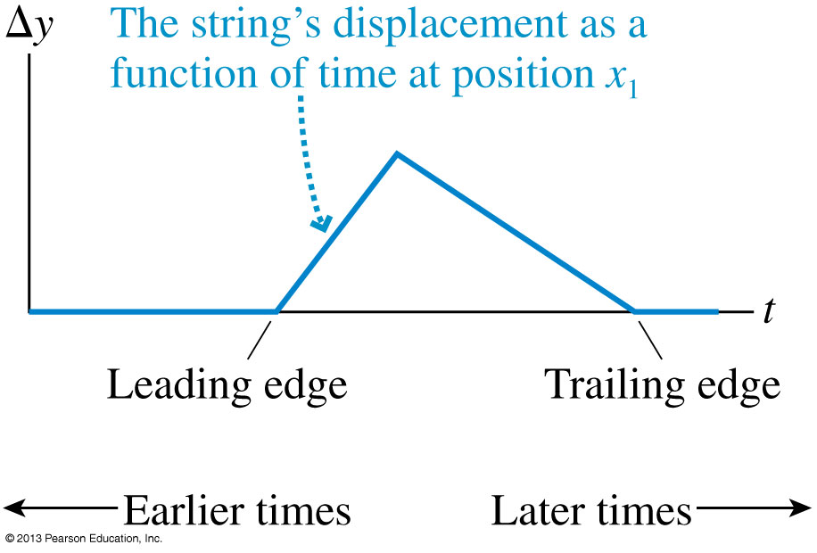
History Graph
A graph that shows the wave’s displacement as a function of time at a single position in space is called a history graph.
This graph tells the history of that particular point in the medium.
Note that for a wave moving from left to right, the shape of the history graph is reversed compared to the snapshot graph.

Slide 21
The Mathematics of Sinusoidal Waves
$y=A\cos{(kx−ωt)}$ is a sinusoidal wave traveling in the +x direction.
$y=A\cos{(kx+ωt)}$ is a sinusoidal wave traveling in the −x direction.
The angular frequency of the wave is omega:
The wave number of the wave is k:
This wave travels at a speed: $v=\frac{ω}{k}$.

Slide 22
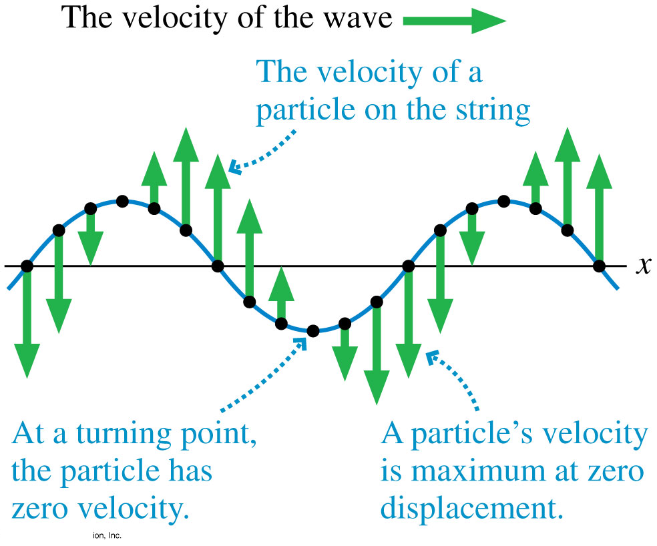
Wave Motion on a String
Shown is a snapshot graph of a wave on a string with vectors showing the velocity of the string at various points.
As the wave moves along x, the velocity of a particle on the string is in the y-direction.
y
$$y=A\cos{(kx−ωt)}$$
$$v_{y}=\frac{∂y}{∂t}=Aω\sin{(kx−ωt)}$$

Slide 23
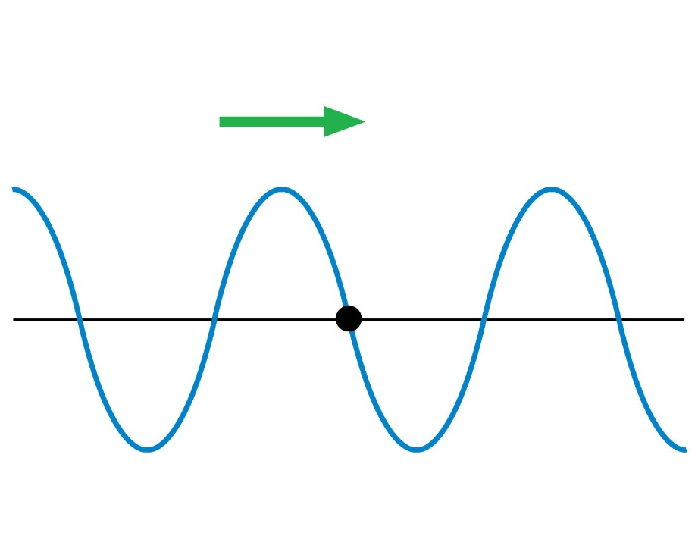
Learning Catalytics Question 4
A wave on a string is traveling to the right. At this instant, the motion of the piece of string marked with a dot is
Up.
Down.
Right.
Left.
Zero. Instantaneously at rest.
Notes:
23

Slide 24
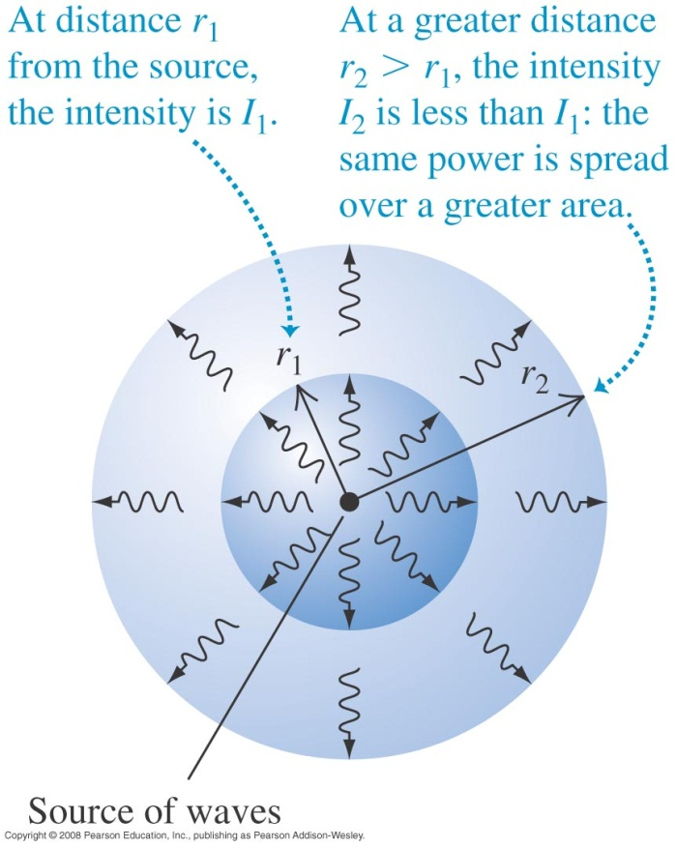
Wave intensity
The intensity of a wave is the average power it carries per unit area.
If the waves spread out uniformly in all directions and no energy is absorbed, the intensity I at any distance r from a wave source is inversely proportional to r².

Slide 25
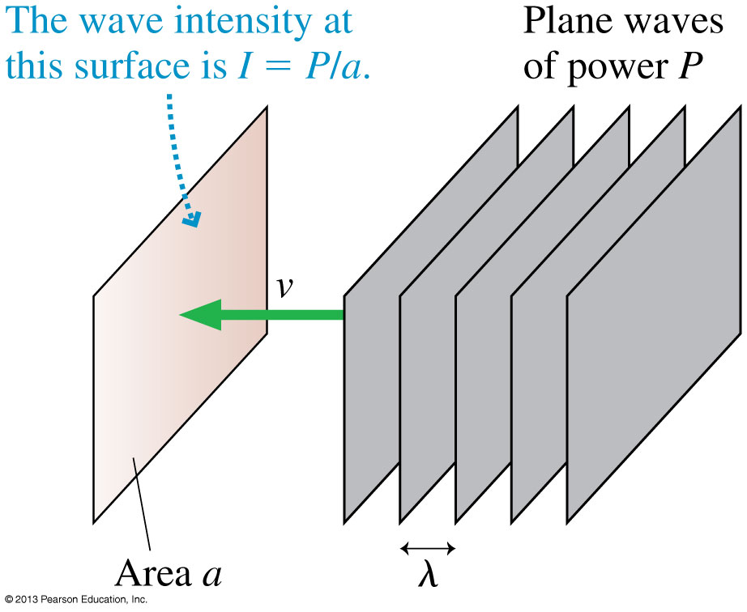
Power and Intensity
When plane waves of power P impinge on area a, we define the intensity I to be:

Slide 26
Example 20.9.
A laser pointer emits 1.0 mW of light power into a 1.0 mm diameter laser beam. What is the intensity of the laser beam?

Slide 27
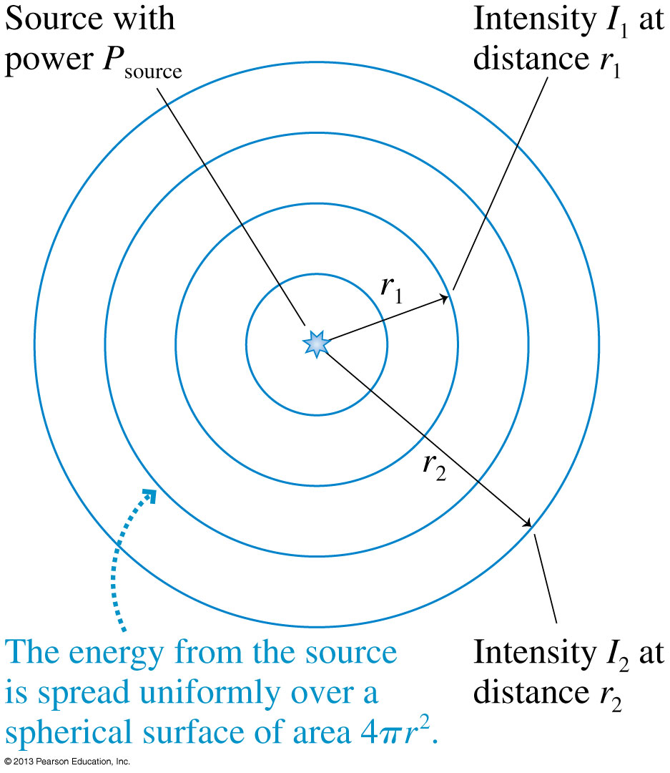
Intensity of Spherical Waves
If a source of spherical waves radiates uniformly in all directions, then the power at distance r is spread uniformly over the surface of a sphere of radius r.
The intensity of a uniform spherical wave is:

Slide 28
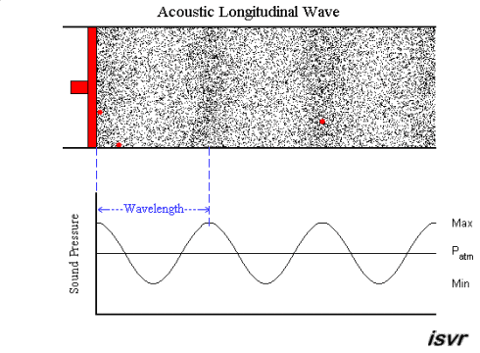
Sound Waves
A sound wave in a fluid is a sequence of compressions and rarefactions.
Animation from http://resource.isvr.soton.ac.uk/spcg/tutorial/tutorial/Tutorial_files/Web-basics-nature.htm

Slide 29
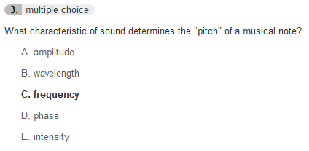
Pre-class 22 Quiz from This Morning

Slide 30
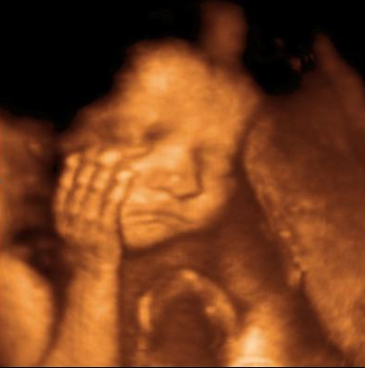
Sound Waves
For air at room temperature (20°C), the speed of sound is v_{sound} = 343 m/s.
Your ears are able to detect sinusoidal sound waves with frequencies between about 20 Hz and 20 kHz.
Low frequencies are perceived as “low pitch” bass notes, while high frequencies are heard as “high pitch” treble notes.
Sound waves with frequencies above 20 kHz are called ultrasonic frequencies.
Oscillators vibrating at frequencies of many MHz generate the ultrasonic waves used in ultrasound medical imaging.
Image from http://www.weblocal.ca/uc-baby-3d-ultrasound-brampton-on.html

Slide 31
Before Class 23 on Wednesday
If you haven’t done it, please check your utoronto email, respond to the course_evaluations email and evaluate us!
Please read up to the end of Section 14.7 of Chapter 14 on Waves, and/or watch the Preclass 23 Video
We are skipping section 14.8 on Doppler Shift for this course.
Something to think about over the weekend:
What is a “Standing Wave”?
NOTE: We will be meeting right here, 11:10am-12:00pm on Thursday for the last class of the semester!

