Slide 1
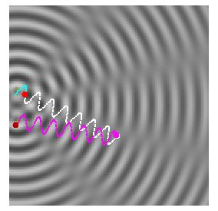
PHY131H1F - Class 23
Today:
Sound Wave Intensity and the decibel system
Wave Interference: The Principle of Superposition
Constructive and Destructive Interference
Beats
Reflection and Refraction
Standing Waves
Musical Instruments

Slide 2
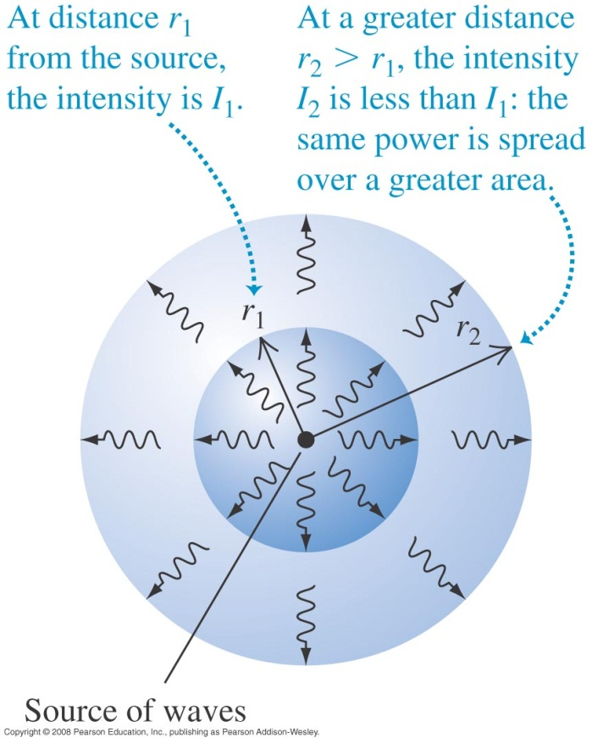
Wave intensity
The intensity of a wave is the average power it carries per unit area.
If the waves spread out uniformly in all directions and no energy is absorbed, the intensity I at any distance r from a wave source is inversely proportional to r².

Slide 3
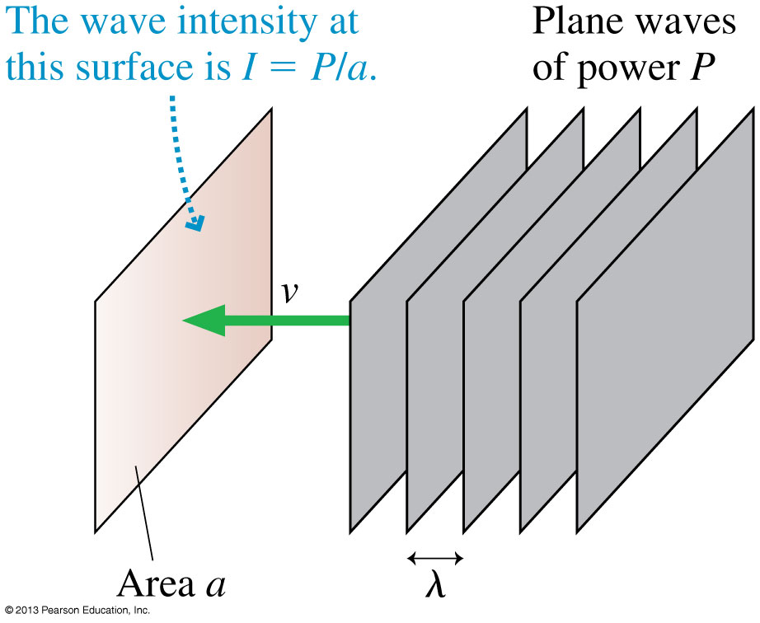
Power and Intensity
When plane waves of power P impinge on area a, we define the intensity I to be:

Slide 4
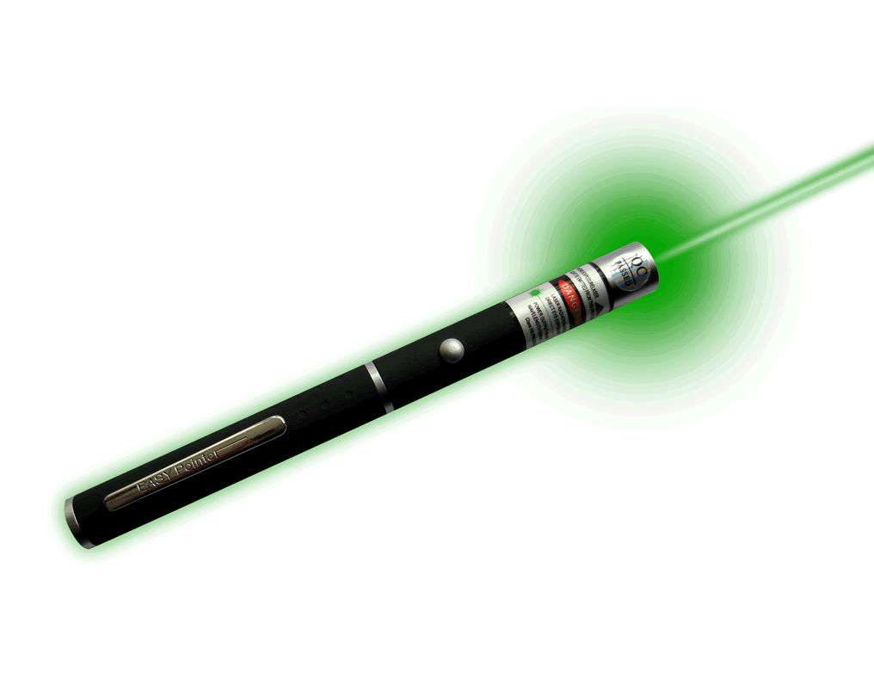
Example 20.9.
A laser pointer emits 1.0 mW of light power into a 1.0 mm diameter laser beam. What is the intensity of the laser beam?

Slide 5
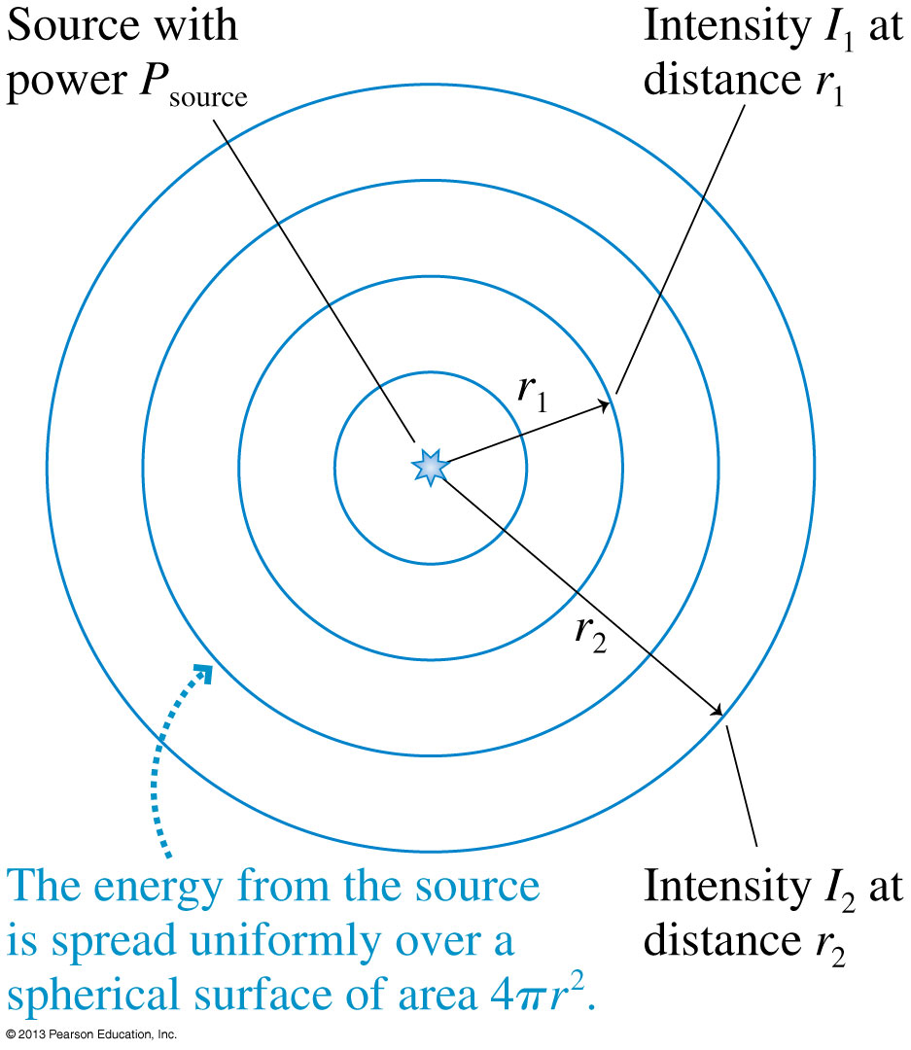
Intensity of Spherical Waves
If a source of spherical waves radiates uniformly in all directions, then the power at distance r is spread uniformly over the surface of a sphere of radius r.
The intensity of a uniform spherical wave is:

Slide 6
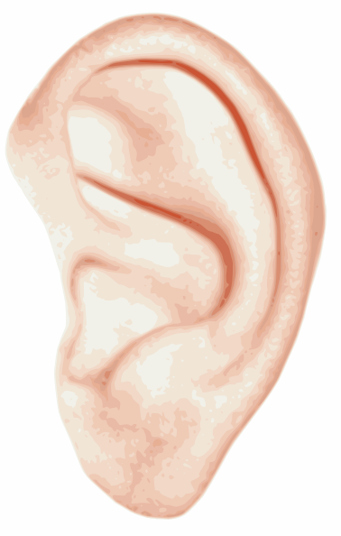
Intensity and Decibels
Human hearing spans an extremely wide range of intensities, from the threshold of hearing at ≈ 1 × 10⁻¹² W/m² (at midrange frequencies) to the threshold of pain at ≈ 10 W/m².
If we want to make a scale of loudness, it’s convenient and logical to place the zero of our scale at the threshold of hearing.
To do so, we define the sound intensity level, expressed in decibels (dB), as:
where I₀ = 1 × 10⁻¹² W/m².

Slide 7
Sound Intensity Levels – Representative Values
Source | Sound Intensity Level, β (dB) | Intensity, I (W/m²)
Military jet aircraft 30 m away | 140 | 10²
Threshold of pain | 120 | 1
Elevated train | 90 | 10⁻³
Busy street traffic | 70 | 10⁻⁵
Quiet radio in home | 40 | 10⁻⁸
Average whisper | 20 | 10⁻¹⁰
Threshold of hearing at 1000 Hz | 0 | 10⁻¹²

Slide 8
Learning Catalytics Question
A sound level of 10 decibels has 10 times more intensity than a sound level of zero decibels.
A sound level of 20 decibels has ___ times more intensity than a sound level of zero decibels.
10
20
50
100
200

Slide 9
Learning Catalytics Question
When you turn up the volume on your ipod, the sound originally entering your ears at 50 decibels is boosted to 80 decibels. By what factor is the intensity of the sound has increased?
1 (no increase)
30
100
300
1000

Slide 10
Waves in Two and Three Dimensions
The Principle of Superposition
If two or more waves combine at a given point, the resulting disturbance is the sum of the disturbances of the individual waves.
$$y=y_{1}+y_{2}$$

Slide 11
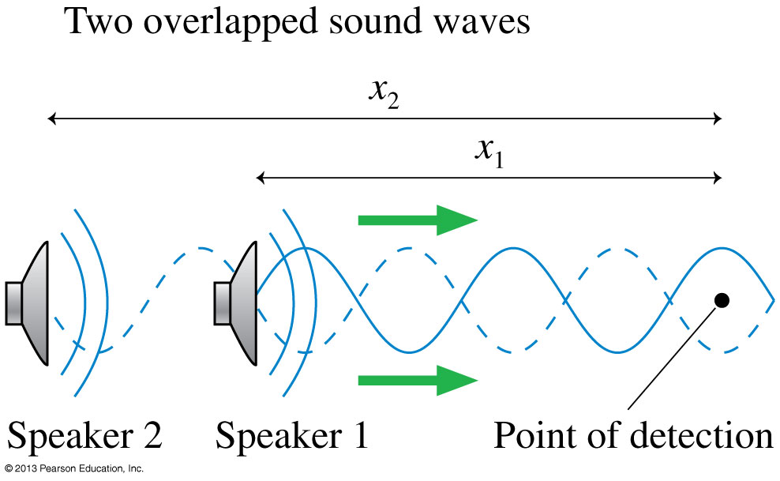
Wave Interference
The pattern resulting from the superposition of two waves is called interference. Interference can be
constructive, meaning the disturbances add to make a resultant wave of larger amplitude, or
destructive, meaning the disturbances cancel, making a resultant wave of smaller amplitude.

Slide 12
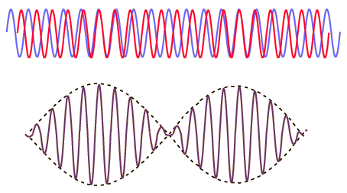
Beats
Periodic variations in the loudness of sound due to interference
Occur when two waves of similar, but not equal frequencies are superposed.
Provide a comparison of frequencies
Frequency of beats is equal to the difference between the frequencies of the two waves.
[image from http://hyperphysics.phy-astr.gsu.edu/hbase/sound/beat.html ]

Slide 13
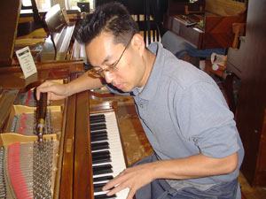
Beats
Applications
Piano tuning by listening to the disappearance of beats from a known frequency and a piano key
Tuning instruments in an orchestra by listening for beats between instruments and piano tone

Slide 14
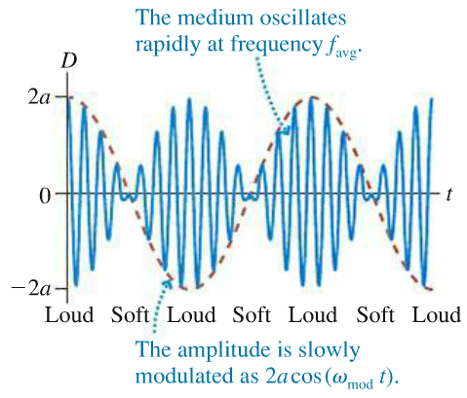
Beats
The amplitude is slowly modulated with a frequency f_{mod} = (f₁−f₂)/2 (red-dashed line)
Beats are heard at f_{beat} = 2f_{mod} = f₁−f₂

Slide 15
The tension in each of two strings is adjusted so that both vibrate at exactly 666 Hz. The tension in one of the strings is then increased slightly. As a result, six beats per second are heard when both strings vibrate. What is the new frequency of the string that was tightened?
Preclass question from this morning
Notes:
B. downward.

Slide 16
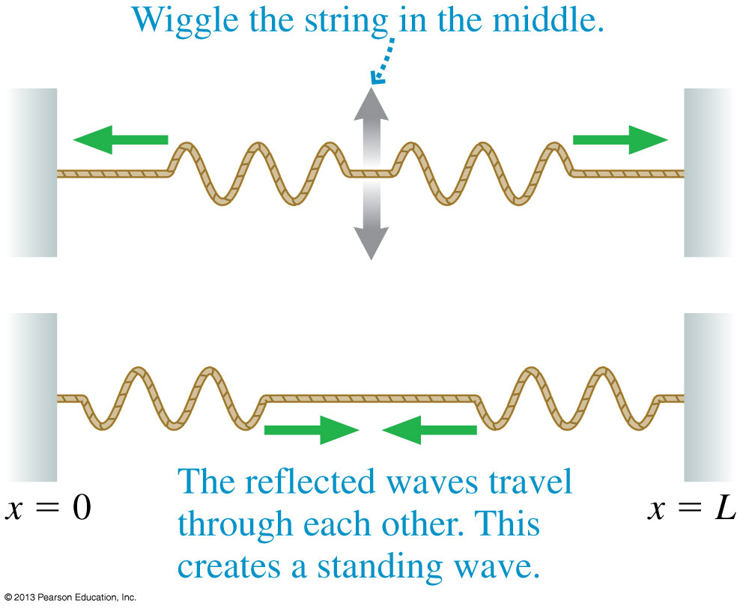
Standing Waves on a String
Reflections at the ends of the string cause waves of equal amplitude and wavelength to travel in opposite directions along the string, which results in a standing wave.

Slide 17
The Mathematics of Standing Waves
According to the principle of superposition, the net displacement of a medium when waves with displacements D_{R} and D_{L} are present is
We can simplify this by using a trigonometric identity, and arrive at:
where
For a standing wave, the pattern is not propagating!

Slide 18
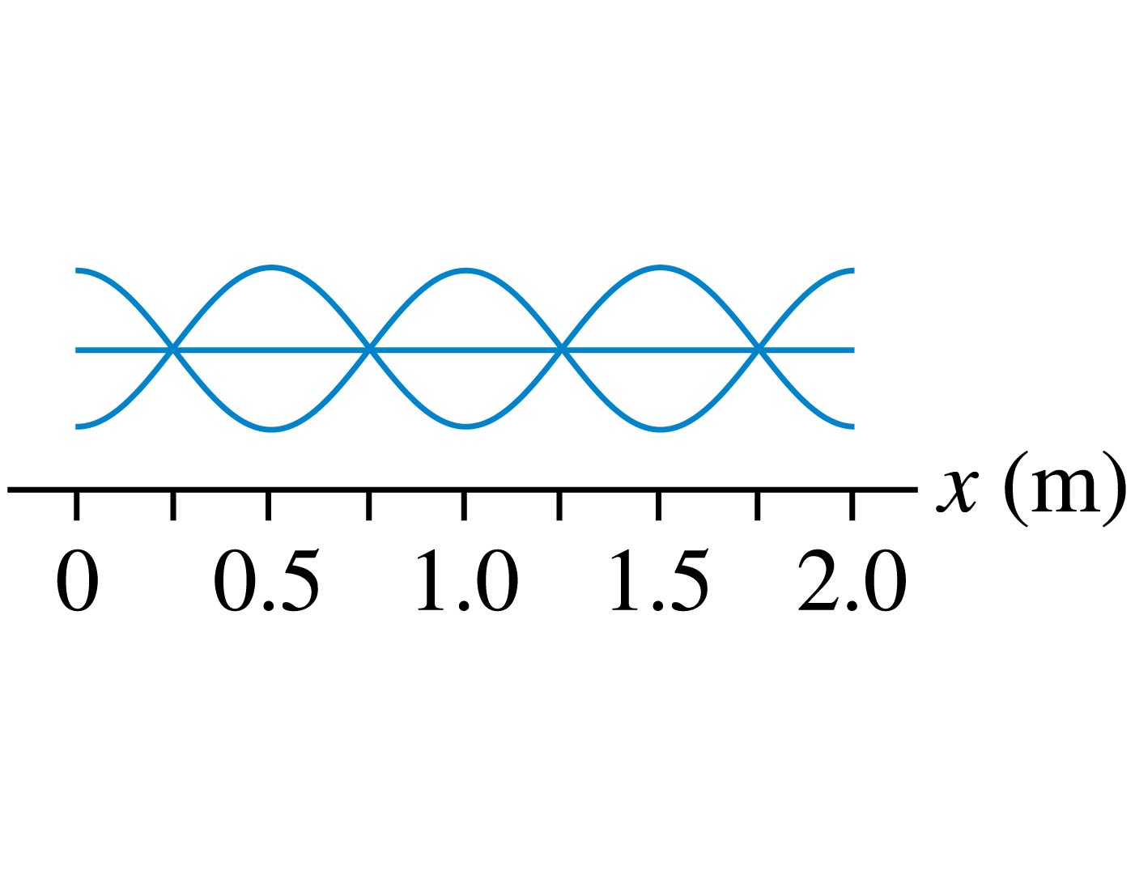
QuickCheck 21.3
Learning Catalytics Question
What is the wavelength of this standing wave?
0.25 m.
0.5 m.
1.0 m.
2.0 m.
Standing waves don’t have a wavelength.
Notes:
18

Slide 19
Node Spacing on a String

Slide 20
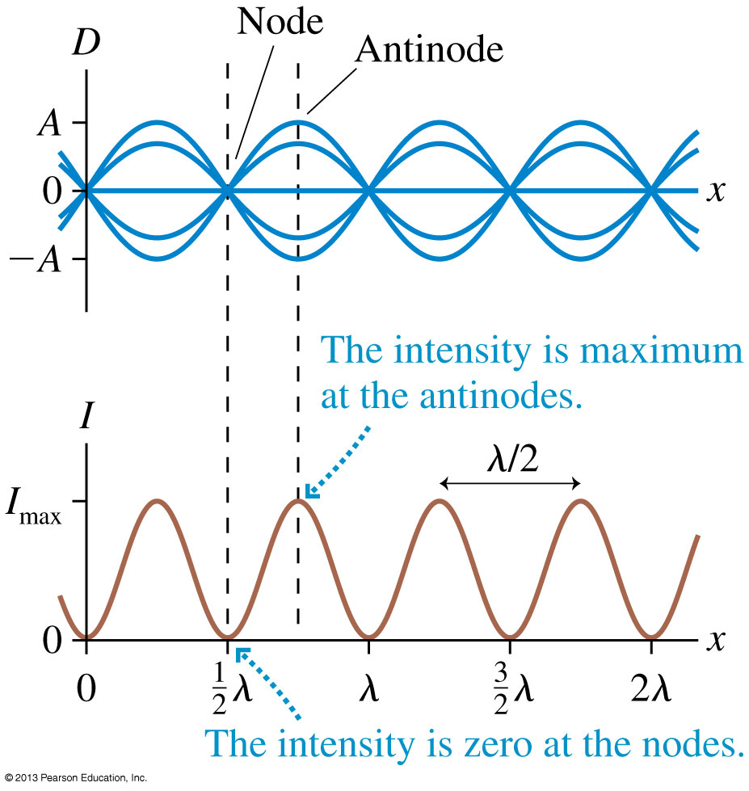
Standing Waves
Recall that the intensity of a wave is proportional to the square of the amplitude: I ∝ A².
Intensity is maximum at points of constructive interference and zero at points of destructive interference.

Slide 21
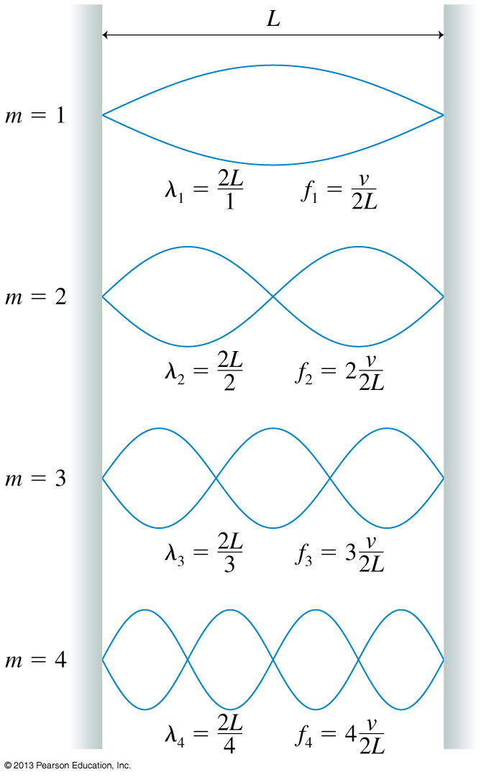
On a string of length L with fixed end points,
Only oscillations with specific wavelengths are allowed.
m is called the mode number
m = 1 is the “fundamental”.
m = 2 is the “second harmonic”

Slide 22
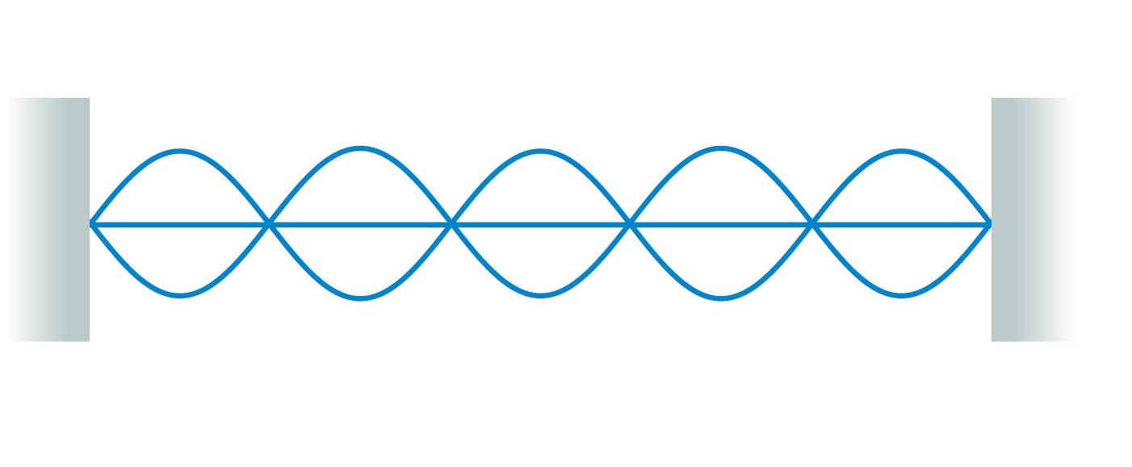
QuickCheck 21.4
Learning Catalytics Question
What is the mode number of this standing wave?
Notes:
22

Slide 23
Standing Waves on a String
There are three things to note about the normal modes of a string:
m is the number of antinodes on the standing wave.
The fundamental mode, with m = 1, has λ₁ = 2L.
The frequencies of the normal modes form a series: f₁, 2f₁, 3f₁, …These are also called harmonics. 2f₁ is the “second harmonic”, 3f₁ is the “third harmonic”, etc.

Slide 24
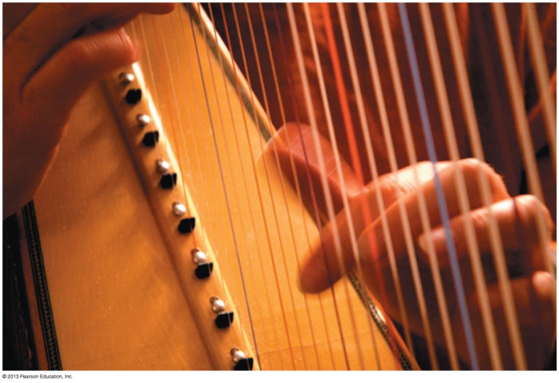
Musical Instruments
Instruments such as the harp, the piano, and the violin have strings fixed at the ends and tightened to create tension.
A disturbance generated on the string by plucking, striking, or bowing it creates a standing wave on the string.
The fundamental frequency is the musical note you hear when the string is sounded:
$$f_{1}=\frac{v}{2L}=\frac{1}{2L}\sqrt{\frac{F}{μ}}$$
where F is the tension in the string and μ is its linear density.

Slide 25
Preclass question from this morning

Slide 26
Class 24 (last class) is Tomorrow!
No Pre-Class Video or Pre-Class quiz
Homework 11 on Chapter 14 is for practice for the final exam – it’s not worth marks but I suggest you try it anyway for studying
If you haven’t done it, please check your utoronto email, respond to the course_evaluations email and evaluate us!
We are skipping section 14.8 on Doppler Shift for this course.
Tomorrow my plan is finish up to section 14.7, then I will do some course review and give some advice about the final exam.
Professor Wilson and I will be giving back-to-back “Exam Jam” sessions on Friday from 1:00-3:00pm in SS2117. I have posted slides Exam Jam on my site with the other slides, and I will post any written notes from Exam Jam on the portal after Friday.

