Slide 1
Exam Jam PHY131 – 2nd Half – Dec. 8, 2017

Slide 2
Exam Jam PHY131 – 2nd Half – Dec. 8, 2017

Slide 3
Exam Jam PHY131 – 2nd Half – Dec. 8, 2017

Slide 4
Exam Jam PHY131 – 2nd Half – Dec. 8, 2017

Slide 5
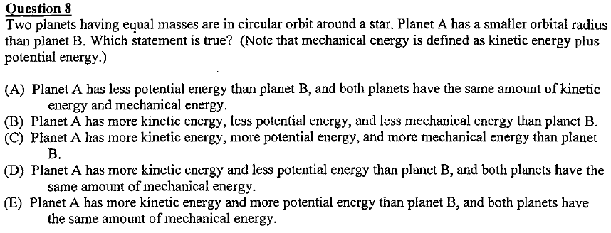
Exam Jam PHY131 – 2nd Half – Dec. 8, 2017

Slide 6
Exam Jam PHY131 – 2nd Half – Dec. 8, 2017

Slide 7
Exam Jam PHY131 – 2nd Half – Dec. 8, 2017

Slide 8
Exam Jam PHY131 – 2nd Half – Dec. 8, 2017

Slide 9
Exam Jam PHY131 – 2nd Half – Dec. 8, 2017

Slide 10
Exam Jam PHY131 – 2nd Half – Dec. 8, 2017

Slide 11
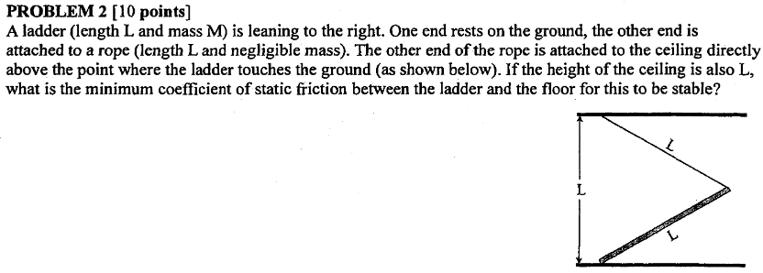
Exam Jam PHY131 – 2nd Half – Dec. 8, 2017

Slide 12
Exam Jam PHY131 – 2nd Half – Dec. 8, 2017

Slide 13
Exam Jam PHY131 – 2nd Half – Dec. 8, 2017

Slide 14
Exam Jam PHY131 – 2nd Half – Dec. 8, 2017

