Slide 1
Being an effective Physics TA
5 September 2018
CJ Woodford
Deepak Chandan
Notes:
A couple notes:
- please interrupt and ask questions throughout our talks!
- this talk will be online: don’t worry about writing anything down

Slide 2
outline
Part I: Role of a TA
Part II: University Policies
Part III: Grading
Part IV: Teaching Tips and Tricks
Part V: Support & Resources

Slide 3
Introductions
Deepak chandan
CJ Woodford
(he/him)
PhD Physics, Sept 2018, (Geophysics, Climate Dynamics, Atmospheric Physics) Prof. Peltier’s group
TA in the Dept. of Physics since 2010
TA for 9 courses across two campuses
Ph.D. candidate, Prof. Murray’s research group + Gravity Group
TA in the Dept. of Physics since 2015

Slide 4
Survey: Do you already have teaching experience?

Slide 5
Part I: Role of a ta

Slide 6
WHAT IS YOUR PURPOSE AS A TA?
Approachable source of help
Share experiences
Insights
Convey the “big picture”
Still remember being in undergrad
Demonstrate high-quality thinking
Model professionalism
Notes:
Ugh…. I don’t like this slide!

Slide 7
Qualities of a great ta
Enthusiastic
Knowledgeable
Motivated
Organized
Patient
Available
Adaptable
Trustworthy
Empathetic
Proactive

Slide 8
Teachers as role models
Set the tone & expectations
Be organized
Be consistent and honest
Be firm in expectations, deadlines, etc.
Be flexible as needed (professional judgement)
Show enthusiasm
Strive to build a good rapport with students
Demonstrate quality thinking

Slide 9
What’s in it for you?
Money…
Opportunity to really understand something well
Career development (looks good on resume)
Speaking skills
Teaching skills
Build relationships with other people, helps expand your network
Resist the temptation of being ”bought out” of TA work by your supervisor in upper years if you don't want to - do what's right for you!

Slide 10
Common teaching concerns for new TAs
Being effective at teaching
Planning tutorial lessons
Classroom management
Maintaining personal and professional boundaries
Grading fairly
Not being able to answer questions
Dealing with plagiarism and academic integrity

Slide 11
Communicating with Course Instructor
Set (realistic) Expectations
Determine the course focus & outcomes
Identify your duties and responsibilities
(& time allocated for them)
Establish communication methods: email? Meetings?
Mid-term Review
Discuss time/work and job performance
Common student issues
Discuss midterm exam (marking scheme)
Feedback
Evaluations from students
Reflect on course: what was effective? What could be improved?
Notes:
Leave in but only read the bold!

Slide 12
Teaching assistant jobs
Traditional tutorial leader
Demonstrator for upper year labs
First-year practicals demonstrator
Marker

Slide 13
Tutorials
Interactive and participatory classroom sessions.
TAs gauge student understanding and provide feedback, in line with assessment guidelines set by the instructor.
Answer questions on lecture topics
Review course material
Work on specific problems and skills
Help with assignments
Quizzes
Tip: In general, don’t hand back work at the start of a class. It will consume students’ attention.

Slide 14
Labs
Teaching experimental skills
Second year and up
Problem solving
Tangible application and proof of theory
Science history: re-create classic experiments
Monitor student work
Ensure lab safety and protocols are followed
Provide feedback
Tip: investigating instrument problems can open up opportunities (“teachable moments”) for learning.

Slide 15
Practicals
A mix of a tutorial and a lab
For first year undergrads only
Students learn theoretical concepts and experimental skills through hands-on activities
Research shows students learn more effectively through participation
Work in small groups
“Tell me and I forget. Show me and I remember. Involve me and I understand." - various attributions
Notes:
Photo from the Undergraduate program webpage of the Physics Dept. website

Slide 16
One-on-one tutoring
Office hours: for students to drop by and ask questions
Or they can make an appointment
Challenge: how to start helping when a student doesn’t arrive with specific questions.
Try to narrow down goals for a meeting to one or two key topics to cover.
Suggest strategies for studying & follow-up actions
You can’t charge students for private tutoring in the course you are a TA in for extra tutoring (conflict of interest, unethical)
There are plenty of under-used opportunities for students to get help: TA & Professors’ office hours, Drop-in Centre, writing centers
Notes:
This will happen right before tests if a student panics and thinks he/she "knows nothing", in which case it helps to be able to boil down with the student what the key take-home messages are

Slide 17
Physics drop-in Centre
Undergrads can stop by during Drop-In Centre hours and ask questions to a TA
Focused on first-year classes (mostly PHY131)
If an advanced undergrad student drops by hoping for help, and you don’t know the material, that’s OK.
Encourage students to use it!

Slide 18
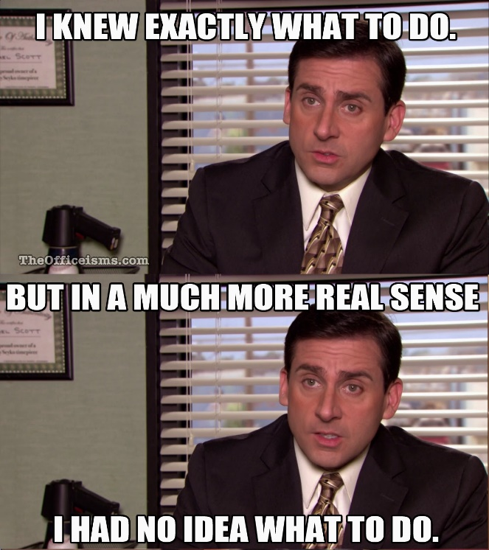
Proactively Check student understanding
Avoid the temptation to think silence & nods indicate students understand.
During practicals & labs, engage student groups. Sometimes, students *think* they’re fine when they aren’t.
Don’t be afraid to be nosy!

Slide 19
Will students remember?

Slide 20
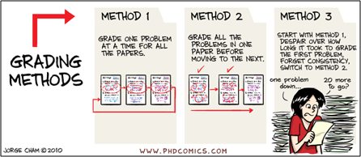
Grading
Evaluation informs students and TAs what they understand
Keep a personal record of grades (e.g. in addition to Quercus – never too safe!)
Marking is more than assessment and formal evaluation: it’s a critical opportunity for feedback that guides learning
Notes:
Be careful about what goes in your records and how well protected they are – keep sensitive information safe or just don’t include it (ie. Student number, grades, etc)

Slide 21
Quercus
A tool for communication between instructors, teaching assistants and students
Send emails to groups of students
Course announcements are posted
Online discussion board
Access to uploaded course documents
Grade book recording and tabulation
Online testing and assignment submission
Quercus: Latin for oak tree. Continues UofT’s obsession with oak

Slide 22
preparation
“Before anything else, preparation is the key to success.”
– Alexander Graham Bell
Give thought to each session:
What should students specifically learn?
Where might students have difficulty?
How will you help students build understanding?
Labs and practicals challenge students in both theoretical knowledge and experimental skills: perform experiments yourself before guiding students
Find a lesson planning format that works for you – it doesn't have to be formal!
Notes:
AGB quote quoted in Sophia's Fire (2005) by Sango Mbella, p. 133.

Slide 23
Your first class
Arrive early & check room for any complications
Write your contact information on the board/slide
Introduce yourself
Use an icebreaker to get students talking to you and each other
Explain how the sessions will run
Leave time for questions

Slide 24
set expectations on the first day
Be clear about how students should communicate with you: email? In person? Blackboard?
How long it will take you to respond.
How students submit work.
Explain the reasons for how you do things…
“I do not respond to emails the night before a mid-term because…”
Notes:
It’s more important to be fair than to over-promise what you can’t deliver. E.g. 10 students emailing you at 10 pm the night before the test.
SETTING POLICIES DURING THE FIRST CLASS WILL HELP SAVE TIME & CONFUSION THROUGHOUT THE SEMESTER

Slide 25
Part II: University policies

Slide 26
TA policies:
Code of Behaviour on Academic Matters
http://www.governingcouncil.utoronto.ca/policies/behaveac.htm
Code of Student Conduct
http://www.governingcouncil.utoronto.ca/Asset4733.aspx?method=1
Freedom of Information and Protection of Privacy
http://www.provost.utoronto.ca/policy/fippa.htm

Slide 27
Areas of responsibility
Respecting confidentiality
Avoiding conflict of interest
Safeguarding the learning environment
Upholding academic integrity

Slide 28
Respecting confidentiality
You have access to sensitive information
As an education professional, you are trusted to keep student information confidential
Avoid putting grades on front page where it is easy for others to see
Don’t identify individual students when discussing challenges or strategies with others (for example, when discussing mistakes in assignments in front of a classroom)
Don’t leave marked tests and assignments out – not on your desk, not in the hallway! This goes for labbooks too.
Encrypt your documents that have sensitive info

Slide 29
Safeguarding the learning environment
Policies:
Code of Student Conduct
Ontario Human Rights Code
Policy on Sexual Harassment
Policy on Appropriate Use of Information Technology
Accessibility for Ontarians with Disabilities Act
Where to go and what to do:
Campus police: (416) 978-2222
Student crisis response: (416) 946-7111
Equity offices on campus: Community Safety; Anti-racism and Cultural Diversity; Sexual and Gender Diversity; Sexual Harassment Office
Notes:
Also connects with relationships with students. Dan can offer story about Teacher’s College training on meeting opposite-sex students one-on-one.
If you’re particularly nervous or concerned, there are also a number of TATP free workshops that cover how to handle stressful situations with students.

Slide 30
Academic integrity
violations
Intellectual honesty
Appropriate use of information
Accurate citation and referencing (a problem for essay-type questions)
Awareness of and adherence to strict academic principles and values
Plagiarism
Impersonation
Copying
Cheating
Purchased essays
Reusing materials from other courses
Misuse of digital sources
www.utoronto.ca/academicintegrity
www.writing.utoronto.ca/advice/using-sources/how-not-to- plagiarize

Slide 31
academic integrity (cheating)
Do not take action independently
Do not tell the student you suspect plagiarism
Do not return any papers
Stop marking once you realize there might be an academic offense
Refer the problem to the instructor, who will follow U of T protocols
Assist the instructor by investigating if asked
It is an academic offence to not report cheating
Notes:
Dan has stories about students pressing him for information about why an assignment didn’t get returned with everyone else’s.
Image is from The Atlantic: http://www.theatlantic.com/national/archive/2012/03/investigation-finds-suspicious-achievement-in-schools-across-the-nation/255105/

Slide 32
Identifying cheating
You’ll get to know your student’s style and quality of work.
Watch for abrupt change in quality: of a single answer or an entire assignment
Out of place sentences/passages that appear copied from another source (try Googling it)
Exact or very close wording to other students
Exact same typos and mistakes

Slide 33
Part III: marking

Slide 34
Fairness in Grading
Cover or ignore names before/while grading to guard against bias
Avoid grading while in a tired/negative emotional state
Be consistent, mark all the students in the same way
Rubrics help with this
Helps to mark one question for all students, then move to next question
When done one question, review the first few papers you marked to make sure you were consistent
Consistency is very important in multi-TA courses (ask other TAs how they approached difficult situations and reach consensus)
Read a few (~10) papers first to get a feeling for how students approached the problem (this “temperature check” helps “normalizing” the grading scheme if need be)

Slide 35
Rubrics
Method of marking which:
Increases efficiency since you know what you’re looking for and how much it’s worth
Ensures consistency and fairness
Justifies grade decisions
Helps students understand expectations and evaluate their own work

Slide 36
Grading: disputes
Students are students – they WILL argue about grades
Do NOT comment on grading issues if you weren’t the marker – refer the student to the course instructor or marker. Listen respectfully and openly to student concerns
Encourage students to discuss why they got their mark – it’s an opportunity to help them identify misunderstandings
Feedback and comments should help remind you why you graded as you did
Use of a standard rubric can help justify grades
If you can’t resolve a dispute, discuss the issue with the course instructor
Notes:
(be careful about what you say regarding a grade dispute, otherwise, your word might be used against you!)

Slide 37
Part IV: teaching tips and strategies

Slide 38
Each class has its own character & challenges
Why are students in the course
What they are getting out of lectures
How do they learn best
Background knowledge & understanding
English language barriers
Get to know your students!

Slide 39
timing
It can be tough to plan the right amount of material for a session
Aim to cover 1-3 critical skills/ideas
Create opportunities to be adaptable
Try to build your lesson plan in modules: enable yourself to drop/add parts because of the flow of the session.
Think about how you would have liked to be taught that subject as a student to identify where to spend more time.
Notes:
Only relevant for proper tutorials; might not be immediate concern for most of the students right now who would be generally doing PHY131

Slide 40
When you don’t know the answer
RELAX! It’s not the end of the world!
Ensure you understand the question
Commit to finding out what the answer is and get back to the student
If you are in front of a class, there is no shame in turning the hunt for an answer into a group effort!
Physicists are like physicians: there are specialists because there’s too much for one person to know everything!

Slide 41
Reflection and iteration
After each class/lab/practical, reflect on what went well or not
Apply new ideas about how to be effective to the next time you teach and share insights with others
Learning to teach is a continuous process

Slide 42
Designing questions to ask students
Be mindful of implying there is a singular “right” answer
Ask a variety of question types
Encourage participation
Probe for intuition, partial understanding, & logic
Aim to ask questions that prompt students to show their understanding

Slide 43
Teaching tips: leave space for answers
Ensure you leave time for students to think about the question you asked
Try not to answer your own questions
Be comfortable standing in front of a class in a few seconds of silence
Make them comfortable and at ease (often, students are shy and scared of being wrong in front of others)

Slide 44
Class management: Potential challenges
Food & drink in labs
Teaching right before/after an exam or deadline
Inattentiveness (e.g. to instructions)
Not working constructively with group members
Creating excessive noise
Entering class late or leaving early
Use of phones (or computers) in the classroom
Disrespecting others’ rights to express their viewpoints

Slide 45
Listening
Listen carefully and attentively
Avoid pre-forming an answer or being too strict in how students should formulate their answer
Restate questions to confirm their understanding
Watch for signals of confusion in students (don’t talk to the board!)

Slide 46
Student questions
Encourage questions. There are many reasons students are reluctant to ask.
Make sure you understand the question
Paraphrasing may help with understanding
Ask them what part they don’t understand
Pause and reflect, to help form clear answers
Notes:
When a student asks a question, repeat the question first for the class.

Slide 47
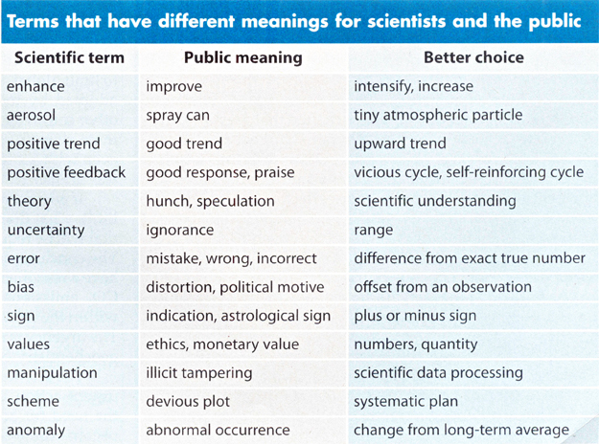
Choose words carefully
Be deliberate & precise in your choice of words
Your use of words is how students learn content
There are many basic terms which may not be understood by all students
E.g. precise vs accurate, error vs uncertainty
A table from “Communicating the Science of Climate Change” by Richard C. J. Somerville and Susan Joy Hassol, October 2011 issue of Physics Today

Slide 48
Effective feedback: more than marking
Formal evaluation (e.g. assignments, tests)
Informal feedback is critical to “scaffolding” student learning
Checking up on lab groups during session (probe with targeted questions)
Answering questions (e.g. tutorials, one-on-one meetings, etc.)

Slide 49
Classroom presence
Be aware, receptive and responsive to the mental, emotional, and physical state of students in the learning environment
Fostering a good relationship between you and students facilitates student learning

Slide 50
Helping with experiments
“Something isn’t working!”
It’s tempting to fix equipment or adjust it to ensure a smooth lab experience. Resist.
“Teachable moment”
Notes:
Dan has a good story to fit here: making clouds in the jar demonstration for a high school class last year

Slide 51
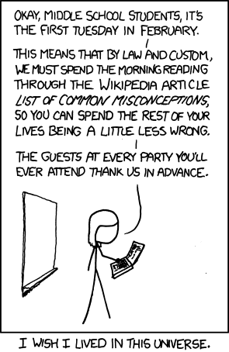
Teaching tips: misconceptions
It’s important to reflect and investigate what misconceptions and misunderstandings your students have.
Try to understand where your students are starting from
Misconceptions are what students think is true but is not. They are a significant obstacle to understanding.

Slide 52
Identifying misconceptions
E.g. “friction always opposes motion” but that’s not quite right
“It [is not] what you don't know that gets you into trouble. It's what you know for sure that just [is not] so. - Mark Twain

Slide 53
Public speaking: everything matters
Become aware of the details
Your voice: volume, tone
Your eye contact
Choice of words
Body language
Enunciation
Confidence
There will be a more detailed talk in two weeks about public speaking.

Slide 54
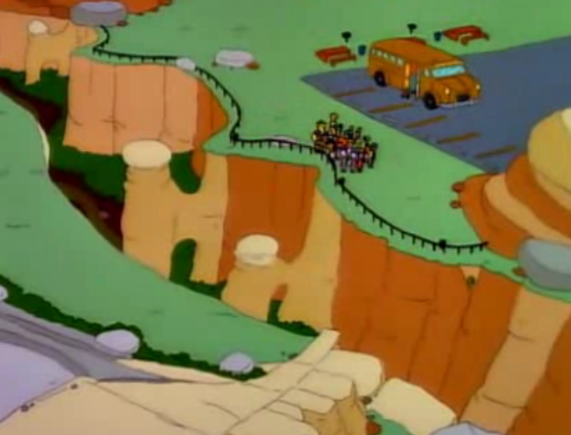
Teaching puts a new lens on the world
You may start to recognize opportunities for new examples to use in the classroom in a variety of places: everyday life, your research, etc.

Slide 55
Part V: Resources

Slide 56
Teaching support
Becoming an educator is a continuous process. You have plenty of support available:
Fellow TAs
Course instructors
Teaching Professors!
TATP
Other online resources

Slide 57
Perspectives
A few key points to remember:
There is no “one-size-fits-all” approach. Learn from your good experiences and mistakes.
You will develop your own teaching style as you go.
There are many opportunities offered by the department: find what suits you best.
See TAing as an opportunity to develop your teaching skills: something that will be useful for your future career!

Slide 58
Useful resources & Professional development

Slide 59
Reminder: TA training schedule
Week 1: Introduction to TAing
Week 2: Micro-teaching (short lessons)
Week 3: Public Speaking (lecture)
Week 4: Micro-teaching, part 2
(also: improvisation workshop Sept. 12!)

Slide 60
Questions?
Contacts:
Deepak Chandan: dchandan@atmosp.physics.utoronto.ca
CJ Woodford: woodford@cita.utoronto.ca
Prof. Jason Harlow: jharlow@physics.utoronto.ca
Acknowledgements & Thanks
Prof. Jason Harlow
TATP
Comics from: XKCD & PHD Comics

