Slide 1

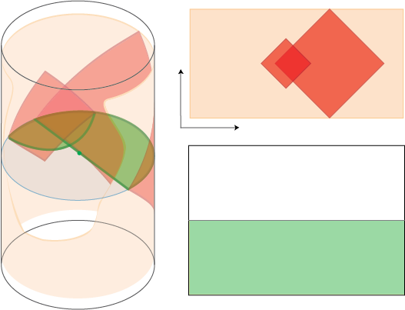
The Stereoscopic Holographic Dictionary
JAMES SULLY
B. Czech, L. Lamprou, S.McCandlish, B. Mosk, JS arXiv: 1604.03110
B. Czech, L. Lamprou, S.McCandlish, B. Mosk, JS arXiv: 1608.06282
B. Czech, L. Lamprou, S.McCandlish, JS Ongoing
(Related Work: de Boer, Haehl, Heller, Myers)
University of Toronto
November, 2016
Notes:
B. Czech, L. Lamprou, S.McCandlish, B. Mosk, JS arXiv: 160X.XXXX

Slide 2
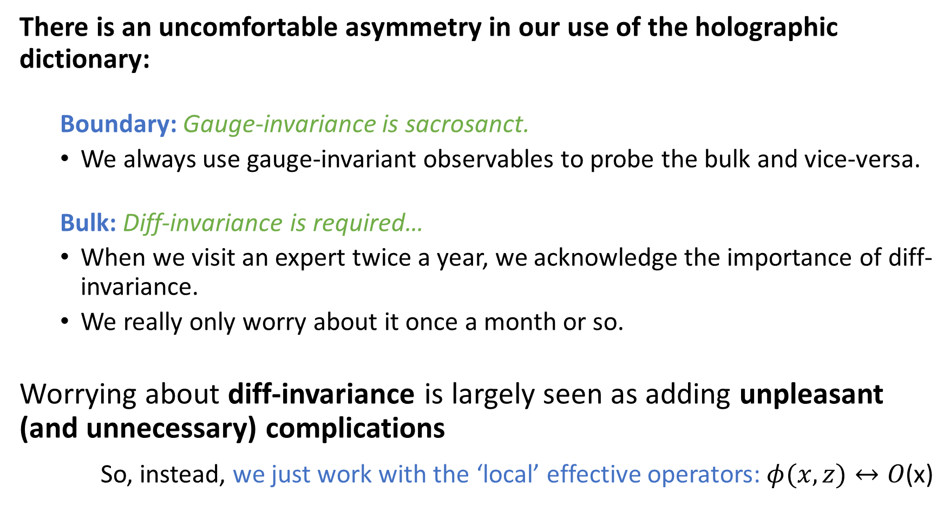
Motivation
There is an uncomfortable asymmetry in our use of the holographic dictionary:
  Boundary: Gauge-invariance is sacrosanct.
  We always use gauge-invariant observables to probe the bulk and vice-versa.
  Bulk: Diff-invariance is required…
  When we visit an expert twice a year, we acknowledge the importance of diff-invariance.
  We really only worry about it once a month or so.
Worrying about diff-invariance is largely seen as adding unpleasant (and unnecessary) complications
So, instead, we just work with the ‘local’ effective operators: $φ(x,z)↔O$(x)
in the same way that flossing is required.

Slide 3
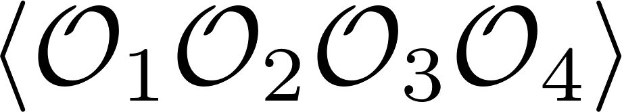



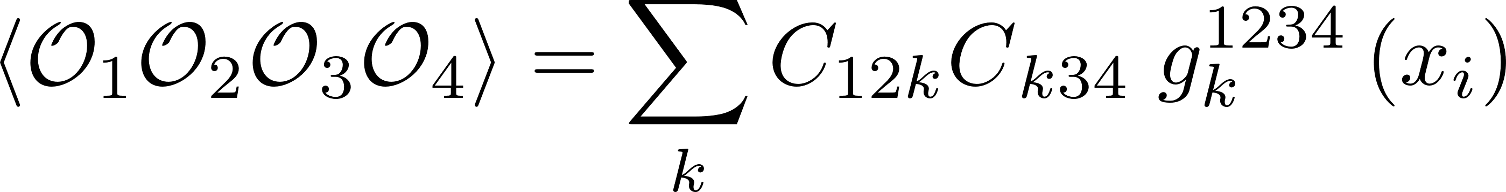
What has locality done for us lately?
Using these non-invariant effective observables is meant to be an easier way to do bulk calculations:
Gravity:
hard integrals …
CFT:
How do we compare?
Dynamical Parameters
Conformal Kinematics: All integrals hidden here!

Slide 4

Standard picture is much easier?
Not really....
… then, are diff-invariant (non-local) variables really that bad?
Aim of this talk: NO.
Questions:
What is an improved gauge/gravity dictionary that is gauge-invariant on one side and manifestly diff-invariant on the other?
Can we find a better connection to the natural CFT variables that make the OPE so simple?
Answer:
Stereoscopic Dictionary:
Surface Operators in AdS
(Non-local, diff-invariant)
$$↔$$
Partial Waves of the OPE
(building blocks of the OPE)

Slide 5
The Kinematic Dictionary
This will be a powerful framework. It brings together many familiar ideas in holography, including:
  The Entanglement First Law and Einstein’s Equations [Faulkner, Guica, Hartman, Lashkari, McDermont, Myers, Swingle, Van Raamsdonk]
  Geodesic Witten diagrams and conformal blocks [Hijano, Kraus, Perlmutter, Snively]
  The HKLL construction of interacting ‘local’ bulk fields [Hamilton, Kabat, Lifschytz, Lowe; Kabat, Lifschytz]
  de Sitter dynamics for the variations of EE [de Boer, Heller, Myers, Neiman]
  [Nozaki, Numasawa, Prudenziati, Takayanagi], [Bhattacharya, Takayanagi]
And I will show it’s importance is more than just a kinematic coincidence!

Slide 6
Outline
Lessons from Gauge Theory
Kinematic Space
OPE Blocks
Geodesic Operators
Applications
Ongoing Work
Our Work = General Dimensions
This Talk = 2D CFT / 3D Bulk
(… easier to draw pictures)

Slide 7
Lessons from Gauge Theories

Slide 8
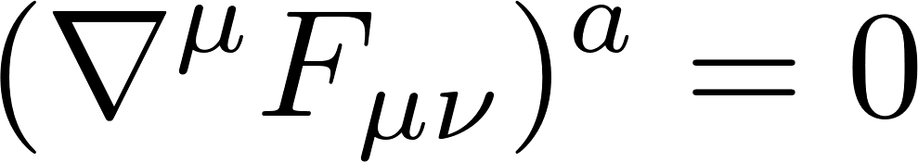
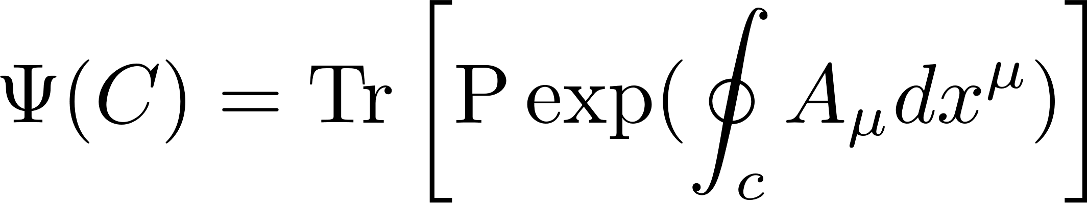
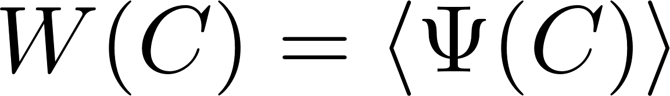
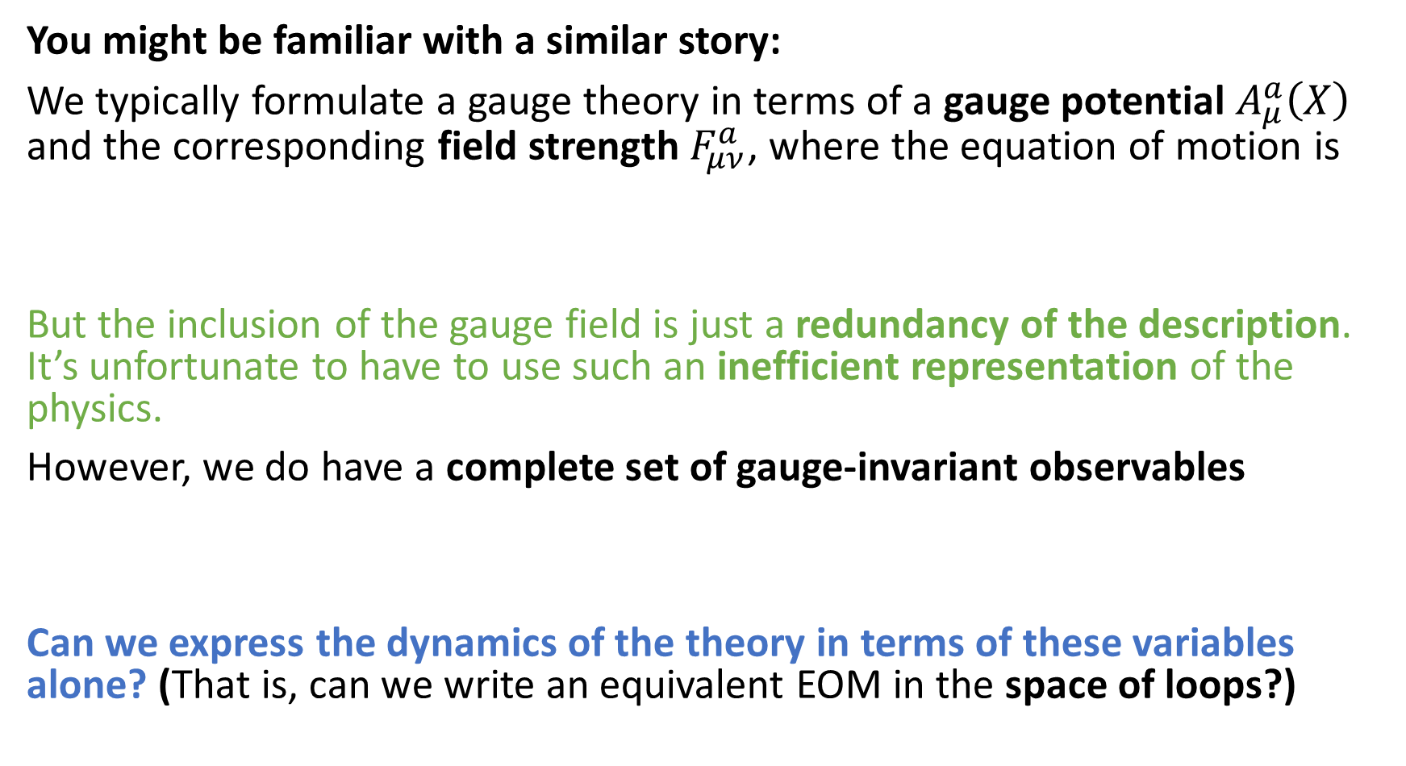
Lesson from gauge theories
You might be familiar with a similar story:
We typically formulate a gauge theory in terms of a gauge potential $A_{μ}^{a}\left(X\right)$ and the corresponding field strength $F_{μν}^{a}$, where the equation of motion is
But the inclusion of the gauge field is just a redundancy of the description. It’s unfortunate to have to use such an inefficient representation of the physics.
However, we do have a complete set of gauge-invariant observables
Can we express the dynamics of the theory in terms of these variables alone? (That is, can we write an equivalent EOM in the space of loops?)

Slide 9
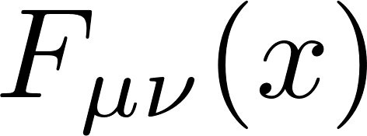
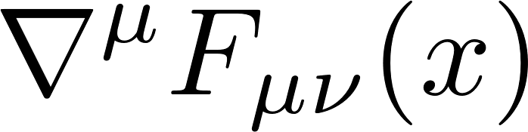






Loops
[Migdal, Makeenko; Polyakov; Halpern, Makeenko;…]
How do we insert the equation of motion into a Wilson loop?
Can also define a field space Laplacian $□_{F}$, and view Wilson loop as a ‘loop transform’ $W$ of the gauge field. At large N:
Loop Equation: (Classically)
Intertwining Operators

Slide 10
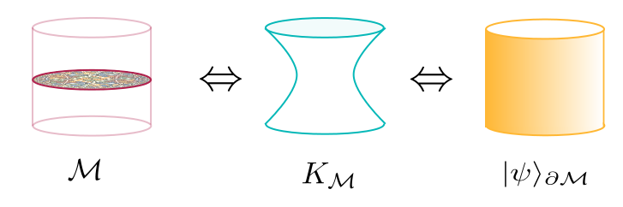
Requirements for a new language
The loop equations are analogous to the organization of gravitational physics we have been looking for.
We might re-express our search for the correct language:
What is the right loop space for gravity?
What are the loop operators and their loop equations for bulk physics?
What do the loop equations and loop operators look like in the gauge theory?
$$⇔$$
Loop Space

Slide 11

Loop Space = ?
We need to understand: what is the right loop space for gravitational physics in AdS/CFT?
Thankfully an example of the type of construction we’re searching for has already been found: Ryu-Takayanagi Proposal.
The Ryu-Takayanagi (RT/HRT) proposal connects:
S
$$A$$
The entanglement entropy of a region A on the boundary.
The area of a minimal surface S in the gravitational dual

Slide 12
Integral Geometry
What is the lesson from Ryu-Takayanagi?
The CFT sees the bulk geometry naturally through codimension-2 minimal surfaces.
  Boundary conditions are codimension-2 surfaces on the CFT cylinder
One could define the relevant loop space to be all possible spacelike surfaces.
  Probably enormously redundant: infinite-dimensional space
Let’s define our loop space to be the space of minimal surfaces with spherical boundary conditions (in any frame)
We will give it a new name: Kinematic Space
  Familiar object of study for some mathematicians: it is a primary object in the field of integral geometry.

Slide 13
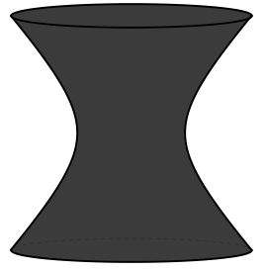
A Survey of Kinematic Space

Slide 14
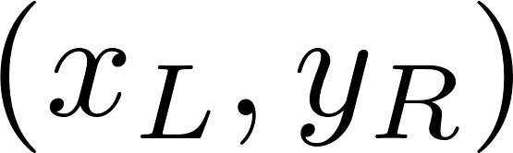

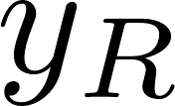
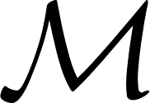




Kinematic Space
Let’s stick to 3D bulk / 2D boundary for now:
Consider ordered pairs of spacelike-separated points on the ${CFT}_{2}$ cylinder:

Slide 15
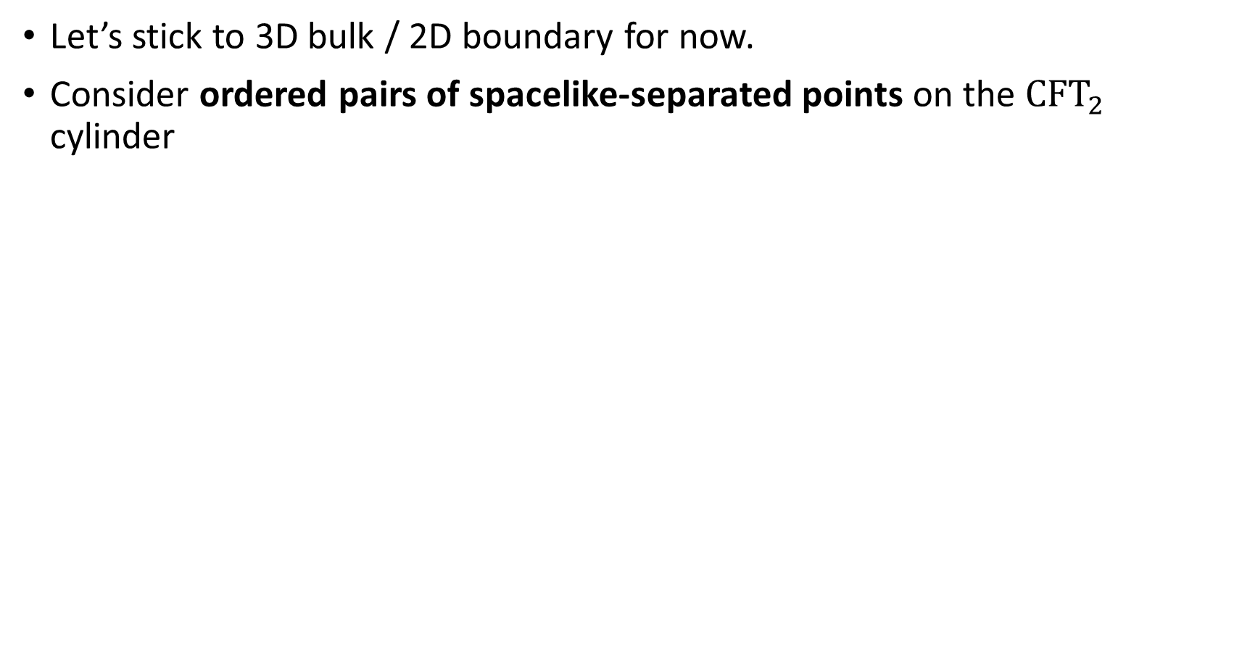
Kinematic Space
Let’s stick to 3D bulk / 2D boundary for now.
Consider ordered pairs of spacelike-separated points on the ${CFT}_{2}$ cylinder
and spacelike geodesics in $AdS_{3}$

Slide 16

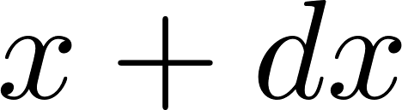

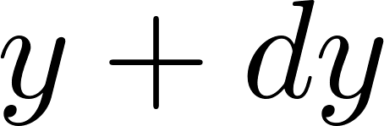
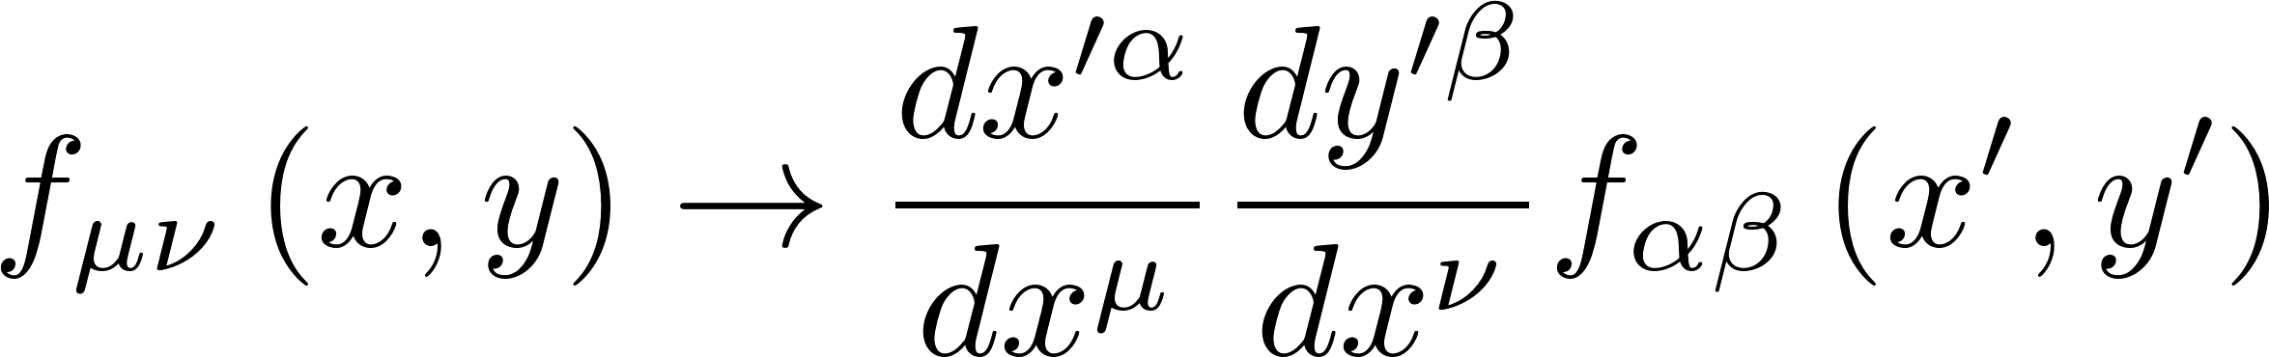
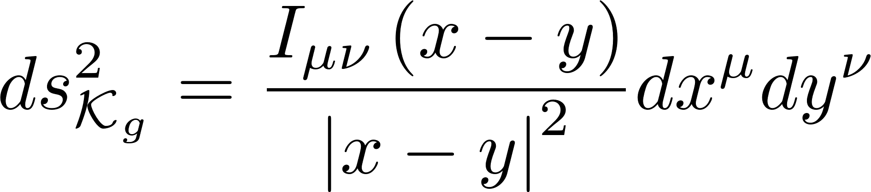
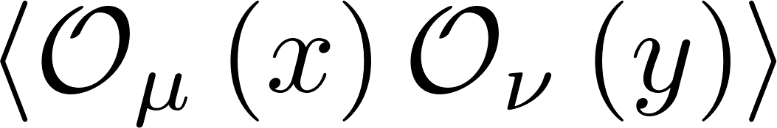
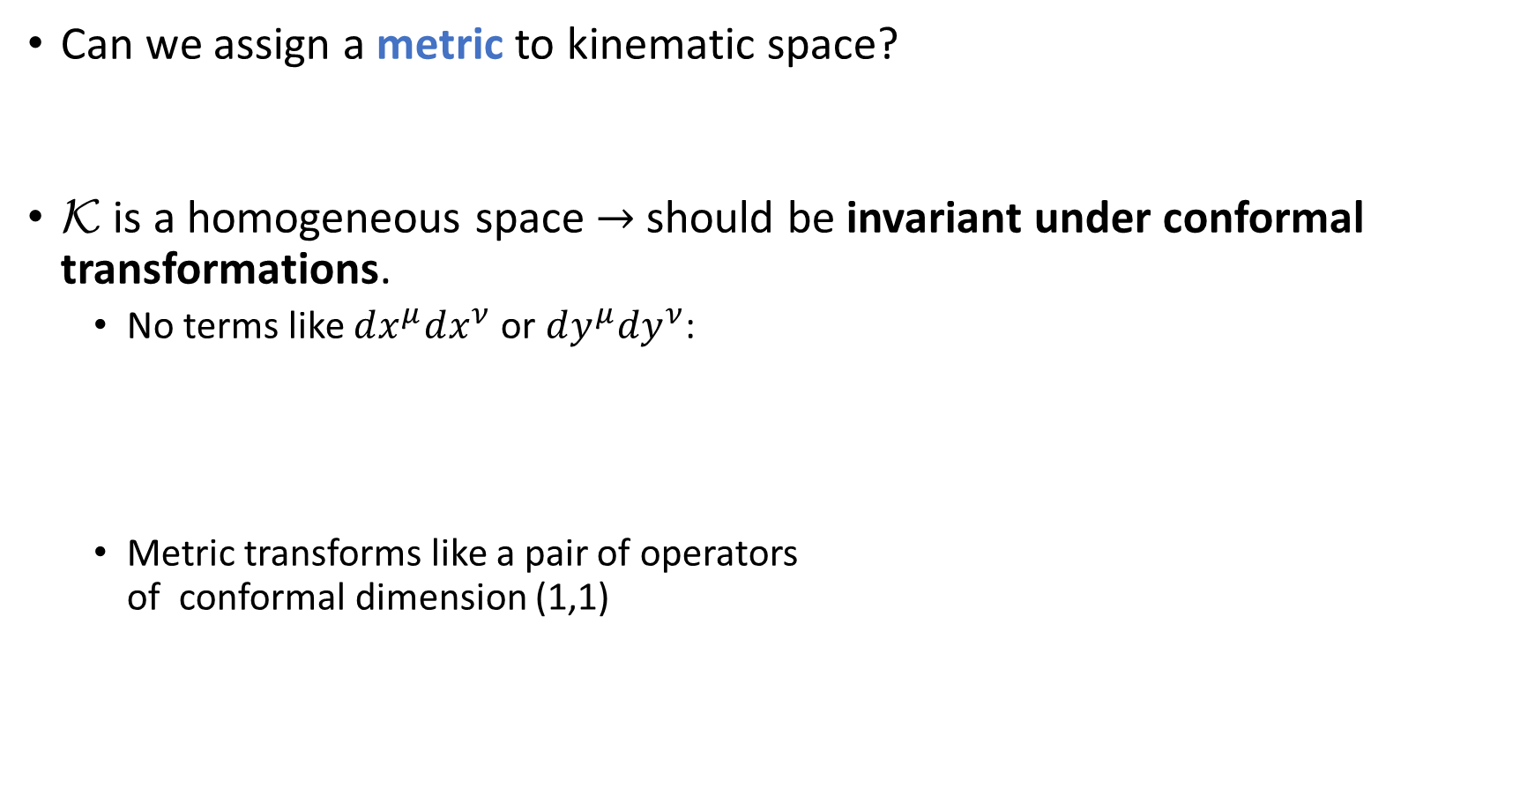
Kinematic Space
Can we assign a metric to kinematic space?
$\text{K}$ is a homogeneous space $→$should be invariant under conformal transformations.
  No terms like $dx^{μ}dx^{ν}$ or $dy^{μ}dy^{ν}$:
  Metric transforms like a pair of operators
  of conformal dimension (1,1)

Slide 17
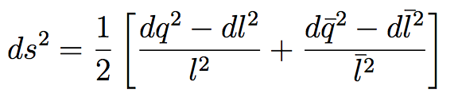

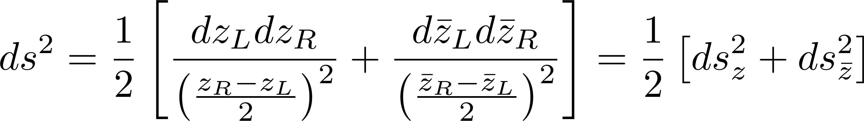

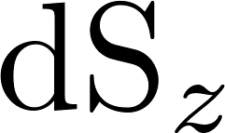
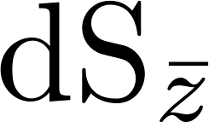


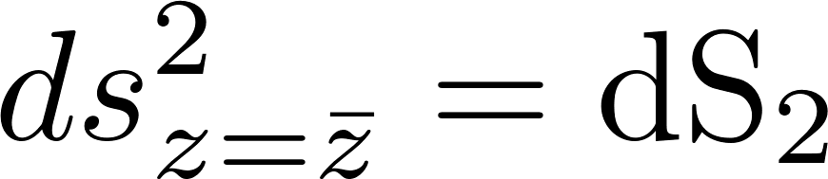


Kinematic Space for $AdS_{3}/CFT_{2}$
This metric simplifies for d=2:
  Change to left-moving and right-moving coordinates $\{ Δz=l {, z}_{c}=q , z↔\overline{z} \}$for the CFT
  We can also restrict to pairs of points that lie on a time slice.
  Gives the diagonal space in the two coordinates
(2)
(1)

Slide 18

Kinematic Metric
$\text{K}$ has two time directions.
Still has a notion of causality: Partial order of causal diamonds.
$l, \overline{l}→−∞$ we reach the asymptotic past of $\text{K}$ and boundary of AdS

Slide 19
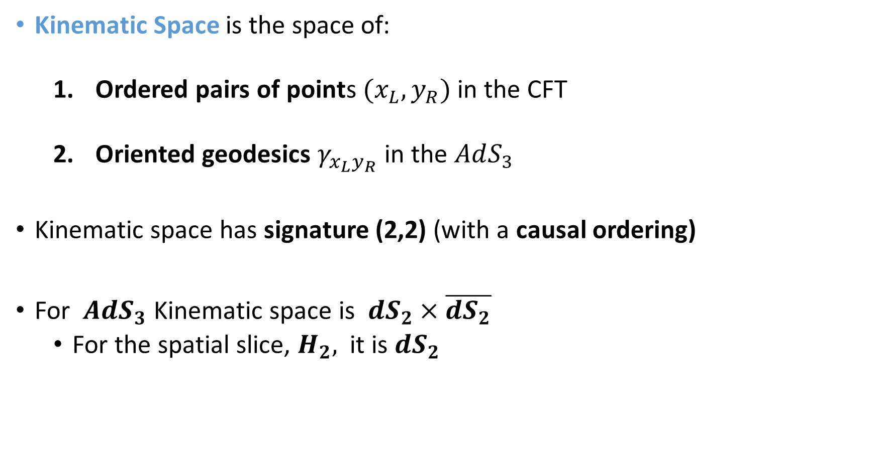
Summary
Kinematic Space is the space of:
  Ordered pairs of points $(x_{L},y_{R})$ in the CFT
  Oriented geodesics $γ_{x_{L}y_{R}}$ in the $AdS_{3}$
Kinematic space has signature (2,2) (with a causal ordering)
For $AdS_{3}$ Kinematic space is $dS_{2}×\overline{dS_{2}}$
  For the spatial slice, $H_{2},$ it is $dS_{2}$

Slide 20
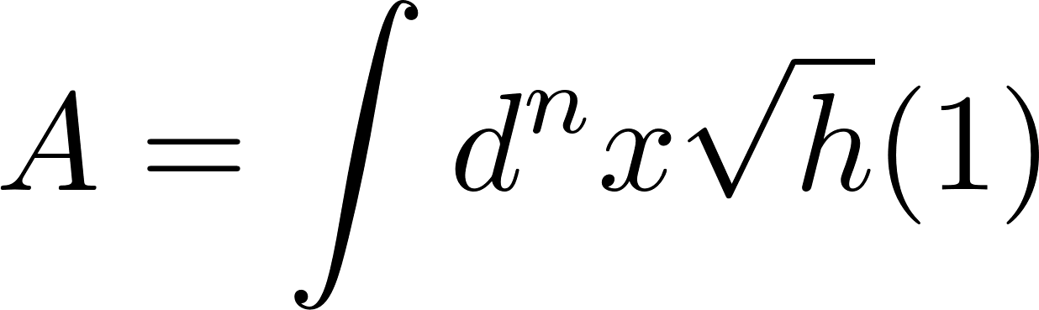

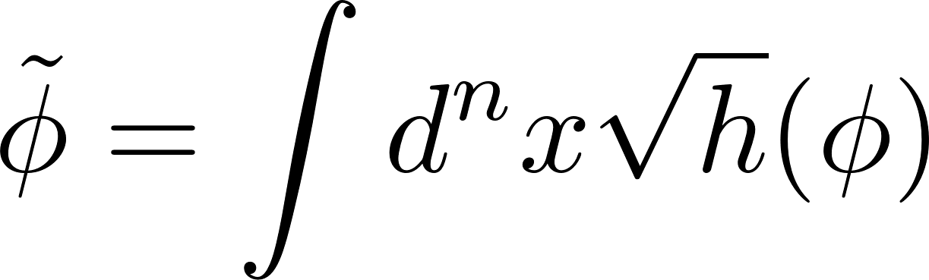


Kinematic Fields
We have a ‘loop space’, but still need the right ‘Wilson Loops’
We can think of their areas as integrating the unit operator over the minimal surface:
A natural generalization then is:
This bulk surface/geodesic operator is a non-local and diff-invariant bulk probe.
Radon Transform: $R\left[φ\right]≔\tilde{φ }$

Slide 21
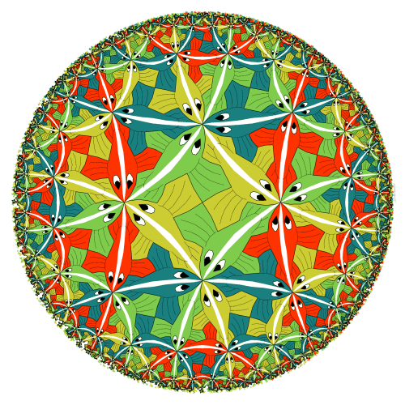
Geodesic Operators
_
_

Slide 22
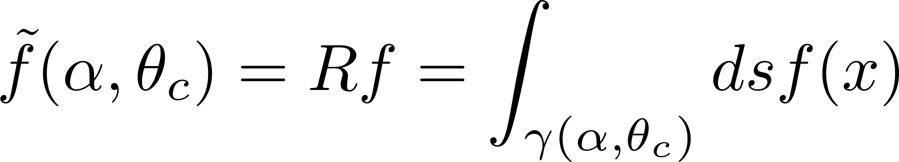
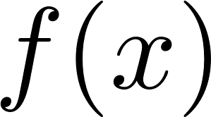
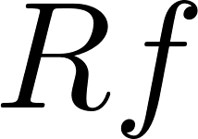
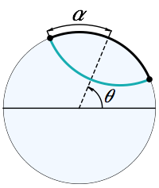
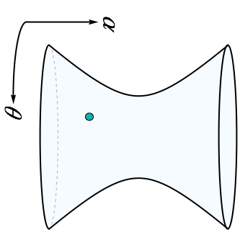

X-Ray Transform
In our 3D example, the Radon Transform is known as the X-ray transform.
To be explicit, consider just the spatial slice $H_{2}$ :

Slide 23
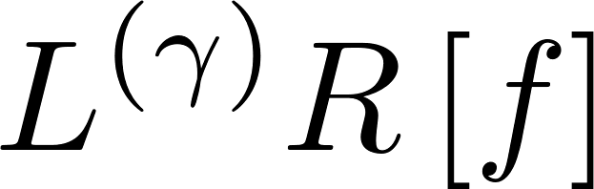
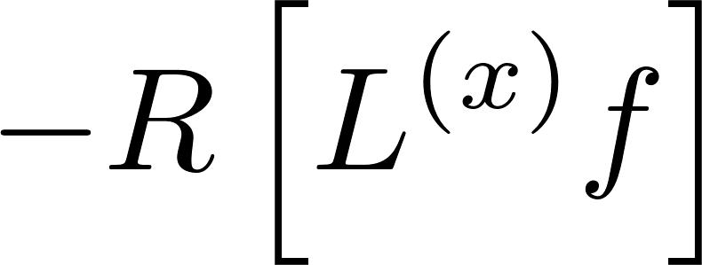





X-Ray Transform
The X-ray transform has nice properties under isometries of the geometry:
_
_
$$f(x)$$
$$K$$
$$M$$
_
_
_
_
_
_
$$f(x)$$
$$f(x)$$
$$f(x)$$
“Intertwining Operators”

Slide 24
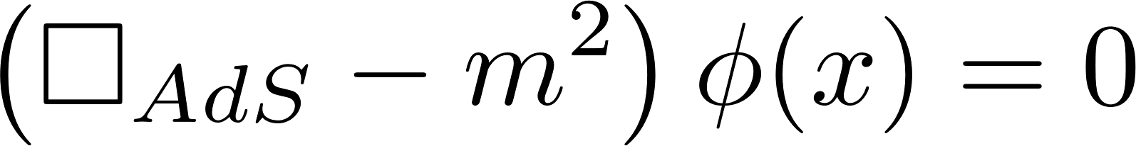
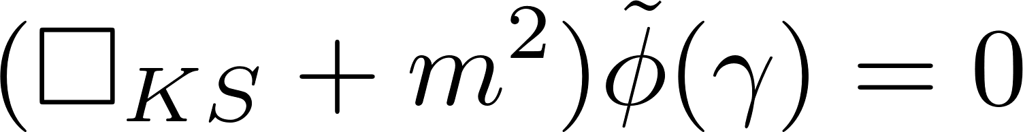
Loop Equations in kinematic space
Intertwinement allows us to rewrite the dynamics of the gravitational theory in terms of dynamics on kinematic space:
Free Scalar Field:
Loop EOM for free scalar
= Kinematic Free scalar EOM

Slide 25

Constraints
$dS_{2}×dS_{2}$ is a 4-dimensional space $AdS_{3}$ is 3-dimensional.
  KS is a redundant description of the real geometry and functions that live on it
  Many more functions $\tilde{f}$ we can specify on KS than are are consistent images $Rf$ of the transform
What constraints do the ray transforms obey?
John’s equation:
  Intuitive meaning: we can determine function
  from flat slicing geodesics. Boosted geodesics are a
  redundant description.

Slide 26
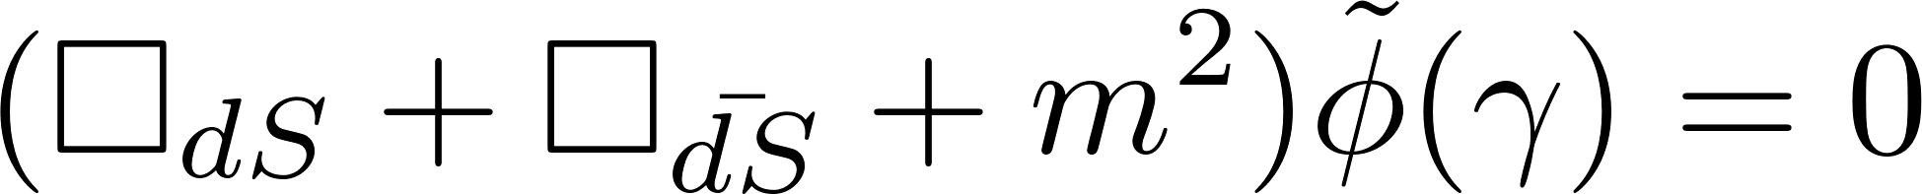
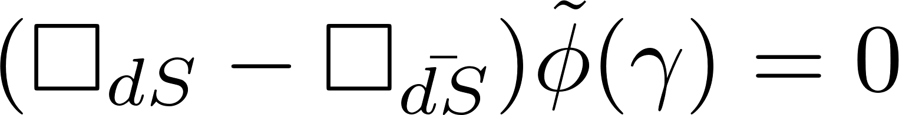
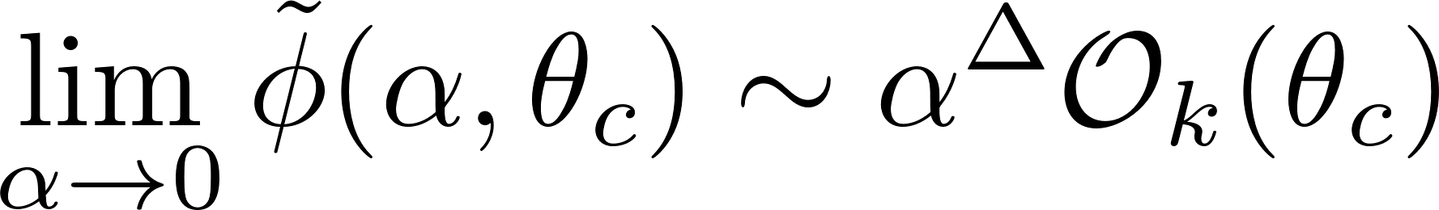
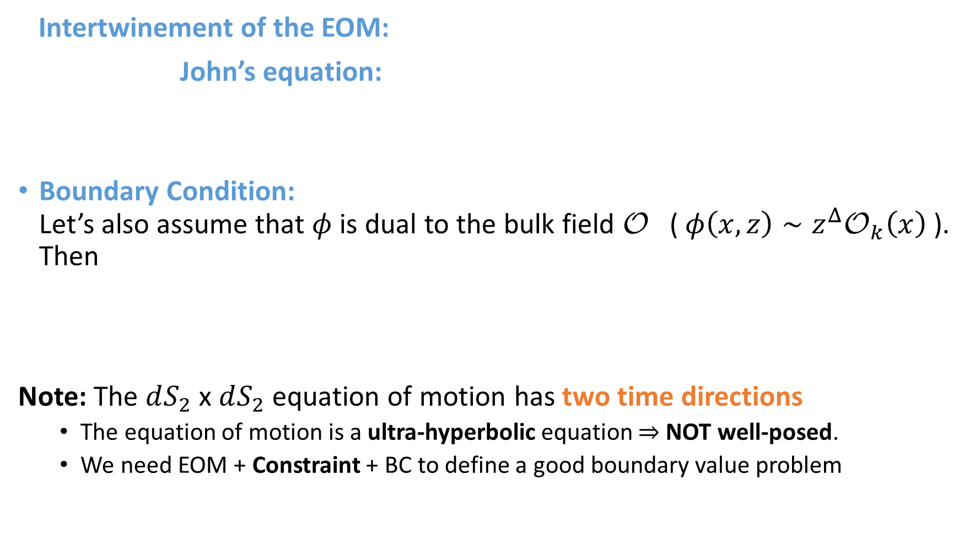
Geodesic Operators
Intertwinement of the EOM:
John’s equation:
Boundary Condition:
Let’s also assume that $φ$ is dual to the bulk field $\text{O}$ ( $φ\left(x,z\right)∼z^{Δ}{\text{O}}_{k}\left(x\right)$). Then
Note: The $dS_{2}$ x $dS_{2}$ equation of motion has two time directions
  The equation of motion is a ultra-hyperbolic equation $⇒$NOT well-posed.
  We need EOM + Constraint + BC to define a good boundary value problem

Slide 27


OPE Blocks
$$x$$
$$y$$

Slide 28




The Operator Product Expansion
Consider two quasi-primary operators ${\text{O}}_{i}\left(x\right), {\text{O}}_{j}(y)$ of dimensions $Δ_{i},Δ_{j}$. We can expand the product of these two operators using a local basis of operators:
Let us introduce a more compact notation for this expansion
We will call ${\text{B}}_{k}^{ij}\left(x,y\right)$ the ‘OPE Block’
$${\text{O}}_{i}\left(x\right)$$
${\text{O}}_{j}(0)$
Dynamical Parameters
Conformal Kinematics

Slide 29


OPE Blocks as Kinematic Fields
The OPE block carries coordinates of two points $\left(x,y\right)$, so we might also naturally identify it with a field living in our kinematic space.
Consider a scalar block $(Δ_{k},l=0)$. Let’s characterize this field:
1) What type of field is an OPE block on KS?
Consider a conformal transformation $x→x^{′}$ and $Ω\left(x^{′}\right)=\det\left(\frac{∂x^{′μ}}{∂x^{ν}}\right)$.
Then
In the simplest case where $Δ_{i}=Δ_{j}$, this transforms as a scalar field under isometries of KS.
Let’s keep this simplifying assumption for the purposes of this talk: ${\text{B}}_{k}^{}\left(x,y\right)$

Slide 30


OPE Blocks as Kinematic Fields
2) What is its equation of motion?
A quasi-primary operator and its descendants have the same conformal Casimir so the OPE block satisfies the equation
The OPE block transforms in a bi-local representation of the conformal group, so the Casimir is represented

Slide 31

OPE Blocks as Kinematic Fields
We thus find an equation of motion for the OPE block
This is precisely the wave equation for a scalar field propagating in our kinematic space.

Slide 32

OPE Blocks as Kinematic Fields
3) Boundary conditions?
When the two points approach, we reach the boundary of kinematic space
  In this limit, the OPE block reduces to the primary operator:
4) Constraint?
The conformal group in 2D factorizes and there are two quadratic Casimirs:

Slide 33







OPE Blocks and Geodesic Operators
Let’s compare now to the bulk geodesic operator dual to the operator $𝓞_{k}$:
 | Gravity | CFT
EOM
BCs
Constraint

Slide 34



The Kinematic Dictionary
We have now established a new organization of the holographic dictionary
between OPE Blocks and geodesic operators (and extensions to surface operators).

Slide 35
Requirements for a new language
We might re-express our search for the correct language:
What is the right loop space for gravity?
  A: Kinematic space of minimal surfaces
What are the loop operators and their loop equations for bulk physics?
  A: Surface operators. Their loop equations take the form of simple equations of motion in kinematic space.
What do the loop equations and loop operators look like in the gauge theory?
  A: The gauge theory sees the loops equations through the decomposition of the operator product expansion.

Slide 36




Applications

Slide 37



Some Applications
Geodesic Witten Diagrams
Local Operators
  The radon transform is invertible: $\tilde{φ}\left(γ\right)→φ(x)$
  Recover the spacelike smearing function of HKLL:
[Hijano, Kraus,
Perlmutter, Snively;]
[Hamilton, Kabat,
Lifschytz, Lowe]

Slide 38


3) Linearized Einstein Equations
We have the linearized EOM:
Can define Radon Transforms:
and prove an analogous intertwining relation:
We find the Kinematic version of the EOM:
Cf. [de Boer, Heller, Myers, Neiman]
[Nozaki, Numasawa, Prudenziati, Takayanagi], [Bhattacharya, Takayanagi]

Slide 39









Cf. [Faulkner, Guica, Hartman, Lashkari, McDermont, Myers, Swingle, Van Raamsdonk]
What about the CFT?
Casimir Eqn:
Using the 1/N expansion
Then, for a perturbation near the vacuum:
Read in the opposite direction, this is a derivation of the bulk expression for $H_{mod}$
EE 1st Law:
$H_{mod}$ is just an OPE Block!

