Slide 1
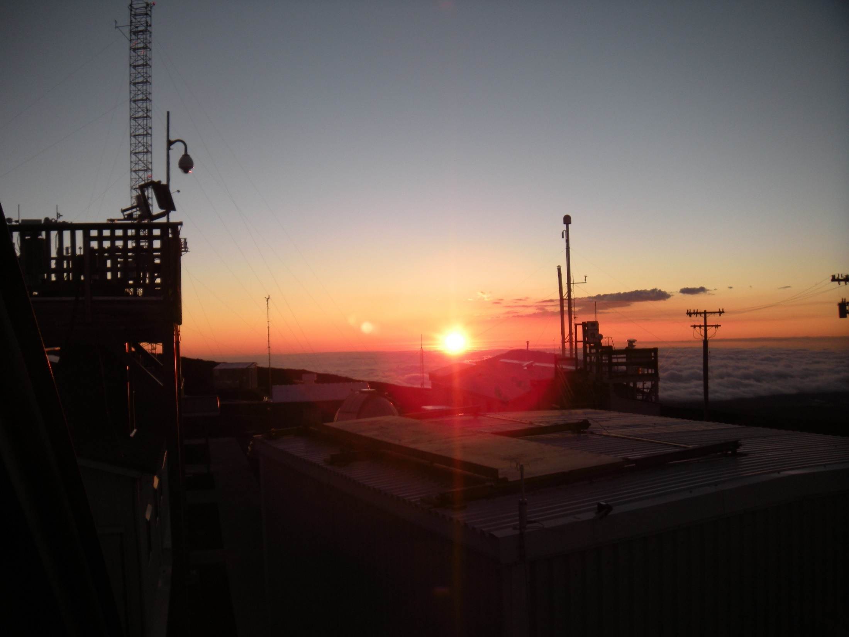

The surprising case of CFC-11:
Have we fallen off the path to ozone layer recovery?
Steve Montzka
NOAA Global Monitoring Division, Boulder, USA
Sunrise at the Mauna Loa Baseline Observatory
Thanks to:
Colleagues at NOAA and CIRES.
All co-authors on associated papers
Montzka et al., 2018, https://doi.org/10.1038/s41586-018-0106-2
Rigby et al., 2019, https://doi.org/10.1038/s41586-019-1193-4
Ray et al., 2020, https://doi.org/10.1038/s41561-019-0507-3
Station personnel and cooperative institutes around the world helping with flask sampling and instrument maintenance
AGAGE community of scientists

Slide 2
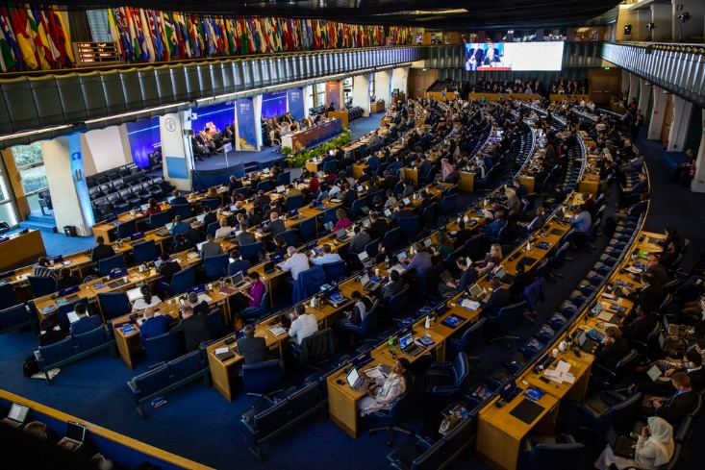
The 1987 Montreal Protocol
* Designed to heal the stratospheric ozone layer (limit UV exposure), which showed large depletions particularly over Antarctica during springtime.
* Mandated a global phase-out of production & trade of ozone-depleting gases.
* The first universally ratified treaty in UN history.
* Parties have held 2 meetings/yr since the late 1980s to ensure continued success.
Problem causers: long-lived chlorinated and brominated gases:
e.g., Chemicals used
- in refrigeration & air conditioning, foam-blowing, as solvents (CFCs, or chlorofluorocarbons)
- as chlorinated solvents (CH₃CCl₃, CCl₄)
- in fire-extinguishing (halons-1211,halon-1301)
- as pesticide (methyl bromide)
1st generation substitutes:
HCFCs (hydrochlorofluorocarbons)
2nd generations substitutes:
HFCs (hydrofluorocarbons)
A view of the Meeting of the Parties,
Rome, Nov., 2019

Slide 3
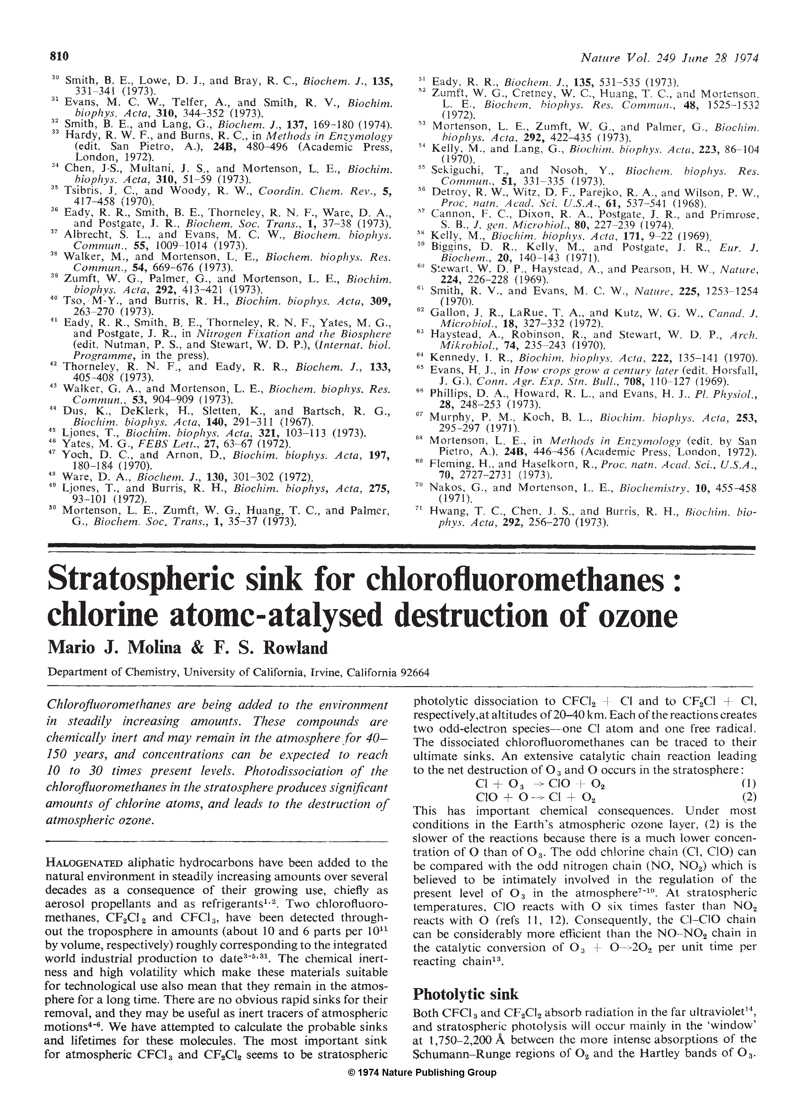
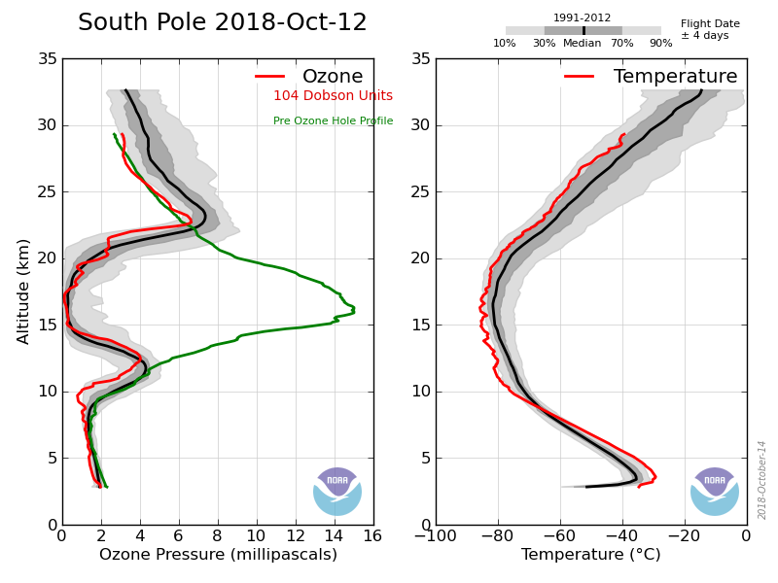
Despite a warning over 45 years ago…
…and the universal ratification of the Montreal Protocol on Substances that Deplete the Ozone Layer in 1987
The stratospheric ozone layer is far from recovered:
Nature, 249, 810, 1974
Ozone over South Pole during fall of 2018 (red line)
(ozonesonde flights by
NOAA-GMD):
1991-2012 ave

Slide 4
So why is the Montreal Protocol considered perhaps the single most successful international agreement ever?
Adherence to the Montreal Protocol has led to:
1) Near elimination of ozone-depleting substance (ODS) production, particularly chlorofluorocarbons (CFCs)
CFC production reportedly phased-out in 2010
Minimal production reported by 2007
Global reported
production*
(ODP-kt/yr)
* Reported to the WMO/UNEP Ozone Secretariat
Notes:
Significant player in ozone-depletion and ODGases. Second largest contributor… that’s because production for all uses has been ~zero since 2007.

Slide 5
So why is the Montreal Protocol considered perhaps the single most successful international agreement ever?
Adherence to the Montreal Protocol has led to:
1) Near elimination of ozone-depleting substance (ODS) production, particularly chlorofluorocarbons (CFCs)
2) declines in ODS emissions and concentrations:
→ Pre-ozone-hole concentrations of ODSs are projected for later in this century (WMO reports),
provided continued adherence to the Protocol’s controls
From NOAA/GMD-measured tropospheric concentrations of CFCs, HCFCs, chlorinated solvents, methyl halides, halons
Ozone-depleting
chlorine
Ozone-depleting
bromine
NOAA
year
(see updates at http://www.esrl.noaa.gov/gmd/odgi/)
Notes:
Significant player in ozone-depletion and ODGases. Second largest contributor… that’s because production for all uses has been ~zero since 2007.

Slide 6
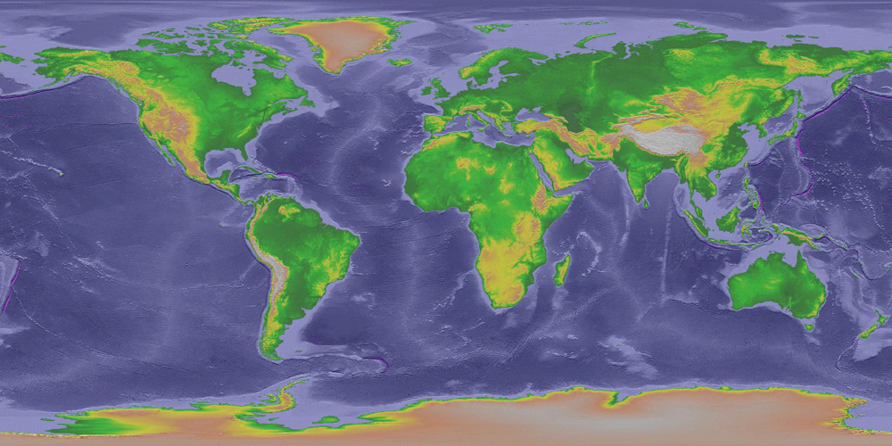
NOAA/GMD: Tracking ozone-depleting gas concentrations globally
•
•
•
•
•
ALT
SUM
•
BRW
weekly
hourly
MHD
•
~40 gases measured including:
- ozone-depleting gases controlled by the Montreal Protocol
- hydrofluorocarbons (HFCs)
- other methyl halides
- other poly-chlorinated & brominated hydrocarbons
- benzene & other hydrocarbons
- carbonyl sulfide
Providing an independent assessment of the Montreal Protocol,
and scientific insights into:
- global atmospheric oxidation variability
- carbon uptake by the biosphere
- non-CO₂ GHG contributions to radiative forcing (climate change)
- climate sensitivities of natural processes
- atmospheric transport processes
•
•
•
LEF
•
•
•
•
THD
•
HFM
WIS
•
NWR
•
AMY
(just added)
•
MLO
KUM
•
•
SMO
•
CGO
PSA
•
•
•
SPO
Notes:
NOAA network, weekly flasks at remote sites, and in-situ data, but also dairly samples over the US from towers, and bi-weekly from aircraft—vertical monitoring of the atmosphere over the US and a few other locations (RTA).

Slide 7
Atmospheric measurements for tracking the effectiveness of the Montreal Protocol
CFCs, CH₃CCl₃, etc. → HCFCs → HFCs → HFOs
CFC-11
(CCl₃F)
HCFC-22
(CHClF₂)
Northern
Hemisphere
Southern
Hemisphere
ppt
ppt
NH
SH
CH₃CCl₃
HFC-134a
(CH₂FCF₃)
NH
ln(ppt)
SH
ppt
NH
(log scale)
SH
Chemical lifetimes range from 5 to 50 years
NOAA/CIRES flask data

Slide 8
Atmospheric CFC-11
CFC-11:
Second most abundant ODS; accounts for 20-25% of
ozone-depleting chlorine
→ Was the largest contributor to the overall decline of atmospheric Cl from 2007-2012
While production was reportedly phased out in 2010, significant emissions persist, primarily from a foam “bank” of ~900 kt currently
Reported
production
phase-out
NH
SH
Mole fraction (ppt)
Concentration
(hemispheric mean ppt)
NOAA/GMD
In situ & flasks
1995 2000 2005 2010 2015
Global rate (per yr)
3
1
2
After a production phase-out:
* concentration decline should have accelerated
as bank becomes depleted by emissions…
(the zero-emission limit is −2%/yr given its 50 yr lifetime)
Difference
(N – S; ppt)
Notes:
acknowledgements

Slide 9
Atmospheric CFC-11
Reported
production
phase-out
Hemispheric mean
concentration
NH
SH
Concentration
(hemispheric mean ppt)
Expectation
1
NOAA/GMD
In situ & flasks
2
3
1995 2000 2005 2010 2015
Global rate (per yr)
3
1
2
1995 2000 2005 2010 2015
Difference
(N – S; ppt)
Notes:
acknowledgements

Slide 10
Atmospheric CFC-11
Reported
production
phase-out
Hemispheric mean
concentration
NH
SH
Mole fraction (ppt)
Concentration
(hemispheric mean ppt)
Expectation
1
NOAA/GMD
In situ & flasks
2
3
Global rate of change
Global rate (per yr)
3
Expectation
1
2
1995 2000 2005 2010 2015
Difference
(N – S; ppt)
Notes:
acknowledgements

Slide 11
Atmospheric CFC-11
Reported
production
phase-out
Hemispheric mean
concentration
NH
SH
Mole fraction (ppt)
Concentration
(hemispheric mean ppt)
Expectation
1
NOAA/GMD
In situ & flasks
2
3
Global rate of change
Global rate (per yr)
3
Expectation
1
2
Hemispheric concentration
difference
Difference
(N – S; ppt)
Qualitatively consistent with
an increase in NH emissions
Notes:
acknowledgements

Slide 12
Why the unexpected slowdown?
Consider the evidence:
It does NOT seem to be a measurement problem:
→ slowdown observed by independent measurements (NOAA and AGAGE) using multiple techniques, and in different aspects of the data
It is NOT unique to certain sites, it is observed everywhere
→ initially in the NH, and then later in the SH
NOAA flasks analyzed by GCMS

Slide 13
Why the unexpected slowdown?
What does it imply about global emission rates?
Considering a mass balance approach to CFC-11 in the global atmosphere:
dG_{F11}/dt = Emission – G_{F11}*k_{F11}
dG_{F11}/dt = Emission – G_{F11}/τ_{F11}
Where
G_{F11} = global CFC-11 mass
k_{F11} = pseudo 1st-order loss
rate constant
τ_{F11} = global CFC-11 lifetime
Estimated from measurements
and, typically, simple box models that:
a) constrain G and dG/dt based on surface measurements
b) constrain k and τ based on laboratory studies

Slide 14
  Deriving emissions from concentrations
Global CFC-11 concentration changes reflect the balance of
a) EMISSION
b) REMOVAL (lifetime & transport)
For a ~ 50 yr lifetime,
atmospheric concentrations should decline at ~1/50 yr⁻¹ or
2% yr⁻¹
in the absence of emissions.
MEASURED
−2%
E₁
−2%
E₂
−2%
E₃

Slide 15
  2) The derived CFC-11 emissions history
Mass balance considerations (a simple box-model analysis):
dG_{F11}/dt = Emission – G/τ_{F11}
dG_{F11}/dt = Emission − Loss
Emission
Measured
13 ± 5 Gg/yr
(25%) increase
(2014-2016 vs. 2002-2012; 2017 is similarly elevated)
Emission or Production (Gg/yr)
Reported
Production
1995 2000 2005 2010 2015
Are CFC-11 emissions really
increasing despite the Montreal Protocol and reported phase-out by 2010?
Montzka et al., 2018

Slide 16
  2) The derived CFC-11 emissions history
Mass balance considerations (a simple box-model analysis):
dG_{F11}/dt = Emission – G/τ_{F11}
Emission
Measured
13 ± 5 Gg/yr
(25%) increase
(2014-2016 vs. 2002-2012; 2017 is similarly elevated)
Emission or Production (Gg/yr)
Reported
Production
1995 2000 2005 2010 2015
Or has CFC-11 loss and transport changed (“τ_{F11}”)?
How constant is the Brewer-Dobson circulation, or the CFC-11 lifetime?
Montzka et al., 2018

Slide 17
Taking a closer look with 3-D CCM simulations
Have changes in dynamics affected the CFC-11 decline?
Derived
emission
Mass balance box model
& constant dynamics
3-Dimensional model
& Reanalysis
Meteorology
Observed concentration
Global mean, rate, &
Hemispheric difference
Simulated
Global mean, rate &
Hemispheric difference
How do these compare?
→ any differences could imply dynamical influences

Slide 18
3-D modeling of CFC-11 global concentration decline
WACCM results
3-D model
simulated
← 3-D model with
fixed dynamics
Global concentration
rate of change (per year)
observed
←3-D model with
emissions kept
constant after 2012
Montzka et al., 2018

Slide 19
3-D modeling of CFC-11 global concentration decline
WACCM suggested a significant dynamical contribution to the CFC-11 slowdown of ~50% (other models suggested a smaller effect),
but an emission increase is needed to fit observed increases in rate and hemispheric difference
WACCM results
3-D model
simulated
Global concentration
rate of change (per year)
observed
Montzka et al., 2018

Slide 20
  Derived CFC-11 emission
Global CFC-11 concentration changes reflect the balance of
a) EMISSION
b) REMOVAL (lifetime & transport)
d[CFC-11]/dt = Emission − Removal
Derived
Emission
← constant dynamics
Emission or Production (Gg/yr)
← changing dynamics
Reported
Global
Production
Montzka et al., 2018

Slide 21
  Derived CFC-11 emission
Global CFC-11 concentration changes reflect the balance of
a) EMISSION
b) REMOVAL (lifetime & transport)
d[CFC-11]/dt = Emission − Removal
Derived
Emission
We concluded:
Emissions had increased, but up to 50% of the increases could have been from dynamics or lifetime changes…
Emission or Production (Gg/yr)
Reported
Global
Production
Montzka et al., 2018

Slide 22
  Derived CFC-11 emission
Global CFC-11 concentration changes reflect the balance of
a) EMISSION
b) REMOVAL (lifetime & transport)
d[CFC-11]/dt = Emission − Removal
Derived
Emission
Emission or Production (Gg/yr)
25-30 Gg/yr
above expectations…
Reported
Global
Production
Montzka et al., 2018

Slide 23
  Derived CFC-11 emission
Global CFC-11 concentration changes reflect the balance of
a) EMISSION
b) REMOVAL (lifetime & transport)
d[CFC-11]/dt = Emission − Removal
Revised Conclusion (unpublished):
The original WACCM runs had some issues that overestimated the dynamical contribution.
Subsequent multiple model analyses reveal that any dynamical contribution to the derived emission increase is <10%.
Quantification of the emission increase becomes more accurate when averaged over more years…
Given that other models showed a role for dynamics, and because the N-S difference increase required and emission increase, we concluded:
Emissions had increased, but up to 50% of the increases could have been from dynamics or lifetime changes…
Derived
Emission
Emission or Production (Gg/yr)
Reported
Global
Production

Slide 24
Do the observations themselves suggest emissions increasing?
Air reaching Hawaii in autumn can be influenced by Eurasian emissions (Lin et al., 2014, DOI: 10.1038/NGEO2066).
A close look at our results from the Mauna Loa station showed:
Before 2012: pollution plumes reaching Hawaii DID NOT contain elevated concentrations of CFC-11
After 2012: pollution plumes reaching Hawaii NOW CONTAIN elevated concentrations of CFC-11.
Notes:
acknowledgements

Slide 25
Do the observations themselves suggest emissions increasing?
Pollution plume events reaching Hawaii were identified by:
1) Increased concentrations of a number of gases:
HCFC-22, CH₂Cl₂, and CO
HCFC-22
CFC-11
CFC-11 (ppt)
HCFC-22 (ppt)
CFC-11 (ppt)
HCFC-22 (ppt)
Notes:
acknowledgements

Slide 26
Do the observations themselves suggest emissions increasing?
Pollution plume events reaching Hawaii were identified by:
1) Increased concentrations of a number of gases:
HCFC-22, CH₂Cl₂, and CO
HCFC-22
CFC-11
CFC-11 (ppt)
HCFC-22 (ppt)
CFC-11 (ppt)
HCFC-22 (ppt)
Only after 2012 do pollution plumes contain elevated CFC-11 concentrations
Correlations among HCFC-22, CH₂Cl₂, & CO are strong in all years
Notes:
acknowledgements

Slide 27
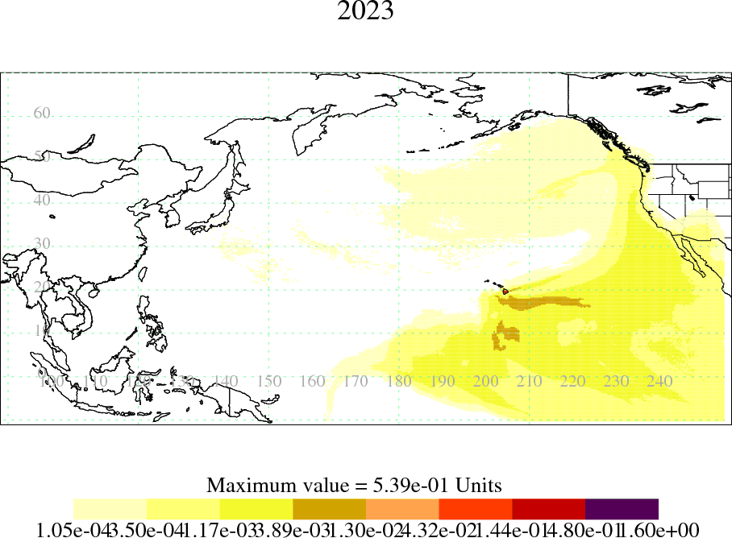
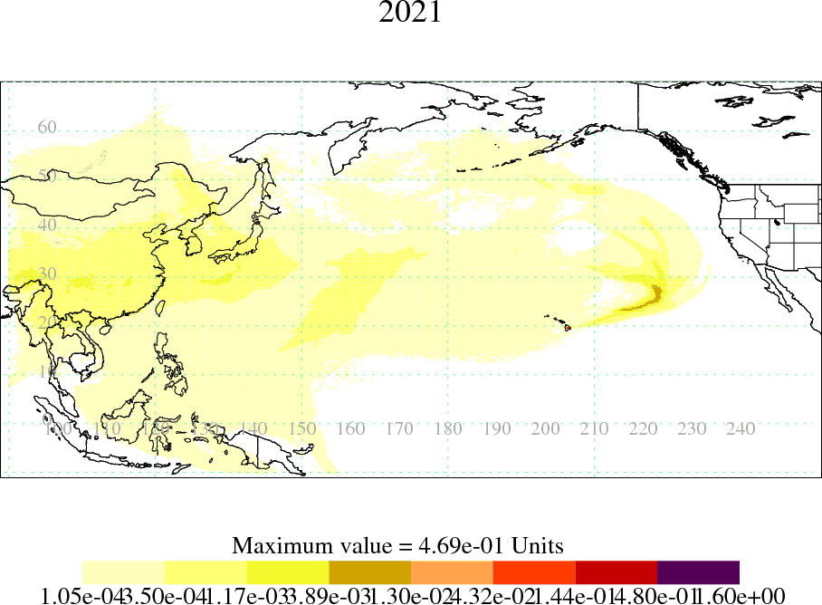
The source region for those pollution plumes reaching Hawaii were identified by meteorological models of air transport:
Lower [HCFC-22] & [CFC-11]
Higher [HCFC-22] & [CFC-11]
2013-2016 2013-2016
Darker colors indicate the surface region influencing samples collected in Hawaii
After 2012, air associated with eastern Asia contains relatively higher concentrations of CFC-11
→ Some portion of the global emission increase is from Eastern Asia
Montzka et al., 2018
Notes:
acknowledgements

Slide 28
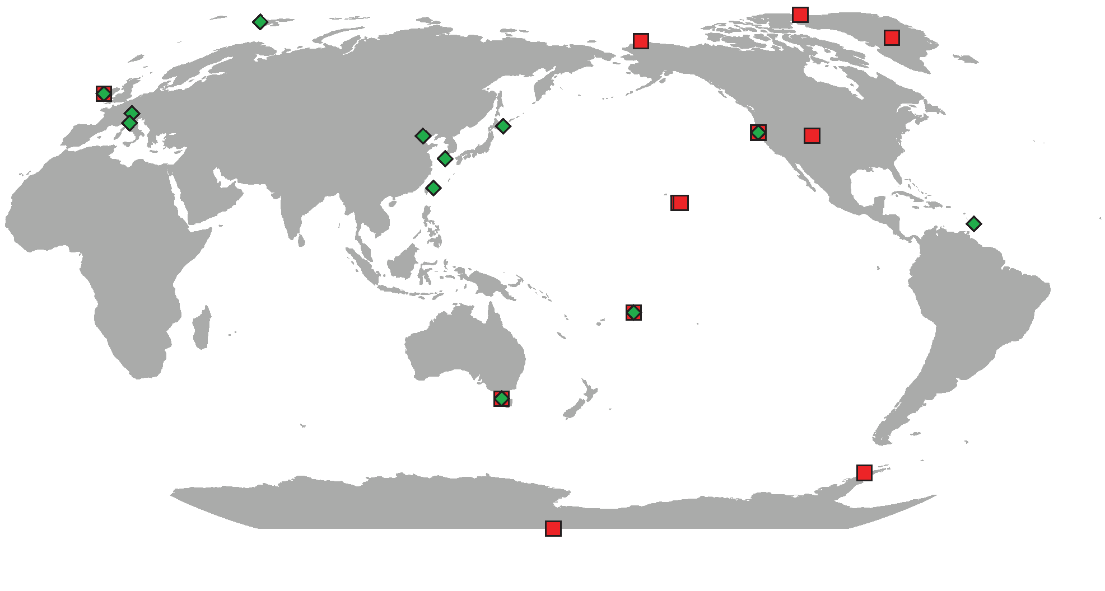
In a second study (Rigby et al., 2019), measurements within eastern Asia are analyzed…
AGAGE & affiliates plus NOAA sampling locations
(Rigby et al., 2019)
GSN
HAT
MLO
Between 12 and 34 measurements per day at AGAGE & affiliate sites
Rigby et al., 2019
7

Slide 29
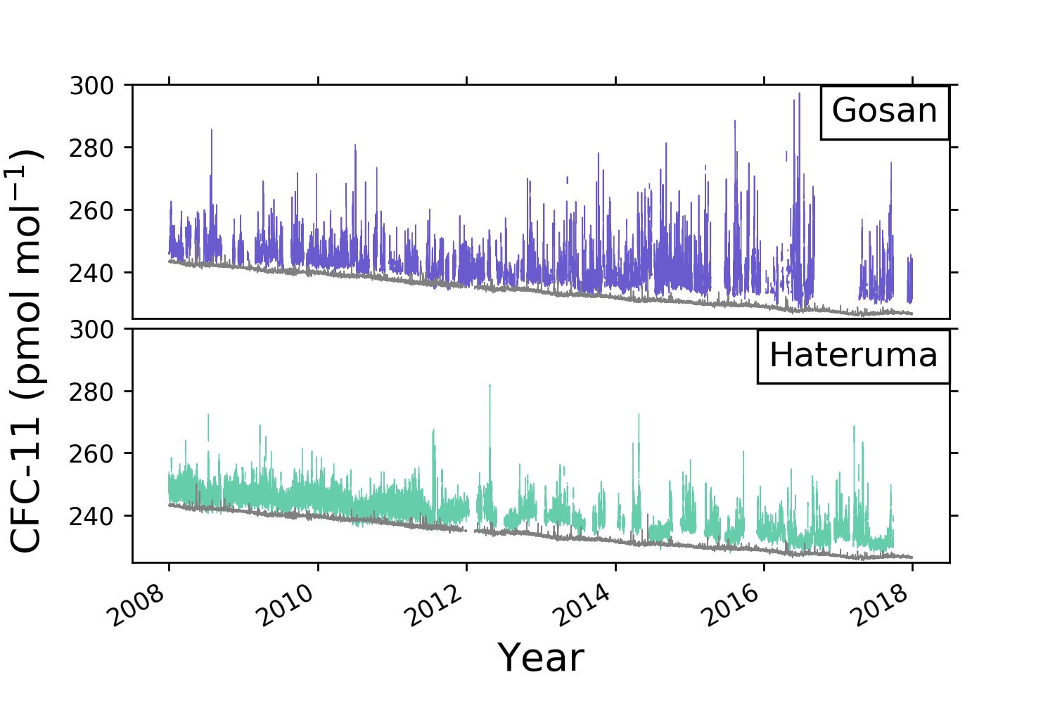
From Rigby et al., 2019:
Discrete air sample results:
After 2012,
CFC-11 concentrations are increasingly elevated in pollution plumes reaching these sites, particularly at GSN
40°S
CFC-11 concentration (ppt)
40°S
Grey = 40°S (C.Grim, CSIRO)
AGAGE, R.O.K. (K.N.U.), and Japan (NIES)
Rigby et al., 2019
9

Slide 30
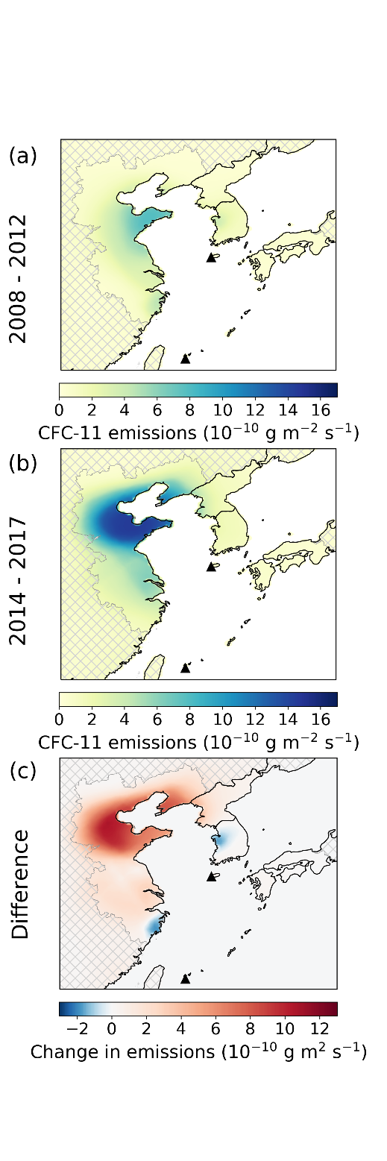
Inverse Lagrangian model analyses of these measurements in
Rigby et al., 2019:
Red = regions where emissions increased after 2012>>
About 50% of the global emission increase comes from eastern Asia,
specifically the Chinese provinces of Shandong and Hebei.
Where’s the other half???
Similar inverse analyses of observations from the U.S., Europe, and Australia suggest low emissions (< 10 Gg/yr) and no recent increases.
Regional estimates from many parts of the world are not possible.
AGAGE data
Rigby et al., 2019, https://doi.org/10.1038/s41586-019-1193-4
Rigby et al., 2019
NAME-HB
NAME-InTEM
FLEXPART-MIT
FLEXPART-Empa
Notes:
acknowledgements

Slide 31
  2) Do the results imply renewed production?
  → is the Montreal Protocol being violated?
OR: is CFC-11 escaping more rapidly from the foam “bank”
(~1200 Gg in 2012)?
Emission
Emission or Production (Gg/yr)
Reported
Production
1995 2000 2005 2010 2015

Slide 32
  2) Do the results imply renewed production?
  → is the Montreal Protocol being violated?
OR: is CFC-11 escaping more rapidly from the foam “bank”
(~1200 Gg in 2012)?
Emission
Emission or Production (Gg/yr)
Reported
Production
With no new production, the escape rate from the ‘bank’ would have had to nearly double since the early 2000s…
→ this seems
highly unlikely
Implied annual release from bank (%/yr)
Montzka et al., 2018

Slide 33
Implications for the ozone layer:
If the problem is rapidly fixed, the impact on the ozone layer should be small.
If these emissions continue → ozone recovery delay of 7 to 20 yr.
Unlikely?
Perhaps, but the magnitude of the problem ultimately depends on the magnitude of unreported production.
Have we detected only the “tip of the iceberg”??
Most likely use of the new production:
Polyurethane insulating foams (WMO-TEAP; 2019)
→ if so, then, emissions detected are << associated production.
and enhanced emissions could be sustained even with effective mitigation.
(WMO-SAP, 2018; Dhomse et al., 2019 & others)
25-30 Gg/yr emissions for foams implies
→ 50-100 Gg/yr of CFC-11 production (peak prod. was 400 Gg/yr)

Slide 34

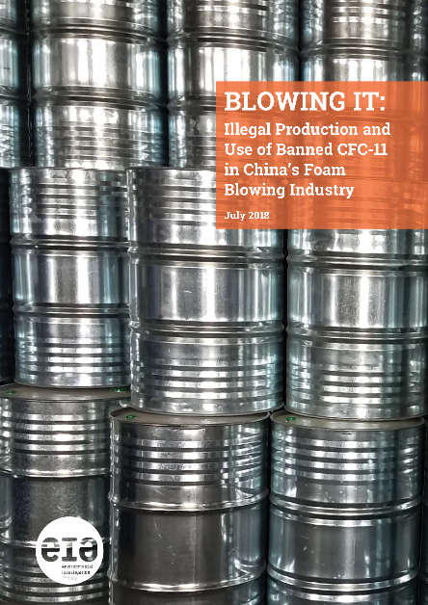
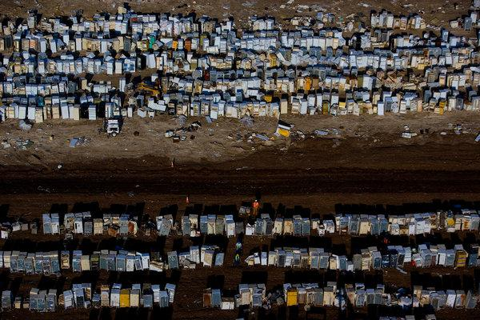
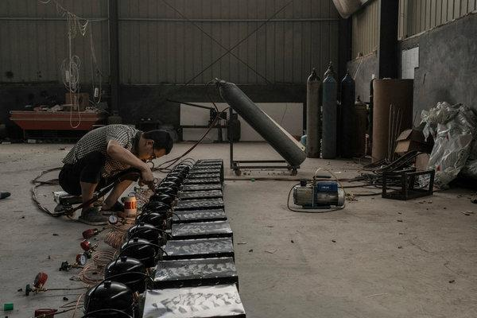
Global reaction to our results:
On-the-ground investigative reporting by the NY Times and EIA
→ evidence for ongoing use and production of CFC-11 in China
→ Overall quantities unknown…
Ozone-Harming Gas Is Detected, Despite Ban
By Henry Fountain, NY Times
p. A4, May 16, 2018
…and the EIA
An Environmental Win Falters. Why? Some Clues Point to China
By Chris Buckley and Henry Fountain, NY Times
p. A1, June 24 2018
More Evidence Points to China as Source of Ozone-Depleting Gas
By Chris Buckley and Henry Fountain, NY Times
p. A14, November 3, 2018
The EIA suggests that in 2018 most of the closed-cell foam industry in China had reverted back to using CFC-11
But this was from a very limited survey of users…

Slide 35
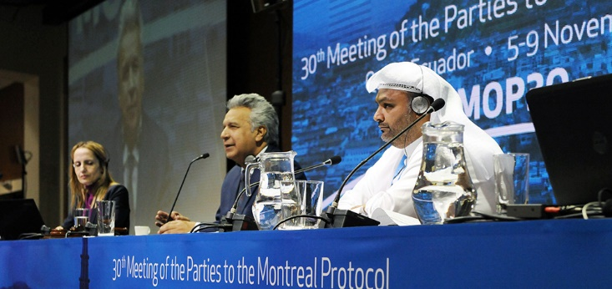
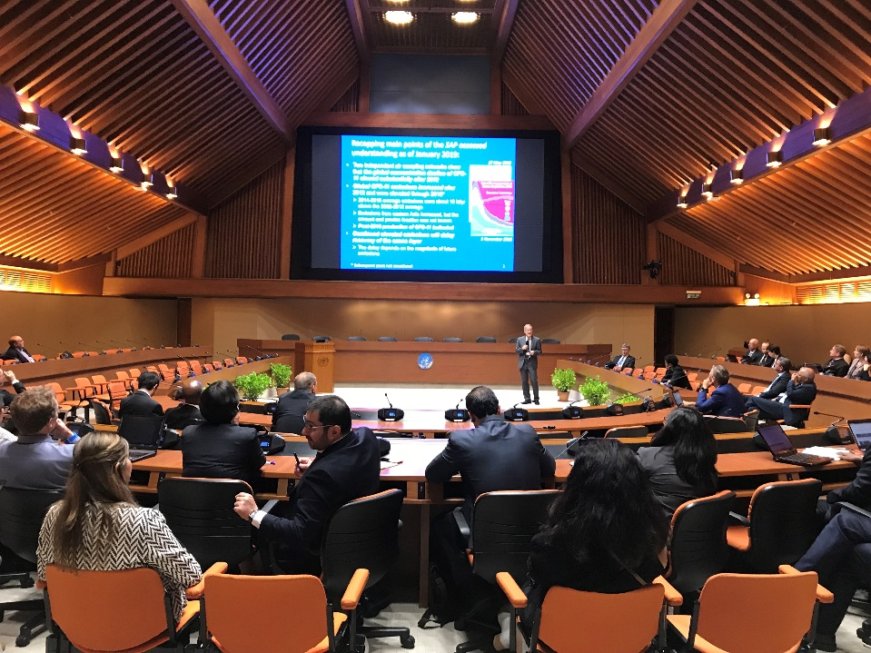
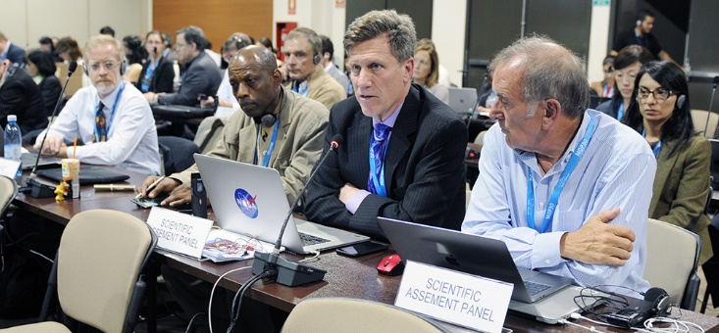
The Parties to the Montreal Protocol consider the findings in their annual meetings in 2018 and 2019:
Ecuadorian President Mr. Lenín Moreno and meeting co-chairs open the meeting
Science Assessment Panel members (+ Dave F.)
Presenting the science to the Parties in side events

Slide 36
Remaining questions:
What is being done about the issue?
The Parties to the Montreal Protocol are:
* taking the issue seriously (recent meetings dominated by this issue)
* looking for more information (meetings held, reports requested)
- what will be the ozone layer impact? Are emissions increasing outside of NE China? What led to the issue? How is the CFC-11 being produced?
…to facilitate rapid mitigation of the issue
They are also:
* reconsidering $$ being transferred to China via the Multi-lateral Fund
(the Protocol’s fund for assisting developing countries with compliance; $1.3 billion was dispersed to China via the MLF since the 1980s…)
- China’s most recent funding allotments were substantially reduced
* considering punitive action (remedial too?)
* considering amendments to the Protocol to prevent future violations
- for ODSs, and wrt the HCFCs phase-out and HFC phase-down
(similar if not larger challenges to monitor adherence to these control schedules seem likely…)

Slide 37
China’s response:
Has repeatedly indicated a commitment to work with other countries, scientists, and industry experts to locate and eliminate the true source of the increased CFC-11 emissions.
Has conducted inspections of 1,172 enterprises across the country, and found instances of illegal production and use (and prosecuted those responsible), but amounts were small (29.9 tonnes and 10 enterprises)
→ not enough to account for atmosphere-based results?
Has formulated a plan of action (with international input and before the Rigby et al paper fingering China in particular) that involves:
- Developing national-scale atmospheric monitoring of ODSs and HFCs
- Building 6 testing laboratories (will help with enforcement)
- Strengthening inspections and enforcement (ecology and environment bureaus, but difficult as businesses are many and officials are few)
- Better tracking of CCl₄ (source material)
- New programs to enhance enforcement
- Facilitating reporting of non-compliance by industry (e.g., competitors)
- Extending penalties to end-users for non-compliance

Slide 38
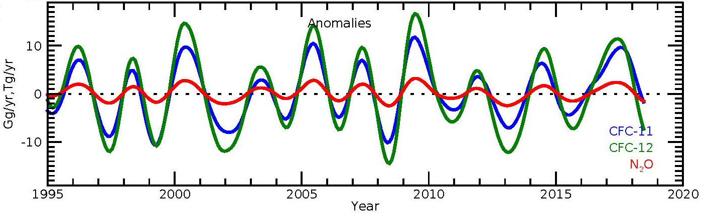
How have things changed since 2017?
with constant dynamics in 3 or 12 box model:
Recalculating emissions with WACCM-derived QBO-related flux anomalies subtracted from the derived box-model results:
← 2018
← 2019
Emiss: constant dynamics
Emiss: dynamics subtracted
?
?
Expected
decrease
Subtracted emission anomalies →
Emission variability in recent years is reduced &
an apparent decrease in 2018 goes away…
10
Emissions
anomalies
Gg/yr(CFCs) or
Tg/yr(N₂O)
0
10
1995
2000
2005
2010
2015
2020
Ray et al., 2020; QBO-related biases on derived annual emission estimates are possible

Slide 39
Concluding remarks:
State-of-the-art atmospheric monitoring and modeling enabled:
→ the early detection of a significant violation of the Montreal Protocol
→ an indication of the location of the renewed source of CFC-11
→ the Parties to consider potential revisions to strengthen the Protocol
That’s all good, but the path to rapid and lasting mitigation remains unclear
→ are there other regions contributing to the increased CFC-11 emissions?
> the delay in ozone layer recovery is not yet well constrained…
More broadly, considering the future:
is our atmospheric “vigilance” capability up to the task (obs., models)?
→ HCFC phase-out, HFC phase down…
→ greenhouse gases whose budgets are much more complex?
If we hope to provide actionable information to policymakers in the future our science capabilities need improving, especially in their ability to quantify, locate, and attribute emissions on global to regional scales.

Slide 40
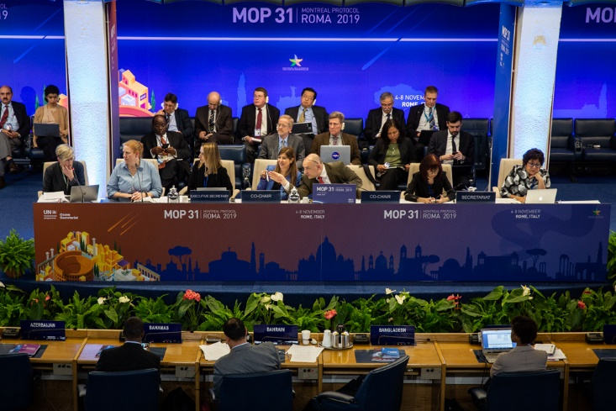
Thanks for your attention
The Science Assessment Panel (+1) at MOP30

Slide 42
Can we locate the region where emissions are increasing?
•
•
•
•
•
ALT
SUM
•
BRW
weekly
hourly
•
MHD
•
•
LEF
•
•
•
THD
•
daily
HFM
•
NWR
bi-weekly
(aircraft)
•
•
MLO
KUM
From our measurements (~25,000 from 2008-2014)
no CFC-11 emission increase is implied for the U.S. over this period (Hu et al., 2017).
Similar conclusions have been drawn for NW Europe
(A. Manning, unpublished)
•
•
SMO
•
CGO
PSA
•
•
•
SPO
Notes:
NOAA network, weekly flasks at remote sites, and in-situ data, but also dairly samples over the US from towers, and bi-weekly from aircraft—vertical monitoring of the atmosphere over the US and a few other locations (RTA).

Slide 43
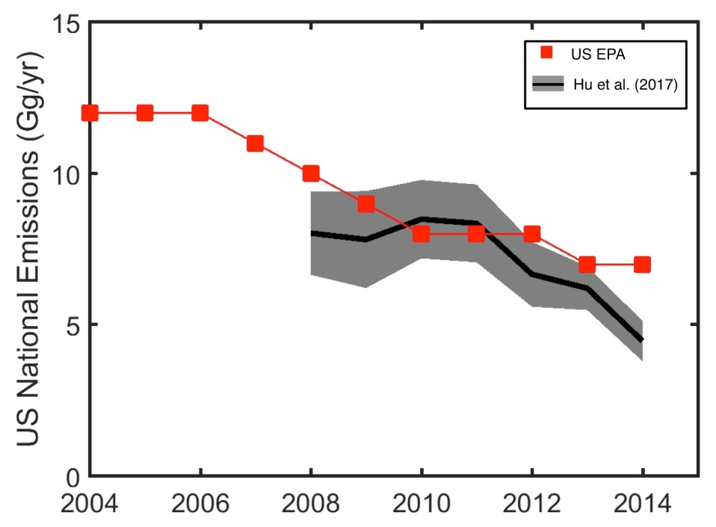
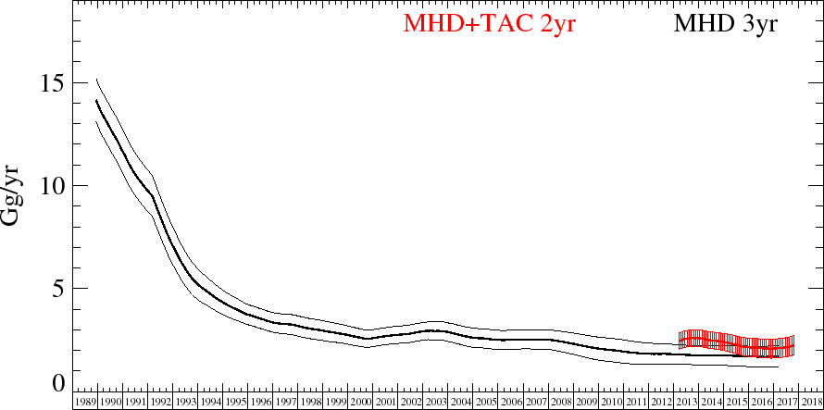
* No significant emission increases are derived from the U.S. based on inverse analyses of these measurements
…or from Europe:
CFC-11 emissions from
western Europe
(unpublished)
CFC-11 emissions from
the continental U.S.
1992
1997
2002
2007
2012
2017
A. Manning (UK Met Office): Derived from measurements (sites MHD and TAC) with procedures to estimate UK emissions of all non-CO₂ Kyoto Protocol gases. These are reported annually in the UK National Inventory Report to the UNFCCC.
Hu et al., GRL, 2017
Derived from measurements (20 sites) over the U.S. (NOAA)

Slide 44
Quantifying magnitudes and locations of emissions
with inverse modeling of atmospheric concentration data
Four components:
Atmospheric concentration data:
  Two independent measurement locations and programs (GSN and HAT)
Meteorological data:
  UK Met Office Unified Model (3 hr, ~0.6→0.1º longitude x 0.4→0.1º latitude)
  ECMWF (0.2º x 0.2º over NE China, 1ºx1º over the globe)
Lagrangian transport models:
  NAME driven with UK Met Office Met. data
  FLEXPART driven with ECMWF Met. data
Inverse modeling frameworks:
  NAME/InTEM (Met Office); NAME-HB (U. Bristol); FLEXPART-Bayesian1 (MIT); FLEXPART-Bayesian2 (Empa)
In Rigby et al., four different state-of-the-art inversion systems were used to derive emission estimates based on measurements at GOSAN and HATERUMA
13

Slide 45
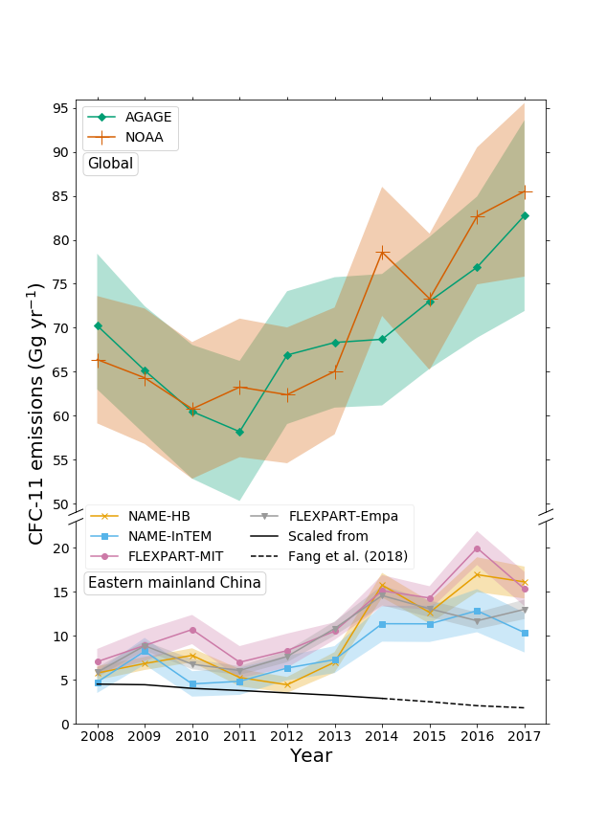
Emissions derived from FOUR different Inversion approaches
(averaged over MULTIPLE years for TWO different time intervals)
Global total
Global totals from NOAA and AGAGE (Montzka et al., SAP 2018) updated beyond 2016:
→ emissions in 2017 remain elevated.
CFC-11 emission (kt/yr)
Eastern mainland China
Solid black line is inventory-based estimate
Figure 2, Rigby et al., 2019
19

Slide 46
Prospects for improved future understanding
2018
Montzka et al.
* global CFC-11 emissions increasing
* eastern Asian emissions increasing
* new production suggested
Informing the Parties to the Protocol
* results confirmed with 2nd sampling network
SAP Assessment
* two Chinese provinces
account for much of the
global emission increase
* new production suggested
2019
Rigby
et al.
In the
future
✓
Updated
measurements
Past
×
Information for
additional regions → for past years
→ for future years
Future
More accurate global and regional estimates
??
✓
(CFCs, HCFCs, HFCs??)

Slide 47
Recap of the scientific capabilities that allowed us to discern a substantial violation of the Montreal Protocol:
Sustained global-scale observations:
  - Long-term, highly consistent, global coverage, redundancies within and among independent groups
Sustained regional-scale observations:
  - long-term, in many regions of interest
Global Modeling expertise
Regional inverse modeling expertise
(both relying on including accurate meteorological reanalysis data):
- enabling quantification and spatial attribution of regional emissions
Only possible with sustained efforts over decades to enhance our understanding of measurement science and the physics and chemistry of the atmosphere on global-to-regional scales…

