Slide 1
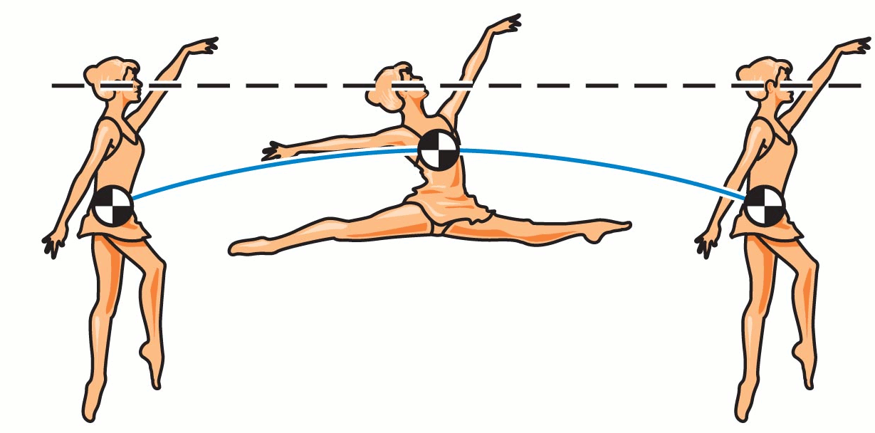
PHY131H1F - Class 14
Today, we are starting Chapter 9 on Momentum:
Centre of Mass
Momentum of systems
http://www.chegg.com/homework-help/questions-and-answers/grand-jete-classic-ballet-manoeuvre-dancer-executes-horizontal-leap-moving-arms-legs--cent-q5975347

Slide 2
From Fall 2017 PHY131H1F Midterm Test 2

Slide 3
Learning Catalytics Question 1
Where do you think is the centre of mass of this object?

Slide 4
Last day I asked at the end of class:
How is it possible to clear the bar in a high jump if your center of mass does not reach to the height of the bar?
ANSWER:
For a projectile, the motion of the centre of mass is governed by the equations of constant acceleration we already know.
The center of mass of a complicated shape (like a person doing a back arch) does not need to be within the object.

Slide 5
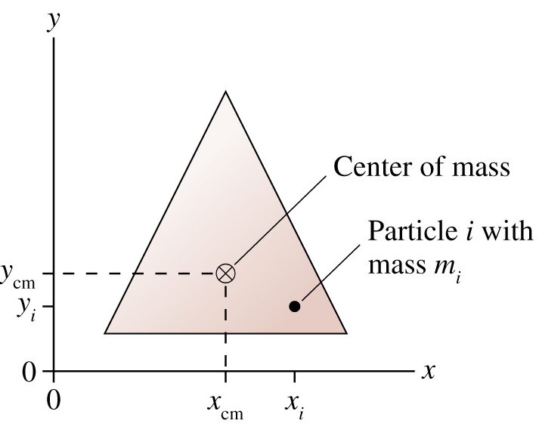
Center of Mass
Consider an object made of particles. Particle i has mass m_{i}. The center-of-mass is at
Calculating center of mass is much like calculating your grade-point average. Marks in full-courses count twice as much as marks in half-courses. Particles of higher mass count more than particles of lower mass.

Slide 6
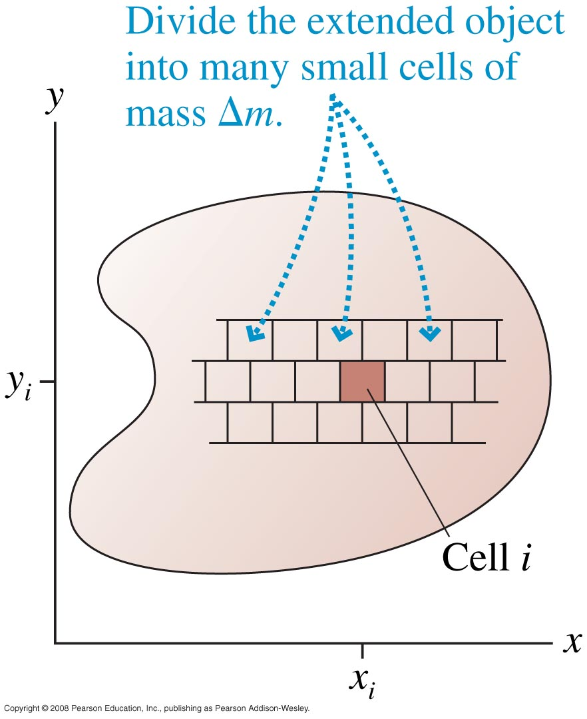
Center of Mass of a Solid Object
Divide a solid object into many small cells of mass Δm. As and is replaced by dm, the sums become
Before these can be integrated:
dm must be replaced by expressions using dx and dy.
Integration limits must be established.

Slide 7
Where is the centre of mass of a semicircular ring?
Notes:
7
Answer: D

Slide 8
Rotation About the Center of Mass
An unconstrained object (i.e., one not on an axle or a pivot) on which there is no net force rotates about a point called the center of mass.
The center of mass remains motionless while every other point in the object undergoes circular motion around it.
[Image from http://resources.yesican-science.ca/discover_2006_2/images/hammer2.jpg ]

Slide 9
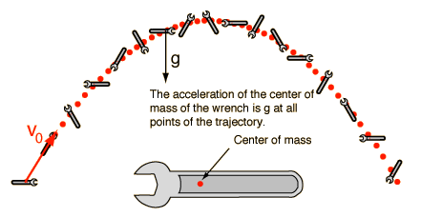
[image from http://hyperphysics.phy-astr.gsu.edu/hbase/mechanics/n2ext.html ]

Slide 10
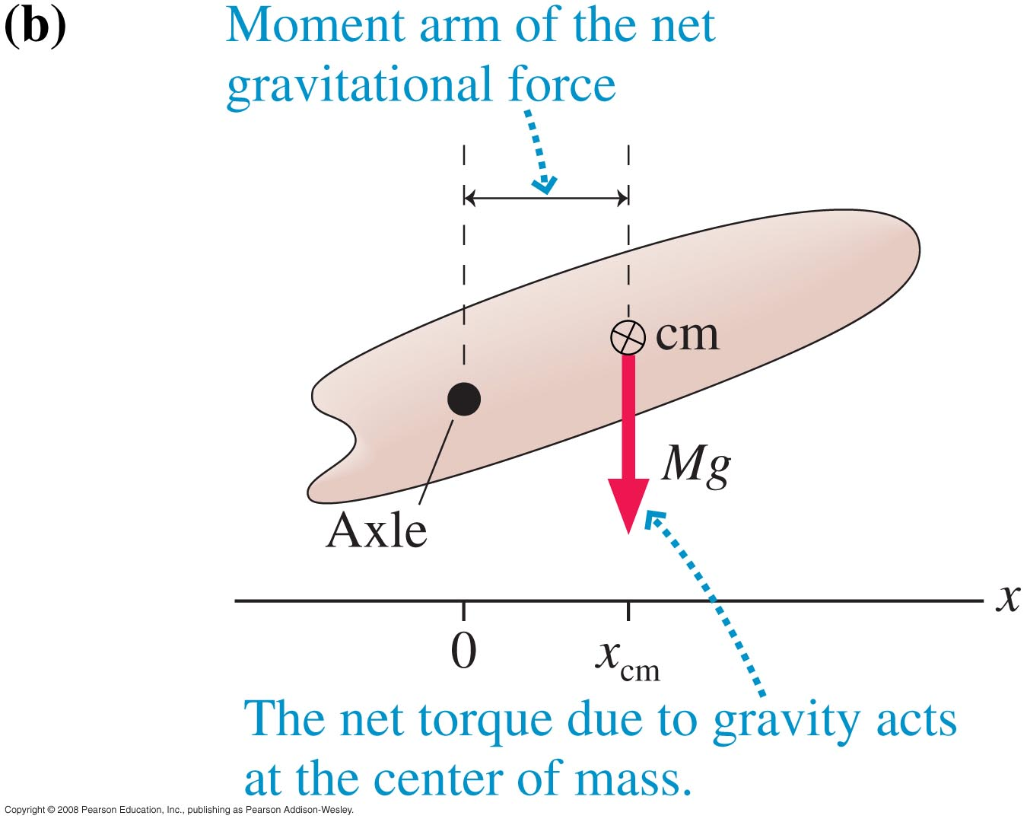
Gravitational Torque
When calculating the torque due to gravity, you may treat the object as if all its mass were concentrated at the centre of mass.
More about this in Chapter 10!

Slide 11
Chapter 9 big idea: “Conservation of Momentum”
A system of particles has a total momentum,
If the system is isolated, meaning that there is no external net-force acting on the system, then:
This means the momentum is “conserved”; it doesn’t change over time.

Slide 12
Chapter 9 summary:

Slide 13
Learning Catalytics Question 2
Two particles collide, one of which was initially moving, and the other initially at rest. Is it possible for both particles to be at rest after the collision? [Assume no outside forces act on the particles.]
Yes
No

Slide 14
Learning Catalytics Question 3
Two particles collide, one of which was initially moving, and the other initially at rest. Is it possible for one particle to be at rest after the collision? [Assume no outside forces act on the particles.]
Yes
No

Slide 15
A yellow Hummer (m_{H} = 3900 kg) was driving South and collided with a blue Toyota (m_{T} = 1200 kg) which was driving East. The speed limit on both roads is 50 km/hr.
After the collision, the two cars stuck together and the combined mass skidded along the ground.
The police measure that the skid marks are a line 10 m long, angled 32°East of South.
The coefficient of kinetic friction between rubber and road is 0.8.
How fast were the cars going before the collision? Who is at fault?
Notes:
15
Answer: D

Slide 16
Notes:
16
Answer: D

Slide 17
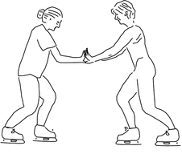
Learning Catalytics Question 4
Two ice skaters, Paula and Ricardo, push off from each other. They were both initially at rest. Ricardo has a greater mass than Paula. Which skater has the greater magnitude of momentum after the push-off?
Ricardo
Paula
neither

Slide 18
Learning Catalytics Question 5
Two ice skaters, Paula and Ricardo, push off from each other. They were both initially at rest. Ricardo has a greater mass than Paula. Which skater has the greater speed after the push-off?
Ricardo
Paula
neither

Slide 19
Before Class 15 on Wednesday
Remember MasteringPhysics.com Problem Set 6 on Ch.7 is due tonight by 11:59pm!!
Please finish reading Chapter 9 and/or watch Preclass 15 Video:
Something to think about:
Consider the two integrals below. What’s the difference? [Hint: one is the change in energy of an object, and one is the change in momentum of an object.]
$$\vec{J}=\int{\vec{F}dt}$$
$$W=\int{\vec{F}∙d\vec{r}}$$

