Slide 1
PHY131H1F - Class 18
Today:
Today, Chapter 11:
Angular velocity and Angular acceleration vectors
Torque and the Vector Cross Product
Angular Momentum
Conservation of Angular Momentum
Gyroscopes and Precession
From https://www.vat19.com/item/fidget-spinner-whisper-quiet

Slide 2
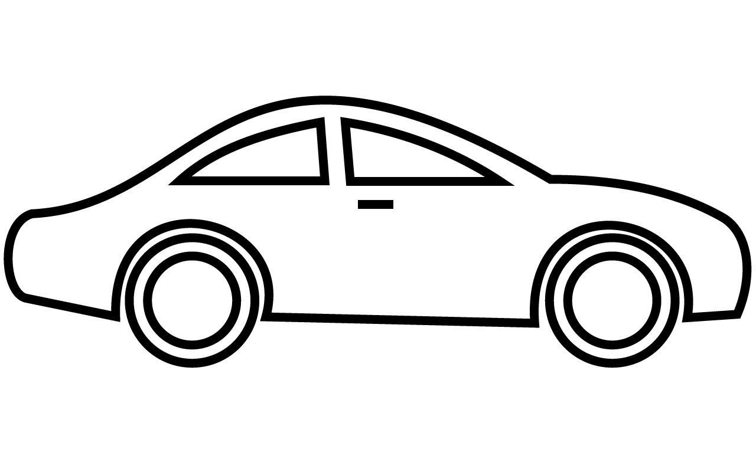
Learning Catalytics Question (part 1 of 2)
$$\vec{a}$$
$$τ_{engine}$$
You are sitting in your car, and you step on the gas pedal. The car accelerates forward.
Your car has Front Wheel Drive (FWD). That means the front two wheels are connected to the engine, but the back two wheels just freely rotate on their axles.
As you accelerate, what is the direction of the force of static friction of the road upon the front wheels?
Forward
Backward
The static friction force on the front wheels is zero

Slide 3
Learning Catalytics Question (part 2 of 2)
$$\vec{a}$$
$$τ_{engine}$$
You are sitting in your car, and you step on the gas pedal. The car accelerates forward.
Your car has Front Wheel Drive (FWD). That means the front two wheels are connected to the engine, but the back two wheels just freely rotate on their axles.
As you accelerate, what is the direction of the force of static friction of the road upon the rear wheels?
Forward
Backward
The static friction force on the rear wheels is zero

Slide 4
The Vector Description of Rotational Motion
One-dimensional motion uses a scalar velocity v and force F.
A more general understanding of motion requires vectors and .
Similarly, a more general description of rotational motion requires us to replace the scalars ω and τ with the vector quantities and .
Doing so will lead us to the concept of angular momentum.
Notes:
4

Slide 5
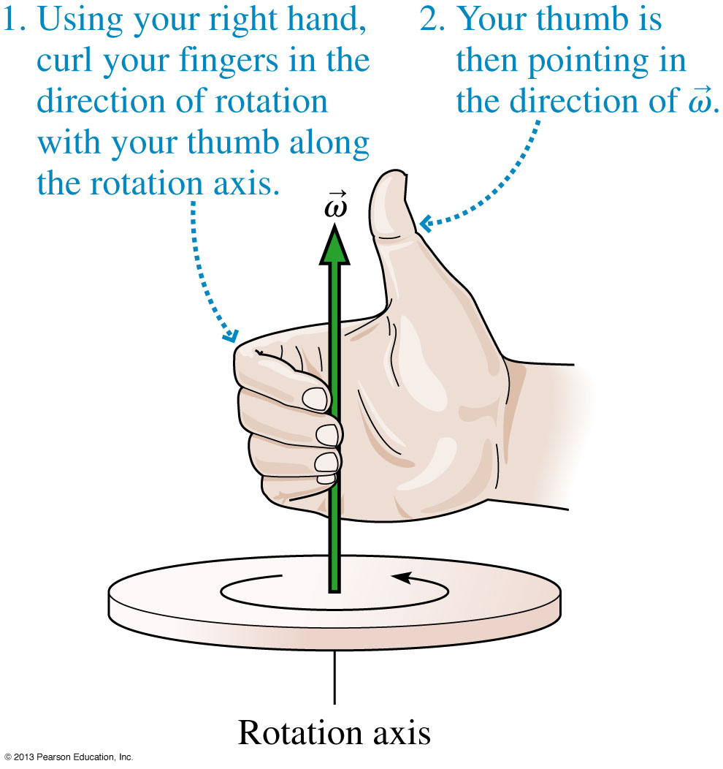
The Angular Velocity Vector
The magnitude of the angular velocity vector is ω.
The angular velocity vector points along the axis of rotation in the direction given by the right-hand rule as illustrated.
Notes:
5

Slide 6
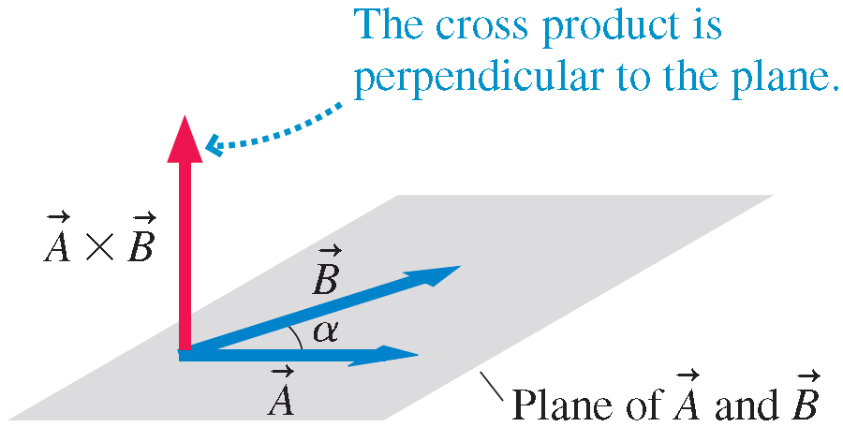
The Cross Product of Two Vectors
The scalar product (dot) is one way to multiply two vectors, giving a scalar. A different way to multiple two vectors, giving a vector, is called the cross product.
If vectors and have angle α between them, their cross product is the vector:
Notes:
6

Slide 7
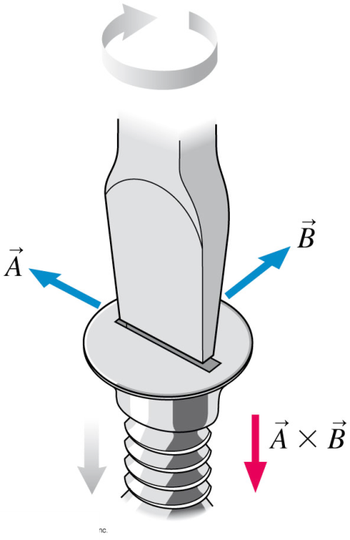
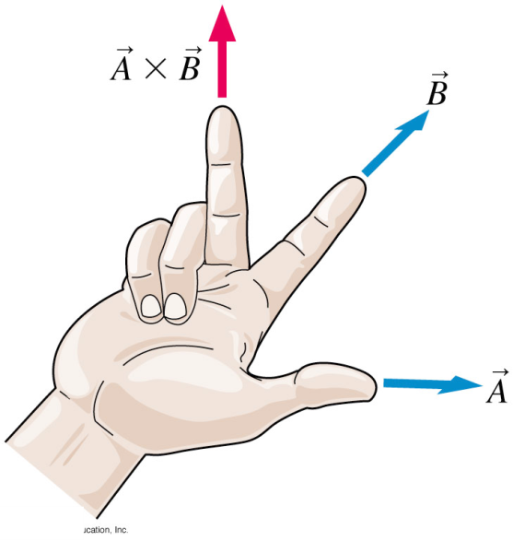
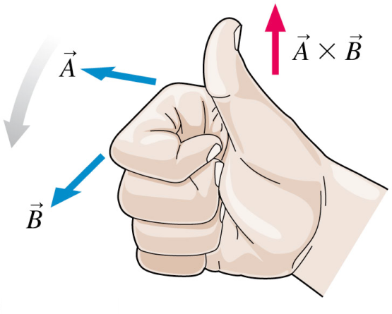
The Right-Hand Rule
The cross product is perpendicular to the plane of and . The right-hand rule for the direction comes in several forms. Try them all to see which works best for you.
Note that .
Instead, .
Notes:
7

Slide 8
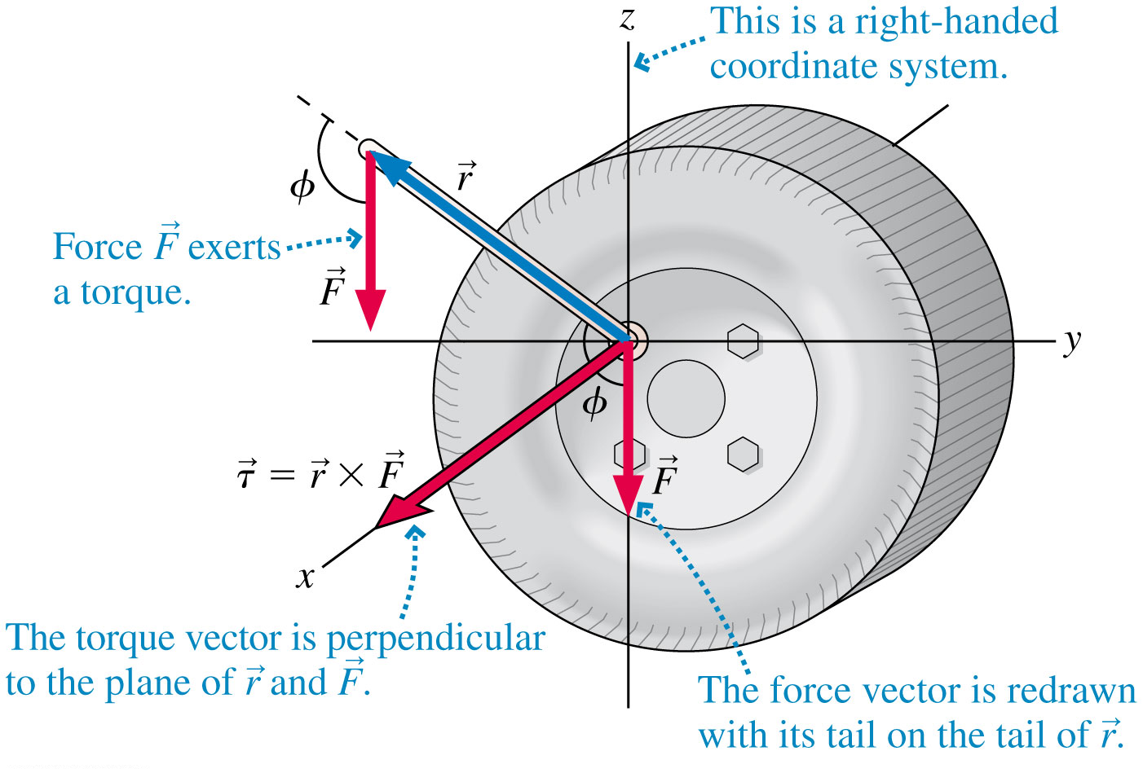
The Torque Vector
We earlier defined torque τ = rFsinϕ. r and F are the magnitudes of vectors, so this is a really a cross product:
A tire wrench exerts a torque on the lug nuts.
Notes:
8

Slide 9
Learning Catalytics Discussion Question
“Lefty-loosey, righty-tighty.”
In order to loosen the nuts on a flat tire, a woman attaches the wrench so that it sticks out to the left, and then she presses down on it with her foot.
What is the direction of the torque vector she applies to the nut?
Left
Right
Up
Down
Into the page
Out of the page
http://www.gettyimages.ca/detail/photo/woman-changing-flat-tyre-on-car-royalty-free-image/599018624
Notes:
9

Slide 10
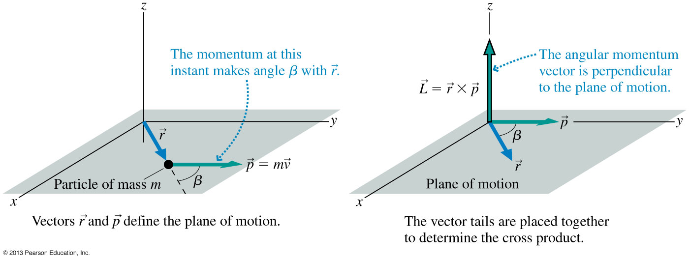
Angular Momentum of a Particle
A particle of mass m is moving. The particle’s momentum vector makes an angle β with the position vector.
Notes:
10

Slide 11
Angular Momentum of a Particle
Why this definition?
If you take the time derivative of and use the definition of the torque vector, you find:
Torque causes a particle’s angular momentum to change. This is the rotational equivalent of and is a general statement of Newton’s second law for rotation.
Notes:
11

Slide 12
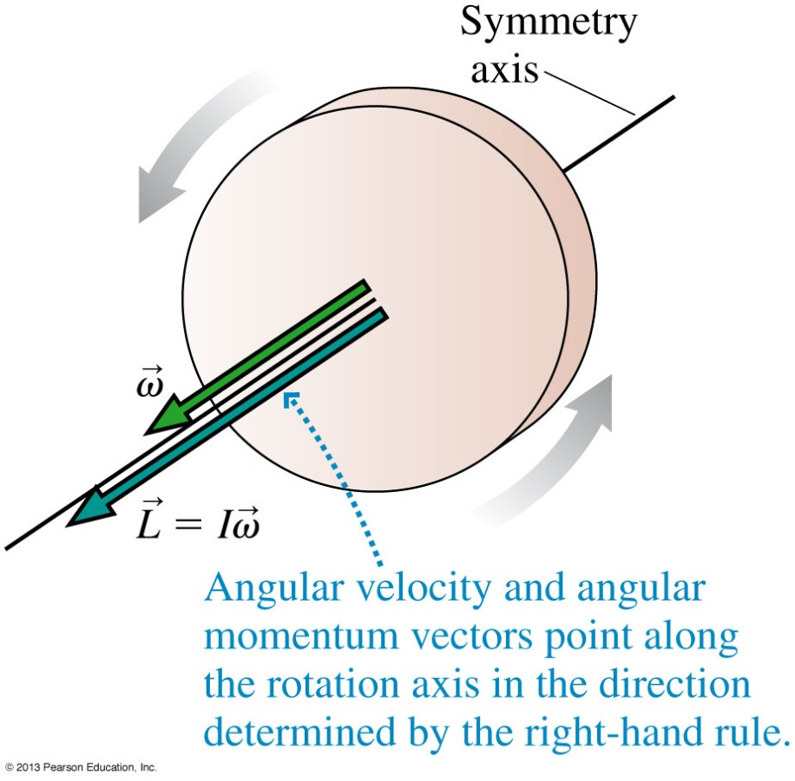
Angular Momentum of a Rigid Body
For a rigid body, we can add the angular momenta of all the particles forming the object. If the object rotates
on a fixed axle, or
about an axis of symmetry
then it can be shown that
And it’s still the case that .
Notes:
12

Slide 13
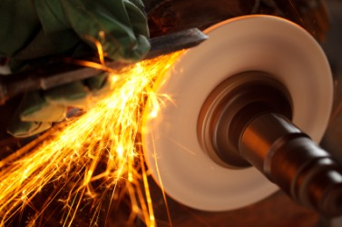
Angular Momentum
Angular momentum = rotational inertia × rotational velocity
This is analogous to
Linear momentum = mass × velocity
$$\vec{L}=I\vec{ω}$$
$$\vec{p}=m\vec{v}$$

Slide 14
Learning Catalytics Discussion Question
$$\vec{v}$$
You are driving your car towards the right.
What is the direction of the angular momentum, $\vec{L}$, of the wheels?
Left
Right
Up
Down
Into the page
Out of the page

Slide 15
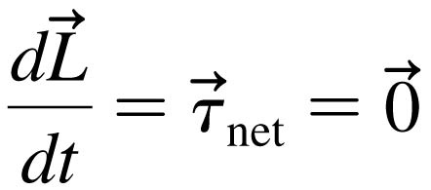
Conservation of Angular Momentum
An isolated system that experiences no net torque has
and thus the angular momentum vector is a constant.
Notes:
15

Slide 16
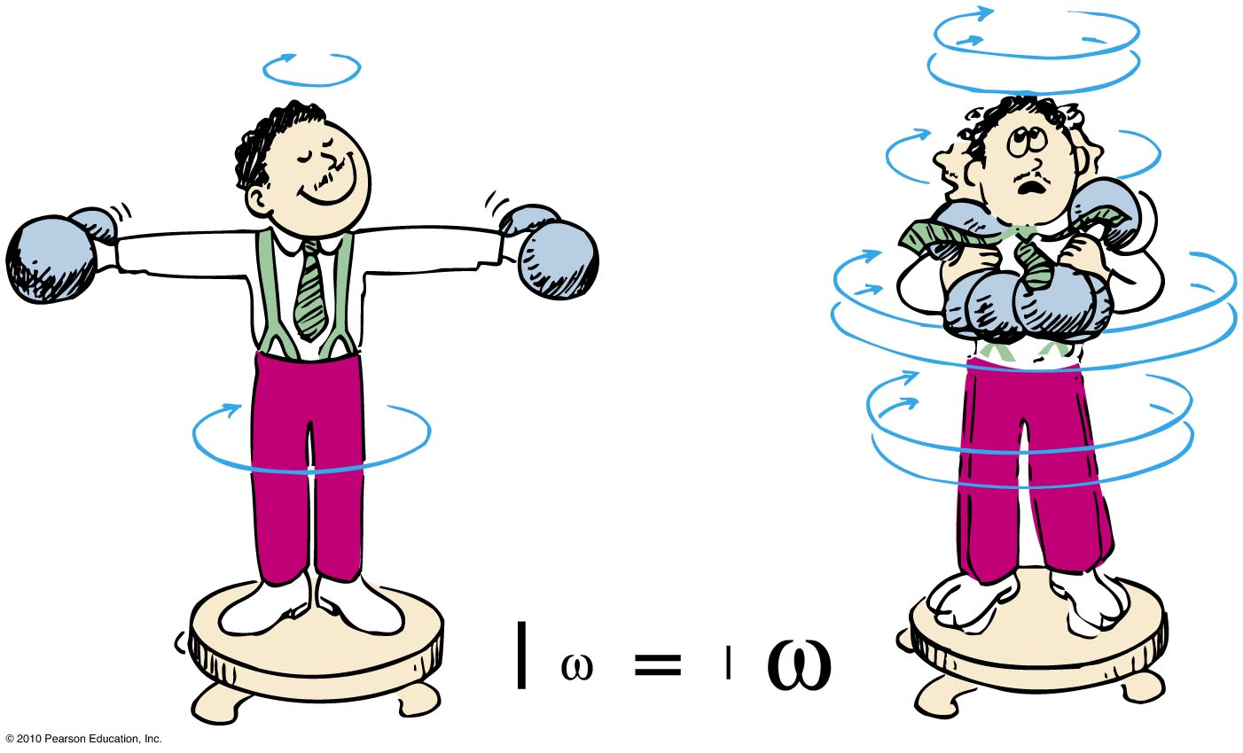
Conservation of Angular Momentum
Example:
When the professor pulls the weights inward, his rotational speed increases!

Slide 17
EXAMPLE 12.19 Two Interacting Disks
Notes:
17

Slide 18
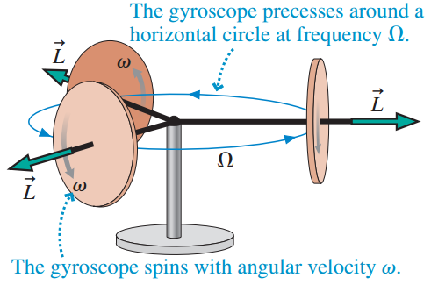
Precession of a Gyroscope
Consider a horizontal gyroscope, with the disk spinning in a vertical plane, that is supported at only one end of its axle, as shown.
You would expect it to simply fall over—but it doesn’t.
Instead, the axle remains horizontal, parallel to the ground, while the entire gyroscope slowly rotates in a horizontal plane.
This steady change in the orientation of the rotation axis is called precession, and we say that the gyroscope precesses about its point of support.
Notes:
18

Slide 19
Precession of a Gyroscope
The precession frequency of a gyroscope, in rad/s, is
$$Ω=\frac{Mgd}{Iω}$$
Here M is the mass of the gyroscope, I is its moment of inertia, and d is the horizontal distance of the center of mass from the support point.
The angular velocity of the spinning gyroscope is assumed to be much larger than the precession frequency; ω >> Ω.
Notes:
19

Slide 20
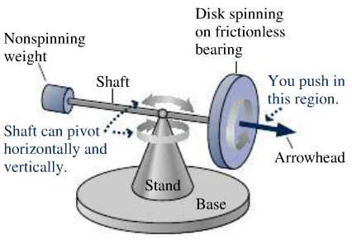
Precession of a Gyroscope
Wolfson end-of-chapter 11.65
If you push on the shaft between the arrowhead and the disk, pushing horizontally away from you (ie, into the page), the arrowhead end of the shaft will move
Away from you (ie into the page)
Toward you (ie, out of the page)
Downward
Upward.
Notes:
20

Slide 21
Precession of a Gyroscope
Wolfson end-of-chapter 11.66
If you push on the shaft between the arrowhead and the disk, pushing directly upward on the bottom of the shaft, the arrowhead end of the shaft will move
Away from you (ie into the page)
Toward you (ie, out of the page)
Downward
Upward.
Notes:
21

Slide 22
Precession of a Gyroscope
Wolfson end-of-chapter 11.67
If an additional weight is hung on the left end of the shaft, the arrowhead will
pivot upward until the weighted end of the shaft it’s the base.
pivot downward until the arrowhead hits the base.
precess counterclockwise when viewed from above.
precess clockwise when viewed from above.
Notes:
22

Slide 23
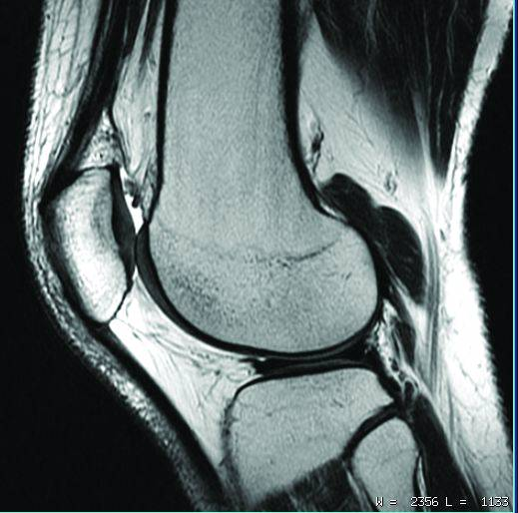
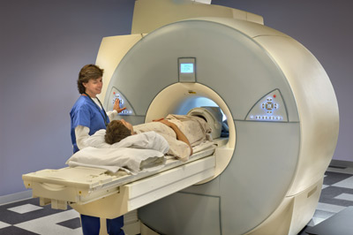
Nuclear Magnetic Resonance
A proton in the nucleus of an atom is like a little spinning top.
When placed in a strong static magnetic field, the magnetic force produces a torque on the proton, which causes it to precess.
The precession frequency is in the radio-frequency range, which allows the proton to absorb and re-emit radio-waves.
This allows doctors to image inside the human body using completely harmless radio waves.
Notes:
23

Slide 24
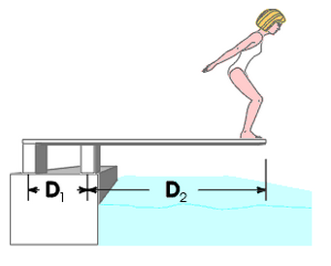
Before Class 19 on Wednesday
Please read chapter 12 on Static Equilibrium, or at least watch the Preclass 19 Video.
Problem Set 9 on Chapters 10 and 11 is due Monday at 11:59pm.
Something to think about over the weekend: The supports to the diving board provide a vertical force on the board so the girl will not fall. What are the directions of the force on the board at point 1 and point 2: up or down? Why?
1
2

