Slide 1
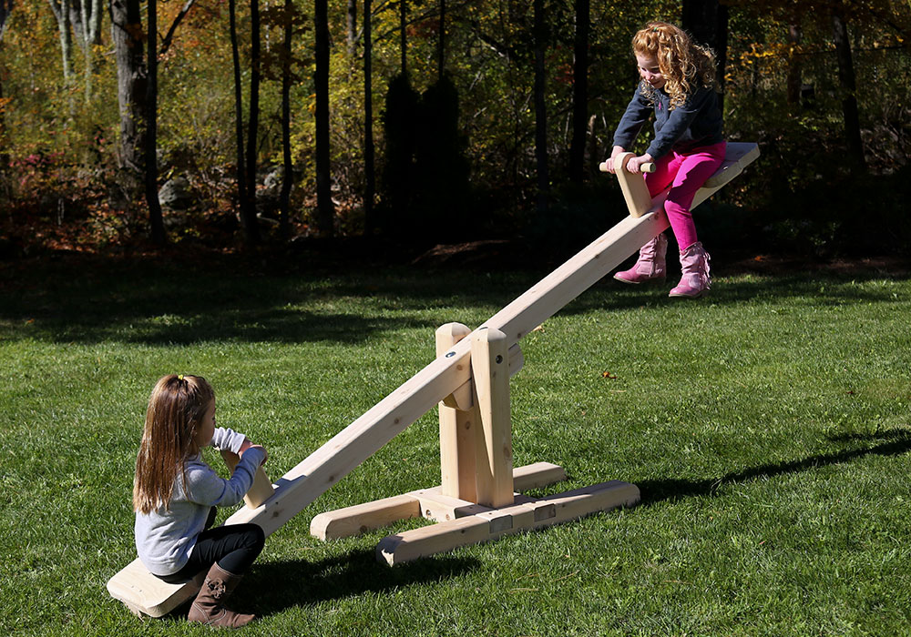
PHY131H1F - Class 19
Today, Chapter 12:
Conditions for Static Equilibrium
Center of Gravity
Static Equilibrium Problems
Stability

Slide 2
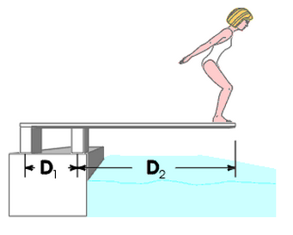
Last day I asked
The supports to the diving board provide a vertical force on the board so the diver will not fall. What are the directions of the force on the board at point 1 and point 2: up or down? Why?
1
2
4 m
100 N
1 m

Slide 3
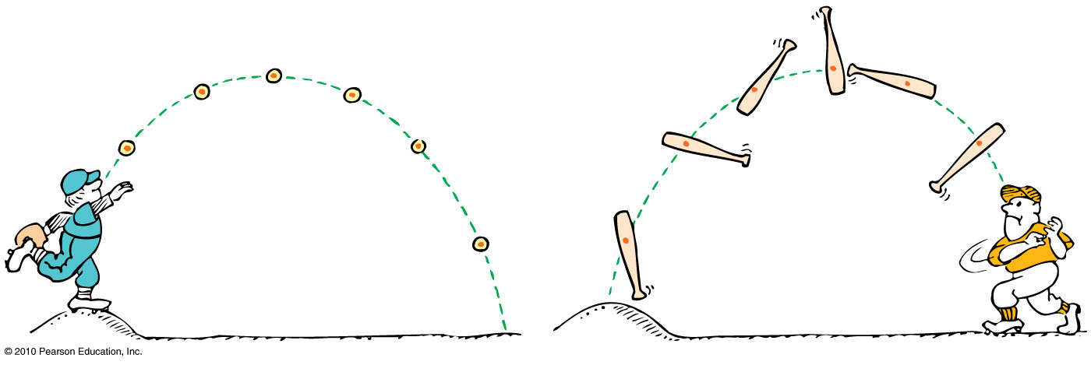
Centre of mass is the average position of all the mass that makes up the object.
Centre of gravity (CG) is the average position of weight distribution.
Since here on Earth weight and mass are proportional, centre of gravity and centre of mass always refer to the same point of an object.

Slide 4
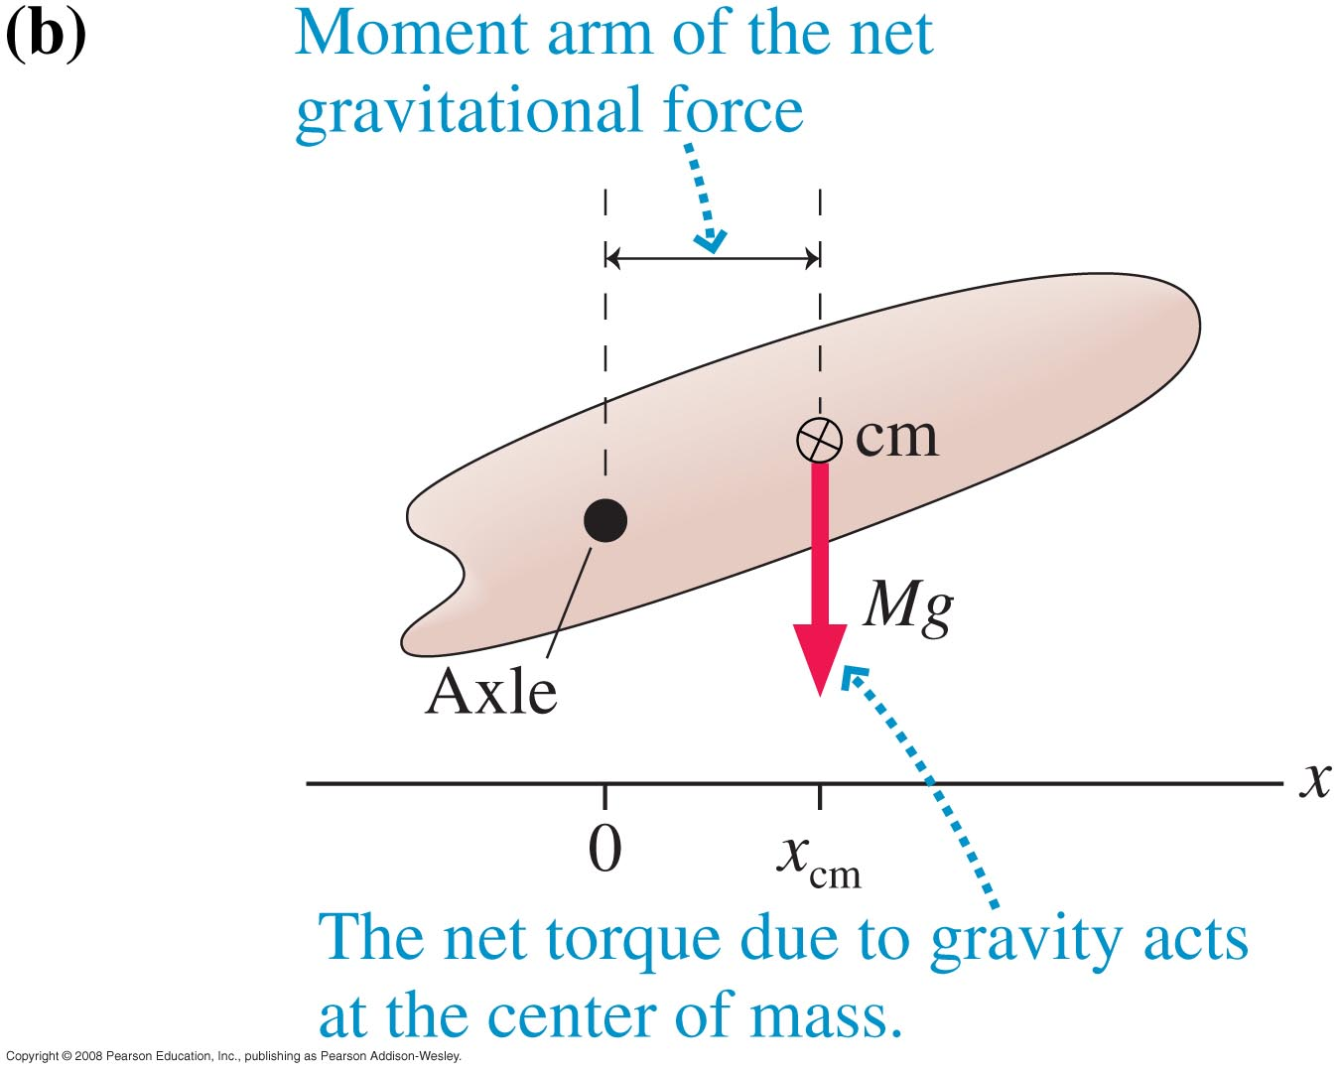
Gravitational Torque
When calculating the torque due to gravity, you may treat the object as if all its mass were concentrated at the centre of mass.

Slide 5
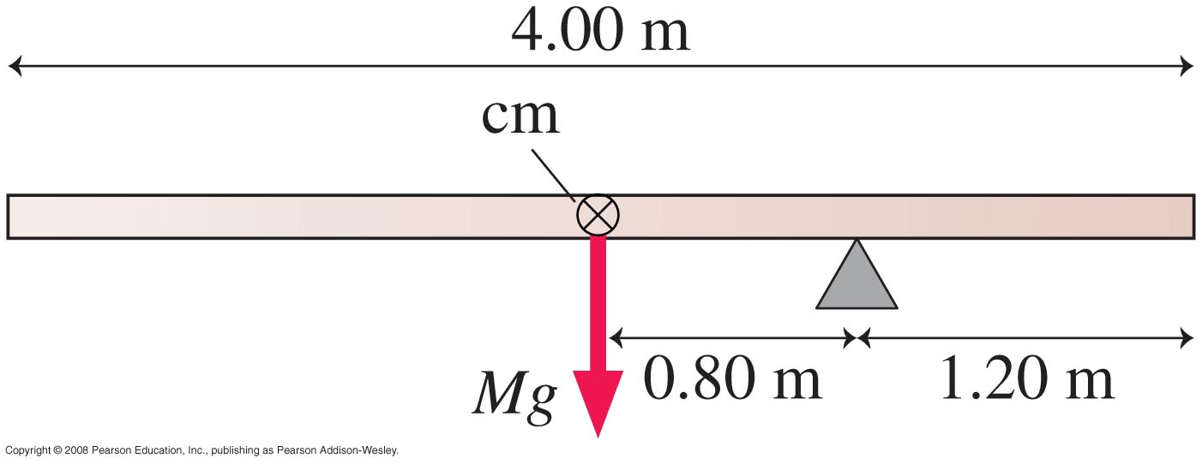
A 4.00 m long, 500 kg steel beam is supported 1.20 m from the right end. What is the gravitational torque about the support?

Slide 6
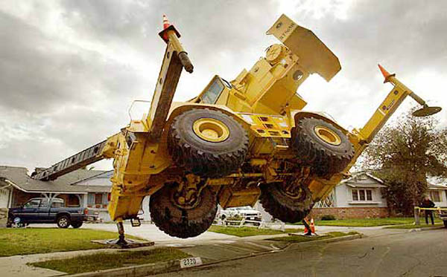
Equilibrium When Rotation is Possible
The condition for a rigid body to be in static equilibrium is that there is no net force and no net torque.
No matter which pivot point you choose, an object that is not rotating is not rotating about that point.
For a rigid body in total equilibrium, there is no net torque about any point.

Slide 7
Static Equilibrium Problems
In equilibrium, an object has no net force and no net torque.
Draw an extended free-body diagram that shows where each force acts on the object.
Set up x and y axes, and choose a rotation axis. All of these choices should be done to simplify your calculations.
Each force has an x and y component and a torque. Sum all of these up.
Three equations which you can use are:

Slide 8
Learning Catalytics Question. An object could be in static equilibrium when
only one force is acting on it.
two or more forces are acting on it.
only one torque is acting on it.
Notes:
Answer: b

Slide 9
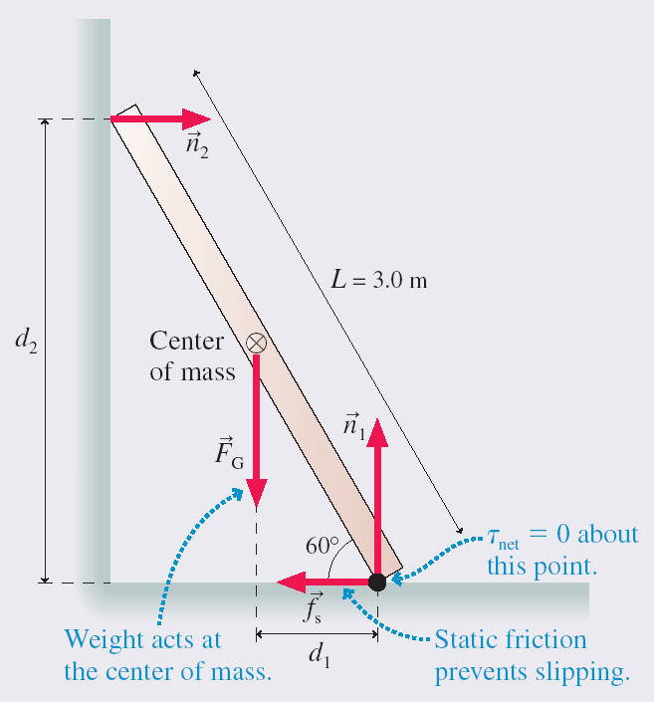

Slide 11
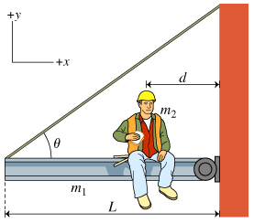
A uniform steel beam of length L and mass m₁ is attached via a hinge to the side of a building.
The beam is supported by a steel cable attached to the end of the beam at an angle θ, as shown.
Through the hinge, the wall exerts an unknown force, $\vec{F}$, on the beam.
A workman of mass m₂ sits eating lunch a distance d from the building.
Find T, the tension in the cable.
Find F_{x}, the x-component of the force exerted by the wall on the beam ($\vec{F}$), using the axis shown.

Slide 12
Find T, the tension in the cable.

Slide 13
Find F_{x}, the x-component of the force exerted by the wall on the beam ($\vec{F}$), using the axis shown.

Slide 14
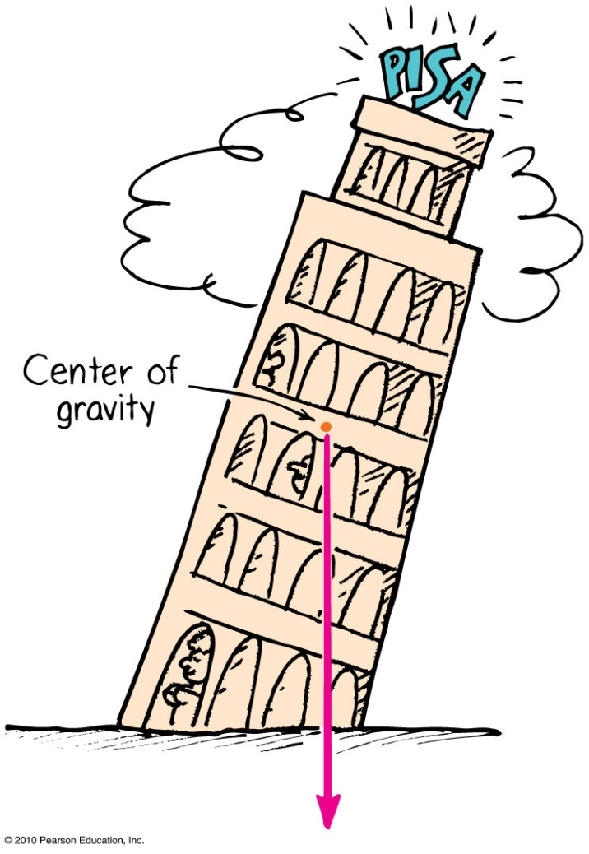
Centre of Gravity—Stability
The location of the centre of gravity is important for stability.
If we draw a line straight down from the centre of gravity and it falls inside the base of the object, it is in stable equilibrium; it will balance.
If it falls outside the base, it is unstable.

Slide 15
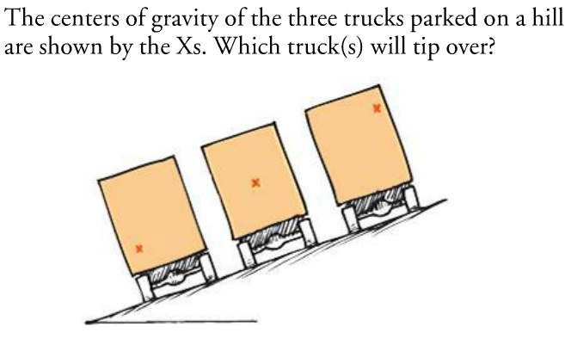
Learning Catalytics Question
C
B
A
D. All three of the trucks will tip over.
E. None of the three will tip over.

Slide 16
Demo and example
One block of length L is hanging off the edge of a table. How far off the edge can it go without tipping?
Notes:
Answer: B

Slide 17
Demo and example
Two blocks have length L. The top one is hanging a distance L/2 off the one below it.
How far off the edge can the bottom block be before the entire stack topples over?
Notes:
Answer: B

Slide 18
Demo and example
Three blocks have length L. The top one is hanging a distance L/2 off the one below it. The one below that is hanging a distance L/4 off the one below it.
How far off the edge can the bottom block be before the entire stack topples over?
Notes:
Answer: B

Slide 19
Demo and example
Three blocks have length L. The top one is hanging a distance L/2 off the one below it. The one below that is hanging a distance L/4 off the one below it. The one below that is hanging a distance L/6 off the one below it.
How far off the edge can the bottom block be before the entire stack topples over?
Notes:
Answer: B

Slide 20
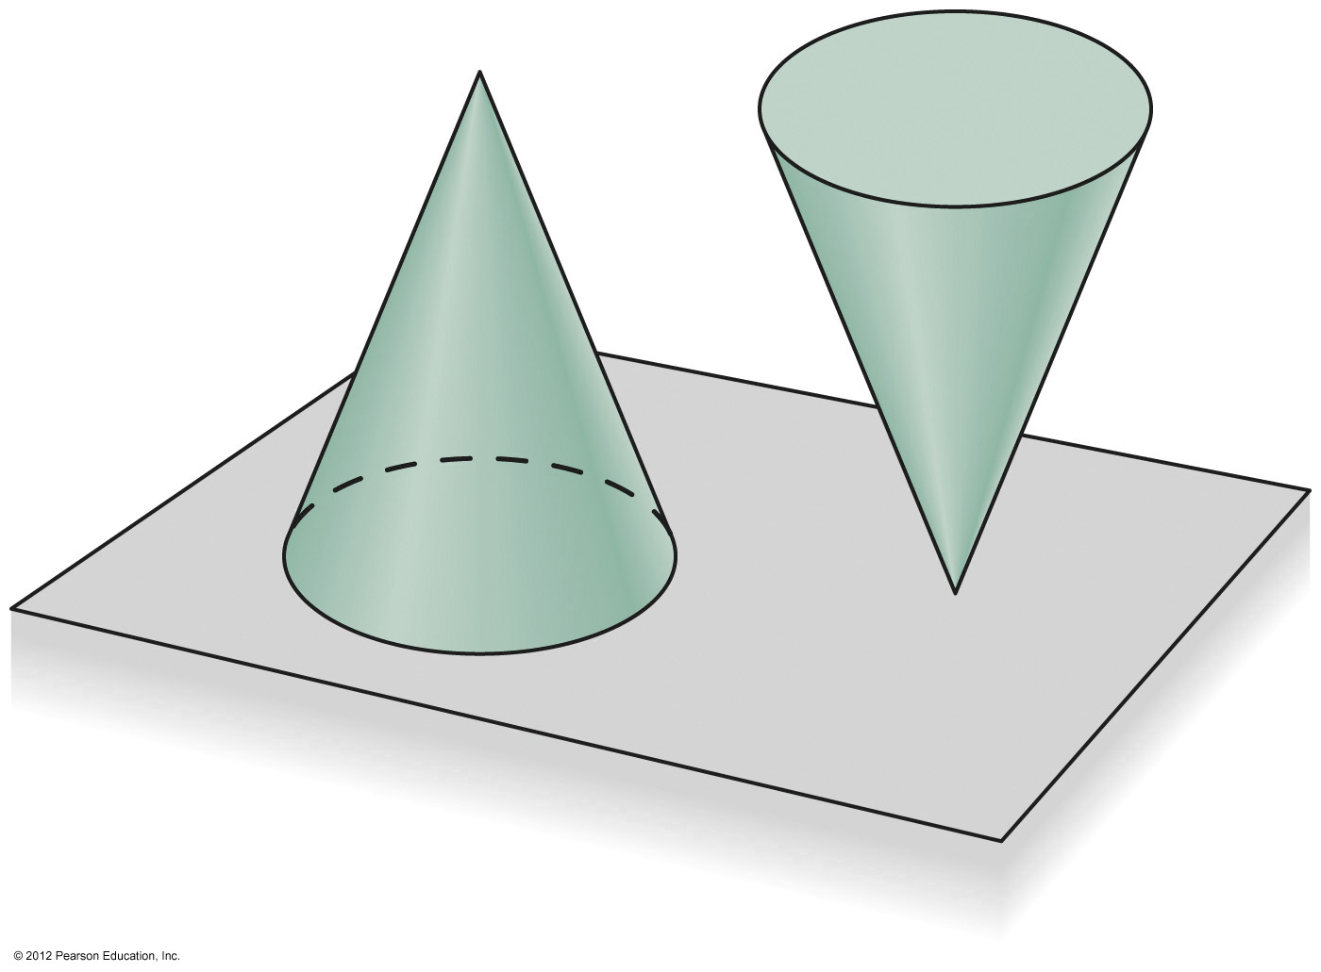
Stability
An equilibrium is stable if a slight disturbance from equilibrium results in forces and/or torques that tend to restore the equilibrium.
An equilibrium is unstable if a slight disturbance causes the system to move away from the original equilibrium.
Cone on its base is stable
Cone on its tip is unstable

Slide 21
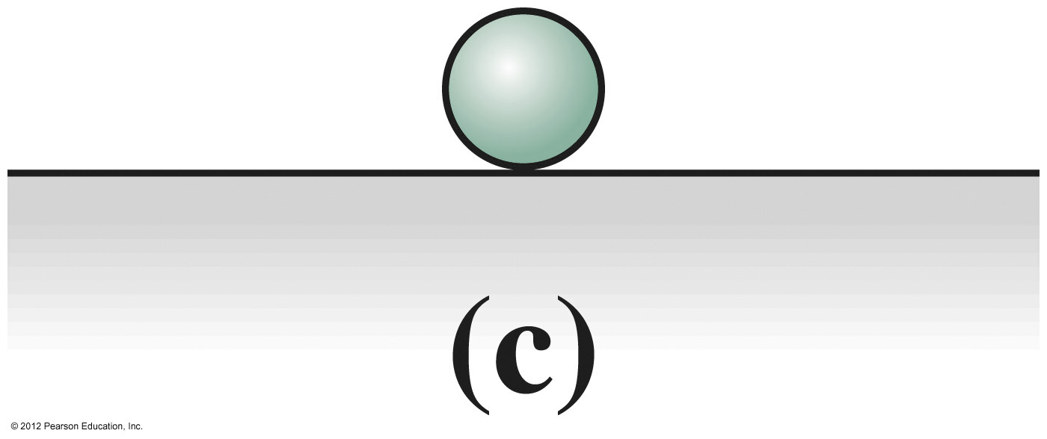
Kinds of Stability
What kind of equilibrium is this?
Stable
Neutrally stable
Unstable
Metastable

Slide 22
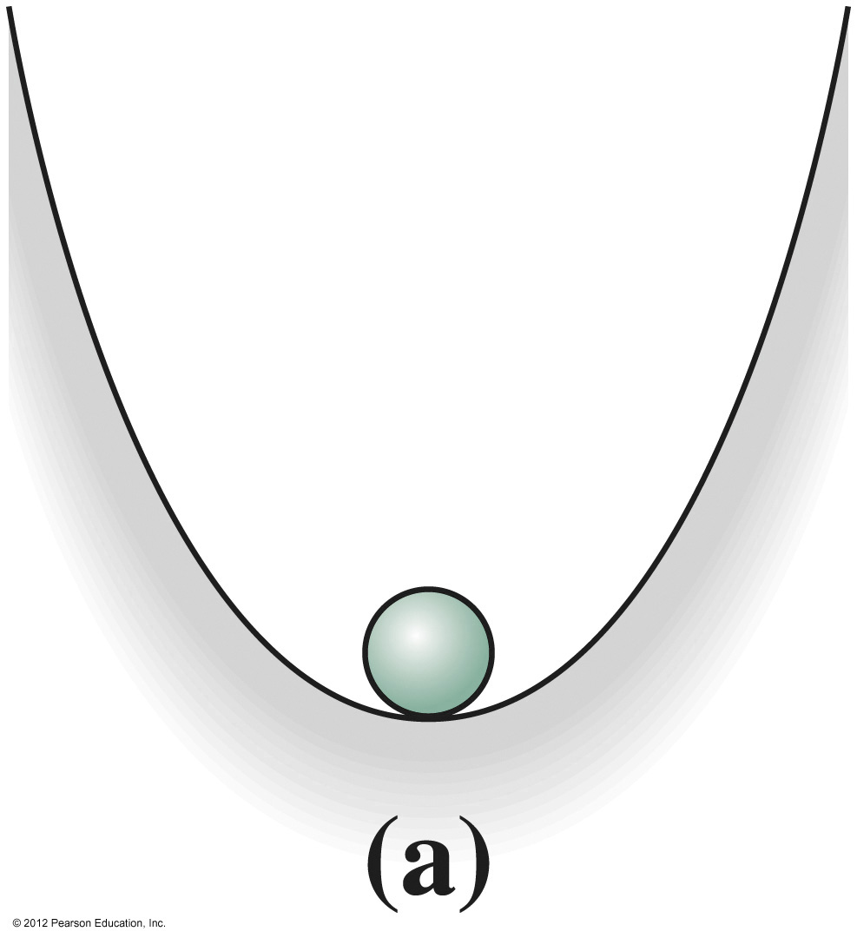
Kinds of Stability
What kind of equilibrium is this?
Stable
Neutrally stable
Unstable
Metastable

Slide 23
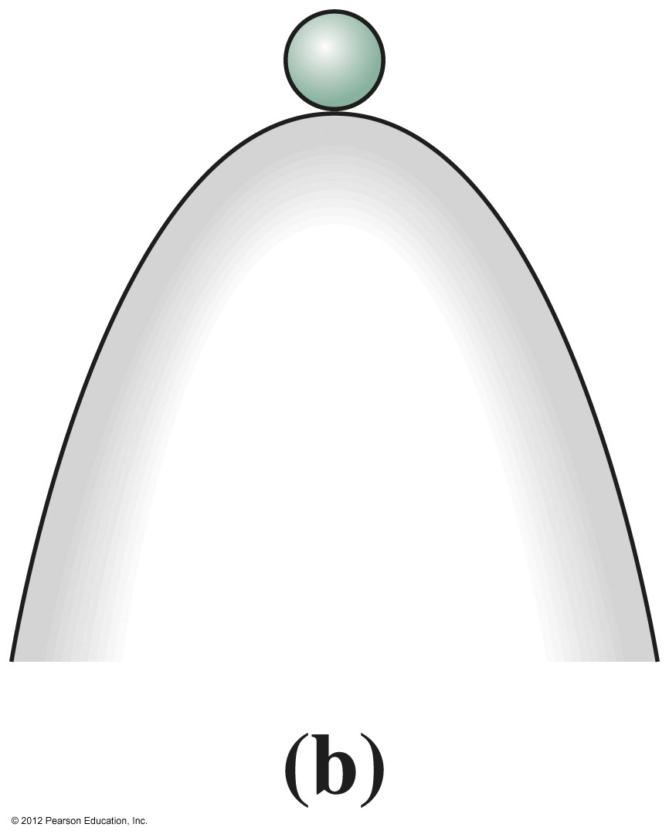
Kinds of Stability
What kind of equilibrium is this?
Stable
Neutrally stable
Unstable
Metastable

Slide 24
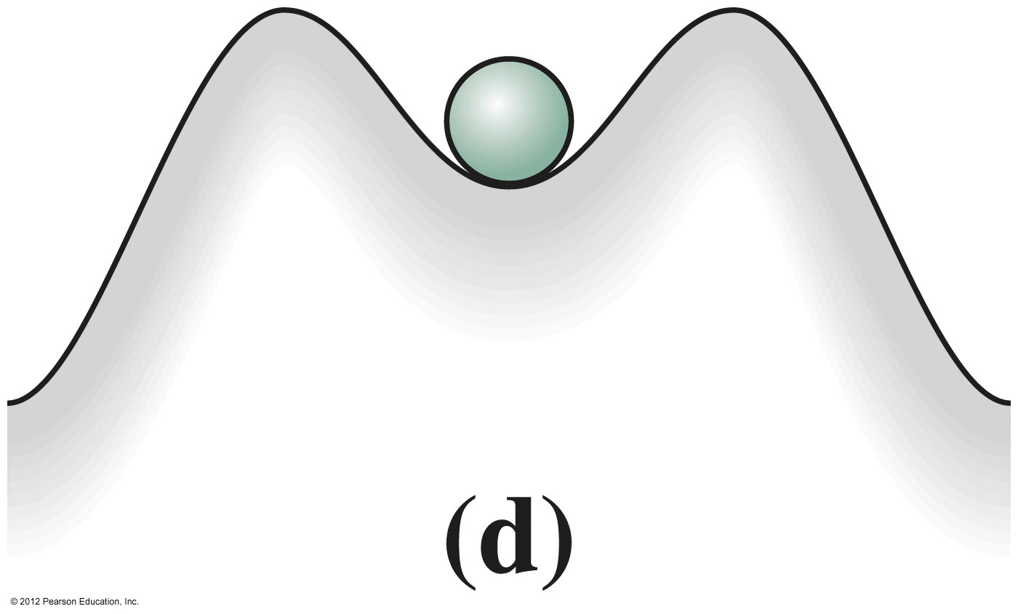
Kinds of Stability
What kind of equilibrium is this?
Stable
Neutrally stable
Unstable
Metastable

Slide 25
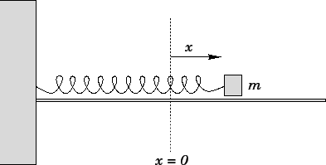
Before Class 20 on Monday
Please read sections 13.1 and 13.2 of chapter 13 on oscillations, or at least watch the Preclass 20 Video
The preclass quiz is due Wednesday morning at 8:00am.
Something to think about over the weekend: A spring with a mass attached to it is stretched and released. When the spring returns to equilibrium, is the mass moving?

