Slide 1
Being an effective Physics TA
7 September 2016
Dan Weaver &
Stephen Foster
Notes:
A couple notes:
- please interrupt and ask questions throughout our talks!
- this talk will be online: don’t worry about writing anything down

Slide 2
Outline
The role of a TA
University policies
Grading
How to engage students
Support & Resources

Slide 3
INtroductions
Dan WEaver
Stephen Foster
Ph.D. candidate, Prof. Strong’s research group
TA in the Dept. of Physics since 2011
B.Ed. (OISE), Ontario College of Teachers certified
Ph.D. candidate, Prof. John’s research group
TA in the Dept. of Physics since 2010

Slide 4
Survey: Do you already have teaching experience?

Slide 5
Discuss: What is your purpose as a TA?
Talk with one or two people near you
Write down at least one idea
Be ready to share with everyone in a few minutes!

Slide 6
Value of tas
Approachable source of help
Insights
Share experiences
Convey the “big picture”
Still remember being in undergrad
Demonstrate high-quality thinking
Model professionalism

Slide 7
Qualities of a great ta
Enthusiastic
Knowledgeable
Motivated
Organized
Patient
Available
Adaptable
Trustworthy
Empathetic
Proactive

Slide 8
Teachers as role models
Set the tone & expectations
Be organized
Be consistent and honest
Be firm in expectations, deadlines, etc.
Be flexible as needed (professional judgement)
Show enthusiasm
Strive to build a good rapport with students
Demonstrate quality thinking

Slide 9
Common teaching concerns for new TAs
Being effective at teaching
Planning tutorial lessons
Classroom management
Maintaining personal and professional boundaries
Grading fairly
Not being able to answer questions
Dealing with plagiarism and academic integrity

Slide 10
Teaching Assistant jobs
Tutorials
Labs
Practicals
One-on-one tutoring
Marking

Slide 11
Communication with Course Instructor
Set (realistic) Expectations
Determine the course focus & outcomes
Identify your duties and responsibilities
(& time allocated for them)
Establish communication methods: email? Meetings?
Mid-term Review
Discuss time/work and job performance
Common student issues
Discuss midterm exam (marking scheme)
Feedback
Evaluations from students
Reflect on course: what was effective? What could be improved?

Slide 12
Tutorials
Interactive and participatory classroom sessions.
TAs gauge student understanding and provide feedback, in line with assessment guidelines set by the instructor.
Answer questions on lecture topics
Review course material
Work on specific problems and skills
Help with assignments
Quizzes
Tip: In general, don’t hand back work at the start of a class. It will consume students’ attention.

Slide 13
Labs
Teaching experimental skills
Problem solving
Tangible application and proof of theory
Science history: re-create classic experiments
Monitor student work
Ensure lab safety and protocols are followed
Provide feedback
Tip: investigating instrument problems can open up opportunities (“teachable moments”) for learning.

Slide 14
Practicals
A mix of a tutorial and a lab
Students learn theoretical concepts and experimental skills through hands-on activities
Research shows students learn more effectively through participation
Work in small groups
“Tell me and I forget. Show me and I remember. Involve me and I understand." - various attributions
Notes:
Photo from the Undergraduate program webpage of the Physics Dept. website

Slide 15
One-on-one tutoring
Office hours: for students to drop by and ask questions
Or they can make an appointment
Challenge: how to start helping when a student doesn’t arrive with specific questions.
Try to narrow down goals for a meeting to one or two key topics to cover.
Suggest strategies for studying & follow-up actions
You can’t charge students for private tutoring in the course you are a TA in for extra tutoring (conflict of interest, unethical)
There are plenty of under-used opportunities for students to get help: TA & Professors’ office hours, Drop-in Centre, writing centers
Notes:
This will happen right before tests if a student panics and thinks he/she "knows nothing", in which case it helps to be able to boil down with the student what the key take-home messages are

Slide 16
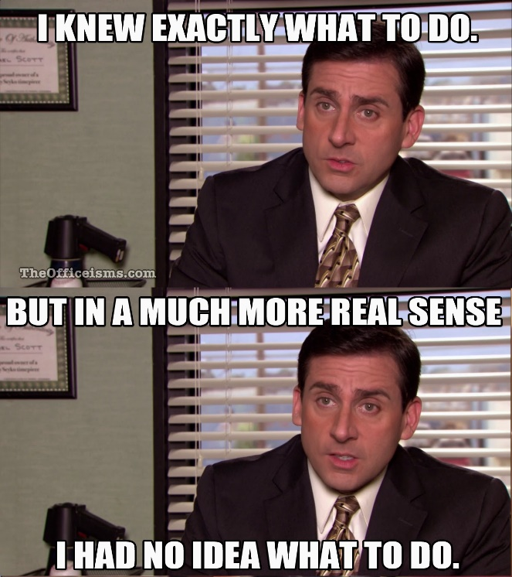
Proactively Check student understanding
Avoid the temptation to think silence & nods indicate students understand.
During practicals, engage student groups. Sometimes, students *think* they’re fine when they aren’t.
Don’t be afraid to be nosy!

Slide 17
Will students remember?

Slide 18
Physics drop-in Centre
Outside MP125B in student lounge
Undergrads can stop by during Drop-In Centre hours and ask questions to a TA
Focused on first-year classes (mostly PHY131)
If an advanced undergrad student drops by hoping for help, and you don’t know the material, that’s OK.
Encourage students to use it!
Notes:
)

Slide 19
Grading
Evaluation informs students and TAs what they understand
Keep a personal record of grades (e.g. in addition to Blackboard – never too safe!)
Marking is more than assessment and formal evaluation: it’s a critical opportunity for feedback that guides learning

Slide 20
Later, we will do a marking activity!

Slide 21
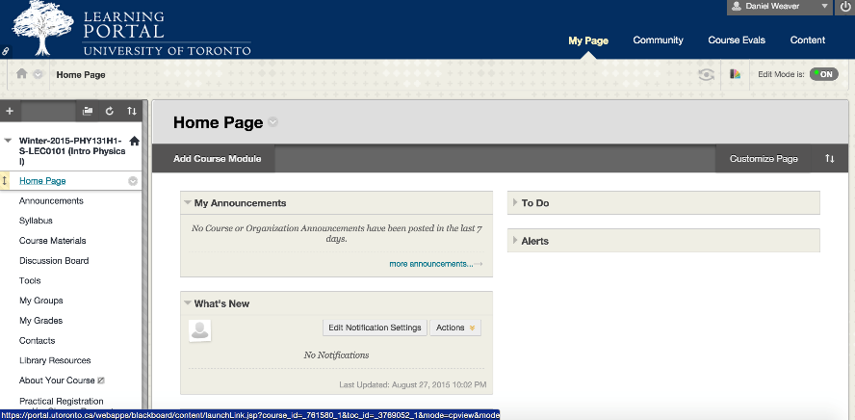
Blackboard
A tool for communication between instructors, teaching assistants and students
Send emails to groups of students
Course announcements are posted
Online discussion board
Access to uploaded course documents
Grade book recording and tabulation
Online testing and assignment submission

Slide 22
preparation
“Before anything else, preparation is the key to success.”
– Alexander Graham Bell
Give thought to each session:
What should students specifically learn?
Where might students have difficulty?
How will you help students build understanding?
Labs and practicals challenge students in both theoretical knowledge and experimental skills: perform experiments yourself before guiding students
Notes:
AGB quote quoted in Sophia's Fire (2005) by Sango Mbella, p. 133.

Slide 23
Find a way to plan lessons that works for you
It doesn’t need to be a formal and detailed document, but it should be something

Slide 24
Your first class
Arrive early & check room for any complications
Write your contact information on the board/slide
Introduce yourself
Use an icebreaker to get students talking to you and each other
Explain how the sessions will run
Leave time for questions

Slide 25
set expectations on the first day
Be clear about how students should communicate with you: email? In person? Blackboard?
How long it will take you to respond.
How students submit work.
Explain the reasons for how you do things…
“I do not respond to emails the night before a mid-term because…”
Notes:
It’s more important to be fair than to over-promise what you can’t deliver. E.g. 10 students emailing you at 10 pm the night before the test.

Slide 26
Setting policies during the first class will help save time & confusion throughout the semester

Slide 27
Part two: University policies

Slide 28
TA policies:
Code of Behaviour on Academic Matters
http://www.governingcouncil.utoronto.ca/policies/behaveac.htm
Code of Student Conduct
http://www.governingcouncil.utoronto.ca/Asset4733.aspx?method=1
Freedom of Information and Protection of Privacy
http://www.provost.utoronto.ca/policy/fippa.htm

Slide 29
Areas of responsibility
Respecting confidentiality
Avoiding conflict of interest
Safeguarding the learning environment
Upholding academic integrity

Slide 30
Respecting confidentiality
You have access to sensitive information
As an education professional, you are trusted to keep student information confidential
Avoid putting grades on front page where it is easy for others to see
Don’t identify individual students when discussing challenges or strategies with others (for example, when discussing mistakes in assignments in front of a classroom)

Slide 31
Safeguarding the learning environment
Policies:
Code of Student Conduct
Ontario Human Rights Code
Policy on Sexual Harassment
Policy on Appropriate Use of Information Technology
Accessibility for Ontarians with Disabilities Act
Where to go and what to do:
Campus police: (416) 978-2222
Student crisis response: (416) 946-7111
Equity offices on campus: Community Safety; Anti-racism and Cultural Diversity; Sexual and Gender Diversity; Sexual Harassment Office
Notes:
Also connects with relationships with students. Dan can offer story about Teacher’s College training on meeting opposite-sex students one-on-one.

Slide 32
Academic integrity
violations
Intellectual honesty
Appropriate use of information
Accurate citation and referencing (a problem for essay-type questions)
Awareness of and adherence to strict academic principles and values
Plagiarism
Impersonation
Copying
Cheating
Purchased essays
Reusing materials from other courses
Misuse of digital sources
www.utoronto.ca/academicintegrity
www.writing.utoronto.ca/advice/using-sources
/how-not-to- plagiarize

Slide 33
academic integrity (cheating)
Do not take action independently
Do not tell the student you suspect plagiarism
Do not return any papers
Stop marking once you realize there might be an academic offense
Refer the problem to the instructor, who will follow U of T protocols
Assist the instructor by investigating if asked
It is an academic offence to not report cheating
Notes:
Dan has stories about students pressing him for information about why an assignment didn’t get returned with everyone else’s.
Image is from The Atlantic: http://www.theatlantic.com/national/archive/2012/03/investigation-finds-suspicious-achievement-in-schools-across-the-nation/255105/

Slide 34
Examples What should you do as a TA?
1. You notice that Jack and Jill’s assignments look strangely similar, with the exception of a few variables or of a few explanations worded differently.
2. Susan’s assignment was flawless. However, while entering the grades you notice that her two previous assignments were poorly done and so was her mid- term.
3. When marking 50 assignments you start to get a feeling you have read one particular phrase or sentence over and over again.
4. A student is doing okay for a long question, but the writing style suddenly switches.

Slide 35
Part three: Marking
Marking exercise
Time allocation
Fairness
Feedback
Notes:
Use conversation about a mark to identify gaps in knowledge and misconceptions.

Slide 36
Marking activity
Determining “fair”
Interpreting answers & where students went wrong
Precision & uncertainties

Slide 37
Marking activity
First, everyone read and mark one of the sample student solutions.
Compare with other TAs in your group:
Grade you assigned to an answer
How you decided on the mark
Feedback you offered the student

Slide 38
Marking activity
Feedback ideally included:
Mention of a strength in their work
Suggested area of improvement
A strategy on how to improve
No need for a novel: key words are fine!

Slide 39
Time management & marking
Some courses are at times quite marking-intensive! Some strategies you can use:
Summary list: Note frequent mistakes and discuss them in class in more detail
Set small goals (e.g. one question, 10 papers)
Allow a “buffer” of time & have reasonable deadlines
Enter grades as you go, or all at once
Have everything you need on hand (text, rubric)
Read a few (~10) papers first to get a feeling for how students approached the problem
Depending on the submission format, create a set of responses and recycle them

Slide 40
Feedback
Giving students useful (constructive) feedback is a key part of being a Teaching Assistant
Ensure you give both positive and negative feedback
Avoid being general and vague in comments (if useless, it’s just a waste of everyone’s time)
Comments on assignments can be very helpful if they clarify where a student went wrong (minimally), why (better), and how it could be avoided (wow!).
Balance feedback & advice
Especially valuable early in the year

Slide 41
Fairness in Grading
Cover or ignore names before/while grading to guard against bias
Avoid grading while in a tired/negative emotional state
Be consistent, mark all the students in the same way
Rubrics help with this
Helps to mark one question for all students, then move to next question
When done one question, review the first few papers you marked to make sure you were consistent
Consistency is very important in multi-TA courses (ask other TAs how they approached difficult situations and reach consensus)
Read a few (~10) papers first to get a feeling for how students approached the problem (this “temperature check” helps “normalizing” the grading scheme if need be)

Slide 42
Rubrics
Method of marking which
Increases efficiency since you know what you’re looking for and how much it’s worth
Ensures consistency and fairness
Justifies grade decisions
Helps students understand expectations and evaluate their own work

Slide 43
Example of a rubric (grade 11 physics class project)

Slide 44
Grading: disputes
Students are students – they WILL argue about grades
Do NOT comment on grading issues if you weren’t the marker – refer the student to the course instructor or marker Listen respectfully and openly to student concerns
Encourage students to discuss why they got their mark – it’s an opportunity to help them identify misunderstandings
Feedback and comments should help remind you why you graded as you did
Use of a standard rubric can help justify grades
If you can’t resolve a dispute, discuss the issue with the course instructor
Notes:
(be careful about what you say regarding a grade dispute, otherwise, your word might be used against you!)

Slide 45
Part four: Teaching tips and strategies

Slide 46
Each class has its own character & challenges
Why are students in the course
What they are getting out of lectures
How do they learn best
Background knowledge & understanding
English language barriers

Slide 47
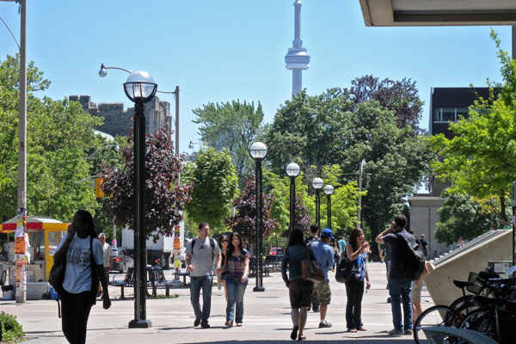
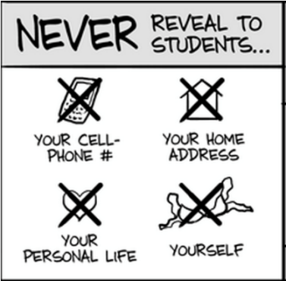
Getting to know your students
Who are they?
Why are they taking the class?
What background knowledge do they have?
What do they expect to learn from the course?
How do they learn effectively?
This will help you be adaptable, and will put your students at ease.

Slide 48
Identifying cheating
You’ll get to know your student’s style and quality of work.
Watch for abrupt change in quality: of a single answer or an entire assignment
Out of place sentences/passages that appear copied from another source (try Googling it)
Exact or very close wording to other students
Exact same typos and mistakes

Slide 49
timing
It can be tough to plan the right amount of material for a session
Aim to cover 1-3 critical skills/ideas
Create opportunities to be adaptable
Try to build your lesson plan in modules: enable yourself to drop/add parts because of the flow of the session.
Think about how you would have liked to be taught that subject as a student to identify where to spend more time.

Slide 50
When you don’t know the answer
RELAX! It’s not the end of the world!
Ensure you understand the question
Commit to finding out what the answer is and get back to the student
If you are in front of a class, there is no shame in turning the hunt for an answer into a group effort!
Physicists are like physicians: there are specialists because there’s too much for one person to know everything!

Slide 51
Reflection & iteration
After each class/lab/practical, reflect on what went well or not
Apply new ideas about how to be effective to the next time you teach and share insights with others
Learning to teach is a continuous process

Slide 52
Designing questions to ask students
Be mindful of implying there is a singular “right” answer
Ask a variety of question types
Encourage participation
Probe for intuition, partial understanding, & logic
Aim to ask questions that prompt students to show their understanding

Slide 53
Teaching tips: leave space for answers
Ensure you leave time for students to think about the question you asked
Try not to answer your own questions
Be comfortable standing in front of a class in a few seconds of silence
Make them comfortable and at ease (often, students are shy and scared of being wrong in front of others)

Slide 54
Class management: Potential challenges
Food & drink in labs
Teaching right before/after an exam or deadline
Inattentiveness (e.g. to instructions)
Not working constructively with group members
Creating excessive noise
Entering class late or leaving early
Use of phones (or computers) in the classroom
Disrespecting others’ rights to express their viewpoints

Slide 55
Listening
Listen carefully and attentively
Avoid pre-forming an answer or being too strict in how students should formulate their answer
Restate questions to confirm their understanding
Watch for signals of confusion in students (don’t talk to the board!)

Slide 56
Student questions
Encourage questions. There are many reasons students are reluctant to ask.
Make sure you understand the question
Paraphrasing may help with understanding
Ask them what part they don’t understand
Pause and reflect, to help form clear answers

Slide 57
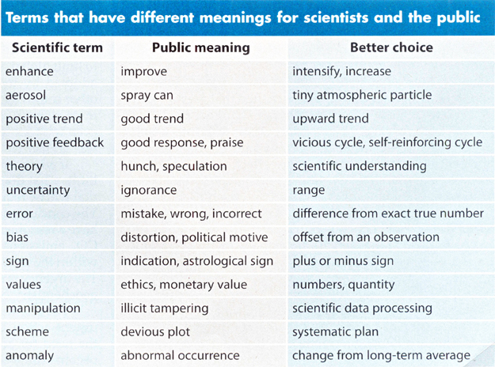
Choose words carefully
Be deliberate & precise in your choice of words
Your use of words is how students learn content
There are many basic terms which may not be understood by all students
E.g. precise vs accurate, error vs uncertainty
A table from “Communicating the Science of Climate Change” by Richard C. J. Somerville and Susan Joy Hassol, October 2011 issue of Physics Today

Slide 58
Effective feedback: more than marking
Formal evaluation (e.g. assignments, tests)
Informal feedback is critical to “scaffolding” student learning
Checking up on lab groups during session (probe with targeted questions)
Answering questions (e.g. tutorials, one-on-one meetings, etc.)

Slide 59
Classroom presence
Be aware, receptive and responsive to the mental, emotional, and physical state of students in the learning environment
Fostering a good relationship between you and students facilitates student learning

Slide 60
Experimental skills
“Something isn’t working!”
It’s tempting to fix equipment or adjust it to ensure a smooth lab experience. Resist.
“Teachable moment”

Slide 61
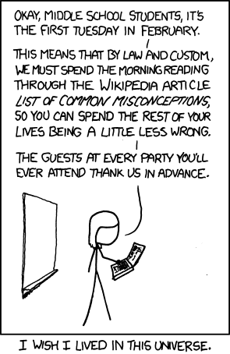
Teaching tips: misconceptions
It’s important to reflect and investigate what misconceptions and misunderstandings your students have.
Try to understand where your students are starting from
Misconceptions are what students think is true but is not. They are a significant obstacle to understanding.

Slide 62
Identifying misconceptions
E.g. “friction always opposes motion” but that’s not quite right
“It [is not] what you don't know that gets you into trouble. It's what you know for sure that just [is not] so. - Mark Twain

Slide 63
Public speaking: everything matters
Become aware of the details
Your voice: volume, tone
Your eye contact
Choice of words
Body language
Enunciation
Confidence
There will be a more detailed talk in two weeks about public speaking.

Slide 64
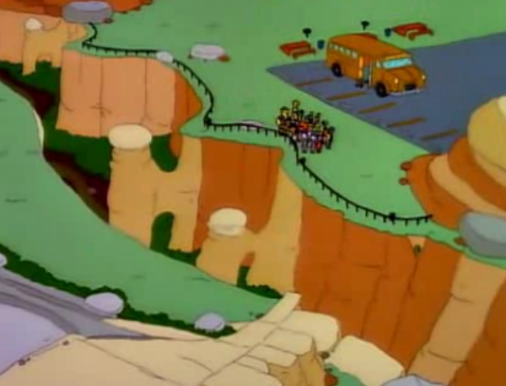
Teaching puts a new lens on the world
You may start to recognize opportunities for new examples to use in the classroom in a variety of places: everyday life, your research, etc.

Slide 65
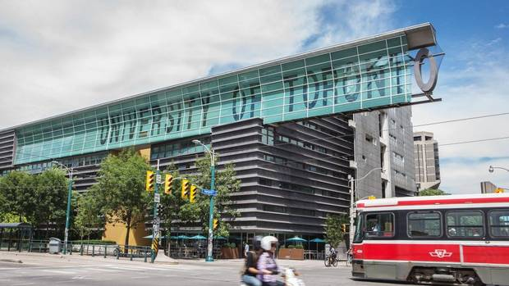
Your ta colleagues
Can help you with:
Lesson planning, problem solving, marking
Classroom management strategies
Teaching approaches
How to interact with other TAs and CI

Slide 66
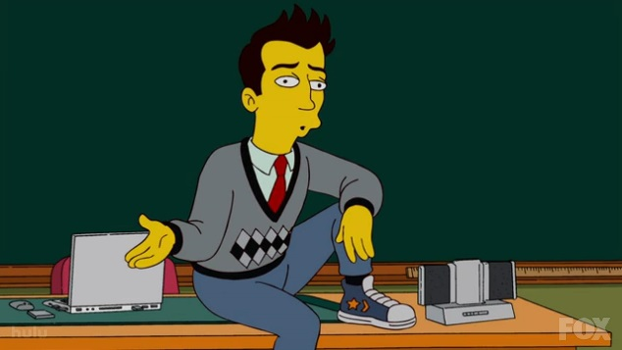
Teaching support
Becoming an educator is a continuous process. You have plenty of support available:
Fellow TAs
Course instructors
Teaching Professors!
TATP
Other online resources

Slide 67
Perspectives
A few key points to remember:
There is no “one-size-fits-all” approach. Learn from your good experiences and mistakes.
You will develop your own teaching style as you go.
There are many opportunities offered by the department: find what suits you best.
See TAing as an opportunity to develop your teaching skills: something that will be useful for your future career!

Slide 68
Useful resources & Professional development

Slide 69
TA training schedule
Week 1: Introduction to TAing
Week 2: Micro-teaching (short lessons)
Week 2: Improv sessions & colloqium
Week 3: Public Speaking (lecture)
Week 4: Micro-teaching, part 2

Slide 70
Questions?
Contacts:
Dan Weaver: dweaver@atmosp.physics.utoronto.ca
Stephen Foster: sfoster@physics.utoronto.ca
Prof. Jason Harlow: jharlow@physics.utoronto.ca
Acknowledgements & Thanks
Prof. Jason Harlow
Andreea Lupascu
TATP
Comics from: XKCD & PHD Comics

