Slide 1
Solar Fusion
Solar fusion cycle starts from Hydrogen nuclei
  Sun has a mass of about 10³⁰ kg
  Mostly hydrogen atoms (10⁵⁶ atoms)
Primary energy cycle comes from fusion of protons (pp cycle)
  ¹H + ¹H -> ²H + e⁺ + ν_{e} + 0.4 MeV
  ¹H + ²H -> ³He + γ + 5.5 MeV
  ³He + ³He -> ⁴He + 2(¹H) + 13 MeV
    Large energy release in final stage comes from the fact that the ⁴He nucleus is doubly-magic, so extremely strongly bound
  Overall reaction is
    4(¹H) -> ⁴He + 2 e⁺ + 2 ν_{e} + 2 γ + 24.8 MeV
    In addition e⁺ produced in fusion, find e⁻ in solar plasma and contribute a further 1 MeV for each annihilation

Slide 2
CNO Cycle
The CNO cycle (or carbon forming cycle) builds on Helium prod.
  Plays a fundamental role in stellar evolution
  Is the source of all C and O found in the Universe
  Helium produced in the pp cycle can produce C via:
    3(⁴He) →¹²C + 7.3 MeV
  Carbon can absorb a further proton (¹H nucleus)
    ¹²C + ¹H →¹³N + γ + 2.0 MeV
      ¹³N →¹³C + e⁺ + ν_{e} + 1.2 MeV
    ¹³C + ¹H →¹⁴N + γ + 7.6 MeV
    ¹⁴N + ¹H →¹⁵O + γ + 7.3 MeV
      ¹⁵O →¹⁵N + e⁺ + ν_{e} + 1.7 MeV
    ¹⁵N + ¹H →¹²C + ⁴He + 5.0 MeV
  Overall the reaction is:
    3(⁴He) + 4 (¹H) → ¹²C + ⁴He + 2 e⁺ + 2 ν_{e} + 3 γ + 32 MeV

Slide 3
Terrestrial Fusion
Man-made fusion experiments have succeeded in laboratories
  ²H + ³H -> ⁴He + n + 17.6 MeV
  ²H + ²H -> ³He + n + 3.2 MeV
  ²H + ²H -> ³He + ¹H + 4.0 MeV
Main difficulty is to confine the fuel long enough at a high enough temperature to penetrate the Coulomb barrier
    Magnetic confinement
      Plasma circulating in a toroidal confinement field
      ITER – International Collaboration
    Inertial confinement
      Electromagnetic energy (lasers) bombard a small volume containing fuel
      Increase pressures enough to generate ignition

Slide 4
Extra material not covered in 2023
Consider the following ‘bonus’ material.
I will make sure none of this ends up appearing in a question for the final exam.
I don’t think any of it is needed for PS5 either.

Slide 5
Summary
Many clear applications of nuclear physics
  Controlled fusion is still an active area of research
    Significant progress over last 40 years
    Still some way to go to achieve break-even
      Even further for a suitable energy plant
      A central part of modern nuclear weapons
Significant medical applications of nuclear physics
  Beam therapy uses ionising radiation to disrupt biological activity
  Imaging achieved by attaching short-lived radioactive elements to biological structures
    Also take advantage of nuclear/particle detectors to image the decays of these elements inside the patient

Slide 6
PHY357 – Lecture 21
The Higgs Boson
How it fits in the Standard Model theory
How it was discovered at the LHC
What’s next?

Slide 7
The Standard Model Higgs
A cornerstone of the Standard Model is
  All interactions involve gauge invariant fields
    Photon field gauge invariant → there are no observables that depend on absolute voltage (only on E etc.)
  Gauge Invariance is natural for forces with massless force carriers
    OK for photon and gluons
    Manifestly not the case for W/Z bosons
Higgs proposal ‘works around’ massless nature of gauge particles
  W and Z start massless (and so gauge invariant like photon and gluon)
  Acquire their mass by interacting with a scalar field
    The Higgs field → ie. by interacting with Higgs bosons
    Known as the Higgs mechanism
      Proposed ~same time by six theorists (B, E, H, H, G, K)

Slide 8
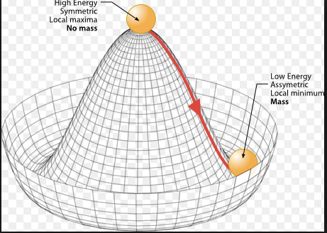
Spontaneous Symmetry Breaking
Mass of W/Z bosons determined by distance from origin
  Mass difference between W and Z determined by phase around brim

Slide 9
Higgs Coupling to Fermions
In addition to giving mass to the W and Z bosons in a gauge invariant way
  It was noticed/proposed that Higgs could also interact with fermions
  They could all be ‘naturally’ massless (simplest a-priori assumption)
  But would acquire a mass through their interactions with the Higgs
    g_{f} = √2 g_{W} (m_{f}/m_{W})
  Although the Higgs mass itself was not predicted
    In the simplest standard model, Higgs has precisely predicted couplings to all other particles
This is the focus of current Higgs research
  Ultimately exploring Higgs couplings to matter particles may reveal some structure
    An explanation for the range of masses seen?

Slide 10
Higgs Decay Modes

Slide 11
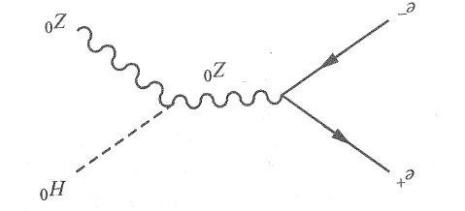
Pre-LHC Experimental Searches
First search carried out at LEP (up to 200+ GeV e⁺e⁻ collisions)
  At these energies the dominant Higgs production mechanism is
          e⁺ + e⁻ → Z⁰ + H⁰
  Given collision energy and a Z⁰ boson in the final state
    Only explore up to m_{H} = 110-120 GeV
Interestingly there were hints of a possible signal
  H⁰ → τ⁺ + τ⁻
  A handful of candidates
Bremmstrahlung limits prevented LEP from exceeding 208 GeV collisions and decision to replace it with LHC was taken in 2001

Slide 12
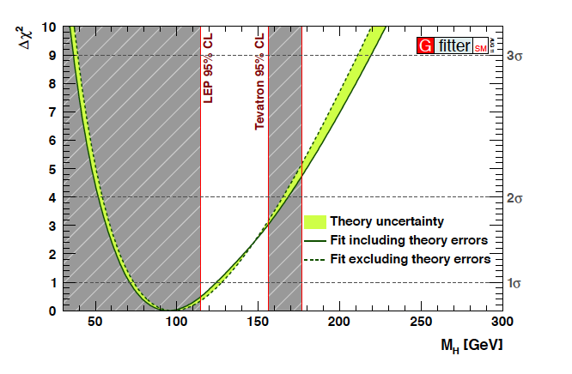
Tevatron Searches for Higgs
For 10 years the Fermilab Tevatron had a shot at the Higgs
  Also searching for associated Higgs production (H → WW)
  Along with precision measurements of top quark and W boson mass

Slide 13
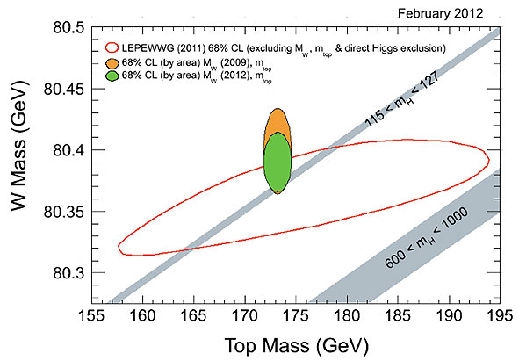
W, Higgs, top mass constraints

Slide 14
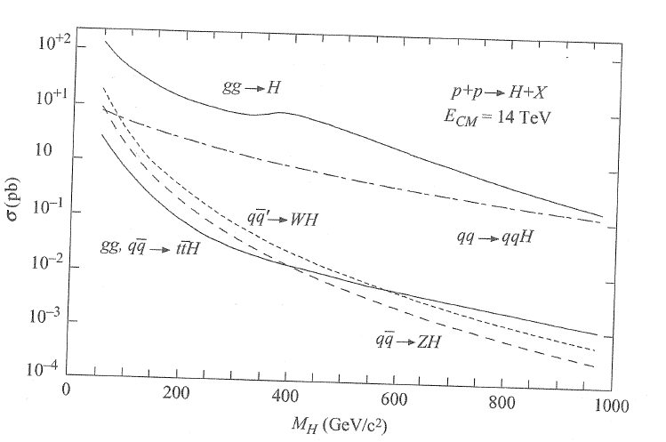
Higgs Production Mechanisms
Knowing the Higgs mass
  Provides precise predictions about how it is produced at the LHC

Slide 15
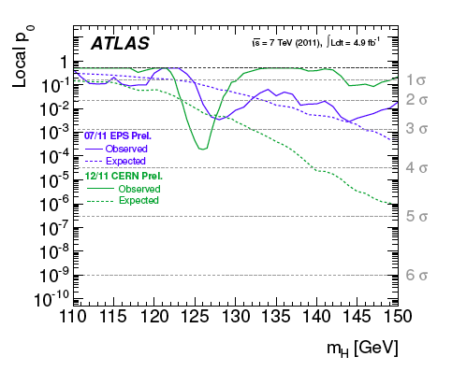
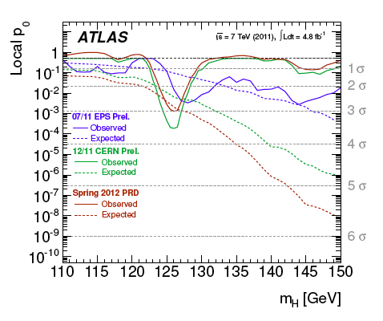
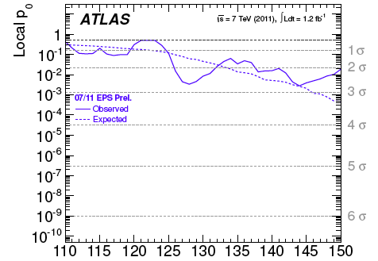
Early ATLAS/LHC Higgs Hints

Slide 16
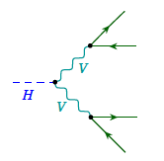
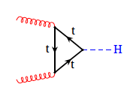
H → Z Z* → l l l l
Production depends on coupling to top quark (in SM!)
Decay depends on coupling to Z boson
Small branching fraction to 4-lepton final state (need L )
A good discovery final state:
  Low backgrounds
  Very good Higgs mass resolution
  Requires good lepton reconstruction efficiencies
  Clear/robust signal of coupling of Higgs to Weak bosons

Slide 17
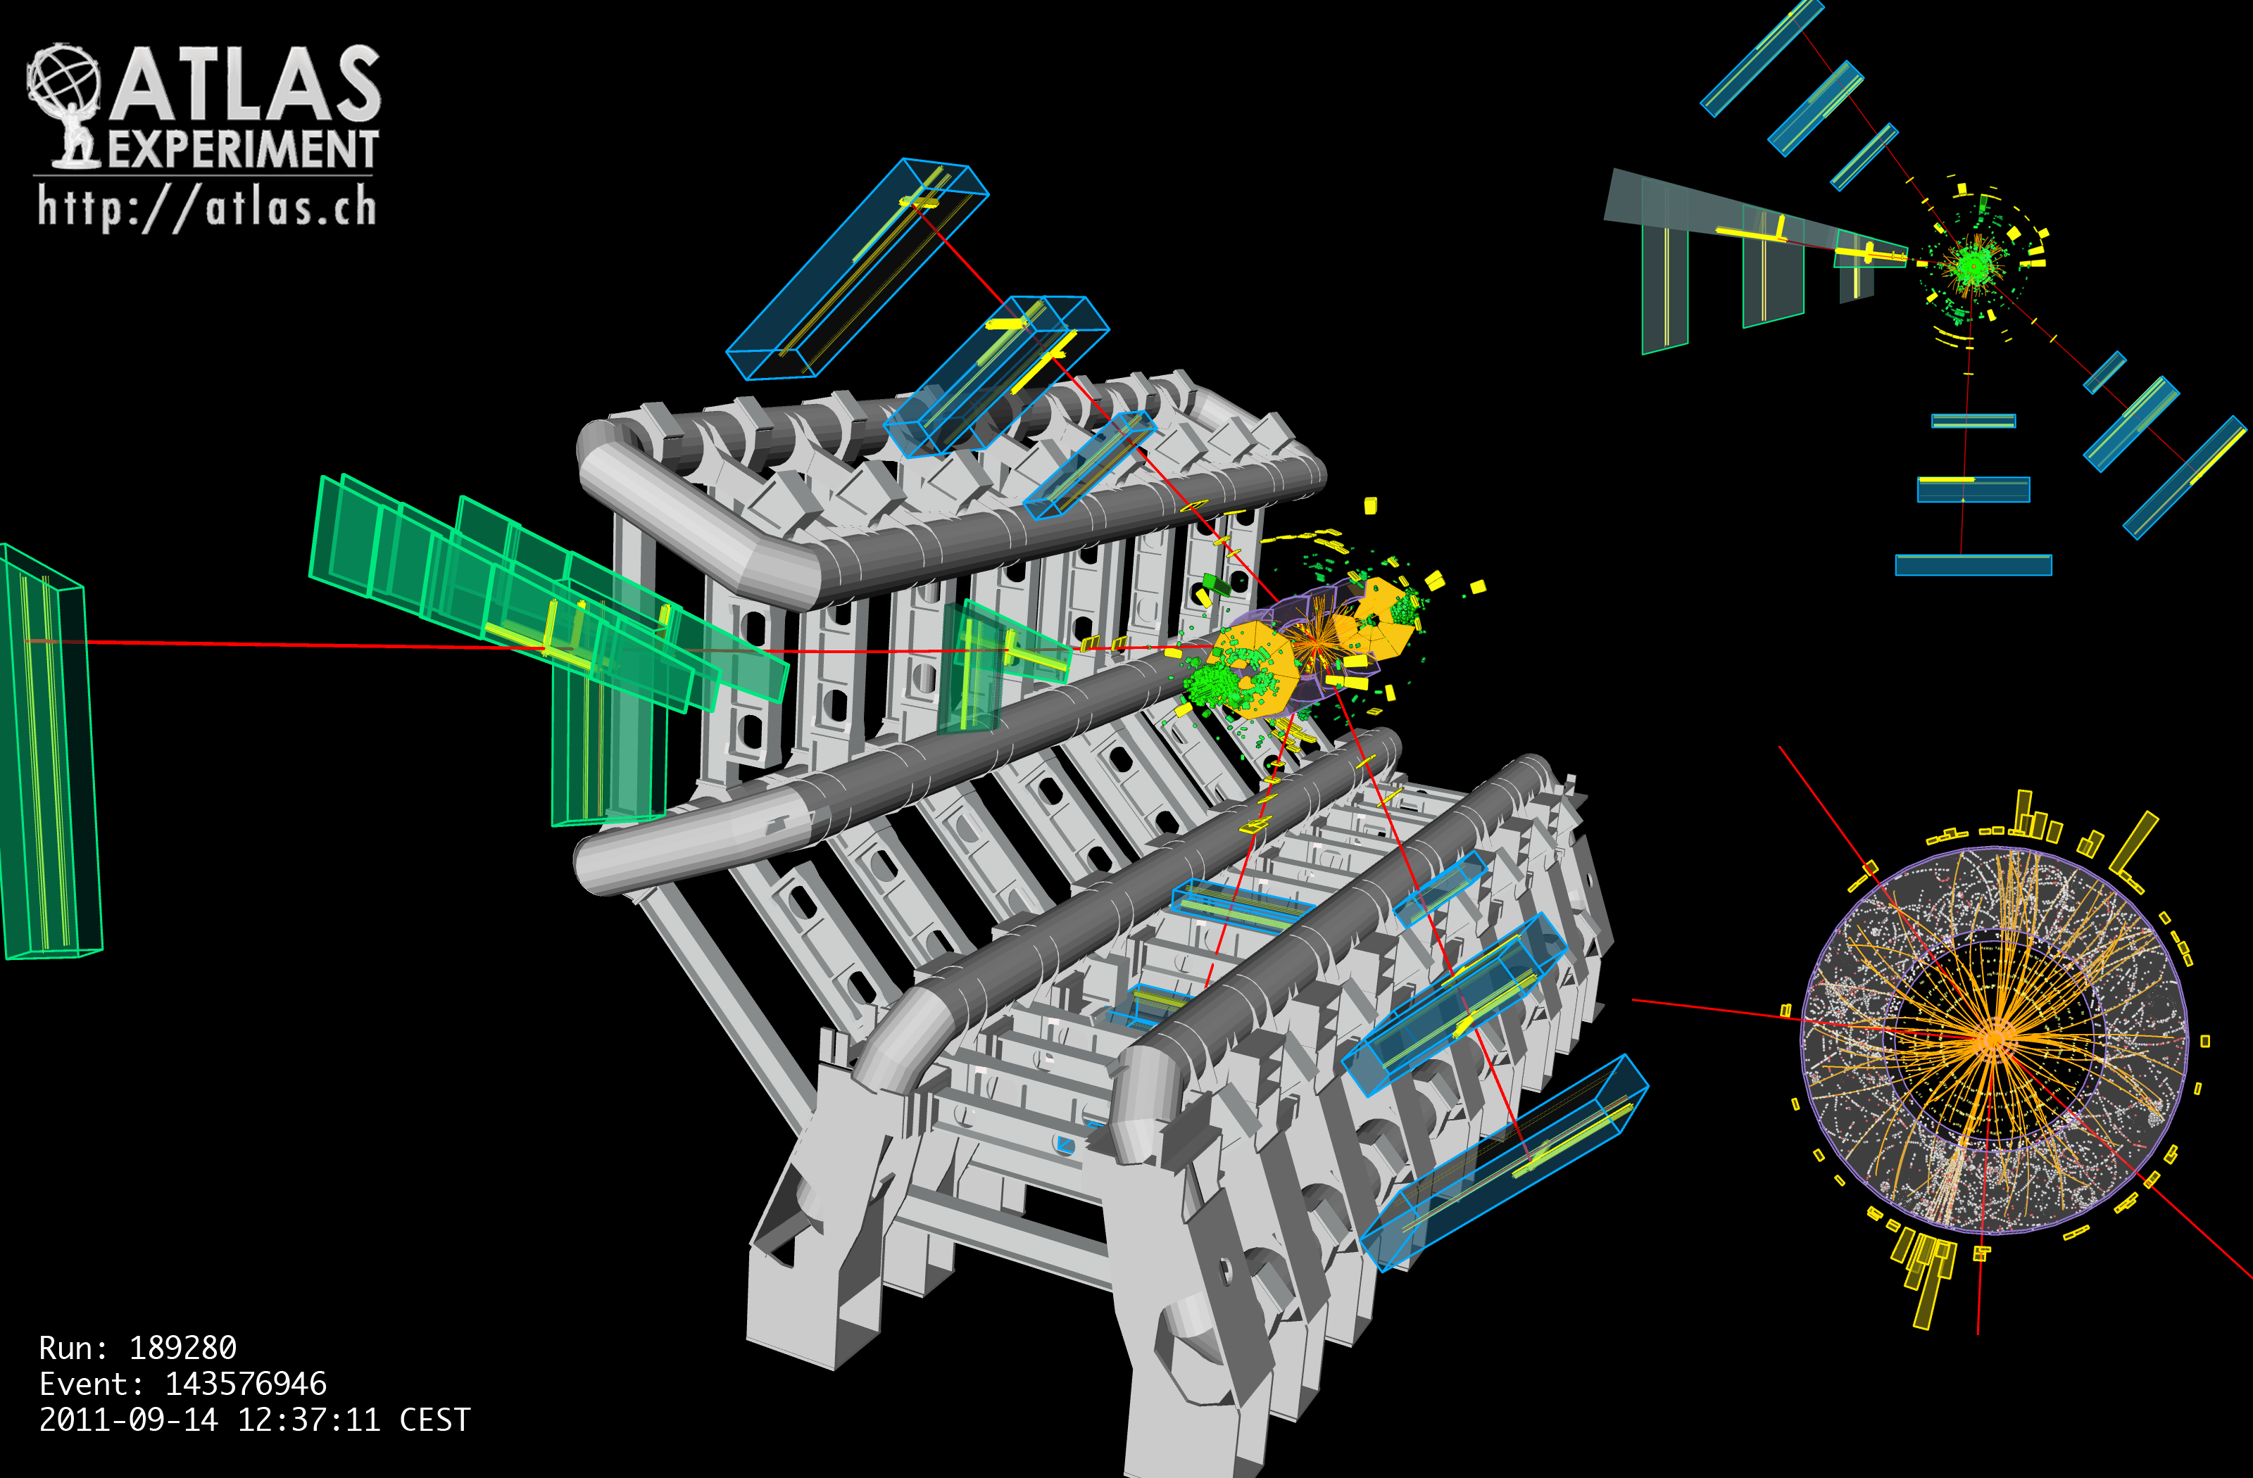
4μ candidate with mass = 124.6 GeV

Slide 18
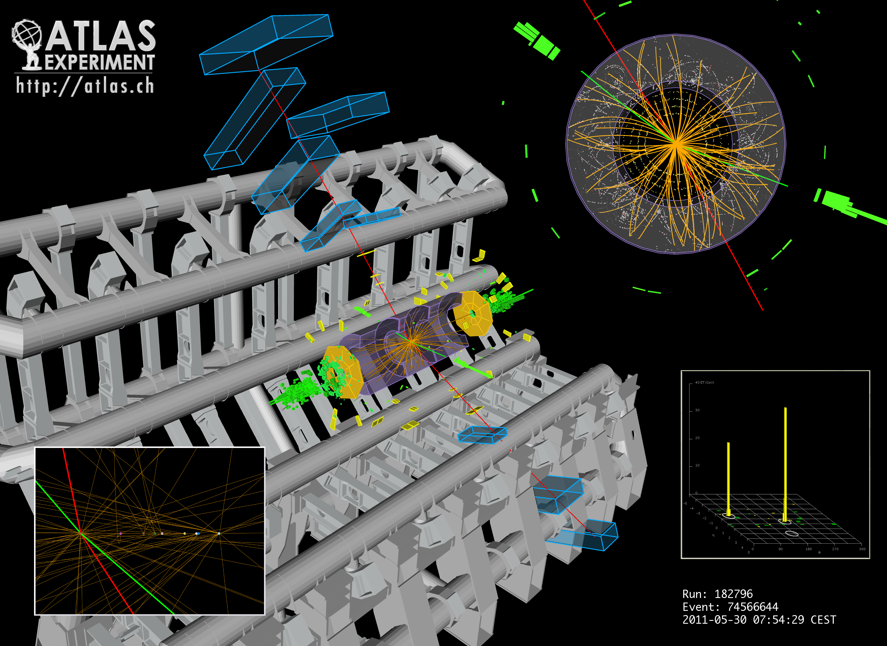
2e2μ candidate with mass= 124.3 GeV

Slide 19
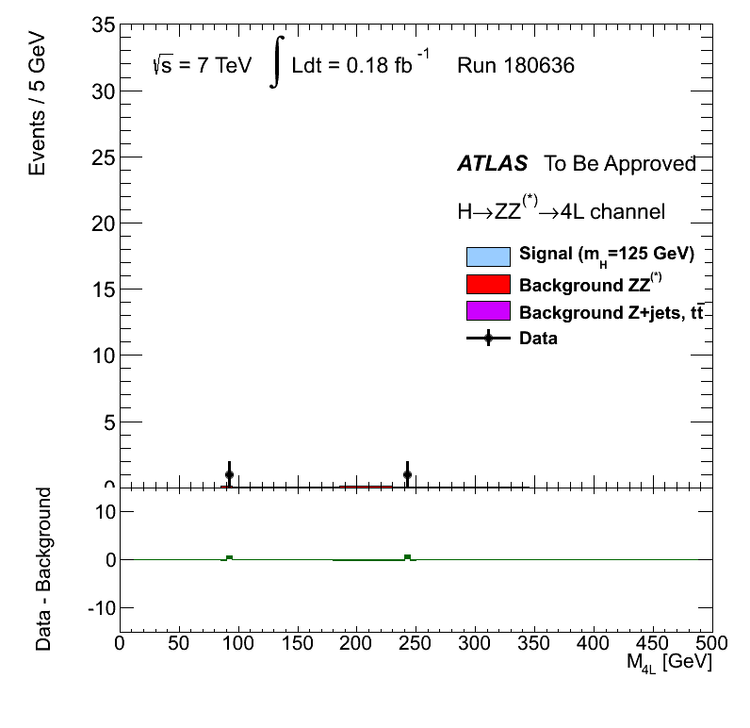
Signal as Data Collected

Slide 20
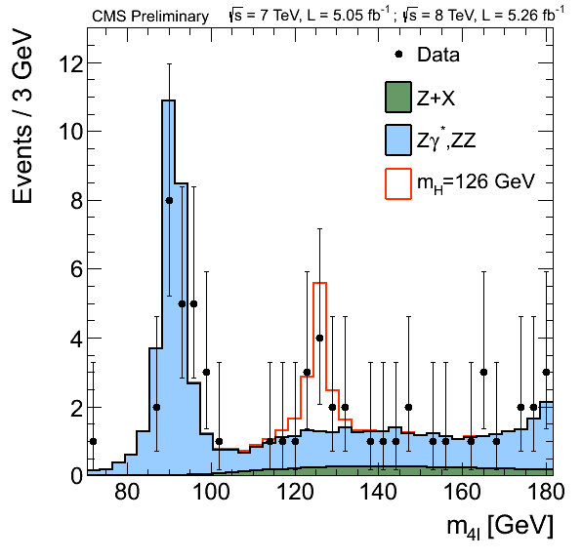
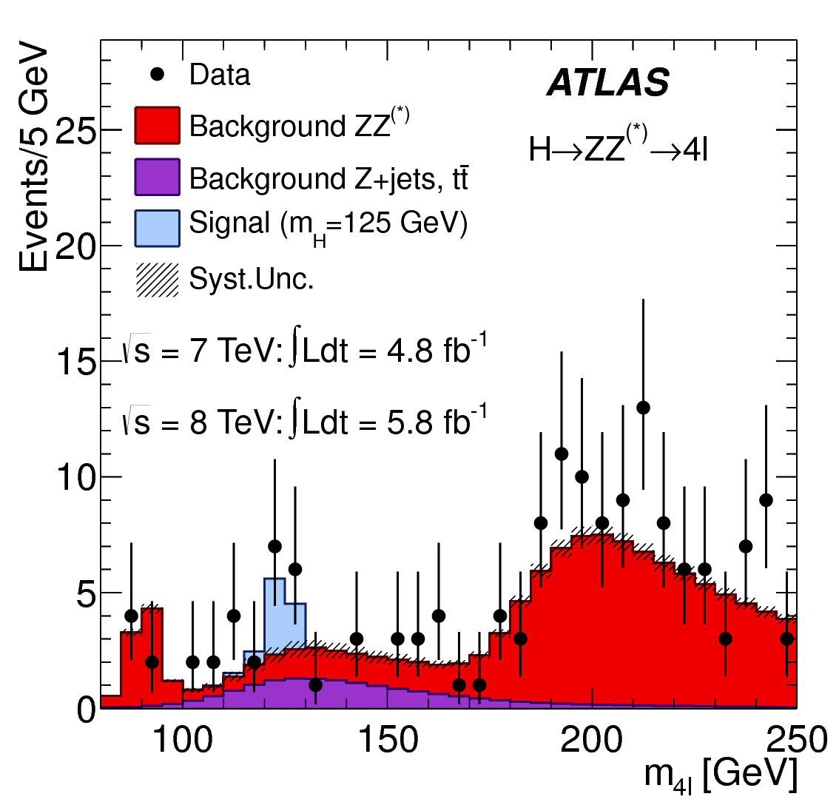
H → Z Z* → l l l l
4 lepton mass spectrum for the Higgs decay to two Z bosons
CMS
ATLAS

Slide 21
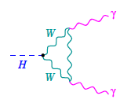
H → γ γ
Production depends on coupling to top quark (in SM!)
Decay depends on coupling to top and W boson
Large backgrounds: need good photon identification
  ATLAS calorimeter designed with this signal in mind
Very small branching ratio (need L)
A good discovery final state:
  Excellent Higgs mass resolution
  Looking for a resonance on top of smooth background

Slide 22
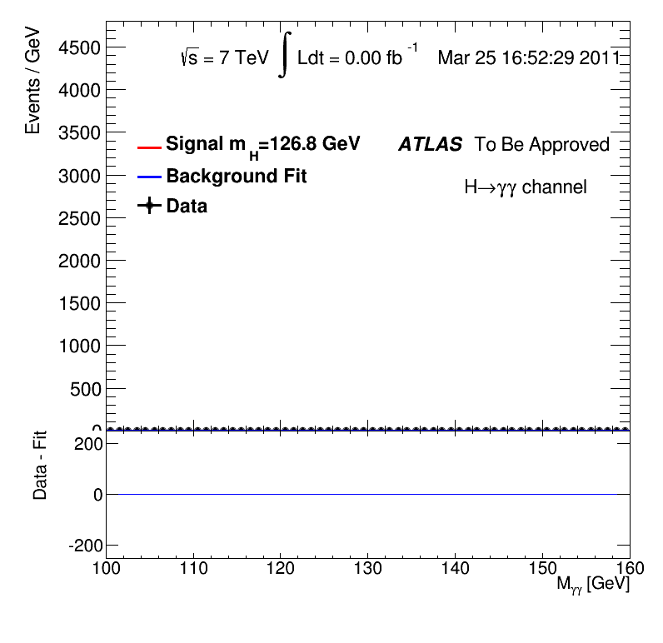
Animation of Data Arriving

Slide 23
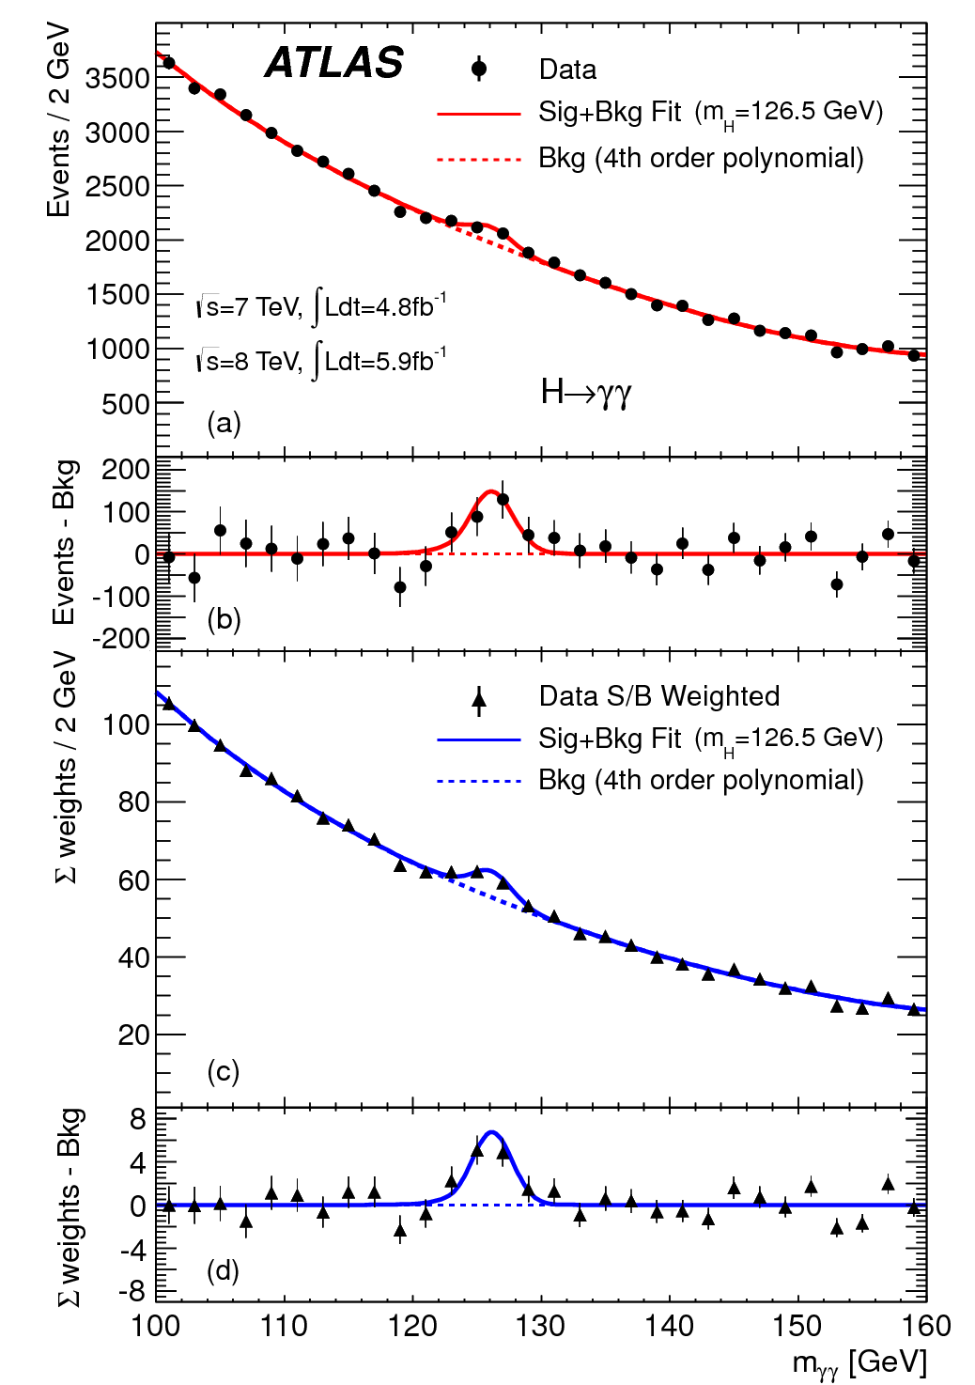
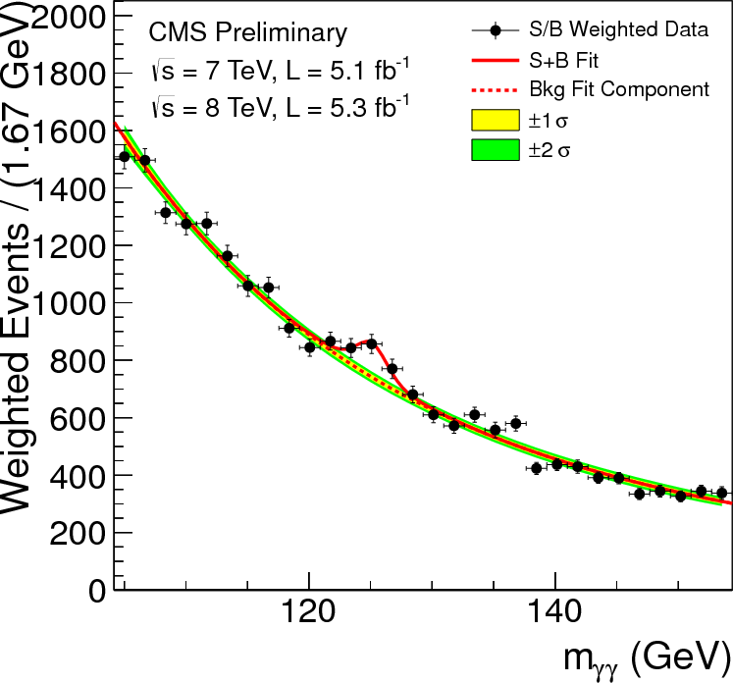
H → γ γ
ATLAS
Diphoton mass spectrum
CMS

Slide 24
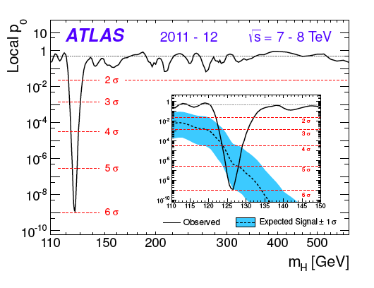
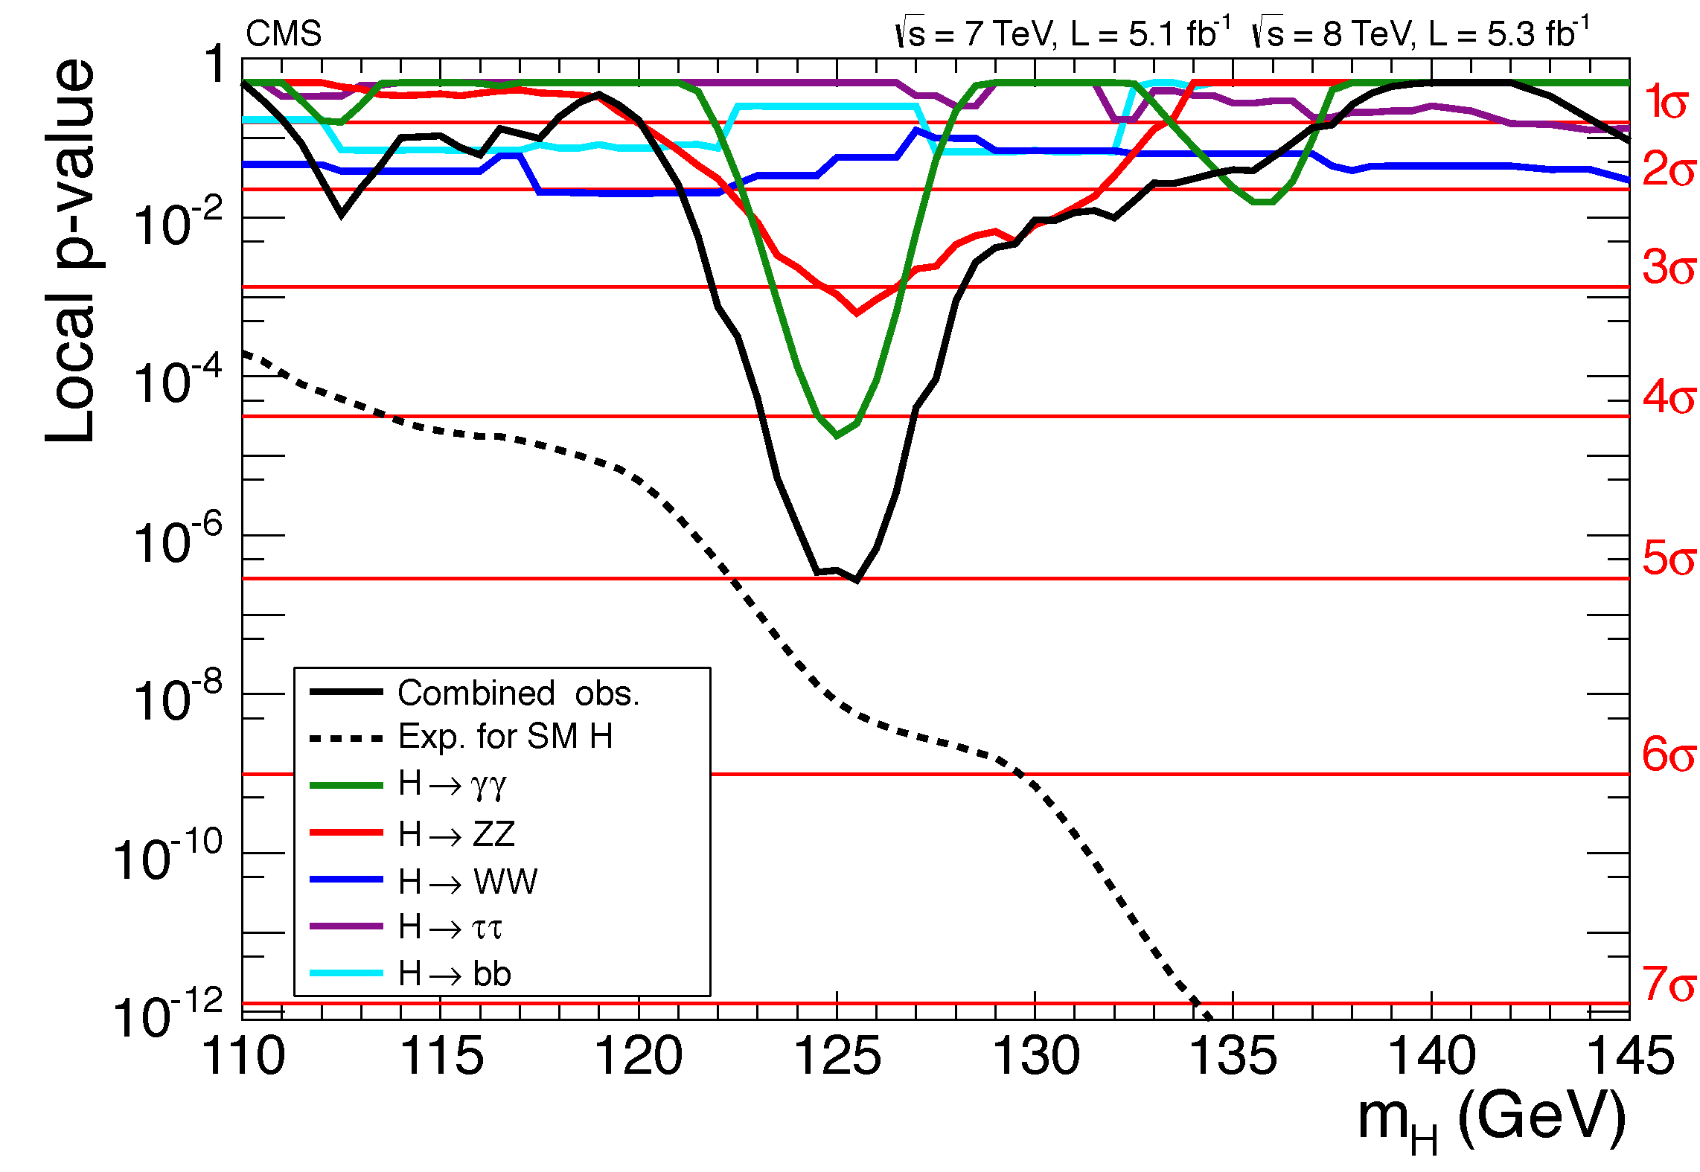
Significance of Combined Channels
Probability background fluctuated producing observed distributions:
ATLAS
CMS

Slide 25
Higgs Discovery: Final steps
The LHC started collisions in early April 2012.
  Scheduled “technical stop”: June 15th
  Major particle physics conference started on July 4th
  Very little time to analyze the data, produce simulated events
The groups worked non-stop in June to prepare the analysis, validate simulation samples as they became available
Dataset frozen on June 20th
On June 25th, everything in hand and satisfied with the agreement in our validation regions
On June 27th, agreed to look in signal regions

Slide 26
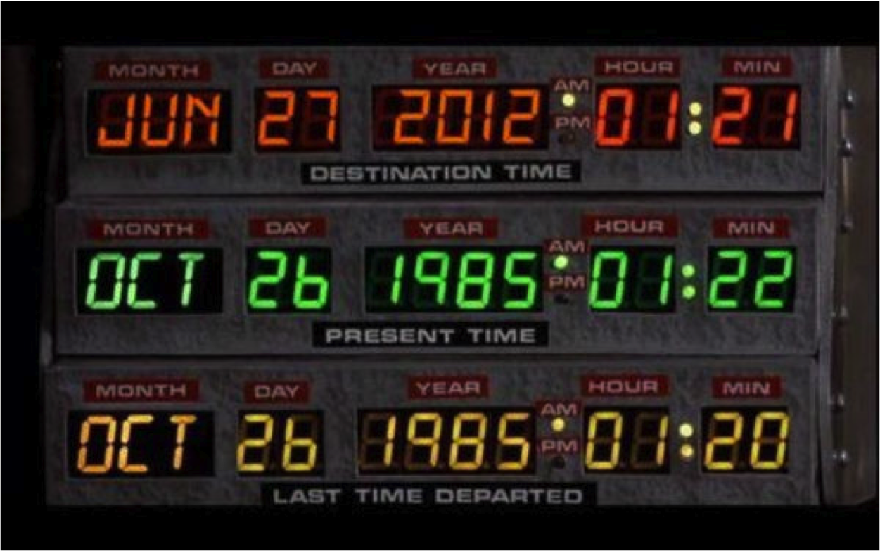
Higgs Discovery: Final steps

Slide 27
Higgs Discovery: Final steps
The LHC started collisions in early April 2012.
  Scheduled “technical stop”: June 15th
  Major particle physics conference started on July 4th
  Very little time to analyze the data, produce simulated events
The groups worked non-stop in June to prepare the analysis, validate simulation samples as they became available
Dataset frozen on June 20th
On June 25th, everything in hand and satisfied with the agreement in our validation regions
On June 27th, agreed to look in signal regions
The results were consistent among all channels
Approved to be shown on July 2nd and 3rd

Slide 28
Higgs Publications
July 5th work on paper began. Goal: submit with CMS on July 31st
1 week to produce a draft: First decide what kind of paper to write
Work in parallel on 3 observation channels and combination
First draft had 60 sets of comments (~20 comments per analysis)
Second draft had 90 sets of comments
Submitted to Journal (Physics Letters B) at 14:00 on July 31st
Comments from referees minor, published by August 20th

Slide 29
Higgs Publications
July 5th work on paper began. Goal: submit with CMS on July 31st
1 week to produce a draft: First decide what kind of paper to write
Work in parallel on 3 observation channels and combination
First draft had 60 sets of comments (~20 comments per analysis)
Second draft had 90 sets of comments
Submitted to Journal (Physics Letters B) at 14:00 on July 31st
Comments from referees minor, published by August 20th
T-shirt available August 29th

Slide 30
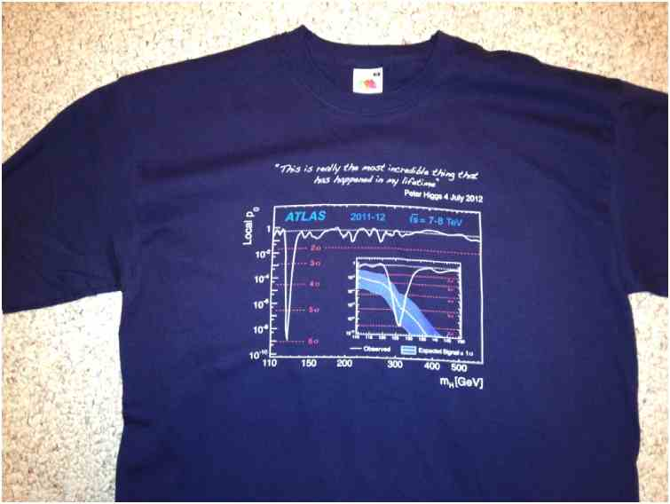

Slide 32


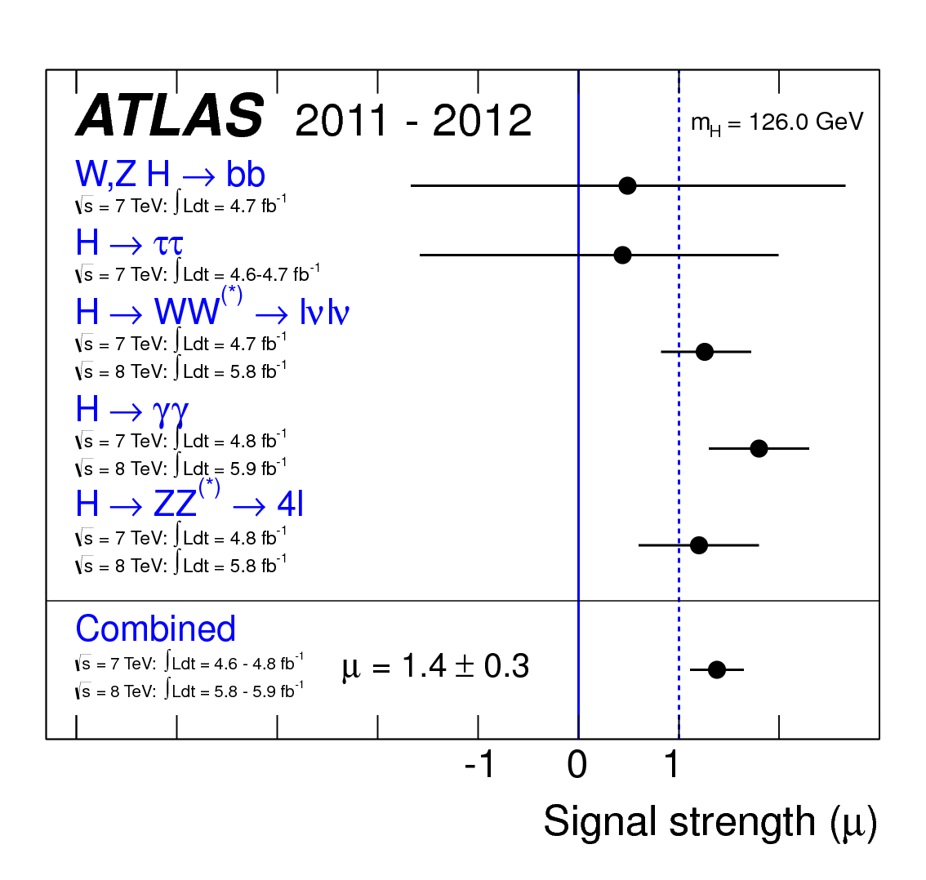
Higgs Search Measurements
What had we found exactly?
A particle consistent with the Higgs boson but relatively large uncertainties
Have undertaken an ambitious program to measure properties of this new particle
May take years to complete but with 6x as much data everything still consistent with Standard Higgs

Slide 33
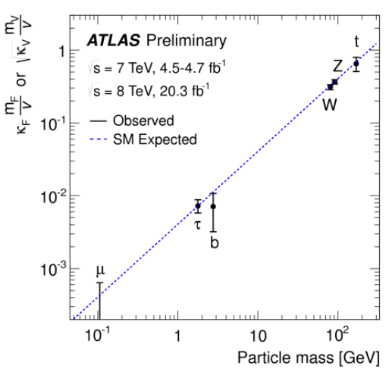
Current State of Higgs Couplings

Slide 34
Summary
The Higgs boson provides an elegant way to give particles mass in the Standard Model
  Preserves gauge invariance of weak interactions even though they are mediated by massive particles (W and Z)
Prior to LHC only knew 100 < m_{H} < 1000 GeV
  Unknown parameters of Higgs potential accommodate any mass
LHC (ATLAS&CMS) found Higgs evidence in two main channels
  H → Z Z (→ l l l l) and H → γ γ
Now the focus is on measuring the Higgs coupling to all other SM particles
  And looking for couplings to non SM particles !

